Slide 1

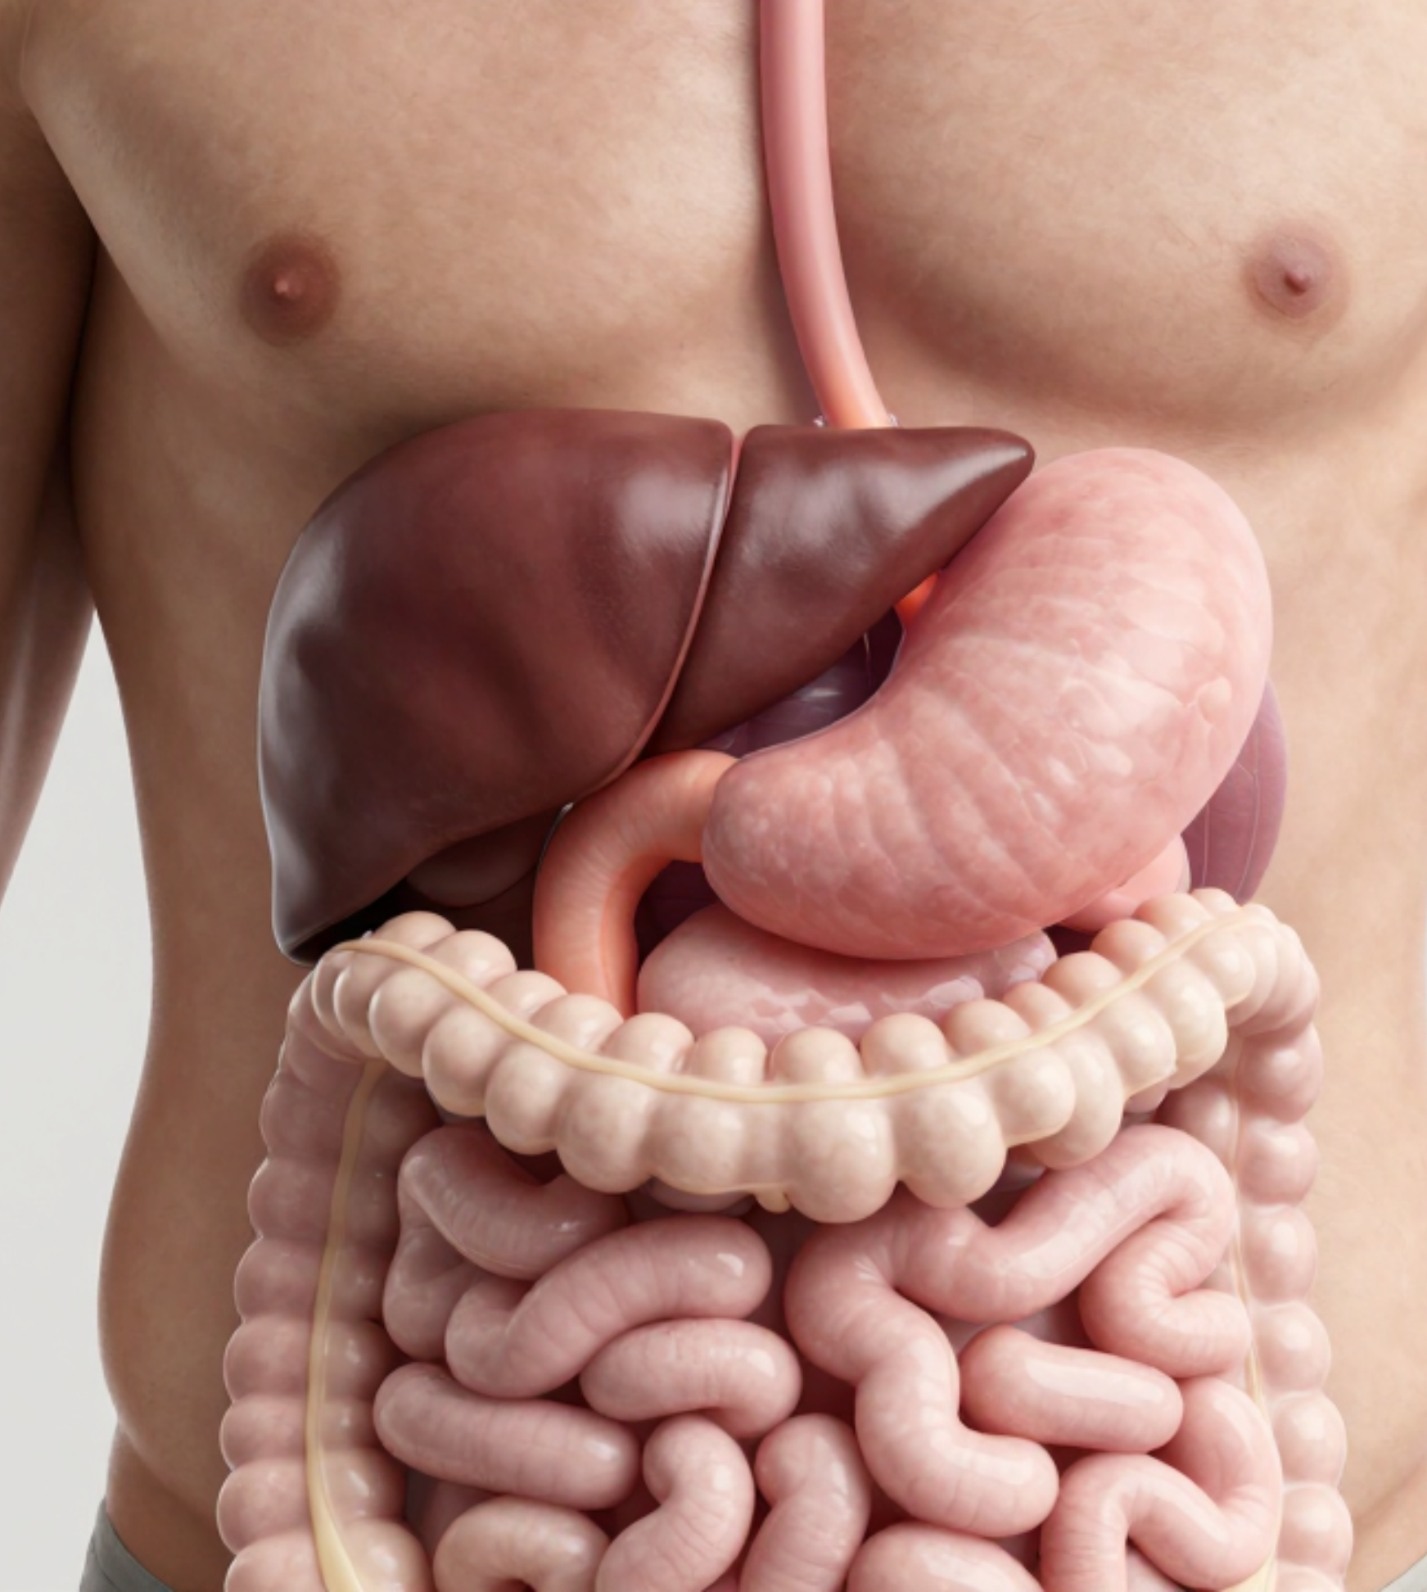


BRADFORD VTS TEACHING DECK
Gastroenterology in General Practice
Clinical Standards Update:
NICE CG184 (Dyspepsia/GORD, 2024)
NICE NG12 (Suspected Cancer, 2026)
www.bradfordvts.co.uk | May 2026 Session

Slide 2













Disclaimer and Clinical Overview
GASTROENTEROLOGY | BRADFORD VTS TEACHING
Source Material & Updates
Updated to NICE CG184 (2024) for Dyspepsia/GORD management.
Incorporates NICE NG12 (April 2026) standards for suspected cancer referral.
Includes 2024 NHS H. pylori eradication and NICE CG61 IBS surveillance.
Key Clinical Focus Areas
Clinical Disclaimer
Upper GI: Dyspepsia, GORD, and H. pylori strategies.
This teaching material is for educational purposes for GP trainees. Clinical guidelines evolve rapidly; clinicians must always verify against the latest national (NICE/SIGN) and local ICB protocols before making treatment decisions.
Lower GI: FIT testing, CRC screening, and IBD.
Liver/Biliary: Recognition of jaundice and obstructive causes.
Cancer: Recognition of alarm features and 2WW pathways.

Slide 3















Dyspepsia: Definition and Lifestyle Factors
GASTROENTEROLOGY | BRADFORD VTS TEACHING
NICE CG184 Definition
Epigastric pain or discomfort
Lifestyle Factors: STRAWS
Heartburn and acid regurgitation
Excessive belching and bloating
S
T
Smoking cessation
Tobacco (Alcohol)
Nausea and occasional vomiting
R
Refined sugar
A
Acidic foods
Clinical Classification
W
Weight loss
S
Stress reduction
Non-ulcer (functional):Most common in GP
GORD:Reflux-dominant symptoms
Peptic Ulcer:H. pylori or NSAID related
Initial Management Summary (NICE CG184)
STEP 1
STEP 2
STEP 3
STEP 4
Identify Alarm Symptoms and manage red flags first.
Review meds (NSAIDs, Bisphosphonates, Nitrates, Steroids).
Lifestyle: Weight loss, stop smoking, avoid late meals.
Full-dose PPI (4 weeks) OR H. pylori test-and-treat.

Slide 4

















H. pylori: Test and Treat Strategy
GASTROENTEROLOGY | BRADFORD VTS TEACHING
Patient Selection Criteria
Testing Modalities
Age under 55 years
Urea Breath Test (UBT): Preferred (High Sens/Spec)
No alarm features (weight loss, dysphagia, etc.)
Stool Antigen: Acceptable alternative
Manage lifestyle factors (STRAWS) and review medications first
Serology: Not for retesting; less accurate
Stop PPIs 2 weeks and Antibiotics 4 weeks before testing
NICE Strategy Options
1-MINUTE REFLECTION
Empirical PPI Trial: Full-dose for 4 weeks
What would you do next?
Test-and-Treat: Non-invasive H. pylori testing
"A 52-year-old patient presents with new-onset epigastric pain and acid reflux. They have no dysphagia or weight loss. They are currently taking Naproxen for knee pain."
Offer both strategies where appropriate

Slide 5
















H. pylori Eradication and Testing Protocols
GASTROENTEROLOGY | BRADFORD VTS TEACHING
Eradication Regimens (7 Days)
Pre-Testing Requirements
Stop 2 Weeks
PPIs must be stopped at least 2 weeks before a UBT or stool antigen test.
NO PENICILLIN ALLERGY — FIRST LINE
Stop 4 Weeks
Antibiotics & Bismuth must be stopped at least 4 weeks before testing.
Triple Therapy (Standard)
PPI (e.g., Lansoprazole 30mg BD) + Amoxicillin 1g BD + Clarithromycin 500mg BD
WITHHOLD STATINS during Clarithromycin course (myopathy risk)
NO PENICILLIN ALLERGY — SECOND LINE
Alternative (If Clarithromycin exposure)
Re-Testing (Post-Eradication)
PPI BD + Amoxicillin 1g BD + Metronidazole 400mg BD
Indications for confirmation of clearance:
Peptic ulcer patients (Gastric or Duodenal)
MALT lymphoma or early gastric cancer resection
PENICILLIN ALLERGY — FIRST LINE
Persistent symptoms despite treatment
Penicillin-Free Triple Therapy
Wait ≥4 weeks after antibiotics and ≥2 weeks after PPIs.
PPI BD + Clarithromycin 500mg BD + Metronidazole 400mg BD
Note: Avoid metronidazole if used in the previous year.
Source: NHS H. pylori eradication guidelines (Nov 2024) | www.bradfordvts.co.uk

Slide 6














PPI Use: Indications and Long-term Risks
GASTROENTEROLOGY | BRADFORD VTS TEACHING
CLINICAL CONDITION
NICE MANAGEMENT STRATEGY (CG184)
Long-term Risks
Full-dose PPI for 4–8 weeks; then step down to lowest effective dose or 'on-demand'.
Bone & Metabolic: Increased risk of osteoporosis/fractures, Hypomagnesaemia, and B12 deficiency.
Moderate / Severe GORD
Infections: Higher risk of C. difficile colitis and community-acquired pneumonia.
Complicated GORD
Full-dose PPI maintained long-term to prevent complications.
(Stricture, Ulcer, Barrett's)
Stewardship: Annual review required; check for ongoing indication and attempt step-down.
Peptic Ulcer
Triple therapy eradication. Consider PPI for 4 weeks post-treatment for large ulcers.
(H. pylori related)
Stop NSAID if possible. PPI for healing; co-prescribe PPI if NSAID is unavoidable.
NSAID-related Ulcer
PPI trial for 4 weeks only. NICE suggests H2RA as a viable first-line alternative.
AKT Pearl: Clopidogrel
Functional Dyspepsia
AVOID: Omeprazole or Esomeprazole
USE: Pantoprazole or Lansoprazole
Significant interaction reduces anti-platelet efficacy.

Slide 7



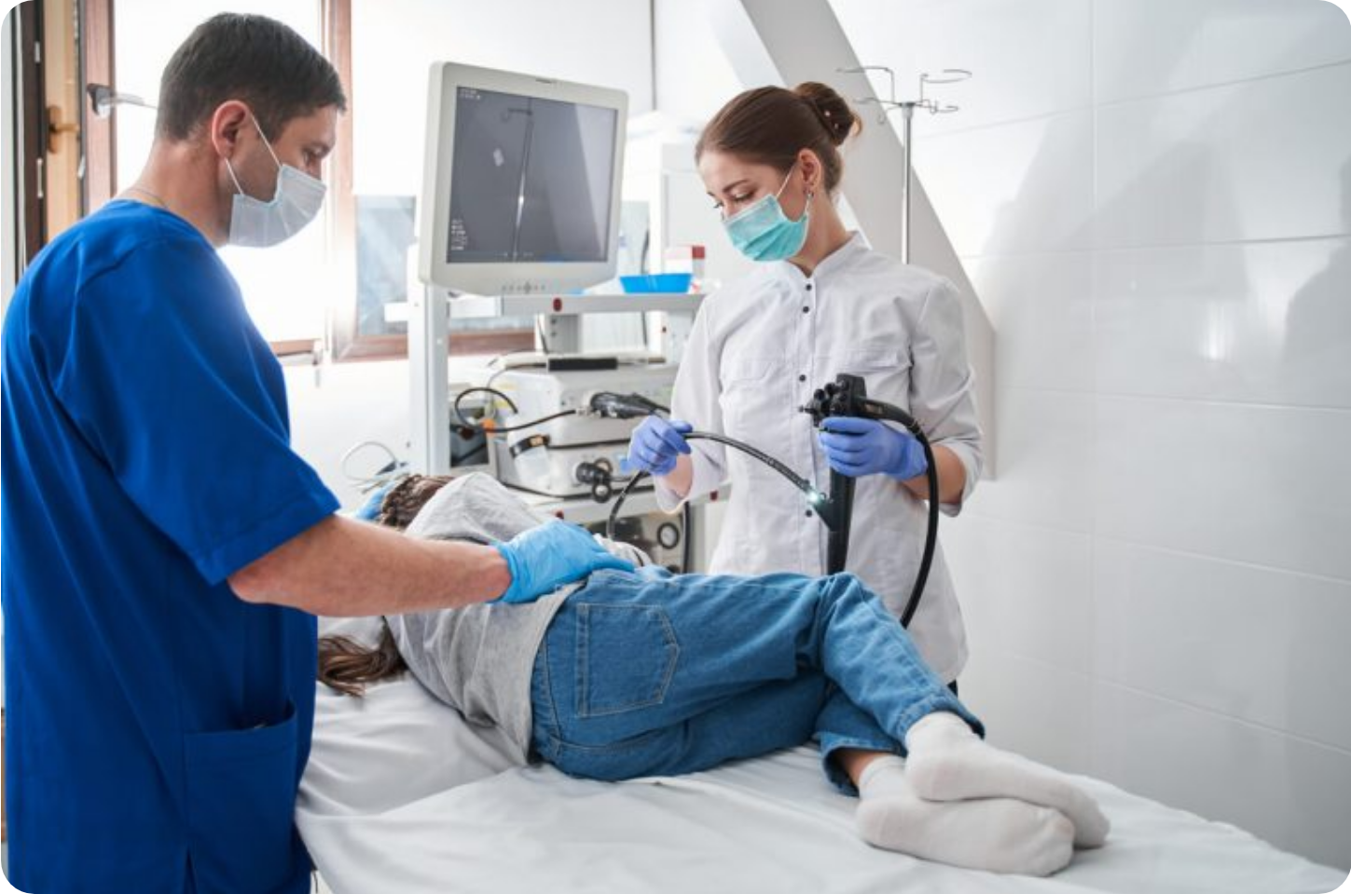






Endoscopy Referral Criteria (NICE CG184)
GASTROENTEROLOGY | BRADFORD VTS TEACHING
Urgent Endoscopy (2WW Suspected Cancer)
Dysphagia: Any age, urgent referral required.
Age ≥55 + Weight Loss AND any of: Upper abdominal pain, reflux, or dyspepsia.
Non-Urgent Endoscopy Criteria
Haematemesis: Requires investigation (urgent if active/significant).
Age ≥55 + Any of: Treatment-resistant dyspepsia, upper abdominal pain with low Hb, or raised platelets with GI symptoms.
Age ≥55 + Nausea/Vomiting AND any of: Weight loss, reflux, dyspepsia, or pain.
CRITICAL THRESHOLD UPDATE
NICE CG184 sets the threshold at 55 years.
Guidance Change: The previous threshold of 45 is obsolete. Patients aged 45-54 without alarm symptoms do not require automatic endoscopy.
No Investigation Needed: Patients <55 with uncomplicated dyspepsia and no alarm symptoms should be managed with "test-and-treat" or empirical PPI trial.

Slide 8

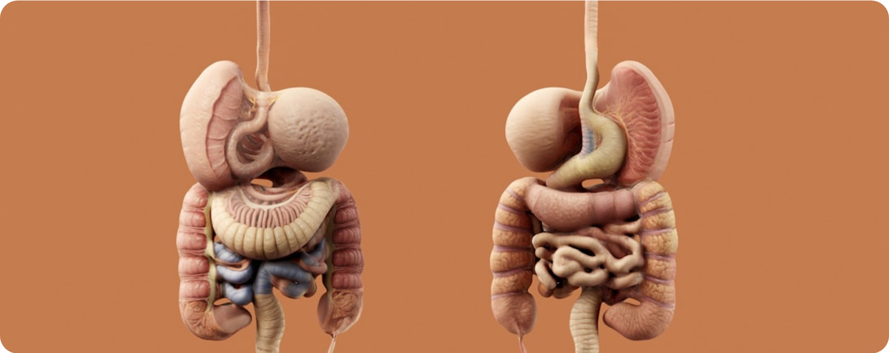





GORD and Peptic Ulcer Disease
GASTROENTEROLOGY | BRADFORD VTS TEACHING
GORD Management Strategy
Mild GORD
Antacids, alginates, or H2 receptor antagonists; avoid PPI as first step.
Moderate / Severe GORD
Full-dose PPI for 4–8 weeks; step down to lowest effective dose or 'on-demand'.
Complicated GORD
Stricture, ulcer, or Barrett's; maintain full-dose PPI indefinitely and refer.
Peptic Ulcer Disease (PUD)
Barrett's Oesophagus & Advice
Classification
Clinical Significance
H. pylori-related (most common), NSAID-related (co-prescribe PPI), or stress.
Columnar metaplasia; risk factor for adenocarcinoma; requires surveillance.
Major Complications
Lifestyle Measures
Haemorrhage (Admit same day), Perforation (999), Gastric outflow obstruction.
Weight loss, elevate head of bed, stop smoking, avoid late meals (3h pre-bed).
Critical Follow-up
Confirm healing of all gastric ulcers via endoscopy to exclude cancer.
www.bradfordvts.co.uk | Updated to NICE CG184 (2024)

Slide 9






Inflammatory Bowel Disease and Diverticular Disease
GASTROENTEROLOGY | BRADFORD VTS TEACHING
Crohn's Disease
C. difficile Colitis
Features: Any part of GI tract (mouth to anus); skip lesions; transmural inflammation.
Risk Factors: Recent broad-spectrum antibiotics, PPI use, elderly, or hospital stays.
Symptoms: Abdominal pain (often RIF), diarrhoea, weight loss, and perianal disease.
Treatment: First-line is Oral Vancomycin (NHS 2023); stop offending antibiotics.
Recurrence: Consider Fidaxomicin for recurrent cases or referral for persistent symptoms.
Extra-intestinal: Uveitis, erythema nodosum, pyoderma gangrenosum, and mouth ulcers.
Ulcerative Colitis (UC)
Diverticular Disease Management
Features: Affects colon only; mucosal inflammation; continuous from rectum upwards.
Acute Diverticulitis: Fever, LIF pain, and tenderness; treat with oral antibiotics.
Antibiotics: Amoxicillin + Metronidazole OR Co-amoxiclav; high-fibre diet once acute phase resolves.
Symptoms: Bloody diarrhoea, mucus, urgency, tenesmus, and lower abdominal pain.
Complications: Abscess, perforation, fistula, or haemorrhage (require urgent hospital admission).
Risks: Toxic megacolon (acute admission) and long-term colorectal cancer risk.
Updated to NICE CG184 (2024) | www.bradfordvts.co.uk

Slide 10












FIT Testing and Colorectal Cancer Referral
GASTROENTEROLOGY | BRADFORD VTS TEACHING
Offer FIT to Adults with:
Referral Threshold
General: Abdominal mass, change in bowel habit, or iron-deficiency anaemia.
≥ 10
Age ≥40: Unexplained weight loss + abdominal pain.
μg Hb/g faeces
Age <50: Rectal bleeding + abdominal pain or weight loss.
Age ≥50: Rectal bleeding, abdominal pain, or weight loss (unexplained).
URGENT 2-WEEK WAIT REFERRAL
Age ≥60: Anaemia (even without iron deficiency).
Screening: Offer even if previous NHS screening FIT was negative.
Direct Referral (No FIT)
Rectal mass
Unexplained anal mass or ulceration
Safety Netting: If FIT < 10 μg/g, normal examination, and normal FBC, the risk of CRC is < 0.1%.
NICE NG12 (2023 Update) | www.bradfordvts.co.uk

Slide 11






Jaundice: Classification and Referral
GASTROENTEROLOGY | BRADFORD VTS TEACHING
Pre-hepatic
Hepatocellular
Obstructive
MECHANISM: HAEMOLYSIS
MECHANISM: LIVER DAMAGE
MECHANISM: BILIARY BLOCKAGE
Unconjugated hyperbilirubinaemia
Mixed (Conjugated + Unconjugated)
Conjugated; pale stools / dark urine / itch
Haemolytic anaemia
Viral Hepatitis (A, B, C, E)
Gallstones (Choledocholithiasis)
Sickle cell disease
Alcoholic hepatitis or NAFLD/NASH
Pancreatic cancer (Head of pancreas)
G6PD deficiency
Drug-induced (Fluclox, Co-amoxiclav)
Cholangiocarcinoma / Strictures
URGENT 2-WEEK WAIT REFERRAL (NICE NG12)
Refer using the 2WW suspected cancer pathway if age ≥ 40 years with jaundice and no obvious cause.
Classic Triad: Painless Jaundice + Weight Loss + Age ≥ 40 → Suspect Pancreatic Cancer

Slide 12









GI Cancer Overview: 2WW Pathways
GASTROENTEROLOGY | BRADFORD VTS TEACHING
Oesophageal Cancer
Gastric Cancer
KEY RISK FACTORS
KEY RISK FACTORS
Chronic GORD, Barrett's Oesophagus, Obesity, Smoking, High Alcohol Intake.
H. pylori infection, Smoking, Diet (high salt/processed meats), Family History.
URGENT 2WW REFERRAL
URGENT 2WW REFERRAL
• Dysphagia (any age, immediate 2WW)
• Age ≥55 + Weight Loss + (Reflux/Dyspepsia/Pain)
• Age ≥55 + Weight Loss + Symptoms
• Symptoms: Dyspepsia or Upper Abdominal Pain
Colorectal Cancer
Pancreatic Cancer
KEY RISK FACTORS
KEY RISK FACTORS
Age, Low-fiber diet, IBD (UC/Crohn's), Adenomatous Polyps, Family Hx.
Smoking, Type 2 Diabetes, Chronic Pancreatitis, Obesity, Age.
FIT-GUIDED 2WW REFERRAL
URGENT 2WW / CT
• FIT ≥10 μg Hb/g (Symptomatic criteria per NG12)
• Rectal Mass or Anal Mass/Ulcer (Direct 2WW)
• Age ≥40 + Jaundice (Urgent 2WW)
• Age ≥60 + Weight Loss + GI Symptoms (Urgent CT)

Slide 13





















Top Tips and Exam Pearls
GASTROENTEROLOGY | BRADFORD VTS TEACHING
Clinical Top Tips
AKT High-Yield Pearls
Stop PPIs 2 weeks before H. pylori testing (Breath/Stool) to prevent false negatives.
The endoscopy threshold for dyspepsia is Age 55 (Common distractor: 45).
Withhold statins during Clarithromycin courses to avoid myopathy risk.
Triple therapy (1st line): PPI + Amox + Clari for 7 days.
Always ask about Alarm Features (Weight loss, Dysphagia, Anaemia) before empirical management.
Avoid Omeprazole/Esomeprazole with Clopidogrel; use Lansoprazole instead.
Use FIT threshold of ≥10 μg/g for colorectal 2WW referral.
GORD management: Start with lifestyle and antacids/alginates for mild symptoms before stepping up to PPI.
Review long-term PPIs annually for ongoing indication, magnesium, and B12 levels.
SCA Consultation Pearls
Explore ICE: Many patients with dyspepsia fear cancer even without alarm symptoms.
FIT Explanation: Reassure <0.1% CRC risk if FIT <10 with normal exam/FBC.
Discuss the "Test-and-Treat" strategy vs. PPI trial for patients under 55.
Source: NICE CG184 (2024) & NG12 (2026)

Slide 14








Red Flags and Common Pitfalls
GASTROENTEROLOGY | BRADFORD VTS TEACHING
URGENT ALARM FEATURES
COMMON CLINICAL PITFALLS
EMERGENCY & ADMISSION
REFERRAL & SCREENING ERRORS
Dysphagia: Any age requires urgent 2-week wait referral.
Age Cut-off: Referring age 45-54 automatically (NICE threshold is 55).
Haematemesis / Melaena: Same-day emergency admission.
Obsolete Tests: Using qualitative FOB instead of quantitative FIT.
Acute Abdomen: Perforation or toxic megacolon (999).
FIT Threshold: Ignoring FIT results <10 despite normal examination.
SUSPECTED MALIGNANCY (2WW)
PRESCRIBING & TESTING RISKS
Progressive Weight Loss: Combined with upper GI symptoms.
H. pylori Timing: Failing to stop PPIs 2 weeks before testing.
Unexplained Masses: Palpable abdominal or rectal mass.
Statin Interaction: Not withholding statins during Clarithromycin.
Iron-Deficiency Anaemia: Persistent or unexplained low Hb.
PPI Review: Continuing long-term PPI without annual indication check.
AGE-SPECIFIC TRIGGERS
DIAGNOSTIC BLIND SPOTS
Age ≥55: New weight loss + dyspepsia or reflux.
Painless Jaundice: Missing pancreatic cancer in the elderly.
Age ≥40 + Jaundice: Urgent referral (exclude pancreatic CA).
Barrett's Oesophagus: Overlooking surveillance for long-term GORD.
SAFETY FIRST: Always safety-net FIT <10 cases; consult NICE NG12 (2026) for latest criteria.
Resource: www.bradfordvts.co.uk

Slide 15









Quick Recall and Resources
GASTROENTEROLOGY | BRADFORD VTS TEACHING
Vital Thresholds
Practice Essentials
FIT ≥ 10 μg Hb/g: The threshold for urgent 2WW colorectal referral.
Dysphagia: Any age, always requires an urgent 2WW referral.
Mild GORD: Step-up approach; use antacids or alginates before PPIs.
Age ≥ 55: The new threshold for investigating treatment-resistant dyspepsia.
Long-term PPI: Annual review for side effects (Magnesium, B12, Bone density).
Age ≥ 40 + Jaundice: Urgent CT or ERCP required to exclude pancreatic cancer.
H. pylori Protocols
Teaching Resources
Stop PPIs: At least 2 weeks before urea breath or stool antigen tests.
Access full clinical decks, exam preparation guides, and the latest NICE updates for GP trainees.
Stop Antibiotics: At least 4 weeks before any H. pylori testing.
www.bradfordvts.co.uk
Statins: Must be withheld during 7-day Clarithromycin courses.
References: NICE CG184 (2024), NICE NG12 (2026 update), NHS H. pylori (2024).

