Slide 1



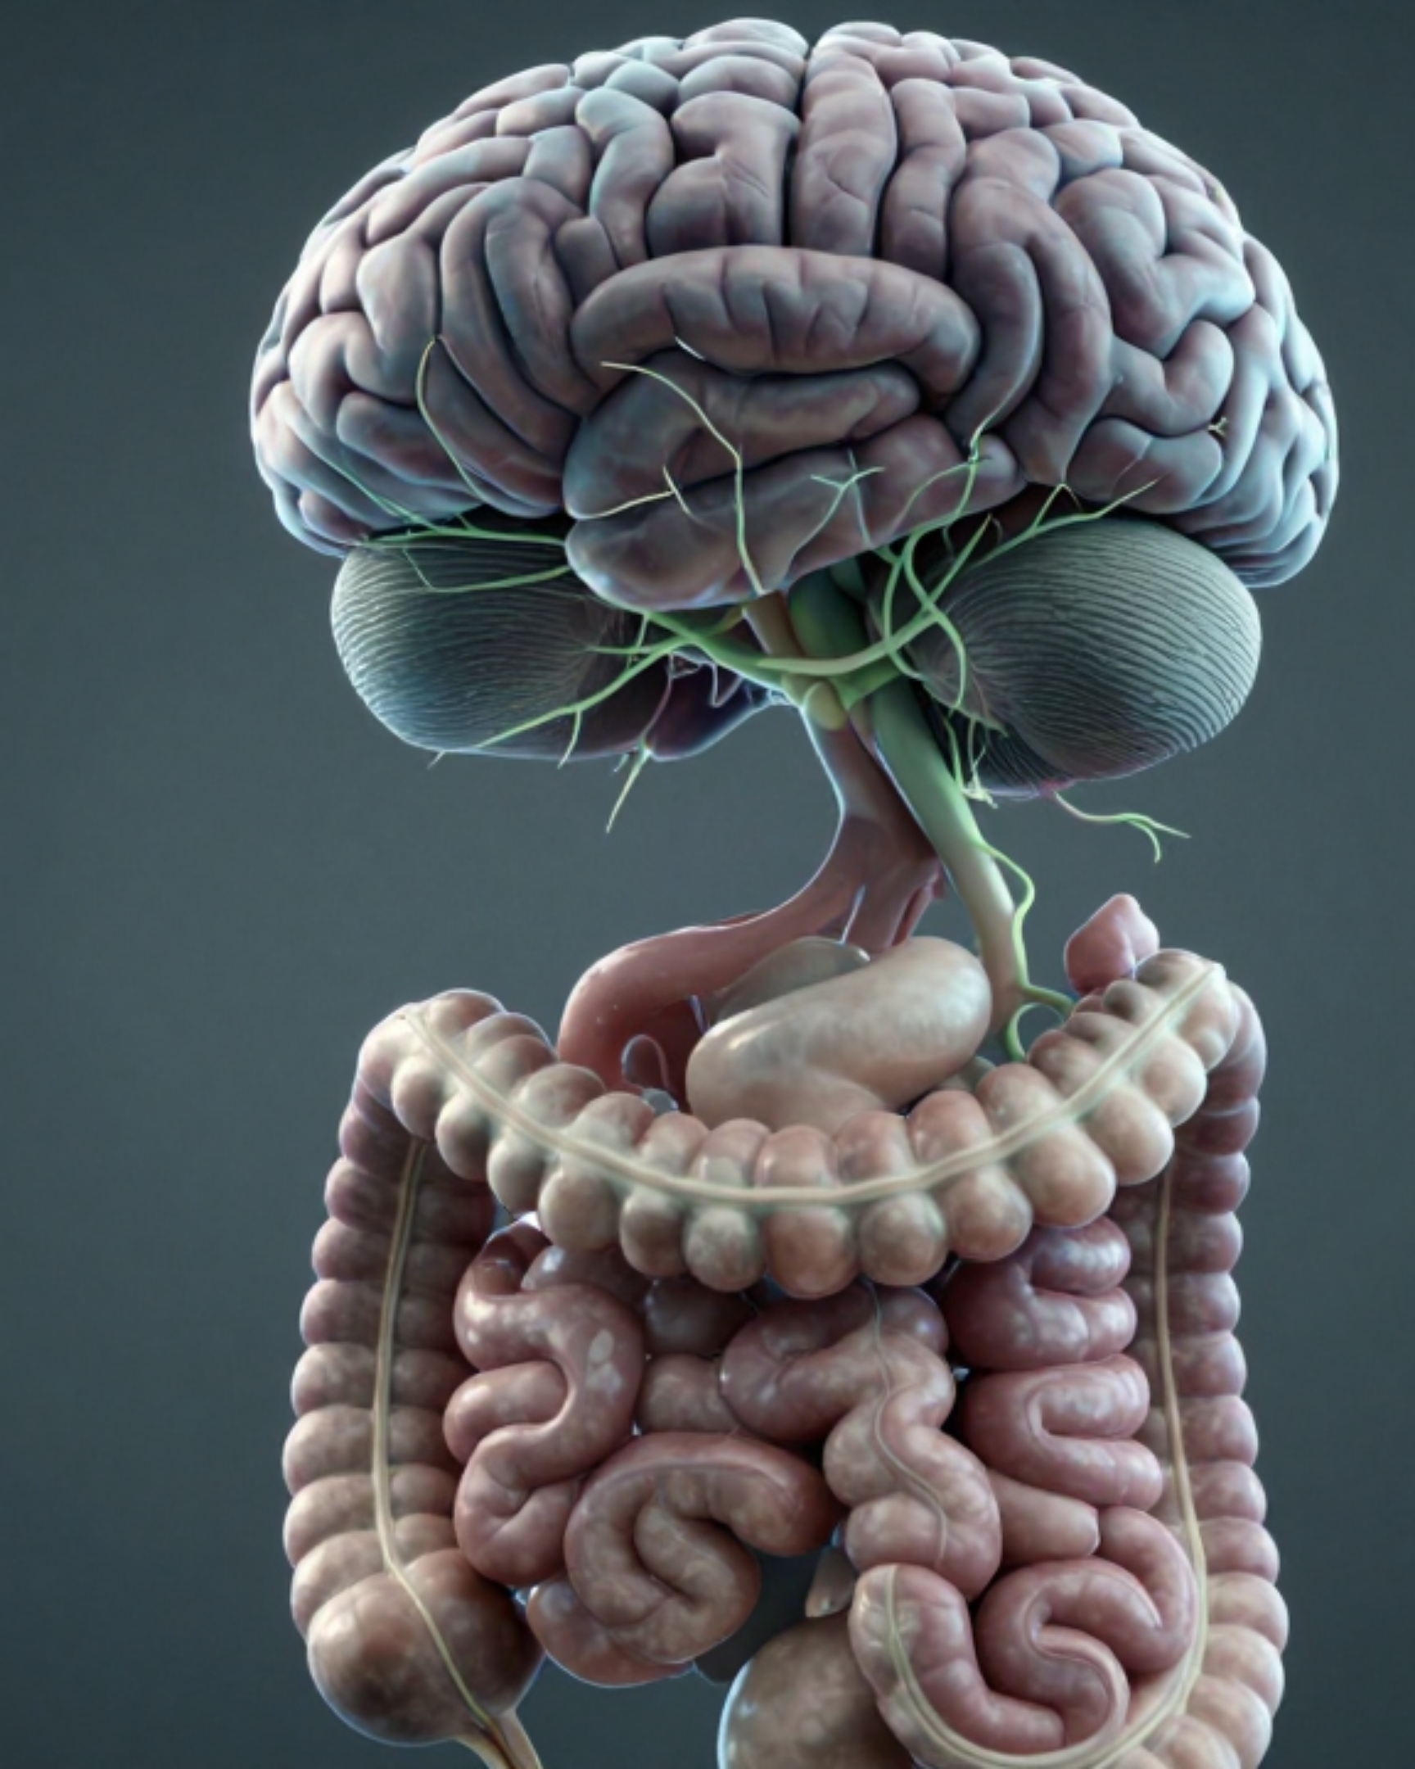



BRADFORD VTS TEACHING RESOURCE
IRRITABLE BOWEL
SYNDROME (IBS)
IBS in General Practice
Comprehensive Guide to Diagnosis and Management
Updated to NICE CG61 and 2024 CKS Evidence Created May 2026
Primary care application & MRCGP Exam focus (AKT/SCA)
www.bradfordvts.co.uk

Slide 2















IBS IN GENERAL PRACTICE
Introduction and Disclaimer
What is IBS?
Impact on Primary Care
Irritable Bowel Syndrome (IBS) is a functional gut disorder characterized by altered gut-brain interactions.
GPs diagnose ~1 new case per week.
Typical GPs see 4–5 IBS patients every week.
No identifiable structural or biochemical abnormality.
70% are symptom-free after 5 years (good prognosis).
Involves visceral hypersensitivity and motility issues.
Prevalence & Demographics
MANDATORY DISCLAIMER
Affects 10–15% of the UK population.
This deck is a teaching aid for Bradford VTS. Clinical management must always align with the most recent NICE CG61 (updated 2024), CKS evidence, and local Bradford formulary guidelines.
Female to Male ratio is 2:1.
50% of patients present before age 35.
Material synthesized from legacy VTS content and updated to 2022/2024 standards.
Bradford VTS Teaching Resource • www.bradfordvts.co.uk

Slide 3














IBS IN GENERAL PRACTICE
Diagnostic Criteria: NICE vs. Rome IV
NICE CG61 (UK Standard)
Rome IV (International)
The "ABC" Diagnostic Triad. Consider IBS if all three have been present for at least 6 months:
Recurrent abdominal pain, averaging ≥ 1 day/week for the last 3 months.
A
Abdominal Pain
Pain or discomfort, often relieved by defecation.
PLUS AT LEAST 2 OF THE FOLLOWING:
B
Bloating
Feeling of distension, tightness, or visible swelling.
Related to defecation: Symptoms may improve or worsen after passing stool.
Change in stool frequency: Associated with a change in how often stool is passed.
C
Change in Bowel Habit
Altered frequency or stool consistency.
Change in stool form: Associated with a change in the appearance of stool (Bristol Scale).
Symptoms must be present for ≥ 6 Months
*Rome IV is the research standard; NICE is the UK clinical standard for GPs.
www.bradfordvts.co.uk
Clinical Teaching Resource • 2024 Updates
AKT/SCA High Yield

Slide 4












IBS IN GENERAL PRACTICE
IBS Subtypes & Supporting Symptoms
Subtypes (Bristol Stool Scale)
Supporting Symptoms
IBS-D (Diarrhoea)
IBS-C (Constipation)
Incomplete Evacuation: Feeling of persistent rectal fullness after stool passage.
>3 BMs/day, loose/watery, urgency predominant.
<3 BMs/week, hard/lumpy, straining predominant.
Mucus per Rectum: Passage of clear or white mucus, especially with straining.
IBS-M (Mixed)
IBS-U (Unclassified)
Abdominal Distension: Visible bloating or feeling of excessive gas/fullness.
Alternating constipation and diarrhoea symptoms.
Symptoms do not meet criteria for D, C, or M.
Symptom Modulation: Relief or worsening of pain/discomfort after defaecation.
Classification is based on the predominant stool pattern on days with abnormal bowel movements.
Clinician Note: These are not required for diagnosis but significantly increase clinical suspicion of IBS.

Slide 5









IBS IN GENERAL PRACTICE
Recommended Investigations
IBS is a positive clinical diagnosis — not a diagnosis of exclusion. Extensive investigation is not routinely needed unless red flags are present.
Recommended Minimum Panel
NOT Routinely Recommended
Colonoscopy or Barium studies (unless red flags).
Full Blood Count (FBC): Exclude anaemia and infection.
Stool cultures (unless travel history/acute onset).
CRP or ESR: Screen for systemic inflammation or infection.
Coeliac Serology (tTG IgA): Mandatory for ALL patients at diagnosis (NICE CG61).
Faecal calprotectin (only to differentiate IBD).
FIT testing (only if criteria for CRC screening met).
Note: Ensure the patient is eating gluten for at least 6 weeks prior to coeliac testing for accurate results.
Clinical Pearl
Avoid over-investigation. Excessive testing increases patient anxiety and healthcare costs without improving diagnostic accuracy for functional disorders.

Slide 6









IBS IN GENERAL PRACTICE
Section 5: Differential Diagnosis — What else could it be?
Inflammatory & Autoimmune
Gynaecological & Systemic
IBD: Crohn’s disease or Ulcerative Colitis.
Ovarian Cancer: Check CA125 in women ≥50 with new bloating/urinary symptoms.
Coeliac Disease: Mandatory rule-out with tTG IgA.
Endometriosis: If symptoms are cyclical or involve dysmenorrhoea.
Microscopic Colitis: Watery diarrhoea in older patients.
Malignancy Concerns
Systemic & Other GI
Colorectal Cancer: Consider FIT/Colonoscopy if rectal bleeding, weight loss, or age >50.
Thyroid Disease: Hypo- (constipation) or Hyper- (diarrhoea).
Bile Acid Malabsorption: Post-cholecystectomy or ileal disease.
Diverticular Disease: Common LIF pain mimic in older adults.
Clinical Pearl: IBS is a positive diagnosis based on the ABC triad, but always perform mandatory Coeliac serology and check for Red Flags before confirming.

Slide 7










IBS IN GENERAL PRACTICE
Red Flags and Referral Criteria
NICE CG61 Red Flags
Urgent / 2WW Referral (NG12)
Presence of any red flag symptoms warrants immediate investigation or urgent referral rather than a positive IBS diagnosis.
Age >50 at first presentation (especially males)
Rectal bleeding (unexplained)
Unintentional weight loss or anaemia
Key trigger: Unexplained rectal bleeding, FIT positive (if applicable), or mass on examination.
Nocturnal symptoms (waking from sleep)
Constant abdominal pain (not episodic)
Fever or elevated inflammatory markers (CRP/ESR)
Family history of Colorectal Cancer or IBD
Routine Referral Criteria
Ovarian Cancer Mimicry: In women ≥50 with new IBS symptoms, check CA125 if bloating/urinary symptoms occur ≥12 times/month.
Diagnostic uncertainty or atypical features
Primary care failure after 3 months of therapy
Significant psychological co-morbidity
RED FLAG FLASH-QUIZ
A 52-year-old male presents with 3 months of bloating and loose stools. FBC shows Hb 10.5g/dL. Action? → Urgent 2WW (Anaemia + New onset >50)
Source: NICE CG61 & NICE NG12 Guidelines
www.bradfordvts.co.uk

Slide 8


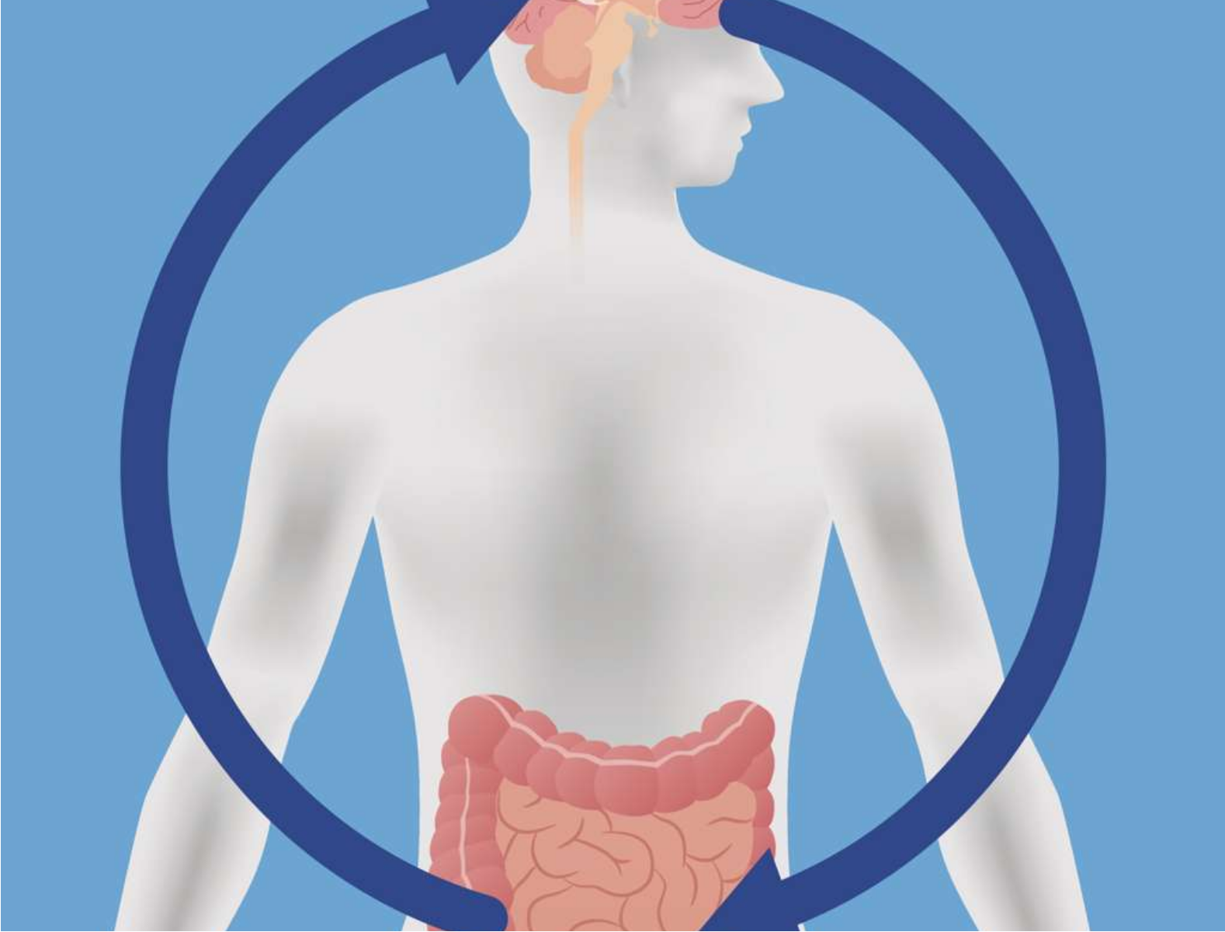







IBS IN GENERAL PRACTICE
Associated Features & Gut-Brain Axis
Gut-Brain Interaction
IBS is a functional disorder of gut-brain interaction where bidirectional communication between the central and enteric nervous systems is altered.
Psychological Comorbidity
25% of clinical patients have co-morbid depression or anxiety; however, non-consulting sufferers show psychological health identical to the general population.
Visceral Hypersensitivity
Patients experience heightened perception of normal gut sensations (visceral hypersensitivity), providing a genuine physiological basis for abdominal pain.
Validate and explain the diagnosis: IBS is NOT hypochondria. Use the gut-brain axis model to build trust and explain physical symptoms.
Source: NICE CG61 & BSG Guidelines 2022
www.bradfordvts.co.uk

Slide 9



















IBS IN GENERAL PRACTICE
Section 7: First-Line Management & Lifestyle
General Clinical Approach
Dietary Adjustments
Explain & Validate: Use the gut-brain axis model; acknowledge symptoms are real and physiological.
Stimulants: Limit tea and coffee to 3 cups per day; reduce alcohol intake significantly.
Positive Language: Avoid dismissive phrases like "nothing's wrong" or "it's just stress."
Fiber Modification: Reduce intake of insoluble fiber (e.g., wheat bran) which often worsens bloating.
Meal Regularity: Advise consistent meal times; avoid skipping meals or long fasting periods.
Fruit Limitation: If diarrhea is present, limit fresh fruit to no more than 3 portions (80g each) per day.
Clinical Pearl: 55% of IBS patients report worsening symptoms with wheat bran supplements.
Hydration & Fluid Intake
Aim for at least 8 cups of fluid per day, focusing on water or non-caffeinated options.
Initial Patient Advice
Reduce intake of fizzy drinks and carbonated beverages to minimize bloating/gas.
Encourage a symptom diary to identify specific personal triggers before major restrictions.
Advise that dietary changes may take 4 weeks to show full effect.
Source: NICE Guideline CG61 (Updated 2024)
www.bradfordvts.co.uk | Teaching Resource

Slide 10















IBS IN GENERAL PRACTICE
Dietary Management: Low FODMAP Diet
Evidence-Based Overview
Key High FODMAPs to Avoid
Effective in ~70% of patients; superior to standard advice in clinical trials.
Oligosaccharides
Disaccharides
Wheat, rye, garlic, onion, legumes (lentils, beans).
Lactose (milk, yogurt, soft cheeses).
Reduces fermentation and osmotic load in the small/large intestine.
LANCET EVIDENCE 2024
Monosaccharides
Polyols
Excess fructose (honey, apples, high-fructose corn syrup).
Sorbitol, mannitol (stone fruits, artificial sweeteners).
The Three-Phase Process
Mandatory Clinical Guidance
PHASE 1Restriction
(2–6 weeks)
PHASE 2Reintroduction
(Trigger ID)
PHASE 3Personalization
(Long-term)
NOT a DIY diet: Requires specialist dietitian guidance to ensure nutritional adequacy.
High risk of disordered eating if implemented without professional support.
*Reintroduction is essential to avoid unnecessary long-term nutritional deficits.
Screen for malnutrition and existing eating disorders before referral.
www.bradfordvts.co.uk

Slide 11















IBS IN GENERAL PRACTICE
Pharmacological Treatment by Subtype
IBS-D (Diarrhoea)
IBS-C (Constipation)
Pain & Bloating
Loperamide (First-line)
Ispaghula Husk (Fybogel)
Mebeverine (First-choice)
Start 2mg dose; titrate to reduce frequency and urgency.
Soluble fibre of choice; take with adequate water.
135mg TDS or 200mg MR BD (Success in ~66%).
Osmotic Laxatives
Antispasmodics
Hyoscine Butylbromide
Macrogol (Polyethylene Glycol) is preferred.
For associated cramps/pain.
10mg QDS; can be added for acute cramping.
Linaclotide
For mod-to-severe cases if laxatives fail for 12 months.
Peppermint Oil
Enteric-coated capsules for bloating and pain.
AVOID BRAN: 55% of patients worsen with insoluble fibre.
AVOID LACTULOSE: Worsens flatulence and bloating symptoms.
Second-line: Consider low-dose Amitriptyline (TCA) 10mg nocte for persistent pain.

Slide 12

















IBS IN GENERAL PRACTICE
Second-Line and Psychological Therapies
Tricyclic Antidepressants (TCAs)
Psychological Interventions
Amitriptyline (1st Choice): Start 10mg nocte, titrate slowly up to 75mg.
Cognitive Behavioural Therapy (CBT): Strong evidence; targets unhelpful thoughts and symptom patterns.
Analgesic Dose: Used at lower doses than for depression; excellent evidence for pain.
Gut-Directed Hypnotherapy: Specialist service that successfully reduces visceral hypersensitivity.
Superiority: Significant evidence base showing TCAs are more effective than SSRIs for IBS pain.
Mindfulness: Emerging evidence for stress reduction and symptom management.
SSRIs
EXAM PEARL
Referral & NICE Guidance
Limited Evidence: Weaker for specific GI pain control compared to TCAs.
Consider referral for patients with chronic IBS (>12 months) non-responsive to pharmacological options.
Global Well-being: May offer benefits for overall quality of life and anxiety co-morbidity.
Communication Strategy:
Always validate the physical diagnosis and explain theGut-Brain Axisbefore introducing psychological therapy to ensure trust.

Slide 13















IBS IN GENERAL PRACTICE
Section 13: Patient Communication & SCA Focus
Key Consultation Phrases
SCA Exam Strategy (MRCGP)
"IBS is a real condition—your gut is genuinely more sensitive than average. There is a powerful connection between the gut and the brain."
Explore ICE: Explicitly ask about concerns regarding cancer or inflammatory bowel disease early on.
Explain the Axis: Use the "Gut-Brain interaction" model to validate physical symptoms without sounding dismissive.
"The tests we’ve done are important to rule out other causes; the good news is they are normal, which helps confirm the diagnosis of IBS."
Avoid "Stress-Only": Never say it is "just stress." Frame stress as a trigger for a physiological process.
"This condition will not develop into cancer or anything more serious, though I understand how debilitating the symptoms feel."
Shared Decision Making: Offer lifestyle and dietary advice first before jumping to pharmacological options.
"There isn't a single 'cure', but we can work together to find the right combination of diet and medication to manage it well."
Patient Resources
Provide evidence-based self-help links to empower the patient.
The IBS Network: theibsnetwork.org.uk
Gut UK: guts.org.uk (Evidence-based info)
*Direct to dietitian if considering Low FODMAP.
Teaching aid for Bradford VTS. Always follow latest local formulary and NICE updates. www.bradfordvts.co.uk

Slide 14








IBS IN GENERAL PRACTICE
Section 14: Top Tips and Exam Pearls
Top Clinical Tips - Part A
AKT Exam Pearls
Positive Diagnosis: Use the ABC triad (Pain, Bloating, Habit change) ≥ 6 months; avoid over-investigation.
Diagnostic Triad: Must be present for at least 6 months (NICE CG61).
Mandatory Test: Always perform Coeliac serology (tTG IgA) at diagnosis to avoid missing Coeliac Disease.
Second-line Pain: Amitriptyline used at low analgesic dose (10–75mg nocte), not antidepressant dose.
Antispasmodics: Mebeverine 135mg TDS is first-line; hyoscine or peppermint oil are useful add-ons.
IBS-C First-line: Ispaghula husk or osmotic laxatives are preferred over stimulant laxatives.
Top Clinical Tips - Part B
SCA Consultation Pearls
Fibre Caution: Insoluble fibre (bran) can worsen bloating/pain; recommend soluble fibre (ispaghula) instead.
Validate & Explain: Acknowledge symptoms are real; use the Gut-Brain Axis model to avoid "it's just stress."
Laxative Choice: Use macrogol for IBS-C; avoid lactulose as it increases gas and flatulence.
Address ICE: Proactively explore fears of cancer, especially in patients with persistent bloating or habit changes.
Low FODMAP: Effective in ~70% of cases but requires dietitian guidance; do not DIY recommend.
Lifestyle First: Always offer dietary and lifestyle adjustments before jumping to long-term medication.
www.bradfordvts.co.uk | NICE CG61 & 2024 CKS Updates

Slide 15







IBS IN GENERAL PRACTICE
Section Title: Common Pitfalls & Quick Recall
Common Pitfalls
Quick Recall
Missing Coeliac Serology: Mistaking coeliac disease for IBS-D. NICE mandates tTG IgA testing at diagnosis.
Diagnosis: ABC triad (Pain, Bloating, Habit change) present for ≥6 months.
Mandatory Tests: FBC, CRP, and Coeliac serology (tTG IgA).
"Nothing Wrong" Messaging: Invalidates symptoms and harms trust. Always explain the genuine physiological gut-brain basis.
IBS-D: Loperamide (titrated) + Mebeverine 135mg TDS.
Inappropriate Fibre: Recommending bran or insoluble fibre which can worsen bloating and pain.
IBS-C: Ispaghula husk (soluble fibre) or Macrogol.
Pain (2nd line): Amitriptyline 10mg nocte (analgesic dose).
Lactulose in IBS-C: Causes excessive gas and fermentation. Use osmotic macrogols instead.
Diet: Low FODMAP (Dietitian-led) or traditional "NICE diet".
Referral: Urgent if Red Flags; routine if diagnostic uncertainty or failed treatment.
Missing Ovarian Cancer: In women ≥50, new "IBS" symptoms require CA125 and pelvic assessment.
Over-Investigation: Ordering multiple scopes or scans without red flags increases patient anxiety.
Teaching Aid Only: Clinical judgment must follow latest local formulary and NICE updates.
Bradford VTS | www.bradfordvts.co.uk

