Slide 1


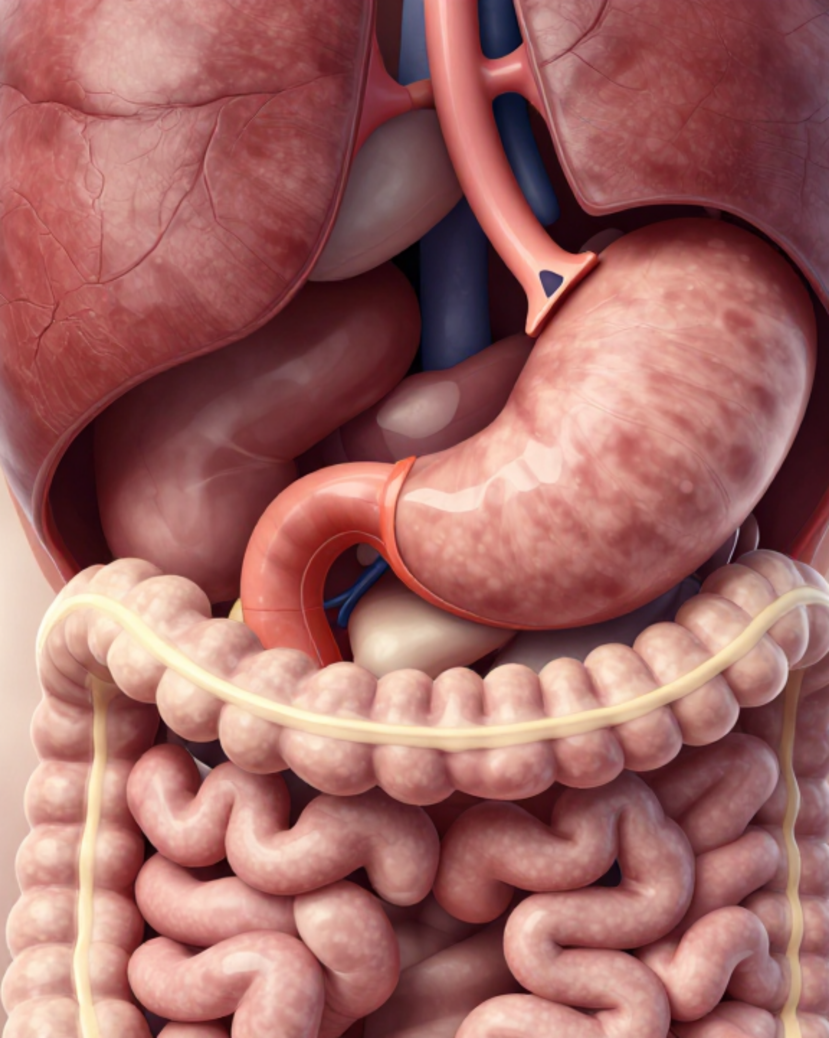

UPPER GI CANCER
IN GENERAL PRACTICE
BRADFORD VTS TEACHING DECK
The Triumvirate: Oesophageal, Gastric & Pancreatic
Updated to NICE NG12 (2026) Guidelines
www.bradfordvts.co.uk

Slide 2









UPPER GI CANCER
Bradford VTS Teaching Series
Disclaimer and Introduction
CLINICAL DISCLAIMER
SOURCE MATERIALS
This presentation is strictly for educational purposes for GP Trainees. While every effort is made to ensure accuracy, clinical guidelines are subject to change.
This teaching deck integrates specialist expertise with primary care perspectives to cover the "Triumvirate" of Upper GI cancers.
Updated to NICE NG12 (April 2026) criteria for suspected cancer recognition and referral.
Clinical Input: Mr John P Griffith (Consultant GI Surgeon) & Dr Eamonn Sheridan (Consultant Clinical Genetics).
Always refer to the latest local CCG/Trust pathways and NICE Clinical Knowledge Summaries (CKS).
Scope: Epidemiology, Risk Factors, NICE Criteria, and Hereditary Predisposition Syndromes.
Clinical judgment must be applied to the individual patient context in primary care.
Focus: Early recognition and survival improvement strategies for General Practice.
www.bradfordvts.co.uk

Slide 3













THE TRIUMVIRATE OF UPPER GI CANCER
Bradford VTS Teaching Series
Oesophageal Patterns
Adenocarcinoma of the cardia/lower oesophagus is rising, linked to obesity, GORD, and Barrett's. Squamous cell remains associated with smoking and alcohol in the upper oesophagus.
Three cancers dominate upper GI malignancy, accounting for the majority of mortality. Most patients present late, making GP recognition of early warning signs critical.
Cancer Type
Male (per 100k)
Female (per 100k)
Gastric Patterns
Overall incidence is declining in the UK. However, there is a distinct migration from distal gastric cancer to proximal and gastro-oesophageal junction (GOJ) locations.
Oesophageal
~14–16
~7–9
Gastric
~13
~7
Pancreatic
~14
~12
Pancreatic Patterns
Incidence remains relatively static. Tragically, survival rates have seen minimal improvement over several decades compared to other malignancies.
www.bradfordvts.co.uk

Slide 4




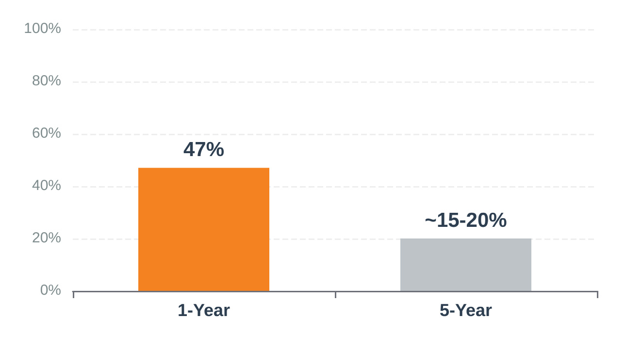


OESOPHAGEAL CANCER: RISK & SURVIVAL
Bradford VTS Teaching Series — NICE NG12 (2026 Updated)
Major Risk Factors
UK Survival Statistics (Approx)
GORD: Chronic reflux >5 years (PPIs alone do NOT reduce risk)
Barrett’s Oesophagus: Major precursor to adenocarcinoma
Lifestyle: Obesity (BMI >30), Smoking, and Alcohol (synergistic)
Pre-existing: Achalasia (Squamous risk) and Age (majority >60)
Barrett's Oesophagus Management
Late Presentation: Majority of patients present with advanced disease (T3/T4 stage), which significantly drives the poor 5-year outlook.
Surveillance endoscopy programme (specialist-led)
Full-dose PPI for symptom control only
Ablation (RFA/EMR) for high-grade dysplasia
www.bradfordvts.co.uk | MRCGP AKT High-Yield Series

Slide 5












UPPER GI CANCER
Bradford VTS Teaching Series
Gastric Cancer: Risk Factors, Survival & Clinical Presentation
Key Risk Factors
Clinical Presentation
H. pylori infection: Most significant modifiable factor; leads to chronic gastritis and intestinal metaplasia.
Early Stage: Vague epigastric discomfort or indigestion; often dismissed as routine dyspepsia.
Dietary Habits: High salt intake, processed meats, and smoked foods; low fruit/vegetable consumption.
Late Stage: Progressive dysphagia, persistent vomiting, unexplained weight loss, or haematemesis.
Medical History: Atrophic gastritis, pernicious anaemia, or previous partial gastrectomy.
Physical Findings: Palpable epigastric mass or iron-deficiency anaemia on blood tests.
Genetics: First-degree relative (RR ~2.1–3.1); Blood Group A association.
Classic "Alarm" Nodes
UK Survival Statistics
Recent NCRAS data reflects modest improvements but late presentation remains a challenge.
VIRCHOW'S NODE
Left supraclavicular lymphadenopathy; indicates advanced abdominal malignancy.
~44%
~19%
SISTER MARY JOSEPH NODULE
1-Year Survival
5-Year Survival
Periumbilical metastasis; a sign of very advanced/terminal disease.
www.bradfordvts.co.uk | NICE NG12 (2026 Updated)

Slide 6








PANCREATIC CANCER OVERVIEW
Bradford VTS Teaching Series
Risk Factors & Aetiology
Clinical Presentation
Smoking: Most significant modifiable risk factor.
THE CLASSIC TRIAD
New-onset Diabetes: Type 2 DM can be an early manifestation (Age ≥60).
Painless Obstructive Jaundice + Weight Loss + Epigastric Pain (radiating to back)
Chronic Conditions: Chronic pancreatitis & obesity (BMI >30).
Hereditary: BRCA2 mutations, Lynch syndrome, and FAP.
Age: Majority of cases present in patients >60 years.
Steatorrhoea: Pale, bulky stools (exocrine insufficiency).
Pruritus: Due to bile salt accumulation in the skin.
Trousseau's Sign: Migratory thrombophlebitis.
Vascular: Increased risk of DVT and systemic clots.
UK Survival Outcomes
Biliary: Dark urine and pale stools in obstructive jaundice.
Prognosis remains poor due to late presentation.
~20%
~7%
1-Year Survival
5-Year Survival
*Only 10–15% are resectable (Whipple's procedure) at diagnosis.
www.bradfordvts.co.uk

Slide 7












NICE NG12 REFERRAL CRITERIA 2026
Bradford VTS Teaching Series
Urgent 2WW (Suspected Cancer)
Non-Urgent Direct Access
Dysphagia: Immediate referral for any age or cause.
Haematemesis: Direct access endoscopy (if hemodynamically stable).
Upper Abdominal Mass: Consistent with stomach cancer.
Age ≥55 + Dyspepsia: Treatment-resistant or persistent symptoms.
Urgent Age-Based Criteria
Age ≥55 Cluster Criteria
Age ≥55 + Weight Loss PLUS any of: Upper abdominal pain, Reflux, or Dyspepsia.
Low Hb or Raised Platelets: Along with any upper GI symptoms.
Nausea or Vomiting: Combined with other non-specific GI symptoms.
Age ≥40 + Jaundice: Suspected pancreatic cancer pathway.
Upper Abdominal Pain: Combined with low hemoglobin levels.
www.bradfordvts.co.uk

Slide 8














HEREDITARY GI CANCER SYNDROMES
Bradford VTS Teaching Series — Mendelian Predisposition Overview
FAP
APC Gene
Lynch Syndrome
MMR Genes
Prevalence 1/8,000; Autosomal Dominant inheritance.
Most common (1/2,500); uses Amsterdam 3-2-1 criteria.
Hundreds of colonic polyps; ~100% CRC risk by age 40.
Gastric Cancer: RR 4.1 (median age 54).
Extra-colonic: Clear excess of periampullary & duodenal cancers.
Small Bowel Cancer: RR 25; also hepatobiliary risks.
Peutz-Jeghers
STK11 Gene
Hereditary Diffuse GC
CDH1 Gene
Mucocutaneous pigmentation (lips, digits) + GI hamartomas.
Rare Autosomal Dominant; 56–70% lifetime risk of diffuse GC.
Highest excess risk for Small Bowel tumours.
Prophylactic total gastrectomy recommended for carriers.
Capsule endoscopy surveillance every 2–3 years from puberty.
Associated with elevated risk of lobular breast cancer.
GP Role: Identify "Red Flag" families for Clinical Genetics referral
www.bradfordvts.co.uk

Slide 9












RECOGNISING THE HEREDITARY PATIENT
Bradford VTS Teaching Series: Genetic Risk & GP Recognition
Familial & Age Red Flags
GP Action & Assessment
Multiple 1st-degree relatives with the same cancer or related GI malignancies.
Refer to Clinical Genetics for formal risk assessment and gene testing.
Provide information about NHS Hereditary Cancer Services and counselling.
Diagnosis at an unusually young age (<50 years) in any family member.
Multiple primary cancers in one individual (e.g., Colorectal + Endometrial = Lynch).
Document full three-generation family pedigree if clusters are suspected.
Syndromic & Ethnic Indicators
Management of Relatives
Associated features: Pigmentation (Peutz-Jeghers), Bone (FAP), or Thyroid signs.
Offer cascade testing to 1st-degree relatives of proven mutation carriers.
Ashkenazi Jewish background (higher prevalence of BRCA and Lynch mutations).
Coordinate surveillance (e.g., OGDs or Colonoscopies) with regional specialist centers.
Presence of rare skin conditions like Tylosis (palmar/plantar hyperkeratosis).
Review patient records to ensure H. pylori eradication in high-risk family members.
Reference: NICE NG12 (2026) | Bradford VTS Teaching Materials | www.bradfordvts.co.uk

Slide 10















PREVENTION AND PRIMARY CARE ROLE
Bradford VTS Teaching Series
H. pylori Eradication
Smoking Cessation
Target high-risk populations (atrophic gastritis, family history) to reduce gastric cancer risk. Eradication is protective.
The most significant modifiable factor for all three cancers. Vital for reducing squamous and adenocarcinoma risk.
Barrett's Surveillance
Weight Management
Ensure patients with known Barrett's are in a specialist programme; audit GP records to prevent missed follow-ups.
Tackle obesity (BMI >30) to lower the incidence of oesophageal adenocarcinoma and gastric cardia cancer.
Upper GI Cancer Audit
Alcohol Reduction
Regularly review local 2WW referral pathways and data to ensure early identification and diagnostic accuracy.
Reduce intake to lower risk of squamous cell carcinoma, particularly due to its synergistic effect with smoking.
www.bradfordvts.co.uk | NICE NG12 (2026 Updated)

Slide 11



















UPPER GI CANCER
Bradford VTS Teaching Series
Top Tips for General Practice
Dysphagia = Always 2WW
New-Onset Diabetes (60+)
Red flag at any age, for any cause. Never "wait and watch" or treat empirically with PPIs without investigation.
If accompanied by weight loss or GI symptoms, consider urgent CT to exclude pancreatic cancer before labeling as Type 2 DM.
Painless Jaundice (40+)
NICE NG12 Key Threshold
Suspect pancreatic cancer until proven otherwise. This requires an urgent 2WW CT scan pathway referral.
Age ≥55 + weight loss + any of (upper abdominal pain, reflux, dyspepsia) = urgent 2WW suspected cancer referral.
Barrett's Surveillance
H. pylori Eradication
Check GP records for patients with known Barrett's; ensure they are actively enrolled in a specialist surveillance programme.
The most important modifiable risk factor for gastric cancer. Eradication is protective and should be prioritised.
Family History Matters
Survival & Early Referral
≥2 first-degree relatives with upper GI cancer, especially at a young age, should trigger a referral to Clinical Genetics.
5-year survival is poor for the "triumvirate." Early recognition and prompt referral in primary care are the only ways to improve outcomes.
www.bradfordvts.co.uk
High-yield clinical pearls for GP Trainees

Slide 12


















UPPER GI CANCER
Bradford VTS Teaching Series
Exam Pearls: AKT & SCA Preparation
AKT: Knowledge Retrieval
SCA: Communication Strategy
Dysphagia: Any age, any cause = Urgent 2WW. Never wait-and-watch or empirical PPI.
Explore Alarms: Sensitively check for red flags without inducing panic. "I need to ask a few specific questions about your weight and swallowing."
NICE NG12: Age ≥55 + weight loss + (upper abdominal pain / reflux / dyspepsia) = 2WW criteria.
Framing the 2WW: Explain the pathway clearly. Avoid "this is cancer" but emphasize urgency for safety.
Pancreatic: Age ≥40 + jaundice = 2WW. Age ≥60 + weight loss + new DM2 = Urgent CT.
"This is a fast-track referral to rule out anything serious. It's a precaution to ensure we get expert eyes on this as quickly as possible."
Epidemiology & Genetics
Safety-Netting & Closing
Prevalence: FAP (1/8,000) vs HNPCC/Lynch (1/2,500). HNPCC is the most common inherited CRC syndrome.
Time-frames: Advise they should hear from the hospital within 2 weeks. If not, they must contact the surgery.
Lynch Risks: RR 4.1 for Gastric Cancer; RR 25 for Small Bowel Cancer.
Worsening Symptoms: Explicit instructions on what to do if they cannot swallow liquids or if they vomit blood.
Shift: Oesophageal adenocarcinoma is now more common than squamous cell in the UK.
Updated to NICE NG12 April 2026 Guidelines.
www.bradfordvts.co.uk
High-Yield Exam Prep

Slide 13





RED FLAGS: MUST NOT MISS
Critical Alarm Symptoms Requiring Immediate GP Action
DYSPHAGIA & HAEMATEMESIS
JAUNDICE & PANCREATIC RISK
Dysphagia: Any age, any cause — ALWAYS 2WW. Never "watch and wait" or empirical PPI.
Painless Jaundice: In age ≥40 is pancreatic cancer until proven otherwise — Urgent 2WW CT.
Haematemesis: Acute admission if active/hemodynamic instability; urgent direct-access endoscopy if stable.
New-onset DM2: Age ≥60 + weight loss + GI symptoms (diarrhoea/back pain) → exclude pancreatic malignancy.
WEIGHT LOSS & MASSES
NODAL & HEREDITARY SIGNS
Unintentional Weight Loss: Significant when paired with upper abdominal pain, reflux, or dyspepsia (especially if age ≥55).
Virchow’s Node: Left supraclavicular lymphadenopathy — highly suggestive of metastatic upper GI cancer.
Abdominal Mass: Palpable epigastric or upper abdominal mass consistent with stomach cancer.
Family Clustering: Multiple relatives with GI cancers at young age (<50) → refer to Clinical Genetics.
© 2026 NICE NG12 Updated Guidelines
www.bradfordvts.co.uk

Slide 14













COMMON PITFALLS IN DIAGNOSIS
Bradford VTS Teaching Series
Empirical Treatment of Dysphagia
Ignoring Non-Urgent Criteria
Dysphagia is always a red flag. Prescribing antacids or PPIs without investigation is dangerous and delays diagnosis.
Haematemesis or treatment-resistant dyspepsia in patients ≥55 requires urgent direct-access endoscopy, even if 2WW criteria aren't fully met.
New-Onset Diabetes & Weight Loss
Missing Hereditary Clues
In patients age ≥60, new DM + weight loss is a classic presentation of pancreatic cancer. Avoid labeling as "Type 2" without imaging.
Failing to screen for family history or young age of onset (<50). Clustered GI cancers require a referral to Clinical Genetics for assessment.
Barrett’s Surveillance Gaps
Over-Reassurance on Symptoms
PPIs control symptoms but do not eliminate cancer risk. Ensure all Barrett's patients are actively enrolled in a specialist surveillance programme.
Dyspepsia at age ≥55 with even mild weight loss is not routine. Do not dismiss persistent upper abdominal pain as simple indigestion.
Note: Guidelines updated to NICE NG12 April 2026
www.bradfordvts.co.uk

Slide 15












UPPER GI CANCER
Bradford VTS Teaching Series
Quick Recall: High-Yield Facts
Resources
URGENT REFERRALS
Dysphagia: Always 2WW referral regardless of age or duration.
Painless Jaundice: Age ≥40 requires urgent 2WW suspected cancer pathway.
Access full teaching materials at:
www.bradfordvts.co.uk
Pancreatic Screen: Age ≥60 + weight loss + new DM = Urgent CT scan.
Clinical Genetics Referral & NICE NG12 Pathways
RISK & GENETICS
Closing Summary
H. pylori: The most significant modifiable risk for gastric cancer.
Lynch Syndrome: High risk for gastric (RR 4.1) and small bowel (RR 25) cancers.
1. Early referral is the only way to improve survival.
2. Never empirical PPI for red-flag symptoms.
3. Think family history in young patients.

