Slide 1



BRADFORD VTS TEACHING DECK
Familial Breast and
Ovarian Cancer
GP Management & Clinical Guidance
Comprehensive training updated to NICE CG164 (Reviewed July 2024)
and NICE NG241 (Published March 2024). Includes hereditary risks,
referral criteria, and high-yield exam pearls.
www.bradfordvts.co.uk
Academic Session • 2026-05-07

Slide 2


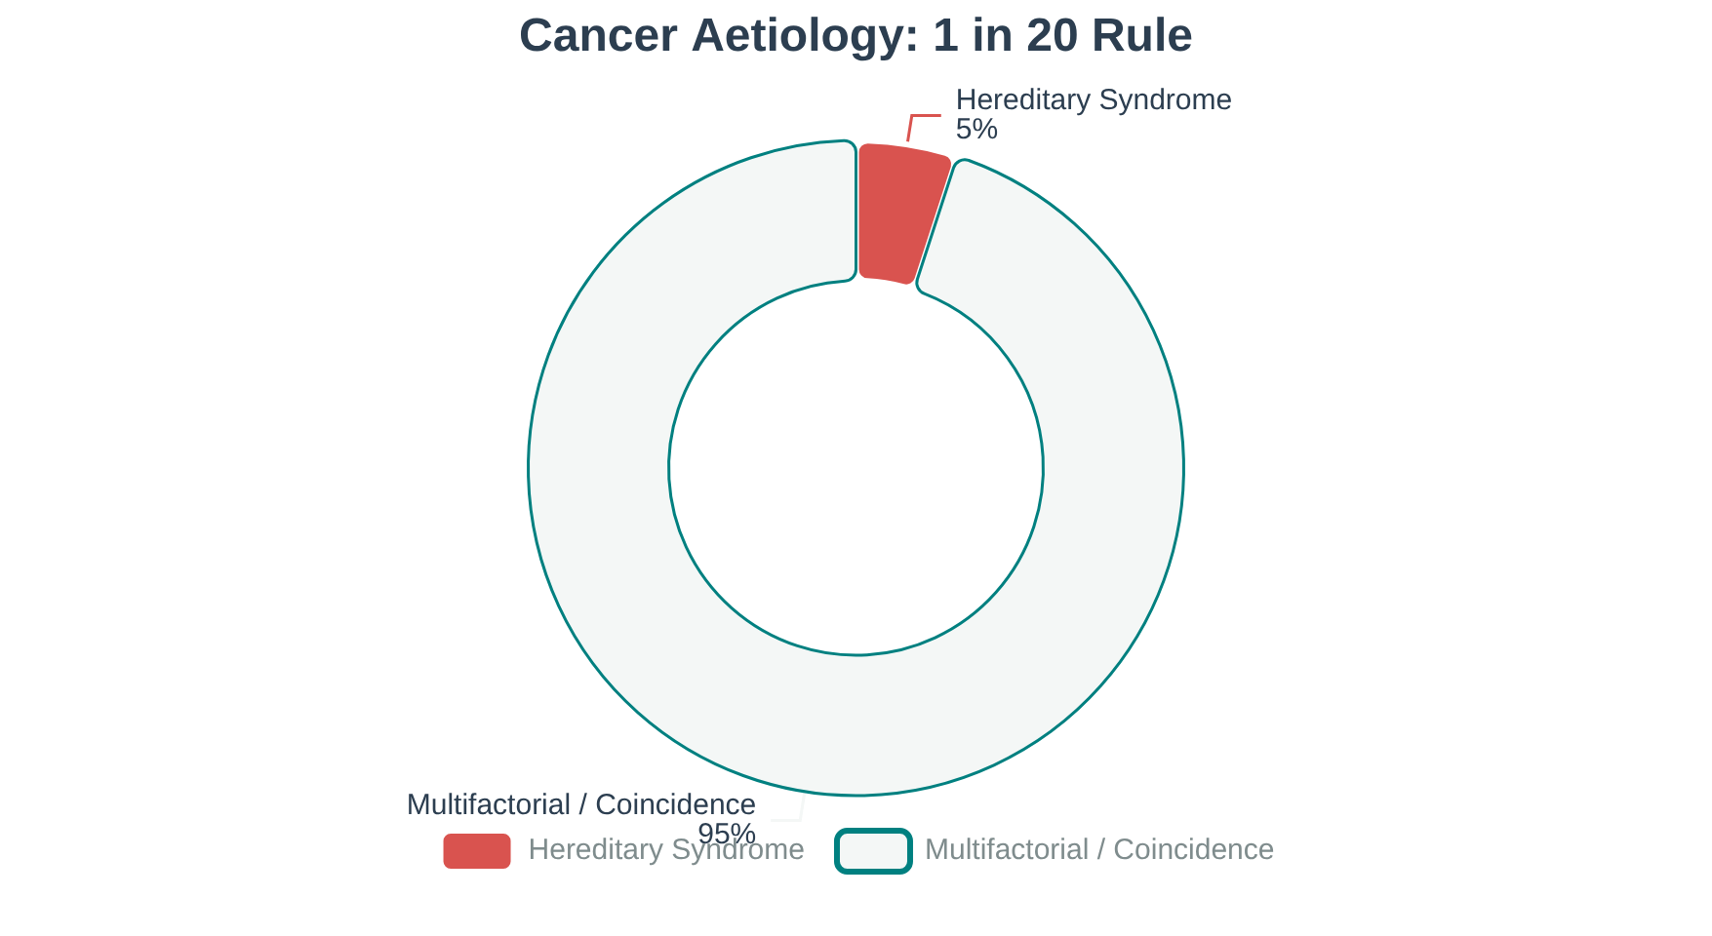










BRADFORD VTS | FAMILIAL CANCER MANAGEMENT
www.bradfordvts.co.uk
Epidemiology and Hereditary Cancer Overview
Clinical Guidance & NICE Updates
"A patient is worried because her grandmother was diagnosed with breast cancer at 75. Is this likely to be a hereditary syndrome?"
BREAST CANCER LIFETIME RISK
1 in 7 Women
OVARIAN CANCER LIFETIME RISK
1 in 50 Women
GP's Key Task
COLORECTAL CANCER RISK
Most cancer in a family is coincidence or multifactorial (age, hormones, lifestyle). Your primary goal is to identify the 1 in 20 with a high-penetrance hereditary cause from the larger population.
1 in 15 (M) / 1 in 18 (W)

Slide 3



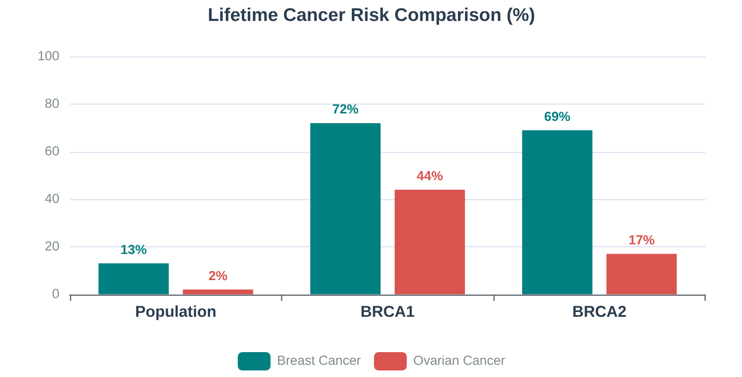



BRADFORD VTS | FAMILIAL CANCER MANAGEMENT
www.bradfordvts.co.uk
Key Genes in Hereditary Cancer Syndromes
Clinical Guidance & NICE Updates
BRCA1 & BRCA2 Pathogenic Variants
BRCA1: Lifetime breast risk ~72%; ovarian risk ~44%.
BRCA2: Lifetime breast risk ~69%; ovarian risk ~17%.
Associated Risks: Male breast cancer, prostate, pancreatic cancer, and melanoma (BRCA2).
PALB2 & RAD51 Variants (NG241)
GENETIC PRINCIPLES & ANCESTRY
PALB2: Moderate-to-high breast cancer risk (lifetime risk ~35%).
RAD51C/D: Now included in NICE NG241 (2024). Associated with 10–12% ovarian risk.
Autosomal Dominant
Ashkenazi Jewish
One copy enough for risk; 50% chance of transmission per child. High but incomplete penetrance.
Higher prevalence (~1 in 40) due to 3 founder mutations in BRCA1/2.
Testing: Recommended when family history suggests high ovarian risk.
Li-Fraumeni (TP53)
Negative Results
Extremely high risk; often presents with unusual early cancers (sarcoma/brain).
A negative BRCA test does NOT exclude all hereditary risk; other genes may be involved.

Slide 4












BRADFORD VTS | FAMILIAL CANCER MANAGEMENT
www.bradfordvts.co.uk
Taking a Comprehensive Family History
Essential GP skills for identifying red flags and accurate risk stratification
The Two Vital GP Questions
Essential Information to Collect
Suspicious Symptoms? If breast/ovarian symptoms are present, refer via 2-week wait pathway regardless of family history.
Maternal & Paternal Sides: Assess each separately; paternal history is frequently missed in risk assessments.
Known Genetic Mutation? Has a BRCA or other pathogenic variant already been identified in the family? Refer directly to genetics.
Age at Diagnosis: The single most important factor. Cancers under age 40 or 50 carry significantly higher genetic weight.
Blood Relatives Only: Exclude in-laws. Note specific types (ovarian, bilateral breast, male breast, pancreatic).
Degrees of Relationship
Red Flags for Genetic Risk
1st
Parents, siblings, children (50% shared genetics).
Early & Multiple: Breast cancer <40, bilateral breast cancer, or combination of breast + ovarian cancer.
2nd
Grandparents, aunts/uncles, nieces/nephews, half-siblings.
3rd
Unusual Presentations: Male breast cancer, sarcoma <45, glioma, or Ashkenazi Jewish ancestry.
Great-grandparents, cousins, grand-nieces/nephews.
Strong Lineage: Three or more relatives with breast cancer or complex patterns of multiple cancers.

Slide 5



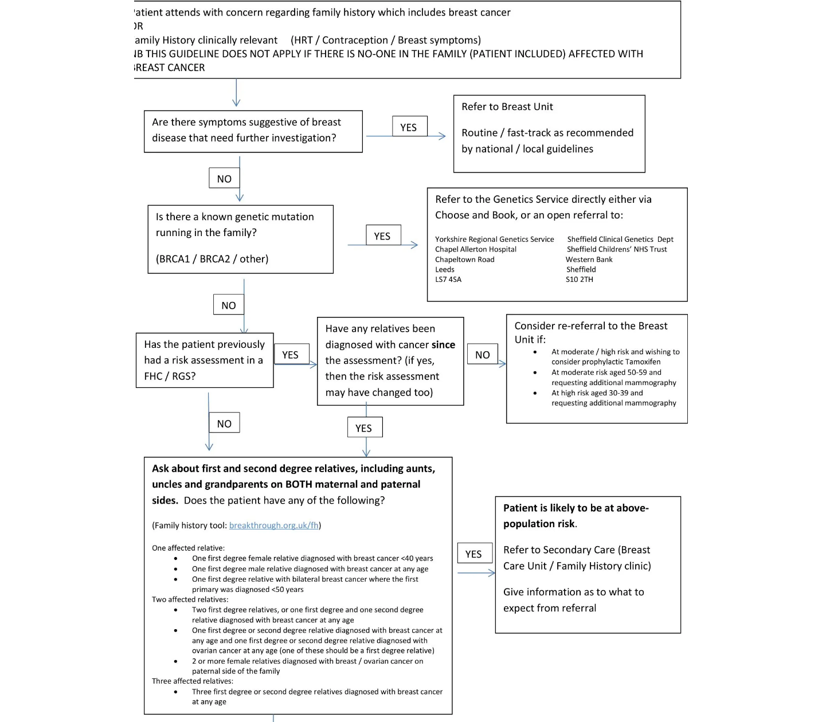










BRADFORD VTS | FAMILIAL CANCER MANAGEMENT
www.bradfordvts.co.uk
Referral Criteria for Familial Breast Cancer
Clinical Guidance & NICE Updates (CG164)
IMMEDIATE ACTION
If ANY suspicious breast or ovarian cancer symptoms are present, refer via the 2-week wait (2WW) urgent pathway regardless of family history.
Female Breast Cancer (Referral Thresholds)
One 1st-degree relative diagnosed with breast cancer aged <40 years.
Two 1st- or 2nd-degree relatives diagnosed at average age <60 years.*One relative must be a 1st-degree relative.
Three 1st- or 2nd-degree relatives diagnosed at any age.
Male, Bilateral & Combined Risks
Male Breast Cancer: One 1st-degree male relative at any age.
Bilateral Breast Cancer: One 1st-degree relative where the 1st primary was <50 years.
Breast & Ovarian: One 1st/2nd-deg ovarian relative AND one 1st/2nd-deg breast relative (one must be 1st-degree).
Management of Population Risk
If criteria are not met, manage in Primary Care:
• Provide breast awareness information & lifestyle advice.
• Safety-net: Advise return if family history changes or symptoms develop.

Slide 6
















BRADFORD VTS | FAMILIAL CANCER MANAGEMENT
www.bradfordvts.co.uk
Referral Criteria for Familial Ovarian Cancer
Clinical Guidance & NICE Updates (NG241)
Who to Refer (NICE NG241)
New Genetic Testing (2024)
Close relative with epithelial ovarian cancer (High-grade serous, endometrioid, or clear cell).
Testing now recommended for high-risk family history to include:
RAD51C
RAD51D
Family history suggestive of BRCA1/2 pathogenic variant (see breast criteria).
Cascade testing should be offered to at-risk relatives of identified carriers.
Family history suggestive of Lynch syndrome with ovarian involvement.
Ashkenazi Jewish ancestry plus any ovarian cancer in the family.
Male relatives with known pathogenic BRCA2 variants (can pass it to daughters).
Risk Reduction Strategies
Note: If symptoms present, refer via 2-week wait urgent pathway regardless of family history.
Bilateral Salpingo-Oophorectomy (BSO):
• BRCA1: Age 35–40
• BRCA2: Age 40–45
NOT RECOMMENDED
Ovarian Cancer Screening (CA125 + USS) has NOT been shown to reduce mortality (UKFOCSS trial) and is NOT recommended.

Slide 7












BRADFORD VTS | FAMILIAL CANCER MANAGEMENT
www.bradfordvts.co.uk
Familial Colorectal Cancer Risks
Clinical Guidance & NICE Updates
Hereditary CRC Syndromes
Urgent Symptomatic (2WW)
Syndrome (Gene)
Lifetime CRC Risk
Key Features
Bleeding & Habits: Rectal bleeding with looser/frequent stools for ≥6 weeks.
Masses: Any palpable right-sided abdominal or rectal mass.
40–80%
Early onset; Endometrial (40-60%), Gastric, Ovarian risks.
Age ≥60: IDA without cause, or habit change without bleeding for ≥6 weeks.
Lynch (HNPCC)
MLH1, MSH2, MSH6
FAP
~100%
Hundreds of polyps from teens; Desmoid tumours.
APC Gene
Linked Cancers (Lynch Spectrum)
Genetic Assessment Triggers
Endometrial
Ovarian
Known Lynch syndrome, FAP, or 1st-degree relative with CRC aged <45.
Stomach
Urinary Tract
Two 1st-degree relatives with CRC at any age or two parents with CRC.
Three 1st/2nd-degree relatives with CRC or linked cancers (e.g., endometrial).
Pancreatic
Biliary Tract
Note: Prophylactic aspirin and 1-2 yearly colonoscopy are standard in Lynch management.

Slide 8




















BRADFORD VTS | FAMILIAL CANCER MANAGEMENT
www.bradfordvts.co.uk
Risk Stratification and Surveillance
Clinical Guidance & NICE Updates
Surveillance Schedule
Risk Level
Definition (NICE CG164)
Primary Management Strategy
Moderate Risk: Annual mammogram aged 40–49 (rejoins NHSBSP at age 50).
Family history does not meet specific referral criteria.
Primary Care: Breast awareness, lifestyle advice (BMI, alcohol), and safety-netting for new FH.
High Risk (BRCA1/2): Annual MRI from age 30 AND annual mammogram from age 40.
POPULATION
Above population risk but below defined high-risk threshold.
Secondary Care (Breast Unit): Annual surveillance and formal risk assessment.
50% Risk (Untested): Managed as High Risk until carrier status is clarified.
MODERATE
Confirmed BRCA1/2, PALB2, or extremely strong family history.
Specialist Genetics Centre: Multi-modal screening (MRI/Mammogram) and risk-reducing options.
HIGH
Critical Clinical Note (NICE NG241)
Ovarian cancer screening using CA125 and Ultrasound is NOT RECOMMENDED for risk reduction in any category. Trial data (UKFOCSS) confirms it does not reduce mortality.
NICE CG164 (reviewed July 2024) & NICE NG241 (March 2024). GPs are not expected to proactively case-find but must respond to raised concerns.

Slide 9














BRADFORD VTS | FAMILIAL CANCER MANAGEMENT
www.bradfordvts.co.uk
Genetic Testing: Benefits & Limitations
Clinical Guidance & NICE Updates
"A 35-year-old patient asks: 'If I have the gene test and it's negative, does that mean I'll never get cancer?' How do we guide their expectations?"
Limitations & Pitfalls
Uncertainty: May yield a Variant of Uncertain Significance (VUS) which does not clarify clinical risk.
Not Deterministic: Cannot predict if, when, or how cancer will present; penetrance is rarely 100%.
Psychosocial: Potential for significant anxiety, guilt (survivor or parental), and relationship strain.
Clinical Benefits
Clarify Risk: Confirms high-risk status (e.g., BRCA1/2) or provides reassurance if negative for a known family variant.
Management Pathway: Directly alters access to high-intensity screening (MRI) and risk-reducing surgery (BSO/Mastectomy).
Cascade Testing: Allows predictive testing for unaffected first-degree relatives once a variant is identified.
INSURANCE & STRATEGY (ABI CONCORDAT)
Strategy: Always test an affected family member first where possible.
Insurance: Results declared voluntarily for life insurance ≤£500k; most other types do not require disclosure of predictive test results.

Slide 10







BRADFORD VTS | FAMILIAL CANCER MANAGEMENT
www.bradfordvts.co.uk
Risk Reducing Treatment Options
Overview of chemoprevention and surgical interventions for high-risk carriers
TAMOXIFEN (CHEMOPREVENTION)
PROPHYLACTIC SURGERY
Dose: 20mg daily for 5 years for pre-menopausal women at moderate/high risk.
Mastectomy: Bilateral risk-reducing surgery reduces risk by 90–95%.
BSO: Recommended age 35–40 (BRCA1) or 40–45 (BRCA2) per NG241.
Benefit: Reduces breast cancer risk by ~30% in high-risk populations.
Ovarian: BSO reduces breast cancer risk by ~50% if pre-menopausal.
CI: Personal history of VTE, current anticoagulants, or pregnancy.
RALOXIFENE (CHEMOPREVENTION)
CLINICAL CONSIDERATIONS
Dose: 60mg daily for post-menopausal women at moderate/high risk.
COCP: UKMEC 2 for confirmed BRCA1 (20% relative risk increase).
Benefits: Reduces invasive breast cancer risk and vertebral fracture risk.
BRCA1 preference: Non-hormonal or progestogen-only (POP/IUS) methods.
Safety: No increased risk of endometrial cancer (unlike tamoxifen).
HRT: Risk remains similar to general population; assess case-by-case.
Primary Care Pearl: Eligibility for chemoprevention is determined in Secondary Care. GPs should request named specialist contacts for long-term prescribing queries.

Slide 11







BRADFORD VTS | FAMILIAL CANCER MANAGEMENT
www.bradfordvts.co.uk
Communicating Risk to Patients
Clinical Guidance & NICE Updates
"A 32-year-old presents worried about their family history. How do you translate complex NICE criteria into a reassuring yet accurate conversation?"
Explaining Population Risk
Cancer is common: 1 in 7 women will develop breast cancer in their lifetime.
Many families show clusters by statistical coincidence rather than shared inheritance.
Rule out non-hereditary triggers: Lung (Smoking), Cervical (HPV), and Skin (UV) cancers.
Managing Expectations & Testing
Explaining Moderate or High Risk
Non-Directive Counseling: The specialist helps you understand risks to make your own informed decisions.
"Based on your family history, your risk is higher than the general population."
Testing Limits: Results can be uncertain (VUS) and carry psychosocial impacts for siblings and children.
Referral is for specialist assessment—this does not automatically mean a genetic test.
Insurance: Mention ABI Concordat—results are declared voluntarily for life insurance ≤£500k.
Options include increased surveillance, chemoprevention, or counseling.

Slide 12












BRADFORD VTS | FAMILIAL CANCER MANAGEMENT
www.bradfordvts.co.uk
Top Tips for Primary Care
Clinical Guidance & NICE Updates
AGE MATTERS
PATERNAL HISTORY
OVARIAN SCREENING
NICE NG241
Ask about age at diagnosis. It is the single most important piece of info for accurate risk assessment.
Two or more breast cancers on the father's side is highly significant. Do not dismiss it as the "wrong side."
Do NOT order CA125 or Ultrasound for screening. It is not evidence-based for risk reduction.
Ensure referrals include details for RAD51C/D variants if family history suggests high ovarian risk.
DUAL ASSESSMENT
DIRECT REFERRAL
CHEMOPREVENTION
POPULATION RISK
Always assess maternal AND paternal sides separately. Genetic risk is passed through either parent.
If a known BRCA mutation is in the family, refer directly to genetics. Do not wait for family risk scores.
GPs should not decide Tamoxifen eligibility. Refer to secondary care specialists for this decision.
Provide breast awareness info, lifestyle advice, and a safety net: return if family history changes.

Slide 13















BRADFORD VTS | FAMILIAL CANCER MANAGEMENT
www.bradfordvts.co.uk
Exam Pearls for AKT and SCA
Clinical Guidance & NICE Updates
AKT: GENETICS & RISKS
SCA: CLINICAL CONSULTATION
72% / 44%
69% / 17%
1
Check for red flag symptoms (2WW first).
BRCA1: BREAST / OVARIAN
BRCA2: BREAST / OVARIAN
2
Full Family History (maternal & paternal independently).
RAD51C/D: New NICE NG241 focus; tested if high ovarian cancer risk in family.
3
Classify risk level (Population / Moderate / High).
Screening: CA125 and USS are NOT recommended for any risk category.
4
Reassure (if Pop. risk) or explain non-directive referral.
AKT: HORMONAL & MEDS
SCA: KEY COMMUNICATION
UKMEC 1: For women with family history only.
Safety-netting (Population Risk):
"I recommend you return if there are any new diagnoses in the family, or if you notice any changes in your breasts."
UKMEC 2: Specifically for confirmed BRCA1 mutation.
Tamoxifen: Chemoprevention for Premenopausal women.
Raloxifene: Chemoprevention for Postmenopausal women.
Explaining Chemoprevention:
"The specialist team will determine if you benefit from risk-reducing tablets. This is not a GP-led decision."

Slide 14





BRADFORD VTS | FAMILIAL CANCER MANAGEMENT
www.bradfordvts.co.uk
Red Flags and Common Pitfalls
Critical symptoms requiring 2-week wait referrals and common mistakes
Urgent Referral Triggers
Misinterpretation of History
Any suspicious Breast/Ovarian symptoms: Refer via 2-week wait immediately regardless of family history.
Missing Paternal Side: Assuming breast cancer genes only pass through women; BRCA variants are autosomal dominant.
Known hereditary mutation identified: Direct referral to Genetics if BRCA1/2, TP53, or PALB2 is confirmed in family.
Irrelevant Cancers: Including lung (smoking) or cervical (HPV) in a "hereditary pattern" assessment.
Male breast cancer: One 1st-degree male relative diagnosed at any age requires Genetics referral.
Dismissing Ovarian: Overlooking a single case of ovarian cancer, which significantly alters risk when combined with breast history.
High-Risk Family History
Management & Screening Errors
Early onset: One 1st-degree relative diagnosed with breast cancer aged <40 years.
Inappropriate Screening: Ordering CA125 or USS for ovarian screening; NICE/UKFOCSS confirms this does not reduce mortality.
Combined Cancer: One 1st/2nd-degree relative with ovarian cancer AND one with breast cancer (at least one 1st-degree).
Independent Prescribing: Starting Tamoxifen in GP; eligibility must be determined by Secondary Care/Specialist teams.
Multiple relatives: Three or more 1st or 2nd-degree relatives diagnosed with breast cancer at any age.
Dismissing Population Risk: Failing to provide breast awareness and lifestyle advice to those not meeting referral criteria.

Slide 15















BRADFORD VTS | FAMILIAL CANCER MANAGEMENT
www.bradfordvts.co.uk
Quick Recall and Guidelines
Clinical Guidance & NICE Updates
1 in 7
Clinical Currency Statement
1 in 20
Lifetime breast cancer risk (General Female Population)
Cancers linked to hereditary syndromes
NICE CG164: Familial Breast Cancer
Reviewed July 2024. Current recommendations remain in force while update is in progress (2025).
NICE NG241: Familial Ovarian Cancer
72% / 44%
69% / 17%
Published March 2024. First dedicated guideline. Includes RAD51C/D testing.
BRCA1 lifetime risk: Breast / Ovarian
BRCA2 lifetime risk: Breast / Ovarian
NICE NG12: Suspected Cancer
Updated 2023. Covers 2-week wait referral criteria for symptomatic patients.
Key Referral Triggers
BNF Compliance: Chemoprevention (Tamoxifen/Raloxifene) verified against current edition.
One 1st-degree relative diagnosed with breast cancer <40 years.
Male breast cancer in any 1st-degree relative (at any age).
Symptomatic patients: Refer 2WW regardless of FH.
One 1st/2nd-degree relative with Ovarian AND one with Breast cancer.
Known gene mutation identified in the family (BRCA/PALB2/TP53).

