Slide 1




BRADFORD VTS TEACHING DECK
Genetics in
Primary Care
Equipping General Practitioners to identify, risk-stratify, and refer in the genomic era.
May 2026
www.bradfordvts.co.uk
This resource is for educational purposes only. Please check latest clinical guidelines in your area.

Slide 2








GENETICS IN PRIMARY CARE
The Genetics Explosion in Primary Care
Public Awareness & Media
~10%
Headlines: "Designer Babies", DNA profiling, and GM food debates fuel patient interest.
Direct-to-Consumer (DTC) tests: Patients present with raw DNA results (e.g., 23andMe).
of all GP Consultations
Information Gap: Patients may know more about specific rare variants than their GP.
have a genetic component
Source: RCGP Genetic Guidance
The Clinical Challenge
The Spectrum of Care
Perceived as "tricky, dry, and highly specialised".
Multifactorial: Coronary heart disease, Diabetes, Asthma, and Alzheimer’s disease.
Difficult to explain complex inheritance in a standard 10-minute consultation.
Single-Gene: Cystic Fibrosis, Huntington’s, and Familial Hypercholesterolaemia.
Viewed as a "quagmire" that clinicians often feel unprepared to enter.
Reproductive: Pre-conception risk and haemoglobinopathy screening.

Slide 3



















GENETICS IN PRIMARY CARE
Session Scope and Objectives
Scope
Clinical Presentations
Outline the breadth of genetic issues encountered in primary care.
Discuss common genetic presentations in the 10-minute consultation.
Guidelines
Inheritance
Identify useful NICE-aligned guidelines and clinical resources.
Review basic genetics and core patterns of inheritance.
Services
Ethos
Outline the structure of the Yorkshire Regional Genetics Service.
Encourage "thinking genetics" in everyday clinical consultations.
This session is tailored for GP trainees, focusing on practical risk-stratification and referral pathways.

Slide 4














GENETICS IN PRIMARY CARE
The Role of Primary Care in Genetics
Identification & Referral
Multifactorial Inheritance
Identify patients who would benefit from specialist genetic services (e.g., Regional Genetics Service).
Most common conditions result from complex interactions:
Conduct initial risk-stratification using family history tools and standard clinical criteria.
Nature
(Genetics)
+
Nurture
(Environment)
=
Disease
Risk
Consider family history in multifactorial diseases: cancer, diabetes, and CHD.
"Strong family history shifts risk even without a single-gene disorder."
Management & Communication
Provide ongoing management and support for families identified as being at-risk.
Effective communication of genetic information to patients in the context of primary care.
Bridge the gap between complex genetic theory and patient-centered consultations.
The GP's role involves translating complex genetic risks into actionable clinical advice.

Slide 5










GENETICS IN PRIMARY CARE
Why Take a Family History?
Accurate Risk Assessment
Identify Genetic Conditions
Quantify the clinical likelihood of a patient developing specific multifactorial diseases, such as cancer, coronary heart disease, or diabetes.
Detect subtle clinical patterns that suggest an underlying single-gene disorder or hereditary syndrome in symptomatic or asymptomatic patients.
Protect At-Risk Relatives
Guide Management Strategies
Identify other family members who may be at significant risk, enabling proactive cascade screening and early intervention strategies.
Inform appropriate clinical pathways, including referral to specialist genetics services, enhanced surveillance, or preventative medications.
Family history is a dynamic clinical tool; it must be updated regularly as families grow, age, and develop new health conditions.

Slide 6







GENETICS IN PRIMARY CARE
How to Take an Effective Family History
The "Same Side" Rule
Core Questions to Ask
For accurate risk stratification (e.g., NICE cancer criteria), all relatives counted must be blood relatives on the same side of the family.
Who is affected?
Maternal side and Paternal side are assessed independently.
Focus exclusively on blood relatives.
Significant history may exist on both sides.
Which side of the family?
Must document both Maternal and Paternal sides.
How many relatives?
Clinical Documentation
Count all affected individuals on the same bloodline.
Beyond the core pedigree, capture environmental and multifactorial risk factors that influence genetic expression:
Specific Diagnosis?
Record the type of cancer (primary site) or disease.
Smoking Status: Essential for lung/bladder risks.
Age at Diagnosis?
BMI/Obesity: Relevant for CHD and Diabetes.
Crucial for identifying early-onset syndromes.
Ancestry: e.g., Ashkenazi Jewish (BRCA risk).
Non-blood relatives: Mentioned for context, but excluded from risk math.

Slide 7














GENETICS IN PRIMARY CARE
Defining Degrees of Relationship
1st Degree
2nd Degree
3rd Degree
~50% Shared DNA
~25% Shared DNA
~12.5% Shared DNA
Mother / Father
Grandparent / Grandchild
First Cousin
Daughter / Son
Aunt / Uncle
Great Grandparent
Sister / Brother
Niece / Nephew
Great Aunt / Uncle
Half-siblings
Key Clinical Rule: All relatives counted in a risk assessment must be on the SAME side of the family (maternal OR paternal) and be blood relatives of each other.

Slide 8

















GENETICS IN PRIMARY CARE
Standard Pedigree Symbols
Individual Identifiers
Clinical Status
Family Dynamics
Male
Affected
Partnership
Square symbol
Solid filled shape
Horizontal line connection
Female
Carrier
Offspring
Circle symbol
Half-filled shape
Vertical line from partnership
Pregnancy / P
Deceased
Consanguinity
Diamond with 'P' or Triangle
Diagonal line through shape
Double horizontal line
Sex Unknown
Clinical Tip: Always note the specific condition next to the affected symbol for clarity.
Relationship Ended
Diamond symbol
Slash through partnership line

Slide 9


















GENETICS IN PRIMARY CARE
Autosomal Dominant Inheritance
This pattern affects multiple generations with a 50% transmission risk, as seen in BRCA mutations and Huntington’s disease.
Core Characteristics
Clinical Examples
Vertical Transmission: Multiple generations are typically affected.
BRCA1 & BRCA2
Hereditary Breast/Ovarian Cancer
Equal Distribution: Males and females are affected in equal proportions.
Familial Hypercholesterolaemia (FH)
Lynch Syndrome (HNPCC)
M-to-M Transmission: Male-to-male transmission occurs (excludes X-linked).
Huntington’s Disease
Neurofibromatosis Type 1
These conditions often present with early-onset disease compared to the general population.
Transmission Risk
GP Action Point
50% Risk
When you see a vertical pattern in a pedigree spanning three generations, suspect Autosomal Dominant inheritance. Check for reduced penetrance if a generation appears "skipped" despite the clinical pattern.
For each offspring of an affected parent to inherit the condition.
Refer to Regional Genetics Service for risk-stratification.
The risk is independent for each pregnancy; "chance has no memory."

Slide 10




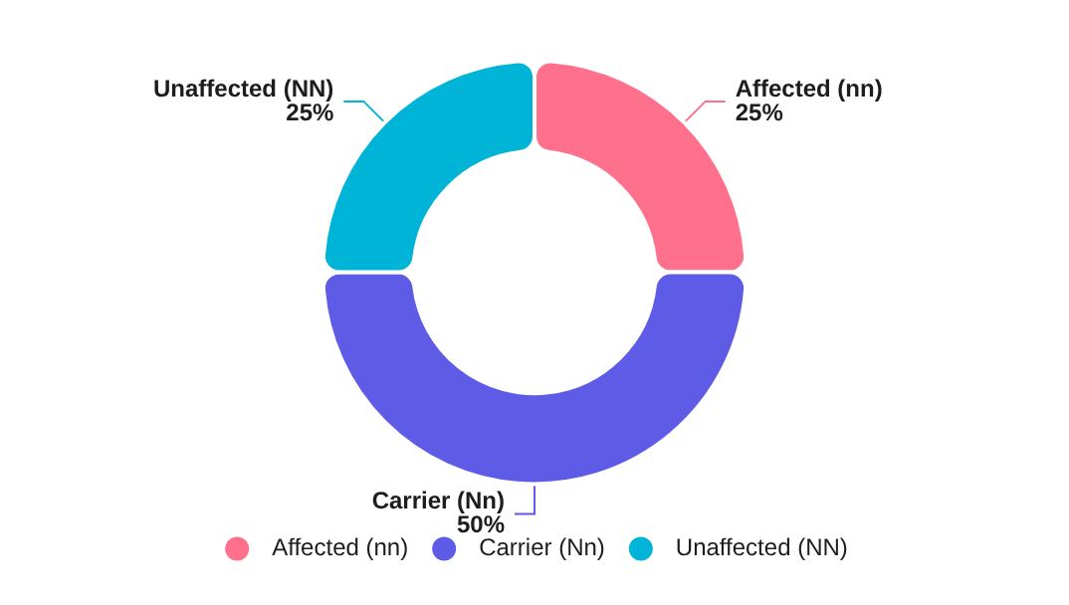



INHERITANCE PATTERNS
Autosomal Recessive Inheritance
Inheritance Mechanics
Offspring Risk (Two Carriers)
Both parents are typically unaffected carriers (Nn).
25% chance of an affected child (nn) in every pregnancy.
50% chance of children being asymptomatic carriers (Nn).
"Horizontal" transmission: often affects siblings in one generation.
Probability distribution per pregnancy
Clinical Examples
Cystic Fibrosis:Most common in N. Europeans.
Haemochromatosis:Low penetrance iron overload.
Consanguinity: Related couples are more likely to share identical recessive mutations from a common ancestor, significantly increasing the risk of offspring inheriting rare recessive disorders.
Haemoglobinopathies:Sickle Cell, Thalassaemia.

Slide 11


















GENETICS IN PRIMARY CARE
X-Linked Inheritance Patterns
Carrier Mother & Normal Father
50% Transmission Risk
50% of Sons are Affected
50% of Daughters are Carriers
Affected Father & Normal Mother
Daughter-Only Transmission
100% of Daughters are Carriers
0% of Sons are Affected
Core Characteristics
Primarily affects males (Hemizygous for X)
GP Consultation Red Flag
Females are typically carriers (Heterozygous)
Carrier females may show mild symptoms (Skewed X-inactivation)
When assessing a family pedigree for X-linked conditions, always look for the diagnostic pattern:
CRITICAL RULE: No Male-to-Male Transmission
Clinical Examples
Registrar Tip: If you see an affected male with an affected son, it is NOT a standard X-linked recessive pattern.
Haemophilia A/B
Duchenne MD

Slide 12














GENETICS IN PRIMARY CARE
Hereditary Cancer Syndromes Overview
UK GENERAL POPULATION: LIFETIME RISK
~1 in 20
Breast Cancer
1 in 7 – 8 Women
Cases of Breast, Ovarian, and Colorectal cancers are due to a hereditary syndrome
Colorectal Cancer
1 in 15 Overall
Ovarian Cancer
1 in 50 Women
Epidemiological Context: While genetic factors are significant, overall cancer incidence increases sharply with age in the general population.
GP Role: Identifying the "5%" allows for life-saving risk stratification and targeted surveillance through regional genetics services.

Slide 13









GENETICS IN PRIMARY CARE
BRCA1 and BRCA2 Mutations
These mutations significantly increase lifetime risks for breast and ovarian cancer, and are also linked to male breast and prostate cancers.
BRCA1
Chromosome 17
Associated Risks
Lifetime Breast Cancer Risk
Up to 85%
Increased risk of Male Breast Cancer and Prostate Cancer.
Associated with certain Melanomas.
Lifetime Ovarian Cancer Risk
40 – 60%
BRCA2: Specifically linked to increased risk of Pancreatic Cancer.
BRCA2
Chromosome 13
High-Risk Populations
Lifetime Breast Cancer Risk
Up to 45%
Autosomal dominant inheritance pattern (50% transmission).
Lifetime Ovarian Cancer Risk
10 – 27%
Ashkenazi Jewish Ancestry: Significantly higher prevalence of specific "founder mutations" compared to the general population.

Slide 14







GENETICS IN PRIMARY CARE
Breast Cancer Risk Stratification (NICE CG164)
STEP 1: SYMPTOMS FIRST
General Population Risk
If any symptoms suspicious of breast or ovarian cancer → refer via 2-week wait (2WW) pathway immediately.
Does not meet specialist referral criteria.
Only one relative diagnosed with breast cancer >40 years.
High Risk: Refer to Regional Genetics
PRIMARY CARE MANAGEMENT
≥1 first-degree relative diagnosed with breast cancer <40 years.
Provide Breast Awareness advice and safety-netting.
≥2 first- or second-degree relatives diagnosed (avg age <60). One must be first-degree.
Discuss modifiable risk factors (BMI, Alcohol, Smoking).
≥3 first- or second-degree relatives diagnosed at any age.
Review HRT/COCP benefits and risks based on family history.
Male breast cancer in a first-degree relative at any age.
Advice to return if family history changes.
Bilateral breast cancer in first-degree relative (first primary <50 years).
Breast AND Ovarian cancer history in first- or second-degree relatives.
Ashkenazi Jewish Ancestry: Lower referral threshold due to higher prevalence of BRCA founder mutations.
GP Clinical Tip
Always document the paternal family history. BRCA mutations can be inherited through the father's side just as frequently as the mother's.

Slide 15








GENETICS IN PRIMARY CARE
Management for High-Risk Breast Cancer
Enhanced Surveillance
Chemoprevention
Annual MammographyUsually offered from age 40 for high-risk women.
TamoxifenFirst-line option for premenopausal women (NICE NG101).
MRI Breast ScreeningOffered if mutation carrier or ≥50% lifetime risk, from age 30.
AnastrozoleRecommended for postmenopausal women at high risk.
Risk-Reducing Surgery
Ovarian Cancer Update
Bilateral Prophylactic MastectomyDiscussion with specialist surgical oncology teams.
Routine Screening Not RecommendedUKFOCSS trial showed no significant mortality reduction.
Salpingo-Oophorectomy (BSO)Recommended for BRCA1 carriers by age 40 (post-childbearing).
Symptom VigilanceAdvise patients on bloating, pelvic pain, and early satiety.NICE GUIDELINE UPDATE

Slide 16







GENETICS IN PRIMARY CARE
Colorectal Cancer Syndromes: FAP and Lynch
Familial Adenomatous Polyposis (FAP)
Lynch Syndrome (HNPCC)
GENETICS
APC Gene (Chromosome 5q)
Autosomal Dominant inheritance
GENETICS
Mismatch Repair (MMR) Genes
MLH1, MSH2, MSH6, PMS2
PHENOTYPE
Presence of >100 colonic polyps
Develops usually by late teens/early 20s
PHENOTYPE
Fewer polyps than FAP, but rapid progression to cancer. Amsterdam Criteria (3-2-1 rule) used for screening.
CLINICAL RISK
~100% Lifetime CRC Risk
ASSOCIATED
Extra-colonic malignancies:
Requires prophylactic colectomy to prevent malignancy
Endometrial
Ovarian
Gastric
Biliary Tract
Urinary Tract
Pancreatic
CRC Risk: 40–80% (Higher in males)
Early screening is vital for first-degree relatives

Slide 17


















GENETICS IN PRIMARY CARE
Colorectal Cancer Risk Stratification (NICE CG131)
Step 1: Urgent Symptoms (2WW)
Step 3: High-Risk Family History
REFER URGENTLY TO COLORECTAL SURGERY IF:
REFER TO REGIONAL GENETICS SERVICE IF:
Rectal bleeding WITH change in bowel habit (looser/more frequent) for ≥6 weeks
≥1 first-degree relative with CRC aged <45
≥2 first-degree relatives with CRC at any age
Palpable right-sided abdominal or rectal mass
≥3 first- or second-degree relatives with CRC or linked cancers
Unexplained iron deficiency anaemia
Adenomatous polyps in a first-degree relative aged <50
Age >60: Rectal bleeding OR change in bowel habit for ≥6 weeks
LYNCH / HNPCC LINKED CANCERS:
Endometrial
Ovarian
Stomach
Urinary Tract
Biliary
Pancreatic
Population Risk
Manage in primary care if criteria above are not met.
Step 2: Known Syndromes
Lifestyle Advice
Safety Netting
If known mutation (e.g. Lynch, FAP) → Refer directly to Genetics.

Slide 18














GENETICS IN PRIMARY CARE
Case Study: Mrs B and Hereditary Risk
Patient Presentation
Clinical Risk Stratification
PATIENT
INITIAL REASON
HIGH RISK
Mrs B, 52y
BP Check (152/96)
Meets NICE CG164 criteria: ≥2 first-degree relatives with breast/ovarian cancer, average age < 60, including one ovarian cancer.
Action: Refer to Regional Genetics Service
Family History Details
Management Options
Sister: Ovarian cancer (age 48)
Surveillance: Annual mammography from age 40; MRI if mutation carrier.
Sister: Breast cancer (age 52)
Genetics: BRCA1/2 testing (starting with affected relative if possible).
Paternal Aunt: Breast cancer (age 61)
Risk Reduction: Discussion of prophylactic mastectomy or oophorectomy (BSO).
Chemoprevention: Tamoxifen/Anastrozole per NICE NG101.

Slide 19











GENETICS IN PRIMARY CARE
Case Study: Mrs T and Population Risk
Mrs T's Family History
Clinical Assessment
Mother (Maternal)
No 1st-degree relative with Breast CA <40 yrs
Breast Cancer diagnosed at age 64
Cervical Cancer: Not a linked BRCA syndrome cancer
Sister
Cervical Cancer in her 30s
Prostate Cancer: Late-onset and on paternal side
Paternal Grandfather
Lung Cancer: Likely environmental (smoking history)
Prostate Cancer aged 80s
Paternal Uncle
REASSURANCE STRATEGY
Lung Cancer (heavy smoker, 60s)
Cancer is common: Explain 1 in 2 lifetime risk in the general population. Most cases are sporadic/age-related, not hereditary.
Action: Reassure and manage in Primary Care. Provide breast awareness advice and return if family history changes.
CLASSIFICATION: POPULATION RISK

Slide 20









GENETICS IN PRIMARY CARE
Contraception and HRT in High-Risk Women
Hormonal Contraception
Hormone Replacement Therapy
UKMEC 1
UKMEC 3
Population Risk / Non-Carriers: HRT use confers similar additional risk as general population (Million Women Study).
Non-Carriers
BRCA Carriers
BRCA Mutation Carriers: Generally NOT recommended without high-level specialist oncology/genetics input.
COCP Benefits: Confers approximately 20–40% reduction in ovarian cancer risk if used for ≥5 years (NICE CG164).
Joint Decisions: Decisions must be made jointly considering premature menopause vs. cancer risk.
BRCA Carriers: UKMEC Category 3 — increased breast cancer risk generally outweighs ovarian benefits; requires specialist genetics/oncology discussion before prescribing.
GP Management Strategy
Preferred Options: Progestogen-only pill (POP) or LNG-IUS (Mirena) are preferred for BRCA carriers.
Identify mutation status early in consultation.
Avoid initiating HRT/COCP in BRCA carriers in primary care without specialist guidance.
Refer to NICE NG101 for chemoprevention alternatives.
Clinical Note
UKMEC categories for non-carriers with family history remain similar to the general population.

Slide 21






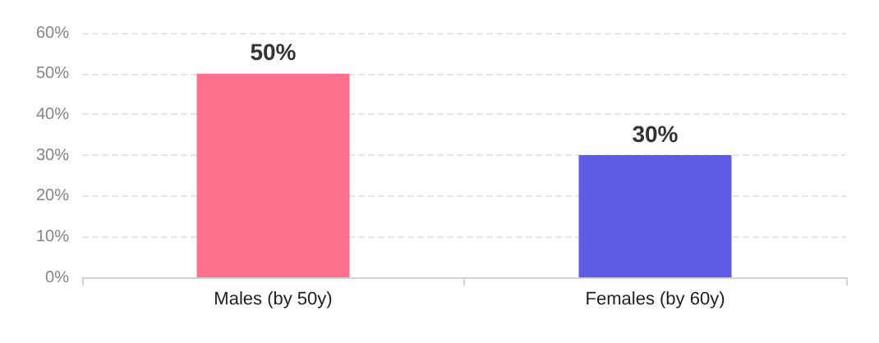





GENETICS IN PRIMARY CARE
Familial Hypercholesterolaemia (FH)
Epidemiology Update
CVD Risk in Untreated FH
1 in 250
Updated UK Prevalence (NICE 2017)
Estimated 240,000 cases in the UK population.
Previously estimated at 1 in 500; risk is more common than perceived.
Lifetime risk of CHD events without early intervention
Inheritance Pattern
Autosomal Dominant: 50% risk for first-degree relatives.
The Identification Gap
Key mutations: LDLR (most common), APOB, or PCSK9.
Leads to significantly reduced clearance of LDL-C.
< 15% Identified
Majority of cases remain undiagnosed until a premature MI.
GPs are critical for case-finding and cascade screening.

Slide 22

















GENETICS IN PRIMARY CARE
Diagnosing FH: Simon Broome Criteria
> 7.5 mmol/L
> 4.9 mmol/L
Total Cholesterol
LDL-Cholesterol
*Starting criteria for adult diagnosis
DEFINITE FH
POSSIBLE FH
DNA Evidence: Confirmation of a pathogenic mutation (LDLR, APOB, or PCSK9).
Early MI (1st Degree): Myocardial infarction occurring before age 60.
Early MI (2nd Degree): Myocardial infarction occurring before age 50.
Tendon Xanthomata: Present in the patient or a first/second-degree blood relative.
Family Hypercholesterolaemia: TC > 7.5 in 1st/2nd degree relative.
Clinical Examination Red Flags
Tendon Xanthomata
Corneal Arcus
Xanthelasma
Achilles / Hand extensors
If diagnosed before age 45
Yellow plaques on eyelids

Slide 23











GENETICS IN PRIMARY CARE
FH Management and Cascade Screening
Pharmacological Management
Cascade Screening Strategy
First-line High-intensity statin: Atorvastatin 80 mg daily for all adults with FH.
1. Identify Index CasePatient diagnosed with definite or possible FH via Simon Broome criteria.
Target Aim for ≥50% reduction in LDL-C from the baseline measurement.
2. Family NotificationOffer systematic testing to all first-degree relatives (parents, siblings, children).
Escalation: Add Ezetimibe if target not met with maximum tolerated statin dose.
Referral: Specialist lipid clinic if targets remain unmet or for PCSK9i consideration.
3. Clinical TestingMeasurement of LDL-C levels; use age-adjusted thresholds for children.
NICE CG71: Address all CV risk factors (BP, smoking, BMI, diabetes).
4. Genetic TestingDNA/genotyping if a pathogenic mutation is identified in the index case.
Clinical Monitoring
Genetic Context
Assess for symptoms/signs of Ischaemic Heart Disease at every review.
Annual review of medications, lifestyle, and cardiovascular risk.
Inheritance Autosomal Dominant: 50% risk to offspring.
Key Genes: Mutations in LDLR (most common), APOB, or PCSK9.
Prevalence Updated estimate: 1 in 250 (NICE 2017).

Slide 24













GENETICS IN PRIMARY CARE
Hereditary Haemochromatosis Presentation
Genetics & Epidemiology
Late Complications
1 in 10
1:200-400
Liver: Cirrhosis and Hepatocellular Carcinoma (HCC).
Endocrine: Diabetes Mellitus and Hypogonadotrophic Hypogonadism.
Carrier Rate
Prevalence
Cardiac: Cardiomyopathy and Heart Failure.
Autosomal Recessive: Most common serious genetic disorder in Northern Europeans.
Musculoskeletal: Progressive Arthritis.
Gender Bias: Predominantly affects men; women protected by menstruation until menopause.
Iron Overload: Progressive accumulation leading to multi-organ damage.
Early Clinical Features
The "Classic Triad" (Late Presentation)
Historical clinical signs of advanced iron overload. Aim to diagnose well before this stage for normal life expectancy.
Highly non-specific – requires high index of suspicion:
Unexplained Fatigue / TATT
Cirrhosis
Diabetes
Skin Bronzing
Joint Pain (esp. 2nd & 3rd MCP joints)
Often referred to as "Bronze Diabetes"
Unexplained Weight Loss
Early diagnosis is key: Venesection before cirrhosis/diabetes results in normal life expectancy.

Slide 25










GENETICS IN PRIMARY CARE
Haemochromatosis: Diagnosis and Genetics
Diagnostic Pathway
Management & Treatment
Initial Screen: Ferritin is non-specific (elevated in alcohol, metabolic syndrome, inflammation).
Venesection (Phlebotomy): The gold standard treatment to remove excess iron.
Confirmation: Fasting Transferrin Saturation is the earliest and most sensitive marker.
Inheritance: Autosomal Recessive but with low penetrance (not all with mutations develop disease).
TRANSFERRIN SATURATION THRESHOLDS:
>45%
>50% / 55%
Life expectancy is NORMAL if started before cirrhosis or diabetes mellitus develop.
EITHER SEX (INVESTIGATE)
FEMALES / MALES (SUSPECTED)
HFE Genotyping
Clinical Pearl
Common Mutations: C282Y homozygosity (>95% cases) or compound heterozygosity (C282Y/H63D).
Women are often protected by menstruation until menopause; maintain a high index of clinical suspicion in post-menopausal presentations.
Cascade Screening: Offer genotyping to all 1st-degree relatives of confirmed cases.

Slide 26










GENETICS IN PRIMARY CARE
Genomics and Personalised Medicine
Pharmacogenetics
The Genomic Paradigm Shift
TPMT Testing: Routine screening before prescribing Azathioprine to prevent toxicity.
Genome-Wide Association Studies (GWAS): Testing the whole genome to identify variants across populations.
Warfarin & Clopidogrel: Using CYP2C19 variants to guide optimal dosing and efficacy.
Susceptibility Loci: Identifying variants that increase disease likelihood without being necessary or sufficient causes.
Polygenic Risk Scores (PRS): Combining multiple small-effect variants to stratify risk (e.g., in breast and prostate cancer).
Precision Oncology
Phenotypic data (lifestyle, age, clinical history) remains the strongest predictor for most common conditions.
Tumour Profiling: HER2 testing determines eligibility for Trastuzumab (Herceptin).
BRCA & PARP Inhibitors: BRCA testing in cancer tissue guides the use of Olaparib.

Slide 27







GENOMICS IN PRIMARY CARE
Managing Direct-to-Consumer Genetic Results
GPs should acknowledge patient concerns while explaining the limitations and low predictive value of population-based genomic reports.
GP Clinical Strategy
Acknowledge: Validate the patient's initiative and address specific health anxieties.
Modifiable Risks: Shift focus back to BMI, smoking, and blood pressure—stronger predictors than GWAS variants.
ELSI Discussion: Discuss Ethical, Legal, and Social Implications, including impact on life insurance.
Only refer to Regional Genetics if a genuinely elevated single-gene risk (e.g., BRCA) is identified.
Psychological Considerations
Scientific Limitations
Genetic Fatalism: Patients may believe their health outcome is fixed, leading to hopelessness.
Population vs. Individual: GWAS data provides average risks that have low predictive value for specific patients.
Behavior Change: Opportunity to leverage results for positive lifestyle adjustments.
Missing Heritability: DTC tests often ignore environmental factors and rare variants that may carry higher risk.
Health Anxiety: Unexpected results for conditions like AF or Diabetes can cause significant distress.
Key Message: Phenotypic data (family history + clinical markers) remains the "Gold Standard" for risk assessment in primary care.

Slide 28











GENETICS IN PRIMARY CARE
Case Study: Cystic Fibrosis Carrier Risk
Patient Vignette: Jane & Christopher
Calculating the Reproductive Risk
Jane (28): Currently 6 weeks pregnant. Healthy, but concerned about family history of Cystic Fibrosis (CF).
1
Jane's probability of being a carrier (sibling of obligate carrier)2/3
Family History: Jane's brother John has a son, Richard (4), who is affected by CF.
2
Christopher's risk (Population carrier rate)1/25
Implication: John and his partner are obligate carriers. Their parents (Jane's parents) must also be carriers.
3
Risk of both passing on the mutation1/4
Christopher (29): Jane's husband. Only child, no known family history of CF. Northern European ancestry.
COMBINED RISK IF JANE IS CARRIER
1 in 100
*Note: Total prior risk before Jane's testing is (2/3) × (1/25) × (1/4) = 1 in 150. Once Jane is confirmed as a carrier via testing, the risk shifts to 1 in 100.
GP ACTION
Urgent Action: If carrier status affects reproductive decisions, provide an urgent telephone referral to the Regional Genetics Service.
Calculation assumes Northern European population frequency.

Slide 29

















GENETICS IN PRIMARY CARE
Antenatal and Newborn Screening Programmes
Pre-conception & Initial Screening
Newborn Blood Spot (Heel Prick)
Haemoglobinopathy: Sickle cell and thalassaemia screening offered early.
Day 5 Screening for 9 Conditions:
Infectious Diseases: HIV, Hepatitis B, and Syphilis (opt-out).
Cystic Fibrosis
Congenital Hypothyroidism
Sickle Cell Disease
PKU
MCADD
Blood Grouping: ABO group, Rhesus (RhD) status, and red cell antibodies.
Homocystinuria (HCU)
MSUD
IVA
GA1
Folic Acid: 400mcg/day standard; 5mg/day if high risk (e.g. DM, BMI >30, previous NTD).
*Early detection prevents severe disability or death via dietary/medical intervention.
Antenatal Trisomy & Anomaly
Physical Exam & Hearing
Combined Test (10–14 weeks): NT scan + PAPP-A + hCG for Down's, Edwards', and Patau's syndromes.
Newborn Physical (NIPE): Performed within 72 hours and again at 6–8 weeks (GP role).
Fetal Anomaly Scan (18–20 weeks): Detailed structural assessment of 11 physical conditions.
Focus: Eyes (red reflex), Heart, Hips (DDH), Testes.
Hearing Screening (NHSP): AOAE testing performed before discharge or within 4 weeks.
NIPT: Offered as an evaluative second-line screen if combined test risk > 1:150.
GP Essential: Ensure timely 6-8 week NIPE and review any screening results if the mother presents with concerns.

Slide 30








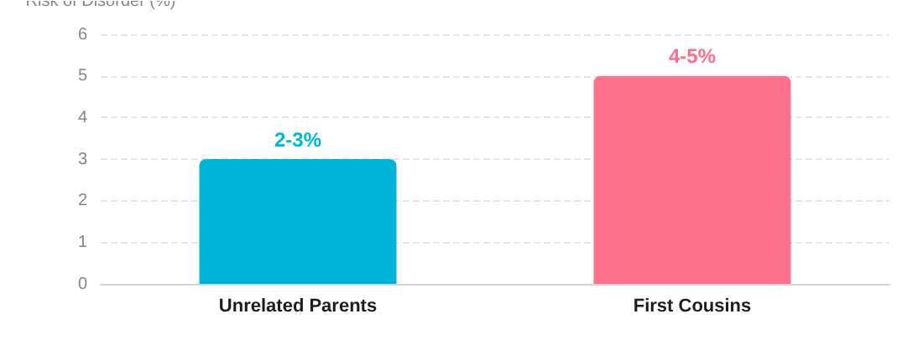

GENETICS IN PRIMARY CARE
Consanguinity and Clinical Context
Understanding the increased risk of recessive disorders in related couples while providing non-judgmental, culturally sensitive counselling.
Definition & Global Context
The Bradford VTS Context
Marriage between second cousins or more closely related individuals.
Significant South Asian population with traditional marriage patterns.
Common in Middle East, South Asia, North Africa, and some European communities.
Every Baby Matters: Bradford infants historically 1.7x more likely to die in first year.
Shared ancestors increase the probability of inheriting identical recessive mutations.
Objective: Proactive health promotion and early identification of at-risk pregnancies.
Congenital Disorder Risk Comparison
Counselling Principles
Non-Directive: Provide accurate information to support patient autonomy.
Non-Judgmental: Acknowledge cultural significance while explaining clinical risks.
Focus on informed reproductive choice and access to screening services.
Note: 96% of children born to first cousins are completely healthy.

Slide 31










GENETICS IN PRIMARY CARE
Principles of Genetic Counselling
Genetic counselling is a communication process which deals with the human problems associated with the occurrence, or the risk of occurrence, of a genetic disorder in a family.
Non-Directive
Non-Judgmental
Informed Choice
Provides facts and risk data without influencing the patient’s final decision.
Creates a safe space for patients with diverse cultural or religious values.
Ensures patients fully grasp the implications of genetic results (ELSI).
Respects individual autonomy and the right to refuse testing or intervention.
Critical in sensitive contexts, such as consanguinity or reproductive choices.
Supports long-term management: screening, surgery, or family planning.
The clinician acts as a facilitator, not a director of the patient's life choices.
Validates patient concerns while maintaining clinical objectivity.
Aims to reduce "genetic fatalism" through clear, actionable information.
GP Role: While specialist geneticists provide in-depth counselling, the GP’s role is to initiate these principles during the initial risk assessment and referral discussion.

Slide 32
















GENETICS IN PRIMARY CARE
Key Messages and Clinical Resources
The GP's Core Role
Clinician Toolkit
Identification: Think genetics in multifactorial disease and recognize "red flags" (early onset, multiple relatives).
GeNotes
NICE Guidelines
Genomic notes for clinicians: just-in-time clinical guidance.
CG164 (Breast), CG131 (Colorectal), CG71 (FH).
Risk Stratification: Use NICE criteria (Cancer, FH) to distinguish population risk from high-risk referral needs.
RCGP Genomics
Yorkshire Genetics
Comprehensive toolkit and educational modules for GPs.
Regional referral forms and local pathway documentation.
Family History: Document three generations accurately; use standard pedigree symbols for professional communication.
Patient Support
Support & Guidance: Provide non-directive, non-judgmental counseling, especially in cases of consanguinity.
Genetic Alliance UK
Macmillan Cancer
Support for patients living with rare genetic conditions.
Excellent info on hereditary breast and bowel cancers.
HEART UK
Haemochromatosis UK
Specialized support and diet advice for FH patients.
Patient guides on venesection and iron overload.
Dr Jude Hayward • GPwSI in Genetics • Yorkshire Regional Genetics Service
BRADFORD VTS TRAINING

