Slide 1
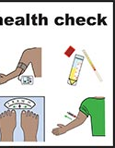
Annual Health Checks for People with Learning Disabilities
Vicky Donnelly
CCG Clinical lead
for Learning Disabilities &
Strategic Health Facilitator, BDCFT
Victoria.Donnelly@bdct.nhs.uk
Sarah O’Donnell
Lead GPN Rooley Lane
National GPNSNN Lead
Sarah.O'Donnell@bradford.nhs.uk

Slide 2
People with learning disabilities have more health conditions than general population
Health services don’t always make the reasonable adjustments required under the Equality Act
Health inequalities
Preventable & premature deaths

Slide 3
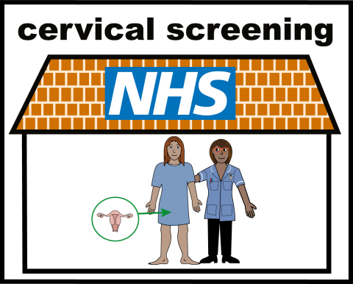
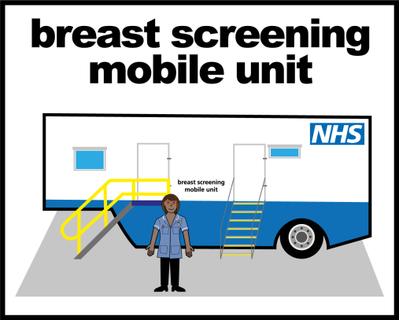
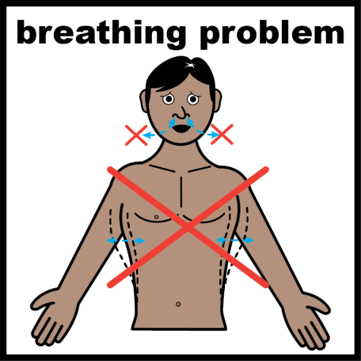
National Agenda
NHS 10 year plan: People with LD are included in all NHS priorities:
Mental Health
Cancer
Cardio vascular disease
Children's services
Specific objective to also reduce health inequalities for people with LD in particular - annual health checks are key to this - expectation that practices will ensure 75 % of the people on their LD register have an annual health check.

Slide 4
Feedback from people with Learning Disabilities about accessing primary care
They talk to my carers and not me
I ring up and they don’t know what I’m talking about when I ask for a health check
I like the nurse - she knows me well and lets my carer come with me
Some of the equipment looks scary
I cant remember what they told me - I need them to write it down so I don’t forget (Health action plan)
Sometimes the waiting room is too busy - I want to wait somewhere quiet
They don’t explain things in simple words

Slide 5

Reasonable adjustments -
Everyone is an individual so these will vary from person to person
Accessible information standard - If you complete the Accessible Information standard on Systmone this identifies for you what adjustments you need to make for each person - make sure this is done for everyone on your LD register.
Inviting the person - A phone call may be more useful than a letter - can discuss what support is needed for a good health check.
Communication - Think about body language, words you use, easy read, etc. Help people remember what was talked about by using the health action plan.
Clinic area - Think about environment, noise levels, quiet sessions, desensitisation, distractions.
Joint working - Work with social prescribers, health & social care teams, Self advocacy groups etc

Slide 6
Learning Disabilities Registers
Have you got the right people on your register? Don’t be afraid to talk to people about whether they should be on register or not.
Recent local searches been done to identify young people as the numbers aren’t reflective of local population.
Raise awareness at school EHCP’s (particularly special schools), parent/ carer groups, with Paediatricians, school nursing teams & transition nurses of LD register and AHC

Slide 7
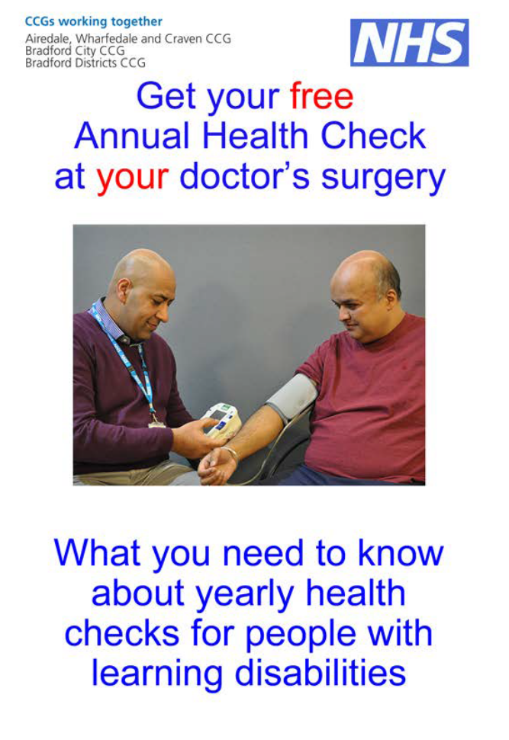
Annual Health Checks
Offered to people age 14 and above on LD register – opportunity to develop relationships with young people who may only have seen Paediatrician previously
Get the right template - Search on tree:
DQT ES Learning Disabilities
Make it meaningful - start off asking the person how they are and how they feeling - do they have any health concerns?
Some variation across district in how these done

Slide 8
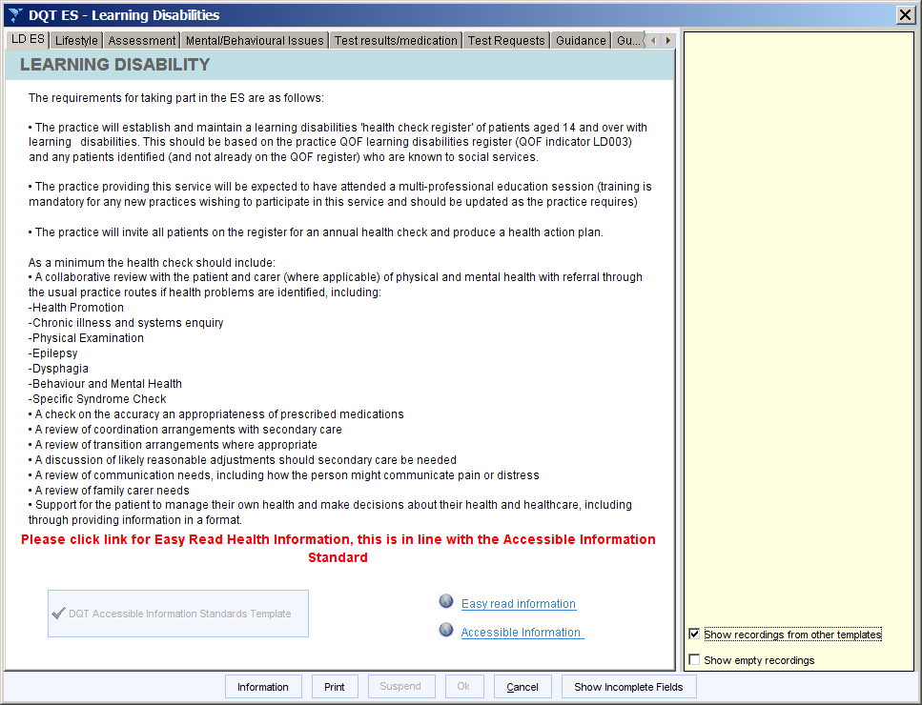
Annual Health Check Template
Link to easy read info

Slide 9
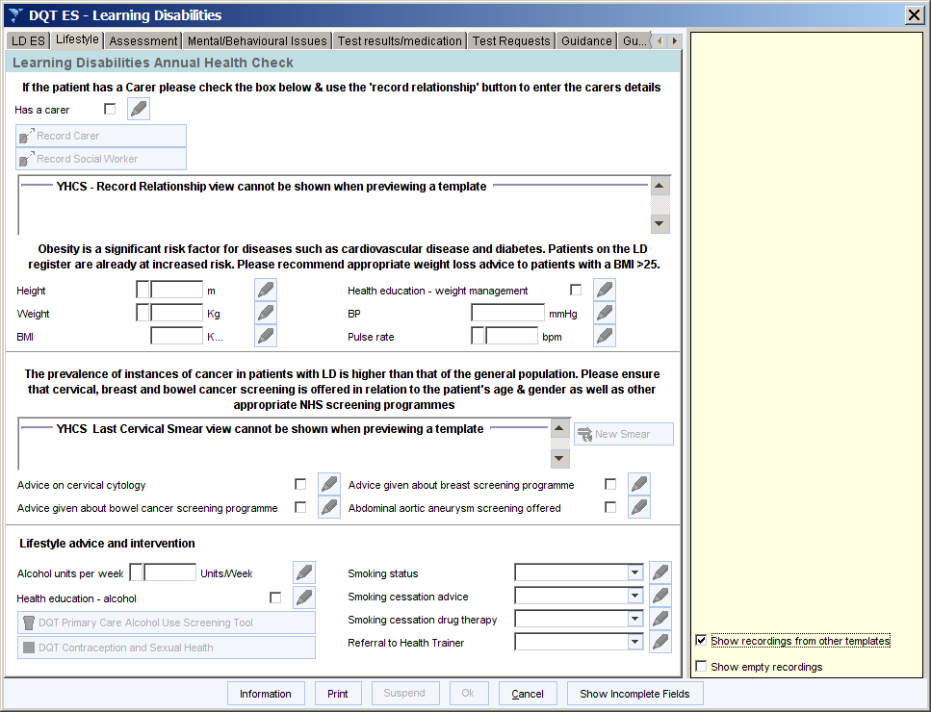
Talk about cancer screening - people with LD don’t access as much as rest of population
Accessible information about screening

Slide 10
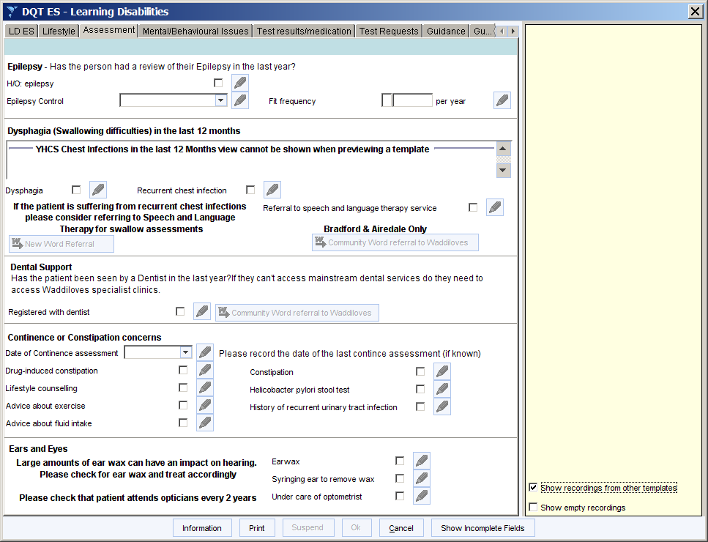
Chest infections are the biggest killer - check whether someone having frequent chest infections and refer to SALTs if so
Constipation - talk about Bristol stool chart - are they having a poo regularly ? If not what can you do?

Slide 11
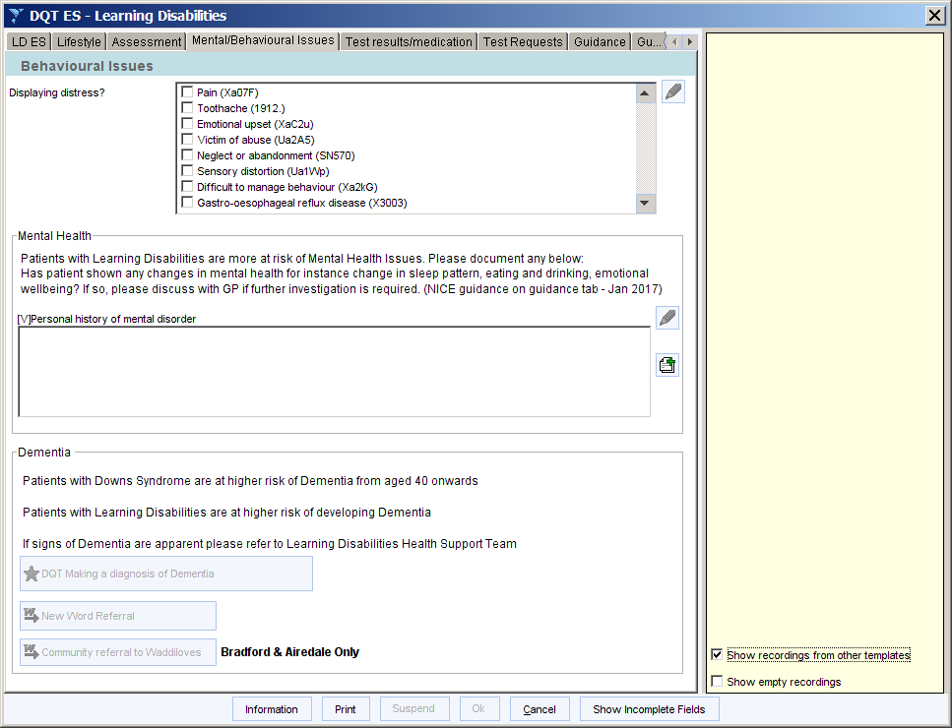
Changes in behaviour - is this due to pain?
Are you aware of dementia risk in people with Downs syndrome

Slide 12
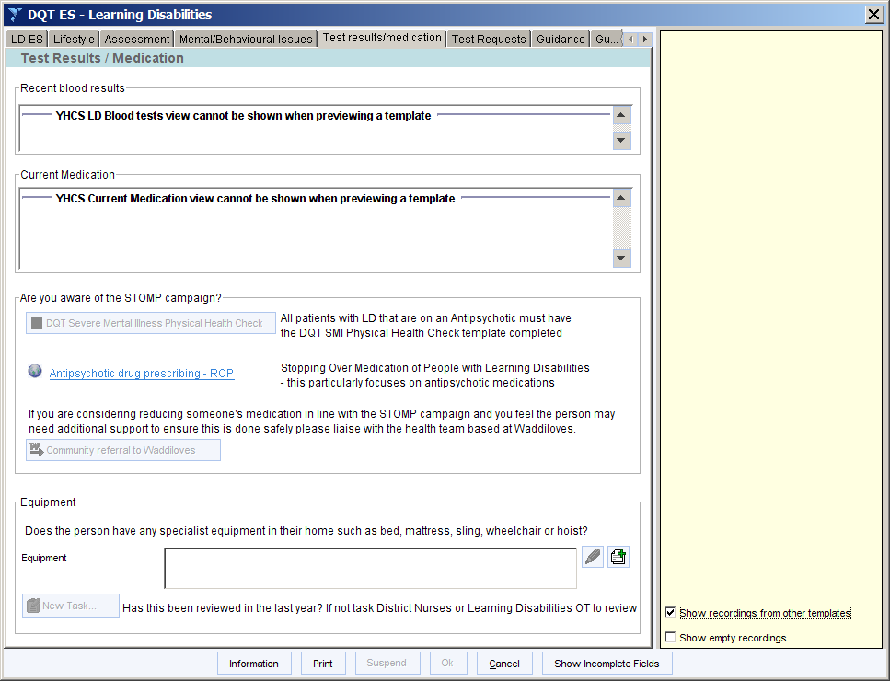
GP section - medication review
Equipment might not be reviewed -consider task to DN team to check ?

Slide 13
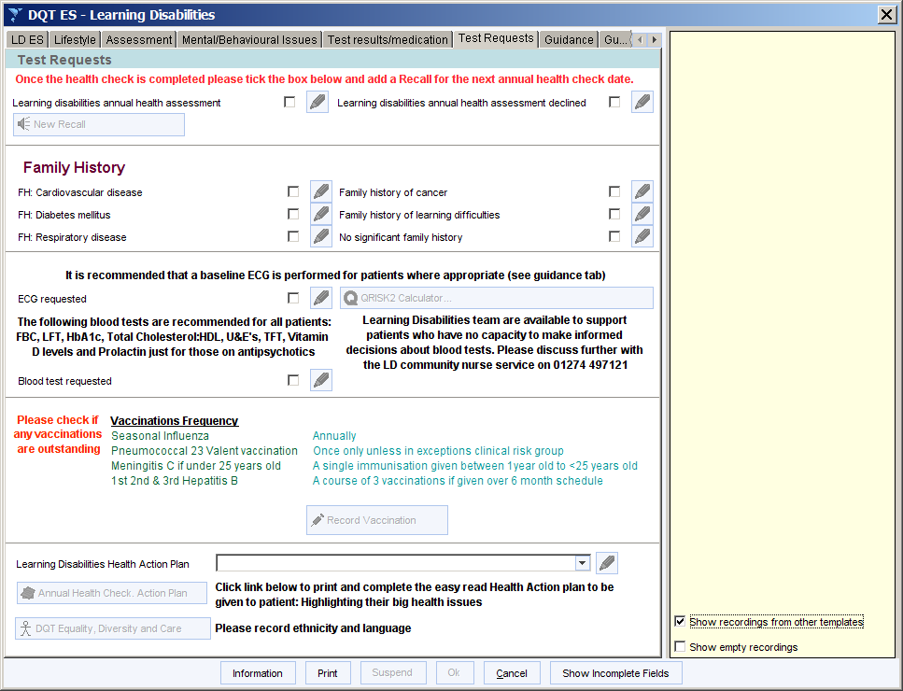
When to do an ECG?
Health action plan - people need reminder of what talked about

Slide 14
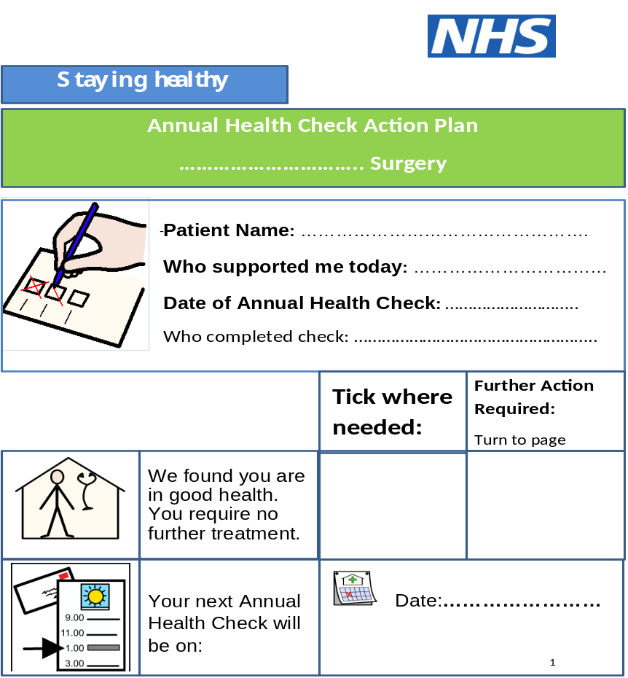
Health Action Plan:
To be given to person at end as reminder of discussion
Print off and fill in as you go through the template

Slide 15
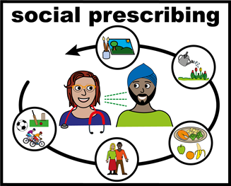
Health Action Plans:
Does the person need to come back for any further checks eg bloods
Do they need to lose weight, give up smoking, develop confidence - Would they benefit from accessing things in local community such as exercise sessions or cooking groups?
Think about referrals to social prescribing / link workers attached to your practice

Slide 16
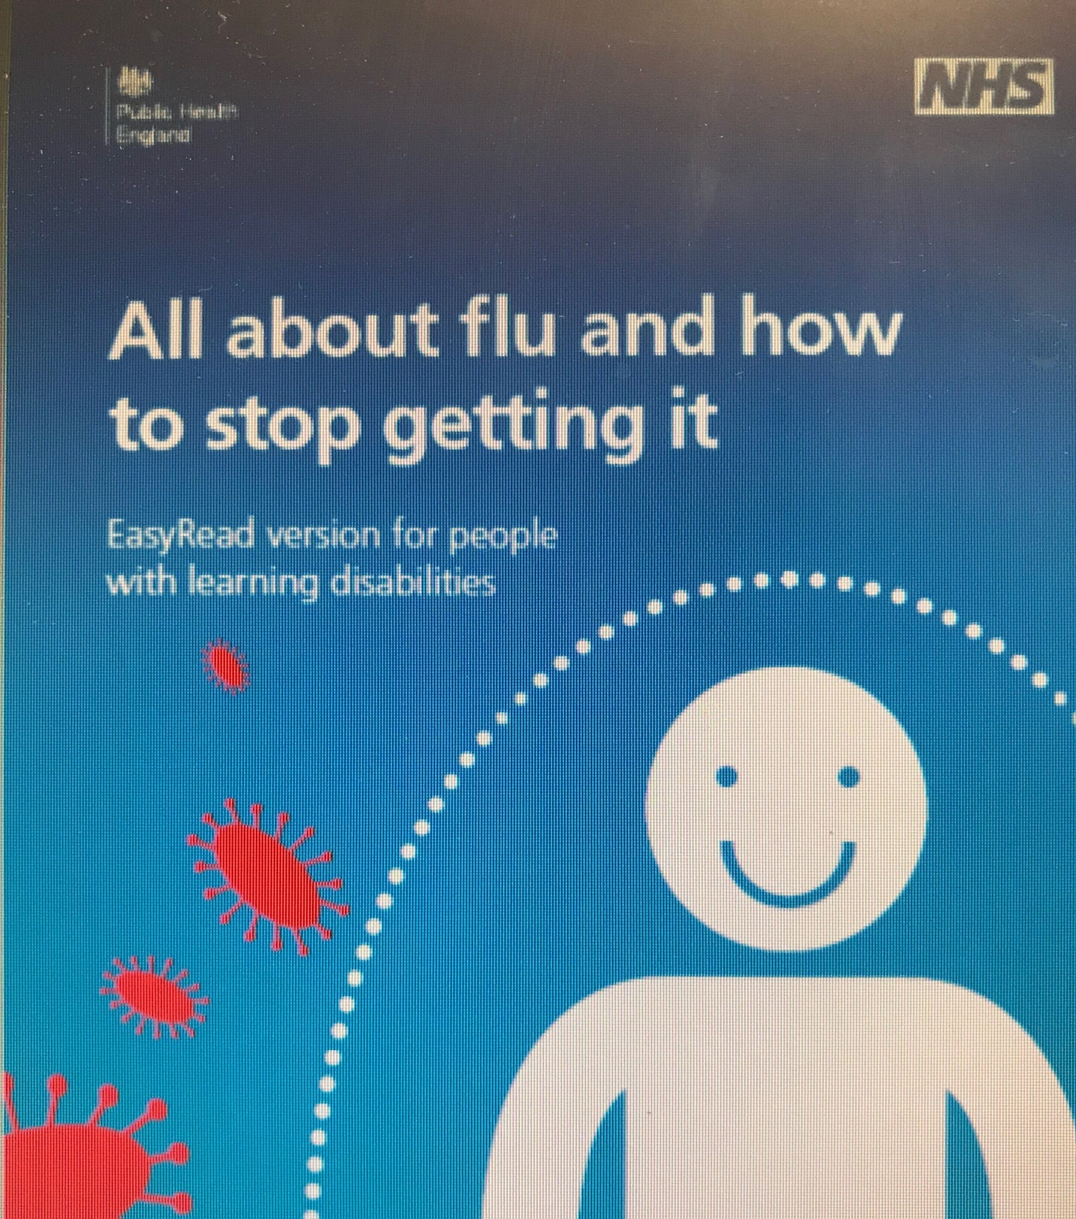
Immunisations / Vaccination
Flu vaccine
Pneumonia
HPV for young people up to 25
Hep A vaccine for MSM
MEN ACWY up to age 25
Hep B in some services
Routine vaccines up to date

Slide 17
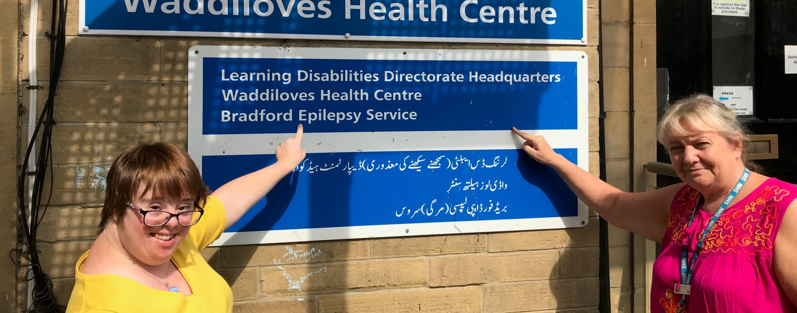
Support available in community :
Social care support - respite/ carers support/ day time activities
Access - 01274 435400
Health care support - Waddiloves includes SALT, Nursing, OT, physio, psychology, psychiatry, dietetics
Dental clinics, podiatry, visual assessments etc
Referrals via 01274 497121 or referral form
embedded in AHC template and in referral repository.
BTHFT Hospital support - LD Liaison nurse in post via Safeguarding team in BRI

Slide 18
Why would you make a referral to LD health team ?
Examples such as:
If someone has diabetes and not understanding how to manage this safely
Constipation - repeat hospital admissions
Numerous chest infections - safe swallowing issues or postural input ?
Desensitisation around accessing cervical screening or having bloods taken - joint work
Changes in someone's behaviour
Possible dementia - people with Downs syndrome in particular
Referring them to hospital for treatment/ investigations and likely to struggle with this - LD community can support with hospital admissions

Slide 19
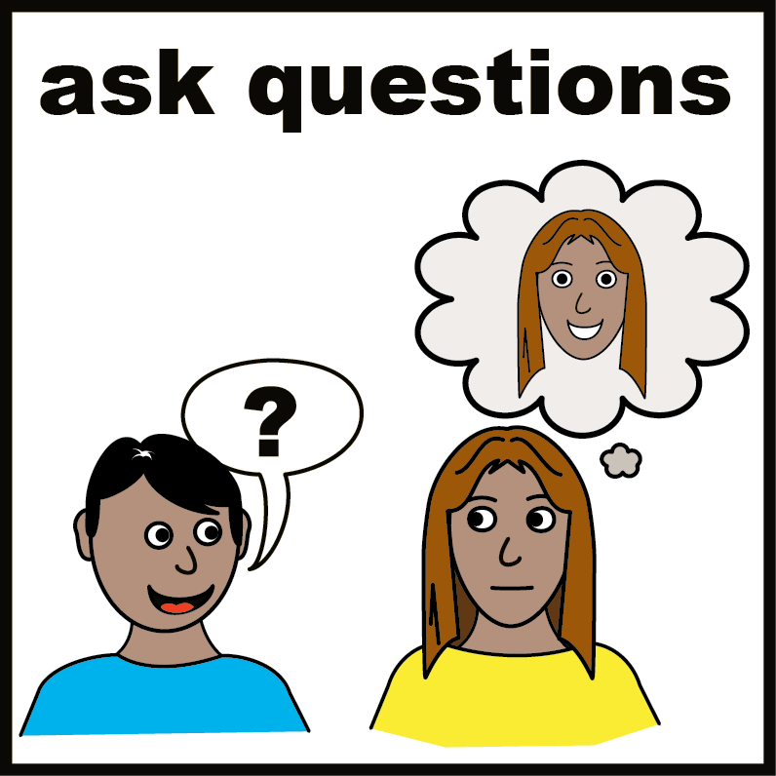
To finish:
Primary care “LD Champions “ network - buddy up with others, share learning, good practice, support etc.
Let us know if you want
adding to the group
Any questions?

