Slide 1
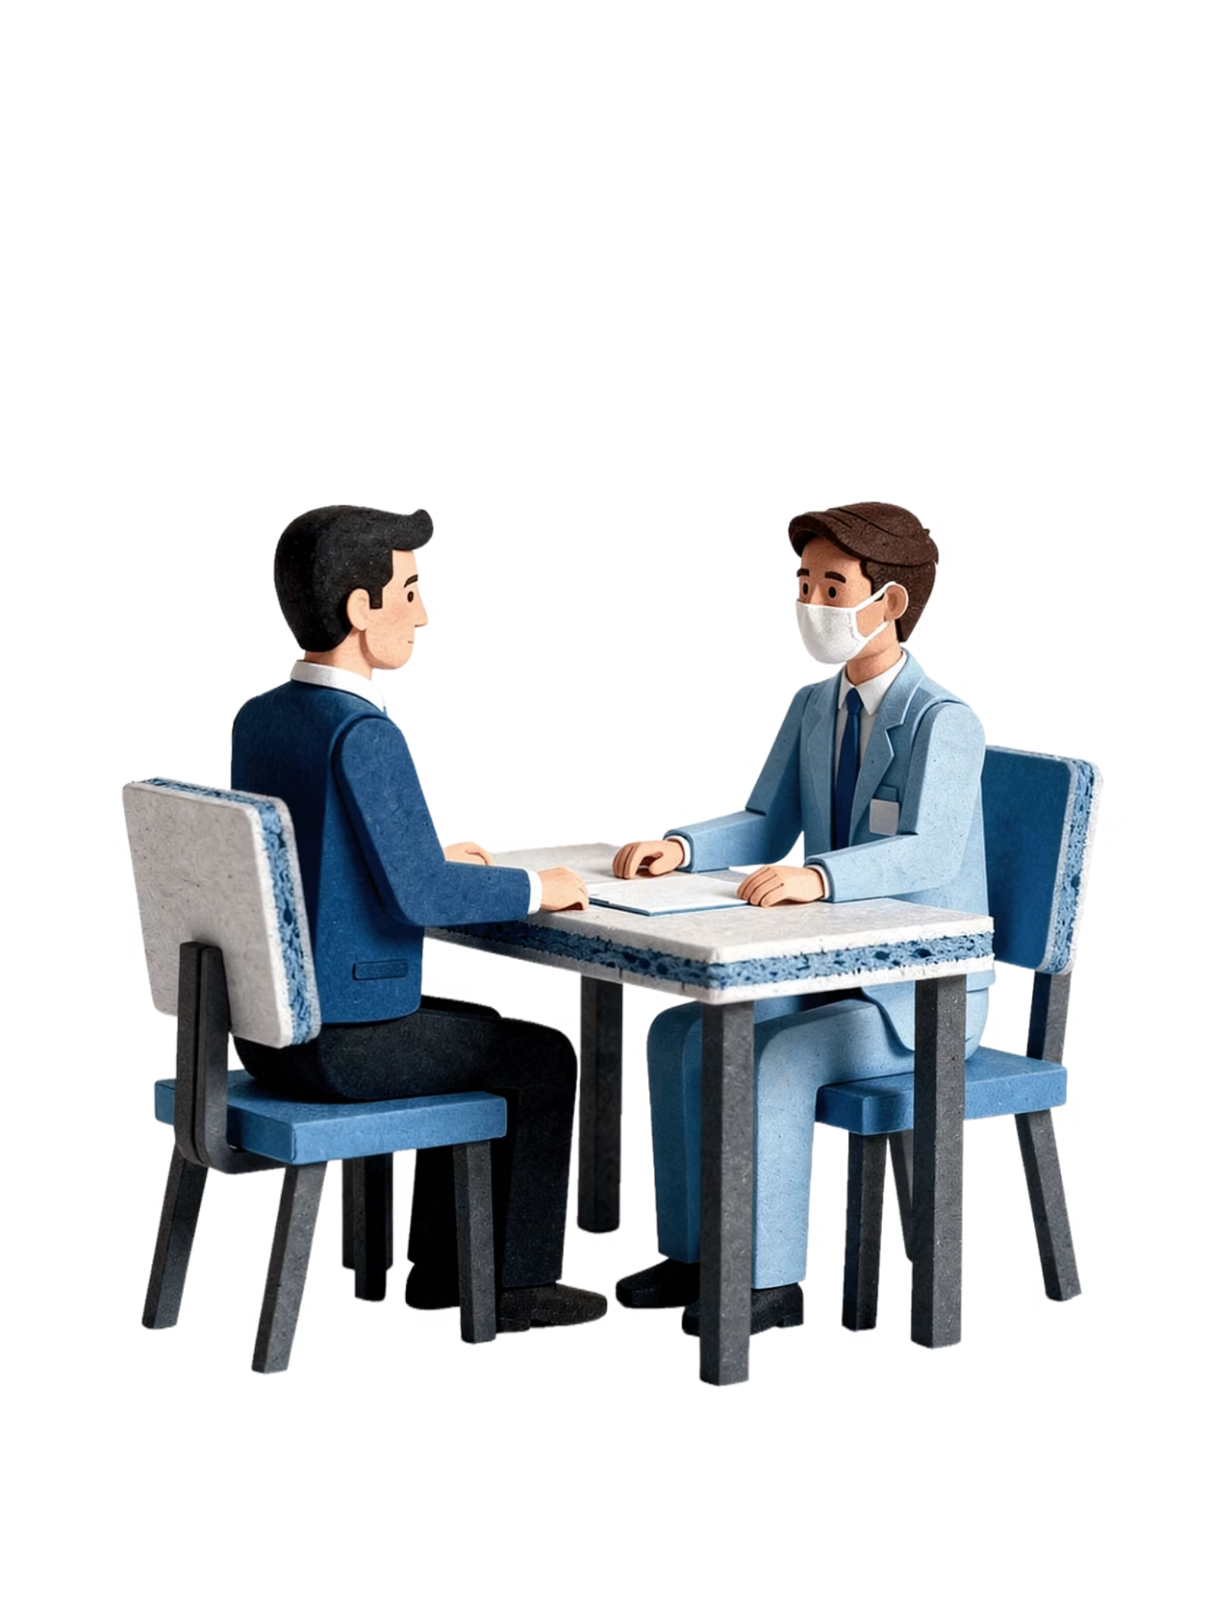
BRADFORD VTS TEACHING DECKS
Men and Doctors
Men's Health & Help-Seeking Behaviour · (June 2026)
A GP consultation — the gateway to better health for men. For GP trainees, understanding why men delay or avoid seeking help is essential for patient-centred care, passing the SCA, and practising proactively in the community.

Slide 2

OVERVIEW
The Scale of the Problem
Men are significantly less likely than women to consult their GP or attend dental check-ups. This gender gap has real consequences — and in November 2025, the government published England's first-ever Men's Health Strategy.
4 yrs
61.5
Shorter Lives
Healthy Life Expectancy
Men in England live nearly 4 years fewer than women on average.
Men's healthy life expectancy is just 61.5 years — fallen by 1.5 years in a decade.
54%
36%
Avoided Help
Premature Death
54% of men did not seek medical help for a concern in the last 3 years (DHSC, 2025).
36% of men died before their 75th birthday in 2024.
Suicide remains the leading cause of death in men under 50. In the most deprived areas, men die 10 years earlier than in the wealthiest areas.

Slide 3
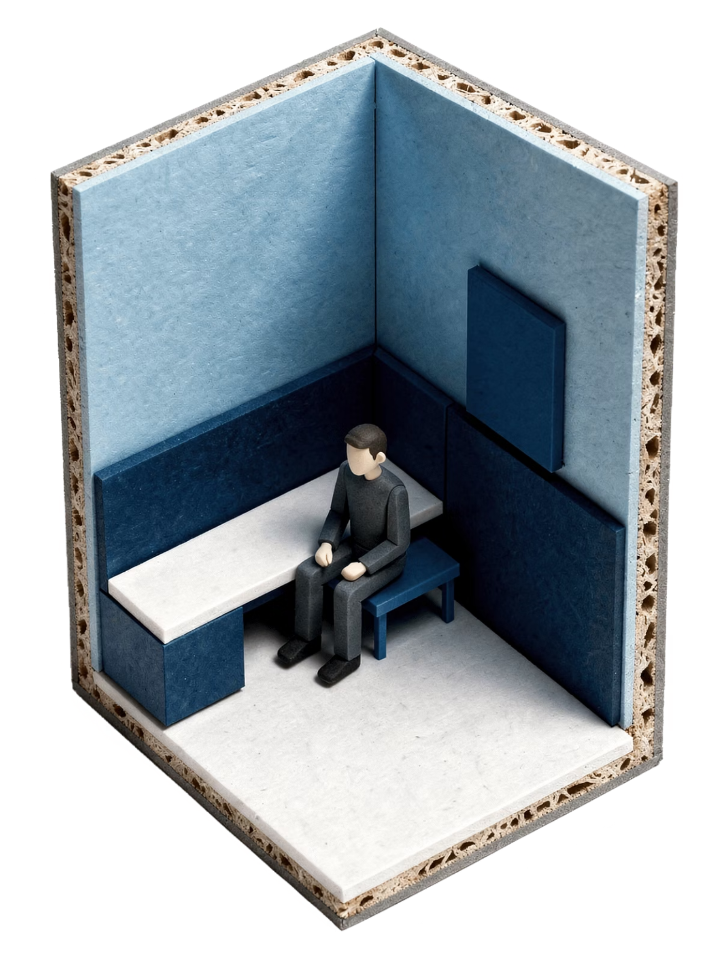
GP CONSULTATIONS
The Engagement Gap
The NHS England Men's Health Strategy (November 2025) confirms men are consistently less likely to consult their GP than women, even when managing established chronic conditions such as cardiovascular disease. This is a structural and behavioural pattern, not simply a matter of men being healthier.
Women's Advantage
A Critical Warning Sign
Women have more 'opportunistic' contact points — contraception, pregnancy, maternity — naturally increasing GP contact frequency.
Men who die by suicide are more likely to have been in contact with primary care in the three months prior to death (43%), yet their underlying mental health was often not identified or addressed. Proactive screening is essential.

Slide 4

DENTAL ATTENDANCE
The Same Gap in Dental Care
The pattern seen in general practice is mirrored in dental care. Men are consistently less likely to attend for regular check-ups (NHSBSA; DHSC Men's Health Strategy, 2025). Overall NHS dental attendance remains below pre-pandemic levels for both genders.
Metric
Figure
Adult patients seen by NHS dentist (24 months to March 2025)
18 million (40% of adults)
Child patients seen (12 months to March 2025)
6.9 million (57% of children)
Total courses of treatment (COTs) 2024/25
35 million (+4% vs 2023/24)
Dentists in England with NHS activity
24,655 (+1.4%)
The key clinical message: men are less likely to attend the dentist routinely, resulting in later presentation of dental disease, oral cancer, and other preventable conditions.

Slide 5
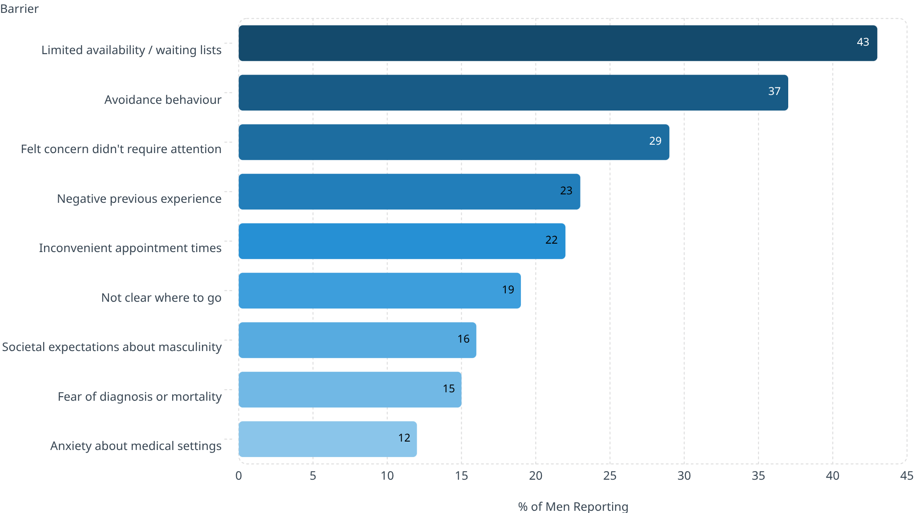
BARRIERS TO ACCESS
Why Men Avoid Seeking Help
The DHSC Men's Health Strategy Call for Evidence (2025) surveyed ~2,900 men. 54% reported not seeking medical help for a concern that warranted it in the last 3 years. Barriers ranked by prevalence:

Slide 6

MASCULINITY & NORMS
Cultural Barriers: Masculinity and Societal Norms
The DHSC strategy identifies that cultural and gender norms play a significant role. Many men associate seeking help with weakness — 'being sick symbolises weakness as a man' — reinforced by traditional notions of masculinity.
Risk-Taking Behaviour
Harmful Messaging
Men are more likely to smoke, misuse alcohol, and use drugs, and less likely to engage in preventive health activities.
Conflicting societal messages about masculinity — particularly for younger men — contribute to poorer health literacy and delayed help-seeking.
Compounded Disadvantage
Men from working-class backgrounds, deprived areas, and certain ethnic groups face compounded barriers with significantly worse health outcomes.

Slide 7
HEALTH INEQUALITIES
Inequalities in Men's Health
Area
Evidence
Strategy Priorities (DHSC, 2025)
Expand access to support services for men
Help men take better care of physical and mental health
Challenge stigma; empower men to seek help
Move from sickness to prevention — bring care to workplaces and community
Embed men's health in NHS commissioning and digital innovation
Address inequalities: deprivation, ethnicity, social exclusion
Deprivation
Men in most deprived areas die 10 years earlier; ~19 fewer years in good health
Ethnicity
Deaths from diabetes and heart attacks highest among South Asian men
Mental health
1 in 8 men in England has a common mental health problem
NHS Health Checks
Only 37% of eligible men had ever been invited (Healthwatch, 2025)
Cancer red flags
Men are 2% more likely to wait over 6 months before consulting (8.2% vs 6.2%)

Slide 8




GP TRAINEES
Implications for GP Trainees: In the Consultation
Non-Judgmental Language
Proactive Screening
Use open, welcoming language: 'Many people find it hard to come and see us — I'm glad you're here.' Avoid implying blame for delay; focus forward.
If a man attends for any reason, consider brief enquiry about mental health, cardiovascular risk, alcohol, and smoking. Offer written information — men often prefer to research independently.
Flexible Access & Safety-Netting
Shared Decision-Making
Telephone/online appointments reduce barriers. Safety-net explicitly: 'If you're worried about anything, please do come back — you won't be wasting our time.'
Involve men in decisions about their care — this increases engagement and adherence to treatment.

Slide 9
EXAM FOCUS
SCA & AKT Exam Hints
SCA Exam Focus
AKT Key Facts
This topic appears in cases involving: a man who has delayed coming to the GP; a man attending for the first time with a long-standing problem; health promotion / NHS Health Check scenarios.
Suicide = leading cause of death in men under 50
54% of men did not seek help for a concern in the last 3 years
Healthy life expectancy = 61.5 years (fallen 1.5 years in a decade)
Only 37% of eligible men invited for NHS Health Check
Top barrier: limited availability / waiting lists (43%)
Know the hierarchy: avoidance → normalisation → societal norms
Demonstrate empathy without being paternalistic
Explore ICE and barriers to engagement
Demonstrate understanding of social/cultural context — avoid assumptions
Safety-net appropriately: specify symptom, timeframe, and where to go

Slide 10













RED FLAGS
Red Flags — Do Not Miss in Male Patients
Suicidal Ideation
Cancer Red Flags
Men are less likely to disclose — ask directly. 43% were in contact with primary care in the 3 months before suicide.
Haematuria, rectal bleeding, dysphagia, unexplained weight loss — men delay longer before presenting.
Cardiovascular Symptoms
Alcohol Misuse
Chest pain and cardiac symptoms — men are less likely to act on them promptly.
Normalised in male culture. Use CAGE or AUDIT-C to screen proactively.
Testicular / Penile Symptoms
Domestic Abuse (as Victim)
Embarrassment is a common barrier to disclosure — create a safe, non-judgmental space.
Significantly under-reported and under-recognised in male patients — ask sensitively.
This document is for educational purposes only. Always verify clinical guidance against current NICE/BNF sources before applying in practice. Source: DHSC Men's Health Strategy for England (November 2025).

