Slide 1




BRADFORD VTS TEACHING DECK
Adolescent & Child Mental Health
in primary care
www.bradfordvts.co.uk
Created July 2026, updated to current NICE 2025/2026 standards
CLINICAL DISCLAIMER
This educational resource modernises older teaching materials. Clinical guidance is subject to change. Always double-check advice and drug dosages against the latest NICE (NG87, NG134, NG225), BNF/BNFC, and local CAMHS pathways before clinical application.

Slide 2





Why Mental Health Matters in General Practice
BRADFORD VTS TEACHING SERIES
The Somatic "Mask"
The Primary Care Role
Physical Symptoms
The Power of Continuity
Recurrent sore throat, abdominal pain, or urinary frequency.
Functional Issues
GPs offer brief, repeated consultations over time. This allows for the gradual uncovering of mental health concerns through a trusting relationship.
School problems, refusal, or sudden decline in grades.
Indirect Requests
Contraception requests or acne concerns may mask underlying distress.
Parental Anxiety
SCA TIP
Look behind the physical symptom. Use active listening to identify if the "agenda" is clinical or emotional.
Often the parent presents the concern rather than the young person.
"Most young people do not present with a diagnosis; they present with a problem."

Slide 3




















A Developmental Lens on Presentations
BRADFORD VTS TEACHING SERIES
Babies & Infants
Preschool
Primary School
Adolescence
Persistent or excessive crying (Colic)
Severe tantrums / Breath holding
Disruptive school behaviour
Eating disorders / Body image
Initial school refusal signs
Feeding difficulties or refusal
Enuresis (Bedwetting)
Somatic symptoms (Tummy aches)
Depression and Self-harm
Sleep-wake cycle disturbances
Encopresis (Soiling)
Substance misuse (Vaping/Alcohol)
Separation anxiety
Peer relationship difficulties
Attachment concerns
Sexual health and risk-taking
0 – 1 Year
2 – 5 Years
6 – 11 Years
12 – 18 Years

Slide 4









Risk and Protective Factors
BRADFORD VTS TEACHING SERIES
RISK FACTORS
PROTECTIVE FACTORS
Individual / Child
Relationships
Developmental delay or learning difficulties
At least one supportive, reliable adult
Chronic physical illness or disability
Strong, positive family/friend networks
Difficult temperament or low self-esteem
Consistent and warm parenting style
Family / Home
School & Community
Parental mental illness or substance misuse
High engagement and sense of belonging
Domestic abuse or family breakdown
Opportunities for extracurricular activities
Bereavement and loss
Positive teacher-student relationships
Environment / Social
Conceptual Framework: Vulnerability vs. Protection
Personal Resilience
Poverty, poor housing, and social adversity
Good problem-solving and coping skills
Bullying, racism, or peer exclusion
Positive self-esteem and identity
Exposure to war or community violence
Sense of agency and purpose

Slide 5










Starting the Consultation: Building Rapport
BRADFORD VTS TEACHING SERIES
Establishing the Connection
Prioritize the young person: Greet them first and speak directly to them, not just the parent/carer.
Rapport before risk: Invest time in low-stakes conversation about hobbies or school before diving into mood or safety.
Ask permission: "Is it okay if I ask some questions about how things are going at home and school?"
Normalize sensitive topics: Use the universal approach to reduce stigma and anxiety.
"I ask everyone your age about mood, safety, home, and school—it’s a standard part of what I do."
A focused, empathetic interaction establishes a safe environment for disclosure.
SCA Exam Pearl
Building rapport is a marked competency. Acknowledge the patient's presence immediately and use non-judgmental body language. Summarize their initial concerns in their own words to show you are truly listening.

Slide 6











Navigating the Parent and Carer Relationship
BRADFORD VTS TEACHING SERIES
Strategies for Dominating Parents
SCA EXAM PEARL
Rapport First: Greet the young person first. Maintain eye contact with them to signal they are the primary focus of the consultation.
Sensitive Transitioning:
"I'd like to spend a few minutes with [Name] alone now, as I do with all my young patients. Is that okay with you both?"
Explicit Negotiation: "I want to hear from both of you today. I'll start with [Name]'s view, then I'll ask you for your perspective, Dad."
Summarize the shared part of the consult before the parent leaves to ensure alignment.
Separate Appointments: If conflict is high, offer the parent a dedicated follow-up slot to discuss their concerns without the child present.
The Family-Centered View
Negotiating Time Alone
Remember the Systemic Lens: The young person exists within a family unit.
Routine Normalization: Frame it as standard practice for all teenagers rather than a suspicious request to the parents.
Who is the patient vs. who is the driver of change?
Identify the parent as an essential ally for safety and support.
The "Part 2" Strategy: Use the first half for shared history and the second half for private psychosocial screening (HEADSSS).
Consider parental mental health and stress levels.

Slide 7















Confidentiality and Gillick Competence
BRADFORD VTS TEACHING SERIES
Explaining Confidentiality Early
Define the "Promise": What is said here stays here, unless there is a safety risk.
Limits: Serious risk to self, risk to others, safeguarding/abuse, or coercion.
Encourage involving a trusted adult to provide ongoing support and safety.
Assure the patient that if confidentiality must be broken, they will be informed first.
Assessing Capacity (Gillick)
The young person must be able to:
Understand
Retain
Weigh Up
Communicate
Document: Record the rationale for your competence assessment clearly.
SCA SUCCESS TIP
"Everything we talk about is private between us. The only time I’d have to share it is if I’m worried you or someone else is in serious danger. If that happens, I'll talk to you about it first."
Assess decision-by-decision; capacity is dynamic and task-specific.

Slide 8


The HEADSSS Psychosocial Screen
BRADFORD VTS TEACHING SERIES
"I ask everyone your age about mood, safety, home, school and substances..."
H
Home
Who do you live with? Are there any recent changes or stresses at home?
E
Education / Employment
How is school or college? Any problems with bullying or your grades?
A
Activities
What do you do for fun? Who are your main friends? Do you get out much?
D
Drugs / Alcohol
Do you use tobacco, alcohol, vaping, or other drugs? How often?
S
Sexual Health / Relationships
Are you in a relationship? Any concerns about sex, identity, or your body?
S
Self-harm / Suicide
Do you ever have thoughts of hurting yourself or ending your life?
S
Safety / Safeguarding
Do you feel safe at home, school, or online? Is anyone hurting you?
SCA
Rapport First: Use the HEADSSS framework to transition from physical symptoms to psychosocial exploration. Start with less sensitive topics (Home, Education) before moving to high-risk areas like Drugs or Self-harm.

Slide 9











Adapting ICE for Young People
BRADFORD VTS TEACHING SERIES
Ideas
Concerns
Expectations
YOUNG PERSON
YOUNG PERSON
YOUNG PERSON
"What do you think is going on?" or "Any thoughts on why you're feeling this way?"
"What worries you the most about this?" or "Is there anything you're scared might happen?"
"What would you like to be different after today?" or "How can I help you most right now?"
PARENT/CARER
"What is your take on what's been happening with [Name] recently?"
PARENT/CARER
PARENT/CARER
"What is your biggest worry for [Name] right now?"
"What are you hoping we can achieve together in this consultation?"
SCA
Ask parent/carer ICE separately where appropriate. They often have different agendas (e.g., "getting back to school" vs the child's "feeling safe at home"). Uncovering these conflicting expectations early prevents consultation breakdown.

Slide 10



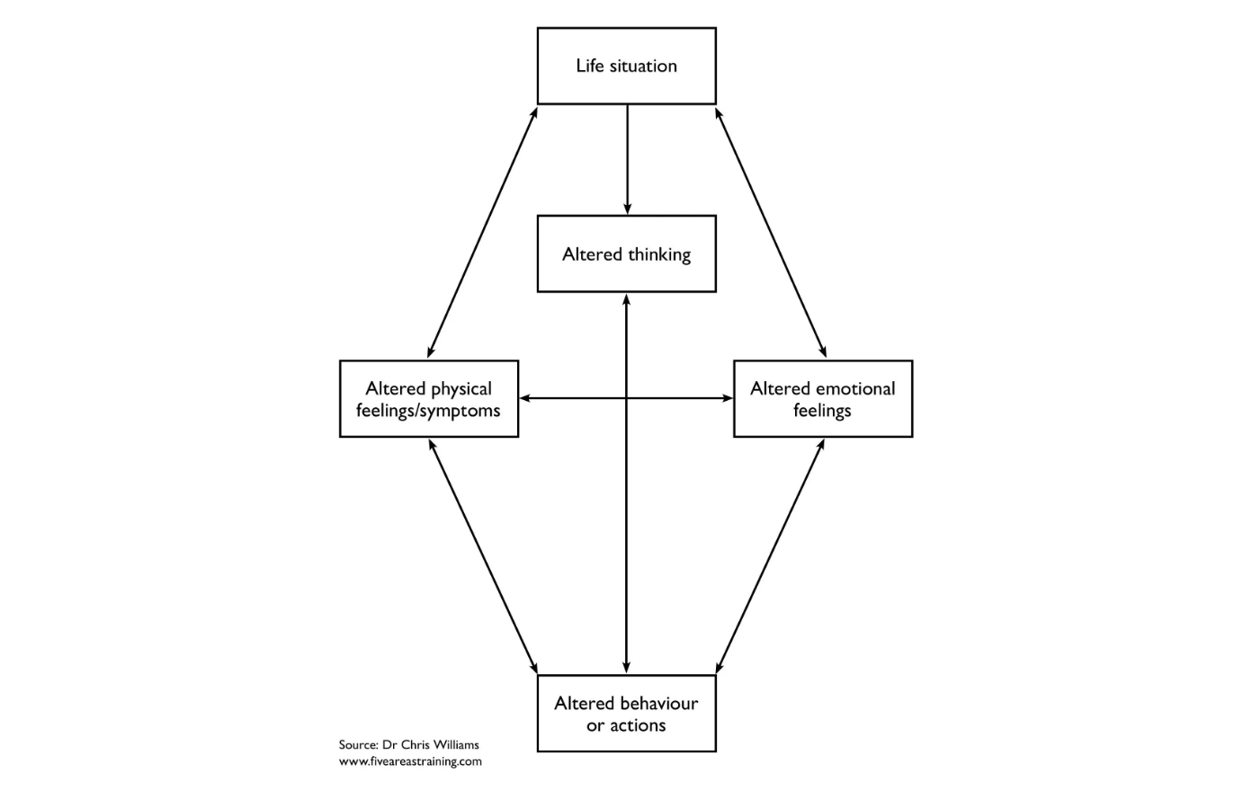

The 5-Area Consultation Framework
BRADFORD VTS TEACHING SERIES
GP TOOLKIT CORE TOOL
Why Use This Framework?
•
Non-Stigmatising: Moves away from clinical labels and focuses on the young person's actual lived experience.
•
Biopsychosocial Link: Explicitly connects Life Events to Physical Symptoms (e.g., tummy aches) and Thinking patterns.
•
Consultation Mapping: Perfect for a 10-minute slot to identify where the "vicious cycle" is most easily broken.
•
Collaborative Tool: Can be sketched out together with the patient to build shared understanding.
Conceptual model illustrating interconnections between life situation, thoughts, feelings, and behaviour.

Slide 11








Case Study: Zoe
BRADFORD VTS TEACHING SERIES
PATIENT PROFILE: 15Y FEMALE
The "Hidden" Agenda
The Presenting Complaint
When seen alone, Zoe reveals a complex psychosocial background that explains the somatic presentation:
Zoe presents with a recurrent sore throat and persistent tiredness. This is her 3rd visit in 8 weeks requesting antibiotics.
Family Stress: Parents are separating; high-conflict home environment.
Mood: Feeling "heavy," loss of interest in netball, poor sleep.
Physical exam: Normal tonsils, no lymphadenopathy.
Risk-Taking: Started drinking alcohol at weekends to "numb out."
School: Significant absence recently due to "feeling unwell."
Body Image: Feeling "fat" and skipping meals (NICE NG69 red flag check needed).
Interaction: Parent answers most questions; Zoe is monosyllabic.
Concern: Parent is worried about "Glandular Fever" or "low iron."
Key GP Learning
Continuity is Tool: Use the "sore throat" as an entry point to build rapport.
Psychosocial Screening: HEADSSS helps move from body to mind.
Management: Focus on sleep hygiene, family support, and a planned review.
AMBER PITFALL: Avoid "medicalizing" stress. Repeated antibiotics or blood tests for non-specific symptoms can reinforce sick-role behavior and delay mental health support.

Slide 12









Practical Problem-Solving Guide
BRADFORD VTS TEACHING SERIES
1
2
3
4
5
Identify
List
Analyze
Choose
Review
Pick one small, specific, and solvable problem.
Brainstorm all possible solutions without judgment.
Consider the pros and cons for each solution.
Select one solution and plan the first step.
Set a date to check progress and adjust.
Avoid tackling "everything"
Encourage creativity
Is it realistic?
Keep the bar low
Celebrate small wins
Be very specific
No idea is "bad" yet
What are the barriers?
Define "what" and "when"
Problem-solve barriers
SCA Exam Pearl
Use this framework to demonstrate a shared management plan. Empowering the young person to choose their own "first step" demonstrates patient-centeredness and fosters self-efficacy—key markers for SCA success.
Remember: Do not over-complicate. A "small win" (e.g., attending one lesson, calling one friend) is better than a failed large goal.

Slide 13
















Primary Care Mental Health Checklist
BRADFORD VTS TEACHING SERIES
Use this structured checklist to ensure a holistic management plan covering self-help, school, and local community resources.
Social & Family
School & College
Digital Resources
Support from family and siblings
School Mental Health Leads
Kooth(Online support)
Engagement with friends
Pastoral care & counseling
YoungMinds/Childline
Positive adult role models
Special Educational Needs (SEN)
NHS-approved self-help apps
Peer support groups
Educational Psychology input
Crisis text lines (e.g. Shout)
Lifestyle & Social
Practical & Safety
GP Clinical Plan
Physical activity & sports
Domestic abuse support
Regular GP follow-up
Creative arts & music
Money and work advice
CAMHS / EIP referral (if needed)
Social Prescribingleads
Housing & environment check
CYP Talking Therapies (IAPT)
Local voluntary sector groups
Safeguarding risk assessment
Review Continuity

Slide 14










Behavioural and Conduct Problems
BRADFORD VTS TEACHING SERIES
The "Tip of the Iceberg"
Primary Care Management
Developmental Stage: Are the outbursts age-appropriate (e.g., "terrible twos" vs. adolescent rebellion)?
Listen & Validate: Acknowledge the stress on the family without jumping to medicalisation.
Neurodevelopmental: Screen for ADHD (hyperactivity/impulsivity) or Autism (social communication differences).
Exclude Physical: Rule out pain, hearing/vision issues, or sleep deprivation as triggers.
Trauma/ACEs: Consider underlying domestic abuse, neglect, or attachment difficulties.
MDT Liaison: Essential for multi-setting assessment (Home + School).
Health Visitor
School Nurse
Parenting Stress: Parental mental health or substance misuse can significantly impact child behaviour.
Safeguarding
Social Care
SCA TIP
PITFALL
Explore the Impact: Ask "How is this affecting your relationship with your child?" or "What happens when the school calls?" to gauge the severity and safety.
Avoid labelling a child as "naughty" or "manipulative" before exploring the function of the behaviour. It is often a form of communication for unmet needs.

Slide 15









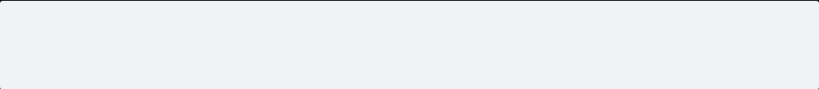

Anxiety and School Refusal
BRADFORD VTS TEACHING SERIES
Types of Presentation
SCA PEARL
Separation Anxiety: Excessive fear of being away from caregivers; somatic complaints on school mornings.
Consultation Skills
Validate Distress: Use the young person's words. "I can see how scary it feels when you walk through the school gates."
Social Phobia: Fear of scrutiny, performance anxiety, and avoidance of social classrooms.
Liaison Role: Offer to contact the school mental health lead or school nurse with their permission.
GAD & Panic: Persistent "what-if" worrying or acute physical symptoms of autonomic arousal.
Avoid Medicalising: Frame school refusal as a coping mechanism for anxiety rather than "truancy."
PTSD: Re-experiencing or avoidance following trauma (e.g., bullying or domestic abuse).
Key Assessment Areas
The Graded Return Plan
Somatic Signals: Recurrent abdominal pain, headaches, or nausea with no organic cause.
1. Small Steps
Start with attending for one favorite lesson or just visiting the library at lunch.
Neurodiversity: Screen for Autism/ADHD; school may be sensory-overwhelming or socially complex.
2. Safe Environment
Identify a "safe adult" at school and a quiet space the student can access if overwhelmed.
Social Factors: Directly ask about bullying, online safety, and home environment stressors.
3. Planned Review
Agree a GP review in 2 weeks to monitor progress and adjust the plan.

Slide 16











Depression in Children and Young People (NG134)
RECOGNITION AND MANAGEMENT IN PRIMARY CARE
Identification & Symptoms
MODERATE TO SEVERE
Low mood, irritability, or persistent sadness
Referral & Medication
Anhedonia (loss of interest in activities)
Refer to CAMHS/Psychological therapy pathway
Changes in sleep, appetite, or energy levels
Fluoxetine (NICE NG134/CKS)
Feelings of guilt, worthlessness, or hopelessness
Start:10 mg daily (Age 5-18)
Concentration issues and school withdrawal
Increase:To 20 mg daily if needed
Risk-taking: Substance use or self-harm ideation
Max:40 mg (usual); 60 mg (specialist only)
⚠ Specialist initiation & monitoring required. Check latest BNFC.
MILD DEPRESSION
Watchful Waiting
AKT PEARL
Monitor for 2–4 weeks for symptoms that are not persistent
NICE NG134 replaces CG28. Fluoxetine is the only antidepressant with evidence of benefit outweighing risk for CYP; monitor for increased suicidal ideation.
Provide self-help resources (e.g., Kooth, YoungMinds)
Arrange a planned follow-up to reassess mood and risk
SCA TIP
Validate the young person's distress. Use open questions: "How is this affecting your friendships and school work?" Summarize their words to build rapport.

Slide 17








Self-Harm and Suicidal Ideation (NG225)
BRADFORD VTS TEACHING SERIES
Compassionate Clinical Assessment
Assessment should focus on the individual’s immediate safety, psychological needs, and social context rather than just the physical act.
MANDATORY: NO RISK SCALES
NG225
Do not use risk assessment tools or scales to predict future self-harm or suicide, or to determine who should be offered treatment, referred, or discharged. They lack predictive validity and can give a false sense of security.
NICE GUIDELINE
SAFETY PLANNING
INVOLVEMENT
Co-produced, written safety plan.
Involve parents/carers where safe.
Updated August 2024.
Covers recognition, assessment,
and initial management.
Identify internal coping strategies.
Assess Gillick competence for solo.
List external support (Crisis team).
Explain confidentiality limits clearly.
Address means safety (Medication).
Provide written info for families.
SCA SUCCESS
RED FLAG
Ask directly: "Have you had any thoughts of wanting to take your own life?" Use the patient's own words.
Active suicidal intent, a specific plan, or a recent serious overdose requires same-day specialist MH assessment.

Slide 18





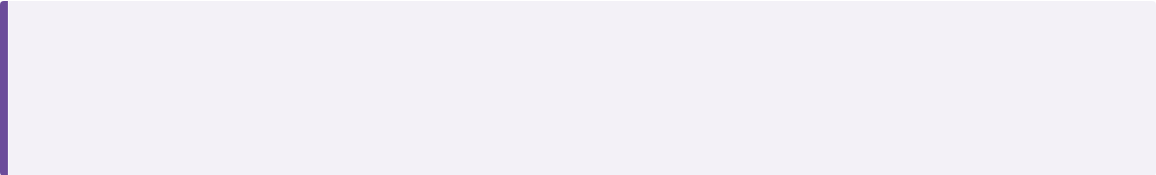


OCD and Body Dysmorphic Disorder (CG31)
BRADFORD VTS TEACHING SERIES
Recognition & Symptoms
Management Pathway
Obsessions:Intrusive, repetitive, distressing thoughts, images, or urges (e.g., contamination, harm).
First-line:CBT including Exposure and Response Prevention (ERP) delivered by a specialist service.
Compulsions:Repetitive behaviors or mental acts performed to reduce distress or prevent a feared event.
ERP:Gradually facing fears without performing the compulsive ritual.
Medication:Specialist-led only. SSRIs (e.g., Sertraline) if CBT is insufficient or refused.
BDD:Excessive preoccupation with perceived defects in physical appearance (often unnoticeable to others).
Referral:To CAMHS for multidisciplinary assessment if symptoms are persistent or moderate/severe.
Functional Impact:Assess time taken (e.g., >1 hour/day), school avoidance, and social withdrawal.
Assessment Focus
AKT Pearl
DistressHow much do these thoughts upset you or interfere with your day?
Family RoleHow are parents "helping"? (e.g., cleaning for them, providing reassurance).
NICE CG31 remains the current guidance. For children/young people, psychological treatment (CBT with ERP) MUST be offered before or alongside medication.
SCA Pearl
Explore "Family Accommodation". Parents often inadvertently reinforce OCD by participating in rituals to reduce the child's short-term distress.

Slide 19








Eating Disorders: Recognition and Referral (NG69)
BRADFORD VTS TEACHING SERIES
CRITICAL RED FLAGS
Rapid Weight Loss
Loss of >0.5kg/week or crossing centiles. Significant change is more critical than absolute weight.
Refer immediately regardless of BMI
Physical Instability
Bradycardia (<50 bpm), postural hypotension, hypothermia, or fainting/dizziness.
Do not wait for a low BMI or "physical evidence" before referring to age-appropriate specialist services. Early intervention is the strongest predictor of recovery.
Metabolic Compromise
Electrolyte disturbance (esp. hypokalaemia from purging), insulin manipulation (T1DE), or severe self-neglect.
URGENT PATHWAY MANDATE
Safety Risk
High suicide risk, physical exhaustion, or inability of carers to maintain safety at home.
Source: NICE NG69 (2024 update). Primary care role: physical risk monitoring and safeguarding.

Slide 20






ADHD: Recognition and Management (NG87)
BRADFORD VTS TEACHING SERIES
Recognition & Diagnosis
Clinical Management
Multi-setting Impairment: Symptoms must be present in at least two settings (e.g., home and school/work).
First-Line Medication: Methylphenidate is the primary choice for children aged 5 years and over.
Specialist Diagnosis: ADHD is neurodevelopmental; diagnosis must be made by a specialist psychiatrist or paediatrician.
Specialist Initiation: Medication must be started and monitored by a specialist until stable.
Functional Impact: Symptoms (Inattention, Hyperactivity, Impulsivity) must cause significant social or academic impairment.
Shared Care: GPs only take over prescribing under formal shared care agreements once the dose is stable.
Modern Approach: Consider environmental factors, trauma, and co-morbidities (Autism/LD) during assessment.
Holistic Support: Always offer environmental/behavioural support and coordinate with school mental health leads.
AKT
NICE NG87 is the current guideline for ADHD. Do not confuse with NG134 (Depression). Methylphenidate is 1st line for 5+.
SCA
Explore functional impact: ask about school reports, friendships, and home life to confirm "multi-setting" impairment.

Slide 21









Autism Spectrum: Modern Perspectives (CG128)
BRADFORD VTS TEACHING SERIES
Identity-First Language Preferred
Masking & Subtle Signs
Referral Pathway
Core Features
Social Mimicry: Copying peers to "fit in" (highly prevalent in girls).
MDT Assessment: Involves Paediatrics, SALT, Educational Psych, and CAMHS.
Social Communication: Differences in reciprocity, non-verbal cues, and relationship building.
The 'Coke Bottle' Effect: Holding it together at school, followed by "meltdowns" at home.
Primary Care Role: Document functional impairment across home, school, and social life.
Restricted Patterns: Repetitive movements, insistence on sameness, and intense interests.
Somatic Flags: School refusal, anxiety, eating/sleep disturbances.
Needs-Led Support: Do not wait for a formal diagnosis to start school/social support.
Sensory Processing: Hyper- or hypo-reactivity to sensory input (noise, light, textures).
Girls may have socially "acceptable" intense interests (e.g., animals, literature).
Check for co-morbidities: ADHD, Anxiety, Depression, and Learning Disability.
Avoid "Asperger's" as current diagnosis; use Autistic Young Person.
Source: NICE CG128 (Last updated 2021)
AKT PEARL
SCA TIP
AKT PEARL
CG128 covers recognition and referral from birth to 19. Diagnosis requires symptoms in multiple settings.
Validate parental concerns even if the child appears socially competent in clinic. Explore the "home vs. school" contrast.
Methylphenidate is NOT first-line for Autism alone; pharmacological interventions focus on co-morbidities or severe distress.

Slide 22









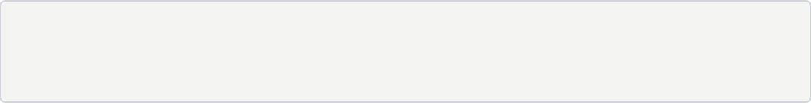
Psychosis and Severe Mental Illness
BRADFORD VTS TEACHING SERIES
Clinical Snapshot: "Paul" (Age 17)
Urgent Referral Criteria
Suspected first-episode psychosis or mania
DECLINE
SLEEP
Severe depression with self-neglect
Rapid school decline and social withdrawal.
Complete sleep reversal; up all night, sleeping all day.
Catatonia (stupor or excessive motor activity)
Severe agitation or threat to others
Significant risk of self-harm or suicide
BEHAVIOR
PARANOIA
Muttering to self; appearing distracted or agitated.
Belief that TV/Radio are broadcasting personal messages.
RED FLAG: ESCALATION
Refer urgently to Early Intervention in Psychosis (EIP) or CAMHS Crisis Team. Do not wait for symptoms to "settle" if functional decline is evident.
SCA CLINICAL APPROACH
Use open questions to explore "unusual experiences" without validating or dismissing delusions: "Does it ever feel like the TV is talking specifically to you?"
EIP services aim to provide intensive support within 2 weeks of referral to improve long-term outcomes.

Slide 23







Substance Use and Risk-Taking
BRADFORD VTS TEACHING SERIES
Substances & Vaping
Exploitation & Safety
The Mental Health Link
Vaping:High prevalence; often perceived as "safe" but linked to nicotine addiction.
CCE / County Lines:Using substances as currency; debt bondage and "cuckooing."
Coping Mechanism:Often a way to self-medicate for trauma, ADHD, or low mood.
Alcohol:Binge patterns; assess context (social vs. solitary/numbing).
Safeguarding:Risk-taking is a signal of vulnerability, not just "bad behavior."
CSE / Sexual Risk:Early sexual activity, multiple partners, or coercion.
Cannabis/Edibles:Link with anxiety, paranoia, and poor school performance.
Online Harm:Cyberbullying, grooming, and exposure to self-harm content.
Functional Impact:Does it affect school attendance, sleep, or safety?
Nitrous Oxide:Assess for neurological symptoms (B12 deficiency).
Gangs:Risk of violence and carrying weapons; peer group pressure.
SCA PEARL
Use the "Normalisation" technique: "I ask everyone your age about substances and safety so we can keep you healthy. Is it okay if I ask you a few questions about vaping or alcohol?" This reduces stigma and builds rapport.
www.bradfordvts.co.uk

Slide 24






CAMHS Thresholds and Local Pathways
BRADFORD VTS TEACHING SERIES
Specialist Tiers (CAMHS)
Community & Primary Care
REFERRAL THRESHOLDS
EARLY INTERVENTION SERVICES
Persistent & Impairing: Symptoms significantly affecting daily functioning/school.
MHST: Mental Health Support Teams embedded in schools.
CYP Talking Therapies: For mild-to-moderate anxiety and depression.
High Risk: Active suicidal intent, serious self-harm, or psychosis.
Digital Support: Local social prescribing, Kooth, or YoungMinds.
Complex Needs: Multi-agency involvement or co-morbid neurodevelopmental issues.
GP ROLE & MONITORING
DEDICATED PATHWAYS
Watchful waiting for mild cases (review in 2-4 weeks).
Liaison with School Nurse and Health Visitors.
Neurodevelopmental (ADHD/ASD)
Urgent Eating Disorder Service
Specialist initiation/monitoring for medication (e.g. Fluoxetine, Methylphenidate).
SCA PEARL
Validate the family's frustration with wait times. If a patient is below CAMHS threshold, never just "reject"—actively signpost to MHST or school counselling and arrange a safety-netting review.

Slide 25




Red Flags: Urgent Referrals and A&E
BRADFORD VTS TEACHING SERIES
Suicidal Risk
Psychosis & Mania
Active intent, clear plan, or recent serious self-harm/overdose.
Hallucinations, paranoia, severe agitation, or manic symptoms.
Eating Disorders
Severe Neglect
Rapid weight loss, bradycardia, hypotension, or syncope.
Severe depression leading to inability to eat, drink, or self-care.
URGENT
Safeguarding
Safety Failure
Acute disclosure of abuse, sexual exploitation, or serious neglect.
Carers unable to maintain safety at home or risk to others.
Immediate Escalation Required
Substances
Crisis Access
Acute intoxication or withdrawal with medical/psychiatric risk.
Inability to engage with any community safety plan.
www.bradfordvts.co.uk

Slide 26






Safeguarding in the Consultation
BRADFORD VTS TEACHING SERIES
GP Responsibilities
Information Sharing: You have a legal duty to share information where a child is at risk of serious harm. Safety overrides confidentiality.
"Always Think..." - Domains of Concern
Emotional / Physical Abuse
Sexual Abuse / Coercion
Neglect / Self-Neglect
Bullying / Online Harm
Documentation: Record facts, observations, and the child's exact words. Clearly state your rationale for actions taken or omitted.
Fabricated or Induced Illness
FGM / Forced Marriage
Contextual & Exploitation Risks
"Document why you decided to refer—or why you decided a referral wasn't needed at this stage. Logic is as important as the outcome."
Domestic Abuse (Witness/Victim)
County Lines / Gang Involvement
Parental Mental Health Issues
Parental Substance Misuse
Criminal / Sexual Exploitation
Local Policy: Know your Safeguarding Lead and your local Multi-Agency Safeguarding Hub (MASH) pathways.
Unsafe Online Contacts
RED FLAG ESCALATION
Direct disclosure of abuse, immediate risk to life, signs of trafficking, or active sexual exploitation requires immediate same-day specialist referral/police involvement.

Slide 27













Safety-Netting Language for SCA
BRADFORD VTS TEACHING SERIES
Effective safety-netting in the SCA requires specific, actionable instructions and a collaborative approach to risk management.
ACUTE CRISIS
RELATIONAL SAFETY
"If you feel you might act on thoughts of harming yourself, call 999 or go to A&E now."
"Can we agree who you will tell tonight if you feel unsafe?"
Clear, directive language for immediate life-threatening risk.
Assesses support network and creates a specific interpersonal plan.
SCA ESSENTIAL
COLLABORATIVE PLAN
DETERIORATION
BREAKING CONFIDENTIALITY
"If things get worse before our review, contact the surgery same day."
"I would like to involve your parent/carer because I am worried about safety."
Ensures the patient knows how to access urgent primary care.
Transparently explains the shift from autonomy to safety-first.
ACCESS ROUTE
RISK MANAGEMENT

Slide 28
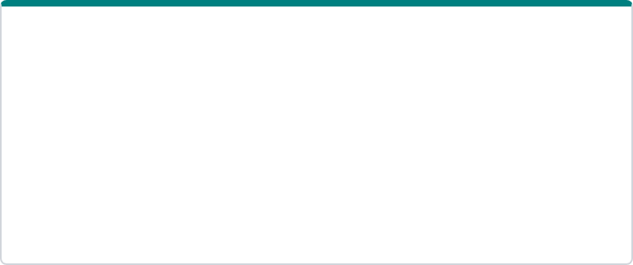

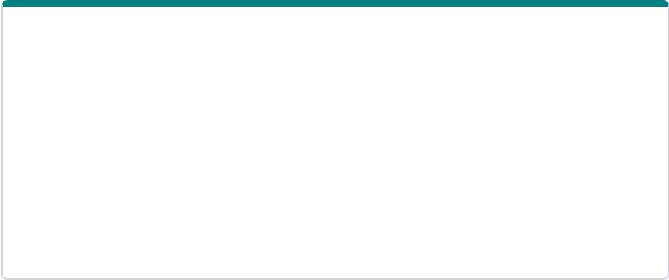























Top Tips for Child Mental Health
BRADFORD VTS TEACHING SERIES
SCA
AKT
SCA
See the Patient Alone
Confidentiality Limits
Use HEADSSS Screen
Allocate time to speak with the young person without parents present to allow for disclosure of sensitive issues.
Explain confidentiality early and clearly, including the specific limits regarding serious risk of harm or safeguarding.
Systematically cover Home, Education, Activities, Drugs, Sexual health, Self-harm, and Safety in every assessment.
PITFALL
REASSURING
RED FLAG
Link Somatic Symptoms
Continuity & Review
Ask Directly About Risk
Carefully link physical symptoms (e.g., abdominal pain) with stress/mood to avoid unnecessary medical investigations.
Use the GP's unique position for brief, repeated consultations over time to monitor progress and build rapport.
Always ask directly about self-harm and suicidal ideation; it is safe, compassionate, and essential for risk assessment.
AKT
AKT
Involve Parents Safely
Know Local Pathways
Robust Documentation
Parents are essential allies. Encourage the young person to involve a trusted adult unless it increases their risk.
Understand local thresholds for CAMHS, crisis teams, eating disorder services, and neurodevelopmental clinics.
Clearly document Gillick competence, risk assessment, safeguarding rationale, and the specific safety-netting plan.
www.bradfordvts.co.uk

Slide 29









Exam Pearls – AKT
BRADFORD VTS TEACHING SERIES
CORE NICE STANDARDS
FLUOXETINE RULES
ADHD: Use NG87 (not NG134). Focus on multi-setting impairment.
Only antidepressant for moderate/severe depression in CYP.
Depression: NG134 (replaces CG28). Stepped care model.
Dosing (NICE CKS):
• Starting dose: 10 mg daily
• Maintenance: 20 mg daily
• Usual Max: 40 mg daily (60mg specialist)
Self-Harm: NG225 (replaces CG16/CG133). No risk scales.
NOTE Must be specialist-led and combined with psychological therapy.
SPECIALIST DOMAINS
ADHD PHARMACOTHERAPY
Autism: CG128 (Under 19s). Focus on recognition & referral.
First-line: Methylphenidate for children aged 5+.
Eating Disorders: NG69. Early referral; BMI is not the sole guide.
Initiation and titration must be specialist-led.
OCD/BDD: CG31. First-line is CBT with exposure (ERP).
GP role: Shared care for monitoring (growth, BP, HR) only once stable.
AKT TIP Dexamfetamine is second-line if methylphenidate is ineffective.
www.bradfordvts.co.uk

Slide 30











Exam Pearls – SCA
BRADFORD VTS TEACHING SERIES
SCA SUCCESS
Focus on the interpersonal dynamics and clinical safety of the consultation.
Rapport First
Confidentiality
Time Alone
Their Words
Build strong rapport before jumping into sensitive risk questions. Acknowledge the difficulty of the situation.
Explain limits clearly and early. Ensure they understand that safety trumps secrecy without scaring them off.
Ask the parent to step out sensitively. "I usually spend a few minutes with the young person alone. Is that okay?"
Use the young person's own vocabulary. Reflecting their language shows you are listening and builds trust.
Summarise
Practical Plan
Safety-Netting
Significant Risk
Validate distress and summarise frequently. "So, school feels overwhelming because of the exams and friendship issues?"
Agree on one small practical plan. Avoid overly complex goals; focus on one achievable first step this week.
Provide clear, specific safety-netting. Arrange a follow-up date and ensure they know who to call in a crisis.
Don't hesitate to involve safeguarding or CAMHS if risk is significant. Document your rationale and safety plan clearly.

Slide 31










Red Flags Summary
BRADFORD VTS TEACHING SERIES
Suicide & Self-Harm
URGENT ACTION
Active suicidal intent or specific plan for harm
Recent serious self-harm episode or overdose
Immediate
Inability to engage with or agree to safety planning
Contact CAMHS Crisis Team or Duty Clinician for same-day assessment.
Psychosis & Severe SMI
Emergency
Direct to A&E if there is immediate medical risk or serious overdose.
First presentation of suspected psychosis or mania
Severe agitation, aggression, or paranoia
Profound withdrawal and decline in self-neglect
Safeguarding
Escalate to Social Care if abuse, neglect, or exploitation is suspected.
Eating Disorders & Physical Risk
Rapid weight loss or very low BMI with medical instability
"If you feel you might act on thoughts of harming yourself, call 999 or go to A&E now."
Bradycardia, hypotension, or syncope (fainting)
Abuse, exploitation, or no safe adult support available

Slide 32





















Common Pitfalls in Primary Care
BRADFORD VTS TEACHING SERIES
"Normalizing" Distress
Parental Dominance
Secrecy Promises
Dismissing serious clinical distress as just "typical teenage behavior" or "hormones."
Talking only to the parent; failing to see the young person alone for any part of the consultation.
Promising absolute confidentiality. Always explain limits: risk of harm or safeguarding concerns.
AVOID DISMISSAL
SEE PATIENT ALONE
EXPLAIN LIMITS
Somatic Tunnel Vision
BMI Dependency
Premature Diagnosis
Treating physical symptoms (e.g., sore throats) repeatedly without exploring underlying stress or mood.
Relying solely on BMI for eating disorders. NG69: Look at rate of loss and physical stability.
Diagnosing ADHD or Autism without multi-setting impairment or a specialist MDT pathway.
EXPLORE MOOD
NICE NG69 WARNING
SPECIALIST REFERRAL
Prescribing Errors
Risk Scale Reliance
Documentation Gaps
Initiating antidepressants or stimulants in primary care. Must be specialist-led for children/young people.
Using risk scores to "predict" future suicide. NG225: Scales should not decide discharge or safety.
Failing to document capacity (Gillick), specific safety-netting, or safeguarding rationale.
SHARED CARE ONLY
NG225 COMPLIANCE
RECORD RATIONALE

Slide 33











What Can Safely Stay in Primary Care?
BRADFORD VTS TEACHING SERIES
GREEN: REASSURING CRITERIA
Symptom Nature
No Red Flags
Supportive Adult
Physical Health
Symptoms are mild, short-lived, or clearly linked to a transient life stressor.
Absence of suicidal intent, psychosis, mania, or severe self-neglect/weight loss.
A safe, supportive, and engaged parent or carer is present and available at home.
Normal physical observations and no immediate concerns regarding physical safety.
Functioning
Engagement
Safety Plan
Local Support
Young person is still attending school and maintaining some hobbies or social links.
The young person is able to engage in the consultation and agrees to a follow-up plan.
A clear, documented safety plan is in place with agreed emergency contacts.
Active school support, social prescribing, or voluntary sector engagement is available.
Risk is Dynamic
Mental health status can change rapidly. Primary care management requires planned, periodic reviews. Always re-screen for red flags and re-assess risk/capacity at every single contact.
www.bradfordvts.co.uk

Slide 34








Quick Recall
BRADFORD VTS TEACHING SERIES
01
07
Explain confidentiality early
Depression guideline is NG134
02
See young person alone
08
Self-harm guideline: NG225
03
Use HEADSSS every time
09
Eating disorders: refer early
04
Ask self-harm directly
10
Safety-net using exact words
05
Physical symptoms may mask distress
11
Document capacity and risk
06
ADHD guideline is NG87

Slide 35


Disclaimer
BRADFORD VTS TEACHING SERIES
Always double check this advice and drug doses with the latest NICE/BNF guidance.
This document is for educational purposes only and should be cross-referenced with current local CAMHS pathways and national standards at the time of clinical decision-making.
www.bradfordvts.co.uk

