Slide 1

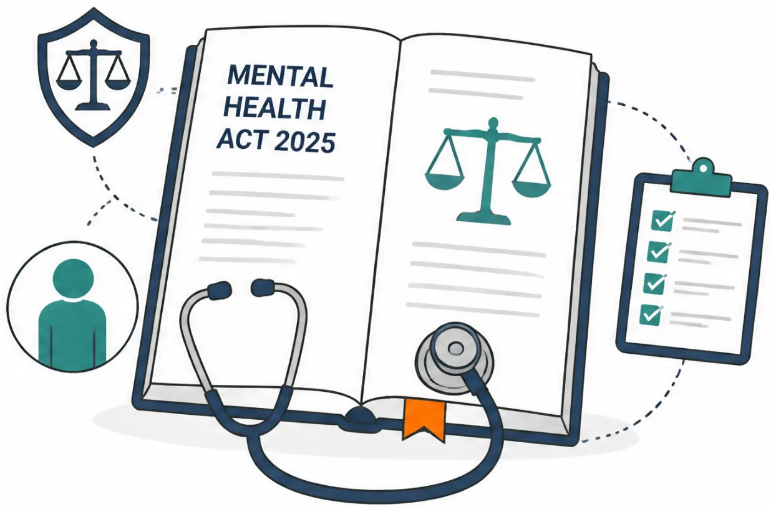



BRADFORD VTS TEACHING DECK
Mental Health Act 2025 • NICE NG225
Mental Health Act
and Suicide Risk
A comprehensive guide for GPs & trainees on the
Mental Health Act 2025 reforms and NICE NG225
suicide risk assessment standards.
AKT
SCA
Clinical Practice
Created July 2026 · Updated to MHA 2025 & NICE NG225 2023/2024
www.bradfordvts.co.uk
Teaching Resource · For Educational Use Only

Slide 2














BRADFORD VTS TEACHING DECK
Major Reforms in the Mental Health Act 2025
Royal Assent 18 December 2025 — most significant changes since the original 1983 Act
Nominated Person
Autism & LD: Section 3 Exclusion
Replaces the old Nearest Relative hierarchy.
Patients with capacity now choose their
own trusted person. The Nominated Person
can object to detention and apply for discharge.
Autism spectrum conditions and learning
disabilities alone no longer justify Section 3
detention for treatment. Section 2 assessment
remains available. A co-occurring psychiatric
disorder is required for S3.
Patient Rights Reform
MHA 2025 Key Change
Tighter Detention Criteria
Faster Tribunal Access
Now requires evidence of a 'likelihood of
serious harm' — not merely 'necessary in the
interests of health or safety'. Raises the
threshold for compulsory admission and aims
to reduce unnecessary detentions.
Section 2: patient can apply within 14 days
(was 28). Section 3: patient can apply within
21 days (was 6 months). Dramatically
improves access to independent review.
Higher Threshold
Improved Oversight
www.bradfordvts.co.uk
Mental Health Act 2025 · Bradford VTS Teaching Resource

Slide 3







BRADFORD VTS TEACHING DECK
Essential MHA Sections for General Practice
Section 2 · Section 3 · Section 4 — Assessment, Treatment and Emergency Admissions
Section 2
Section 3
Section 4
Admission for Assessment
Admission for Treatment
Emergency Admission for Assessment
28 Days
6 Months
72 Hours
Maximum duration · Cannot be renewed
Renewable · For treatment of mental disorder
Emergency only · Convert to S2 as soon as possible
● Application by AMHP + 2 medical
recommendations
● Application by AMHP + 2 medical
recommendations
● Only 1 medical recommendation
required — usually the GP
● One recommendation must be
Section 12 approved
● MHA 2025: Autism / learning disability
alone no longer sufficient grounds
● AMHP application still required
● Used when waiting for 2 doctors would
cause undesirable delay
● Second recommendation: usually
the patient's own GP
● Co-occurring psychiatric disorder
required if LD/autism present
GP most likely sole doctor — use only
in genuine emergency
Tribunal access within 14 days (MHA 2025)
Tribunal access within 21 days (MHA 2025)
www.bradfordvts.co.uk
Mental Health Act · For Educational Use Only

Slide 4














BRADFORD VTS TEACHING DECK
Holding Powers and Community Provisions
Sections 5(2), 5(4), 136, and 117 — what GPs need to know
Section 5(2)
72 hours
Section 5(4)
6 hours
Doctor's Holding Power
Nurse's Holding Power
• Applies to already-admitted inpatients only — not A&E
• Applied by a suitably trained registered nurse
• Applied by responsible clinician or nominated deputy
• Applies to voluntary inpatients on mental health wards
• Bridges the gap until a doctor arrives to apply S5(2)
• Not a GP power — inpatient hospital setting only
Not applicable in A&E
Precursor to S5(2)
Section 136
24h + 12h
Section 117
Ongoing
Police Powers in Public Places
Statutory Free Aftercare
• Free aftercare after S3, 37, 45A, 47, or 48 discharge
• Removes person from public place to a Place of Safety
• Joint NHS and Local Authority responsibility
• Assessment only — not a treatment power
• MHA 2025: placing authority remains responsible
if patient moves area
• MHA 2025: police cells banned as Place of Safety
MHA 2025 CHANGE
Cannot be charged for — remind patients
— police cells now unlawful
www.bradfordvts.co.uk
MHA 2025 • Teaching Resource • Educational Use Only

Slide 5











BRADFORD VTS TEACHING DECK
The GP Role in Mental Health Assessments
Medical recommendations · AMHP collaboration · Collateral history
Medical Recommendation
Collateral History
After Discharge
Most Common GP Role
Uniquely Valuable
Ongoing Duty
— Second recommendation for S2 or S3
alongside a Section 12-approved
doctor
— GP knows the patient’s baseline and
background
— Ensure Section 117 aftercare plan is
in place
— Sole recommendation for S4
emergency (one doctor only)
— Previous mental health history and
episodes
— Confirm named care coordinator
assigned
— Social circumstances, family context
— Must know the patient and provide a
strong clinical history
— Medication monitoring and shared care
— Liaison with CMHT
— Medication history and adherence
— Must be satisfied the grounds for
detention are met
— Can provide context the AMHP and
S12 doctor may not have
— Section 136: may be contacted for
follow-up
Important Distinction: The GP provides a medical recommendation — the AMHP makes the formal
application and coordinates the assessment. The GP does NOT ‘section’ the patient.
AMHP = Approved Mental Health Professional (usually a social worker; can also be nurse, OT, or psychologist)
www.bradfordvts.co.uk
Teaching Resource · For Educational Use Only

Slide 6






BRADFORD VTS TEACHING DECK
www.bradfordvts.co.uk
Suicide Risk Assessment and NICE NG225
Person-centred biopsychosocial assessment · Updated November 2023/2024
⚠ NICE NG225 CRITICAL UPDATE: Do NOT use risk assessment tools or scales (e.g. Columbia,
Beck, Manchester) to predict suicide risk or triage patients. These are no longer recommended.
NG225 · 2023
What TO Do Instead
Key Risk Factors to Assess
Person-Centred Assessment
● Previous self-harm or attempts (strongest predictor)
● Current ideation: frequency, plan, intent, means access
● Biopsychosocial assessment of individual needs and
life circumstances
● Mental illness, substance misuse, recent adverse life events
● Social isolation · chronic pain · male sex
● Direct, compassionate questioning: "Are you having
thoughts of ending your life?"
● Assess plan, intent, and access to means — document
everything
Protective Factors
● Reasons for living · future plans · dependent children
● Collaborative safety planning — not 'no-harm contracts'
● Strong social support · engagement with services
Recommended Approach
● Cultural or religious beliefs against suicide
www.bradfordvts.co.uk
Teaching Resource · For Educational Use Only · July 2026

Slide 7





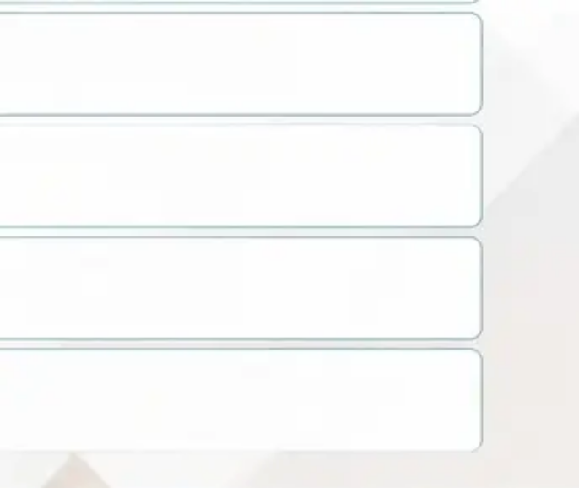










BRADFORD VTS TEACHING DECK
Collaborative Safety Planning and Management
Δ NICE NG25: Safety Planning is preferred over 'no-harm contracts' — collaborative, written, and patient-held
Immediate Management
Safety Plan — Six Elements
1 Create a safe, private space — take the patient
seriously; no interruptions
■ Warning signs — Collaboratively identify
personal early warning signs
2 Ask directly — "Are you having thoughts
of ending your life?"
■ Coping strategies — Things the patient can
do alone before reaching out
3 Assess immediate risk — plan, intent,
access to means
■ Support people — Names and numbers of
trusted individuals to contact
4 Means restriction — discuss removing or
securing access to tablets, sharps, other means
■ Crisis services — Samaritans 116 123 ·
Local crisis team number
5 Refer immediately — crisis team or A&E if high risk;
consider S4 if refusing help
■ Means safety — Steps agreed to make
the environment safer
6 Document everything — clinical reasoning, risk
factors, decisions made
PITFALL Never use a risk score to decide whether
to refer — this is not NICE-compliant
■ Written copy — Plan agreed, printed, and
given to the patient to keep
www.bradfordvts.co.uk
Teaching Resource · For Educational Use Only

Slide 8









BRADFORD VTS TEACHING DECK
Case Scenarios for Clinical Application
Apply MHA 2025 and NICE NG225 standards to real-world clinical situations
CASE 01
CASE 02
Bipolar Disorder — Refusing Admission
First-Episode Psychosis
32-year-old woman · lithium stopped · 4 days no sleep · elated, spending
19-year-old man · 6 weeks hearing voices · responding to unseen stimuli
Consider:
Consider:
Section 3 assessment for known psychiatric disorder · AMHP
involvement · GP as second medical recommendation ·
patient and public safety
Section 2 for assessment of nature/degree · AMHP
coordination · S12-approved doctor + GP recommendation
CASE 03
CASE 04
Suicide Risk — Stockpiling Paracetamol
Learning Disability — Unlawful S3 Detention
45-year-old man · plan to act this weekend · depression ·
recent relationship loss
28-year-old woman · learning disability · no psychiatric diagnosis ·
detained under S3
Consider:
Consider:
NICE NG225 approach · immediate means restriction · crisis
referral · if refusing all help consider S4 · safety plan + document
MHA 2025 — LD alone does NOT justify S3 · detention now unlawful ·
co-occurring psychiatric disorder required for S3
www.bradfordvts.co.uk
Teaching Resource · For Educational Use Only

Slide 9











BRADFORD VTS TEACHING DECK
Exam Pearls, Red Flags & Common Pitfalls
High-yield revision and clinical awareness — AKT · SCA · Practice
EXAM PEARLS
RED FLAGS
COMMON PITFALLS
AKT
SCA
S2 = 28 days assessment · S3 = 6
months treatment · S4 = 72h emergency
Using a suicide risk score to decide
referral — not NICE-compliant
Thinking the GP sections the patient —
GP gives medical recommendation;
AMHP makes the application
S4 needs only 1 medical
recommendation — not two
Confusing MHA with MCA —
completely different legal frameworks
Assuming old Nearest Relative hierarchy
still applies — it doesn't under MHA 2025
MHA 2025: Nominated Person
replaces Nearest Relative — patient
chooses
Detaining under S3 for LD/autism
alone — now unlawful under MHA 2025
Forgetting S5(2) and S5(4) only apply
to already-admitted inpatients, not A&E
Failing to identify active suicidal
ideation with plan, intent, and means
Not documenting clinical reasoning
behind the medical recommendation
MHA 2025: LD/autism alone →
cannot use S3
Assessment in a police cell —
now unlawful under MHA 2025
Failing to provide written crisis resources
after a suicide risk consultation
NICE NG225: No risk scoring tools —
use person-centred biopsychosocial
assessment
Failing to mention Section 117
aftercare to qualifying patients
at discharge
Mixing up section numbers: S2 ≠ S3 ≠ S4 —
know each duration and purpose
SCA opener: "Can I ask you directly —
are you having thoughts of ending
your life?"
www.bradfordvts.co.uk
Teaching Resource · For Educational Use Only

Slide 10












BRADFORD VTS TEACHING DECK
Quick Recall & Clinical Disclaimer
Twelve high-yield points for rapid review — and a note on clinical currency
MHA ≠ MCA — completely
different legal frameworks
GP role: second medical
recommendation, not the applicant
S2 = 28 days assessment;
S3 = 6 months treatment
NICE NG225: no risk scores —
use person-centred assessment
S4 = 72 hours emergency;
one doctor recommendation only
Safety planning preferred
over no-harm contracts
MHA 2025: Nominated Person —
chosen by the patient
S117 aftercare: free after
S3 / S37 / S47 discharge
MHA 2025: LD and autism alone —
cannot use S3
Always ask: plan, intent,
and access to means
MHA 2025: police cells banned
as Place of Safety
Document every step
of the risk assessment
This teaching resource reflects the Mental Health Act 2025 (Royal Assent 18 December 2025) and NICE NG225
(November 2023, updated 2024). Clinical practice must always be guided by current local protocols, trust policies,
and up-to-date national guidance. This material is for educational purposes only and does not constitute legal or
clinical advice.
⚠ DISCLAIMER
www.bradfordvts.co.uk
Created July 2026 · Mental Health Act 2025 · NICE NG225

