Slide 1




BRADFORD VTS TEACHING DECK
Stress and Stress Management
www.bradfordvts.co.uk
Created July 2026, updated to current NICE 2025/2026 standards
Educational resource: always check latest NICE/BNF and local guidance before applying clinical advice or prescribing.
www.bradfordvts.co.uk

Slide 2










Learning Outcomes
BRADFORD VTS CLINICAL MODULE
Modern Definitions
Red Flag Recognition
Differential Diagnosis
Define stress in practical GP terms as a response to demands exceeding coping capacity.
Rapidly identify clinical red flags requiring urgent intervention or safeguarding.
Distinguish stress from GAD, depression, burnout, and physical illness mimics.
Consultation Mastery
Stepped Management
Exam Strategy
Utilize a structured 7-minute primary care assessment for complex presentations.
Build collaborative, practical plans focused on function and social prescribing.
Identify and navigate high-yield AKT and SCA exam traps related to stress.
www.bradfordvts.co.uk

Slide 3
Top Tips for Primary Care
BRADFORD VTS CLINICAL MODULE
01
Validate the Patient's Distress
Acknowledge that their experience is real and significant. Use empathic validation to build rapport before moving to clinical assessment or management plans.
02
Directly Assess for Red Flags
Never assume situational stress is low-risk. Explicitly screen for suicidal ideation, self-harm, and safeguarding concerns like domestic abuse in every consultation.
03
Rule Out Physical Mimics
Identify medical conditions that present as stress. Check for hyperthyroidism, anaemia, or arrhythmias to ensure a psychiatric context isn't masking a physical diagnosis.
04
Prioritize Function over Medication
Avoid prescribing sedatives or antidepressants for ordinary life stressors. Focus on social support, sleep hygiene, and functional adjustments as first-line interventions.
www.bradfordvts.co.uk

Slide 4






Defining Stress in a Modern Context
BRADFORD VTS CLINICAL MODULE
The Transactional Model
Two-Way Response
Modern primary care views stress not as a single diagnosis, but as a dynamic process occurring when an individual's perception of environmental demands outweighs their perceived ability to cope.
Physiological
Psychological
Activation of the HPA axis and sympathetic nervous system (autonomic arousal).
Cognitive states of worry, irritability, and perceived lack of control.
Demands > Resources
Reassuring Feature
THE IMBALANCE FORMULA
Short-term stress is normal and adaptive. It provides the energy and focus needed to overcome immediate challenges. It is the chronicity and lack of recovery that lead to harm.
Subjective Appraisal: Two people may react differently to the same stressor based on previous experience and personality.
Contextual: Influenced by biological, social, and occupational constraints.
GP Clinical Framing
Avoid stating "stress causes disease." Instead, frame it as a contextual factor that exacerbates existing vulnerabilities and impacts functional health.
Slide 5 of 28
www.bradfordvts.co.uk

Slide 5


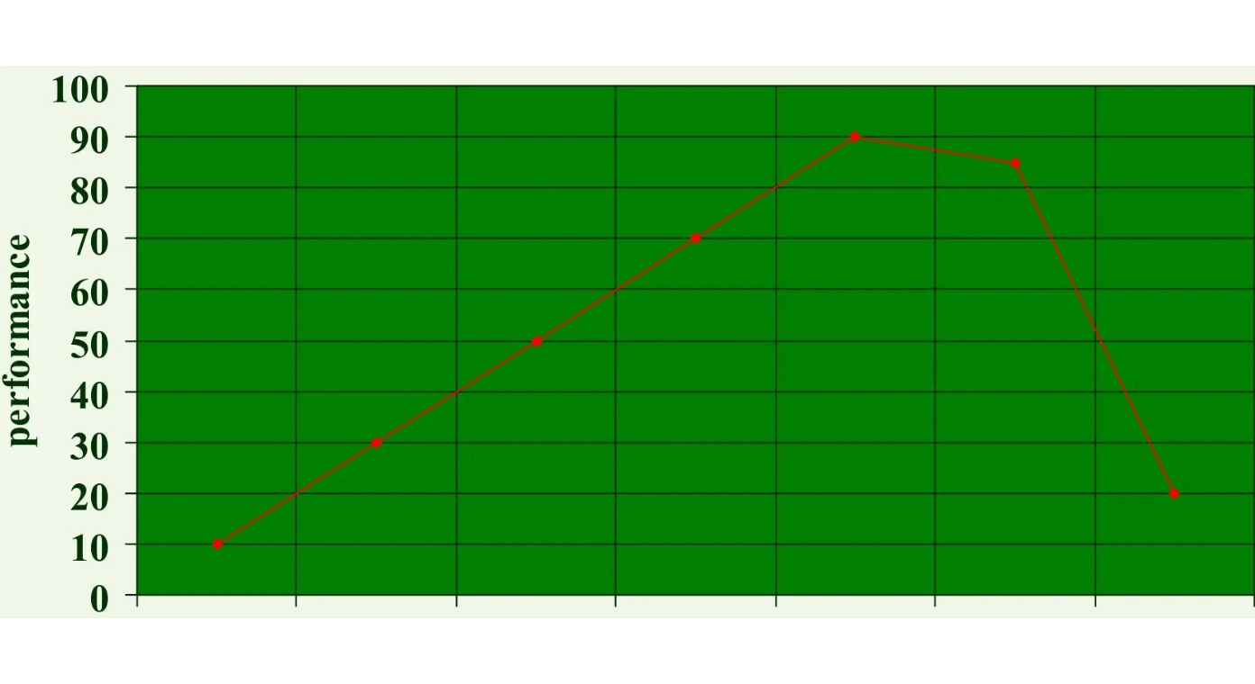


Stress as a Problem or Motivator
BRADFORD VTS CLINICAL MODULE
The Optimal Arousal Concept
Under-arousal: Too little pressure leads to boredom, lack of focus, and reduced engagement.
Optimal Zone: Moderate pressure focuses attention, increases motivation, and peaks performance.
Over-arousal: Excessive or prolonged pressure leads to anxiety, burnout, and rapid performance decline.
Pitfall: Premature Reassurance
Avoid telling patients "stress is good for you" or "it keeps you sharp" when they are clearly in the distress/burnout zone. Validate their struggle first.
The Yerkes-Dodson Law: The relationship between pressure and performance.
www.bradfordvts.co.uk

Slide 6












The GP Workplace Stress Model
BRADFORD VTS CLINICAL MODULE
The Workplace Formula: High Demands + High Constraints + Low Support
High Demands
High Constraints
Low Support
Intense 10-minute consultations
Lack of autonomy over appointment timing
Professional isolation during clinics
High clinical complexity & multimorbidity
Reduced informal "coffee room" debriefs
Increasing administrative burden (Docman)
IT system failures & rigid rotas
Inconsistent clinical supervision/mentoring
Limited physical space/consulting rooms
High patient expectations & emotional drain
Staffing shortages (nursing/reception)
Poor team communication or conflict
Systemic barriers to specialist referral
Systemic lack of "protected time"
Work-home spillover (finishing at home)
PITFALL: Viewing stress as a personal weakness rather than an occupational phenomenon driven by systemic factors.
www.bradfordvts.co.uk

Slide 7






Physiology of the Fight-or-Flight Response
BRADFORD VTS CLINICAL MODULE
Think of this as your body's survival mode. It is a natural response designed to protect you from danger by preparing your body to either fight or run away.
The Accelerator
The Body Armor
The Lookout
Adrenaline floods the system to provide "fuel." This causes physical changes you can feel:
Your muscles tighten to protect vital organs and prepare for sudden action:
The brain switches to high-alert, scanning the environment for potential threats:
Key Point: While helpful in short bursts, staying in this "high-alert" state for too long leads to exhaustion and chronic symptoms.
www.bradfordvts.co.uk

Slide 8







Physical Signs and Somatic Symptoms
BRADFORD VTS CLINICAL MODULE
Cardiovascular & Respiratory
Neuromuscular & General
Palpitations (racing or fluttering heart)
Muscle tension (jaw, neck, shoulders)
Chest tightness or "heaviness"
Tension-type headaches
Breathlessness / Hyperventilation
Fatigue and generalized body aches
Gastrointestinal
Dermatological & Systemic
Nausea and "butterflies"
Skin flares (eczema, psoriasis, hives)
Indigestion / Acid reflux
Altered menstruation / PMS exacerbation
IBS-type symptoms / Bowel habit change
Increased susceptibility to infections
URGENT MEDICAL ASSESSMENT REQUIRED
Chest pain • Syncope • New neurological symptoms • Severe breathlessness
www.bradfordvts.co.uk

Slide 9











Emotional and Cognitive Signs
BRADFORD VTS CLINICAL MODULE
Emotional Impacts
Irritability & Tension: Low threshold for frustration; "snappy" with family or staff.
Helplessness: Feeling overwhelmed by tasks that were previously manageable.
Low Confidence: Self-doubt and persistent guilt regarding performance.
Cognitive Impacts
Loss of Perspective: Small problems feel like major catastrophes (catastrophizing).
Poor Concentration: Often described by patients as "brain fog" or being "all over the place."
Indecisiveness: Struggling with even simple choices, leading to procrastination.
SCA Tip: Validate early. "It sounds like these feelings of guilt are making it very hard for you to switch off at home."
www.bradfordvts.co.uk

Slide 10





Behavioural Signs and Coping Mechanisms
BRADFORD VTS CLINICAL MODULE
Changes in Daily Life
Maladaptive Strategies
Sleep Disturbances
Substance Escalation
Insomnia, early waking, or excessive sleeping (hypersomnia) as a retreat.
Increased alcohol, caffeine, or nicotine use to "medicate" stress or aid sleep.
Social Withdrawal
Altered Appetite
Avoiding friends, cancelling plans, and isolating from supportive networks.
Emotional "comfort" eating (high sugar/fat) or complete loss of interest in food.
Occupational Impact
Risk-Taking & Irritability
Taking work home, increased mistakes, poor time management, or presenteeism.
Impulsive spending, reckless driving, or uncharacteristic aggression.
Neglect of Self-Care
COMMON PITFALL
Stopping exercise, poor personal hygiene, or abandoning previously enjoyed hobbies.
The Coping Paradox: Short-term relief strategies often become long-term stressors. For example, using alcohol to sleep disrupts sleep cycles and creates secondary dependency issues.
www.bradfordvts.co.uk

Slide 11






Mandatory Red Flags
BRADFORD VTS CLINICAL MODULE
Risk to Self or Others
Suicide ideation, intent, or plans; self-harm; escalating aggression or violence.
Psychosis & Mood Instability
RED
FLAGS
Delusions, hallucinations, mania, or severe depression preventing self-care.
Safeguarding & Abuse
Domestic abuse or concerns regarding children/vulnerable adults in the household.
Acute Medical Mimics
Chest pain, syncope, severe breathlessness, or substance withdrawal states.
High-Risk Occupational Impairment
Impaired function in public safety roles (e.g., pilots, surgeons, HGV drivers).
www.bradfordvts.co.uk

Slide 12






Differential Diagnosis and Mimics
BRADFORD VTS CLINICAL MODULE
AKT PEARL: Stress is NOT a clinical diagnosis by itself. It is a context or a presenting problem.
Condition
Key Distinguishing Features and Clinical Clues
Normal Stress / Adjustment Disorder
Symptoms are proportional to an identifiable situational trigger. Function is largely preserved. Symptoms typically resolve when the stressor is removed or managed.
Occupational Burnout
Specifically related to chronic workplace stress. Characterized by the "Three Dimensions": Emotional exhaustion, depersonalization (cynicism), and reduced professional efficacy.
GAD / Panic Disorder
GAD: Excessive, uncontrollable worry about multiple events for ≥ 6 months.
Panic: Recurrent, unexpected panic attacks with persistent worry about future attacks.
Depressive Episode
Pervasive low mood and anhedonia (loss of interest) for ≥ 2 weeks. Look for biological signs: sleep disturbance, appetite changes, and thoughts of self-harm or guilt.
Physical Mimics
EXCLUDE THESE
Hyperthyroidism: Tremor, weight loss, heat intolerance, tachycardia.
Anaemia: Pallor, profound lethargy, breathlessness.
Cardiac: Arrhythmias (palpitations), angina (chest tightness).
www.bradfordvts.co.uk

Slide 13






Brief Primary Care Assessment Structure
BRADFORD VTS CLINICAL MODULE
Story & Triggers
1
2
ICE
3
Functioning
4
Bio & Substances
Open exploration of the timeline.
Understand the patient's perspective.
The key to diagnostic severity.
Screen for comorbidities.
5
Risk Screen
6
Protective Factors
Patient Goal
7
Mandatory direct questioning.
Identify the safety net.
Prioritize the next step.
SCA WORDING
"It sounds as if your body has been on high alert for a long time. Let us check there is nothing dangerous going on, then make a plan that feels doable."
www.bradfordvts.co.uk

Slide 14











Essential Safety-netting Language
BRADFORD VTS CLINICAL MODULE
Self-Harm & Suicide
Acute Medical Symptoms
Worsening Distress
"If you feel you might act on thoughts of harming yourself, please contact the crisis team, call 111, or in an emergency, go to A&E or call 999."
"If chest pain, fainting or severe breathlessness occurs, you must seek urgent medical assessment immediately via 999."
"If things are worsening before our review, or if you find you can no longer manage daily tasks, please book an earlier appointment."
Direct and unambiguous wording
Distinguish stress from emergencies
Threshold based on functioning
Clear escalation pathways (999/111)
Functional red flags (fainting/pain)
Permission to return early
SCA PEARL: SPECIFICITY IS SAFETY
Avoid vague phrases like "come back if you're worried." In the SCA, examiners look for "if-then" instructions. Use the specific phrases above to demonstrate high-quality clinical management and patient safety.
www.bradfordvts.co.uk

Slide 15







Management Overview and Stepped Care
BRADFORD VTS CLINICAL MODULE
STEP 1
STEP 2
STEP 3
STEP 4
Recognition & Advice
Low Intensity
High Intensity
Specialist Care
Validate distress, identify drivers, screen for GAD/Depression, and provide initial psychoeducation.
Guided self-help (6-8 sessions), group exercise, peer support, and social prescribing.
Individual CBT or Behavioral Activation (8+ sessions) and/or pharmacological treatment if criteria met.
Crisis teams, CMHT referral for severe, complex, treatment-resistant, or high-risk cases.
Psychoeducation & Lifestyle
Practical & Social Tools
Explain physiological "Fight-or-Flight"
Establish regular sleep routine
Problem-solving: One small step
Time management & boundaries
Assertiveness training
Social prescribing (Community)
Review caffeine/alcohol intake
Graded aerobic exercise (NICE)
Occupational health / Fit note
Worry time & Reframing
NHS breathing/relaxation practice
Identify maladaptive coping
SCA FOCUS
Collaborative Planning: Always validate first. Avoid jumping to "tips" too early. Ask: "Of all the things we discussed, what is the one small step that feels most doable for you this week?" Ensure the plan is patient-led and includes a safety-net.
www.bradfordvts.co.uk

Slide 16










The TEETH Mnemonic for Resilience
BRADFORD VTS CLINICAL MODULE
T
E
E
T
H
Taking Control
Expectations & Boundaries
Exercise
Time Out & Recovery
Hobbies & Identity
Focus on "Circle of Influence"
Natural biological buffer
Learn to say "no" politely
Micro-breaks during shifts
Keep a life outside medicine
Graded activity for mood
Prioritise what is changeable
Movement as "active rest"
Regular annual leave
Social connection & fun
Challenge perfectionism
Set realistic daily goals
"Unplug" from digital work
Protect your non-work self
Let go of the uncontrollable
Important: Individual resilience tools are essential, but remember that system-level stressors (e.g., safe staffing, workload volume) require system-level solutions and organizational support.
www.bradfordvts.co.uk

Slide 17










Thinking Skills & Problem-Solving
BRADFORD VTS CLINICAL MODULE
Problem-Solving Framework
Managing the Worry
Reframing & Self-Talk
The Problem List: Write everything down. Visualizing the "mountain" makes it a set of tasks.
Control Filter: Separate stressors into 'Controllable' vs. 'Uncontrollable'.
Cognitive Reframing: Challenge negative distortions (e.g., "I must be perfect" to "I am doing my best").
Letting Go: Consciously decide to stop expending mental energy on things outside your control.
Break it Down: Divide complex stressors into smaller, bite-sized components.
Compassionate Self-Talk: Speak to yourself as you would to a colleague or a dear friend.
One Small Next Step: Identify the single most manageable action to take today.
Worry Time: Allocate 15 minutes a day to worry. Outside this time, "file" the worry for later.
Perspective Check: Ask: "Will this matter in 6 months? In 2 years?"
Focus on Agency
Moving from "being a victim of circumstances" to "taking a small action" reduces helplessness.
The 15-Minute Rule
Language Matters
Prevents rumination from bleeding into work, sleep, and family life throughout the day.
Swap "I have to" for "I choose to" to restore a sense of autonomy in the workplace.
SCA PEARL
During the consultation, use a shared whiteboard or paper to map out the patient's "Problem List." This demonstrates active listening and collaborative problem-solving.
www.bradfordvts.co.uk

Slide 18











Relaxation and Breathing Techniques
BRADFORD VTS CLINICAL MODULE
The NHS Breathing Exercise
Clinical Benefits
Down-regulates the sympathetic nervous system.
Position: Make yourself as comfortable as possible. Sit or lie down, loosening any tight clothing.
Reduces immediate heart rate and muscle tension.
Provides a portable "anchor" for patients in high-stress moments.
The Flow: Breathe in through your nose and out through your mouth. Keep it gentle and regular.
Belly Breathing: Fill the lower lungs so your stomach rises. Avoid shallow "chest breathing."
Important Caveats
The Rhythm: Try counting steadily from 1 to 5 on the inhale, and 1 to 5 on the exhale.
Relaxation-Induced Anxiety: Some patients (especially with PTSD or severe GAD) find internal body focus distressing.
Practice: Advise patients to practice when calm so the skill is available when they are stressed.
Source: NHS Mental Health Self-Help Resources (2026)
www.bradfordvts.co.uk

Slide 19





Exercise, Sleep, and Daily Routines
BRADFORD VTS CLINICAL MODULE
Graded Activity
Sleep Hygiene
Substances & Routine
NICE NG222 CONTEXT
CIRCADIAN HEALTH
PHYSIOLOGICAL TRIGGERS
Offer group physical activity for depression (at least 1 session/week for 10 weeks).
Consistency is key: Encourage the same wake-up time every day, even on weekends.
Caffeine review: Half-life is ~6 hours; avoid after midday to prevent sleep disruption.
Focus on "Graded Activity"—start with small, achievable goals (e.g., a 10-minute walk).
Wind-down routine: At least 60 minutes without screens or high-stress activities.
Alcohol check: Often used as a sedative, but fragments sleep and acts as a depressant.
Environment: Ensure the bedroom is dark, quiet, and cool.
Movement reduces physiological tension and helps "burn off" excess adrenaline.
Meal timings: Regular, balanced meals to avoid blood sugar spikes/crashes mimicking anxiety.
Avoid "trying" to sleep—if awake after 20 mins, get up and do a boring task.
Encourage outdoor activity for daylight exposure (Vitamin D and Serotonin).
Hydration: Dehydration can worsen fatigue and cognitive "brain fog."
Amber Pitfall: Avoid overprescribing exercise as a "cure-all." For a severely stressed patient, "going to the gym" can feel like another impossible demand. Keep advice compassionate and realistic.
www.bradfordvts.co.uk

Slide 20









Social Prescribing and Support Networks
BRADFORD VTS CLINICAL MODULE
The Role of Support
Formal Pathways
Community Capital
Affirmation: Validates the patient's experience and reduces isolation.
NHS Talking Therapies: Direct self-referral for CBT, counselling, or guided self-help.
Informal Networks: Family, friends, and trusted colleagues for daily debriefing.
Encouragement: Provides the motivation to attempt behavioral changes.
Social Prescribing: PCN Link Workers connecting patients to community assets.
Third Sector: Charities (e.g., Mind, Samaritans) and local support groups.
Insight: Helps the patient identify potential and realistic goals.
Meaningful Activity: Re-engaging with hobbies, faith groups, or volunteering.
Peer Support: Group-based interventions for shared lived experience.
Adaptability: Crucial for adjusting expectations during acute crises.
Identity: Restoring the "person" beyond the "patient" or "worker."
Occupational Health: Professional advice on workplace adjustments and phased returns.
"Support is the buffer between high demand and individual burnout."
Encourage self-referral to IAPT early to reduce GP administrative burden.
Holistic management requires identifying what gives a patient purpose.
www.bradfordvts.co.uk

Slide 21










Occupational Stress and Fit Notes
BRADFORD VTS CLINICAL MODULE
Workplace Boundaries
The Fit Note (Med 3)
Workload Management: Define start/finish times; avoid "work spillover" into home life.
Focus on function rather than diagnosis; what can they do?
Utilize the "May be fit for work" box to prompt employer-led adjustments.
Admin Flow: Protected "quiet time" for tasks; manage interruptions during clinical sessions.
Liaise with Occupational Health (OH) for complex cases or long-term absence.
Scheduled Recovery: Ensure breaks are taken; use annual leave for genuine rest, not backlog clearance.
Environment: Peer support and debriefing sessions within the surgery team.
COMMON PITFALL
Signing someone off "sick" without a recovery plan or a review date. Long-term sickness is a major risk factor for permanent job loss and social isolation.
Reasonable Adjustments
Phased Return
Altered Hours
Amended Duties
Workplace Adaptations
Employers have a legal duty to consider these under the Equality Act if stress relates to a disability (e.g., diagnosed GAD/Depression).
Pro-tip for Fit Notes:
If the patient is fit for some work, specify the limitations (e.g., "Avoid heavy lifting" or "No public-facing roles for 2 weeks"). This empowers the patient to negotiate with HR.
www.bradfordvts.co.uk

Slide 22




Exam Pearls: AKT & SCA Focus
BRADFORD VTS CLINICAL MODULE
AKT KNOWLEDGE
SCA SKILLS
DIAGNOSIS & THRESHOLDS
VALIDATION & ICE
Stress is a context, not a diagnosis. Screen for GAD and Depression using NICE-compliant tools (PHQ-9 / GAD-7).
Validate early: "It sounds as if your body has been on high alert for a long time." Explore ICE to avoid missing hidden agendas.
NICE STEPPED CARE (CG113/NG222)
CLINICAL SAFETY & RISK
Ask directly about self-harm and suicidal ideation.
Step 1: Recognition, advice, and active monitoring.
Avoid premature reassurance; check for red flags first.
Step 2: Low-intensity psychological interventions.
Identify the "why now?" — look for the tipping point.
Step 3: High-intensity therapy OR drug treatment.
THE SHARED PLAN
Prescribing Quick-Check
Agree one achievable first step (e.g., sleep routine or breathing). Avoid advice overload. Ensure safety-netting is specific and documented.
Sertraline: Start 25mg OD (1wk), then 50mg.
Review: 2 weeks (1 week if <25 years or suicide risk).
Propranolol: 40mg 2-3x daily for somatic symptoms.
www.bradfordvts.co.uk

Slide 23





Exam Pearls: SCA Focus
BRADFORD VTS CLINICAL MODULE
SCA SKILLS MASTERY
AKT KNOWLEDGE
Validation & Empathy
Acknowledge distress early. Use verbal nods: "I can see how much this is weighing on you."
Diagnostic Thresholds
Know GAD-7, PHQ-9, and DSM-5 criteria for GAD, Panic, and Depression.
Direct Risk Screening
Ask clearly: "Have you felt so low that you've thought about ending your life?"
Prescribing Cautions
Sertraline start 25mg for 1 week then 50mg. Propranolol for autonomic symptoms only.
Shared Decision Making
Avoid "telling" the patient what to do. Negotiate one small, achievable first step.
Monitoring Intervals
Review SSRIs in 1 week if <25yrs or high suicide risk; otherwise 2 weeks.
CONSULTATION PEARL
"It sounds as if your body has been on high alert for a long time. Let us check there is nothing dangerous going on, then make a plan that feels doable."
www.bradfordvts.co.uk

Slide 24




Common Pitfalls in Management
BRADFORD VTS CLINICAL MODULE
Medicalizing Ordinary Stress
CORRECT PRACTICE
Treating difficult life events as clinical disorders rather than normal human responses.
Validate Normality
Reflexive Prescribing
Using benzodiazepines or SSRIs for situational distress without a formal diagnosis.
Non-Drug First
Diagnostic Tunnel Vision
Missing underlying Depression, GAD, PTSD, or physical mimics like hyperthyroidism.
Screen for MD/Mimics
Safety Blind Spots
Failing to screen for domestic abuse, safeguarding issues, or alcohol misuse.
Safeguarding Screen
The Advice Trap
Collaborative ICE
Giving lifestyle lectures before the patient feels heard or validated.
Individualizing System Failures
Advocate for Change
Blaming the patient for burnout while ignoring unsustainable workplace pressures.
www.bradfordvts.co.uk

Slide 25

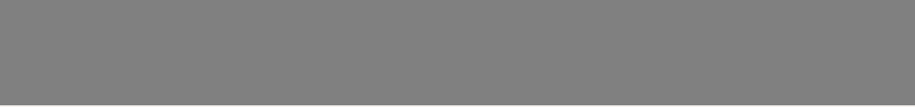


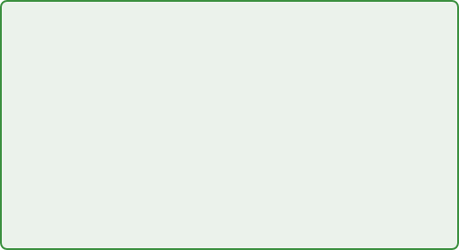








Clinical Case Study: Interactive Scenario
BRADFORD VTS CLINICAL MODULE
Alex, 34, Project Manager
Clinical Discussion Points
"I'm just not coping anymore. Everything feels like it's spiralling out of my control..."
REASSURING
RED FLAGS
Preserved function (no workplace errors yet); no thoughts of self-harm or suicide.
Escalating alcohol use; palpitations (needs clinical assessment); impact on family safety.
Sleep: Waking at 4:00 AM daily, unable to return to sleep.
Physical: Palpitations and chest tightness before team meetings.
1. Identify likely differentials (GAD vs. Adjustment?)
Emotional: Snapping at partner and children over minor issues.
2. Screen for physical mimics (TFTs, ECG, BP)
Coping: Alcohol use increased from 1 to 5 beers every evening.
3. Agree a first step (Sleep hygiene? Alcohol reduction?)
Work: Taking laptop home; "The admin never stops."
4. Define a safety-net for worsening symptoms
www.bradfordvts.co.uk

Slide 26
Quick Recall Summary
BRADFORD VTS CLINICAL MODULE
Validate patient distress first
Check suicide risk explicitly
Stress is context, not diagnosis
Look for physical health mimics
Key Takeaways
Assess impact on daily function
Screen sleep and substance use
Mastering the consultation by balancing empathy, clinical safety, and evidence-based primary care management.
Agree one small doable step
Social support protects against harm
Avoid quick sedative drug fixes
Review clinical progress early
Escalate red flags immediately
Utilize social prescribing resources
www.bradfordvts.co.uk

Slide 27


Important Disclaimer
BRADFORD VTS CLINICAL MODULE
⚠ Disclaimer: Always double check this advice and drug doses with the latest NICE/BNF guidance. This document is for educational purposes only.
Updated to current July 2026 Primary Care Standards
www.bradfordvts.co.uk

