Slide 1



BRADFORD VTS TEACHING DECK
Suicidal Risk Assessment
Guidance for GP Trainees (ST1–ST3) and IMGs
www.bradfordvts.co.uk
CREATED JULY 2026, UPDATED TO CURRENT NICE 2024 STANDARDS
⚠ Disclaimer: Always double check this advice and drug doses with the latest NICE/BNF guidance. This document is for educational purposes only.
www.bradfordvts.co.uk

Slide 2












LEARNING OUTCOMES
BRADFORD VTS TEACHING DECK • CLINICAL GUIDANCE
Ask directly and sensitively about suicide
Assess ideation, plan, intent, means and protective factors
Recognise urgent red flags and clinical triggers
Apply NICE NG225 principles on tools and risk stratification
Manage immediate safety within the GP setting
Document clinical reasoning defensibly
Adapt assessment for young people and students
Apply learning to AKT and SCA exam scenarios
www.bradfordvts.co.uk

Slide 3




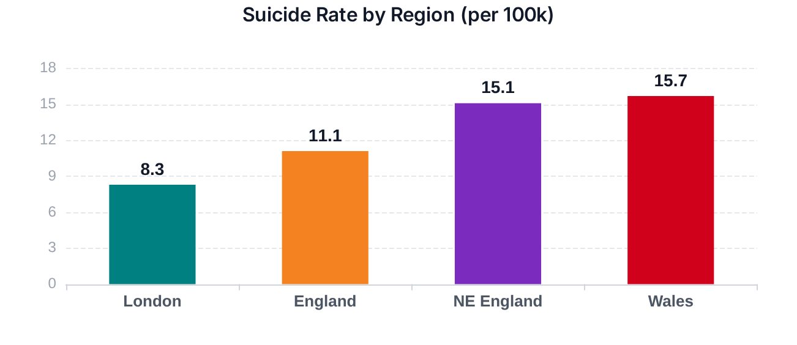
WHY THIS MATTERS IN UK GENERAL PRACTICE
BRADFORD VTS TEACHING DECK • CLINICAL GUIDANCE
6,190
11.4
27.5
Common Risk Themes
AKT
Suicides Registered (2024)
Rate per 100,000
Peak Male Rate (Ages 50–54)
Male sex (3x higher risk)
Significant gender disparity persists: the male suicide rate is 17.6 compared to 5.7 for females. Suicide remains a leading cause of death in young and middle-aged adults.
Middle age (40–60 years)
Prior self-harm or attempts
Diagnosed mental illness
Substance & alcohol misuse
Social isolation & living alone
Source: ONS Suicides in England and Wales: 2024 registrations (Released 3 Oct 2025)
Note: These are population trends; individual risk is dynamic.
www.bradfordvts.co.uk
Created July 2026 • NICE 2024 Standards

Slide 4








WHAT IS SUICIDAL IDEATION?
BRADFORD VTS TEACHING DECK • CLINICAL GUIDANCE
STEP 01
STEP 02
STEP 03
STEP 04
Passive wish not to wake
Thoughts of death
Active suicidal thoughts
Method considered
STEP 05
STEP 06
STEP 07
STEP 08
Specific Plan
Preparation / Final Acts
Active Intent
Suicidal Attempt
SCA
Communication Tip
“When things feel this bad, have you had thoughts of ending your life?”
"Ask where the patient is on this spectrum today."
Ideation is dynamic. A passive wish can rapidly escalate to intent under acute stress.
Use empathy first to build rapport before moving to direct questioning.
www.bradfordvts.co.uk

Slide 5






NICE PRINCIPLE: TOOLS DO NOT PREDICT SUICIDE
BRADFORD VTS TEACHING DECK • CLINICAL GUIDANCE
NICE NG225 Principle: Do not use risk assessment tools or scales to predict future suicide or repetition of self-harm.
NG225
No Stratification: Global low, medium, or high risk labels must not be used to predict future risk or determine access to care.
Clinical Utility: Use tools only to structure a conversation and ensure key psychosocial domains are not missed.
SAFETY FORMULATION
Over Static Prediction
Amber Pitfall: A low score is not a discharge plan.
www.bradfordvts.co.uk
NICE NG225 Guidance • 2026 Update

Slide 6

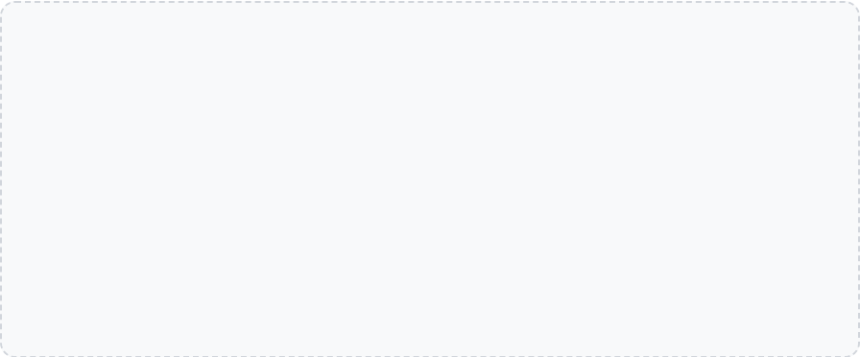


THE GP TASK: DYNAMIC SAFETY FORMULATION
BRADFORD VTS TEACHING DECK • CLINICAL GUIDANCE
The Formulation "Ingredients"
Suicidal Thoughts
Plan / Intent / Means
Avoid False Certainty
Frequency, duration, and intensity of ideation today.
Specific methods, access to tools, and internal drive.
Risk is dynamic, not static. Shifting from a "label" (Low/Medium/High) to a narrative formulation captures the context and identifies what needs to change to improve safety.
Mental State
Acute Stressors
Agitation, hopelessness, psychosis, or intoxication.
Breakdowns, debt, bereavement, or sudden loss.
SAFETY PRINCIPLE
Social Supports
Protective Factors
Risk changes; reassess after triggers, intoxication, medication changes, discharge or missed follow-up.
Presence of reliable, available, and caring networks.
Dependents, faith, future plans, or pets.
Collaboration
Safeguarding
* Formulation should drive the management plan, not a numerical score.
Patient's willingness and ability to engage in safety.
Risk to/from others, children, or vulnerable adults.
www.bradfordvts.co.uk

Slide 7









HOW TO ASK WITHOUT SOUNDING AWKWARD
BRADFORD VTS TEACHING DECK • CLINICAL GUIDANCE
"How bad have things got lately?"
SCA / CONSULTATION TIP
"I can see how much you're struggling right now. Sometimes when people feel this overwhelmed, they think about ending their life. Is that something you've been feeling?"
"Have you wished you would not wake up in the morning?"
"Have you thought about ending your life?"
"Have you thought how you might do it?"
"Do you have access to what you would use?"
"What has stopped you from acting on this so far?"
NORMALISING THE CONVERSATION
Start with empathy. Use "Normalising" phrases (e.g., "Sometimes people in your situation...") to reduce stigma and create a safe space for disclosure.
www.bradfordvts.co.uk

Slide 8





CORE ASSESSMENT: PLM + INTENT
BRADFORD VTS TEACHING DECK • CLINICAL GUIDANCE
Mechanics: PLM Tool
Mindset: DOG-H Drivers
Plans
Desire
Is there a specific method? Has it been researched or rehearsed? Look for timing and location details.
Active wish to die vs. passive "not waking up". How persistent and intrusive are the thoughts?
Lethality
Others
How dangerous is the chosen method? (e.g., firearms, ligatures, or highly toxic medications).
Critical: Reduced concern for the impact on family, children, or friends is a major red flag.
Means
Guilt / Shame
Does the patient currently have access? (e.g., hoarding tablets, owning a weapon, living near heights).
Feeling like a burden or experiencing intense humiliation (e.g., debt, job loss, or legal issues).
Final Acts
Hopelessness
Suicide notes, giving away possessions, or settling financial affairs/wills.
The strongest psychological predictor. A belief that nothing can or will ever get better.
SPECIFIC PLAN + ACCESS + INTENT = URGENT SAME-DAY ACTION
www.bradfordvts.co.uk

Slide 9











IMMEDIATE TRIAGE QUESTIONS
BRADFORD VTS TEACHING DECK • CLINICAL GUIDANCE
IMMEDIATE SAFETY
CURRENT HARM
"Are you able to keep yourself safe while we talk?"
"Have you already harmed yourself today?"
RISK TO OTHERS
ACCESS TO MEANS
"Are you thinking of harming anyone else?"
"Do you have access to weapons, large quantities of medicines, or ligatures?"
CONTEXT & STATUS
"Are you currently under the influence of alcohol/drugs, or are you alone right now?"
RED FLAG: If unsafe now, do not leave the patient alone.
www.bradfordvts.co.uk

Slide 10





STATIC AND HISTORICAL RISK FACTORS
BRADFORD VTS TEACHING DECK • CLINICAL GUIDANCE
Demographics & Social History
Clinical History & Markers
Male sex (Rate ~3x higher in UK)
Prior self-harm or suicide attempts
Middle age (45–54) and older age (75+)
Severe mental illness (e.g., Depression, Bipolar, Psychosis)
Family history of suicide or mental illness
Substance misuse (Alcohol and drugs)
History of abuse, neglect, or childhood trauma
Chronic pain or disabling physical illness
Social isolation and living alone
Repeated psychiatric hospital admissions
Exposure to suicide (friends, peers, media)
Recent discharge from inpatient care
AKT EXAM PEARL: The strongest historical marker for future suicide is previous self-harm or a prior attempt, but it still does not predict individual death with certainty.
www.bradfordvts.co.uk
Source: Bradford VTS & NICE NG225

Slide 11




DYNAMIC RISK FACTORS TODAY
BRADFORD VTS TEACHING DECK • CLINICAL GUIDANCE
Psychological & Behavioral
Social & Service Markers
Hopelessness & Helplessness : The strongest cognitive predictor of suicide.
Acute Loss: Bereavement or relationship breakdown.
Agitation & Panic: High arousal/anxiety increases immediate risk.
Crisis Events: Debt, job loss, or severe bullying.
Insomnia: Severe sleep deprivation impairs judgment.
Environment: Social isolation and access to lethal means.
Intoxication: Lowers inhibition and increases impulsivity.
Disengagement: Missed appointments (DNA) or loss of contact.
Psychosis: Specifically command hallucinations to harm self.
Recent Harm: Self-harm in the last 24-48 hours.
Shame/Humiliation: Sudden loss of face or reputation.
CAUTION: The "Sudden Improvement" Paradox
A sudden improvement in mood can be dangerous if it represents the "calm" that follows a settled decision to die.
Case Link: Recall Terry, whose apparent improvement preceded his final act.
Suicidal Risk Assessment • Created July 2026
www.bradfordvts.co.uk

Slide 12










PROTECTIVE FACTORS AND BUFFERS
BRADFORD VTS TEACHING DECK • CLINICAL GUIDANCE
SOCIAL & RELATIONAL
INTERNAL & PSYCHOLOGICAL
CLINICAL & SAFETY
Supportive family and close friends
Concrete future plans and goals
Willingness to collaborate on safety
Responsibility for children or pets
Faith or spiritual beliefs against suicide
Reduced access to lethal means
Stable housing and basic security
Effective problem-solving history
Active engagement with follow-up
Strong community or cultural ties
Internal "reasons for living"
Accessible and rehearsed crisis plan
Protective factors help management only if they are real, accessible, and current.
www.bradfordvts.co.uk
Clinical Risk Assessment • Page 13

Slide 13


RED FLAGS
BRADFORD VTS TEACHING DECK • CLINICAL GUIDANCE
Active Intent & Specific PlanningURGENT ESCALATION
1
Current intent to die combined with a specific plan and immediate access to lethal means (e.g., stockpiled medication, firearms, ligatures, or planned location).
2
Acute Clinical Instability
Presence of psychosis, command hallucinations ("voices telling me to do it"), severe agitation, panic, or acute intoxication impairing judgment.
3
Behavioral Finality & Transitions
Writing a suicide note, giving away possessions, or "sudden calm" after distress. Highest risk window: recent self-harm or recent discharge from inpatient care.
4
Safety Barrier Collapse
Inability to agree on immediate safety, refusal to collaborate on a plan, or lack of any real protective factors (living alone, no social support, complete hopelessness).
www.bradfordvts.co.uk
CLINICAL RED FLAGS • EMERGENCY ACTION REQUIRED

Slide 14



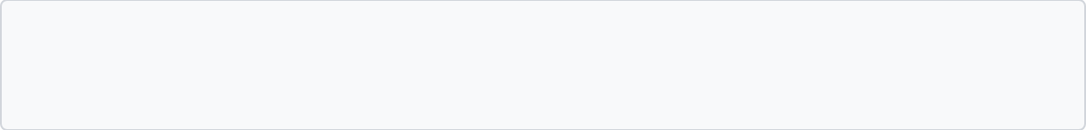


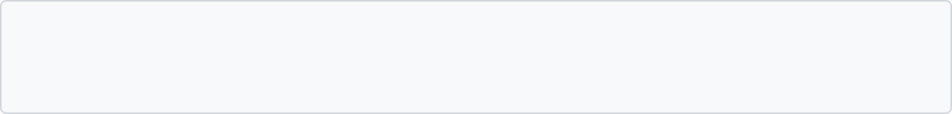






RISK FORMULATION WITHOUT FALSE LABELS
BRADFORD VTS TEACHING DECK • CLINICAL GUIDANCE
NICE NG225 PRINCIPLE
SAFER DOCUMENTATION EXAMPLES
Do not use global risk stratification (Low/Medium/High) to predict future suicide or repetition of self-harm.
"Current concern is high due to active intent and access to lethal means, despite protective family factors..."
"Immediate safety needs are met by the patient's agreement for sister to manage medication and attend Crisis Team review..."
Current Concerns
Explain you are worried (e.g., specific plans or hopelessness).
Safety Needs
"Plan agreed: patient will call 111 if thoughts escalate; follow-up booked with regular GP in 48 hours."
Identify immediate gaps (e.g., patient is alone with access to means).
Protective Factors
List real, current buffers (e.g., supportive family, future orientation).
Uncertainties
Note what is unknown (e.g., "patient reluctant to share full details").
Do not write "low risk" and stop.
www.bradfordvts.co.uk
Slide 15 of 33

Slide 15








SAFE MANAGEMENT IN PRIMARY CARE
BRADFORD VTS TEACHING DECK • CLINICAL GUIDANCE
IMMEDIATE ACTION
Escalation Pathways
Ensuring Immediate Safety
Crisis Resolution Home Treatment (CRHT): Same-day assessment for adults in crisis.
Stay with the patient: Do not leave them alone if in immediate danger.
Involve family/carers: Use safeguarding basis if consent is withheld but risk is high.
Urgent CAMHS Route: Essential for children and young people with active plans.
Restrict Means: Secure medicines, ligatures, or weapons immediately.
Emergency Department (ED): Direct referral if medical stabilization or rapid psych liaison is needed.
Emergency Services: Dial 999 or Police (Section 136) for life-threatening danger.
Local Pathways: Ensure you have the direct GP-referral numbers for your specific trust.
Social Services: Urgent referral if safeguarding concerns or self-neglect are primary.
Documentation & Follow-up
Document clinical reasoning and safety plan details.
Provide written crisis resources (Samaritans, Shout).
Arrange early follow-up (within 1 week if drug-started).
SCA TIP
"I’m really worried about your safety today, so we need to get you some more specialist help right now."
www.bradfordvts.co.uk

Slide 16
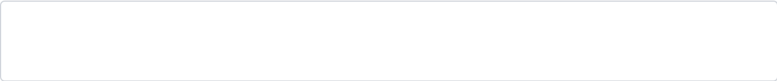


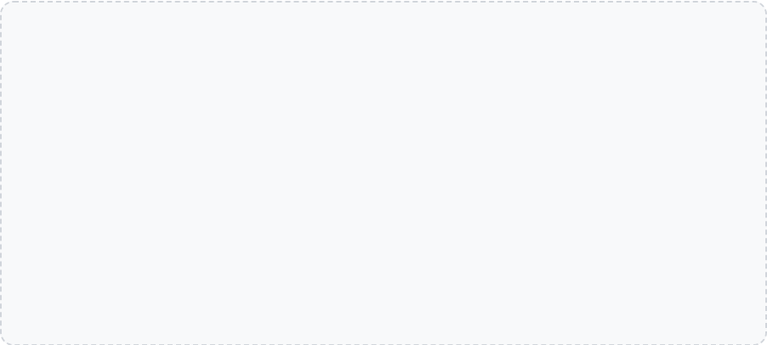










SAFETY PLANNING ESSENTIALS
BRADFORD VTS TEACHING DECK • CLINICAL GUIDANCE
1. Warning Signs
Thoughts, moods, or behaviors that precede a crisis.
Collaborative & Specific
2. Internal Coping Strategies
Things I can do on my own (e.g., breathing, exercise).
Must be co-produced with the patient.
Includes a clear follow-up appointment.
3. Social Distraction & Contacts
Contingency: "What to do if this plan fails."
People or places that provide distraction or support.
Practical: "Who will lock the medicines?"
4. Professional & Crisis Help
Crisis lines, GP, NHS 111, or local Crisis Team.
COMMON PITFALL
5. Environment Safety
No-suicide contracts are not safety plans. They provide a false sense of security and lack clinical evidence.
Restricting access to means (meds, weapons, ligatures).
6. Reasons for Living
Family, pets, future goals, or personal values.
www.bradfordvts.co.uk

Slide 17







PRESCRIBING AND MEDICINES SAFETY
BRADFORD VTS TEACHING DECK • CLINICAL GUIDANCE
General Safety Principles
Children & Young People (NICE NG134)
Assess Toxicity: Always consider the potential lethality of a medication in overdose before prescribing.
Specialist Initiation: Antidepressants should be specialist-led and used only with concurrent psychological therapy.
Limit Quantity: Avoid large supplies. Use shorter dispensing intervals (e.g., weekly or twice-weekly) if risk is significant.
Fluoxetine: The only recommended antidepressant. Start at 10mg daily; can increase to 20mg after 1 week if needed.
Adult Review: NICE NG222 recommends review within 1 week if aged 18–25 or if there is particular concern for suicide risk.
Intensive Monitoring: Weekly contact is required for the first 4 weeks to monitor for suicidal behavior or self-harm.
TCA Caution: CKS suggests avoiding TCAs except lofepramine and venlafaxine when at suicide risk.
Contraindicated: Paroxetine, venlafaxine, and TCAs should not be used in this population.
AKT PEARL
Know the 1-week review rule for 18–25 year olds starting antidepressants. Be aware of fluoxetine dosing and the "weekly contact for 4 weeks" requirement in youth depression.
COMMON PITFALL
SCA COMMUNICATION
Shorter dispensing intervals (e.g., weekly scripts) are a safety adjunct, not a substitute for clinical assessment or referral for those in immediate danger.
"I'm going to prescribe a smaller amount of this medicine to start with so we can see how you're getting on and keep you safe while the treatment begins to work."
www.bradfordvts.co.uk

Slide 18










YOUTH AND STUDENT RISK FACTORS
BRADFORD VTS TEACHING DECK • CLINICAL GUIDANCE
Interpersonal & Family
Academic & Environmental
Clinical & Behavioral
Family conflict or poor parental support
Intense academic pressure / exam stress
Depression, anxiety, or psychosis
Social isolation / withdrawal from peers
Sudden drop in grades or attendance
Substance misuse (alcohol/drugs)
Bullying (face-to-face or cyberbullying)
Body image distress / appearance concerns
Impulsivity and low self-esteem
Interpersonal conflict or breakup
Gambling or conduct problems
Chronic illness or disabling pain
Bereavement or exposure to suicide
Access to lethal means at home
Giving away possessions
History of abuse (physical, emotional, sexual)
Financial stress in older students
Writing suicide notes or goodbye posts
AKT PEARL
SCA TIP
Recognize impulsivity and substance use as major accelerators of risk in youth. Family conflict is often the most proximal trigger for a crisis.
"I know school can be tough—how are things with your exams and your friends? Has anyone been making life difficult for you lately?"
www.bradfordvts.co.uk

Slide 19



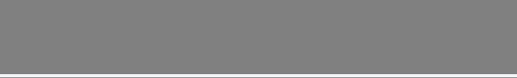
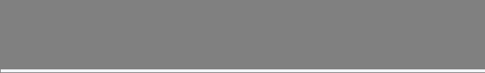



WARNING SIGNS IN CHILDREN AND ADOLESCENTS
BRADFORD VTS TEACHING DECK • CLINICAL GUIDANCE
Daily Behaviour
School Performance
Social & Lifestyle
Direct or indirect death statements
Falling grades or academic decline
Withdrawal from friends/family
Self-injury or cutting
Frequent absenteeism or truancy
Deterioration in peer relationships
Making final arrangements / giving items
Disruptive or rebellious behaviour
Increased alcohol or drug use
Loss of interest in extracurriculars
Risky impulsive acts / running away
Sudden personality change or moodiness
Isolation during lunch/breaks
Sudden weight change or neglect
Significant sleep or eating changes
URGENT RED FLAG
Any active suicidal ideas or plans in a young person need urgent CAMHS assessment and immediate safeguarding consideration.
www.bradfordvts.co.uk

Slide 20



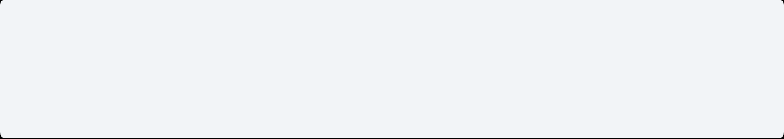






DEPRESSION AND YOUNG PEOPLE: NICE NG134
BRADFORD VTS TEACHING DECK • NICE CLINICAL GUIDANCE (UPDATED MAY 2024)
ASSESSMENT & REFERRAL
PRESCRIBING & MONITORING
Ask Directly: Alcohol/drug use, bullying, abuse, self-harm, and specific suicidal ideation.
Fluoxetine (10mg-20mg)
Only recommended antidepressant for moderate/severe depression (initiation specialist-led).
Refer to CAMHS (Tier 2/3) for: Moderate/severe depression, active suicidal plans, or self-neglect.
Refer to Tier 4 for: High recurrent risk of suicide or need for 24/7 supervision.
Monitoring: Weekly contact for first 4 weeks of treatment.
Watch For: Suicidal behavior, self-harm, or hostility, especially at start.
URGENT ACTION REQUIRED
Contraindicated: Paroxetine, venlafaxine, and TCAs (Must NOT be used).
Any active suicidal plans in a young person require immediate CAMHS interface or safeguarding assessment.
AKT EXAM PEARL
RED FLAG
Child antidepressant prescribing is NOT routine GP initiation. Fluoxetine must be used with concurrent psychological therapy.
Acute self-harm must follow NICE NG225. Do not rely on "low risk" scores to discharge a distressed young person.
www.bradfordvts.co.uk
NICE NG134 • 2024 STANDARDS

Slide 21

















ASSESSMENT FRAMEWORKS OVERVIEW
BRADFORD VTS TEACHING DECK • CLINICAL GUIDANCE
6-Areas Tool
TASR
C-SSRS
Beck / Pierce
NARRATIVE / BROAD
CHECKLIST / PROFILE
SCREENER / TRIAGE
POST-ATTEMPT
Broad exploration of ideation, plans, lethality, and means.
Systematic checklist of individual risk profile.
Columbia Screener (Updated May 2026).
Specifically used after a self-harm event.
Integrates "DOG-H" (Desire, Others, Guilt, Hopelessness).
Covers symptom profile and interview risk factors.
Uses structured triage for Primary Care settings.
Explores circumstances, self-report, and medical risk.
Excellent for building a story in SCA consultations.
Helpful to ensure no historical markers are missed.
Color-coded next steps based on ideation severity.
Identifies "missed" attempts and lethal intent.
NICE Principle: Tools and frameworks must only be used to prompt clinical questions and structure a conversation. They DO NOT predict future suicide.
Bradford VTS • Suicidal Risk Assessment
www.bradfordvts.co.uk

Slide 22






CASE 1: TERRY
BRADFORD VTS TEACHING DECK • CLINICAL GUIDANCE
Discussion Points
The Clinical Timeline
What risks were underestimated here?
Initially presented with disturbed behavior and suspected psychosis.
Increasing social isolation and notable thought disorder.
How do we handle "sudden improvement"?
Diagnosis of depression made; commenced on antidepressants.
What improvements are needed in follow-up?
Showed apparent improvement in mood at the last review.
Disengaged from services; later found to have written a suicide note.
Access to a firearm confirmed after the event.
RED FLAGS IN THIS CASE
System failure: Loss of follow-up after non-attendance (DNA).
Psychosis & Thought Disorder
Severe Social Isolation
Access to Lethal Means (Firearm)
Sudden "Recovery" (Danger Sign)
Disengagement from Care (DNA)
www.bradfordvts.co.uk

Slide 23






CASE 1 DEBRIEF: LEARNING FROM TERRY
BRADFORD VTS TEACHING DECK • CLINICAL GUIDANCE
Refining the Assessment
Systems & Proactive Safety
Assertive follow-up is mandatory for mental health DNAs (Did Not Attend).
Initial non-urgent referral likely underestimated the risk severity.
Diagnostic uncertainty (psychosis vs. depression) mandates closer monitoring.
Do not rely on psychiatric assessment alone; GPs must maintain the safety net.
Always check access to means—especially firearms in rural or specific settings.
Document a narrative safety plan rather than a generic risk label.
Rationale for actions must be defensible and documented in the patient's own words.
Involve family/carers early to get essential collateral history.
THE IMPROVEMENT TRAP
SCA COMMUNICATION TIP
Beware the patient who "looks better." A sudden mood lift can signal relief after deciding on a final suicide plan.
"I can see you're trying to manage a lot on your own. Can we involve your parents today so you aren't carrying this alone?"
www.bradfordvts.co.uk

Slide 24








CASE 2: SARAH-LEE PHONE CALL
BRADFORD VTS TEACHING DECK • CLINICAL GUIDANCE
The Friday Afternoon Call
RED FLAG: IMMEDIATE RISK
Active suicidal intent + Acute intoxication (Alcohol + Benzodiazepines) + Access to lethal means (Propranolol/Diazepam) + Social isolation.
Timing:
Friday, 17:55 (Surgery closing in 5 mins)
Patient:
Sarah-Lee, unknown history to you.
Statement:
Immediate Triage Challenges
"I've had enough. I'm ending it all tonight."
Status:
Slurred speech; admits to drinking vodka and taking "a few" Diazepam.
Location: Do you know exactly where she is? Is she at the registered address?
Access:
Has a full box of Propranolol and more Diazepam at home.
Communication: Risk of the line dropping or patient losing consciousness during the call.
Isolation:
Lives alone; currently in her flat.
Safety: Can she be kept on the phone while emergency services are dispatched?
Capacity: Intoxication complicates assessment but does not negate the duty of care.
Suicidal Risk Assessment • Created July 2026
www.bradfordvts.co.uk

Slide 25











CASE 2 DEBRIEF: PHONE SAFETY
BRADFORD VTS TEACHING DECK • CLINICAL GUIDANCE
SCA COMMUNICATION
Verify Location Immediately
"Sarah-Lee, I'm very concerned for your safety right now. I need you to stay on the line with me while my colleague calls for an ambulance to help you."
Confirm the patient's current exact address and who else is in the house. If they hang up, this is your only way to send help.
Maintain Active Contact
RED FLAGS
Keep the patient on the line. Use a second phone/colleague to call 999 or the Crisis Team. Do not put the patient on hold to call emergency services.
Slurred speech (intoxication), sounds of ligating, refusal to disclose location, or sudden silence on the line.
Restrict Access to Means
COMMON PITFALL
Assuming the patient is "just seeking attention" because they called. A call is an opportunity for intervention; treat it as an acute emergency.
Ask the patient to physically move to a different room away from the tablets/alcohol. Involve a neighbor or family member if present.
No New Sedative Prescriptions
AKT KNOWLEDGE
Never issue a new prescription for Diazepam or similar to "calm down" an acutely suicidal caller. It adds to the available lethal means.
Benzodiazepine and alcohol co-ingestion significantly increases the risk of fatal respiratory depression and lowers the threshold for impulsive acts.
Suicidal Risk Assessment • Case Study Debrief
www.bradfordvts.co.uk

Slide 26





DOCUMENTATION & MEDICOLEGAL ESSENTIALS
BRADFORD VTS TEACHING DECK • CLINICAL GUIDANCE
The "What": Core Data Points
The "Why": Defensible Reasoning
Verbatim Patient Words: Use quotes for ideation (e.g., "I just want it all to stop") to show evidence of direct questioning.
Clinical Formulation: Narrative summary of why the risk is managed in the community (e.g., "Risk mitigated by strong family support and lack of active plan").
Specific Domains Asked: Explicitly record absence of plan, means, or intent (PLM) rather than a global "no risk."
Safety Plan Details: Document specific steps: who they will call, disposal of meds, and agreed triggers for re-presentation.
Mental State Exam (MSE): Note appearance, agitation, eye contact, and presence of psychosis/hallucinations.
Follow-up Logic: Clear date, time, and mode (phone/face-to-face) for review.
Historical Context: Document that prior self-harm or family history was reviewed.
Capacity & Collaboration: Note the patient's ability to engage with the safety plan.
AKT PEARL
SCA SKILL
GMC standards require records to be clear and accurate. In medicolegal terms, the clinical reasoning (the 'Why') is as vital as the assessment findings. If it isn't documented, the GMC assumes it didn't happen.
Narrative documentation: "Patient stated they feel hopeless but agreed to move all tablets to their sister's house" provides tangible evidence of a collaborative safety negotiation in your notes.
www.bradfordvts.co.uk

Slide 27




TOP TIPS
BRADFORD VTS TEACHING DECK • CLINICAL GUIDANCE
Directness is Safety
Avoid euphemisms like "harming yourself." Use the words "ending your life" or "suicide" to ensure total clarity in AKT/SCA.
Restrict the Means
Ask directly,
act decisively:
Safety is a conversation,
not a calculation.
Practical safety involves reducing access. Advise families to lock away medications and remove ligatures or weapons immediately.
Dynamic, Not Static
Risk changes minute-by-minute. Reassess after any trigger, medication change, or missed follow-up appointment.
Verbatim Documentation
Quote the patient exactly. "I have no plan today" is far more defensible than checking a "low risk" box on a template.
www.bradfordvts.co.uk

Slide 28












EXAM PEARLS
BRADFORD VTS TEACHING DECK • CLINICAL GUIDANCE
AKT KNOWLEDGE
SCA SKILLS
Epidemiology (ONS 2024)
Sensitive Questioning
UK rate 11.4 per 100,000. Highest risk: Males aged 50–54 (27.5 per 100k). Previous self-harm is the strongest historical predictor.
Use a progressive approach: Normalize ("Things feel bad") → Passive thoughts → Active intent → Specific plan → Means access.
NICE NG225 (Crucial)
Collaborative Formulation
Do NOT use risk scales/tools to predict future suicide or determine access to care. Avoid global "Low/Medium/High" labels for prediction.
SCA examiners look for Safety Planning, not "No-Suicide Contracts." Identify real buffers (family, pets) and specific coping steps.
Prescribing Safety
Immediate Triage
Consider toxicity in overdose. Review within 1 week of starting antidepressants if aged 18–25. Avoid TCAs (except lofepramine) and Venlafaxine if high risk.
Always ask: "Are you able to keep yourself safe while we talk?" and "Have you already taken anything/harmed yourself?"
Defensible Documentation
Youth Depression (NG134)
Record verbatim phrases. Document the rationale for management (e.g., "Involved crisis team due to active plan/means access despite protective factors").
Fluoxetine is the only recommended SSRI for <18s (specialist initiated). Monitor weekly for first 4 weeks for increased suicidal ideation.
www.bradfordvts.co.uk

Slide 29









COMMON PITFALLS
BRADFORD VTS TEACHING DECK • CLINICAL GUIDANCE
Relying on Risk Scores
The "Contract" Fallacy
Using tools (TASR, Beck) to predict future death rather than structure conversation.
Relying on "No-Suicide Contracts" — these have no evidence in reducing suicide rates.
Treating a "Low Score" as a green light for discharge without clinical formulation.
Confusing a formal clinical safety plan with a verbal "promise to be safe".
Ignoring the dynamic nature of risk (risk can spike 10 minutes after a "safe" score).
Failing to document why a patient is deemed safe to go home today (clinical reasoning).
Communication Gaps
Isolation in Management
Using euphemisms (e.g., "Doing something silly") instead of direct terms like "Suicide" or "Killing yourself".
Working in a vacuum — failing to involve family/carers when safety is at risk.
Assuming expressed suicidal ideas are "just for attention" or "protective" factors.
Neglecting to check for collateral history (what does the spouse/parent see at home?).
Failing to ask about specific means and intent after ideation is confirmed.
Prescribing large quantities of toxic meds (TCAs, Propranolol) to high-risk patients.
Amber Pitfall: A "Low Risk" label must never be used to determine access to care or justify a lack of follow-up.
www.bradfordvts.co.uk

Slide 30




CRISIS RESOURCES AND SIGNPOSTING
BRADFORD VTS TEACHING DECK • CLINICAL GUIDANCE
Immediate Crisis Lines
Digital Tools & Apps
Samaritans
Stay Alive App
Call 116 123 (24/7, free, UK-wide)
Pocket suicide prevention resource with safety plan features
Shout Text Line
Hub of Hope
Text "SHOUT" to 85258 (24/7 text support)
National database of local mental health services by postcode
NHS 111 (Option 2)
Direct access to Mental Health Crisis Teams
Professional Resources
Specialist Support
Zero Suicide Alliance (ZSA)
Free evidence-based online suicide awareness training
PAPYRUS (HOPELINE247)
MIND UK
Under 35s: Call 0800 068 4141
Practical guides on crisis services and legal rights
CALM (Campaign Against Living Miserably)
Call 0800 58 58 58 (5pm–Midnight)
SAFE TO MANAGE / REASSURINGEvery safety plan must include at least two immediate contact numbers. Ensure these are saved in the patient’s phone during the consultation. ZSA training is recommended for all GP staff to improve confidence in using these tools.
www.bradfordvts.co.uk

Slide 31




QUICK RECALL: FINAL REINFORCEMENT
BRADFORD VTS TEACHING DECK • CLINICAL GUIDANCE
Can risk tools/scales predict future suicide?
NO (NICE NG225)
VOID / INSUFFICIENT
Is "Low Risk" an acceptable discharge plan?
SAME-DAY ESCALATION
Patient has a specific plan and immediate intent?
REVIEW IN 1 WEEK
Starting an SSRI in a 22-year-old patient?
RED FLAG: BEWARE
Sudden mood improvement in a distressed patient?
PRIOR SELF-HARM
What is the strongest historical risk marker?
Role of "No-Suicide Contracts" in GP?
OBSOLETE / UNSAFE
www.bradfordvts.co.uk
Clinical Review: July 2026 • NICE 2024 Standards

Slide 32


FINAL DISCLAIMER
BRADFORD VTS TEACHING DECK • CLINICAL GUIDANCE
MANDATORY CLINICAL NOTICE
This presentation is for educational purposes only. While every effort has been made to ensure accuracy as of July 2026, clinical guidance and pharmacological information are subject to rapid change.
Clinicians MUST always verify management strategies, referral pathways, and drug dosages against the latest NICE guidelines, BNF/BNFC editions, and local Trust protocols before implementing clinical decisions.
The authors and Bradford VTS do not accept liability for errors, omissions, or any consequences resulting from the use of this information. Professional clinical judgment remains the responsibility of the individual practitioner.
Reference: NICE NG225 (2024), NG222, NG134 (2024), and ONS (2025).
www.bradfordvts.co.uk
End of Presentation

