Slide 1

BRADFORD VTS TEACHING DECK
Psychological Approaches in Primary Care
Adapted by Bradford VTS from an original
presentation by Dr Andrew Wilson (Bradford)
Bradford GP VTS, July 2026

Slide 2
Aims
1
2
Broaden Nomenclature
Patient-Centred Care
Move beyond just "anxiety" and "depression" to richer descriptions of psychological problems
Work in a patient-centred as opposed to a diagnosis-centred way
3
4
Identify Therapies
Develop GP Skills
Understand and identify mainstream psychological therapies and their evidence base
Label, validate, and develop effective psychological helping behaviours already used in GP practice

Slide 3
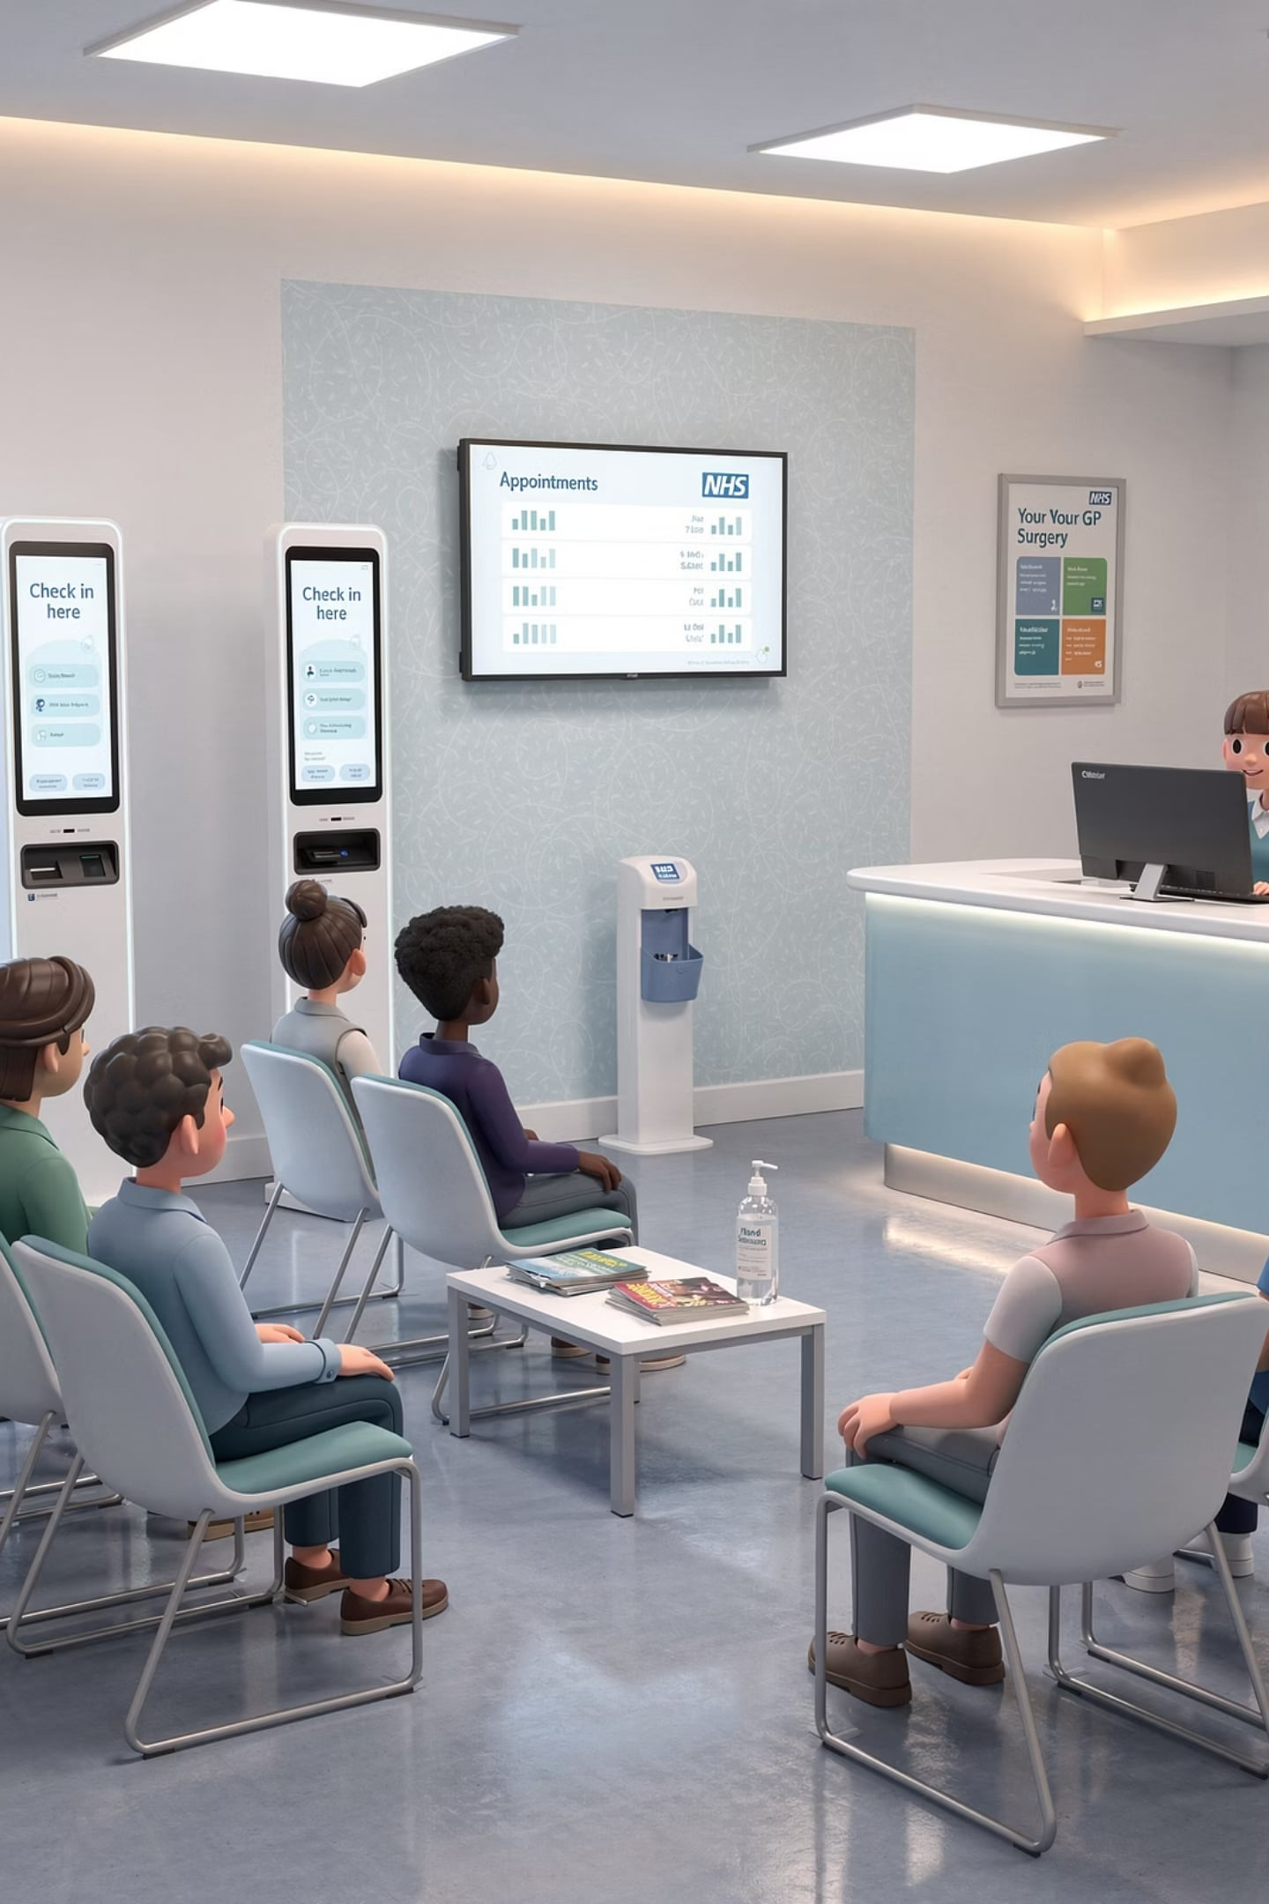
Psychological Problems in GP
Of patients presenting in primary care
5%
Major Depression
5%
Milder Depression
10%
Some Depressive Features
40%
Broader Psychological Distress
When psychological distress is considered as a significant part of presentation

Slide 4
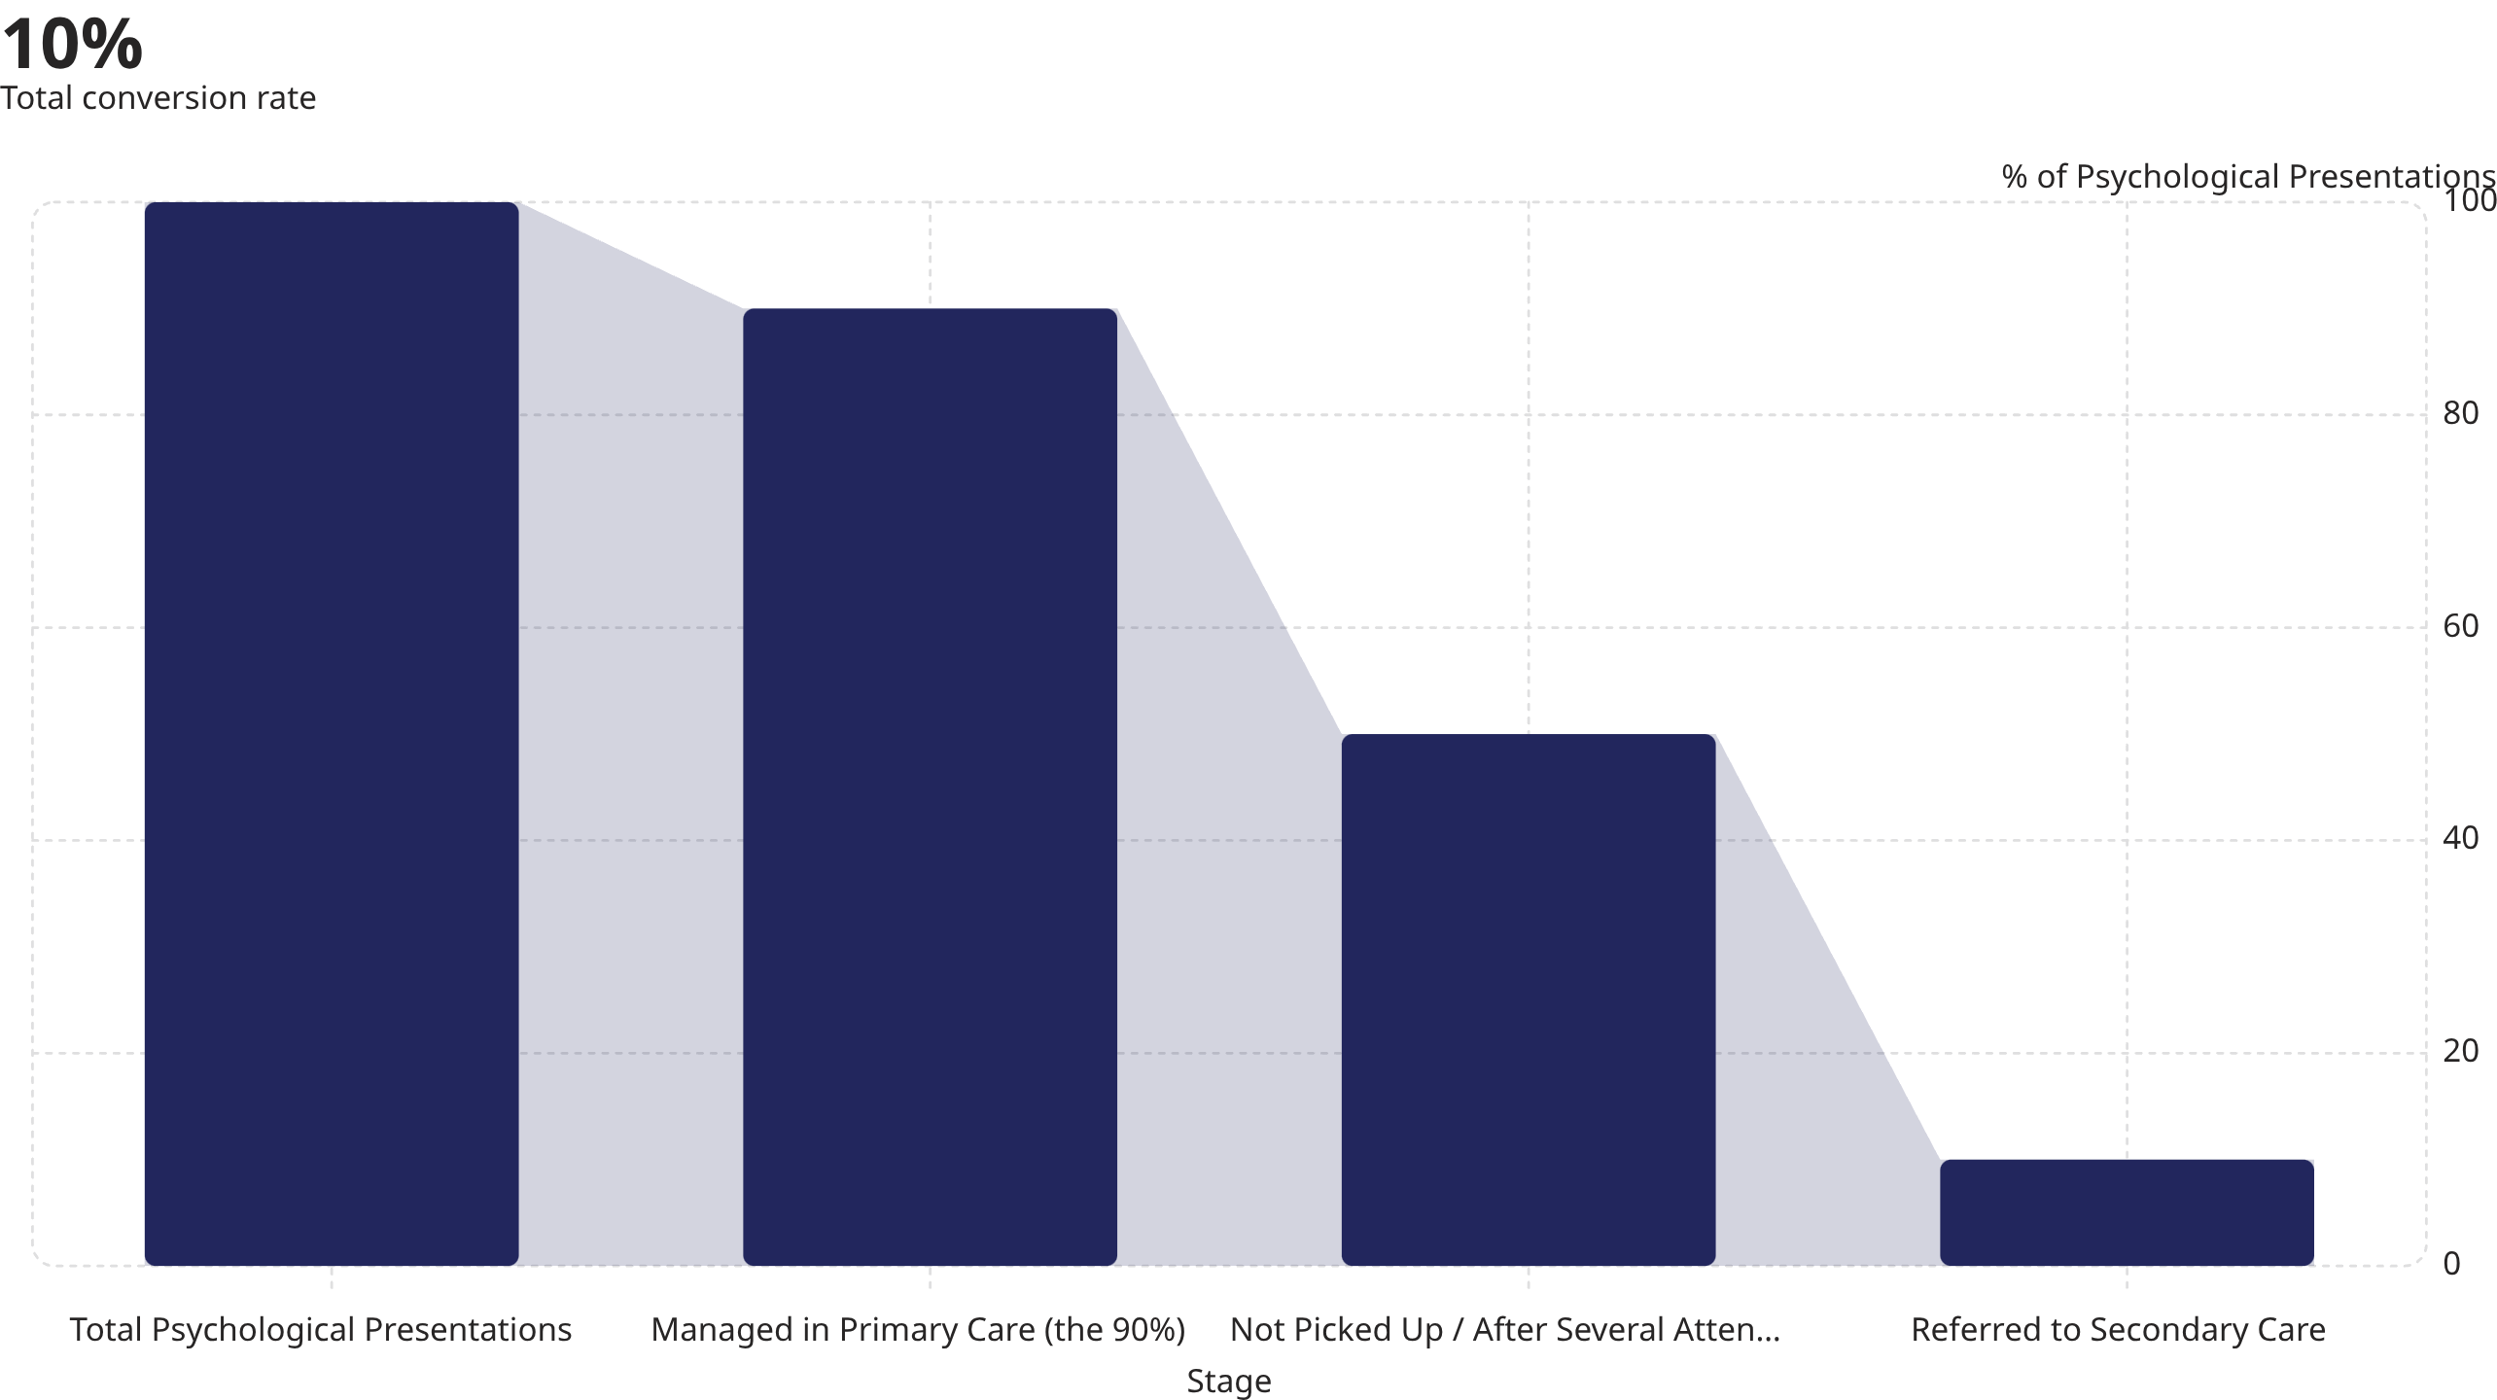
What Do We Do With It?
50% of psychological presentations are not initially identified. Only 10% with a psychological diagnosis are referred to secondary care — leaving 90% managed within general practice.

Slide 5

The 90% — What Should We Call It?
In pairs, list descriptions for how psychological problems present — other than "depression" and "anxiety."
Write ideas on post-its and place on one of the 4 flip-chart sheets.

Slide 6
The 90% — What Did We Call It?
Cognitions
Behaviours
Thoughts, beliefs, interpretations, automatic negative thoughts
Avoidance, withdrawal, compulsions, dysfunctional patterns
Emotions
Physiological
Sadness, fear, anger, guilt, shame, hopelessness
Somatic symptoms, fatigue, tension, sleep disruption

Slide 7
Rational Therapies — Overview
Therapy
Core Focus
Key Feature
CBT
Challenge automatic negative thoughts & maladaptive beliefs; modify dysfunctional behaviour
10–20 sessions; requires homework from patients
Interpersonal Therapy
Link between interpersonal experiences and depressed mood; improve relationships & social functioning
More widespread in the US
Problem Solving Therapy
Identify significant problems; generate practical, achievable solutions
Solutions implemented between sessions
DBT
CBT-like; primarily for borderline personality disorder; 4 skills areas
Mindfulness, interpersonal effectiveness, emotion regulation, distress tolerance
Behavioural Therapy
Change what people do by teaching different responses
Focused on behaviour only — not thoughts or feelings

Slide 8

Cognitive Behavioural Therapy (CBT)
Utilises cognitive techniques to challenge automatic negative thoughts and maladaptive beliefs, alongside structured approaches to modify dysfunctional behaviour patterns.
Cognitive Component
Challenging distorted thinking patterns and negative beliefs
Behavioural Component
Structured homework and exercises between sessions
Duration
10–20 sessions with a trained therapist — a relatively expensive intervention

Slide 9

Interpersonal Therapy (IPT)
Focuses on the relationship between current interpersonal experiences and depressed mood, aiming to reduce depressive symptoms by improving the quality of relationships and social functioning.
Target
Link between interpersonal events and mood disturbance
Goal
Improve relationships and social functioning to alleviate depression
Context
More widespread in the United States

Slide 10


Problem Solving Therapy
Aims to identify significant problems in the patient's life and to generate practical, achievable solutions for the patient to implement between sessions.
This structured approach empowers patients to take ownership of change, bridging insight in the consulting room with real-world action.

Slide 11

Dialectical Behavioural Therapy (DBT)
Has some similarities to CBT and is mostly used with patients with borderline personality disorder. It works across 4 core skills areas:
Core Mindfulness
Awareness of the present moment without judgement
Interpersonal Effectiveness
Building and sustaining healthy relationships
Emotion Modulation
Managing and regulating intense emotional states
Distress Tolerance
Coping with crisis without making things worse

Slide 12

Behavioural Therapy
Modern behavioural techniques work on the premise of changing what people do by teaching them to respond to things in a different way.
What it IS focused on
Changing observable behaviour through structured responses and conditioning
What it is NOT focused on
What is going on in your head — thoughts and internal states are not the target

Slide 13
So What Works?
Across all psychological therapies, the common ingredients of effectiveness are well established.

Slide 14
KEY EVIDENCE
In Summary — What Works
Validation
Goal Orientation
Being Heard
Negotiated Goals
Patients feel their experience is understood and acknowledged
Treatment direction agreed collaboratively between patient and clinician
Empathic Response
Measurable Progress
The therapist genuinely connects with the patient's emotional world
Clear markers to assess change and build motivation over time

Slide 15

Validation — The Evidence
Study
Year / Institution
Finding
Headache Study Group
Western Ontario University, 1986
Better symptom control with validated, patient-centred consultations
Orth et al
1987
Better blood pressure control associated with validating approach
Little et al
1997
Patient-centred approach possibly better than antibiotics for sore throats
Henbest and Stewart
1990
Patient-centredness correlates with resolution of patients' concerns
Validation is not just good practice — it is clinically effective across a range of conditions.

Slide 16
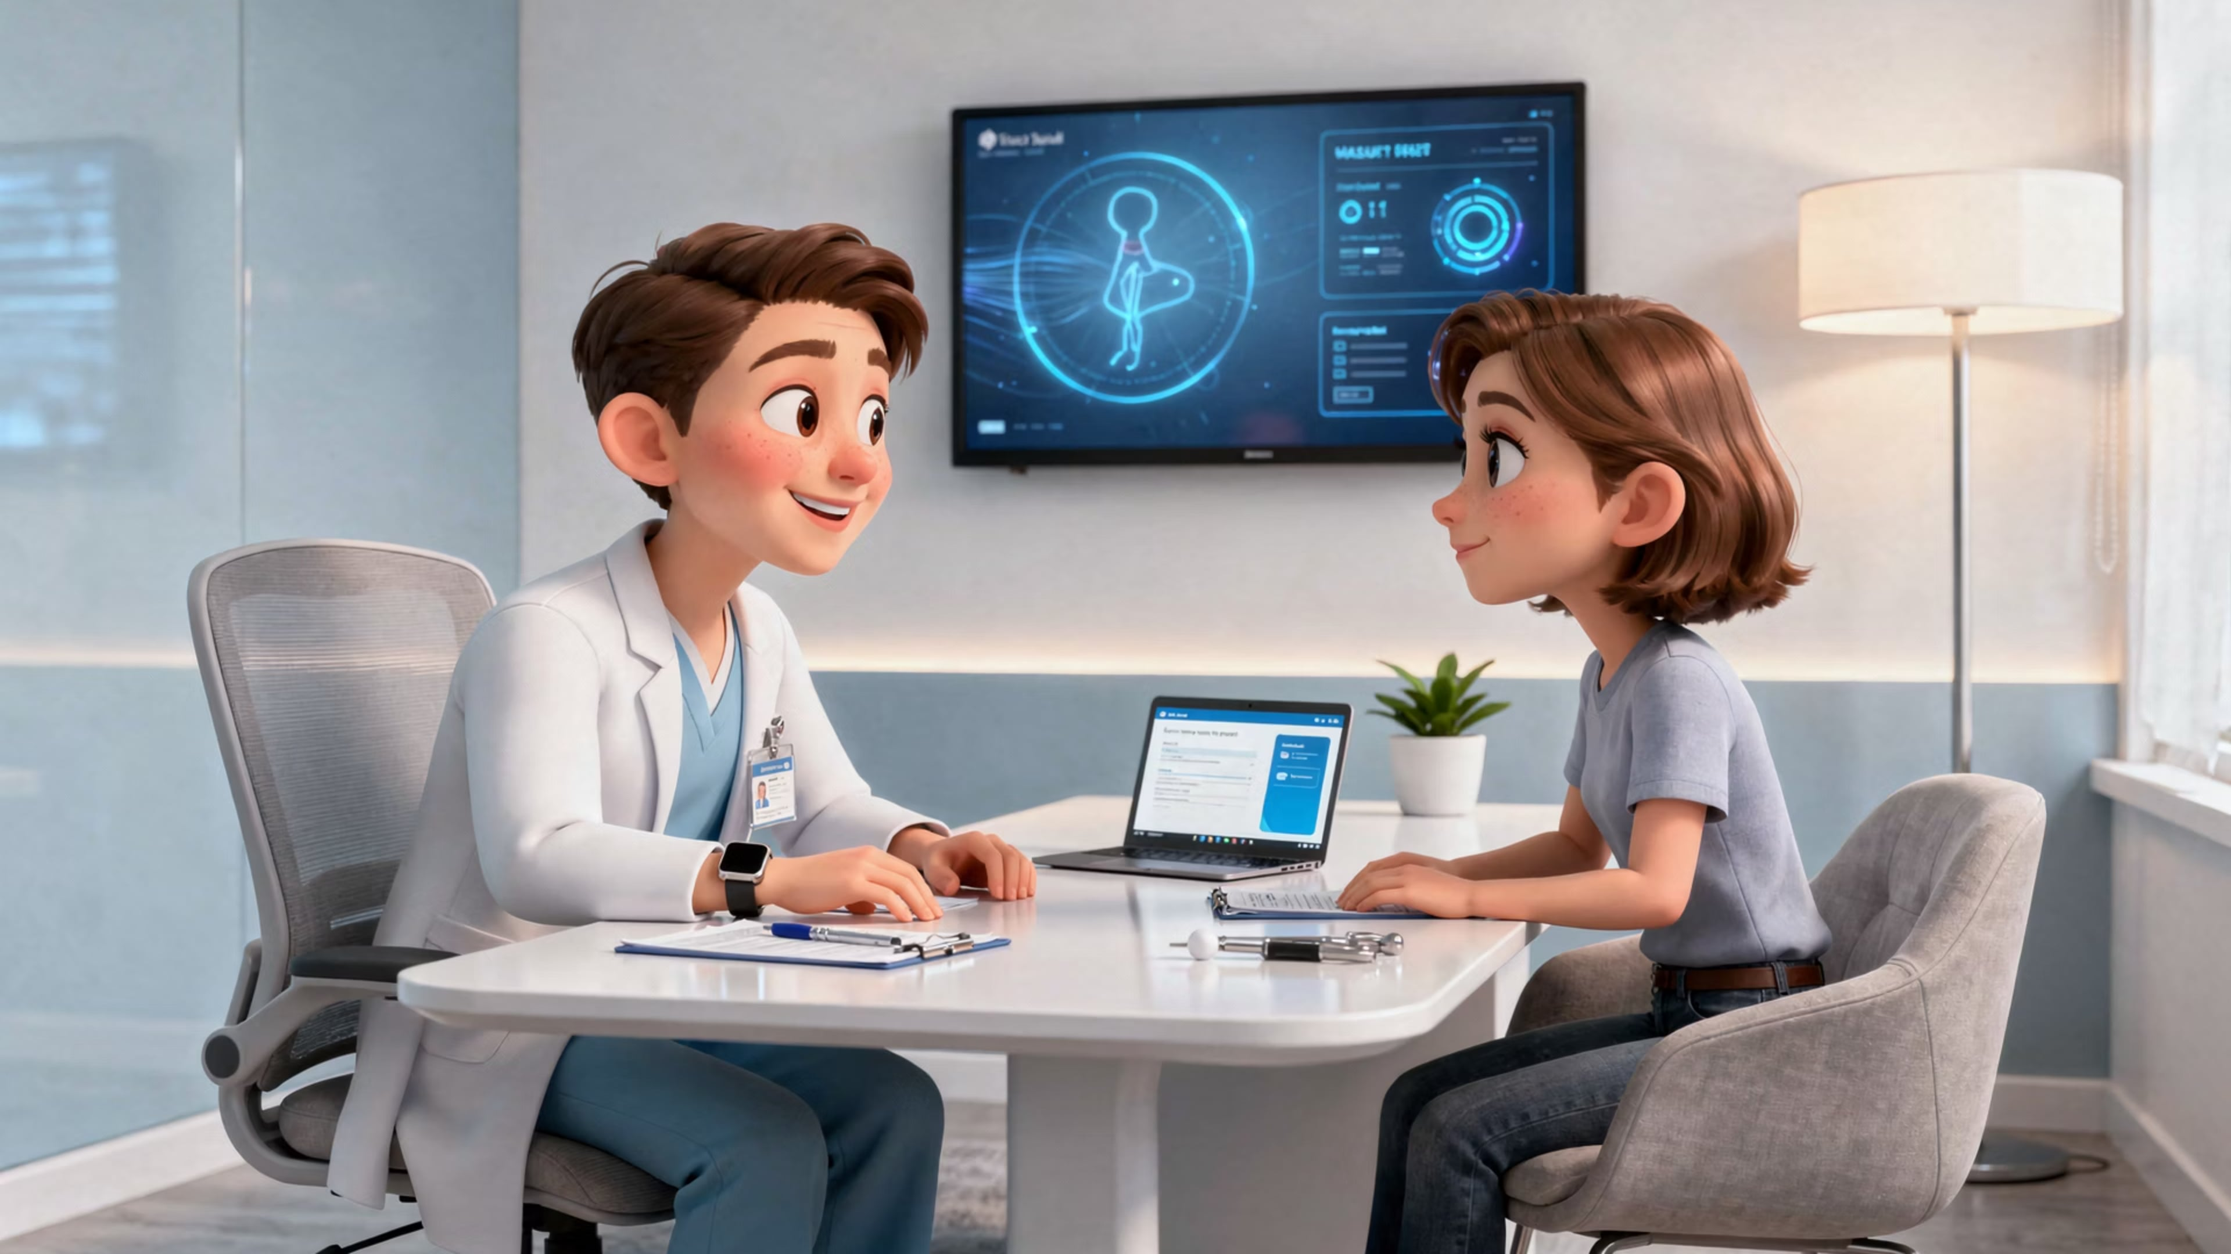
Personal Reflections on Validation
"To be heard is to be healed."
Unhappy Patients
Miguel de Unamuno
Stories from practice where patients felt unheard — and the consequences for care and outcomes
The philosopher's insight into the human need to be acknowledged — with direct relevance to the consultation

Slide 17
Group Work on Validation
01
02
03
Brainstorm
Discuss
Frame
In groups, identify and list things that validate patients in the consultation
Share examples from your own practice — what works, what doesn't
Develop and practise framing validating types of questions

Slide 18
Validating Questions — ICE
💡 Ideas (Beliefs)
⚠️ Concerns
🎯 Expectations
"Tell me about what you think is causing it"
"What are you concerned that it might be?"
"What were you hoping we might be able to do for this?"

Slide 19
Validating Questions — Picking Up Cues
Repetition of Cues
Picking Up & Checking Out Verbal Cues
Picking Up & Checking Out Non-Verbal Cues
"Upset….?"
"You said that you were worried that the pain might be something serious; what theories did you have yourself about what it might be?"
"I sense that you're not quite happy with the explanations you've been given in the past. Is that right?"

Slide 20
Validating Questions — Exploring Feelings
Picking Up & Checking Out Verbal Cues
Repetition of Cues
Picking Up & Reflecting Non-Verbal Cues
"Angry…?"
"You said you felt miserable, could you tell me more about how you've been feeling?"
"I sense that you're very tense; would it help to talk about it?"

Slide 21
Validating Questions — Direct Approaches
Direct Questions (Open)
Asking for Particular Examples
Asking Permission to Enter the Feelings Realm
"How did that leave you feeling?"
"Can you remember a time when you felt like that? What actually happened?"
"Could you bear to tell me just how you have been feeling?"

Slide 22

Validating Questions — Empathic Statements
The most powerful validating language uses both the "I" and the "you" — connecting the clinician's perception directly to the patient's experience.
"I can see that you have been very upset by her behaviour."
This construction signals that the clinician has truly noticed, truly understood, and is willing to name it — the foundation of the therapeutic alliance.

Slide 23
Problems with Validation
Validation is powerful — but patients may respond in ways that derail progress. Recognising these patterns is essential.
🔄 Rumination
📈 Escalation
Repeating complaints and refusing to consider other topics — the patient becomes stuck in the problem narrative
Raising the voice or arguing things are even worse than first stated — the patient becomes personally invested in catastrophising
😤 Negative Feelings Elicited
🤐 Emotional Distancing
Punishing or devaluing the therapist: "You're not helping me", "I'm wasting my time"
Silence communicates that the therapist won't understand — "why bother?" — closing down the therapeutic space
🙈 Viewing Needs as Weakness
🩺 Somatising
The patient is ashamed of having emotional needs and apologises for them, inhibiting genuine disclosure
Emotional distress expressed through physical symptoms rather than acknowledged psychologically

