Slide 1

BRADFORD VTS TEACHING DECK
Psychological Approaches in Primary Care II
Bradford GP Vocational Training Scheme — Reflective Training Session
DR ANDREW R. WILSON

Slide 2
Session Objectives
By the end of today's session, you should be able to:
1
2
3
Reflect on Validation Homework
Understand Rationale Therapies
Tools for Change
Explore practical ways to bring focus and facilitate meaningful change when working with psychological problems in primary care.
Embed and share successes, acknowledge difficulties, and explore strategies to overcome them in practice.
Develop sufficient understanding to facilitate confident and appropriate referral for psychological interventions.

Slide 3
Today's Session — Agenda
Summary of Previous Session
Rationale Therapies — Presentations
Homework Review
Tying in learning from the summer school counselling sub-school, with group reflection on validation exercises.
A brief recap of Session I to consolidate prior learning.
Trainee-led presentations on key therapeutic approaches.
Tools for Change
Summary and Feedback
Practical clinical tools: problem lists, cognitive continuum, and behavioural activation.
Consolidating key learning points and gathering group feedback.

Slide 4


Review of Session I
We begin with a pairs exercise — take a few minutes with a colleague to reflect on what you remember from Session I. Consider what key themes resonated, and what questions or uncertainties remain as we build on that foundation today.
Pairs Work — discuss with the person next to you before we share with the wider group.

Slide 5
Review of Session I
What Works — Core Therapeutic Conditions
The evidence base consistently highlights the following therapist-offered conditions as central to effective psychological work in any setting, including primary care:
Empathy
Genuineness
Warmth
Communicating genuine understanding of the patient's inner world and emotional experience.
Being authentic and congruent — the clinician's verbal and non-verbal communication align.
Unconditional positive regard — accepting the patient without judgement.
Negotiation of Goals
Reflecting
Collaboratively agreeing on what the patient wants to achieve from the encounter or series of sessions.
Feeding back what the patient has expressed to deepen understanding and validate their experience.

Slide 6
Review of Session I
What Works — Relational and Therapeutic Factors
Beyond the core conditions, these relational factors have robust evidence for contributing to positive outcomes across psychological therapies:
Repairing Ruptures
Patient Satisfaction
Acknowledging and addressing breakdowns in the therapeutic relationship is itself therapeutic and builds trust.
When the patient feels heard and that their needs are being addressed, outcomes improve significantly.
Therapeutic Alliance
Cohesion
The quality of the working relationship between clinician and patient is one of the strongest predictors of outcome.
A shared sense of purpose and working together towards a common goal.
Emotional Expression
Changing View of Self
Facilitating the patient to name and express emotions safely is central to psychological change.
Supporting patients to develop a more compassionate and realistic sense of who they are.

Slide 7

Review of Session I
What Works — Broad Classification
Across all effective psychological approaches in primary care, the active ingredients can be distilled into two broad, complementary categories. Understanding this helps GPs frame their consultations with greater intention:
Validation
Communicating to the patient that their thoughts, feelings, and experiences make sense in context — even if those reactions are distressing or unhelpful. Validation builds safety and trust.
Goal Orientation & Change Techniques
Structured, collaborative approaches that help patients move towards something different — whether that is new behaviours, more balanced thinking, or clearer priorities. Change requires direction.

Slide 8

Rationale Therapies
Trainee Presentations
Each trainee has prepared a short presentation on a specific evidence-based psychological therapy. These presentations provide the group with a working understanding of the key therapeutic modalities available for referral in primary care — including their rationale, indications, and typical format.
Listen actively — consider how each therapy might apply to patients you see regularly in your practice.

Slide 9
Homework Review — Validation
In Groups
Reflect on your attempts to use validation in your consultations since the last session. Share honestly within your small group — both successes and challenges are valuable learning opportunities. Consider the questions below as a guide for your discussion:
What Worked Well?
What Worked Less Well?
When did validation feel natural and effective?
How did the patient respond when they felt genuinely heard?
Which phrases or approaches landed particularly well?
Where did you find validation difficult or awkward?
Were there consultations where you felt it wasn't enough?
What barriers — time, uncertainty, patient response — got in the way?

Slide 10
Tools for Change
The following practical tools can be integrated into primary care consultations to bring focus and facilitate psychological change. Each approach is brief, evidence-informed, and usable without specialist training:
3. Behavioural Activation
2. Cognitive Continuum Methods
Scheduling meaningful activities to improve mood and functioning in anxiety and depression.
1. Problem and Goal Lists
Structuring the patient's concerns collaboratively and identifying clear, achievable goals.
Breaking down global, all-or-nothing thinking patterns into more nuanced, evidence-based perspectives.

Slide 11
Problem and Goal Lists
Creating a structured problem and goal list with your patient is one of the most effective brief interventions available in primary care. It transforms an unfocused, overwhelming consultation into a collaborative, purposeful one.
Gives Focus
Breaks Things Down
Prevents the consultation from drifting — both clinician and patient know what is being worked on.
Transforms an overwhelming problem into smaller, more manageable components.
Patient-Defined
Collaborative
Uses the patient's own language and definition — increasing engagement and ownership.
Developed jointly — not imposed by the clinician. Reinforces the therapeutic alliance.
Present-Orientated
Tracks Progress
Focuses on what is happening now and what can change, rather than ruminating on the past.
Over time, a revisited problem list gives the patient a tangible sense of how far they have come.

Slide 12
Sources for Problem Lists
Problems presented in primary care are multidimensional. When constructing a problem list, consider drawing from a range of sources to ensure nothing important is missed and the picture is truly comprehensive:
Situational Problems
Housing, finances, relationships, employment, bereavement — the social context of the patient's distress.
Medical and Psychological Problems
Formally diagnosed conditions as well as psychological symptoms that may not yet have a diagnostic label.
What Others Observe
Concerns raised by family members, carers, or clinicians — sometimes patients lack insight into the impact of their difficulties.
Effect on Others
How the patient's problems are affecting those around them — relationships, parenting, work interactions.
Symptom and Problem Diaries
Self-monitoring between appointments can reveal patterns the patient may not have noticed in the moment.

Slide 13
Why Patients May Under-Report
Problem lists are only useful if they are complete. Be aware that patients frequently present with fewer problems than they are actually experiencing. Understanding why helps you create the conditions for fuller disclosure:
Embarrassment or Shame
Lack of Awareness
Perceived Insolubility
The patient may genuinely not recognise that something is problematic, particularly if it has become normalised.
"There's nothing you can do about it" — patients may withhold problems they believe are unsolvable.
Stigma — particularly around mental health, substance use, or relationship issues — prevents honest disclosure.
Feeling Overwhelmed
Not Seeing It as a Problem
When problems feel too large or numerous, patients may shut down and present only the most immediate concern.
What the clinician identifies as problematic may not align with the patient's own priorities or values.

Slide 14
Setting SMART Goals
Once problems are identified, effective goals are essential to give direction to the work. Poorly defined goals lead to frustration and drift. Use the SMART framework to ensure goals are clinically useful and motivating for the patient:
S — Specific
M — Measurable
A — Achievable
Clearly defined — what exactly will the patient do or achieve? Avoid vague aspirations.
Progress can be tracked — how will both clinician and patient know the goal has been reached?
Within the patient's realistic capacity, given their current circumstances and resources.
R — Realistic
T — Time-Limited
Grounded in the patient's actual life situation — not what the clinician thinks is ideal.
Has a defined time frame — creates a sense of momentum and provides a natural review point.

Slide 15
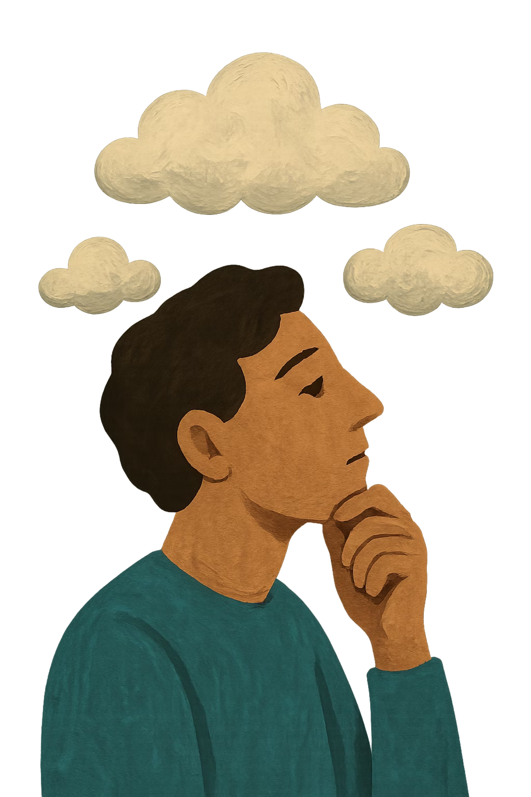
Challenging Global Thinking
Global thinking refers to sweeping, absolute statements patients make about themselves, others, or the world — often rooted in distress and reinforced over time. These cognitive patterns are a major maintaining factor in anxiety and depression.
There are many forms of negative global thinking, and several structured worksheet approaches exist to help patients examine and recalibrate these beliefs. In today's session, we will explore these in groups of three, working through examples drawn from real-world primary care presentations.
Worksheets in groups of three — apply the techniques to a patient scenario from your own practice.

Slide 16
Common Thinking Errors — Part I
These cognitive distortions are frequently encountered in primary care consultations. Recognising them is the first step towards helping patients challenge them:
1
2
3
All-or-Nothing Thinking
Overgeneralising
Mental Filter
Seeing situations in black-and-white terms, with no middle ground. "I either do it perfectly or I've failed completely."
Drawing broad conclusions from a single event. "This always happens to me. Nothing ever works out."
Focusing exclusively on one negative detail whilst ignoring the broader picture — selective abstraction.
4
5
Jumping to Conclusions
Magnifying or Minimising
Catastrophising, mind-reading ("I know what they're thinking"), or fortune-telling ("I know it will go wrong").
Blowing negatives out of proportion whilst shrinking positives — sometimes called the "binocular trick".

Slide 17
Common Thinking Errors — Part II
Further cognitive distortions that commonly underlie low mood, anxiety, and interpersonal difficulties in primary care patients:
1
2
Emotional Reasoning
Shoulds and Musts
Taking feelings as facts. "I feel stupid, therefore I must be stupid." Emotions are treated as evidence rather than responses.
Rigid rules that generate guilt and frustration. "I should always cope." "I must never make mistakes."
3
4
Labelling
Personalising
Attaching a global, fixed label to oneself or others based on a single event. "I'm a failure." "He's an idiot."
Taking excessive responsibility for events outside one's control. "If I'd done more, this wouldn't have happened."
5
6
Tunnel Vision
Disqualifying the Positive
Only seeing the negative aspects of a situation, filtering out any evidence of success or progress.
Dismissing positive experiences as flukes or exceptions that "don't count". Actively maintaining a negative worldview.

Slide 18

The Cognitive Continuum Technique
The cognitive continuum is a practical tool for breaking down global, all-or-nothing beliefs into their component parts, allowing patients to score each element individually. This creates a more nuanced, evidence-based overall picture and typically shifts the global belief score significantly.
Break Down
List component parts and score each
Identify Belief
Re‑score
State the global belief and score 0–100
Combine component scores to update rating
For example, a patient who rates herself as "50% a good mother" at the start may revise this upwards to 70–80% once she has scored specific components such as warmth, feeding, quality time, and building her children's self-esteem — many of which she rates much higher than her global self-assessment.

Slide 19
Cognitive Continuum — Worked Example
"Good Mother" Belief Rescoring
This worked example illustrates how breaking down a global belief into its constituent parts can shift a patient's overall self-perception. The patient begins by rating herself globally, then scores each component — often finding that individual elements are rated far higher than the global belief.
Belief Component
Score (0–100)
Notes
Global "Good Mother" belief — at start
50%
Patient's opening score
Loving
0–100
Often rated highly
Warm and nurturing
0–100
Scored individually
Ensures child is fed and safe
0–100
Practical care
Provides quality time
0–100
Engagement and attention
Builds child's self-esteem
0–100
Emotional development
Global "Good Mother" belief — at end
70–80%
Revised upward
By scoring each component, the patient recognises that many elements of good parenting are present — the global self-criticism was distorted by emotional reasoning and mental filtering.

Slide 20
Behavioural Activation
Behavioural activation (BA) is one of the most robustly evidence-based brief interventions for depression and anxiety in primary care. It rests on a simple but powerful premise: behaviour influences mood.
The Core Principle
The Evidence
In Practice
Certain behaviours reliably produce positive mood changes. When patients are depressed, they withdraw from activities — which deepens low mood, creating a self-reinforcing cycle.
Scheduling activities produces measurable improvement in both anxiety and depression, independent of traditional medical interventions. BA is considered the primary mechanism of action in CBT.
Work with the patient to identify previously enjoyable or meaningful activities, then collaboratively schedule these into the week — starting small and building gradually to create momentum.
Behavioural activation is the main "treatment effect" of CBT — and can be delivered effectively within a primary care consultation framework.

