Slide 1

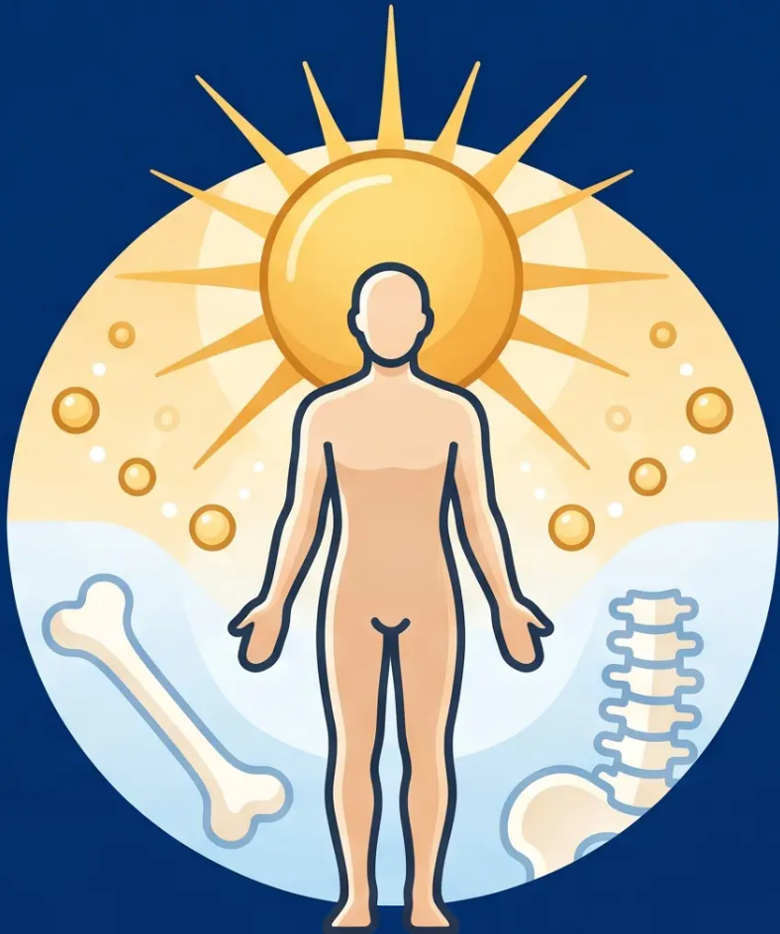

BRADFORD VTS TEACHING DECK
GP Training Resource · RCGP AKT & SCA Preparation
Vitamin D
Deficiency
in Adults
Updated to current NICE CKS 2022/2026 · BNF 2024–2026 standards
Created June 2026
Always double check this advice and drug doses with the latest NICE/BNF guidance.
This document is for educational purposes only.
www.bradfordvts.co.uk
Bradford VTS · West Yorkshire

Slide 2




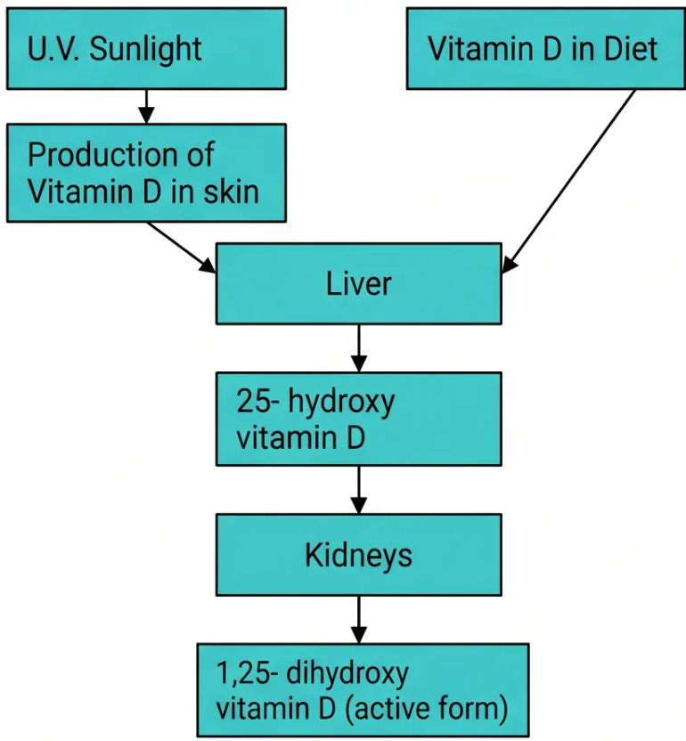









SECTION 1
Overview & Relevance
www.bradfordvts.co.uk
VITAMIN D METABOLISM
>50%
of UK adults have insufficient
Vitamin D during winter & spring
*Particularly high rates in Bradford's South Asian & African-Caribbean communities
CLINICAL CONSEQUENCES
Osteomalacia
& Fractures
Proximal
Myopathy
falls, waddling gait
soft bones, Looser zones
Cardiovascular
& Metabolic
Autoimmune
& Cancer
observational links:
CVD, diabetes
emerging evidence;
causation unproven
*Serum 25(OH)D = the correct blood test —
measures stored vitamin D*
Bradford VTS Teaching Deck — Vitamin D Deficiency in Adults
Created May 2026 · Updated NICE CKS 2022/2026
SECTION 1 OF 7

Slide 3


















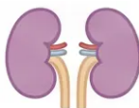

SECTION 2
★ AKT: Memorise these groups
At-Risk Groups
Who should you be thinking about?
Limited Sun Exposure
Cultural/Religious Clothing
Dark Skin Pigmentation
Housebound · indoor workers
· high SPF year-round
Requires longer UVB exposure
for D3 synthesis
Niqab, burqa, or full skin
coverage
Pregnancy & Breastfeeding
Age ≥65 Years
Malabsorption Syndromes
Skin synthesis 4× less
efficient with age
Increased demand; Healthy
Start vitamins available
Coeliac · Crohn's · gastric
bypass · gastrectomy
CKD Stage 3b+
Obesity (BMI >30) & Low-Fish Diet
Enzyme-Inducing Drugs
Impaired 1α-hydroxylation
→ refer, don’t treat
Phenytoin · carbamazepine ·
rifampicin · steroids · HAART
Vitamin D sequestered in adipose tissue ·
vegan/vegetarian diets at increased risk
South Asian and African-Caribbean communities in Bradford are at particularly high risk — darker skin
requires significantly longer or more intense UVB exposure to synthesise equivalent vitamin D3.
📍 Bradford Local Context
www.bradfordvts.co.uk
Vitamin D Deficiency in Adults
Section 2 | At-Risk Groups

Slide 4








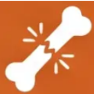
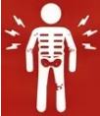



BRADFORD VTS TEACHING DECK
www.bradfordvts.co.uk
SECTION 3
Symptoms & Clinical Presentation
Severity increases left to right — know your thresholds
INCREASING SEVERITY →
INSUFFICIENCY
DEFICIENCY
OSTEOMALACIA
25–50 nmol/L
< 25 nmol/L
Severe Prolonged Deficiency
Often Asymptomatic
Classic Features
Soft Bones — Poor Mineralisation
• 😴 Vague fatigue and tiredness
• 🦴 Deep bone pain — lower back,
hips, ribs, thighs
• 🔴 Pseudo-fractures (Looser
zones) on X-ray
• ☁️ Non-specific musculoskeletal
aches
• 💪 Proximal muscle weakness
(rising from chair, stairs)
• 📈 Raised ALP · Low/normal Ca ·
Low phosphate · Raised PTH
• ⚠️ May mimic fibromyalgia or
somatisation
• 😟 Muscle tenderness and myalgia
• 🚶‍♀️ Waddling gait
• 💊 Statin users: worsened statin
myopathy
• 💪 Proximal myopathy
• 🦴 Fractures: femoral neck, pubic
rami, ribs, vertebrae
• 🚶‍♂️ Generalised bone tenderness
on palpation
Consider in patients labelled with
fibromyalgia
Statins + muscle pain → always
check vitamin D
Looser zones = pathognomonic
pseudo-fractures on X-ray
🔵 Proximal weakness + bone pain + fatigue = think vitamin D before fibromyalgia
www.bradfordvts.co.uk
Section 3 — Symptoms & Clinical Presentation
Bradford VTS · May 2026

Slide 5







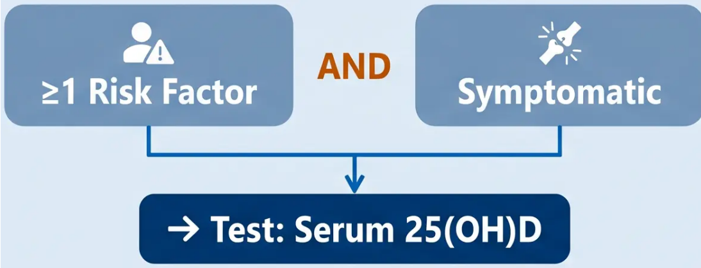




SECTION 4
Diagnosing — Who to Test
NICE CKS 2022
When Should You Test?
Investigation Panel
Serum 25(OH)D — the correct vitamin D test
Adjusted serum Ca — baseline; exclude hypercalcaemia
ALP — raised in osteomalacia
Serum phosphate — low in osteomalacia
LFTs — assess 25-hydroxylation capacity
U&Es + eGFR — CKD affects treatment choice
Bone pain, tenderness, or proximal muscle weakness
FBC — anaemia may suggest malabsorption
Clinical suspicion of osteomalacia or osteoporosis
Prior to parenteral antiresorptive agents
(denosumab, zoledronate)
Consider: · Magnesium · TTG antibodies
· Immunoglobulins · X-ray focal pain
DO NOT routinely screen asymptomatic individuals — even in high-risk groups
NICE CKS / NICE PH56 (stood down December 2025)
www.bradfordvts.co.uk
8
Bradford VTS Teaching Deck — Vitamin D Deficiency in Adults — May 2026

Slide 6

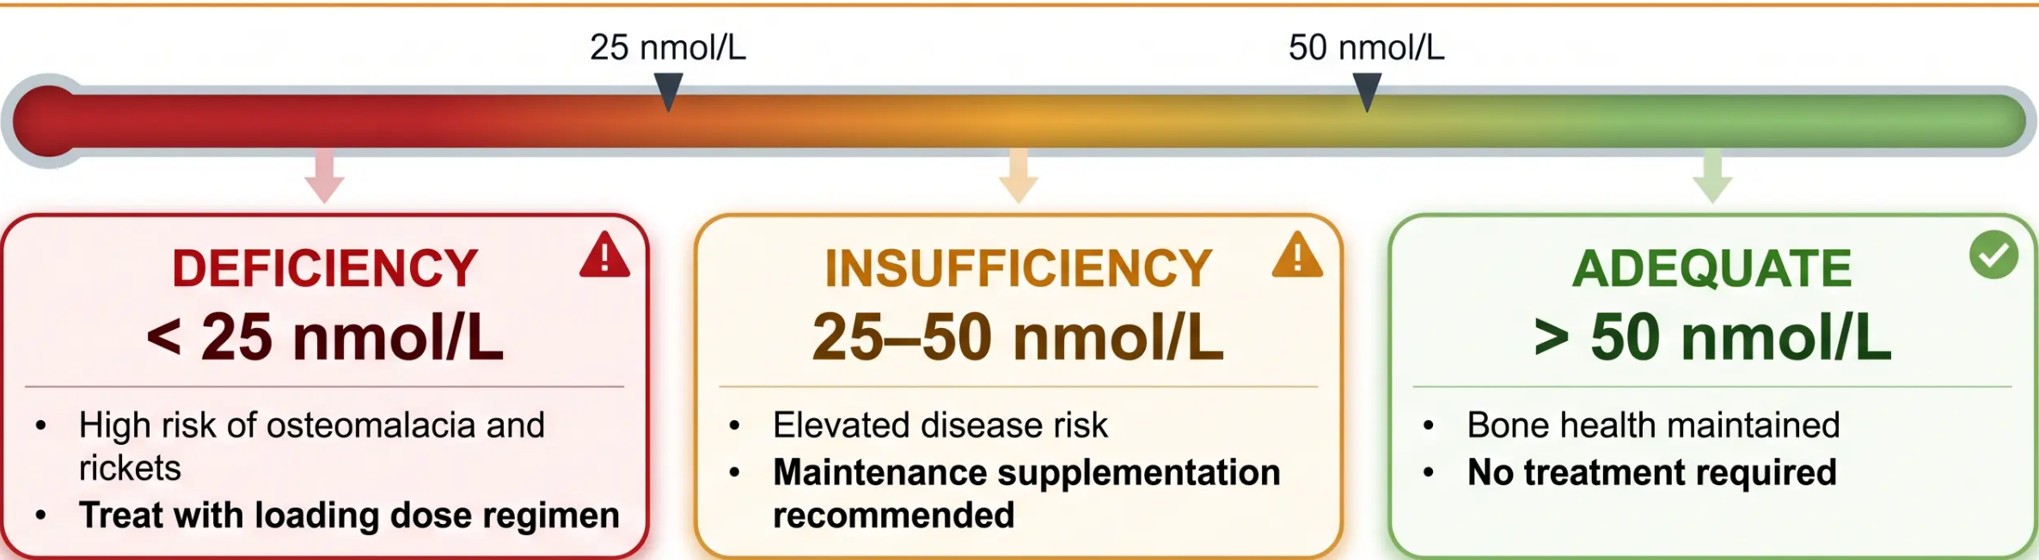


BRADFORD VTS TEACHING DECK
www.bradfordvts.co.uk
Interpreting Results
AKT ★ Common distractor
Serum 25(OH)D Classification — SACN 2016 / NICE CKS 2022
Seasonal note: a 40 nmol/L result in spring may be more clinically significant than the same
result in autumn — vitamin D nadir occurs in late winter/early spring.
Section 5: Interpreting Results
NICE CKS 2022 · SACN 2016
7

