Slide 1

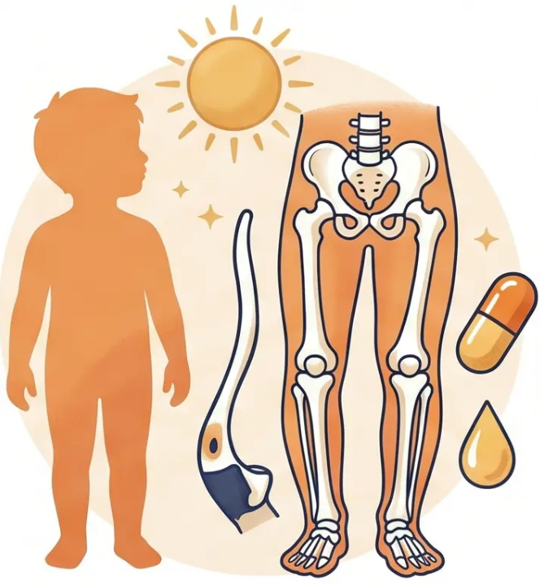

BRADFORD VTS TEACHING DECK
Vitamin D Deficiency in Children:
Rickets & Osteomalacia
GP Training Teaching Deck
Created May 2026 | Updated to NICE CKS 2022/2026
and NICE NG247 2025 standards
www.bradfordvts.co.uk
⚠ Always double-check advice and drug doses with the latest NICE/BNF guidance. For educational purposes only.
www.bradfordvts.co.uk

Slide 2







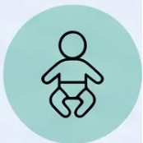




SECTION 1 — OVERVIEW
Overview & Epidemiology of Rickets
Who is Most at Risk in the UK?
RICKETS
Failure of mineralisation of growing bone at the
growth plate — occurs only in children while
bones are still growing.
South Asian · African · African-
Caribbean · Middle Eastern
Darker skin requires more UVB exposure to
synthesise vitamin D
Higher prevalence in Bradford & Yorkshire
Most common UK cause: nutritional vitamin D deficiency
6 – 24 Months
Period of rapid growth — highest calcium and
phosphate demand
OSTEOMALACIA
Also seen during adolescence (second growth spurt)
The same mineralisation failure occurring in adults
— affects mature bone after growth plate closure.
Exclusively Breastfed Infants
Breast milk contains negligible vitamin D —
supplementation essential from birth
Risk amplified if mother is also vitamin D deficient
Bone pain and weakness predominate — no skeletal
deformities as bones are fully formed
⚠ Re-emerging public health concern — global resurgence noted
Bradford VTS Teaching Deck — Vitamin D Deficiency in Children
Slide 2 of 15
www.bradfordvts.co.uk

Slide 3















SECTION 2 — CAUSES & RISK FACTORS
Causes and Risk Factors
Who Is Most at Risk?
The Pathophysiology Chain
Population & Feeding Risk
☀️ Low 25(OH)D
• 🌍 Ethnicity — South Asian, African, African-Caribbean, Middle Eastern (darker skin
needs more UVB)
Reduced intestinal calcium absorption
• 🤱 Exclusively breastfed infants — breast milk very low in vitamin D
• 🍼 Formula-fed infants on <500 ml/day — below threshold for sufficient vitamin D
• 🤰 Maternal vitamin D deficiency — neonatal stores depend on maternal status
⬆️ Secondary Hyperparathyroidism
• 👶 Premature birth (<37 weeks) — limited placental transfer, depleted stores
PTH rises to compensate for low calcium
• 👕 Clothing covering skin / limited sun exposure — cultural, religious, or habitual
🦴 Skeletal Demineralisation
Medical & Dietary Risk
PTH mobilises calcium from bone
• 💊 Medications — phenytoin, carbamazepine, rifampicin, long-term corticosteroids
• 🧬 Genetic causes — XLH (X-linked hypophosphataemic rickets), renal tubular acidosis
• 🫀 Chronic renal disease — impaired 1α-hydroxylation
⚠️ Growth Plate Failure
• 🌱 High-phytate diet — chapati flour binds calcium in gut
• 🔬 Malabsorption — coeliac disease, Crohn's, cystic fibrosis
Widened, soft, deformed growth plates = Rickets
• 🧒 Teenagers — second growth spurt increases demand
⚠️ Bradford / Yorkshire Context
Higher prevalence in Bradford region. Be proactive at antenatal and weigh-in appointments — these are golden opportunities for prevention.
Bradford VTS Teaching Deck — Vitamin D Deficiency in Children
www.bradfordvts.co.uk

Slide 4






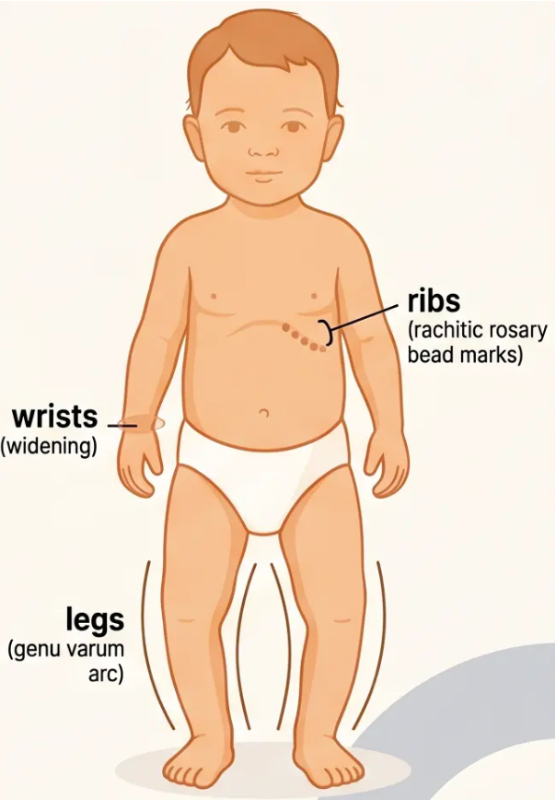





Section 3 — Clinical Features
Clinical Presentation of Rickets
Early Symptoms
Classic Skeletal Signs
• Bone pain and tenderness — legs,
wrists, ribs
• Bow legs (genu varum) — infants/toddlers
• Knock knees (genu valgum) — older children
• Muscle weakness and hypotonia
• Wrist and ankle widening — metaphyseal flaring
• Delayed motor milestones — walking,
sitting
• Rachitic rosary — costochondral beading
• Harrison's sulcus — lower chest groove
• Irritability and lethargy
• Craniotabes, frontal bossing, delayed
fontanelle closure
Dental Features
Hypocalcaemia Signs
• Delayed tooth eruption
• Tetany — carpopedal spasm
• Enamel hypoplasia and dental caries
• Trousseau's sign, Chvostek's sign
• Structural defects in tooth mineralisation
• Hypocalcaemic seizures — can be presenting
feature in infants
• Stridor — laryngospasm
• Prolonged QTc — arrhythmia risk
Seizures or stridor → medical emergency → 999
Bradford VTS Teaching Deck — Vitamin D Deficiency in Children
www.bradfordvts.co.uk

Slide 5














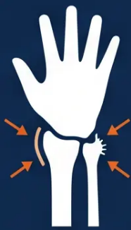






Section 4 — Investigations
Investigations & Diagnostic Markers
Test
Expected Finding in Rickets
Why ALP Matters
25(OH)D — serum vitamin D
Low — below 25 nmol/L confirms deficiency
ALP reflects osteoblast activity at the growth
plate. In rickets, unmineralised osteoid accumula
– driving ALP sky-high. It rises before symptoms
appear and falls with successful treatment.
Adjusted serum calcium
Low or low-normal
Serum phosphate
Low — PTH drives renal phosphate loss
Alkaline phosphatase (ALP)
☆ Markedly elevated — key diagnostic marker
Wrist X-Ray Findings
Parathyroid hormone (PTH)
Elevated — secondary hyperparathyroidism
• Cupping — concave deformity
of the metaphyseal edge
Magnesium
May be low
• Fraying — irregular, hazy
metaphyseal margin
U&Es including eGFR
Assess renal function
• Widening — broadened growth
plate zone
Coeliac screen (TTG)
If malabsorption suspected
*X-ray not required before referral — clinical
+ biochemical diagnosis sufficient.
*ALP is the most sensitive marker of active rickets — a normal ALP makes active rickets unlikely.
Bradford VTS Teaching Deck — Vitamin D Deficiency in Children
www.bradfordvts.co.uk

Slide 6

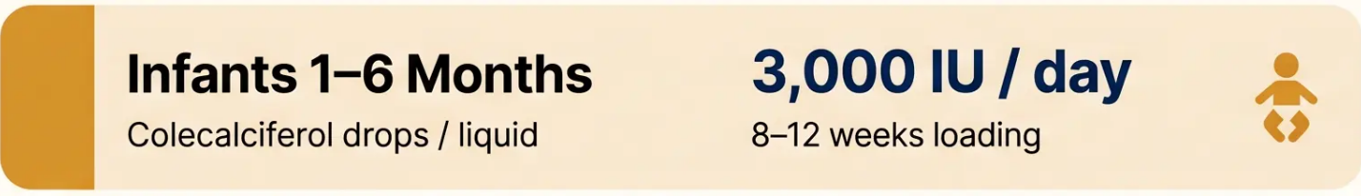




Section 5 — Management
Management & Treatment
Loading Doses
🏥 All children with clinical or radiological rickets → REFER TO PAEDIATRICS
Do not manage confirmed clinical rickets in isolation in primary care. Rule out hypercalcaemia before starting treatment.
Practical Points
● Colecalciferol (D3) ONLY
Ergocalciferol (D2) is no longer recommended for
treating rickets in children — BNF 2024
● Calcium intake
Ensure adequate dietary calcium (500–1,000 mg/day
by age). Supplement if dietary intake is poor.
● Preparations
Infant drops (e.g. InVita D3) — can be added to cold
or drink. Not hot — heat degrades vitamin D.
● Hypercalcaemia check
Exclude before starting treatment. Do not supplement
supplement if hypercalcaemia is present.
After loading: check 25(OH)D, calcium, and ALP at 3–6 months
Bradford VTS Teaching Deck — Vitamin D Deficiency in Children
www.bradfordvts.co.uk

Slide 7















SECTION 6 — SUPPLEMENTATION
Universal Supplementation
Recommendations
NICE NG247 (Jan 2025) | SACN 2016/2024
Breastfed Infants
0–1 Year
Formula-Fed
< 500 ml/day
Children
Children
Pregnant &
1–4 Years
5+ Years
Breastfeeding
8.5–10 mcg/day
(340–400 IU)
8.5–10 mcg/day
10 mcg/day
10 mcg/day
10 mcg/day
Year-round
(400 IU)
Oct–March minimum
Year-round if high risk
Year-round, from birth
If >500 ml/day: not required
Year-round
Year-round
Premature Infants < 37 weeks Double dose Healthy Start drops (10 drops/day) for 6 months if exclusively breastfed
Healthy Start Vitamins
• Infant drops: 5 drops/day = 300 IU (7.5 mcg) vitamin D3
• Women's tablets: 400 IU vit D + 70 mg vit C + 400 mcg folic acid
www.healthystart.nhs.uk
Free for eligible families (benefits/low income) | All pregnant women in Bradford qualify

Slide 8

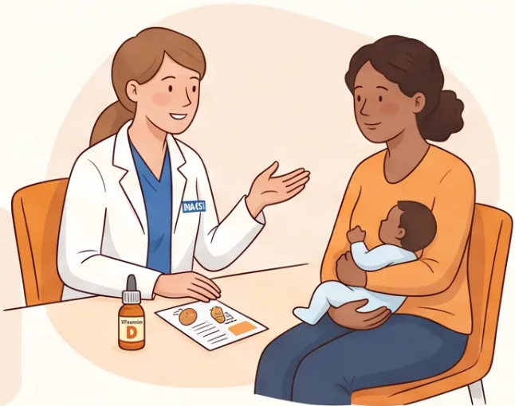








Section 7 — Prevention
Primary Prevention in Primary Care
GPs and health visitors have a vital role in preventing rickets before it develops.
Dietary Calcium Advice
Pregnant & Breastfeeding Mothers
Advise 400 IU vitamin D daily throughout
pregnancy and breastfeeding — year-round.
Encourage oily fish, eggs, dairy or fortified
alternatives. Advise vegan families on
calcium-rich plant sources.
Breastfed Infants
Safe Sun Exposure
Start vitamin D drops from birth (or from 1
month if mother was supplemented throughout
pregnancy — use clinical judgement).
10–20 minutes of face and forearm exposure,
11am–3pm, April–September. No need for
sunburn — short regular exposure is sufficient.
Healthy Start Vitamins
Proactive High-Risk Outreach
Ensure all eligible families are registered. Free
drops for infants, free tablets for mothers.
Raise at every booking and weigh-in visit.
Actively seek out South Asian, African, and
African-Caribbean families. Antenatal visits and
health visitor contacts are golden opportunities.
Bradford VTS Teaching Deck — Vitamin D Deficiency in Children
www.bradfordvts.co.uk

Slide 9








Section 9 — Clinical Practice
Top Tips for Clinical Practice
High-yield clinical pearls every GP trainee must know
01 Refer ALL Clinical
Rickets to Paediatrics
02 ALP is the Most
Sensitive Marker
06 Age-Specific Loading
Doses Matter
Never manage confirmed rickets in
isolation in primary care.
Markedly raised ALP is the key
biochemical flag for active rickets.
1–6m: 3,000 IU/day · 6m–12yr: 6,000
IU/day · 12–18yr: 10,000 IU/day
03 Colecalciferol D3 —
Not Ergocalciferol D2
04 Breastfed Infants
Need Drops from Birth
07 Register Families for
Healthy Start
D3 is first-line treatment in children.
D2 is no longer recommended
(BNF 2024).
Breast milk contains negligible
vitamin D — supplement from
day one.
Under 37 weeks and exclusively
breastfed → double-dose Healthy
Start drops for 6 months.
05 Seizures in Infants?
Think Calcium
08 Register Families for
Premature Infants
10 No Response to Treatment?
Suspect XLH
Hypocalcaemic convulsions can be
the presenting sign of vitamin D
deficiency rickets.
Free vitamin D drops for eligible
families — raise at every booking
and weigh-in visit.
X-linked hypophosphata
vitamin D alone — refer
to endocrinology.
Bradford VTS Teaching Deck — Vitamin D Deficiency in Children
www.bradfordvts.co.uk
10 / 15

Slide 10










Section 11 — Safety & Referral
Red Flags & Urgent Referral Criteria
Know when to act immediately — and when to refer
URGENT / SAME-DAY REFERRAL (Emergency)
REFER URGENTLY / SAME DAY — Medical Emergency
● Hypocalcaemic seizures, tetany, or stridor in an infant — call 999; this is a medical emergency
● Confirmed fractures — consider non-accidental injury alongside rickets; document carefully
● Severe hypocalcaemia on blood results
ROUTINE / SOON PAEDIATRIC REFERRAL
REFER TO PAEDIATRICS — Routine / Soon
● Suspected genetic rickets — XLH, renal tubular acidosis,
Fanconi syndrome
● Clinical or radiological rickets confirmed or strongly suspected
● Failure to thrive with bone deformities
● Child with renal disease or severe malabsorption
● No response to vitamin D treatment after 3 months
CONTRAINDICATIONS TO TREATMENT
CONTRAINDICATIONS — Do NOT treat without checking
● Do NOT supplement if hypercalcaemia is present
● Do NOT use bolus loading doses in neonates without specialist guidance
● Exclude hypercalcaemia BEFORE starting treatment
Bradford VTS Teaching Deck — Vitamin D Deficiency in Children
www.bradfordvts.co.uk

Slide 11











Section 12 — Mandatory
Common Pitfalls in Management
⚠ AVOID THESE ERRORS
⚠ Pitfall 1 — Managing
Rickets Alone in Primary
Care
⚠ Pitfall 2 — Using
Ergocalciferol (D2) as
First-Line
⚠ Pitfall 3 — Not
Supplementing Breastfed
Infants
⚠ Pitfall 8 — Missing
Hypophosphataemic
Rickets (XLH)
Always refer confirmed or suspected
rickets to paediatrics — never
manage in isolation.
Colecalciferol (D3) is first choice in
children — D2 is no longer
recommended (BNF 2024).
Breast milk contains negligible vitamin
D — drops must start from birth.
No response to vitamin D + low
phosphate + normal calcium =
⚠ Pitfall 3 — Not
Supplementing Breastfed
Infants
⚠ Pitfall 4 — Missing
Hypocalcaemia as a
Presenting Feature
⚠ Pitfall 6 — Missing
Coexisting Non-Accidental
Injury
Rickets and NAI can coexist —
document carefully and follow
safeguarding pathways.
Breast milk contains negligible vitamin
D — drops must start from birth.
Seizures or tetany in an infant may be
the first sign — always check calcium.
⚠ Pitfall 5 — Not Checking
Family Members
⚠ Pitfall 7 — Standard
Dose in Premature Infants
⚠ Pitfall 8 — Missing X-
Linked Hypophosphataemic
Rickets (XLH)
If one child has rickets, check the
mother and all siblings — deficiency
is usually shared.
Infants born before 37 weeks
need double-dose Healthy Start
drops for 6 months.
No response to vitamin D + low
phosphate + normal calcium = suspect
XLH — refer urgently.
Bradford VTS Teaching Deck — Vitamin D Deficiency in Children
13 / 15

Slide 12























Section 13 — Quick Recall
Quick Recall Summary
Essential facts — rickets diagnosis, treatment, and prevention. Six words or fewer.
Rickets = growing bone
mineralisation failure
ALP markedly
elevated — key marker
All breastfed infants
need vitamin D
Refer ALL rickets to
paediatrics
1–6 months: 3,000
IU/day treatment
6m–12 yr: 6,000
IU/day treatment
12–18 yr: 10,000
IU/day treatment
Colecalciferol D3 —
not D2
Seizures in infant =
check calcium
Family members:
check all if one affected
Healthy Start: free
drops for infants
XLH: no vitamin D
response → refer
When in doubt — refer, supplement, and document.

Slide 13








SECTION 10 — EXAM PREPARATION
Exam Pearls for AKT & SCA
AKT
SCA
AKT High-Yield Facts
SCA Communication Strategies
◆ ‘Rachitic rosary’ = beading at costochondral junctions —
classic image/description question
Explaining to a Parent:
💬 “Your child’s bones are not hardening properly because of a
lack of vitamin D. This is very common in children in the UK.
The treatment is simple — a vitamin D supplement.”
◆ ALP markedly elevated in rickets — distinguishes from simple
vitamin D deficiency
◆ Hypocalcaemic seizures in infants → always consider rickets in
differential
Safety-Netting:
⚠️ “If your baby becomes very drowsy, has a fit, or develops
muscle twitching — call 999 or come straight to A&E. These
could be signs of low calcium.”
◆ Treatment of choice = Colecalciferol D3, NOT ergocalciferol D2
◆ XLH (X-linked hypophosphataemic rickets): FGF-23 mediated
— does NOT respond to vitamin D alone; needs phosphate +
burosumab (specialist)
Preventive Counselling:
🛡️ “I recommend starting vitamin D drops for your baby from
birth. This is recommended for all breastfed babies in the UK.”
◆ Serum 25(OH)D <25 nmol/L = deficiency threshold (SACN 2016)
Cultural Sensitivity Note:
◆ Wrist X-ray: cupping and fraying of metaphysis = classic
radiological finding.
⭐ Acknowledge clothing practices sensitively. Offer halal-
certified vitamin D drops when relevant. Avoid assumptions
— lead with universal advice.
Bradford VTS Teaching Deck — Vitamin D Deficiency in Children
www.bradfordvts.co.uk

Slide 14









NHS
BRADFORD VTS TEACHING DECK —
Important Notice & Resources
Always double-check this advice and all drug doses against the latest
NICE guidelines and BNF before applying in clinical practice.
This document is for educational purposes only and does not constitute clinical advice.
Clinical decisions must be made in the context of individual patient circumstances.
Key Guidance Referenced in This Deck:
• NICE CKS Vitamin D Deficiency — updated 2022/2026
• NICE NG247 — Vitamin D: supplement use in specific population groups (January 2025)
• Bradford/BLMK Vitamin D Pathway 2025
Further Learning
Bradford VTS Teaching Resources:
www.bradfordvts.co.uk
Additional GP training decks, clinical pathways, and exam preparation resources available online.
Bradford VTS Teaching Deck — Vitamin D Deficiency in Children
May 2026 | www.bradfordvts.co.uk

