Slide 1


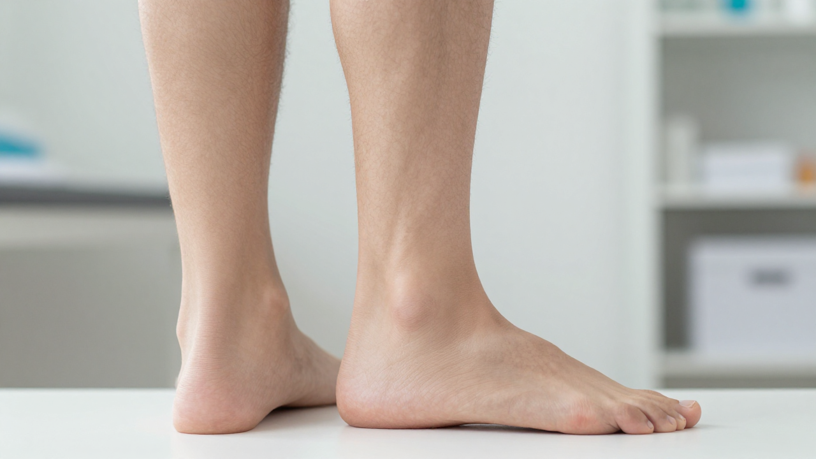


BRADFORD VTS TEACHING DECK
Ankle and Foot Problems in Primary Care
Resource:
Comprehensive Clinical Guidance
Date:
Created June 2026, updated to current NICE standards
⚠ CLINICAL DISCLAIMER
This resource is for educational purposes. Always verify clinical decisions against current NICE guidance and BNF drug doses.
www.bradfordvts.co.uk

Slide 2


















Scope and Overview
CLINICAL GUIDANCE • WWW.BRADFORDVTS.CO.UK
Clinical Scope: What We Cover
Out of Scope
Shin Problems: Overuse injuries, Medial Tibial Stress Syndrome, and compartment syndrome.
Acute bony fractures
Emergency trauma workup
Ankle Injuries: Ligament sprains, tendon pathology, and the POLICE principle.
Septic arthritis management
Paediatric pathology
Foot Problems: Plantar fasciitis, arch collapse, metatarsalgia, and stress fractures.
*Paediatric and surgical emergency topics are covered in dedicated separate VTS modules.
Focus is on evidence-based Primary Care management (NICE CKS 2024 / NG226).
Disclaimer: For educational purposes. Verify clinical decisions against current NICE guidance and BNF.
www.bradfordvts.co.uk

Slide 3











Palindromic Arthritis: Features and Prognosis
CLINICAL GUIDANCE • WWW.BRADFORDVTS.CO.UK
Clinical Presentation
Long-term Prognosis
Episodic Attacks: Sudden onset of severe joint pain and swelling.
>60%
Transient Nature: Attacks last hours to days with 100% resolution between episodes.
of patients eventually progress to seropositive Rheumatoid Arthritis (RA) or Systemic Lupus Erythematosus (SLE).
Distribution: Can affect any joint (including the hip); often monoarticular per attack.
GP Monitoring
Imaging: X-rays are characteristically normal between attacks.
Regular surveillance is essential to catch evolution to chronic disease early:
Function: Movement may be restricted during an acute episode only.
CRP
Rheumatoid Factor
ANA
Anti-CCP
⚠ For educational purposes. Verify clinical decisions against current NICE guidance and BNF.
www.bradfordvts.co.uk

Slide 4




Shin Problems: Medial Tibial Stress Syndrome
CLINICAL GUIDANCE • WWW.BRADFORDVTS.CO.UK
Clinical Profile
Management Strategy
Definition: Overuse injury involving periostitis of the medial tibia (Shin Splints).
Load Management: Relative rest and activity pacing are primary interventions.
High-Risk Groups: Athletes, military recruits, and new runners increasing load too quickly.
Physiotherapy: Focus on muscle strengthening and gradual progressive loading programs.
Symptoms: Gradual onset medial shin pain; worse during exercise; relieved by rest.
Biomechanics: Assess for Plantar Arch Collapse (Flat Feet) which increases medial stress.
Examination: Localized tenderness along the posteromedial border of the tibia.
Orthotics: Custom arch supports often resolve shin pain in patients with biomechanical issues.
Differential Diagnosis
Return to Sport
Always consider stress fractures or compartment syndrome if symptoms are localized or neurovascular.
Gradual return is essential to prevent recurrence; focus on correct footwear and running mechanics.
www.bradfordvts.co.uk
⚠ This resource is for educational purposes. Always verify clinical decisions against current NICE guidance and BNF drug doses.

Slide 5







Shin Problems: Compartment Syndrome
CLINICAL GUIDANCE • WWW.BRADFORDVTS.CO.UK
Acute Compartment Syndrome
Chronic Exertional (CECS)
ETIOLOGY
ETIOLOGY
Post-trauma (fracture), crush injury, or extreme exertion.
Overuse/repetitive exercise; reversible rise in compartmental pressure.
CLINICAL PRESENTATION
Pain out of proportion to injury; "wood-like" tense compartment; passive stretch pain.
CLINICAL PRESENTATION
Predictable pain + tightness with exercise; relieved by rest within minutes.
THE 6 PS (LATE SIGNS)
Pain, Pallor, Pulselessness, Paresthesia, Paralysis, Poikilothermia.
PHYSICAL EXAM
Often normal at rest; may have muscle herniations (fascial defects).
SURGICAL EMERGENCY: IMMEDIATE REFERRAL
CONSIDER SURGICAL FASCIOTOMY IF CHRONIC
Disclaimer: For educational purposes. Verify clinical decisions against current NICE guidance.
www.bradfordvts.co.uk

Slide 6



Shin Problems: Anterior Tendonitis
CLINICAL GUIDANCE • WWW.BRADFORDVTS.CO.UK
Clinical Presentation
Management Strategy
Pathology
Overuse or inflammation of the Tibialis Anterior tendon.
Activity Modification
Reduction in aggravating activities (running/long walks) and pacing return to sport.
Primary Symptom
Pain localized to the dorsum of the ankle and the anterior leg.
Physiotherapy
Focused stretching of the anterior compartment and progressive strengthening.
Pathognomonic Sign
Exquisite pain during active dorsiflexion of the foot.
Pharmacology
Short course of oral NSAIDs or topical NSAID gels to manage acute inflammation.
Typical Patient
Often occurs after sudden increases in walking distance, hill training, or change in footwear.
Supportive Care
Review of footwear and consideration of orthotics if biomechanical issues are present.
⚠ Educational resource only. Verify clinical decisions against current NICE guidance.
www.bradfordvts.co.uk

Slide 7







Ankle: Anatomy and Systematic Examination
CLINICAL GUIDANCE • WWW.BRADFORDVTS.CO.UK
Joints & Movements
Examination Protocol
Tibiotalar Joint (True Ankle)
Inspection from BEHIND
Dorsiflexion (Tibialis Anterior) & Plantarflexion (Achilles Complex)
Check for Achilles inflammation, calcaneal valgus/varus
Subtalar Joint (Talocalcaneal)
Swelling & Erythema
Responsible for Inversion and Eversion
Pitting oedema vs localised joint swelling; check for erythema (gout/septic)
Range of Movement (ROM)
Assess active and passive dorsiflexion/plantarflexion
Lateral Ligament Complex
ATFL (Anterior Talofibular Ligament)
Most commonly injured ligament in inversion sprains
CFL & PTFL
Clinical Pearl: The Tiptoe Test
Calcaneofibular and Posterior Talofibular ligaments
Ask patient to go on tiptoes. If the medial arch restores, it indicates a benign/flexible flat foot.
Disclaimer: ⚠ This resource is for educational purposes. Always verify clinical decisions against current NICE guidance and BNF drug doses. | www.bradfordvts.co.uk

Slide 8


















Lateral Ankle Ligament Sprain: Grading
CLINICAL GUIDANCE • WWW.BRADFORDVTS.CO.UK
Grade 1
MILD
Grade 2
MODERATE
Grade 3
SEVERE
Stretch injury to ligament (ATFL)
Partial tear of ligament
Complete rupture of ligament(s)
Minimal pain and mild tenderness
Moderate pain and tenderness
Unable to weight-bear (4 steps)
No macroscopic tear present
Mild to moderate instability
Gross joint instability
Clinically stable joint
Restricted Range of Movement (ROM)
Significant swelling and bruising
Minimal swelling or bruising
Risk of associated fractures
Localized swelling and ecchymosis
Management: Full weight-bearing usually tolerated immediately.
Management: Functional support/brace often required for 4–6 weeks.
Management: Urgent review; rule out fracture via Ottawa Ankle Rules.
⚠ Educational resource only. Verify clinical decisions against current NICE guidance.
www.bradfordvts.co.uk

Slide 9








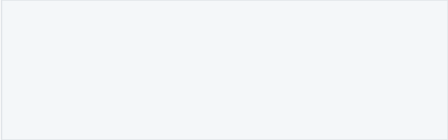
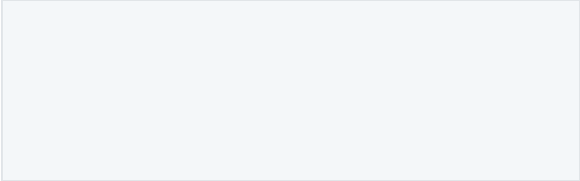



Ottawa Ankle Rules for Fracture Screening
CLINICAL GUIDANCE • WWW.BRADFORDVTS.CO.UK
X-ray ANKLE
X-ray FOOT
IF PAIN IN MALLEOLAR ZONE AND:
IF PAIN IN MIDFOOT ZONE AND:
OTTAWA
ANKLE
RULES
Bony tenderness at posterior tip or edge (6 cm) of lateral malleolus
Bony tenderness at base of 5th metatarsal
Bony tenderness at the navicular
Bony tenderness at posterior tip or edge (6 cm) of medial malleolus
Inability to weight-bear 4 steps — immediately AND in clinic
Inability to weight-bear 4 steps — immediately AND in clinic
NICE CKS
JUNE 2025
STILL VALID
96–99%
SENSITIVITY
FOR FRACTURE
Specificity ~40%
— safe to rule out,
some unnecessary X-rays
Rule-Out Safety
Weight-Bearing Definition
Palpation Technique
Negative rules = no X-ray needed — sensitivity 96–99% means near-zero missed fractures
Must take 4 steps unaided — hopping or limping does not count as weight-bearing
Palpate posterior edge of malleolus — not the tip; bony tenderness, not soft tissue
For educational purposes only — verify clinical decisions against current NICE guidance and BNF drug doses | www.bradfordvts.co.uk

Slide 10
















Management: The POLICE Principle
CLINICAL GUIDANCE • WWW.BRADFORDVTS.CO.UK
NICE CKS June 2025 Update: POLICE replaces the traditional RICE protocol to emphasize Optimal Loading.
P
OL
I
C
E
Protection
Optimal Loading
Ice
Compression
Elevation
Use functional brace or support for 4–6 weeks.
Early mobilisation is preferred over total rest.
Apply for 15–20 mins QDS wrapped in a damp towel.
Use an elastic bandage; apply snugly to limit swelling.
Keep limb elevated during the first 48 hours.
Grade 3 injuries: protection until pain-free walking.
Prolonged immobilisation delays recovery and tissue healing.
Most effective during the first 48 hours post-injury.
Aids venous return and reduces acute oedema.
CRITICAL: Remove bandage before sleeping.
⚠ Resource for educational purposes. Verify clinical decisions against current NICE guidance and BNF.
www.bradfordvts.co.uk

Slide 11








Ankle Sprain: Analgesia and Recovery
GP GUIDANCE: DELAYING NSAIDS & PROGRESSIVE MOBILIZATION
Pharmacological Strategy
Recovery & Physiotherapy
1
First-Line: Paracetamol
WEEK 1
Immediate use for baseline pain control. Consider Codeine for breakthrough if severe.
Alphabet Exercises
Active range of movement by "drawing" letters with the foot.
WEEK 2+
2
The 48-Hour Rule: NSAIDs
Proprioception Training
Delay oral NSAID initiation for at least 48 hours following acute injury.
Balance board work to restore neuromuscular control.
ONGOING
Achilles Stretching
CLINICAL RATIONALE:
Early NSAID use may impair the inflammatory phase of ligament healing.
Maintain flexibility to prevent secondary pathologies.
FINAL PHASE
Optimal Loading
AKT KEY POINT
Progressive sports-specific return protocol (POLICE principle).
Disclaimer: For educational purposes; verify clinical decisions against current NICE guidance and BNF drug doses.
www.bradfordvts.co.uk

Slide 12




Achilles Tendon Rupture: Clinical Presentation
CLINICAL GUIDANCE • WWW.BRADFORDVTS.CO.UK
The "Weekend Warrior"
Classic Symptoms
Typically affects 30–50 year old athletes.
Patient may hear or feel a loud "POP" or "SNAP" in the lower calf.
Sudden onset during explosive push-off (squash, tennis, basketball, jumping).
Common description: "I felt like someone kicked me in the heel."
Often occurs in patients who are relatively sedentary but engage in high-intensity weekend sports.
Immediate difficulty weight-bearing and loss of power during push-off.
CRITICAL: AVOID MISSED DIAGNOSIS
Do NOT be falsely reassured if the patient can still plantarflex. Secondary flexors (e.g., Flexor Hallucis Longus) may allow for weak active movement. The Thompson Test is mandatory for all suspected cases.
⚠ Educational purposes only. Verify decisions against current NICE guidance.
www.bradfordvts.co.uk • June 2026

Slide 13







Achilles Rupture: The Thompson Test
CLINICAL GUIDANCE • WWW.BRADFORDVTS.CO.UK
THOMPSON TEST
Patient Positioning
Patient prone with knees flexed to 90°. Alternatively, patient kneels on a chair with feet hanging off the edge.
Execution
Firmly squeeze the calf muscle belly (gastrocnemius and soleus complex).
NORMAL FINDING
POSITIVE (RUPTURE)
Passive Plantarflexion
No Foot Movement
CRITICAL CLINICAL PEARL: Some active plantarflexion may still be present via other flexors (e.g., Flexor Hallucis Longus). Do NOT be falsely reassured by active movement; the Thompson Test is the gold standard clinical screen.
URGENT ORTHOPAEDIC REFERRAL REQUIRED
⚠ Educational resource only. Verify clinical decisions against current NICE guidance.
www.bradfordvts.co.uk

Slide 14







Achilles Tendinopathy: Non-Rupture Management
CLINICAL GUIDANCE • WWW.BRADFORDVTS.CO.UK
Alfredson Eccentric Loading
Mandatory Warning
NO STEROID INJECTIONS
Chronic Overuse: Degeneration rather than inflammation
Pathology usually 2–6cm above the calcaneal insertion.
Never inject corticosteroids into or adjacent to the Achilles tendon.
The Protocol: High-repetition eccentric exercises (calf drops) performed over a step.
CRITICAL RISK: Direct link to sudden tendon rupture and significant fat pad atrophy.
Dosage: Typically 3 sets of 15 repetitions, twice daily, for 12 weeks.
Load Management: Activity pacing is vital; avoid complete rest but limit high-impact "explosive" movements.
Clinical Distinction
Adjuncts: Heel raises in footwear can reduce immediate tension on the tendon.
Distinguish mid-portion tendinopathy from insertional tendinopathy, as management of the latter may require modified loading angles.
Physiotherapy: Progressive proprioception and stretching of the gastrocnemius/soleus.
Note: Reassure patients that some discomfort during eccentric loading is expected and often necessary for tendon remodeling.
Bradford VTS Teaching Deck • June 2026 Update
Disclaimer: Verify clinical decisions against current NICE guidance. • www.bradfordvts.co.uk

Slide 15
















Foot: Plantar Arch Collapse (Pes Planus)
CLINICAL GUIDANCE • WWW.BRADFORDVTS.CO.UK
Clinical Presentation
Management Strategy
Nature: Pain is often biomechanical, worsening after walking or at the end of the day.
Custom Arch Supports: Essential for weight redistribution. Must use gradual "weaning" to allow foot adaptation.
Referred Pain Sites:
Physiotherapy: Focused on intrinsic foot muscle strengthening and lower limb alignment.
Toes
Ankle
Ant. Tibia
Heel
Knee (Anserine)
Activity Modification: Pacing and appropriate footwear selection.
Clinical Pearls
The Tiptoe Test
NSAIDs: Generally not effective for the structural pain of arch collapse.
Ask the patient to stand on their tiptoes to observe the medial longitudinal arch.
Referral: Urgent if rigid flat foot or associated with neurological symptoms.
FLEXIBLE ARCH
RIGID ARCH
Arch restores on tiptoes. Benign biomechanical issue.
Arch remains flat. Requires orthopaedic referral.
Check the arch in any patient with unexplained shin or medial knee pain.
Disclaimer: This resource is for educational purposes. Verify decisions against current NICE guidance.
www.bradfordvts.co.uk

Slide 16








Plantar Fasciitis: Presentation and Diagnosis
CLINICAL GUIDANCE • WWW.BRADFORDVTS.CO.UK
Epidemiology & Risk
Clinical Examination
Point Tenderness: Medial calcaneal tuberosity.
10%
40–60
Windlass Test: Passive dorsiflexion of big toe triggers pain.
LIFETIME RISK
PEAK AGE RANGE
Tiptoe Walking: Pain significantly increased (diagnostic).
Risk Factors: Overweight (BMI >30), standing occupations.
Check for tight Achilles/gastrocnemius complex.
Biomechanics: Overpronation (pes planus).
Key Presentation
"Start-up pain": Severe heel pain on first morning steps.
Pain improves with initial movement.
CLINICAL PEARL
Imaging & Heel Spurs
Worsens after prolonged standing or activity.
Heel spurs seen on X-ray are INCIDENTAL FINDINGS. They are not the cause of pain. Treat the fasciitis, not the spur. X-rays are usually not required for diagnosis.
Location: Inferior heel, often radiates medially.
www.bradfordvts.co.uk • Created June 2026
⚠ Disclaimer: Verify clinical decisions against current NICE guidance and BNF drug doses.

Slide 17

















Plantar Fasciitis: NICE CKS 2024 Management
CLINICAL GUIDANCE • WWW.BRADFORDVTS.CO.UK
First-Line: Education
Footwear & Orthoses
Specialist Referral
REASSURANCE
Cushioned Heel: Use shoes with good shock absorption.
Corticosteroid Injections: Effective for short-term relief (>70% success).
90% resolve within 12 months with conservative management.
Avoid Barefoot: Especially on hard surfaces at home.
Rupture risk (5-10%) + Fat pad atrophy.
Explain that heel spurs on X-ray are incidental and do not require treatment.
Arch Supports: Off-the-shelf orthoses for overpronation.
ESWT: Extracorporeal Shockwave Therapy for persistent cases (>3-6 months).
Focus on weight management if BMI is elevated to reduce load.
Surgery: Plantar fascia release only after 12 months of failed conservative care.
Pharmacotherapy
Stretching Protocol
Paracetamol: Base-level analgesia for symptom control.
Timing: Perform stretches before first step in the morning.
Topical NSAIDs: First-line pharmacological option.
Plantar Fascia: Passive dorsiflexion of toes and ankle.
Oral NSAIDs: Short course for acute inflammatory flares.
Gastrocnemius: Wall stretches for calf flexibility.
⚠ Educational purposes only. Verify clinical decisions against current NICE guidance and BNF.
www.bradfordvts.co.uk

Slide 18










Stress Fractures of the Foot
CLINICAL GUIDANCE • WWW.BRADFORDVTS.CO.UK
Clinical Presentation
Diagnostic Timeline
Sudden onset localized pain and focal swelling.
Weeks 0–3
Plain X-rays are typically NORMAL. Do not rely on early imaging to exclude fracture.
Common sites: 2nd/3rd Metatarsals and Calcaneus.
Typically follows a recent increase in physical activity.
Weeks 3–6
Differential diagnosis: Often mimics acute Gout.
New bone formation or "callus" may become visible on X-ray during healing.
HIGH RISK GROUPS
Gold Standard
Women (consider Osteoporosis/DEXA scan).
MRI or Bone Scan is required for definitive early diagnosis if clinical suspicion is high.
Military recruits and distance runners.
Management
Rest and activity modification (non-weight bearing if severe).
Protective, stiff-soled footwear or walking boot.
DEXA scan if fractures are multiple or recurrent.
⚠ For educational purposes. Verify decisions against current NICE guidance and BNF.
www.bradfordvts.co.uk • June 2026

Slide 19



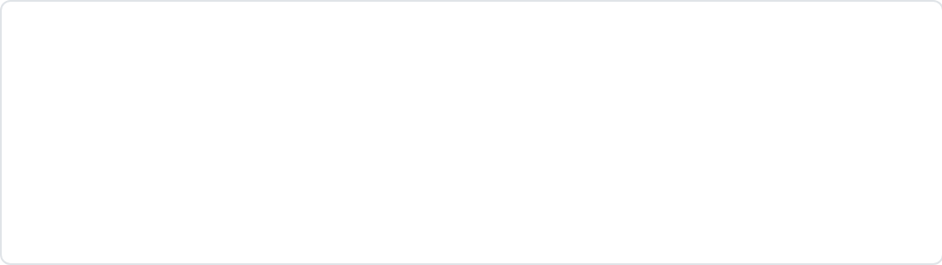
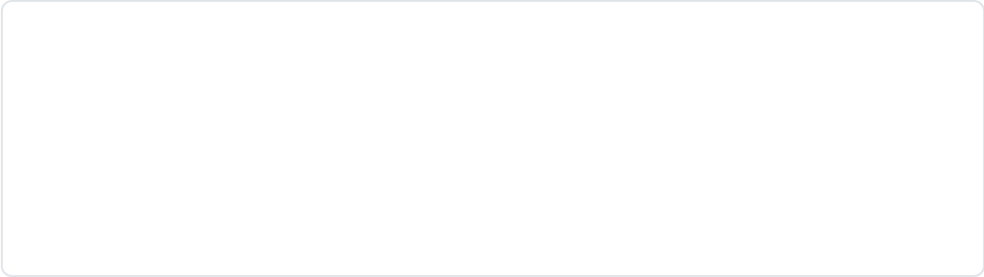
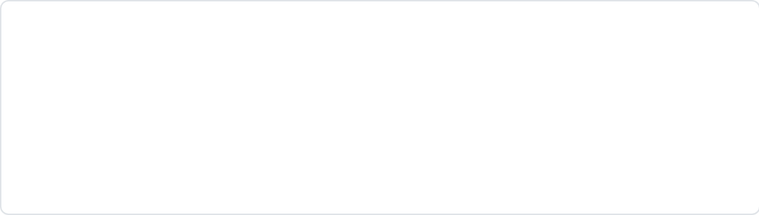
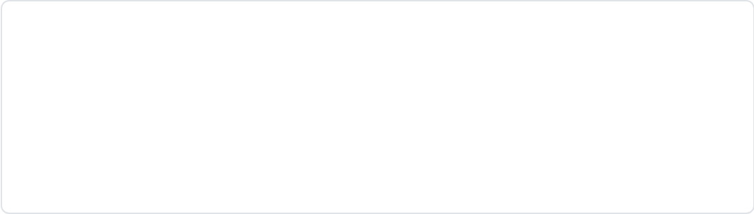





Metatarsalgia and Morton's Neuroma
CLINICAL GUIDANCE • WWW.BRADFORDVTS.CO.UK
Metatarsalgia
Morton's Neuroma
Definition & Presentation
Nerve Entrapment
Generalized forefoot pain under metatarsal heads. Described as a dull, aching pressure or stone-bruise sensation.
Burning or electric shock sensation, typically between the 3rd and 4th metatarsal heads.
Key Etiology
Diagnostic Test
Often secondary to transverse arch collapse or metatarsal head overload. Aggravated by high-impact activity or high heels.
Mulder's Click Test: Palpable click/pain when squeezing metatarsal heads together while applying plantar pressure.
Wide/Flat Footwear
Metatarsal Pads / Arch Supports
Steroid Injection (Intermetatarsal)
Surgical Referral (Last Resort)
⚠ Educational resource. Verify clinical decisions against current NICE guidance and BNF drug doses.
Bradford VTS • www.bradfordvts.co.uk

Slide 20
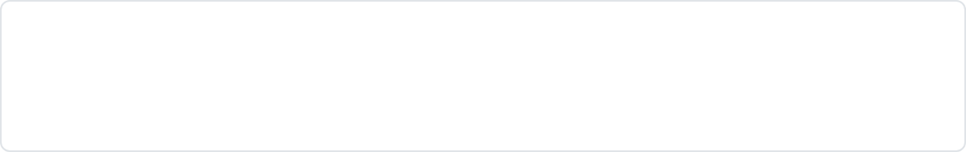


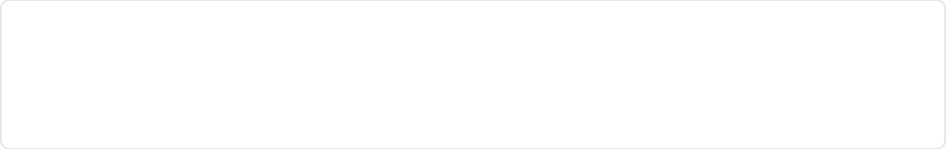



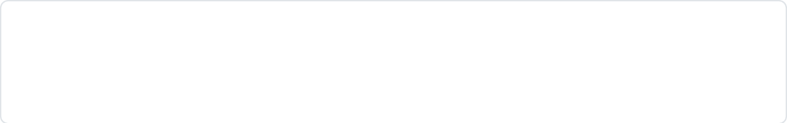


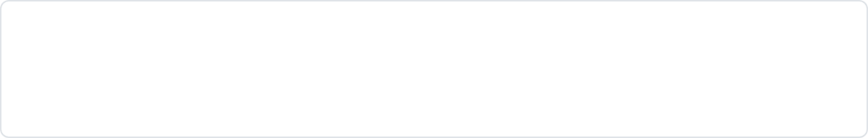


Bradford VTS Mandatory: Top Tips
CLINICAL GUIDANCE • WWW.BRADFORDVTS.CO.UK
Thompson Test (Simmonds)
Plantar Fasciitis Prognosis
Squeeze calf; no passive plantarflexion = Achilles Rupture. Refer urgently even if they can walk.
90% resolve within 12 months. Stretching (fascia + calf) before the first morning step is the first-line treatment.
POLICE Principle
Steroid Injection Safety
Replaces RICE. Emphasize Optimal Loading; early mobilization is superior to prolonged total rest for healing.
Never inject into/adjacent to the Achilles tendon. High risk of total tendon rupture.
Ankle NSAID Timing
Heel Spurs on X-Ray
Start oral NSAIDs only after 48 hours. Early use may impair the inflammatory phase of ligament healing.
Often an incidental finding. Treat the clinical fasciitis/degeneration, not the radiological spur.
The Tiptoe Test
Glucosamine in OA
Ask patient to stand on tiptoes. If arch restores = flexible flat foot (benign). If it remains flat = rigid (refer).
NICE NG226 (2022) explicitly states NOT recommended. Focus on exercise and weight management instead.
⚠ Verify clinical decisions against current NICE guidance and BNF drug doses.
Bradford VTS Teaching Deck • June 2026 • www.bradfordvts.co.uk

Slide 21








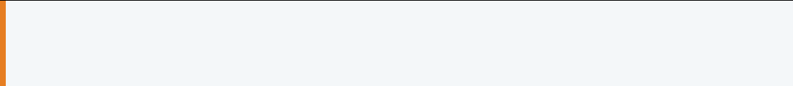
Exam Pearls: AKT and SCA Focus
CLINICAL GUIDANCE • WWW.BRADFORDVTS.CO.UK
AKT Knowledge
SCA Communication
REASSURANCE (PLANTAR FASCIITIS)"I know it's painful, but the good news is that 90% of cases resolve within a year with these stretches."
Ottawa Ankle Rules
Sensitivity ~96-99%. Negative rules = no X-ray needed safely.
ICE & SCREENING (ANKLE)"What's worrying you most today? Are you concerned it might be broken?"
POLICE Mnemonic
Replaces RICE. "Optimal Loading" is the key differentiator.
SHARED DECISION MAKING (INJECTION)"The injection is very effective short-term, but there's a 5-10% risk of tendon damage we must consider."
Pharmacology Timing
Delay NSAIDs for 48h in sprains to prevent impaired healing.
LIFESTYLE ADVICE (POLICE)"The best thing for recovery is not to rest completely—gentle, optimal movement actually helps it heal faster."
Plantar Fasciitis
Stretching is 1st line (CKS 2024); Heel spurs are incidental.
AVN Risk Factors
Steroids, SLE, Alcohol, and Sickle Cell (High-yield AKT list).
⚠ Disclaimer: This resource is for educational purposes. Always verify clinical decisions against current NICE guidance and BNF drug doses.
www.bradfordvts.co.uk

Slide 22






Bradford VTS Mandatory: Red Flags
CLINICAL GUIDANCE • WWW.BRADFORDVTS.CO.UK
01
Septic Arthritis
ADMIT IMMEDIATELY
Hot, swollen joint + fever + systemic malaise. Pediatric limp + fever is an emergency.
02
Achilles Tendon Rupture
URGENT REFERRAL
Positive Thompson test (no passive plantarflexion on calf squeeze). Sudden "pop" history.
03
Neurovascular Compromise
A&E EMERGENCY
Pallor, paraesthesia, pulselessness, or coolness in the distal limb following injury.
04
Suspected Malignancy
URGENT WORKUP
Unexplained hip/bone pain + constitutional symptoms (weight loss, night sweats).
05
Acute Haemarthrosis
SPECIALIST REVIEW
Ankle swelling occurring in <8 hours post-trauma; suggests major ligament complex injury.
06
Metabolic Bone Disease
DEXA / BLOODS
Non-resolving stress fractures or multiple fractures; investigate for underlying osteoporosis.
⚠ This resource is for educational purposes. Always verify clinical decisions against current NICE guidance and BNF drug doses.
www.bradfordvts.co.uk

Slide 23






Common Pitfalls and Quick Recall
CLINICAL GUIDANCE • WWW.BRADFORDVTS.CO.UK
Key clinical errors to avoid in practice and high-yield facts for AKT/SCA exam preparation.
Common Pitfalls
Quick Recall
Using RICE instead of the updated POLICE principle.
Prescribing NSAIDs within 48 hours of ankle ligament injury.
Use POLICE, not RICE.
Delay NSAIDs for 48 hours.
Injecting steroids near the Achilles tendon (rupture risk).
Treating incidental heel spurs instead of the fasciitis.
Thompson test: No plantarflexion = rupture.
No steroids near Achilles tendon.
Recommending glucosamine for OA (not NICE NG226 recommended).
Stretching first for plantar fasciitis.
Ottawa rules: Check bony tenderness.
Missing Achilles rupture due to preserved FHL toe flexion.
Not checking the plantar arch in chronic shin pain.
X-rays initially miss stress fractures.
Septic arthritis: Hot joint, emergency.
Ignoring Morton's neuroma in "general" metatarsalgia cases.
Treating palindromic arthritis as a benign self-limiting condition.
Disclaimer: For educational purposes. Verify clinical decisions against current NICE guidance and BNF drug doses.
www.bradfordvts.co.uk

