Slide 1

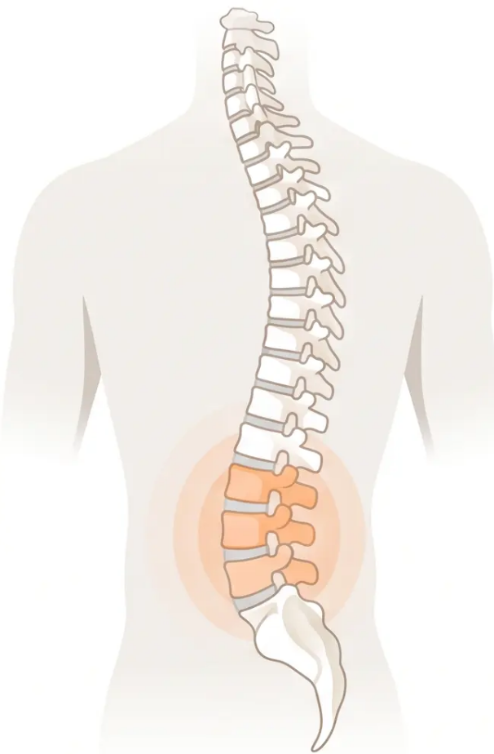

BRADFORD VTS TEACHING DECK
Back Pain
Management, Prescribing
and the Evidence
Verified against:
NICE NG59 (Nov 2016, updated Dec 2020)
BNF 2025
National CES Pathway March 2026
www.bradfordvts.co.uk
*This teaching resource is intended for educational purposes only and does not constitute clinical advice. Always refer to current NICE guidelines, BNF, and local protocols for patient management decisions.
Bradford VTS · www.bradfordvts.co.uk · June 2026
Slide 1 of 10

Slide 2





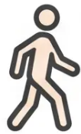



BRADFORD VTS TEACHING DECK
NICE NG59 · Management Principles
NICE NG59 Core Management Principles
The biopsychosocial approach to low back pain — what NICE actually says
Reassure and
Empower
Advise Staying
Active
Do NOT Advise
Bed Rest
Return to
Work Early
Use the STarT
Back Tool
Use positive language.
Avoid 'ruptured disc'
or 'crumbly spine.'
Empower self-
management.
Strong evidence:
activity aids recovery.
Bed rest causes
debilitation and
delays rehabilitation.
2 RCTs: faster
recovery with activity.
5 RCTs: less sick
leave and
chronic disability.
Does not need to be
pain-free first.
Longer absence =
worse prognosis.
Stratify risk to direct
intensity of
management.
Low / medium / high
risk pathways.
⚠ Key NICE NG59 Message:
"Tailor education and information to the individual. The goal is to support the patient in active self-
management — not passive treatment."
Bradford VTS · www.bradfordvts.co.uk · NICE NG59 (updated Dec 2020)
Slide 2 of 10

Slide 3








BRADFORD VTS TEACHING DECK
NICE NG59 • BNF 2025
Pharmacological Management of Low Back Pain
First-line prescribing • Dose guidance • What NOT to prescribe
STEP 1 — FIRST-LINE
Oral NSAIDs
Gastroprotection:
Prescribing:
• Add omeprazole 20mg once daily if:
• Age over 45
• Ibuprofen 400mg three times daily with food
• Naproxen 500mg twice daily (alternative)
• History of peptic ulcer disease
• Co-prescribed aspirin or steroids
• Lowest effective dose • Shortest possible time
• Monitor BP and renal function in at-risk patients
No clear evidence any NSAID is superior to another (NICE NG59).
⚠ DO NOT OFFER
Paracetamol Alone — Not Recommended
• NICE NG59: Do NOT offer paracetamol monotherapy for low back pain
• No placebo-controlled RCT evidence supporting paracetamol in acute LBP
• May be used as an adjunct alongside NSAIDs — but NOT as standalone first-line treatment
• Previous stepwise ladder (paracetamol → NSAIDs) is now outdated guidance
Paracetamol alone is no longer first-line for LBP — NICE NG59 (updated Dec 2020).
STEP 2 — RESTRICTED USE ONLY
Weak Opioids — Only if NSAIDs Contraindicated or Ineffective
When to consider:
Dose and cautions:
• NSAID contraindicated
• Co-codamol 8/500 — two tablets four times daily
• NSAID not tolerated
• Short-term use only • Do not continue routinely
• NSAID ineffective after adequate trial
• Do NOT offer opioids for chronic low back pain
• Short-term acute pain only
• Apply Opioid Risk Tool before prescribing
• Prescribe at regular scheduled intervals — never PRN
Risk factors for opioid misuse: FH substance use, personal history of misuse, psychological vulnerability, age 16–45.
Bradford VTS • www.bradfordvts.co.uk • June 2026
Slide 3 of 10

Slide 4





BRADFORD VTS TEACHING DECK
SECTION 4 OF 10 · SCIATICA & NEUROPATHIC PAIN
Managing Sciatica and Neuropathic Pain
✕ DO NOT OFFER for Sciatica
✓ Consider for Sciatica
No evidence of benefit in sciatica — evidence of harm.
Gabapentinoids
Epidural Injection
Reclassified as Class C Controlled Drugs (abuse and dependence
risk). Prescribing is now a clinical governance issue.
Local anaesthetic + steroid
(gabapentin · pregabalin)
When to consider: Acute and
severe sciatica only
Benzodiazepines
No benefit demonstrated in sciatica. Evidence of harm and
dependency risk. Not recommended by NICE NG59.
(e.g. diazepam)
Not appropriate for:
Oral Corticosteroids
Neurogenic claudication from
central spinal canal stenosis
No benefit in pain or function for sciatica. Not recommended.
Opioids
No evidence of benefit. Significant long-term harms. Do not
offer for chronic presentations.
Not appropriate for: Chronic
sciatica or non-specific LBP
(chronic sciatica)
If a patient is already taking these: explain risks, discuss planned withdrawal as shared decision-making.
⚠ Gabapentinoid Reclassification — Class C Controlled Drug (2019)
Prescribing gabapentin or pregabalin for back pain or sciatica is now explicitly against NICE guidance AND carries controlled drug
governance obligations. Document your rationale carefully if any existing patient is continuing these medications.
Bradford VTS · www.bradfordvts.co.uk · June 2026
Slide 4 of 10

Slide 5




BRADFORD VTS TEACHING DECK
PHARMACOLOGY · SECTION 5 OF 10
Muscle Relaxants: Evidence and BNF Guidance
Cochrane evidence vs. NICE NG59 — and what the BNF actually says
COCHRANE REVIEW 2003 · van Tulder et al.
NICE NG59 · CURRENT GUIDANCE
What the evidence shows
What NICE recommends
• 30 trials reviewed — 77% high quality; 80% focused on
acute LBP
• Muscle relaxants are NOT part of the NICE NG59
management pathway
• Strong evidence: muscle relaxants more effective than
placebo for short-term pain relief in acute LBP
• Previous NICE CKS (pre-2016) listed diazepam as first-line
— this has been removed
• Adverse effects in up to 70% of patients — drowsiness,
dizziness most common
• Modest short-term benefit outweighed by: adverse effects,
dependence risk, and availability of better alternatives
“Muscle relaxants are effective in non-specific LBP, but
adverse effects require they be used with caution.”
⚠ NOT RECOMMENDED IN CURRENT PATHWAY
BNF 2025 · Diazepam for Acute Muscle Spasm
Methocarbamol (Non-Benzodiazepine)
Indication · Starting Dose · Maximum Dose · Duration
BNF dose: 1.5 g QDS (reduced to 750 mg TDS if required)
Acute muscle spasm · 2 mg TDS · 5 mg TDS · 2–5 days maximum
Elderly: up to 750 mg QDS
Sciatica · — · — · — · NOT recommended (NICE NG59)
BNF classification: “Less suitable for prescribing” — clinical
*Significant alertness deterioration at doses above 5 mg. Risk of dependence.
Non-specific LBP only — never for sciatica.
efficacy not well established
Rarely used in modern UK practice
Bradford VTS · www.bradfordvts.co.uk · June 2026
Slide 5 of 10

Slide 6




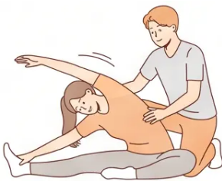

NICE NG59 · Non-Pharmacological Management
Non-Pharmacological Treatments and Evidence
✓ RECOMMEND
✕ DO NOT OFFER
Exercise Programme
Traction — Evidence of no effect
Group or individual — first-line for chronic LBP. Strong RCT
evidence. Note: no benefit in acute LBP.
Acupuncture — No RCTs in acute LBP; poor evidence in chronic
Manual Therapy
Manipulation, mobilisation, soft tissue — only as part of a
package with exercise ± psychological therapy.
TENS — Insufficient and conflicting evidence
Ultrasound / Short-wave Diathermy — No evidence of benefit
Psychological Therapy (CBT)
With exercise — consider for persistent LBP with
psychosocial barriers.
Belts, Corsets, Orthotics — No evidence of benefit
Spinal / Facet Joint Injections — Not for non-specific LBP
Combined Physical + Psychological Programme
Good evidence for chronic LBP. Addresses yellow flags effectively.
⚠️ Manipulation is only recommended as part of a treatment package
with exercise — never as a standalone treatment (NICE NG59)
Bradford VTS · www.bradfordvts.co.uk · June 2026
Slide 6 of 10

Slide 7








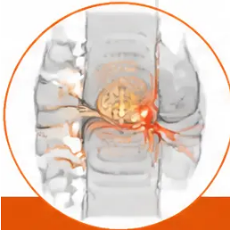

BRADFORD VTS TEACHING DECK
SECTION 7 · EMERGENCY RECOGNITION & SURGICAL EVIDENCE
Red Flags and Surgical Indications
RED FLAGS — Act Immediately
SURGICAL EVIDENCE — What the RCTs Show
CAUDA EQUINA SYNDROME
Weber RCT · n=126 · 10-year follow-up
→ IMMEDIATE surgical referral
• Surgery: better outcomes at 1 year
• At 4 years: difference no longer statistically significant
• Bladder or bowel dysfunction (retention, incontinence)
• Conclusion: Surgery gives faster early relief; long-term
outcomes equalise
• Saddle anaesthesia (perineal numbness)
Classic Evidence
• Bilateral leg weakness or numbness
Peul et al. · n=280 · 1-year follow-up
• Severe or rapidly progressive neurological deficit
• Surgery vs. conservative: similar outcomes at 1 year
Do not delay — same-day emergency referral
• Surgery gave faster recovery and self-perceived pain relief
• Conclusion: Surgery accelerates recovery but does not
change 1-year endpoint
PROGRESSIVE MOTOR WEAKNESS
Key RCT
→ URGENT surgical referral
Cochrane 2008 — Discectomy for Sciatica
• Worsening foot drop
• Surgical discectomy provides effective relief for carefully
selected patients
• Progressive limb weakness despite conservative management
• Sciatica due to lumbar disc prolapse failing conservative management
• Neurological signs worsening over days
• Faster relief from acute attack
Systematic Review
• Long-term outcomes remain unclear
Key Message:
NICE NG59: Spinal fusion NOT offered for non-specific LBP ·
Disc replacement NOT offered · Epidural steroids only for
acute severe sciatica
Surgery = faster early relief. Long-term outcomes are
similar to conservative management. Select patients carefully.
Bradford VTS · www.bradfordvts.co.uk · June 2026
Slide 7 of 10

Slide 8




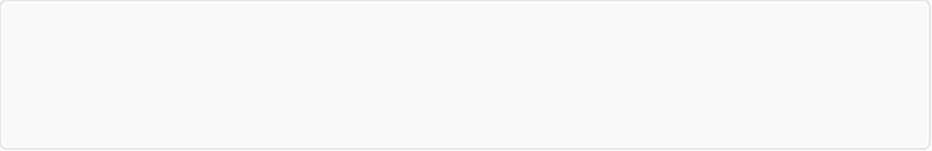

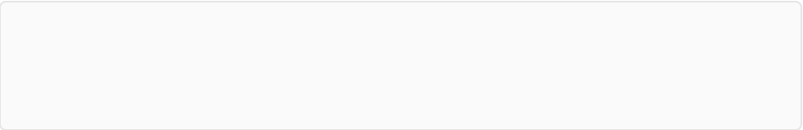




BRADFORD VTS TEACHING DECK
Section 8 • Occupational Management & Consultation Skills
Return to Work & SCA Communication
Return to Work — Key Strategies
SCA Communication — What to Say
Myth-Bust Early
"Tell me about your back pain — when did it start, and how is
it affecting your daily life?"
You don't need to be 100% better to return to work —
activity aids recovery.
Open question, patient-centred, invites narrative before examination.
Ask the Patient First
"I'm confident there's no serious injury. Back pain is extremely
common — the pain doesn't mean damage is happening."
What adjustments at work would help you get back
sooner?' — patient-led solutions.
Normalise, avoid catastrophising language. Never say "crumbly spine"
or "ruptured disc."
Use the Fit Note Well
Communicate with employers: graded return, light duties,
part-time hours, adjusted role.
"I'd suggest an anti-inflammatory like ibuprofen taken regularly
with food — that's what current NICE guidelines recommend first.
Paracetamol alone isn't as effective for back pain."
Occupational Health Referral
Use OH services where available for complex or
prolonged absences.
Addresses patient expectations; explains NICE position simply.
The Numbers Matter
"Being at work often helps recovery. Is there anything we could
adjust to help you go back sooner?"
4–12 weeks off → 40% still off at 1 year.
6 months off → 90% chance of never returning to work.
(Waddell, 2002)
Proactive RTW conversation; use Fit Note to facilitate, not to sign
off indefinitely.
Validate pain before reassurance: "Your pain is real" — then explain, then educate.
Bradford VTS • www.bradfordvts.co.uk • June 2026
Slide 8 of 10

Slide 9








BRADFORD VTS TEACHING DECK
SECTION 4 OF 4 — CLINICAL PRACTICE
Top Tips & Common Pitfalls
Essential clinical pearls and errors to avoid in back pain management
✓ TOP TIPS
Do these
✕ COMMON PITFALLS
Avoid these
1 · Prescribe analgesics at regular intervals — not PRN.
Scheduled dosing gives better pain relief and supports mobilisation.
1 · Paracetamol first for LBP — NOT recommended by
NICE NG59. NSAIDs are first-line.
2 · NSAIDs are first-line for LBP — not paracetamol alone.
Update your prescribing habits to match NICE NG59.
2 · Prescribing gabapentin or pregabalin for back pain or
sciatica — explicitly NOT recommended; now Class C
controlled drugs.
3 · Physiotherapy and exercise outperform most drugs for
chronic LBP. Refer early.
3 · Advising bed rest — strongly contraindicated.
Activity is the evidence-based approach.
4 · Validate the patient's pain first — "Your pain is real" —
before jumping to reassurance or advice.
4 · Opioid escalation trap — avoid long-term opioids for LBP.
Chronic opioid use worsens outcomes.
5 · Discuss return to work proactively. The longer off work,
the worse the prognosis.
5 · Benzodiazepines for sciatica — no benefit, evidence
of harm and dependency risk.
6 · Use the STarT Back Tool to stratify risk and
direct management intensity.
6 · Not exploring yellow flags — failure to address
psychosocial factors is the most common reason for
poor outcomes.
Bradford VTS · www.bradfordvts.co.uk · June 2026
Slide 9 of 10

Slide 10









BRADFORD VTS TEACHING DECK
SECTION 4 OF 4 • EXAM PREPARATION
AKT Exam Pearls & Quick Recall
AKT EXAM PEARLS
QUICK RECALL SUMMARY
NICE NG59: NSAIDs are FIRST-LINE for LBP
DO OFFER
• NSAIDs first-line (lowest dose, shortest time + PPI if needed)
Not paracetamol alone — this is a common exam trap
• Exercise programme — first-line non-pharmacological
• Manual therapy — only as part of exercise package
Gabapentinoids: NOT recommended for LBP or sciatica
• CBT + exercise for persistent LBP with psychosocial barriers
Now Class C controlled drugs — prescribing is a governance issue
• Advice to stay active and return to work early
• Epidural (local anaesthetic + steroid) for acute severe sciatica
• Spinal decompression if non-surgical Rx failed + consistent radiology
Benzodiazepines: NOT recommended for sciatica
No benefit; evidence of harm and dependency
DO NOT OFFER
• Paracetamol alone for LBP
Co-proxamol: WITHDRAWN from UK market 2005
• Gabapentinoids for LBP or sciatica
Never prescribe — still appears in older textbooks
• Benzodiazepines for sciatica
• SSRIs / SNRIs / TCAs for non-specific LBP
• Traction, acupuncture, TENS, ultrasound
Diazepam for muscle spasm: 2mg TDS (max 5mg TDS)
Maximum 2–5 days only — BNF 2025
• Spinal injections or fusion for non-specific LBP
• Opioids routinely for acute LBP; never for chronic LBP
SURGICAL EVIDENCE QUICK-STRIP
Epidural injection: acute, severe sciatica only
Weber RCT (1983)
Cochrane 2008
Peul et al. (2007)
Not for non-specific LBP; not for neurogenic claudication
Surgery better at 1 yr; no
significant difference at 4 yrs
Surgery = faster early recovery;
similar outcomes at 1 yr
Discectomy effective for
selected patients; faster relief,
long-term outcomes unclear
This teaching resource is intended for educational purposes only and does not constitute clinical advice. Always refer to current NICE
guidelines, BNF, and local protocols for patient management decisions. Content verified June 2026.
www.bradfordvts.co.uk
Bradford VTS • www.bradfordvts.co.uk • June 2026
Slide 10 of 10

