Slide 1


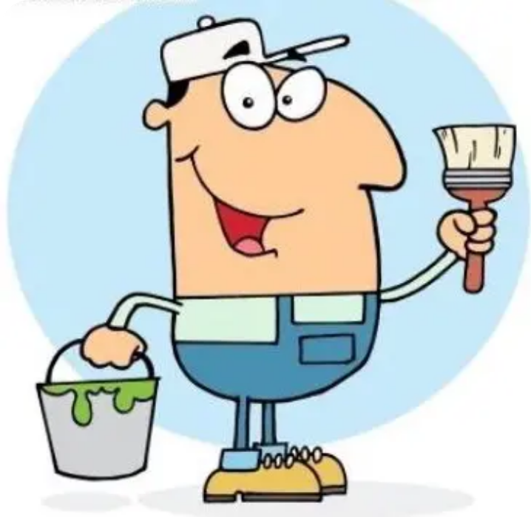


BRADFORD VTS TEACHING DECK
Elbow and Wrist Problems
in General Practice
Evidence-Based Guidance
DESIGNED FOR GPs & TRAINEES
June 2026
www.bradfordvts.co.uk
Updated to NICE 2024/2025 Standards
Medical Disclaimer: This presentation is for educational purposes for GP trainees and IMGs. Clinical decisions must be based on the individual patient assessment and the most current official NICE guidelines and BNF recommendations.
www.bradfordvts.co.uk

Slide 2












INTRODUCTION TO ELBOW AND WRIST PROBLEMS
CLINICAL GUIDANCE & EXAM FOCUS
Primary Care Context
Elbow and wrist problems are high-frequency presentations, particularly in working-age adults. Clinical diagnosis is often precise with systematic assessment.
AKT FOCUS: MUSCLE ATTACHMENTS
FM
Flexors → Medial Epicondyle (Like FM Radio)
EL
Extensors → Lateral Epicondyle
Essential for distinguishing Golfer's vs. Tennis Elbow during resisted testing.
The Biomechanical Chain
Typical Clinical Course
The elbow does not function in isolation; it is biomechanically linked to the wrist and the shoulder.
KEY PRINCIPLE: Always examine the cervical spine and shoulder as part of an elbow assessment to exclude referred pain.
Symptoms often resolve naturally with rest. However, tendinopathies can last 12–18 months, requiring careful patient education on expectations.
www.bradfordvts.co.uk
Created June 2026 | NICE 2024/2025 Standards

Slide 3








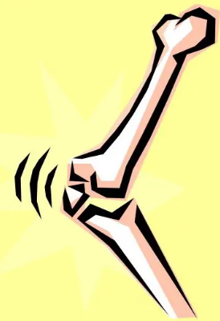


ELBOW ANATOMY AND BIOMECHANICS
CLINICAL GUIDANCE & EXAM FOCUS
Three Articulations
Critical Nerve Pathways
Humeroulnar Joint: Primary hinge for Flexion and Extension (0–145°).
Median Nerve
Courses medially; can be compressed in the cubital tunnel or anterior elbow region.
Humeroradial Joint: Secondary articulation aiding Flexion/Extension.
Proximal Radioulnar Joint: Pivot joint enabling Pronation and Supination.
Radial Nerve
Divides into the Posterior Interosseous Nerve (PIN) near the radial head. PIN compression mimics lateral pain.
Ulnar Nerve
Passes through the Cubital Tunnel (posterior to medial epicondyle). Tinel's test reproduces tingling here.
AKT CLINICAL POINT: The elbow is biomechanically linked to the wrist and shoulder. Bilateral symptoms should always trigger an assessment of the Cervical Spine for referred pathology.
www.bradfordvts.co.uk
Slide 4 of 29

Slide 4






SYSTEMATIC ELBOW EXAMINATION: LOOK AND MOVE
CLINICAL GUIDANCE & EXAM FOCUS
Look (Inspection)
Move (Range of Motion)
Swelling: Look for nodules (RA), joint effusion, or olecranon bursitis (posteriorly).
145°
0°
FLEXION
EXTENSION
Skin Changes: Check for bruising, muscle wasting, erythema, or psoriasis plaques (extensor surfaces).
80–90°
80–90°
Alignment: Assess for Varus or Valgus deformities.
SUPINATION
PRONATION
Carrying Angle: Normal valgus is 5–15°. AKT
SCA COMMUNICATION TIP
Scars: Evidence of previous surgeries (e.g., ulnar nerve release).
Instead of directional commands like "Turn your palm up," use phrasing like "Don't let me move you" while testing power. It is much clearer for patients during high-pressure assessments.
Clinical Point: Extension is usually the first movement lost in inflammatory arthropathy or elbow OA.
www.bradfordvts.co.uk

Slide 5











SYSTEMATIC ELBOW EXAMINATION: FEEL & RESISTED TESTS
CLINICAL GUIDANCE & EXAM FOCUS
Feel (Palpation)
Resisted Tests
Lateral Epicondyle
Resisted Wrist Extension
Point of maximal tenderness in Tennis Elbow.
Forearm pronated, elbow fully extended.
Medial Epicondyle
Pain at lateral epicondyle = Tennis Elbow
Point of maximal tenderness in Golfer’s Elbow.
Resisted Wrist Flexion
Radial Head
Forearm pronated, elbow fully extended.
Tender in fractures or Radial Tunnel Syndrome (distal to head).
Pain at medial epicondyle = Golfer’s Elbow
Olecranon & Bursa
Check for nodules (RA), effusion, or bursitis.
AKT PEARL: Resisted wrist extension with elbow in full extension is the "gold-standard" clinical test for lateral elbow tendinopathy.
Cubital Tunnel
SCA TIP: Use the instruction "Don't let me move you" rather than directional commands. It is clearer and minimizes patient confusion.
Behind medial epicondyle; check for Ulnar nerve sensitivity.
www.bradfordvts.co.uk
June 2026 • Page 6

Slide 6









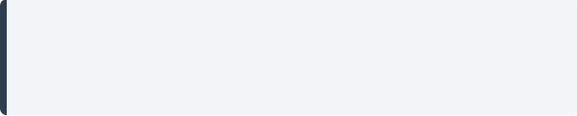
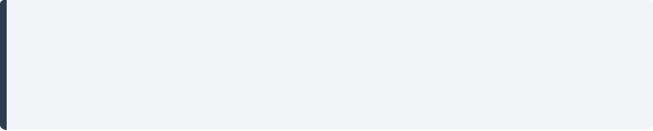
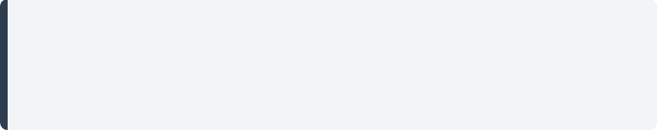




UPPER LIMB NEURAL TENSION TESTS
CLINICAL GUIDANCE & EXAM FOCUS
Median Nerve
Radial Nerve
Ulnar Nerve
TECHNIQUE
TECHNIQUE
TECHNIQUE
Cock wrist up (extension)
"Waiter's Tip" position
"Owl Eyes" position
Abduct arm to 90 degrees
Shoulder internal rotation
Flex fingers at PIPJ/DIPJ
Elbow in full extension
Wrist flexion + ulnar deviation
Extend at MCPJ
NEURAL STRESSOR
NEURAL STRESSOR
NEURAL STRESSOR
Laterally flex neck away from tested side to increase tension.
Depress the shoulder girdle while maintaining elbow extension.
Flex elbow and abduct shoulder to bring hand towards the ear.
AKT
Positive test: Reproduction of symptoms OR clear difference between sides.
SCA
Keep shoulders down throughout to avoid false positives. Explain steps clearly.
Bradford VTS Teaching Deck • June 2026 • Page 7 of 29
www.bradfordvts.co.uk

Slide 7

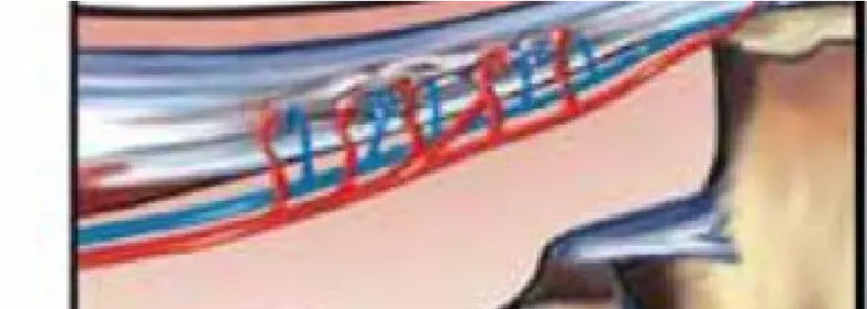

TENNIS ELBOW: THE TENDINOPATHY MODEL
CLINICAL GUIDANCE & EXAM FOCUS
Mucoid / Angiofibroblastic DegenerationNot an inflammatory process. Histology shows a breakdown of collagen and loss of bundled structure.
TENDINOPATHY
NeovascularisationFormation of new, fragile blood vessels accompanied by neural ingrowth—the primary source of chronic pain.
NOT TENDINITIS
AKT EXAM PEARL
Histopathology reveals NO inflammatory cells. This is why NSAIDs provide only short-term symptomatic relief and do not fix the structural pathology.
www.bradfordvts.co.uk

Slide 8







TENNIS ELBOW: EPIDEMIOLOGY & PRESENTATION
CLINICAL GUIDANCE & EXAM FOCUS
Epidemiology
Clinical Presentation
Affects 1–3% of adults per year
Localized Pain: Tenderness at lateral epicondyle radiating down forearm
Peak age: 35–55 years
Significantly more common in dominant arm
Sharp Pain on Gripping: Especially when the elbow is in full extension
Natural history: Symptoms typically last 12–18 months
"Warm-up" Effect: Pain may ease initially with activity but returns/worsens after rest (cool down)
Up to 90% resolve with rest within 1 year
Function: Gradual loss of grip strength and function
Common Triggers
Extrinsic: Repetitive DIY, gardening, painting, or sudden increase in training load
Occupational: Keyboard use, computer-intensive work
AKT FOCUS: NATURAL HISTORY
Sports: Racket sports (poor backhand technique)
For exams, remember the 12–18 month resolution timeframe. Most patients can be reassured that 90% resolve with rest alone, making aggressive early intervention (like injections) less favorable.
www.bradfordvts.co.uk

Slide 9












TENNIS ELBOW: DIFFERENTIAL DIAGNOSIS
CLINICAL GUIDANCE & EXAM FOCUS
Condition
Key Clinical Differentiators
AKT EXAM PEARL
Radial Tunnel Syndrome
Pain 3–4cm distal & anterior to epicondyle; dull, aching; often worse at night; exacerbated by resisted supination.
Radial Tunnel Landmark: Pain is located 3–4cm distal to the lateral epicondyle. It is often described as a dull, nocturnal ache rather than sharp gripping pain. Refer for EMG if suspected.
PIN Entrapment
Posterior Interosseous Nerve: Primarily motor weakness of finger/wrist extension; pain is less prominent than tennis elbow.
COMMON PITFALL
Cervical Radiculopathy (C6)
Neurological signs (weakness/reflex loss); pain radiates from neck; dermatomal distribution; check cervical spine.
Bilateral Symptoms: If a patient presents with bilateral epicondylitis, always examine the cervical spine. This is a common signal of referred pain from neck pathology.
Radiocapitellar OA
Crepitus present; restricted supination/pronation; pain closer to joint line; X-ray shows degenerative changes.
DIAGNOSTIC TIP
Olecranon Bursitis
Localised swelling and tenderness posteriorly at the tip of the elbow; distinct from lateral epicondyle pain.
Resisted wrist extension with elbow in full extension remains the gold-standard test for lateral epicondylitis. If pain is more anterior, think Radial Tunnel.
www.bradfordvts.co.uk
June 2026 | MRCGP Teaching Deck

Slide 10


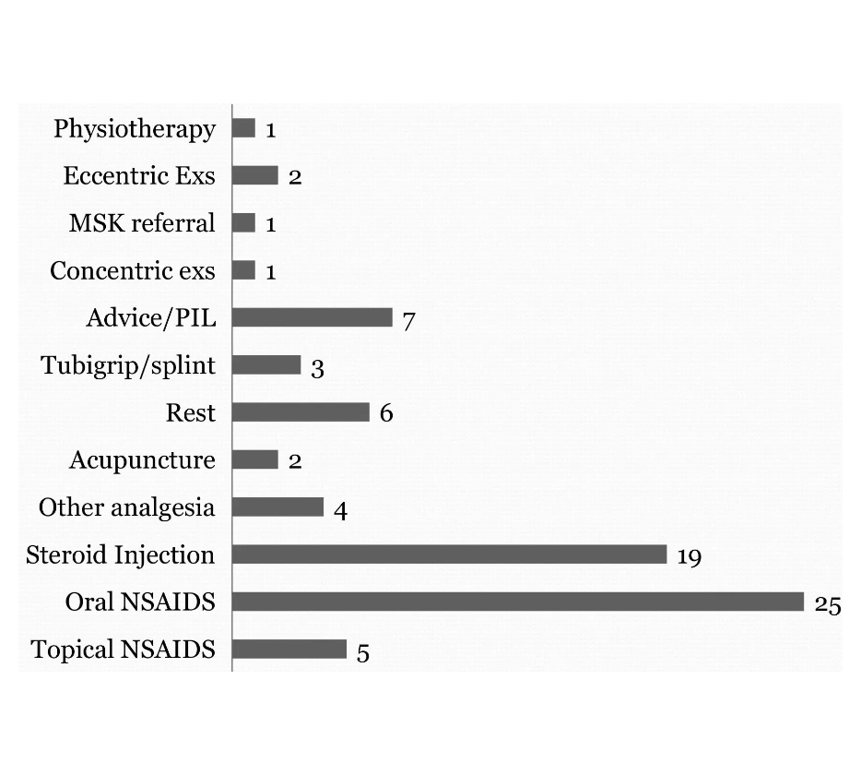







TENNIS ELBOW MANAGEMENT: STEP 1 CONSERVATIVE
CLINICAL GUIDANCE & EXAM FOCUS
Activity & Biomechanics
Activity Modification: Identify and reduce repetitive mechanical strain (DIY, gardening, computer work).
Technique Change: Advise lifting with palm upwards to shift load to wrist flexors.
Rest & Watchful Waiting: Up to 90% resolve within 1 year with rest alone.
Counterforce Bracing: Forearm band may provide short-term symptomatic relief during activity.
NICE CKS Pharmacotherapy
Topical NSAIDs
Oral NSAIDs
Diclofenac 1% gel. First-line for localized pain. Low systemic risk.
Short-term only (Ibuprofen/Naproxen). Caution: GI, CV, Renal risks.
Intervention Frequency in Primary Care: High utilization of Advice, Rest, and NSAIDs in early-stage management.
SAFE PRACTICE: NICE CKS FIRST-LINE
Topical NSAIDs are the preferred first-line pharmacological treatment. They provide symptomatic relief without the systemic risks of oral preparations. Note: They do not address the underlying tendinopathy.
Clinical Point: Corticosteroid injections and Surgery (lower frequency) are reserved for later steps if conservative measures fail (>12 months).
www.bradfordvts.co.uk
Created June 2026 | Updated to NICE 2024/2025 Standards

Slide 11










TENNIS ELBOW: STEP 2 MANAGEMENT
ECCENTRIC PROGRESSIVE LOADING (EPL)
The Alfredson Protocol
Why Eccentric Loading?
Frequency: 2 sets of 15 repetitions, twice daily.
Stimulates collagen synthesis and mechanical remodeling.
Duration: Must continue for months; recovery is slow and gradual.
Targets the underlying mucoid degeneration (not inflammation).
Progression: Start with body weight → resistance bands → free weights.
Addresses neovascularisation and associated neural ingrowth.
Technique: Focus on the controlled lengthening of the extensor carpi radialis brevis (ECRB).
AKT FOCUSEccentric loading is the most effective treatment for long-term recovery in lateral elbow tendinopathy.
The Pain Principle: The protocol is initially painful. It is LESS effective if NOT painful.
SCA FOCUSCounsel patients to exercise INTO the pain. Manage expectations: "Recovery is slow; we are retraining the tendon."
Elbow and Wrist Problems in General Practice • Bradford VTS • June 2026
www.bradfordvts.co.uk

Slide 12












TENNIS ELBOW MANAGEMENT: STEP 3 & 4
CLINICAL GUIDANCE & EXAM FOCUS
Step 3: Steroid Injection
Step 4: Advanced Options
Surgery (Last Resort)
Triamcinolone 10-20mg + 1% Lidocaine
ESWT: Shockwave therapy for chronic (>6mo) cases; NICE approved.
Failure of conservative management for >12 months.
Short-term pain relief only (up to 6 weeks).
PRP: Platelet-rich plasma; specialist-level, limited NICE evidence.
Procedure: Open or arthroscopic release of ECRB origin.
Local infiltration to lateral epicondyle; avoid tendon substance.
GTN Patches: Some evidence for chronic tendinopathy remodeling.
Variable success rates; requires intensive post-op rehab.
Limit to max 3 injections total.
Useful to settle bursa or bridge to physiotherapy.
Sclerosants: Injections targeting neovascularisation.
Refer to Orthopaedics if diagnosis is in doubt or symptoms are intractable.
AKT FOCUS
SCA FOCUS
Steroid injections may produce poorer long-term outcomes (>1 yr) than physiotherapy or watchful waiting.
Shared Decision Making: Counsel patients that injections trade short-term relief for potentially slower overall recovery.
COMMON PITFALL
Missing Radial Tunnel Syndrome—if pain is 3-4cm distal to epicondyle, steroid injections will fail.
June 2026 | NICE 2024/2025 Standards
www.bradfordvts.co.uk

Slide 13










GOLFER'S ELBOW: MEDIAL EPICONDYLITIS
CLINICAL GUIDANCE & EXAM FOCUS
Clinical Presentation
Diagnostic Examination
Pathology:Overuse of the common flexor origin (Pronator Teres, Flexor Carpi Radialis).
Palpation:Localized tenderness specifically over the medial epicondyle.
Prevalence:Less common than tennis elbow (~1:4 ratio).
Resisted Test:Pain on resisted wrist flexion with forearm pronated (Gold Standard).
Symptoms:Medial elbow pain localized to epicondyle, often radiating down medial forearm.
Passive Test:Pain on passive wrist extension with elbow in full extension.
Aggravators:Worse with repetitive gripping, wrist flexion, or lifting with palms down.
Communication:Use "Don't let me move you" to ensure clear patient effort.
COMMON PITFALL
Don't miss Ulnar nerve entrapment (Cubital Tunnel). Check Tinel's behind the medial epicondyle.
RED FLAG
AKT FOCUS
Bilateral epicondylitis (Medial or Lateral) → Strongly consider referred pain from Cervical Spine pathology.
Mnemonic: FM = Flexors → Medial Epicondyle (like FM radio).
Bradford VTS Teaching Deck • June 2026
www.bradfordvts.co.uk

Slide 14





CUBITAL TUNNEL SYNDROME
CLINICAL GUIDANCE & EXAM FOCUS
Clinical Presentation
Examination & Differentiation
Sensory: Numbness and tingling in the ring and little fingers (Ulnar distribution).
Tinel's Sign: Percussion over the cubital tunnel reproduces tingling in the ulnar digits.
Nocturnal Symptoms: Often worse at night or when elbow is flexed (e.g., holding a phone).
Elbow Flexion Test: Full elbow flexion for 60s reproduces symptoms (highly sensitive).
Motor Signs: Weakness of hand intrinsics, difficulty with fine motor tasks, or "clawing" in advanced cases.
vs. Golfer's Elbow: Golfer's involves tendon pain on resisted wrist flexion; Cubital Tunnel is neurological.
Location: Pain/paresthesia centered behind the medial epicondyle.
Cervical Spine: Always exclude C8/T1 radiculopathy if symptoms are diffuse.
AKT FOCUS
COMMON PITFALL
The ulnar nerve passes through the cubital tunnel posterior to the medial epicondyle. Tinel's at this site → symptoms in the little finger.
Do not assume medial elbow pain is just "Golfer's Elbow". They often coexist. Check for sensation loss and intrinsic hand muscle wasting.
www.bradfordvts.co.uk
BRADFORD VTS TEACHING DECK • JUNE 2026

Slide 15









DE QUERVAIN'S TENOSYNOVITIS
CLINICAL GUIDANCE & EXAM FOCUS
Pathophysiology
Examination Technique
Stenosing tenosynovitis of the first dorsal compartment of the wrist at the radial styloid.
Focus on localizing tenderness and performing the pathognomonic test.
Involved Tendons: Abductor Pollicis Longus (APL) & Extensor Pollicis Brevis (EPB).
Finkelstein’s Test:
1. Patient makes a fist with thumb tucked inside fingers.
2. Passively deviate the wrist in the ulnar direction.
3. Positive: Severe sharp pain over the radial styloid.
Mechanism: Thickening of the tendon sheath leads to painful entrapment.
Risk Factors: Repetitive thumb/wrist movement, computer use, and association with Rheumatoid Arthritis.
Palpation: Tenderness localized to the 1st dorsal compartment (just proximal to the anatomical snuff box).
"Mother's Wrist"
Significant prevalence in women, particularly post-partum (6–12 months).
AKT FOCUS
Repetitive lifting of infants creates mechanical stress on the radial styloid.
Finkelstein's test is pathognomonic. APL and EPB are the two tendons involved in the first dorsal compartment.
Hormonal changes may contribute to tendon laxity and irritation.
Often presents as sharp pain when picking up the child or using a stroller.
SCA FOCUS
Counsel new mothers: "This is common due to repetitive lifting." Discuss ergonomic changes (lifting with palms up) to shift load.
www.bradfordvts.co.uk
Updated June 2026 | NICE 2024/25 Standards

Slide 16






DE QUERVAIN'S MANAGEMENT & THUMB BASE OA
CLINICAL GUIDANCE & EXAM FOCUS
Management Protocol
1st CMC Joint Osteoarthritis
Rest & Activity: Avoid lifting (esp. new mothers), cold packs for relief.
Epidemiology: Affects 20% of adults over 55 years.
NSAIDs: Topical or oral for short-term symptom relief.
Location: Tenderness at anatomical snuff box / base of thumb.
Thumb Splint: Immobilise thumb in position of function (OTC/Custom).
Symptoms: Morning stiffness > 30 mins; squared hand appearance.
Physiotherapy: Progressive stretching and strengthening.
SCA FOCUS: DIFFERENTIAL DIAGNOSIS
AKT FOCUS: PROCEDURAL SUCCESS
The Grind Test: Pathognomonic for OA
Corticosteroid injection into the 1st dorsal compartment is highly effective.
Circular compression + axial load of 1st CMC joint.
Positive: Pain + Crepitus (Diagnostic for OA).
Note: Finkelstein's can be positive in both conditions!
www.bradfordvts.co.uk
Created June 2026 | NICE 2024/2025 Standards

Slide 17









OLECRANON BURSITIS
CLINICAL GUIDANCE & EXAM FOCUS
Traumatic
Inflammatory
SepticRED FLAG
Cause: Repetitive pressure or sudden impact.
Gout: Crystal deposition (tophi). Rapid onset, intense pain.
Organism: Usually Staph aureus via skin breach.
Known as: "Student's Elbow" (leaning on desk).
Clinical: Exquisitely tender, erythema, warmth.
Signs: Localized fluctuating swelling at olecranon tip.
Rheumatoid: Associated with rheumatoid nodules.
Systemic: Fever and malaise (may be absent).
Diagnosis: Aspiration shows crystals (Gout) or high protein (RA).
Urgency: Risk of cellulitis and systemic sepsis.
Pain: Usually painless or mild dull ache.
Action: Urgent aspiration for culture and sensitivity.
Skin: Normal color and temperature.
Management: Treat underlying condition (Colchicine/NSAIDs).
SAFE MANAGEMENT• Septic: Flucloxacillin 500mg QDS for 7–14 days.
• Non-septic: Protection (elbow pads), rest, and NSAIDs.
• Aspiration: Only if diagnosis is uncertain or for symptom relief.
COMMON PITFALL• Do not assume a lack of fever excludes infection in septic bursitis.
• Avoid repeated aspirations in non-infective cases (risk of introducing infection).
• Ensure aspiration is sent for both MC&S and Crystals.
Bradford VTS Teaching Deck • June 2026
www.bradfordvts.co.uk

Slide 18






PULLED ELBOW AND ELBOW OSTEOARTHRITIS
CLINICAL GUIDANCE & EXAM FOCUS
Pulled Elbow (Nursemaid's)
Elbow Osteoarthritis
Age Profile:Typically 1–5 years (radial head ligamentous laxity).
Etiology:Often secondary to Rheumatoid Arthritis or heavy manual trauma.
Mechanism:Sudden longitudinal traction on a pronated arm.
Presentation:Refusal to use arm; held slightly flexed and pronated.
Key Sign:Loss ofextensionis usually the first movement restricted.
Imaging:X-ray is usually normal; only needed if trauma/fracture suspected.
Pain Site:Localised to the joint line (unlike epicondylitis which is focal).
Mechanical Symptoms:Crepitus and locking if loose bodies are present.
Reduction Techniques:
Supination + Flexion
Hyperpronation
Management Steps:
AKT FOCUS: REDUCTION SUCCESS
Physiotherapy for ROM maintenance.
Hyperpronation often has higher first-attempt success rates than the traditional supination-flexion method. Success is marked by immediate use of the arm.
Analgesia: Topical/Oral NSAIDs (NICE Step-up).
Intra-articular steroid (limited short-term benefit).
Surgical referral if severe restriction or intractable pain.
www.bradfordvts.co.uk
Bradford VTS Teaching Deck • June 2026

Slide 19














CARPAL TUNNEL SYNDROME DIAGNOSIS
CLINICAL GUIDANCE & EXAM FOCUS
Classic Presentation
Clinical Examination
Nocturnal Symptoms: Pain and tingling that wakes the patient from sleep.
Tinel’s Sign: Percuss over the carpal tunnel; positive if tingling occurs in median nerve distribution.
Flick Sign: Highly specific; symptom relief obtained by "flicking" the wrist/hand.
Phalen’s Test: Hold wrist in maximum flexion for 60 seconds; positive if symptoms are reproduced.
Median Distribution: Tingling in thumb, index, middle, and radial half of ring finger.
Gold Standard: Nerve Conduction Studies (NCS) are definitive for confirming entrapment.
Late Signs: Weakness and wasting of the thenar eminence.
Prevalence: Bilateral in ~50% of cases.
Primary Care Checklist
Key Associations
Assess for thenar wasting (indicates severity).
Physiological: Pregnancy (fluid retention), Obesity.
Screen for underlying causes (TFTs, HbA1c).
Endocrine: Hypothyroidism, Diabetes Mellitus, Acromegaly.
Differentiate from C6/C7 radiculopathy.
Inflammatory: Rheumatoid Arthritis (synovitis).
Mechanical: Previous wrist fracture, repetitive strain.
AKT FOCUS
SCA FOCUS
Nocturnal symptoms + median nerve distribution = classic AKT diagnostic triad. Know your associations (Hypothyroidism/Pregnancy).
Crucial History Point: Always ask "Does it wake you from sleep?" and "Do you find yourself flicking your wrist for relief?"
Bradford VTS Teaching Deck • June 2026
www.bradfordvts.co.uk

Slide 20


















CARPAL TUNNEL SYNDROME MANAGEMENT
CLINICAL GUIDANCE & EXAM FOCUS
1. Conservative
2. Procedural
3. Surgical
First-line (Mild/Mod): Night wrist splints in neutral position.
Steroid Injection: Methylprednisolone 20mg or Triamcinolone.
Decompression: Surgical release of the transverse carpal ligament.
Duration: Trial for at least 4-6 weeks; 50% improvement rate.
Indication: Failure of splints or moderate symptoms.
Indication: Severe pain, sensory loss, or thenar wasting.
Activity Mod: Avoid excessive repetitive wrist flexion/vibration.
Technique: Just proximal to carpal crease, ulnar to Palmaris Longus.
Urgency: Progressive motor weakness requires prompt referral.
Weight Loss: Addressing obesity can reduce tunnel pressure.
Outcome: Excellent short-term relief (70%); may recur.
Success: Over 90% success rate for nocturnal symptom relief.
AKT
Nerve Conduction Studies: Gold standard for diagnosis but NICE suggests clinical diagnosis is often sufficient in primary care for mild cases.
SCA
Shared Decision Making: Discuss "Flick sign" relief and set expectations—surgery fixes numbness/pain but wasting may be permanent.
SAFE
Pregnancy: CTS is common due to fluid retention. Most cases resolve spontaneously post-delivery; prioritize splints.
www.bradfordvts.co.uk
Created June 2026 | NICE 2024/25 Standards

Slide 21











TRIGGER FINGER AND HAND NODES
CLINICAL GUIDANCE & EXAM FOCUS
Trigger Finger (Stenosing Tenosynovitis)
Osteoarthritic Hand Nodes
Definition: Catching or locking of the flexor tendon as it passes through the A1 Pulley at the MCPJ.
Node Type
Joint Affected
Key Symptoms:
Finger locks in flexion (painful)
Heberden's
DIPJ
Audible "click" or "pop" on extension
(Distal Interphalangeal)
Marked morning stiffness
Management Strategy:
PIPJ
Bouchard's
Activity modification and splinting (night)
(Proximal Interphalangeal)
Corticosteroid Injection: Into the A1 pulley sheath
Surgical release: If conservative measures fail
Bouchard's nodes can also be seen in RA, whereas Heberden's are strictly OA. Multiple joint synovitis suggests systemic arthropathy (RA/PsA).
PROCEDURAL SUCCESS
AKT HIGH-YIELD FOCUS
Corticosteroid injection into the tendon sheath has a 70–80% success rate and is often curative in Primary Care.
Remember the mnemonic: Distal = Heberden (H is later in the alphabet than B). Or Bouchard = Base (closer to hand).
www.bradfordvts.co.uk
June 2026 | MRCGP Clinical Teaching Deck

Slide 22


TOP TIPS FOR GPS
CLINICAL GUIDANCE & EXAM FOCUS
Tendinopathy, Not Tendinitis
1
Histology shows mucoid degeneration and neovascularisation, not inflammation. Avoid over-reliance on oral NSAIDs; focus on loading and remodelling strategies rather than anti-inflammatory suppression.
Eccentric Loading = Most Effective Treatment
2
Physiotherapy with progressive eccentric exercises (Alfredson protocol) offers the best long-term outcomes. Counsel patients that they must exercise "into the pain" for effective recovery.
Bilateral Symptoms? Check the Neck
3
Bilateral epicondylitis or wrist pain is a major red flag for cervical spine pathology. Always perform a neck examination to exclude referred pain from C6/C7 radiculopathy.
Manage Steroid Expectations
4
Steroid injections provide short-term relief only. NICE CKS highlights they may result in poorer long-term outcomes compared to physiotherapy. Use them only to "bridge" a patient into active rehab.
www.bradfordvts.co.uk
BRADFORD VTS • JUNE 2026

Slide 23






EXAM PEARLS: AKT FOCUS
CLINICAL GUIDANCE & EXAM FOCUS
HISTOLOGY & NAMING
ESSENTIAL TESTS
"Tendinitis" is incorrect; histology shows NO inflammatory cells.
Finkelstein’s Test: Pathognomonic for De Quervain's tenosynovitis.
Correct term: Tendinopathy (mucoid/angiofibroblastic degeneration).
Resisted wrist extension: Tests lateral epicondyle (Tennis Elbow).
Resisted wrist flexion: Tests medial epicondyle (Golfer's Elbow).
Neovascularisation with neural ingrowth is the primary source of pain.
Mnemonic: FM Radio (Flexors = Medial Epicondyle).
NSAIDs provide symptom relief but do NOT address the pathology.
KEY LANDMARKS
EVIDENCE & OUTCOMES
Radial Tunnel Syndrome: Pain is 3–4cm DISTAL to the epicondyle.
Eccentric Loading: Best long-term recovery for tendinopathy.
Cubital Tunnel: Ulnar nerve symptoms in ring/little fingers (not median).
Steroid for De Quervain's: Extremely effective with > 80% cure rate.
Bilateral symptoms: Always check the Cervical Spine for radiculopathy.
Pulled Elbow: Reduce via Supination + Flexion (immediate relief).
Steroid for Tennis Elbow: Short-term relief only; poorer long-term outcomes.
Carpal Tunnel: Cardinal sign is nocturnal symptoms waking patient.
www.bradfordvts.co.uk
AKT HIGH-YIELD FOCUS

Slide 24














EXAM PEARLS: SCA FOCUS
CLINICAL GUIDANCE & EXAM FOCUS
ICE: Tennis Elbow
Shared Decision-Making
CONSULTATION SKILLS
STEROID INJECTIONS
Ideas: "What do you think is causing the problem?" / "Have you heard of tennis elbow?"
Framing the choice between rapid relief and long-term recovery:
"An injection helps short-term pain, but exercises create long-term recovery. Some evidence suggests injections may delay final healing. Shall we discuss what suits you?"
Concerns: "Many worry about surgery—I want to reassure you most recover without it."
Expectations: "What were you hoping we could do today?"
Safety-Netting Phrases
De Quervain's (New Mums)
RISK MANAGEMENT
SPECIFIC ADVICE
Timeframes: "If no improvement after 6-8 weeks of physio, come back for review."
Building rapport through recognition of lifestyle factors:
"This is very common in new mothers due to repetitive lifting. We can try a thumb splint first, or a steroid injection which has an 80% cure rate."
Nerve Signs: "Return immediately if you notice new weakness or persistent tingling down the arm."
Acute: "Seek help for sudden warmth, fever, or severe swelling."
Advise on baby lifting technique (scooping vs pinching).
www.bradfordvts.co.uk

Slide 25










RED FLAGS
CLINICAL GUIDANCE & EXAM FOCUS
Septic Joint or Bursitis
Fever, systemic malaise, spreading erythema, or skin breach over a hot, exquisitely tender joint/bursa.
Scaphoid Fracture
Anatomical snuffbox tenderness post-FOOSH injury. Treat as fracture even if initial X-rays appear normal.
Progressive Neurological Deficit
RED
FLAGS
Rapidly progressive weakness, intrinsic muscle wasting (thenar/hypothenar), or sudden motor loss (e.g., drop hand).
Malignancy / Bone Tumor
URGENT ACTION
Constant night pain (non-mechanical), unexplained hard masses, or rapid swelling with weight loss.
Acute Ischemia / Compartment Syndrome
The 5 Ps: Pain (out of proportion), Pallor, Pulselessness, Paresthesia, Paralysis. Surgical emergency.
www.bradfordvts.co.uk
June 2026 | MRCGP Clinical Teaching

Slide 26






COMMON PITFALLS
CLINICAL GUIDANCE & EXAM FOCUS
Over-reliance on NSAIDs
Missing Radial Tunnel Syndrome
Treating tendinopathy as "tendinitis" (inflammation).
Mistaking nerve entrapment for Tennis Elbow.
Pitfall: Long-term oral NSAIDs do not address mucoid degeneration and carry significant GI/CV risks.
Differentiation: Radial tunnel pain is 3–4cm distal and anterior to the lateral epicondyle.
Topical NSAIDs are for symptom relief only, not for "curing" the tendon structure.
Dull, aching quality often worse at night; requires EMG referral rather than just elbow physio.
Delaying De Quervain's Injections
The Bilateral Blindspot
Waiting too long with ineffective rest or simple splinting in severe cases.
Treating both elbows as isolated overuse injuries without checking the spine.
Evidence: Steroid injection into the first dorsal compartment has an >80% cure rate.
Clinical Rule: Bilateral epicondylitis should always trigger a cervical spine examination (C6/C7 radiculopathy).
Crucial for new mothers who cannot realistically "rest" their thumb.
Localized treatment will fail if the source is proximal referred pain.
www.bradfordvts.co.uk

Slide 27


















QUICK RECALL
CLINICAL GUIDANCE & EXAM FOCUS
Diagnostic Pathognomonics
Management Gold Standards
Tennis Elbow
SAFE
Tendinopathy Recovery
SAFE
Pain localized to lateral epicondyle on resisted wrist extension (elbow extended).
Eccentric Progressive Loading (EPL) is the most effective long-term treatment for recovery.
De Quervain's
SAFE
De Quervain's Cure
SAFE
Finkelstein's Test: Ulnar deviation with thumb tucked in fist reproduces severe pain.
Corticosteroid injection into the first dorsal compartment offers a >80% cure rate.
Carpal Tunnel
SAFE
Local MSK Pain
SAFE
Cardinal sign: Nocturnal symptoms waking the patient; relieved by the "Flick Sign".
Topical NSAIDs (Diclofenac 1% gel) are first-line per NICE to minimize systemic GI/CV risks.
Bilateral Pain
SAFE
Septic Bursitis
SAFE
Always screen the Cervical Spine; bilateral epicondylitis often stems from referred pain.
Exclude infection in olecranon swelling. Urgent aspiration and Flucloxacillin if erythematous.
www.bradfordvts.co.uk
Current to NICE 2024/2025 Standards • June 2026

Slide 28









SUMMARY & FINAL DISCLAIMER
CLINICAL GUIDANCE & EXAM FOCUS
Key Clinical Takeaways for GP Practice
Tendinopathy Model: Shift focus from inflammation (tendinitis) to degeneration; prioritize mechanical loading over anti-inflammatories.
Gold Standard: Eccentric Progressive Loading (EPL) offers the best long-term outcomes for lateral/medial elbow pain.
Exam Diagnostics: Master pathognomonic tests—Finkelstein's (De Quervain's), Resisted Extension (Tennis), and Phalen's (CTS).
Nerve Entrapment: Always differentiate local joint pain from Cubital (Ulnar) or Radial Tunnel syndromes using distal palpation and Tinel's.
Bilateral Symptoms: Presence of bilateral epicondylitis is a strong indicator to screen the cervical spine for referred pathology.
Procedural Success: De Quervain's and Trigger Finger respond exceptionally well to steroid injections (>80% cure rate).
Mandatory Medical Disclaimer
This teaching material is intended for educational purposes for GP Trainees (ST1-ST3) and International Medical Graduates. While updated to reflect NICE CKS 2024/25 and BNF standards as of June 2026, clinical guidance is subject to rapid change. Diagnostic and treatment decisions remain the sole responsibility of the treating clinician. Always verify drug dosages and local referral pathways. Bradford VTS accepts no liability for clinical outcomes based on this summary.
Created: June 2026
NICE Standards: 2024/2025
www.bradfordvts.co.uk

