Slide 1



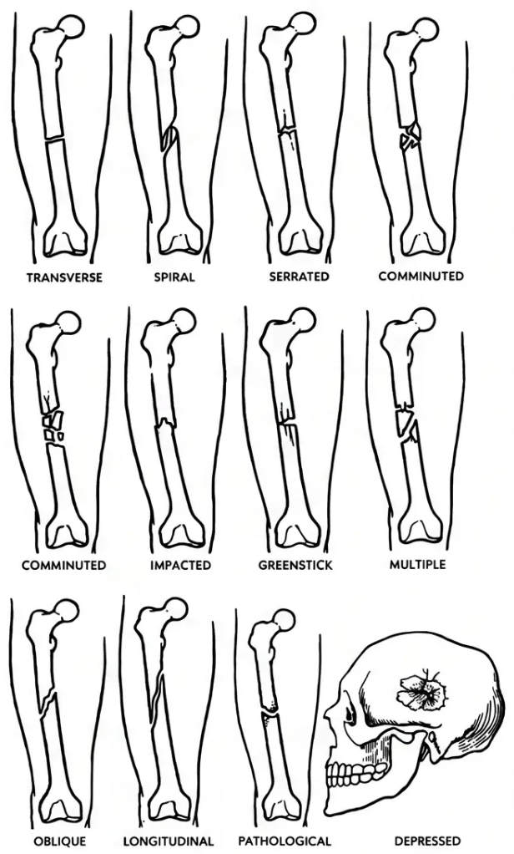
BRADFORD VTS TEACHING DECK
FRACTURE TYPES
Orthopaedics & Trauma
Fractures and
Their Management
Bradford VTS Teaching Deck
A comprehensive guide for GP trainees on
fracture classification, NICE NG38 guidelines,
and clinical management
● Updated: June 2026
NICE NG38 — Last Reviewed June 2025
www.bradfordvts.co.uk
www.bradfordvts.co.uk
Bradford VTS Teaching Deck — Fractures and Their Management
| June 2026

Slide 2

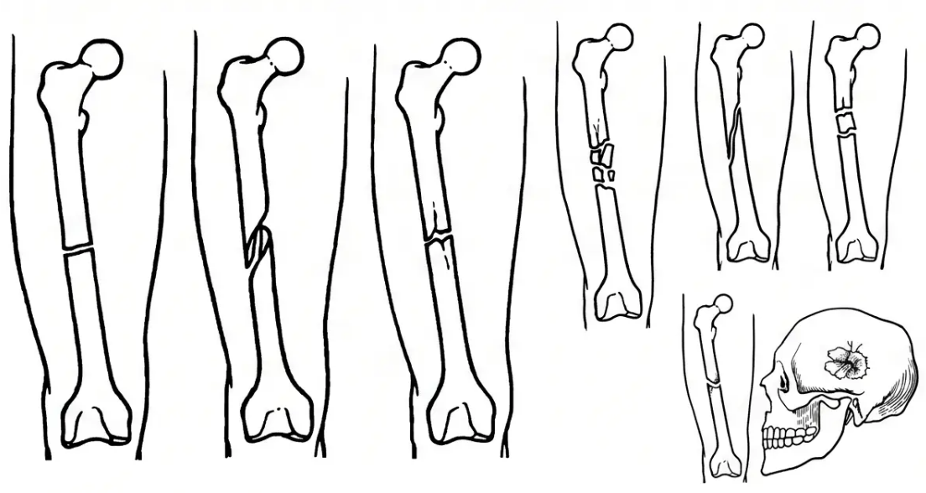
BRADFORD VTS TEACHING DECK
NICE NG38 · June 2025
Fracture Classification & Initial Assessment
Classification
Initial Assessment (NICE NG38)
✔ ABCs First
Major trauma — always prioritise airway, breathing, circulation
✔ Clinical Signs
Pain · deformity · swelling · bruising · loss of function
✔ Neurovascular Status — Always
Distal pulses · capillary refill · sensation · movement distal to fracture
✔ Immobilise Before Moving
Analgesia immediately — oral morphine or ibuprofen
✔ X-Ray: Minimum 2 Views at 90°
Include joints above AND below the fracture
✔ Open Fracture?
✔ Simple/Closed — no skin breach
Photograph wound · saline-soaked dressing · urgent orthopaedics
✔ Open/Compound — skin breached · HIGH infection risk
Document neurovascular status BEFORE and AFTER any reduction
✔ Complicated — bone + nerve/artery/organ injury
Bradford VTS Teaching Deck — Fractures and Their Management
2
www.bradfordvts.co.uk | June 2026

Slide 3
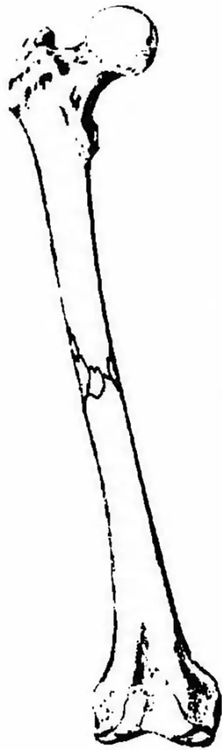



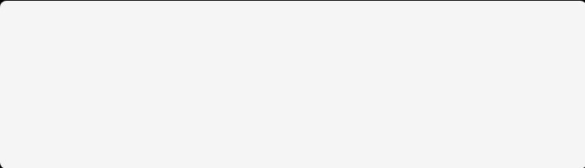
EMERGENCY PROTOCOL | NICE NG38
Open Fractures & Bone Healing
Open Fracture: Emergency Steps
Bone Healing: Four Stages
IV Co-amoxiclav 1.2g within 1 HOUR
(Cefuroxime if penicillin allergic)
1. Haematoma Formation
Immediately after fracture
Blood clot forms; inflammatory cells arrive;
growth factors released.
1. Cover wound — saline-soaked dressing;
do NOT remove protruding bone in primary care
2. Soft Callus
Weeks 2–3
2. Tetanus prophylaxis — check and
administer as needed
Fibrocartilage bridges the gap;
fracture becomes less mobile.
3. Photograph the wound — before dressing;
document thoroughly
3. Hard Callus
Weeks 3–12
Woven bone replaces cartilage;
fracture site stiffens.
4. Urgent orthopaedic referral — definitive
surgery within 24–72 hours depending on
contamination
4. Remodelling
Months to years
Immobilise before moving. Assess neurovascular
status distal to fracture.
Lamellar bone replaces woven bone;
bone returns to original shape.
Fracture of femoral shaft
Bradford VTS Teaching Deck – Fractures and Their Management
3
www.bradfordvts.co.uk | June 2026

Slide 4


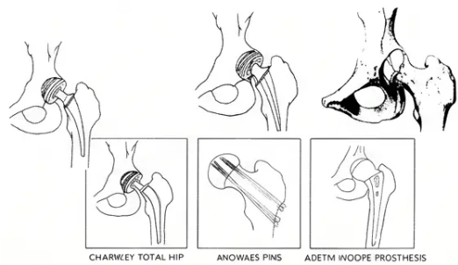
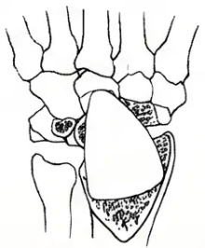
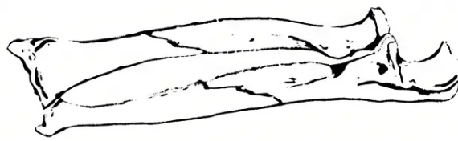



COMMON FRACTURES
Upper Limb and Hip Fractures
Three fractures every GP must know — mechanism, diagnosis, and management
Colles’ Fracture
Scaphoid Fracture
Hip Fracture (NOF)
FOOSH — older women, osteoporosis
FOOSH — young adults; most common carpal fracture
80–85% women, >60 years — osteoporotic fall
• “Dinner fork” deformity on inspection
• Anatomical snuffbox tenderness = scaphoid until
proven otherwise
• Shortened, externally rotated leg; unable to weight bear
• Check median nerve (anterior interosseous branch)
• Intracapsular (femoral neck) → high AVN risk
• Also exclude scaphoid fracture
• X-ray may be NORMAL initially — do not dismiss
• Extracapsular (trochanteric) → lower AVN risk
• Treat as fracture: thumb spica cast
• Undisplaced → below-elbow cast, 5–6 weeks
• Urgent orthopaedic referral — surgery within 36–48 hours
• MRI at 72 hours OR MRI/CT at 10–14 days to confirm
• Displaced → reduction under LA or sedation
• Complications: DVT, PE, pneumonia, pressure sores
• Proximal pole fractures → high AVN risk (blood
supply enters distally)
• Unstable → surgical fixation (ORIF)
• ~10% mortality at 30 days
• Cast check at 1 week post-reduction
• Post-op: DXA scan + bisphosphonate + calcium/vitamin D
Document neurovascular status before
AND after reduction — NICE NG38
Normal X-ray does NOT rule out scaphoid
fracture — treat on clinical grounds
All hip fracture patients need osteoporosis
assessment and secondary prevention
Bradford VTS Teaching Deck — Fractures and Their Management
www.bradfordvts.co.uk
June 2026

Slide 5








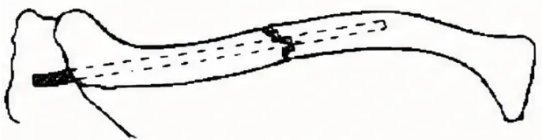
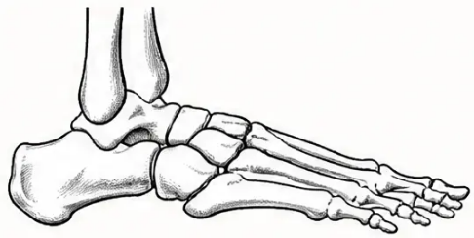

BRADFORD VTS TEACHING DECK
COMMON GP FRACTURES
Clavicle, Ankle & Stress Fractures
Conservative management, Ottawa Rules, and stress fracture recognition in primary care.
Clavicle Fracture
Ankle Fractures
Stress & Vertebral Fractures
Usually Middle Third
Ottawa Rules
Often Missed
📋 Ottawa Rules — X-Ray If:
Stress Fractures
• Bony tenderness at posterior tip of lateral
or medial malleolus
• Repetitive loading — metatarsals, tibia, femoral neck
• X-ray often normal initially → MRI or bone scan to confirm
• Unable to weight bear (4 steps)
• Femoral neck stress fracture → orthopaedic referral
(risk of displacement)
Weber Classification
Vertebral Compression Fractures
• Mechanism: Fall on outstretched hand or
direct blow
A — Below syndesmosis → Stable → Cast/boot 6 weeks
B — At syndesmosis → Variable → Orthopaedic assessment
• Osteoporotic — sudden back pain, minimal trauma,
older patient
• Treatment: Broad arm sling for comfort —
6 weeks
C — Above syndesmosis → Unstable → Orthopaedic
referral ± ORIF
• X-ray: loss of vertebral height / kyphosis
• Manage: analgesia + mobilise + bisphosphonate +
FRAX/DXA
• Surgery if: Open fracture, neurovascular
compromise, or shortening >2 cm
• Red flag: Progressive neuro deficit → urgent MRI
• After sling: Physiotherapy advised
Neurological deficit = Emergency MRI
Bradford VTS Teaching Deck — Fractures and Their Management
5
www.bradfordvts.co.uk
June 2026

Slide 6








NICE NG38 — MANAGEMENT
Management Principles & Complications
MANAGEMENT
COMPLICATIONS
REDUCTION
IMMEDIATE
— Closed Reduction: Manipulation without surgery;
under local anaesthetic or procedural sedation
Blood loss — femur fracture up to 1–2 litres
Neurovascular injury — always assess distal pulses and sensation
— ORIF (Open Reduction Internal Fixation): Plates,
screws, nails, K-wires, intramedullary nails; for
unstable or displaced fractures
Fat embolism — marrow fat enters bloodstream;
respiratory distress, petechiae, confusion
IMMOBILISATION
EARLY
— Plaster cast or backslab
Infection — especially open fractures; requires prophylactic antibiotics
— Functional brace or splint
DVT / PE — particularly hip and femur fractures;
— Sling (upper limb)
anticoagulation and mobilisation
— Surgical fixation (most stable)
Compartment syndrome — orthopaedic emergency; see slide 7
— Traction (now rarely used)
REHABILITATION
LATE
Malunion or non-union
— Weight-bearing advice from day one where appropriate
— Physiotherapy: range of motion, strength
Avascular necrosis — scaphoid proximal pole; femoral head post-NOF
— Occupational therapy for functional recovery
Joint stiffness and post-traumatic osteoarthritis
— Cast check at 1 week post-reduction
Complex Regional Pain Syndrome (CRPS)
— Clinical and radiological review at union
Cast check at 1 week post-reduction — document neurovascular status before AND after any manipulation (NICE NG38)
Bradford VTS Teaching Deck — Fractures and Their Management
6 / 10
www.bradfordvts.co.uk | June 2026

Slide 7


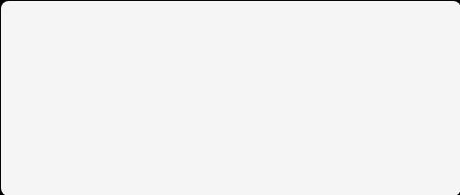






BRADFORD VTS TEACHING DECK
NICE NG38
EMERGENCY
Emergency: Compartment Syndrome and Red Flags
Compartment Syndrome
Red Flags
Orthopaedic Emergency — Fasciotomy within 6 hours
Require urgent or emergency action
P
P
Compartment Syndrome (6 Ps)
Pain
Pressure
Emergency fasciotomy — split cast immediately
disproportionate; worst on
passive stretch.
tight, tense compartment.
Open Fracture
P
P
IV co-amoxiclav 1.2g within 1 hour — urgent orthopaedics
Paresthesia
Paralysis
Neurovascular Compromise Distal to Fracture
tingling, numbness distal
to fracture.
weakness or loss of
movement.
Absent pulse / loss of sensation / pallor → urgent orthopaedics
P
P
Pulselessness
Cauda Equina with Vertebral Fracture
Pallor
late sign — do not
wait for this.
Saddle anaesthesia / bladder/bowel dysfunction → emergency MRI
pale, mottled skin.
Pathological Fracture
• Common sites: Lower leg (tibial fracture), forearm
Minimal trauma, unusual site, history of malignancy →
urgent imaging and referral
• Action: Split any cast immediately → urgent orthopaedics
Do NOT wait for pulselessness — act on pain + paresthesia
When in doubt — refer urgently and document neurovascular status
Bradford VTS Teaching Deck — Fractures and Their Management
www.bradfordvts.co.uk
June 2026

Slide 8





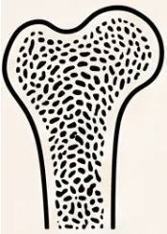
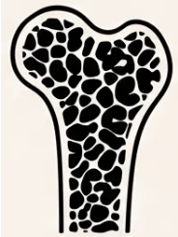
BRADFORD VTS TEACHING DECK
NICE NG38 | SECONDARY PREVENTION
Osteoporosis and Fragility Fractures
Fragility fracture = break from low-energy trauma (fall from standing height) — a warning sign, not just an injury
IDENTIFY
TREAT
PREVENT
Who needs assessment?
First-line pharmacotherapy
Lifestyle and falls prevention
– Fragility fracture in any patient aged ≥ 50
– Alendronate 70 mg — once weekly oral
– Weight-bearing exercise — builds bone density
– Falls prevention programme — refer if
recurrent falls
- Take on empty stomach; remain upright 30 min
– Common sites: wrist · vertebrae · hip · humerus
– Investigate with: FRAX score + DXA scan
– Calcium + Vitamin D if dietary intake inadequate
– Medication review — stop/reduce sedatives,
antihypertensives if contributing to falls
- FRAX estimates 10-year fracture probability
– Review after 5 years (lower-risk patients)
– DXA confirms bone mineral density (T-score)
– Continue if high-risk: hip or vertebral fractures
– Adequate calcium in diet (dairy, leafy greens)
– Vertebral fracture: X-ray shows loss of
vertebral height
– Zoledronate IV: alternative if oral not tolerated
– Vitamin D supplementation — especially
housebound patients
AKT RECALL
– Smoking cessation — smoking accelerates
bone loss
Alendronate 70 mg once weekly + calcium/
vit D — first-line after fragility fracture
– Home hazard assessment — rugs, lighting,
footwear
Every fragility fracture is a missed opportunity unless bone health is
addressed — treat the fracture AND the bone
Normal
Osteoporotic
Bradford VTS Teaching Deck — Fractures and Their Management
www.bradfordvts.co.uk
June 2026

Slide 9





BRADFORD VTS TEACHING DECK
EXAM FOCUS
AKT and SCA Exam Focus
AKT — KNOWLEDGE FOCUS
SCA — COMMUNICATION FOCUS
● NICE NG38: Minimum 2 X-ray views at 90°; include
joints above AND below fracture
Explaining a fracture:
“A fracture means the bone has broken. Most fractures heal
well with the right treatment. I’d like to arrange an X-ray to
see exactly what’s happened.”
● Neurovascular status: Document before and after
any reduction
Safety-netting:
● Open fracture: IV co-amoxiclav 1.2g within 1 hour
of presentation
“If you develop increasing pain, numbness, tingling, or your
fingers or toes turn blue or go cold — go straight to A&E
immediately.”
● Ottawa Rules: X-ray if posterior malleolus tender OR
unable to weight bear
Osteoporosis counselling:
● Scaphoid: Snuffbox tenderness → treat as fracture
even with normal X-ray; MRI/CT at 10–14 days
“This fracture is a warning sign that your bones may be
getting thinner. We can do something about that — let’s
check your bone density and look at treatment.”
● Compartment syndrome: 6 Ps → fasciotomy within
6 hours
Shared decision-making (hip fracture):
● Fragility fracture ≥50: FRAX + DXA + alendronate
70mg once weekly
“There are different surgical options depending on the type
of fracture. The goal is to get you moving as soon as possible.
What matters most to you in terms of recovery?”
● Femoral neck: ~30% non-union; intracapsular →
high AVN risk; surgery within 36–48 hours
Bradford VTS Teaching Deck — Fractures and Their Management
9 / 10
www.bradfordvts.co.uk | June 2026

Slide 10








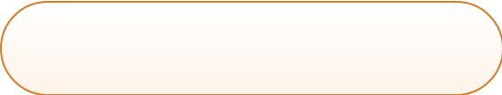
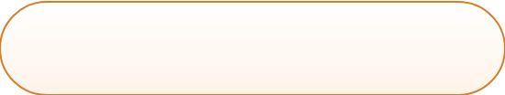
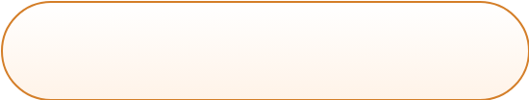

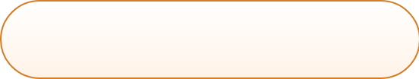
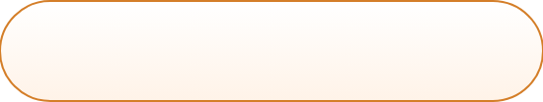
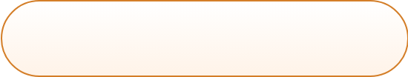

CLINICAL GUIDANCE
Clinical Pitfalls & Quick Recall
⚠ Missing Scaphoid Fracture
⚠ Missing NAI in Children
⚠ Overlooking Compartment
Syndrome
Normal X-ray does NOT rule it out —
treat clinically if snuffbox tender
Spiral fracture in a pre-mobile child →
safeguarding referral immediately
Pain on passive stretch is the early sign
— don't attribute it to the fracture alone
⚠ No Osteoporosis Treatment
⚠ Sending All Fractures to A&E
⚠ Missing Pathological Fractures
Every fragility fracture is a missed
opportunity — start FRAX + alendronate
Stable, undisplaced fractures can be
safely managed in primary care with
follow-up
Minimal trauma + unusual site +
malignancy history → urgent imaging
and referral
⚡ QUICK RECALL
● Open fracture → IV
co-amoxiclav within 1 hour
● Scaphoid → treat despite
normal X-ray
● Ottawa Rules → malleolus
tender or can't weight bear
● Compartment syndrome →
6 Ps → fasciotomy emergency
● Fragility fracture → FRAX +
alendronate 70mg weekly
● 2 X-ray views minimum;
joints above and below
● Hip fracture → surgery
within 36–48 hours
● NAI → spiral fracture in pre-
mobile child → safeguarding
Bradford VTS Teaching Deck — Fractures and Their Management | NICE NG38 (Last Reviewed June 2025)
Bradford VTS Teaching Deck — Fractures and Their Management
www.bradfordvts.co.uk
| June 2026

