Slide 1


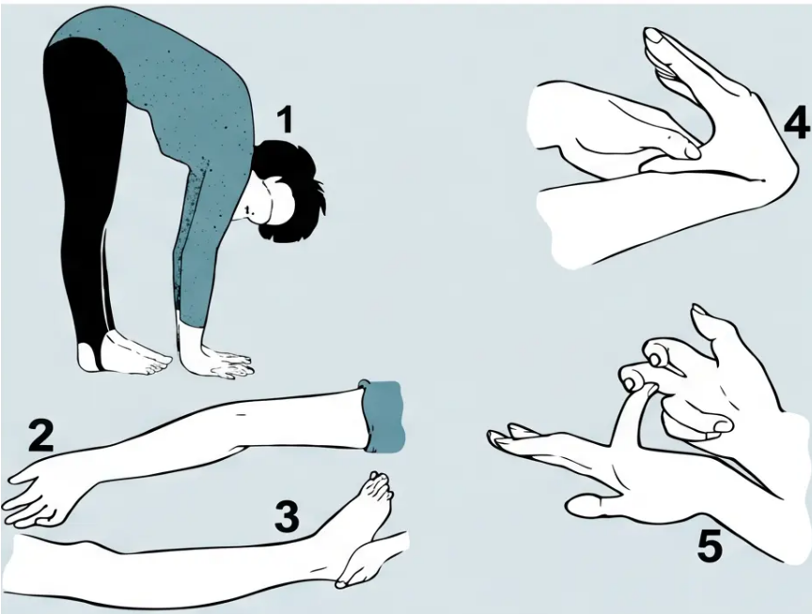













Hypermobility Syndrome
Beighton Score · Brighton Criteria · Management
Beighton Score (max 9 points)
● Palms flat on floor, knees straight [1]
● Elbow hyperextension >10° [1+1]
● Knee hyperextension >10° [1+1]
● Thumb touching forearm (wrist flexion) [1+1]
● Little finger dorsiflexion >90° [1+1]
*Bilateral tests marked L + R separately
Beighton Score — 5 test positions illustrated
Brighton Criteria for JHS
Management
Low-impact exercise — swimming and cycling to
build muscle strength
Beighton ≥ 4/9
Arthralgia > 3 months in ≥ 4 joints
Foot pronation — medial arch inserts recommended
Advise patients — joints dislocate/injure easily;
muscles fatigue quickly
= Joint Hypermobility Syndrome (JHS)
*"Keep active — improve strength, reduce pain, improve posture"
*Not the same as Ehlers-Danlos or Marfan's syndrome
Quick-recall fact: 1 in 5 people have joint hypermobility — usually benign · Common in gymnasts, ballet dancers, musicians
Bradford VTS · MSK Common Conditions & Key Points
Slide 6 of 10
www.bradfordvts.co.uk · June 2026

