Slide 1


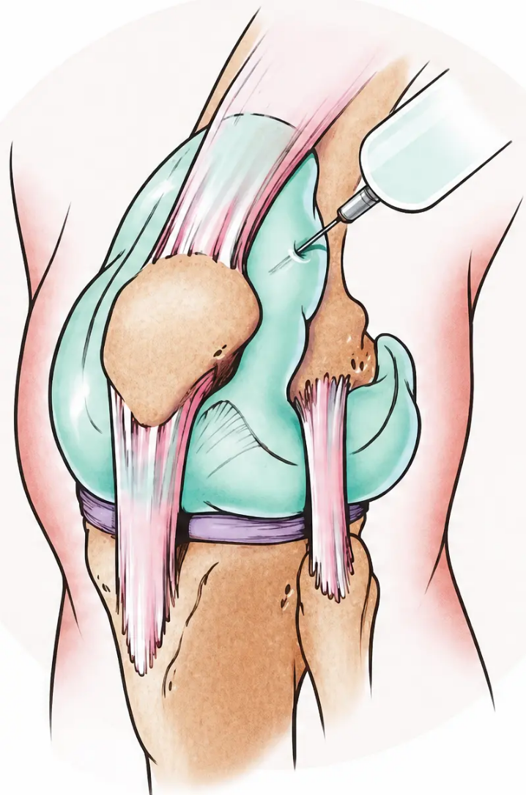
BRADFORD VTS TEACHING DECK
www.bradfordvts.co.uk
Joint Injections
in Primary Care
A comprehensive guide for GP trainees on joint injections
Featuring June 2026 clinical updates • NICE NG226 • Bradford VTS
Bradford VTS | Joint Injections in Primary Care
www.bradfordvts.co.uk
June 2026

Slide 2













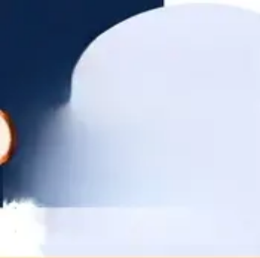
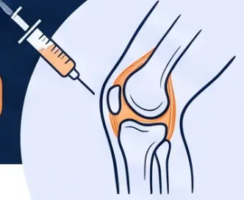

Indications and NICE Clinical Updates
When to consider corticosteroid injection — and when to hold back
Why Inject?
NICE NG226 — Key Guidance
▶ Conservative treatment first — NSAIDs,
physiotherapy, and exercise before
considering injection
Osteoarthritis
Rheumatoid Arthritis
Gout
Synovitis
▶ Injection to support exercise — not as a
standalone fix; continue rehab after injection
Bursitis
Tendinitis
▶ Short-term relief only — expected benefit:
2–10 weeks
Carpal Tunnel
Syndrome
Muscle Trigger
Points
▶ Hyaluronan NOT recommended — no
evidence of benefit; do not offer
*Mechanism: corticosteroid reduces capillary
dilatation and vascular permeability, dampening
the inflammatory cascade.
“Injection = bridge to rehab, not a cure”
Bradford VTS | Joint Injections in Primary Care
June 2026
www.bradfordvts.co.uk

Slide 3





Absolute and Relative Contraindications
Critical safety screening before every injection
ABSOLUTE
RELATIVE
Do NOT inject — no exceptions
Proceed with caution — assess risk
● 1. Septic / infectious arthritis
● 1. Charcot joint (neuropathic sensory loss)
● 2. Periarticular cellulitis or skin infection
● 2. Tumour adjacent to injection site
● 3. Bacteraemia / septicaemia
● 3. Active infections elsewhere (e.g. TB)
● 4. Adjacent osteomyelitis
● 4. Immunosuppressed patients
● 5. Joint prosthesis (high infection risk)
● 5. Hypothyroidism
● 6. Uncontrolled coagulopathy / bleeding disorder
● 6. Bleeding dyscrasias — use smallest needle
● 7. Poorly controlled diabetes mellitus
● 8. Osteochondral fracture
● 7. Anticoagulants (warfarin / DOACs) — not absolute;
assess bleeding risk carefully
● 9. Haemarthrosis
Anticoagulants ≠ automatic exclusion — assess individually
● 10. Impending joint replacement surgery
Hot swollen joint? Exclude septic arthritis before any injection.
Bradford VTS | Joint Injections in Primary Care
www.bradfordvts.co.uk
June 2026

Slide 4


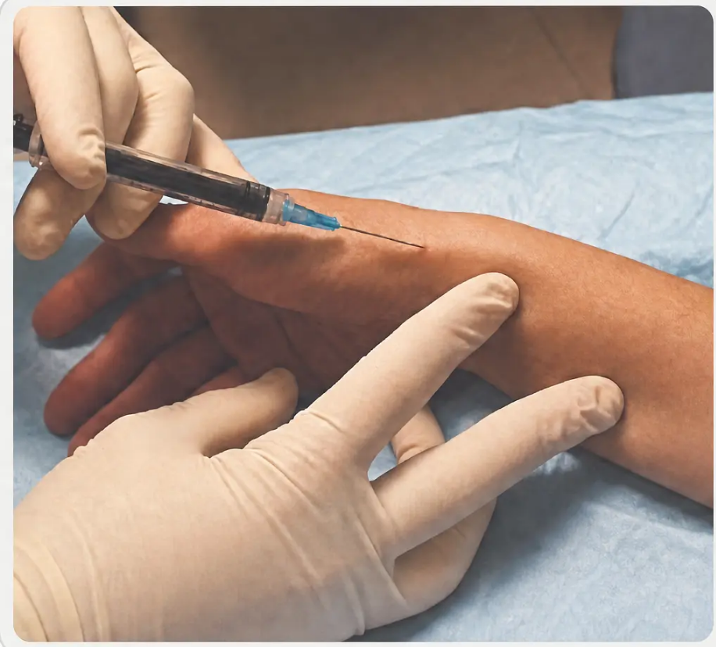






Corticosteroid Selection & Core Technique
Know your drug choices — and how to use them safely
DRUG SELECTION
TECHNIQUE — STEP BY STEP
Triamcinolone Acetonide
1 Aspirate First — Withdraw plunger
before injecting — confirm you are
not in a blood vessel
(Kenalog)
Dose: 10–40 mg per injection
2 Inject Local Anaesthetic — Lidocaine 1%
or bupivacaine 0.5% — inject first
for immediate comfort
Notes: Most commonly used • Longer duration of action
Methylprednisolone Acetate
3 Wait 3–5 Minutes — Allow LA
to take full effect before proceeding
(Depo-Medrone)
Dose: 20–80 mg per injection
4 Switch to Larger Bore Needle —
Use a wider gauge needle for the
corticosteroid injection
Notes: Reliable and widely used
Hydrocortisone Acetate
5 Fluid Should Flow Freely — Resistance
means wrong placement — likely in
tendon substance → reposition
immediately
Dose: Shorter-acting agent
Notes: Preferred for soft tissue injections
Often mixed with lidocaine 1% or bupivacaine 0.5%
for immediate pain relief
6 Sterile Technique Throughout —
Chlorhexidine clean • ensure antiseptic
is fully dry before needle insertion
NEVER inject into the substance of a tendon
Resistance during injection = wrong position → withdraw and reposition • Risk: tendon rupture
Bradford VTS
| Joint Injections in Primary Care
www.bradfordvts.co.uk
June 2026

Slide 5













Post-Injection Advice
& Patient Safety
What every patient must know before leaving the room
LA Wears Off
Post-Injection Flare
Rest 24–48 Hours
Pain may return — sometimes worse than
before. This is normal and temporary.
Warn the patient before they leave.
Occurs in 2–5% of patients. Acute
inflammatory reaction 24–48 hours
after injection. Self-limiting — reassure.
Advise the patient to rest the injected
joint. Avoid heavy use for at least
24–48 hours post-procedure.
Diabetics — Monitor Glucose
Increasing Pain After 48h?
Know the Side Effects
Corticosteroid causes transient blood
glucose rise. Warn diabetic patients to
monitor closely for 24–48 hours.
Severe or worsening pain beyond 48
hours — seek urgent medical review.
Exclude septic arthritis.
Local: skin atrophy, depigmentation.
Systemic (rare): facial flushing, HPA
suppression with frequent injections.
If fever or increasing swelling develops post-injection → urgent review — suspect iatrogenic septic arthritis
Bradford VTS | Joint Injections in Primary Care
www.bradfordvts.co.uk
June 2026

Slide 6

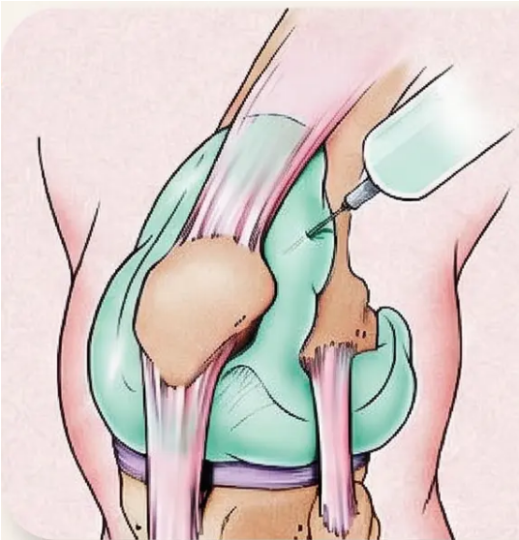

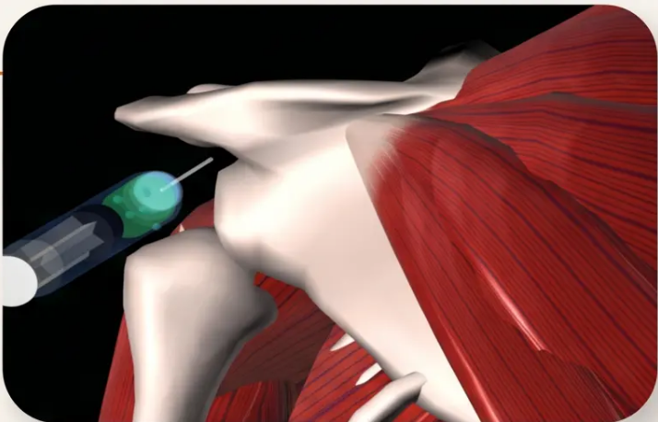










Knee & Shoulder Injection Techniques
Supero-lateral knee approach · Four shoulder sites
KNEE
SHOULDER
Subacromial
Posterior-lateral · inferior to posterolateral acromion · needle toward opposite nipple · most common
• Indication: OA · RA · Synovitis · Gout
Glenohumeral
Posterolateral corner of acromion · 2–3 cm inferior · direct anteriorly toward coracoid
• Approach: Supero-lateral
AC Joint
Palpate distal clavicle · slight depression · anterior-superior approach · direct inferiorly
• Patient on couch, knee slightly bent (~30°)
• Mark: 1 fingerbreadth above and lateral to patella
Biceps Tendon Sheath
Approach bicipital groove · do NOT inject into tendon substance
• Direct needle posteriorly and medially toward joint space
• Aspirate first if effusion present
• Large effusion (>10 ml) — consider aspiration alone first
⚠️ Hot joint → exclude septic arthritis before injecting
⚠️ Younger patients: consider surgical referral if no improvement
Bradford VTS | Joint Injections in Primary Care
www.bradfordvts.co.uk
June 2026 · Slide 6 of 10

Slide 7




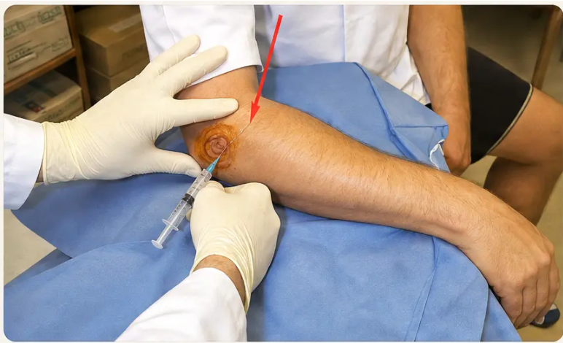
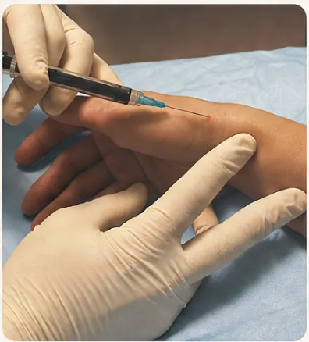

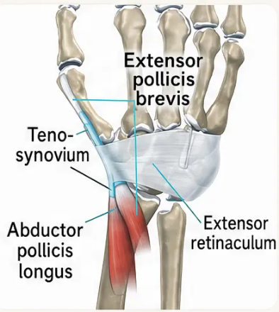

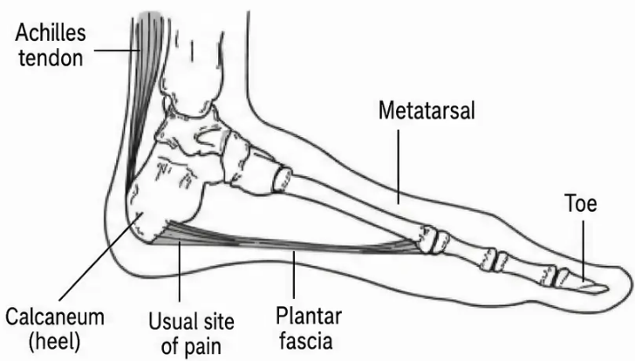




Elbow, De Quervain's & Plantar Fasciitis
Three injection sites — technique, evidence & key cautions
De Quervain's Tenosynovitis
Elbow Injections
Plantar Fasciitis
EPB + APL tendons at radial styloid
Last resort only — no evidence for long-term benefit
• Tennis elbow (lateral epicondylitis)
• Maximally abduct thumb to accentuate tendons
– 92% short-term benefit
• Physiotherapy and stretching first-line
• Injection is painful — counsel patient fully
• Injection site: anatomical snuffbox, base of thumb
– Benefits do NOT persist beyond 6 weeks
– Physio/exercise superior at 1 year
• Approach from medial heel (thinner skin)
– Useful for acute severe pain only
• Angle 30–45° proximally toward radial styloid
• Golfer's elbow (medial epicondylitis)
• Direct needle posterior-laterally
• Insert between the 2 tendons — NOT into substance
– Beware ulnar nerve — stay lateral
• Small blebs near bony insertion
– Elbow 45° flexion, wrist supinated
• Stop if paraesthesia — sensory radial nerve nearby
– Inject at point of maximal tenderness
• Do NOT inject into fascia itself
Physio beats injection long-term
• Risk: fat pad atrophy post-injection
Never into tendon substance
Bradford VTS
| Joint Injections in Primary Care
June 2026 • Slide 7 of 10
www.bradfordvts.co.uk

Slide 8











AKT & SCA Exam Focus
What examiners expect you to know — and say
AKT — Applied Knowledge
SCA — Consultation Skills
Max 3 per joint per year
Explaining the injection to a patient
Exceeding this risks cartilage damage — evidence-based limit
I'm going to give you a corticosteroid injection — this is
a steroid that reduces inflammation. It will work well for
about 6–10 weeks but isn't a permanent fix. After the
local anaesthetic wears off in about 2 hours, the pain
may come back temporarily — sometimes worse than
before. This is normal. If it doesn't settle or gets much
worse, please contact us.
92% short-term benefit
Tennis elbow injection — but effect does NOT persist
beyond 6 weeks
Post-injection flare: 2–5%
Acute inflammatory response at 24–48 hours; self-limiting
Shared decision-making
NICE NG226 — OA
Corticosteroid only when other pharmacological treatments
fail or to support exercise; short-term relief 2–10 weeks;
hyaluronan NOT recommended
An injection is one option, but I'd like to try some
exercises first — the evidence shows that physiotherapy
actually works better in the long run. What do you think
about that?
Never into tendon substance
Risk of tendon rupture — reposition if resistance felt
*ICE · Safety-netting · Shared decision-making = SCA marks
Bradford VTS | Joint Injections in Primary Care
www.bradfordvts.co.uk
June 2026

Slide 9










Red Flags, Pitfalls & Top Tips
Patient safety, clinical errors to avoid, and procedural best practice
RED FLAGS
COMMON PITFALLS
TOP TIPS
Act immediately
Errors to avoid
Procedural best practice
◆ Hot swollen joint — exclude septic arthritis
before any injection; urgent aspiration and
culture
● Injecting over cellulitis or skin infection —
absolute contraindication; always inspect the
skin first
✓ Never inject into tendon substance — if
resistance is felt, stop and reposition the needle
✓ Ensure antiseptic is completely dry before
inserting the needle
◆ Fever after injection — suspect iatrogenic
septic arthritis; urgent same-day review
● Injecting a poorly controlled diabetic
without a glucose monitoring plan in place
● Not warning the patient that pain returns
when local anaesthetic wears off after two hours
✓ Always aspirate first — confirm you are not
in a blood vessel before injecting
◆ Increasing pain and swelling beyond 48
hours — emergency assessment; do not
delay
● More than three injections per joint per year
— cartilage damage risk; document carefully
✓ Inject local anaesthetic first, wait three to
five minutes, then deliver corticosteroid
◆ Sudden pain and loss of function post-
injection — consider tendon rupture
✓ Golfer's elbow — stay lateral to the ulnar
nerve; palpate carefully before injecting
● Offering tennis elbow injection instead of
physiotherapy — exercise has better long-
term outcomes
✓ Warn diabetic patients to monitor blood
glucose for twenty-four to forty-eight hours
after injection
● Not aspirating before knee injection when
effusion is visible or palpable
● Hyaluronan injection — not recommended
per NICE NG226; no evidence of benefit
✓ Younger shoulder patients — consider early
surgical referral if no improvement; repeated
injections risk rotator cuff rupture
When in doubt — do not inject
Document every injection given
Fluid flows freely in the right place
Bradford VTS | Joint Injections in Primary Care
www.bradfordvts.co.uk
June 2026

Slide 10









Quick Recall
Key rules, safety warnings and exam essentials
01 Max 3 injections per joint per year
06 Knee: aspirate effusion before injecting
02 Never inject into tendon substance
07 Warn: pain returns when LA wears off (~2 hrs)
03 Infection = absolute contraindication
08 Diabetics: monitor glucose for 24–48 hours
04 Post-injection flare: 2–5% · self-limiting
09 Hyaluronan: NOT recommended — NICE NG226
05 Tennis elbow: physio beats injection at 1 year
10 Hot swollen joint: exclude sepsis first
■ Limits & Rules · ■ Safety Critical · ■ Evidence / NICE · ■ Clinical Warnings
Bradford VTS Teaching Deck · Joint Injections in Primary Care
www.bradfordvts.co.uk
June 2026

