Slide 1

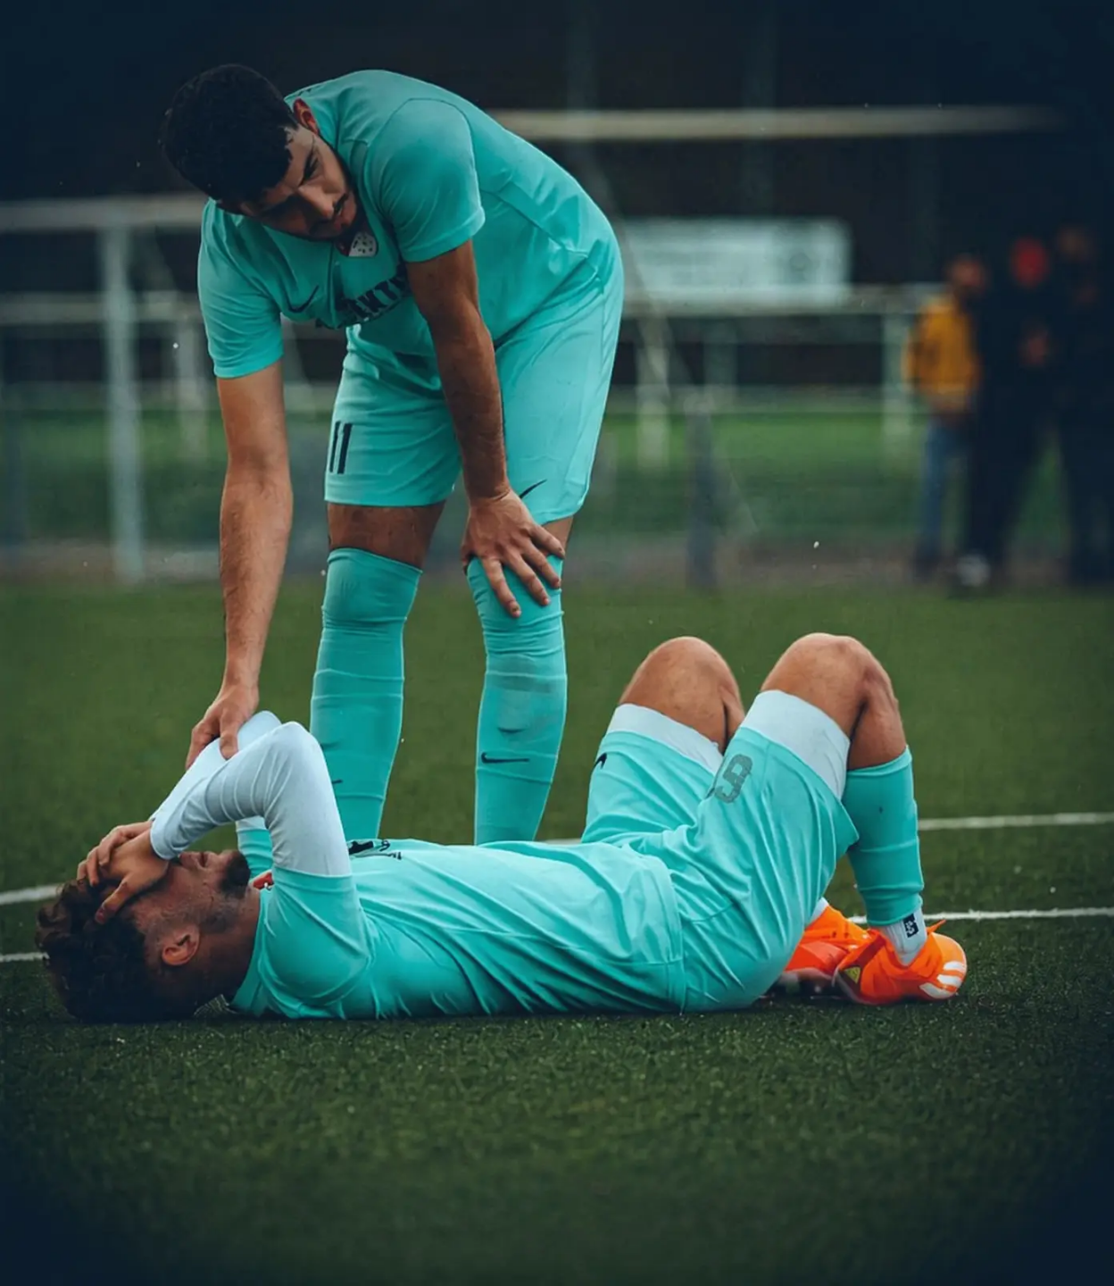


BRADFORD VTS TEACHING DECK
www.bradfordvts.co.uk
Knee Problems
Assessment of the
Acutely Injured Knee
A History-First Consultation Framework for GP Trainees
The knee is the largest joint in the body —
yet has no bony stability. It is the most
commonly injured joint in sport, and
injuries are frequently missed.
Educational purposes only - Always verify against latest NICE/BNF/local pathways - Dr Ramesh Mehay - June 2026

Slide 2
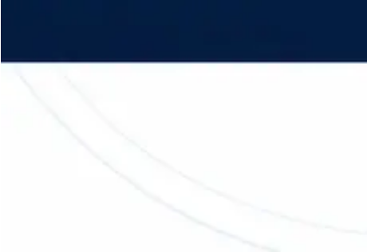








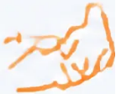







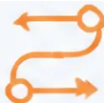

BRADFORD VTS TEACHING DECK
www.bradfordvts.co.uk • June 2026
LEARNING OBJECTIVES
By the End of This Session, You Will Be Able To...
In the AKT & SCA exam: all eight of these domains appear as tested competencies.
01 · History-Taking
02 · Differential Diagnosis
03 · Examination
04 · Special Tests
Use history to diagnose
acute knee injuries with
confidence
Differentiate ACL rupture,
meniscal tear, and PFS
Apply Look / Feel / Move in
a structured sequence
Interpret Lachman, McMurray,
and Anterior Drawer findings
05 · Recognise PCL / MCL / LCL
06 · Locking vs Pseudo-Locking
07 · Safe Referral
08 · Safety-Netting
Identify collateral and
posterior cruciate injuries
Distinguish true mechanical
locking from pain-related
restriction
Apply appropriate referral
pathways for each diagnosis
Use SCA safety-netting
scripts to protect patients
Educational purposes only · Always verify against latest NICE/BNF/local pathways · Dr Ramesh Mehay · June 2026

Slide 3





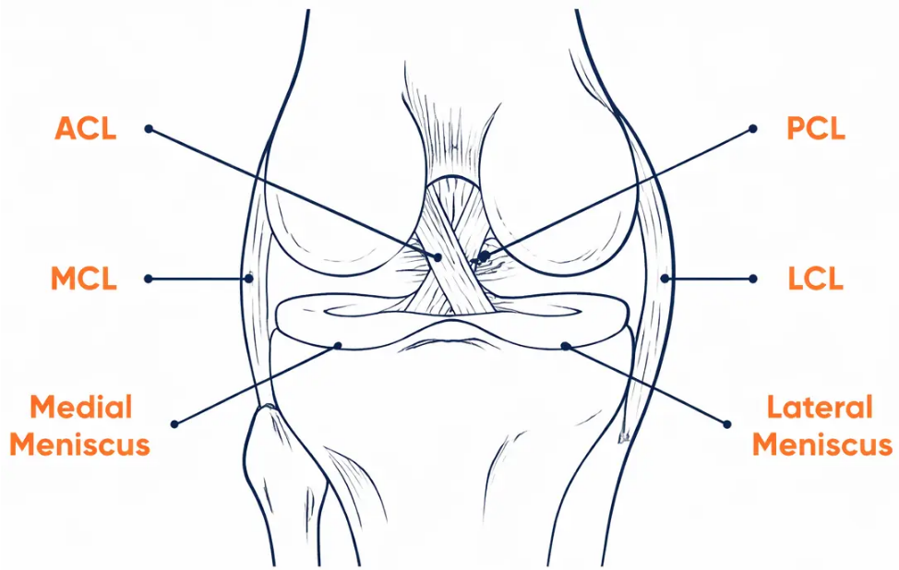






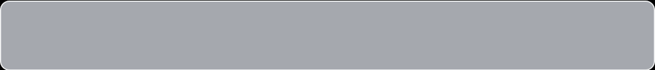
KNEE ANATOMY
70%
29%
Why the Knee is Vulnerable
of traumatic
haemarthroses
are ACL tears
MCL injuries in
acute knee trauma
01
No Bony Stability
The largest joint in the body — yet entirely
dependent on ligaments, menisci, and
muscles for stability.
4%
2%
PCL ruptures in
acute injuries
LCL injuries —
least common
02
Menisci as Shock Absorbers
Outer rim is vascular and can heal.
Central zone is avascular — vulnerable to
permanent damage.
03
How Injuries Happen
Football
Rugby
Hockey
Skiing
RTA
🔑 Key insight: Trauma + no bony stability = ligament and
meniscal injury until proven otherwise.
Educational purposes only · Always verify against latest NICE/BNF/local pathways · Dr Ramesh Mehay · June 2026 · www.bradfordvts.co.uk

Slide 4







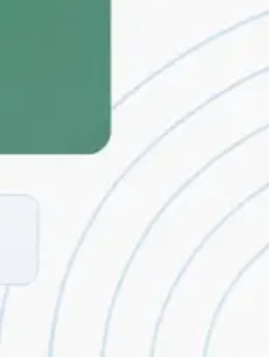

BRADFORD VTS TEACHING DECK • www.bradfordvts.co.uk
DIAGNOSTIC FRAMEWORK
The RTA Analogy Mnemonic
Think of every acute knee injury as a road traffic accident — the severity tells you the diagnosis.
MAJOR RTA
MODERATE RTA
MINOR RTA / NEAR-MISS
ACL Rupture
Meniscal Tear
Patellofemoral Syndrome
• Dramatic presentation
• Twisting on flexed knee
• No acute injury event
• Pop / crack / snap heard
• Medial joint-line pain
• Gradual anterior knee pain
• Immediate complete collapse
• Delayed swelling 24–48 hours
• Worse going down stairs
• Cannot continue playing
• Cinema sign after prolonged flexion
• Hobbling but weight-bearing
• Haemarthrosis within 8 hours
• Minor or absent examination findings
• Mechanical locking possible
• Urgent orthopaedic referral
"Carried off the pitch"
• Acute knee clinic within a week
"Limping home from the pitch"
• Physiotherapy — not orthopaedics
"Drove home fine"
Rule: Use combinations of symptoms — never rely on a single feature alone to diagnose.
Educational purposes only • Always verify against latest NICE/BNF/local pathways • Dr Ramesh Mehay • June 2026

Slide 5




BRADFORD VTS TEACHING DECK • www.bradfordvts.co.uk
June 2026
HISTORY-FIRST EVIDENCE
Evidence for a History-First Approach
70-80%
~90%
~9%
of diagnostic information
comes from the history alone
of ACL ruptures can be
diagnosed from history —
before examination
of first-contact doctors
correctly diagnose ACL at
initial presentation
DIAGNOSTIC CONTRIBUTION
History: 70–80%
Examination: 10–20%
0%
100%
Average delay from ACL injury to correct diagnosis: 21–22 months
A textbook history with a normal examination still warrants referral
IN THE AKT EXAM
Do not be falsely reassured by a normal knee examination. If the history fits ACL rupture — refer.
Acute pain, swelling and guarding render Lachman and pivot shift unreliable.
Educational purposes only · Always verify against latest NICE/BNF/local pathways · Dr Ramesh Mehay · June 2026

Slide 6


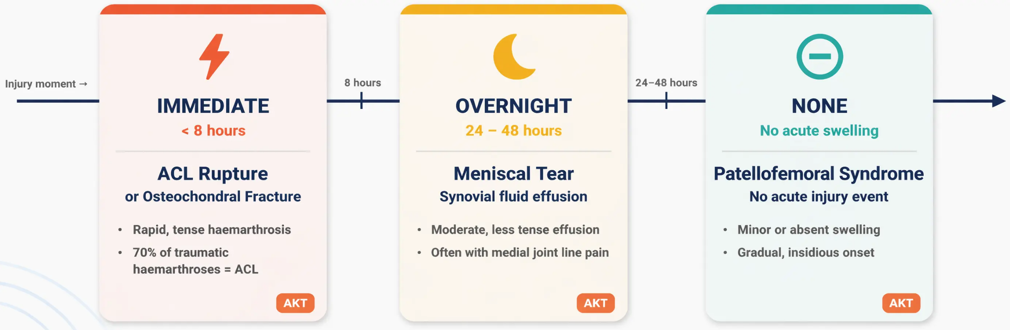

HISTORY-FIRST FRAMEWORK
Diagnostic Timeline and Swelling
When swelling appears tells you what structure is injured
🧠
Memory hook: “Immediate = Blood / ACL • Overnight = Synovial Fluid / Meniscus • None = PFS”
Educational purposes only • Always verify against latest NICE/BNF/local pathways • Dr Ramesh Mehay • June 2026 • www.bradfordvts.co.uk

Slide 7

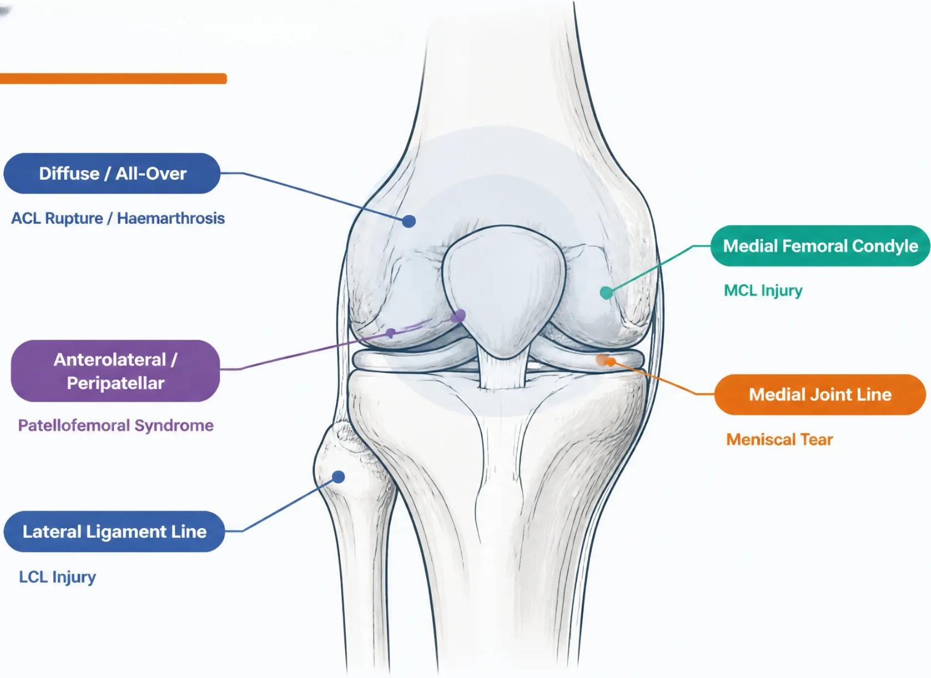




PAIN LOCATION GUIDE
Mapping Pain Location
One-Finger Test
Ask the patient to point to
the pain with one finger.
Where they point is often
more diagnostic than any
special test.
Medial joint line ≠ medial
femoral condyle — the
distinction matters.
Educational purposes only · Always verify against latest NICE/BNF/local pathways · www.bradfordvts.co.uk · Dr Ramesh Mehay · June 2026

Slide 8
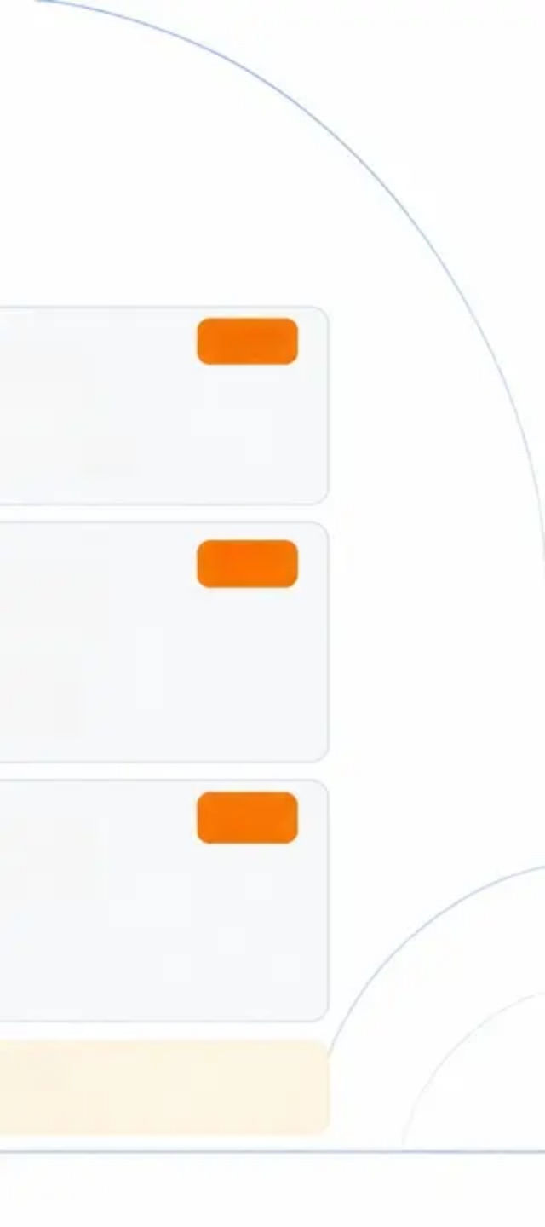
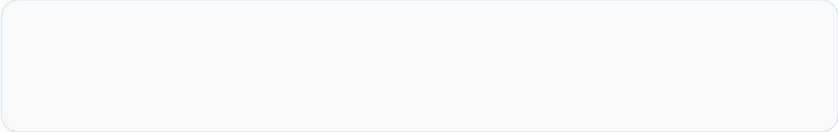
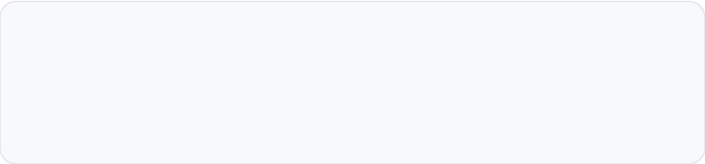


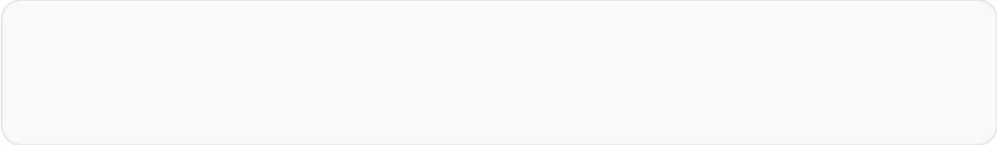

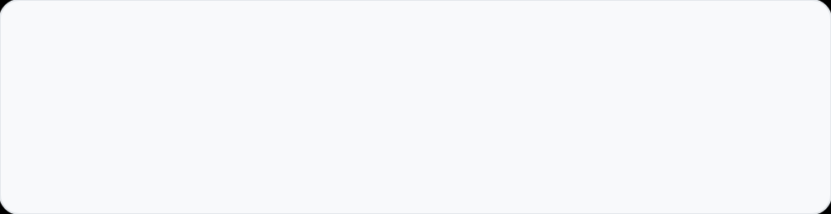
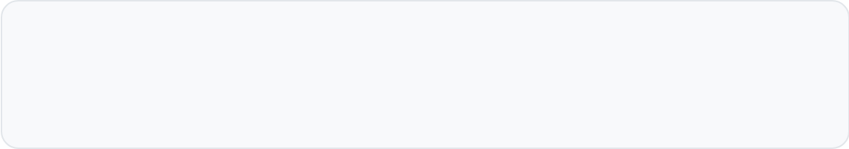
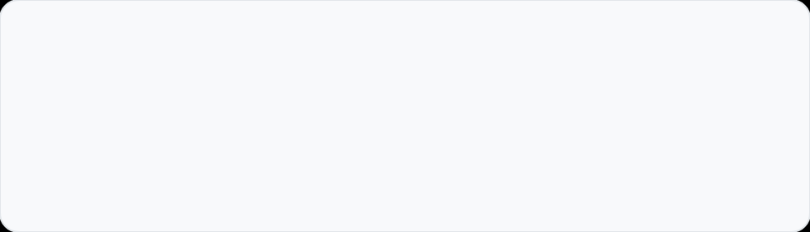
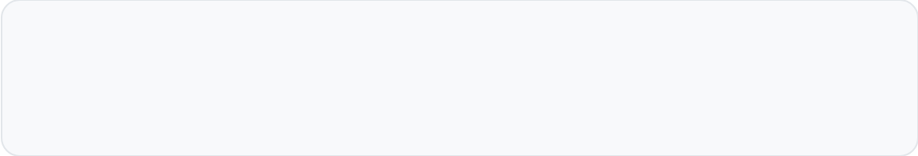


HISTORY · MECHANISM
Key Mechanism Questions
Ask these questions in every acute knee consultation — each answer points to a specific diagnosis
ACL
ACL
Did you hear or feel a pop, snap, or crack?
Could you continue playing or did you
have to stop immediately?
Sudden loud pop at moment of injury is highly
characteristic of ACL rupture
ACL: cannot continue · Meniscal: may hobble on
MENISCUS
Was there a twisting movement on a bent knee?
Rotational force on a flexed, weight-bearing
knee is the classic meniscal mechanism
Was there a direct blow to the front of
your shin with the knee bent?
PCL
Did your knee completely give way at
the moment of injury?
ACL
Dashboard injury or fall onto flexed knee —
posterior force on proximal tibia
Immediate complete collapse on rotation — not
gradual or partial — suggests ACL
Was there a force pushing your knee
inward (valgus)?
MCL
Did your knee lock — could you not
straighten it?
MENISCUS / LOOSE BODY
Tackle from the outside, skiing fall, or
contact sport valgus stress
Mechanical block to extension indicates a
meniscal flap or loose body
AKT / SCA Tip: Never rely on a single answer — combine mechanism, swelling timing, and ability to continue.
Giving way from ACL is immediate and complete; PFS giving way is partial and reflex.
Educational purposes only · Always verify against latest NICE/BNF/local pathways · Dr Ramesh Mehay · June 2026 · www.bradfordvts.co.uk

Slide 9


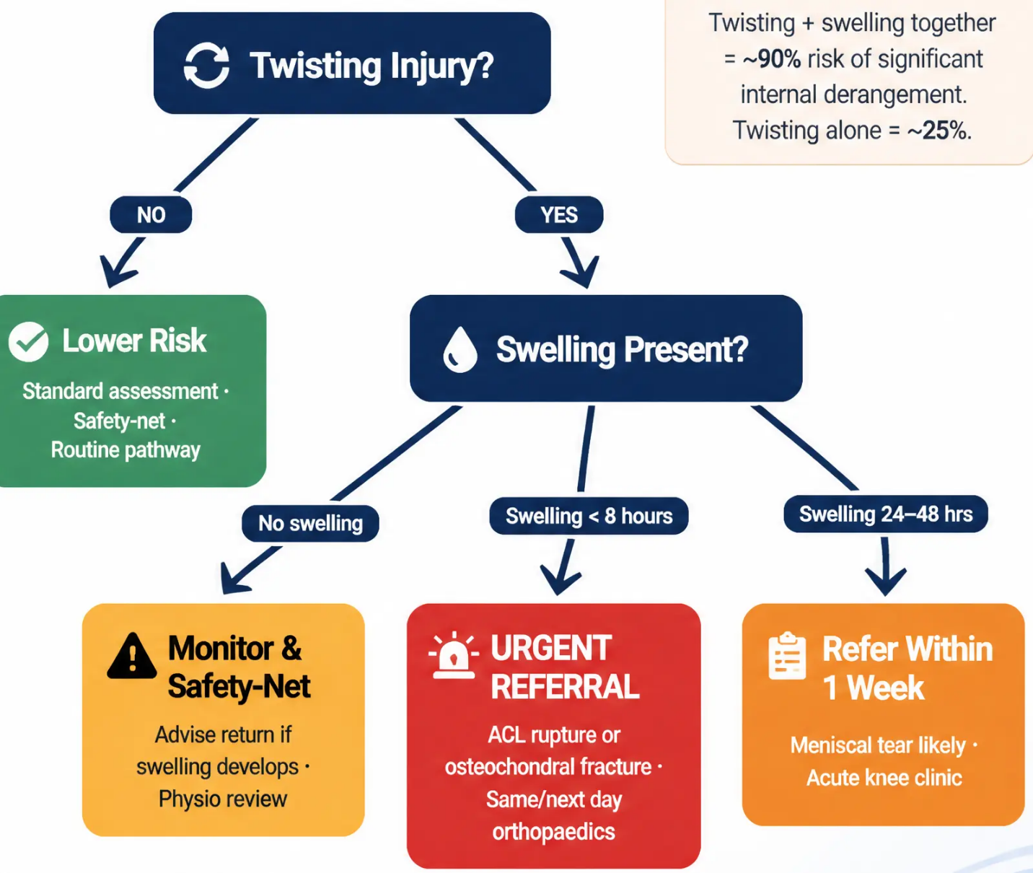





CLINICAL DECISION RULE
T + S = Trouble Rule
T + S = Trouble
T = Twisting Injury
S = Swelling
~25%
~90%
Twisting alone
Twisting + Swelling
Educational purposes only · Always verify against latest NICE/BNF/local pathways · www.bradfordvts.co.uk · Dr Ramesh Mehay · June 2026

Slide 10
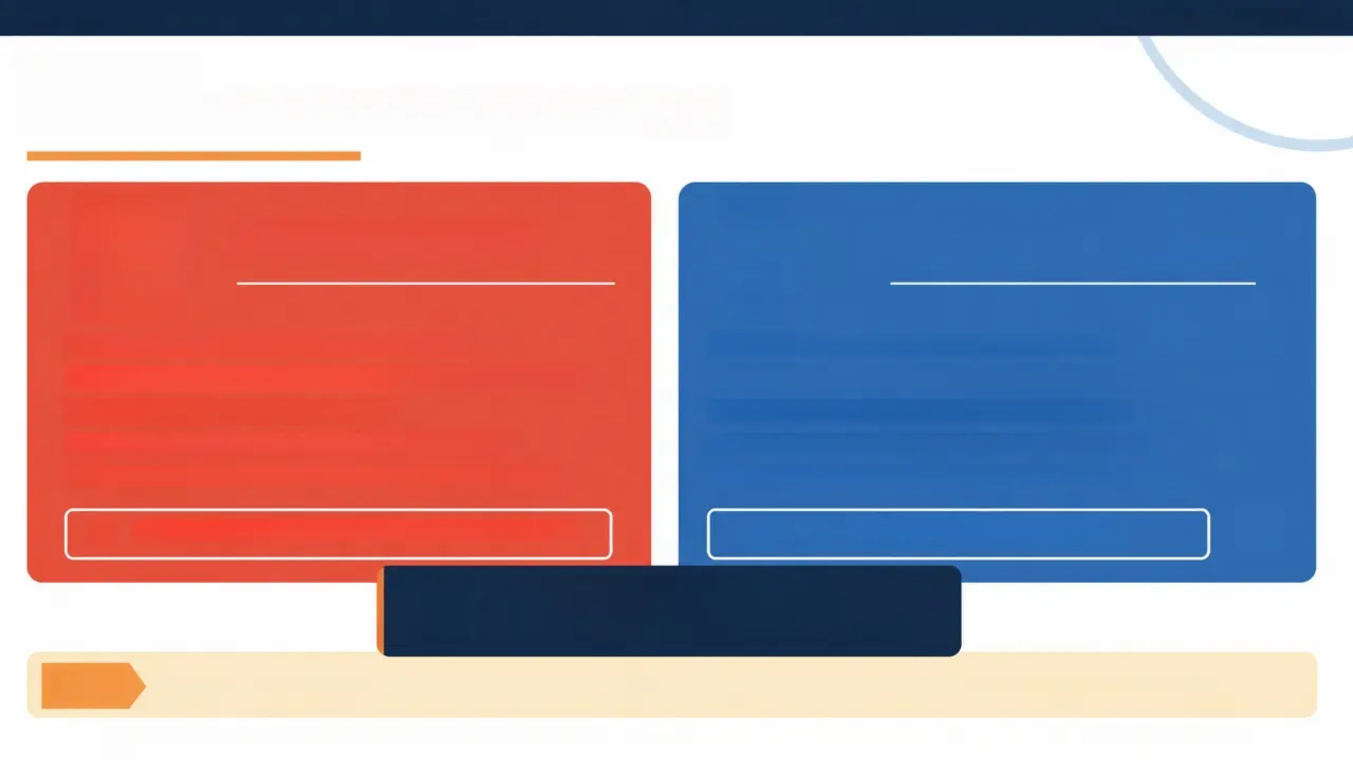
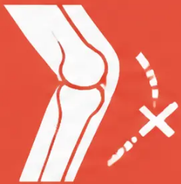





BRADFORD VTS TEACHING DECK • www.bradfordvts.co.uk • June 2026
Educational purposes only.
EXAMINATION
True Locking vs Pseudo-Locking
TRUE LOCKING
PSEUDO-LOCKING
● Cannot EXTEND / straighten the knee
● Cannot FLEX fully — pain and spasm
● Mechanical block — meniscal flap or loose body
● No mechanical block — effusion or muscle guarding
● Usually medial joint line pain
● Often anterior knee pain (PFS pattern)
● Comes on suddenly, often after twisting
● Gradual onset, no clear mechanical event
● Patient cannot fully straighten even passively
● Passive movement often possible with care
URGENT ORTHOPAEDIC REFERRAL
PHYSIOTHERAPY ROUTE
E for Emergency
Cannot EXTEND = True Lock = Act Now
AKT
AKT Pearl: The knee NEVER locks in full extension — true locking always occurs in partial flexion.
Educational purposes only • Always verify against latest NICE/BNF/local pathways • Dr Ramesh Mehay • June 2026 • www.bradfordvts.co.uk

Slide 11
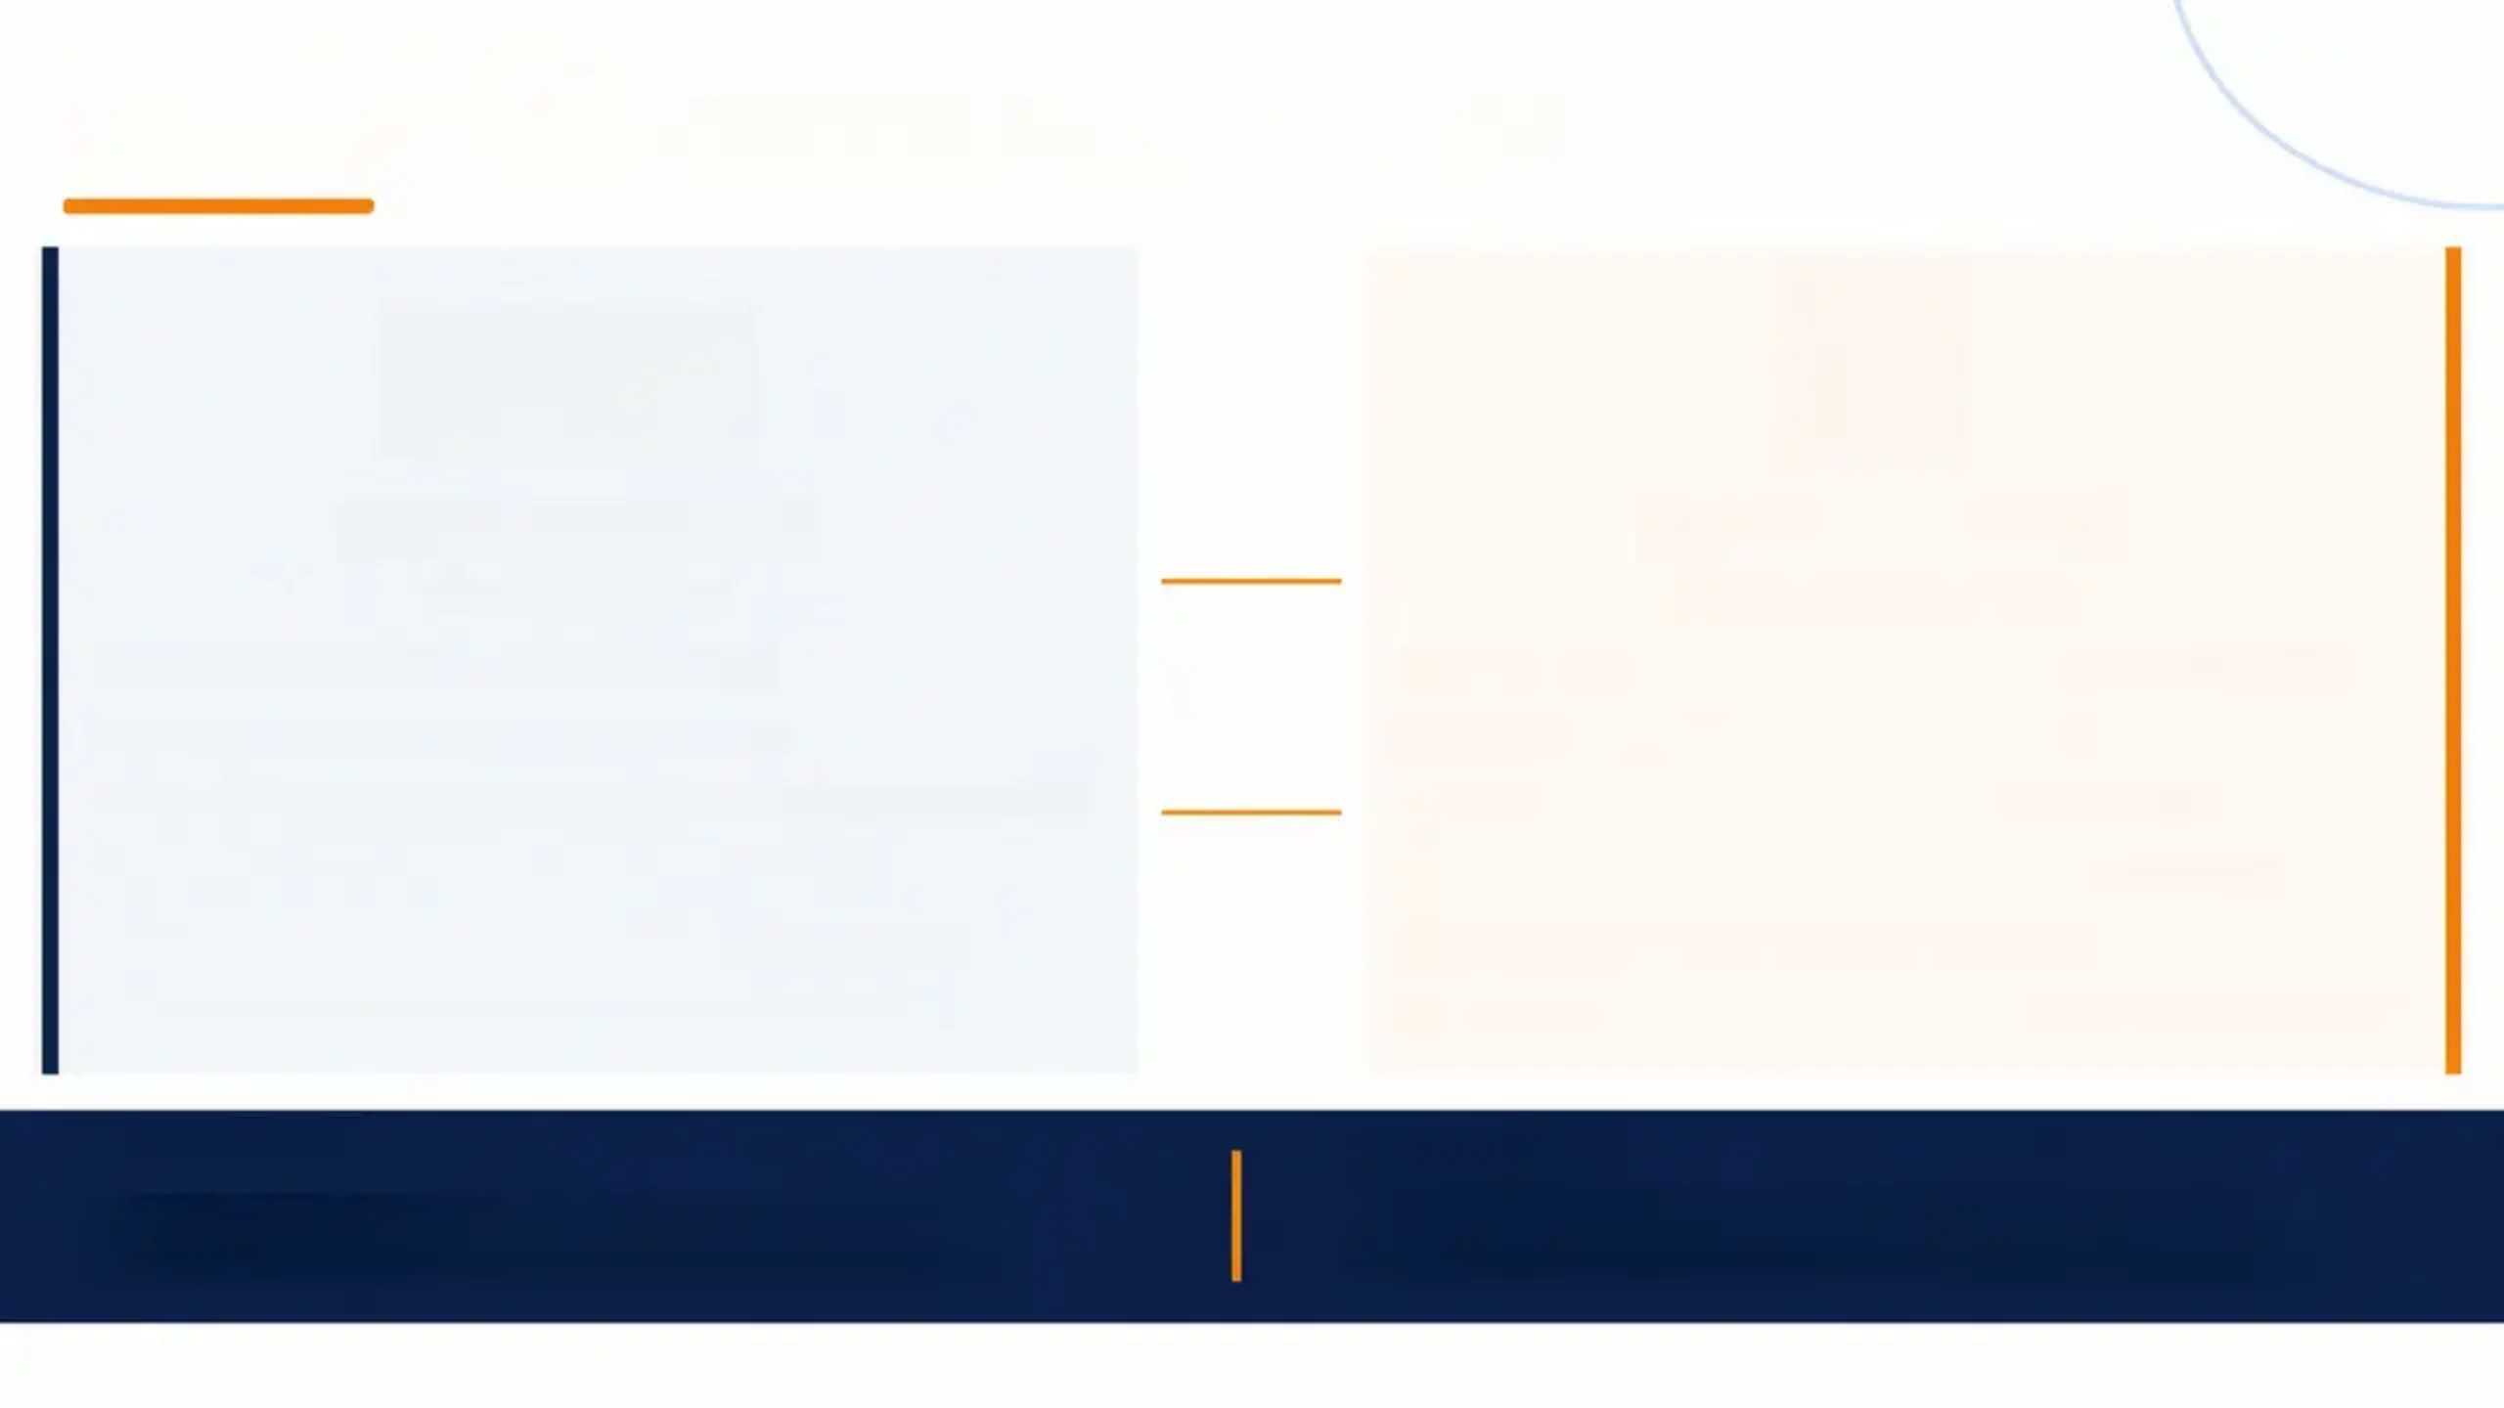
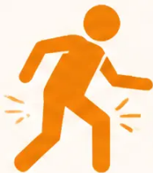
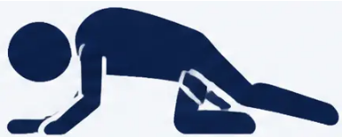
MECHANISMS OF GIVING WAY
Giving Way — Not All Collapses Are Equal
Complete Collapse
Partial Giving Way
ACL-Deficient Knee
Anterior Knee Pain / PFS
VS
Trigger: Rotational / twisting movement
Trigger: Pain or prolonged flexion (stairs, cinema, squatting)
Onset: Immediate, sudden, unexpected
Onset: Gradual, momentary, self-limiting
Severity: Full weight-bearing failure — patient falls or is caught
Severity: Brief buckle — patient catches themselves
Recovery: Cannot self-correct; structural failure
Recovery: Immediate self-correction; no structural failure
Associated: Haemarthrosis, pop/crack at time of injury
Associated: No effusion, no acute injury event
Pattern: Happens on rotation even at low speed
Pattern: Reflex quadriceps inhibition — protective, not structural
CLINICAL EXAMPLE
IN THE SCA EXAM
Gascoigne turns to pass — knee collapses completely,
he is carried off. That is ACL rotational instability.
Ask: 'Did your knee just buckle slightly, or did you
completely fall?' — the answer separates PFS from ACL.
Educational purposes only · Always verify against latest NICE/BNF/local pathways · www.bradfordvts.co.uk · Dr Ramesh Mehay · June 2026

Slide 12













EXAMINATION FRAMEWORK
Structured Examination: Look, Feel, Move
Always start observing as
the patient enters the room
LOOK
FEEL
MOVE
● Start observing gait as patient enters
● Effusion — patellar tap / bulge sign
● Active then passive then resisted movement
● Bony landmarks and joint contours
● Synovial thickening vs fluid
● Flexion and extension range
● AP and lateral alignment — varus / valgus
● Joint line tenderness — medial vs lateral
● Hyperextension — note if present
● Q-angle and patellar position
● Bursae — prepatellar, infrapatellar
● Patellar movement, crepitus, apprehension
● Muscle wasting — especially VMO
● Popliteal cysts (Baker's cyst)
● Collateral stress — valgus and varus at 0° and 30°
● Swelling character — diffuse vs localised
● Femoral condyle tenderness (MCL)
● Lachman test (ACL)
● Temperature — warmth suggests inflammation
● Erythema, bruising, skin changes
● Anterior Drawer (ACL)
● Neurovascular — sensation and pulses
● McMurray test (meniscus)
CLINICAL PEARL
Always consider referred pain from the hip — and screen for generalised
joint disease before attributing symptoms to the knee alone.
Educational purposes only · Always verify against latest NICE/BNF/local pathways · www.bradfordvts.co.uk · Dr Ramesh Mehay · June 2026

Slide 13
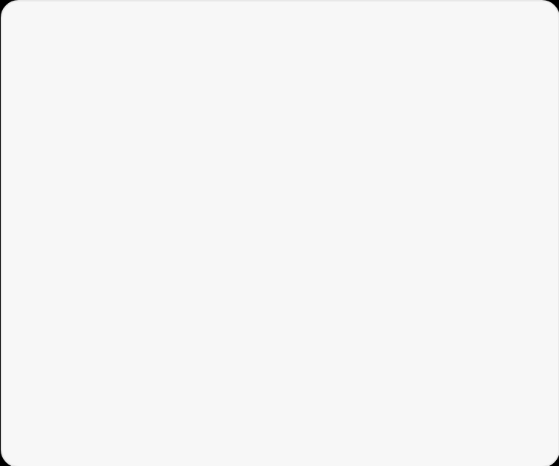

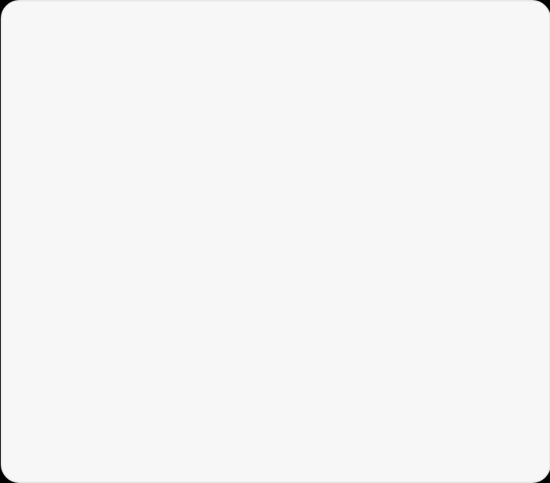




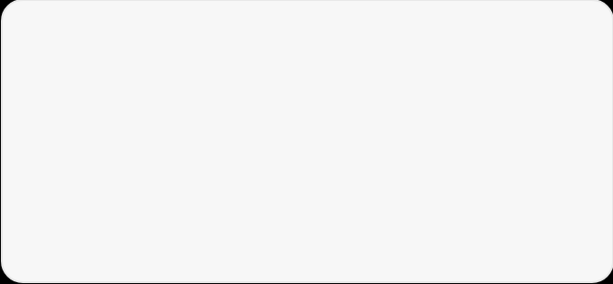
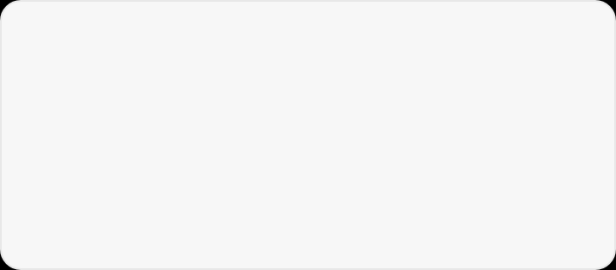




BRADFORD VTS TEACHING DECK • www.bradfordvts.co.uk
June 2026
EXAMINATION
Special Tests & Statistical Accuracy
LACHMAN TEST
ANTERIOR DRAWER
McMURRAY TEST
Tests: ACL integrity
Tests: ACL integrity
Tests: Meniscal integrity
LR+ 25.0
LR+ 3.8
Sensitivity
53%
Composite
77% / 91%
(combined exam)
BEST ACL TEST
LESS RELIABLE ACUTELY
Knee at 20–30° flexion • Anterior tibial pull •
Gold standard in acute setting
Knee at 90° • Hamstring guarding reduces
accuracy • Less useful in acute haemarthrosis
Rotation + extension • Medial/lateral joint line
click • Composite exam far superior
PIVOT SHIFT
COLLATERAL STRESS
Lachman LR+ 25 vs Anterior Drawer LR+ 3.8 —
know the difference and why.
McMurray alone = 53%.
Combined meniscal exam = 77% / 91%.
Pivot shift: high specificity, experience-dependent.
HIGH SPECIFICITY
• Valgus at 30° → isolates MCL
Experience-dependent •
Confirms ACL rotational
instability • Often unreliable
in acute pain/guarding
• Varus at 30° → isolates LCL
Test in extension too — laxity in
extension = major combined injury
Educational purposes only • Always verify against latest NICE/BNF/local pathways • Dr Ramesh Mehay • June 2026 • www.bradfordvts.co.uk

Slide 14




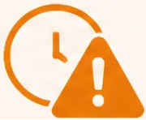
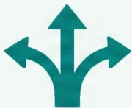




CLINICAL DEEP DIVE
ACL Rupture: A Deep Dive
Missed Diagnosis — The Reality
Classic Presentation
Consequences & Management
21–22 months
Long-term consequences:
◆ Pop / crack / snap at moment of injury
● Rotatory instability & repeated giving way
◆ Immediate complete giving way
average time from injury to diagnosis
◆ Unable to continue activity
● Progressive meniscal injury
~9%
◆ Haemarthrosis within 8 hours
● Early osteoarthritis
of first doctors correctly diagnose ACL
◆ Dynamic / rotational mechanism
Management options:
● First presentation often dismissed
◆ Lachman LR+ 25.0 (most reliable test)
Non-operative
Surgical
● Normal X-ray falsely reassures
Intensive hamstring rehab
Selected: low-demand,
no instability
For instability / high-demand sport
Graft: BPTB · Hamstring · Quad tendon
No single superior graft (BASK/BOA)
● Exam unreliable in acute phase
History gives diagnosis in ~90% of cases
Compelling history = refer, even with normal exam
IN THE AKT EXAM
Haemarthrosis <8h = ACL (70%) or osteochondral fracture · Lachman LR+ 25 vs Anterior Drawer LR+ 3.8 ·
Normal X-ray does NOT rule out ACL · First-doctor diagnosis rate ≈ 9%
Educational purposes only · Always verify against latest NICE/BNF/local pathways · www.bradfordvts.co.uk · Dr Ramesh Mehay · June 2026

Slide 15

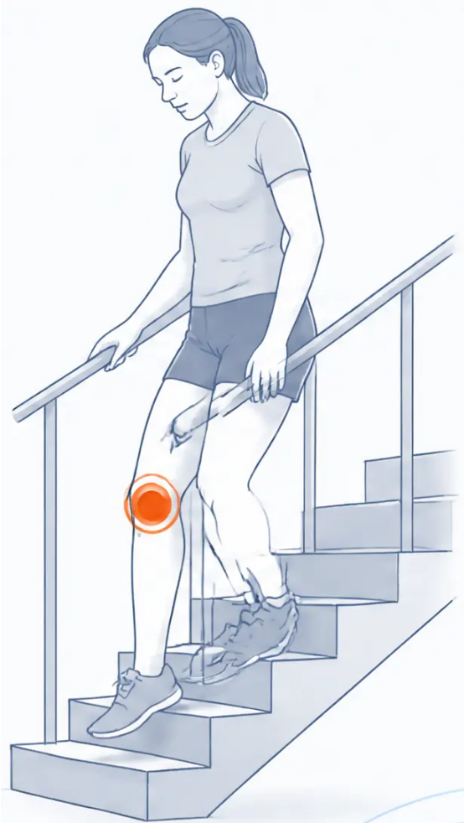







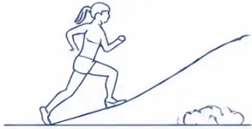
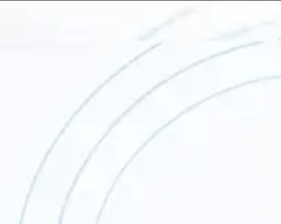

BRADFORD VTS TEACHING DECK
www.bradfordvts.co.uk · June 2026
CONDITION DEEP DIVE — PFS
Patellofemoral Syndrome (PFS)
Anterior knee pain with no acute injury — the most common knee problem in young active people
CLINICAL FEATURES
WHO GETS IT?
MANAGEMENT
● Anterior or anterolateral knee pain
● Prepubertal girls — most
common demographic
● Physiotherapy first — do not
refer to orthopaedics initially
● Worse going DOWN stairs (not up)
● Adults beginning hill walking,
running, or stair climbing
● VMO strengthening (vastus
medialis oblique) — key exercise
● Cinema sign — pain after sitting
with knee bent for prolonged time
(e.g. cinema, long car journey)
● Cyclists and those with
increased Q-angle
● Patellar taping — McConnell
technique
● Worse with squatting, crouching,
cycling, kneeling
● Often bilateral
● Activity modification — reduce
aggravating activities temporarily
● Gradual onset — no acute
traumatic event
● Insidious onset over weeks
to months
● Patient education and reassurance
● Patellar apprehension test may be
positive
● Not associated with a
specific injury event
● Drugs do NOT address the
underlying cause
● J-sign — lateral patellar tracking
on extension
🚫 Glucosamine not recommended —
NICE NG226
No pop, no haemarthrosis, no locking
Good prognosis with structured physiotherapy
AKT + SCA EXAM PEARL
PFS = DOWN stairs (not up) · Cinema sign · VMO programme ·
NO orthopaedic referral initially · Glucosamine NOT recommended (NICE NG226)
Educational purposes only · Always verify against latest NICE/BNF/local pathways · Dr Ramesh Mehay · June 2026

Slide 16




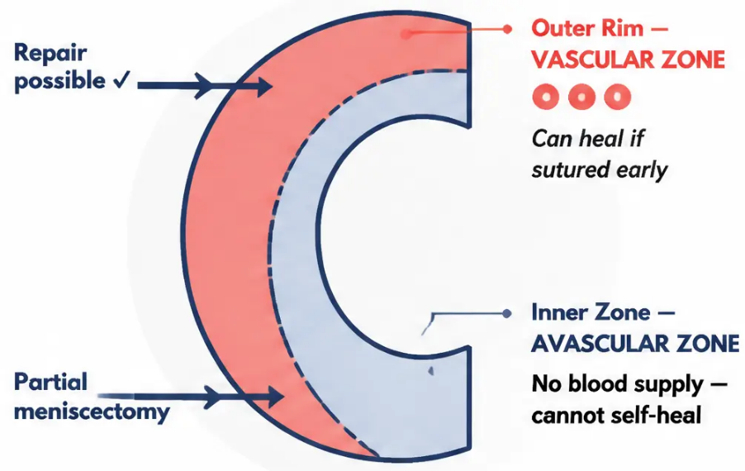












MENISCAL PATHOLOGY
Meniscal Tear Characteristics
Vascular zones • Mechanism • Repair vs Meniscectomy
HOW IT HAPPENS
Meniscus: Zone Anatomy
REPAIR vs MENISCECTOMY
Twisting on a flexed knee
Meniscal Repair
– the classic mechanism
• Outer rim tear
Common in: football, rugby,
skiing, hockey
• Vascular — blood supply present
• Suture repair possible
• Best outcome if done early
Swelling timing: delayed 24–48 hours
(synovial fluid, not blood — unlike ACL)
• Preserves joint function long-term
Pain location: medial joint line
(ask patient to point with one finger)
Partial Meniscectomy
• Central avascular zone tear
Locking: unable to fully extend
= mechanical block from meniscal flap
• Cannot self-heal
• Remove only damaged portion
Twisting + swelling 24–48h =
meniscal tear until proven otherwise
• Avoid COMPLETE meniscectomy
Preserve meniscus wherever possible —
complete meniscectomy → early OA
• Complete removal → early osteoarthritis
TRUE LOCKING
NON-LOCKING TEAR
No locking, mild symptoms
→ Urgent orthopaedic referral
→ Acute knee clinic within 1 week
→ Physio/MSK review
McMurray sensitivity 53%,
Composite meniscal exam sensitivity 77%, specificity 91%.
Swelling 24–48h = synovial fluid, not haemarthrosis.
Educational purposes only • Always verify against latest NICE/BNF/local pathways • www.bradfordvts.co.uk • Dr Ramesh Mehay • June 2026

Slide 17


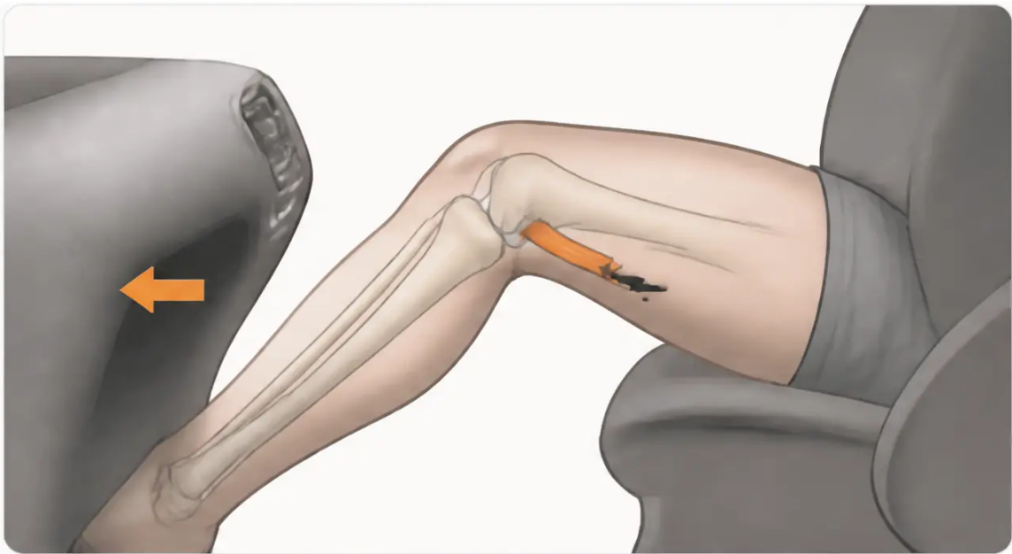










BRADFORD VTS TEACHING DECK
www.bradfordvts.co.uk • June 2026
LIGAMENT INJURIES
PCL Rupture Assessment
4% of acute knee injuries
HOW IT HAPPENS
Dashboard injury — direct anterior blow to
tibia with knee flexed (RTA)
Hyperextension — forced straightening
beyond normal range
Skiing fall — knee driven posteriorly on impact
HOW IT PRESENTS
— Often less dramatic than ACL at moment of injury
— Vague posterior knee pain or patellofemoral pain (posterior tibial displacement)
— May become relatively asymptomatic after acute phase
— Occasional giving way — less rotatory than ACL instability
Dashboard mechanism: anterior tibial force → posterior tibial
displacement → PCL stress
“ Posterior sag sign — tibia drops back compared to uninjured side
In the AKT: "PCL = 4%; dashboard/hyperextension mechanism; conservative
quad rehab first; surgery only for instability or combined injury"
FIRST LINE
ESCALATE IF
LONG-TERM RISK
Quadriceps Rehabilitation
Significant Instability
Early Osteoarthritis
Strengthening quad to compensate
for PCL deficit
Combined ligament injury - Functional
limitation - Ongoing pain
Counsel patients on joint protection
and activity modification
Educational purposes only • Always verify against latest NICE/BNF/local pathways • Dr Ramesh Mehay • June 2026

Slide 18
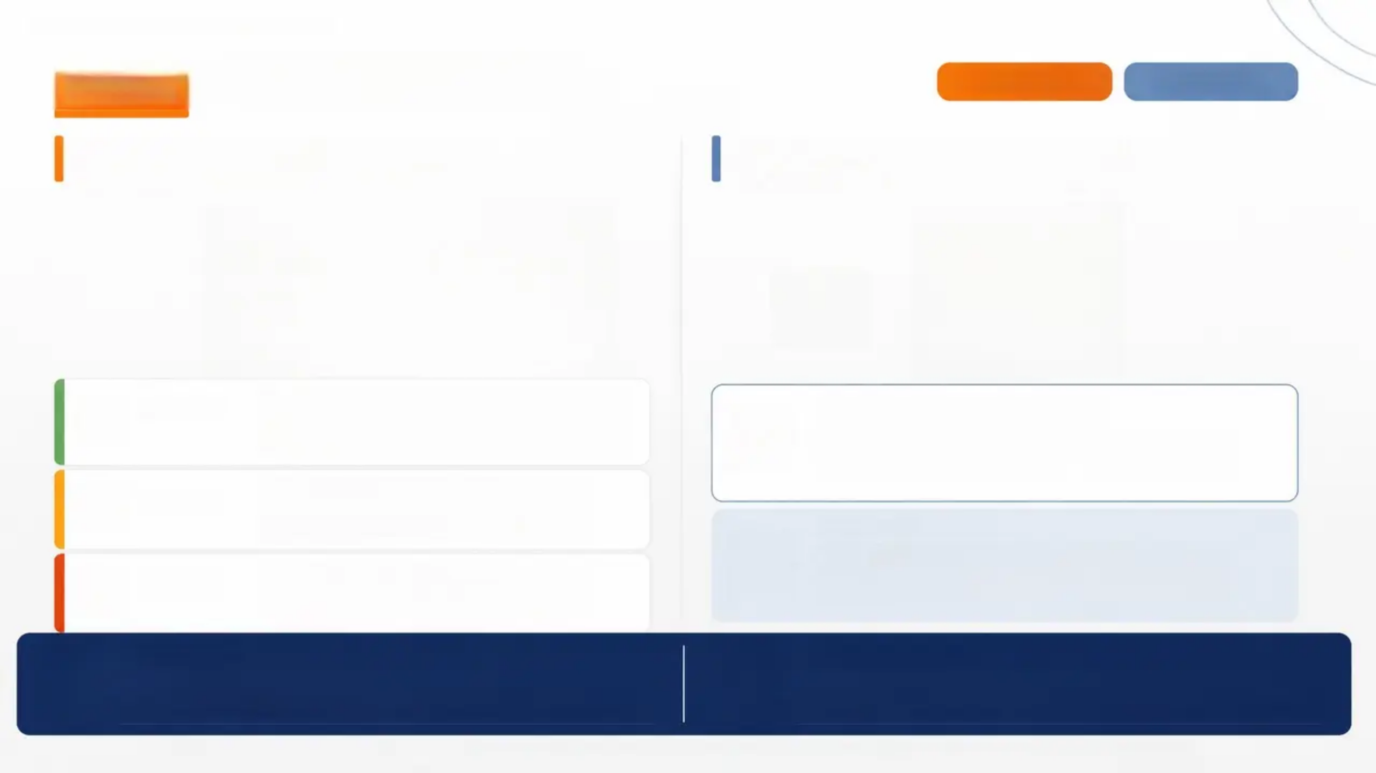
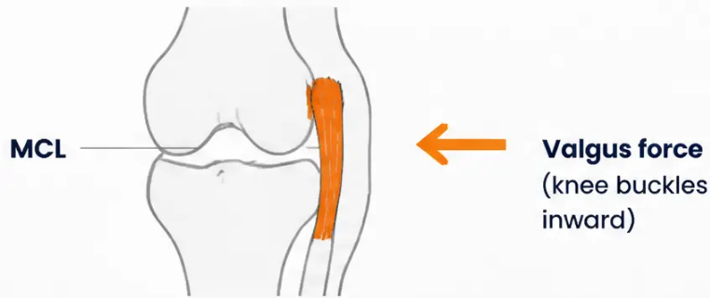
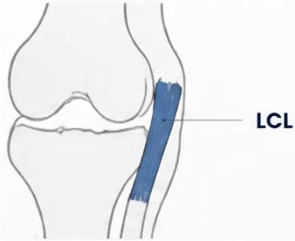






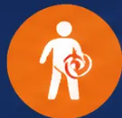

COLLATERAL LIGAMENT INJURIES
MCL and LCL Injuries
MCL — 29%
LCL — 2%
MCL — Medial Collateral Ligament
LCL — Lateral Collateral Ligament
Most common collateral injury · Valgus force
Rare · Varus force · 2% of acute injuries
Varus force
(knee buckles
outward)
Grade 1
Pain and tenderness over medial femoral condyle
No laxity on valgus stress · Intact fibres
Early mobilisation, no brace needed
Same 3-Grade System Applies
Grade 1 → 2 → 3 severity mirrors MCL classification ·
Varus stress test at 30° flexion isolates LCL · Abduct
the hip to relax the iliotibial band before testing
Grade 2
Swelling, pain, and partial laxity on valgus
stress at 30° · Partial tear
Brace for comfort, progressive rehab
CLINICAL TIP
Instability present in full extension suggests major
combined damage — involving capsule, ACL, and
collateral ligament. Urgent referral.
Grade 3
Complete tear · Gross laxity · May have
surprisingly little pain
Brace or surgical review if combined injury
Testing Principle
Management Outlook
Valgus stress at 30° → isolates MCL · Varus stress at 30° → isolates LCL ·
Test in full extension only if collateral intact — laxity here = major
combined injury
Conservative early mobilisation · Good prognosis for isolated injuries ·
Brace for Grade 2-3 · Surgical review only for combined
ligament tears
Educational purposes only · Always verify against latest NICE/BNF/local pathways · www.bradfordvts.co.uk · Dr Ramesh Mehay · June 2026

Slide 19



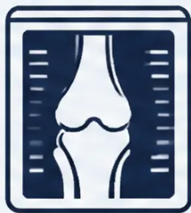
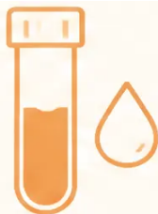
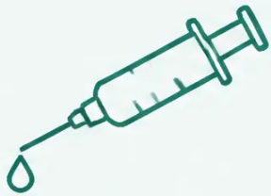


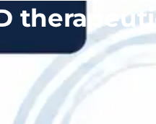
INVESTIGATIONS
Diagnostic Investigations
X-Ray
Blood Tests
Joint Aspiration
• Therapeutic — relieves pain and tension
from large effusion
• Indicated when inflammatory, septic
arthritis, or gout is suspected
• Diagnostic — fluid appearance guides diagnosis
• AP & Lateral views — standard first-line
• Skyline view — patella assessment
● Blood (haemarthrosis) → intra-articular
• WCC — white cell count
injury / ACL rupture
• Tunnel view — intercondylar notch,
loose bodies, osteochondral defects (OCD)
● Lipid droplets → osteochondral fracture
• CRP & ESR — inflammatory markers
(largely supersede plasma viscosity)
● Turbid fluid → send for MC&S
(septic arthritis)
Normal X-ray does NOT rule out
ACL rupture
• Urate — for gout screen
Always use strict aseptic technique
• MRI — typically arranged via orthopaedics
for soft-tissue detail
Not routine for acute mechanical injuries
AKT Pearl: Haemarthrosis within 8 hours = ACL rupture (70%) or osteochondral fracture — aspiration is both diagnostic AND therapeutic
Educational purposes only · Always verify against latest NICE/BNF/local pathways · www.bradfordvts.co.uk · Dr Ramesh Mehay · June 2026

Slide 20
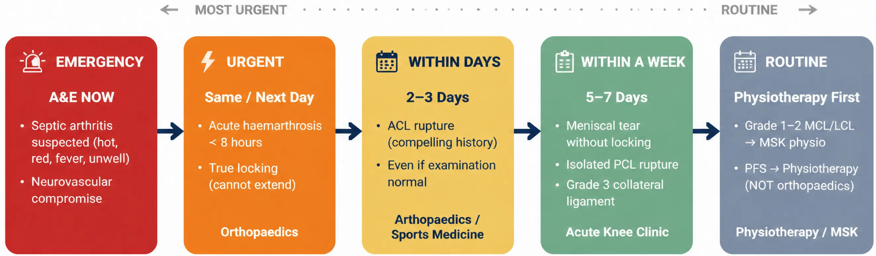
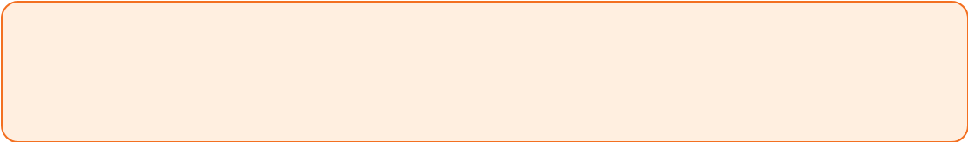

BRADFORD VTS TEACHING DECK ● www.bradfordvts.co.uk
CLINICAL DECISION-MAKING
Referral Pathways Flowchart
In the AKT exam: "A compelling ACL history with a normal
examination still warrants urgent referral — do not be
falsely reassured."
Educational purposes only ● Always verify against latest NICE/BNF/local pathways ● Dr Ramesh Mehay ● June 2026

Slide 21












PATIENT SAFETY
Red Flags & Safety-Netting
EMERGENCY —
CALL 999 / SEND TO A&E
URGENT — SAME DAY /
NEXT DAY ORTHOPAEDICS
IMPORTANT — REFER WITHIN
DAYS TO A WEEK
– Hot, red, swollen joint + fever or
systemically unwell → Septic Arthritis
– Acute haemarthrosis within 8 hours
(ACL / osteochondral fracture)
– ACL rupture confirmed by history →
within days
– True locking — cannot extend/
straighten the knee
– Meniscal tear without locking →
within one week
– Neurovascular compromise (absent
pulse, pallor, paraesthesia, paralysis)
– Grade 3 collateral tear →
within one week
“Do not delay. Every hour matters in
septic arthritis.”
“Compelling ACL history + normal
exam → still refer. Do not be
falsely reassured.”
“PFS and Grade 1–2 collateral →
physiotherapy, not orthopaedics.”
Safety-Netting
Scripts for GP
“If your knee swells rapidly
overnight — call us back
the same day.”
“If you cannot straighten
your knee at all —
go to A&E.”
“If you develop a fever
with knee pain —
this is an emergency.”
IN THE AKT / SCA EXAM
Normal examination does
NOT exclude ACL rupture.
History alone justifies
referral.
Educational purposes only · Always verify against latest NICE/BNF/local pathways · www.bradfordvts.co.uk · Dr Ramesh Mehay · June 2026

Slide 22










BRADFORD VTS TEACHING DECK • www.bradfordvts.co.uk
EXAM PREPARATION
AKT High-Yield Facts
In the AKT Exam — Know These Cold
< 8 hours
24–48 hrs
LR+ 25.0
53% / 77%
Haemarthrosis = ACL rupture
(70%) or osteochondral fracture
Delayed effusion = meniscal
tear (synovial fluid)
Lachman = best single test for
ACL; far superior to Anterior
Drawer (LR+ 3.8)
McMurray sensitivity 53%;
composite meniscal exam
sensitivity 77%, specificity 91%
~9%
~90%
Glucosamine
Never in
full extension
First doctor correctly
diagnoses ACL in only ~9% of
cases; avg delay 21–22 months
Twisting + swelling together
= ~90% risk of significant
internal derangement
NOT recommended by NICE
NG226 for knee pain — do not
advise patients to take it
Knee never locks in full extension —
true locking is always in partial
flexion (mechanical block)
RTA Analogy • T + S = Trouble • Immediate / Overnight / None • E for Emergency
MCL = femoral condyle • Meniscus = joint line • PCL 4% • MCL 29% - LCL 2%
Educational purposes only • Always verify against latest NICE/BNF/local pathways • Dr Ramesh Mehay • June 2026 • www.bradfordvts.co.uk

Slide 23





























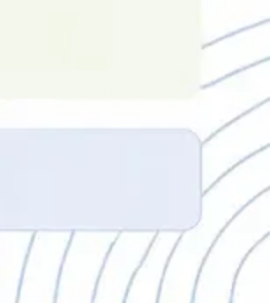
BRADFORD VTS TEACHING DECK
SCA PREPARATION
www.bradfordvts.co.uk
SCA Consultation Tips & Case Studies
Consultation Scripts
Case 1 — Sally, 25
Case 2 — Male, 35
Hockey Tackle
Football Rotation
Acknowledge impact
Presentation: Tackle from behind →
audible crack → rapid tense swelling
within 2 hours → unable to weight-bear
→ normal X-ray at A&E.
Presentation: Rotational injury on flexed
knee → medial joint line pain → overnight
swelling (24–48h) → intermittent locking →
unable to fully straighten at times.
"This must be really frustrating,
especially if you play sport regularly."
Explain swelling timing
"The rapid swelling tells us something
important about wha's injured."
Later course: Intermittent giving way
on rotation over following weeks.
Examination clue: McMurray positive
on medial side.
Safety-net locking
"If your knee locks and you can't
straighten it, come back the same day."
ACL Rupture
Meniscal Tear
Shared decision-making for PFS
"Physio is the most effective treatment —
let's discuss what that involves."
"Do not be reassured by a normal X-ray.
History of crack + haemarthrosis + giving way
= ACL until specialist proves otherwise."
"Overnight effusion + medial joint line +
locking = acute knee clinic within one week.
True locking = urgent same day."
Explore ICE
"What were you hoping we might be
able to do today?"
IN THE SCA EXAM
Always explore ICE · Acknowledge the patient's concern before explaining · Safety-net locking and neurovascular
symptoms · Avoid false reassurance when history is compelling
Educational purposes only · Always verify against latest NICE/BNF/local pathways · Dr Ramesh Mehay · June 2026 · www.bradfordvts.co.uk

Slide 24

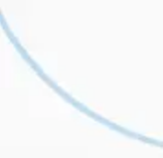

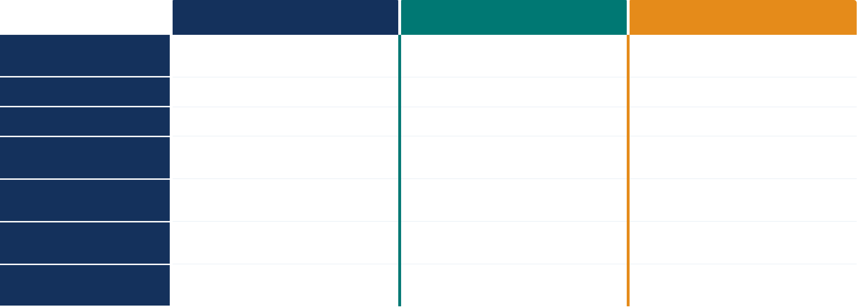

































SUMMARY RECALL
Summary Recall & Comparison Table
Bradford VTS Teaching Deck · June 2026
ACL RUPTURE ⚡
MENISCAL TEAR 🕒
PFS 🪜
Pop/snap/crack · dynamic twisting · immediate collapse
Twisting on a flexed knee · medial joint line
No acute event · gradual onset · overuse
SWELLING
Haemarthrosis within 8 hours — tense, warm
Delayed effusion 24–48 hours — moderate
Minimal or none
Unable to continue · often non-weight-bearing
Can hobble · partial weight bearing
Full · no instability
Diffuse · all-over · entire joint
Medial joint line · specific and localisable
Anterior · peripatellar · worse going DOWN stairs
Lachman LR+ 25 · history is diagnostic in ~90%
McMurray (53%) · composite exam 77% sens / 91% spec
Cinema sign · patellar apprehension · J-sign
Urgent orthopaedics within days
Acute knee clinic within one week (urgent if locked)
Physiotherapy first — NOT orthopaedics initially
Being reassured by a normal exam
Delaying referral if true locking present
Glucosamine (not recommended by NICE NG226)
RTA ANALOGY
T + S = TROUBLE
SWELLING TIMING
E FOR EMERGENCY
"Major · Moderate · Minor RTA"
"Twisting + Swelling = ~90% risk"
"Immediate · Overnight · None"
Educational purposes only · Always verify against latest NICE/BNF/local pathways · www.bradfordvts.co.uk · Dr Ramesh Mehay · June 2026

