Slide 1
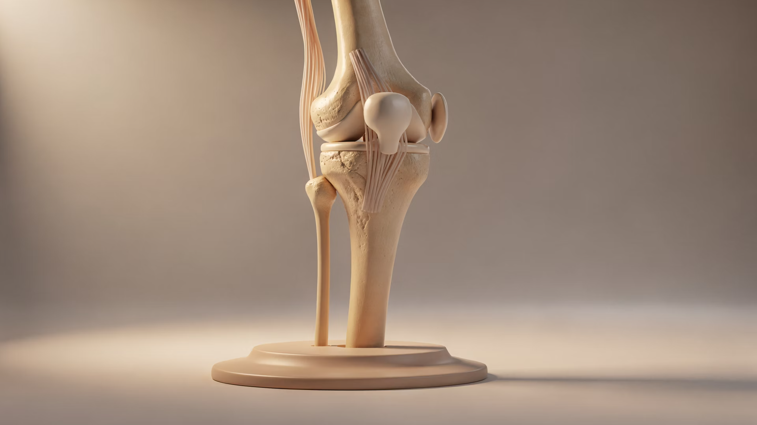
BRADFORD VTS TEACHING DECK
The Acute Knee – 5 things to ask
A rapid clinical framework for diagnosing acute knee presentations
Dr Ramesh Mehay
Created June 2026

Slide 2
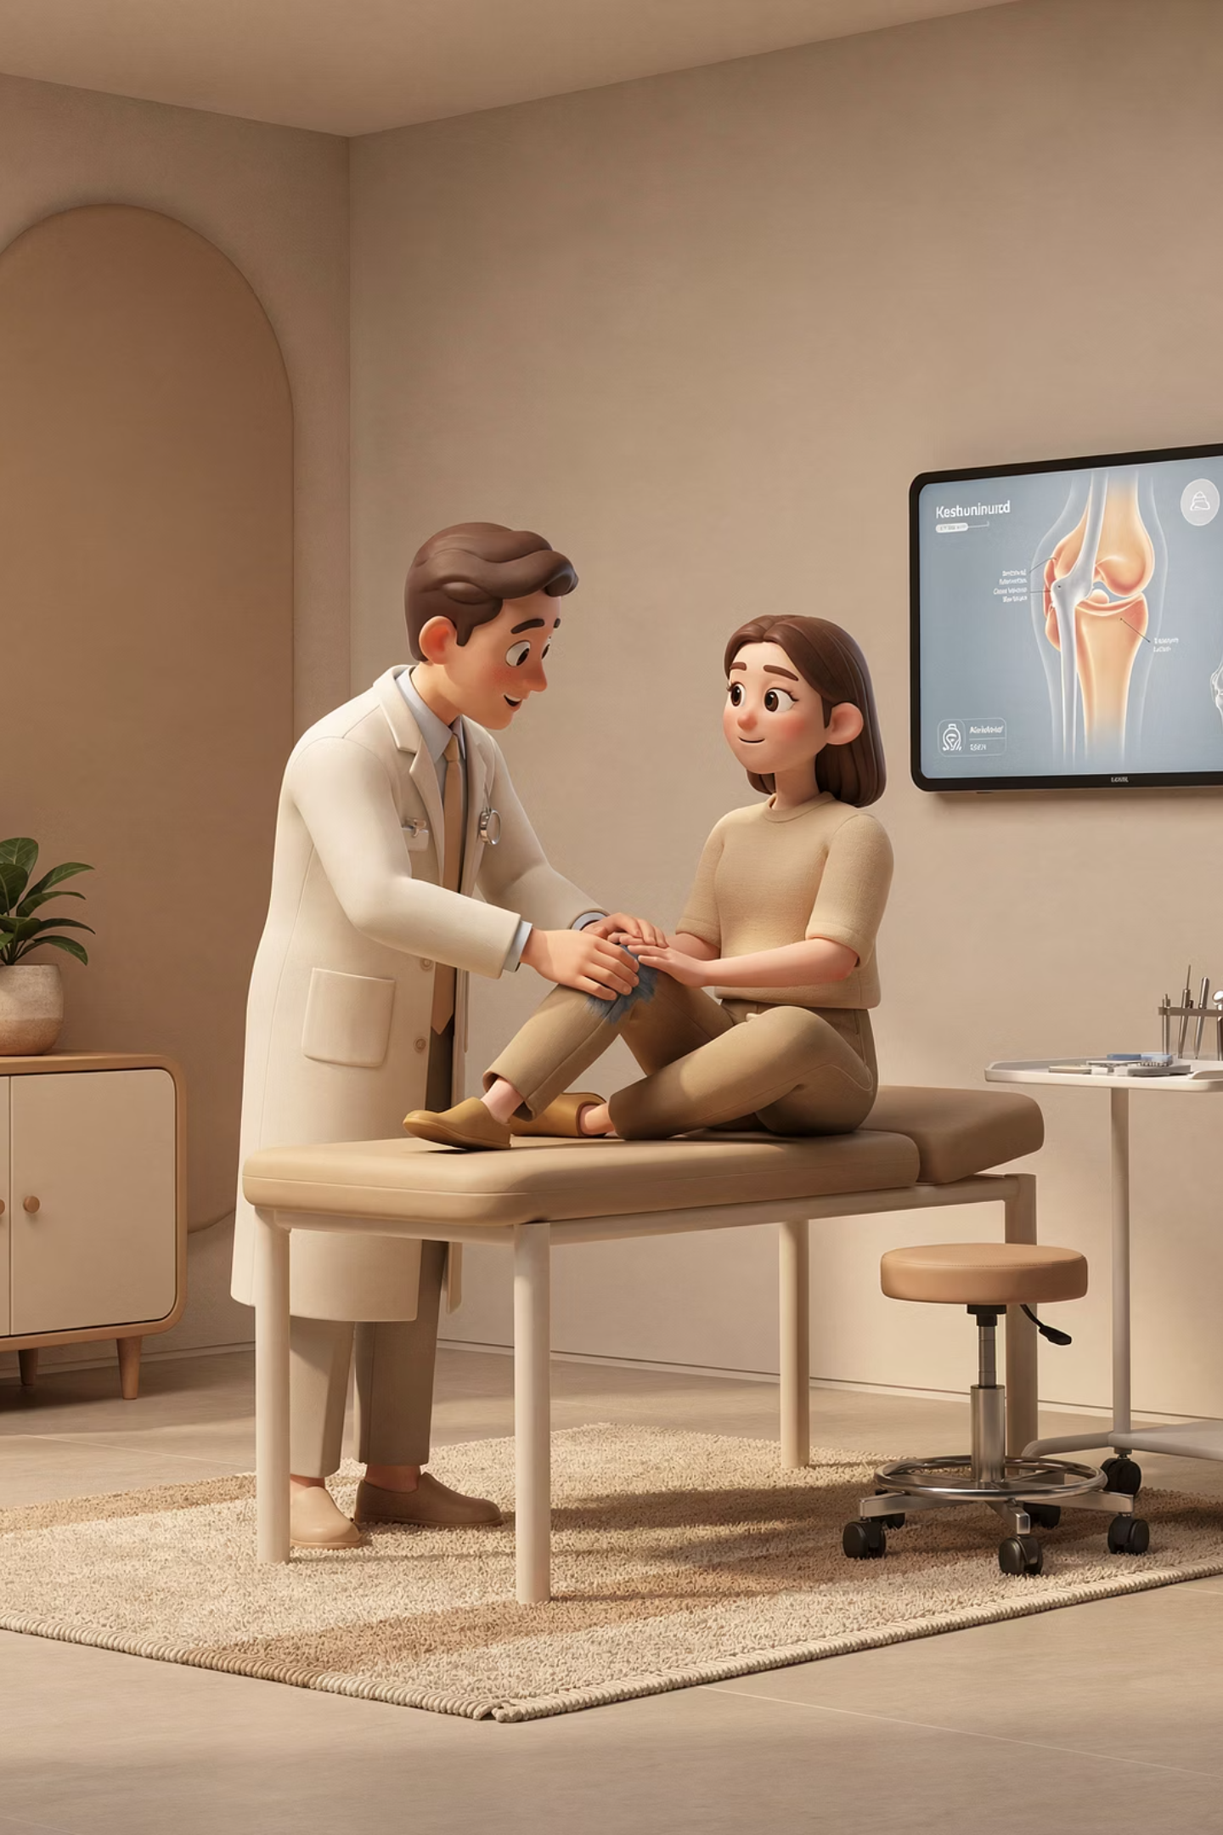
5 things that help you enormously
2. Mechanism of Injury
1. Patient's age + sex
Especially twisting injuries
4. Is there a mechanical problem?
3. Did the knee swell?
Within hours = haemarthrosis = ACL rupture
Next day = meniscal injury
Locking?
Giving way?
5. Pain
Where is it??

Slide 3

Age + sex
Age Group
Males
Females
0-12
Discoid lateral meniscus
Discoid lateral meniscus
12-18
Osteochondritis dissecans
Osgood-Schlatter's
1st patella dislocation
18-30
Longitudinal meniscal tears
Recurrent dislocation patella
Chondromalacia patellae
Fat pad injury
30-50
Rheumatoid arthritis
Rheumatoid arthritis
40-55
Degenerative meniscus lesions
Degenerative meniscus lesions
45+
Osteoarthritis
Osteoarthritis

Slide 4
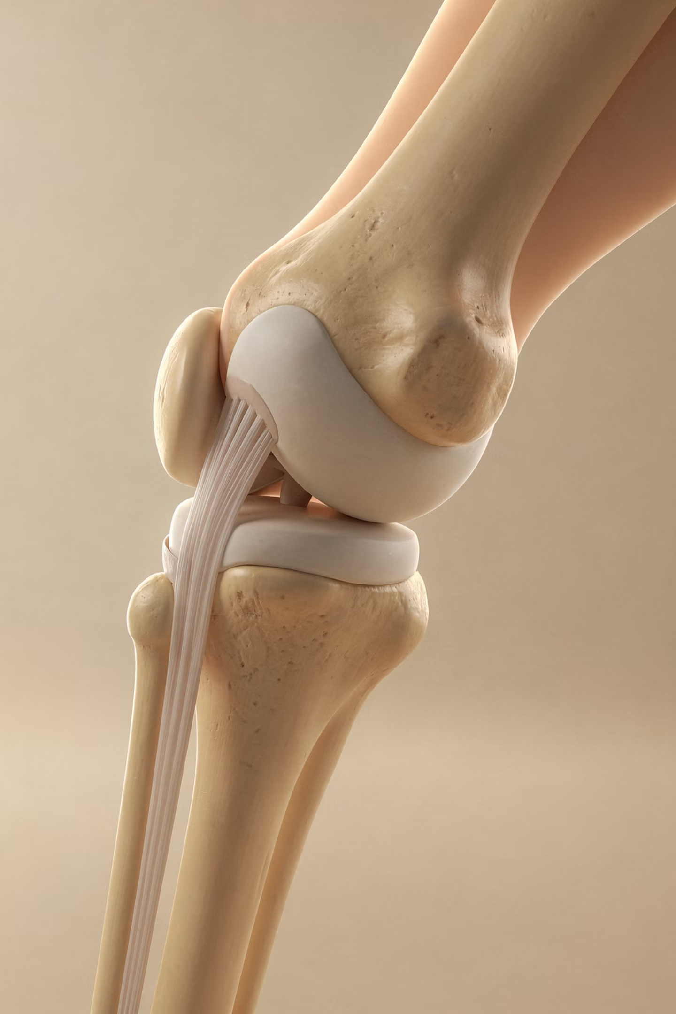
Mechanism of Injury
—
Twisting injury alone → likelihood of internal knee damage =
25%
—
Twisting + Swelling → likelihood of internal knee damage =
90%

Slide 5
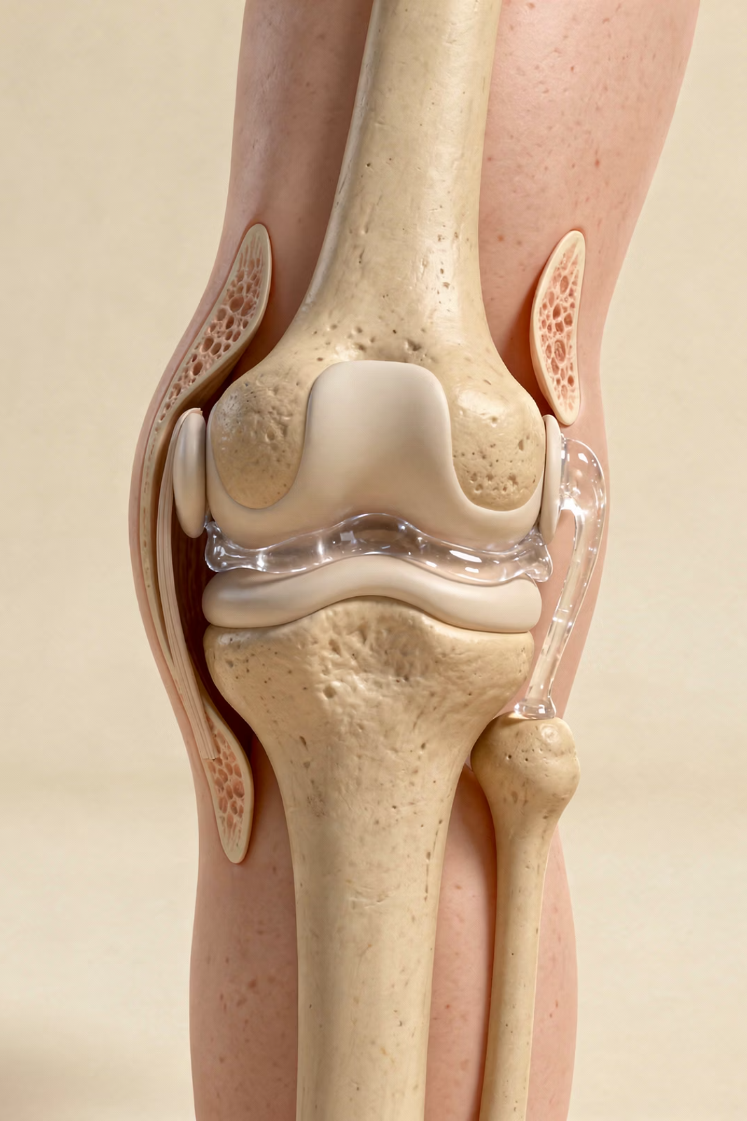
Swelling?
Within Hours
Haemarthrosis → Most likely ACL rupture
Next Day
Meniscal damage

Slide 6
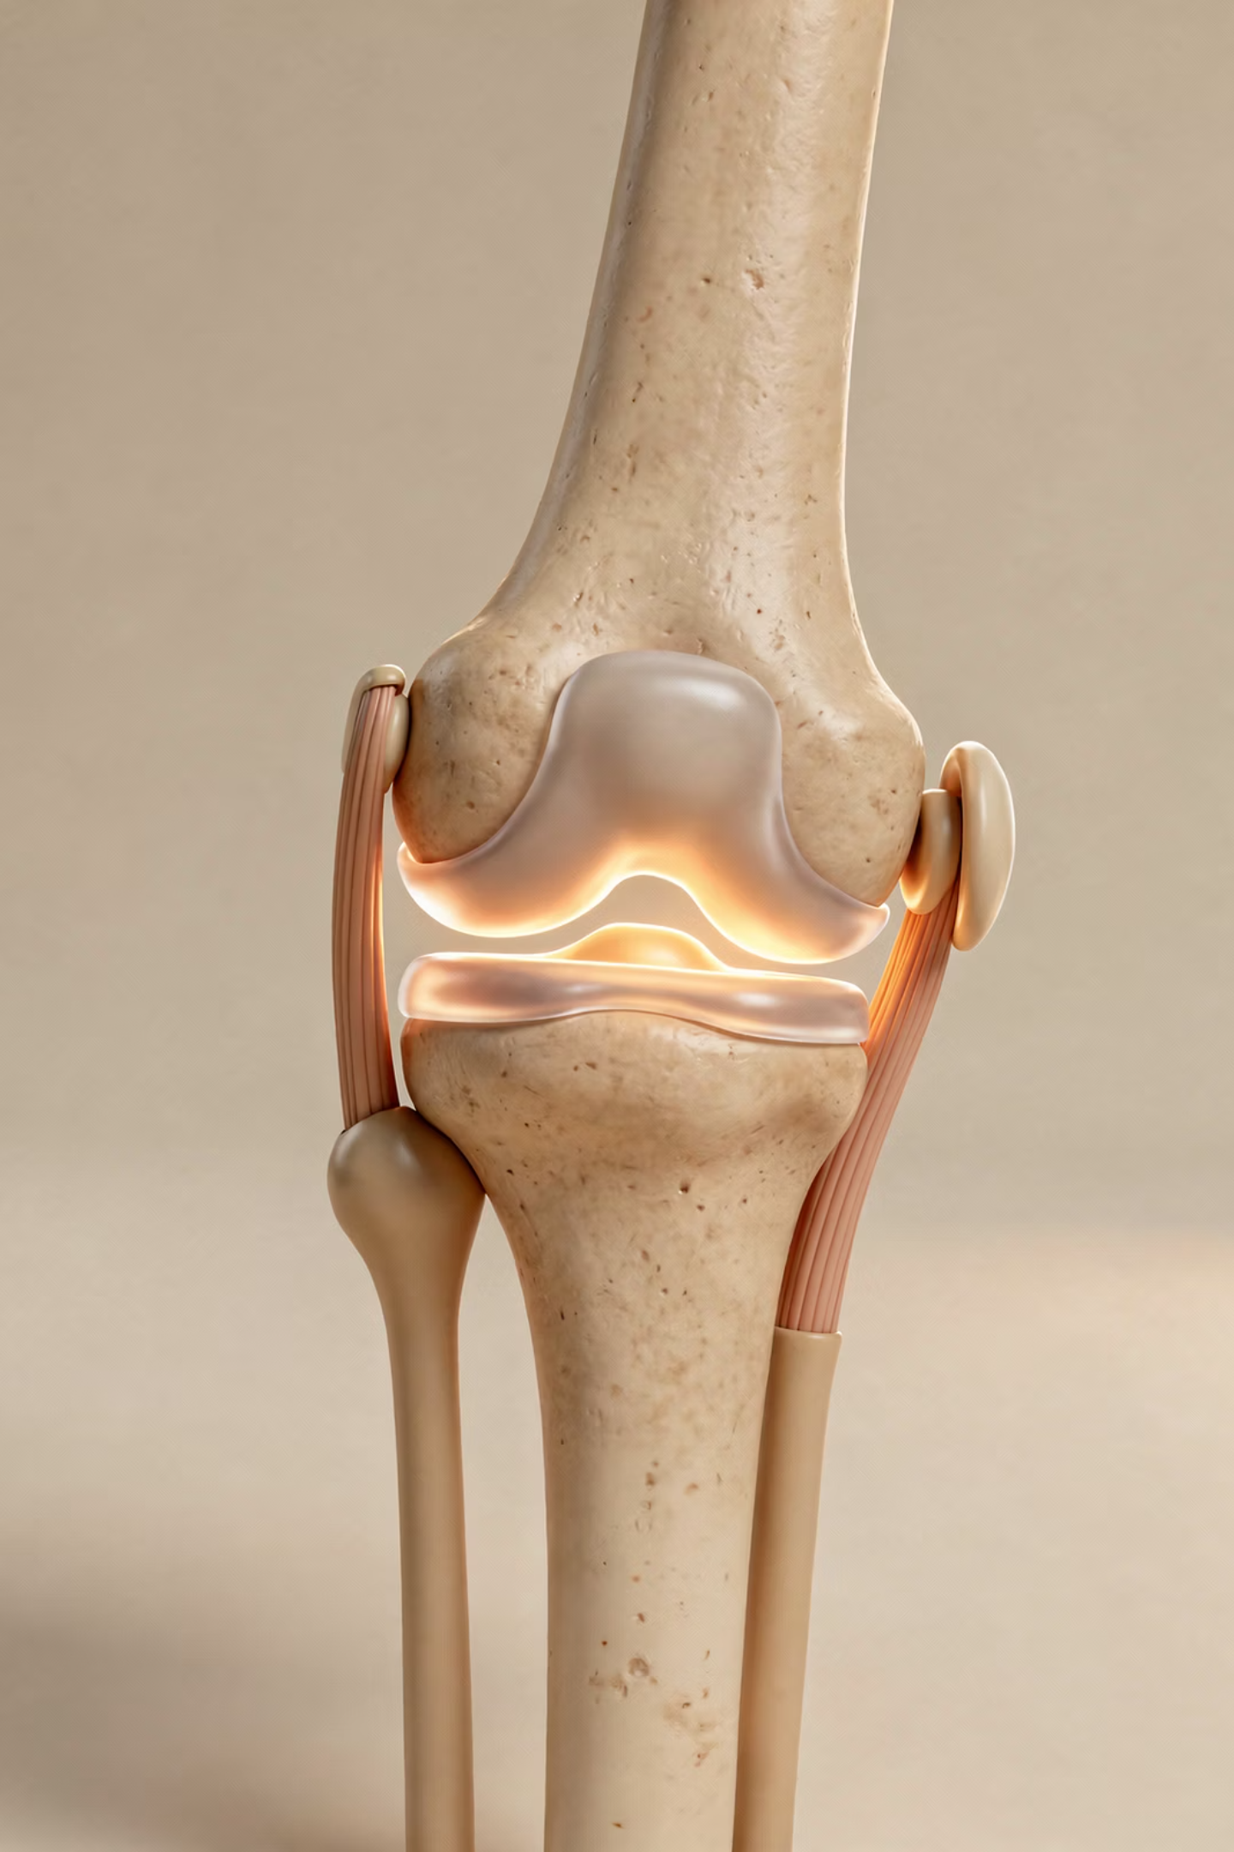
Mechanical problem?
Knee 'Give Way'?
Going down stairs / jumping → cruciate ligament
Twisting / walking / uneven ground → meniscus
Quadriceps inhibition from severe pain (e.g. subchondral cyst) can cause giving way both upstairs and downstairs, but often more noticeable downstairs
Knee 'Locks'?
NEVER locks in full extension
Full flexion but limited extension – FB + meniscal tear ('click')

Slide 7
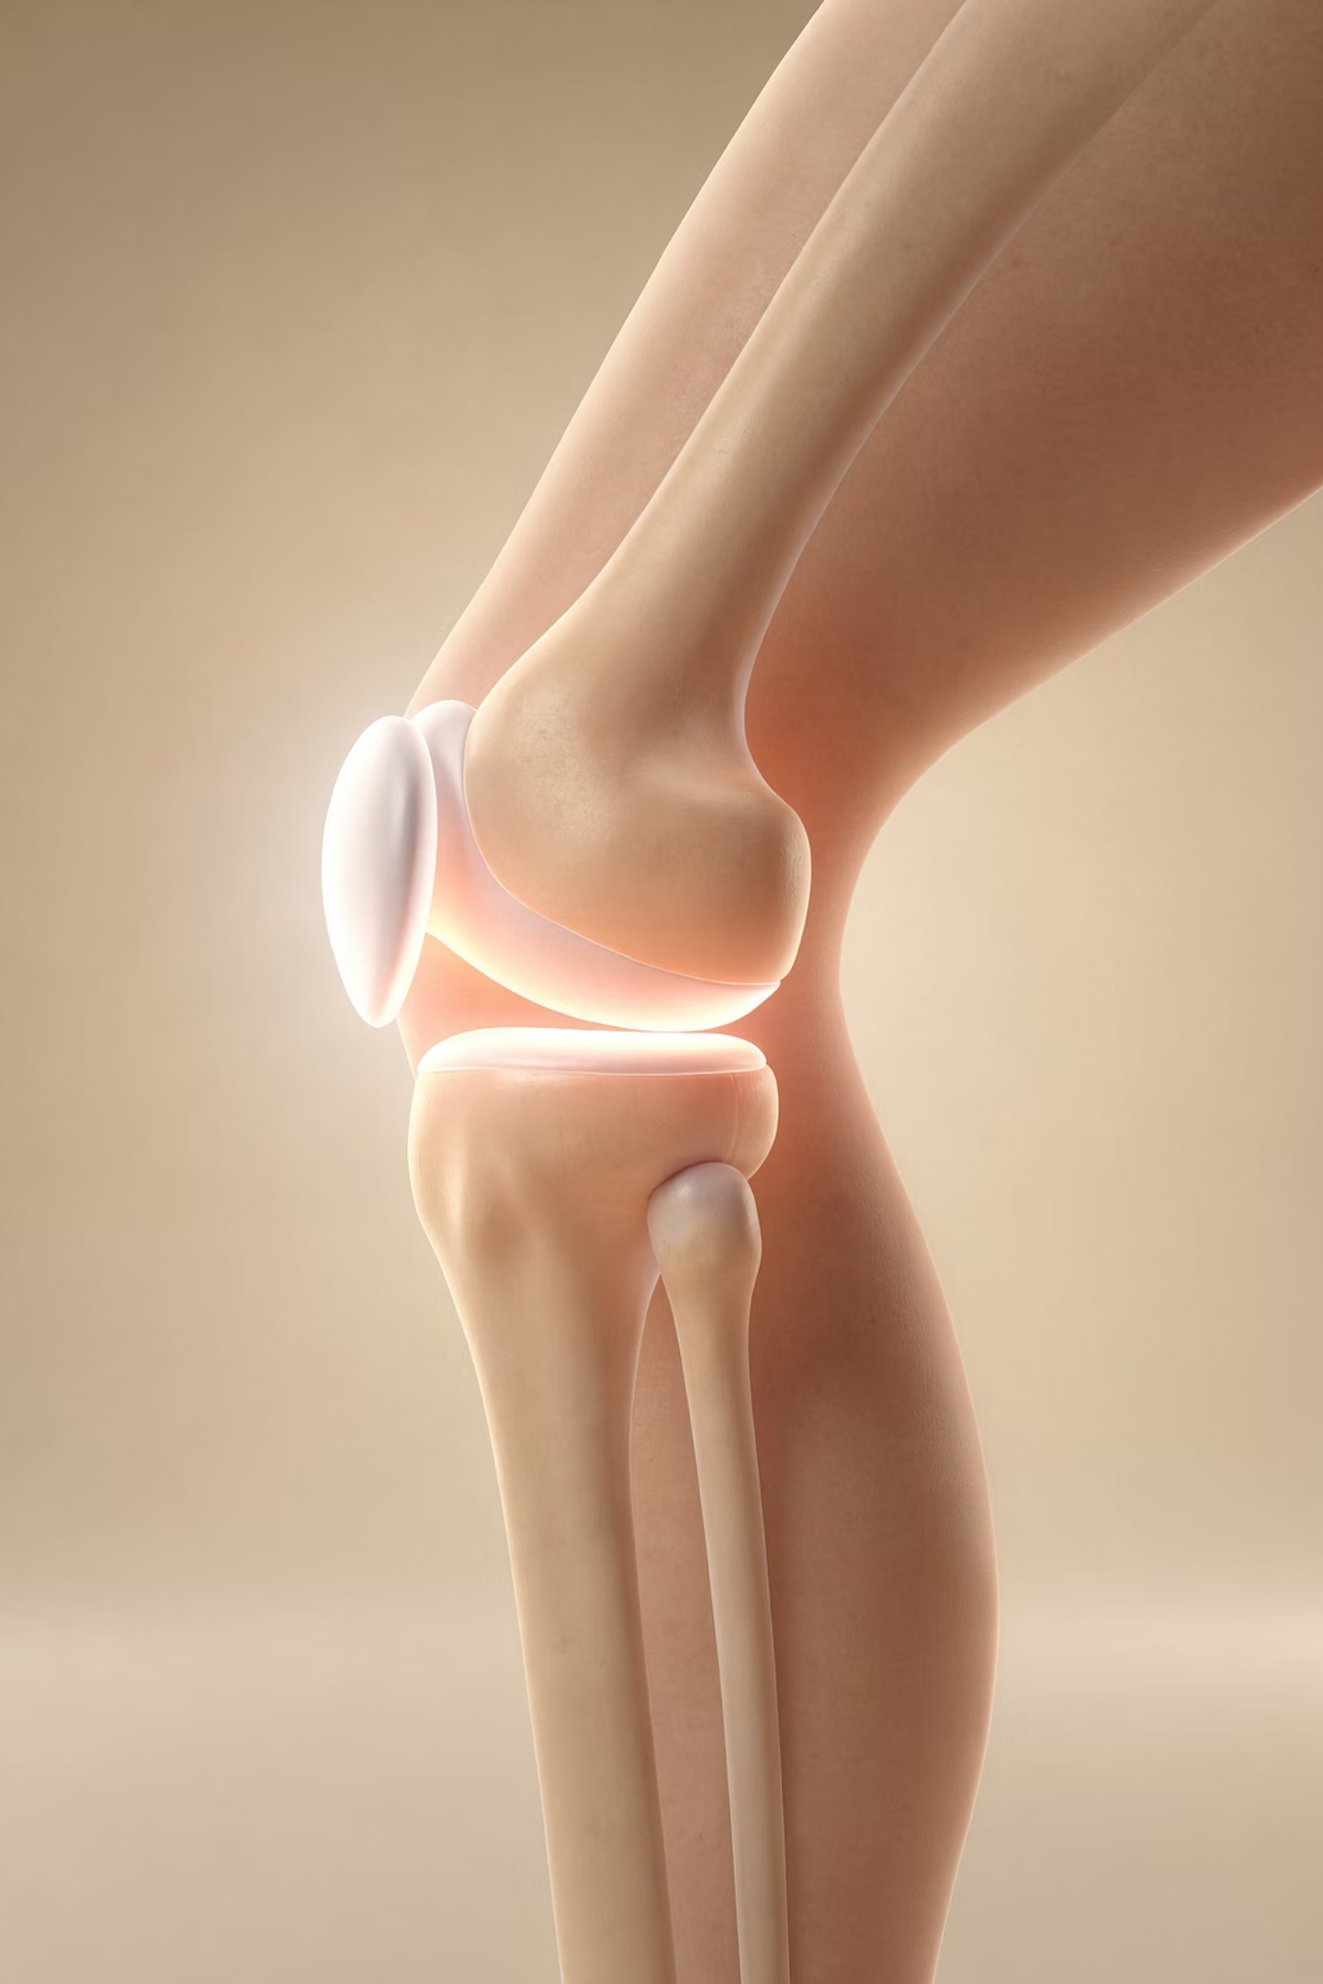
Pain
Joint Line Pain
Perhaps acute → Meniscal tear
Behind Kneecap
Worse on stairs, squatting, sitting → Not acute → More likely Patellofemoral pain
Below Kneecap
Not acute → Patellar tendinopathy

