Slide 1


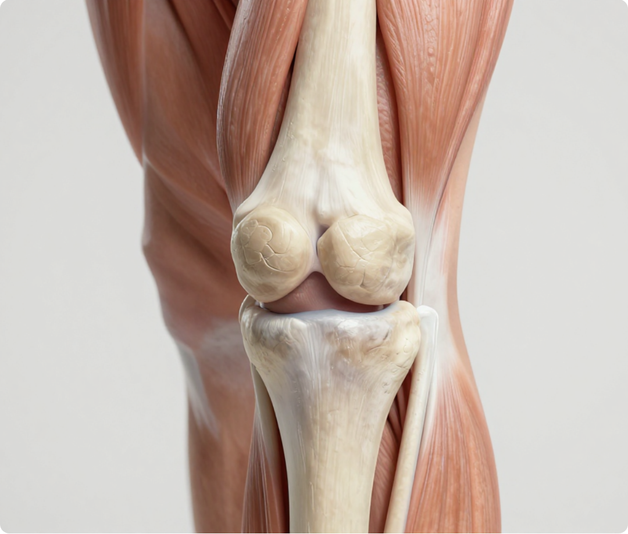
BRADFORD VOCATIONAL TRAINING SCHEME
Knee Problems in Primary Care
Comprehensive Clinical Teaching Module for GP Trainees (ST1–ST3) and IMG Doctors
CLINICAL STANDARDS
Updated to NICE NG226 (October 2022)
Disclaimer: This presentation is for educational and training purposes for healthcare professionals. Clinical decisions should always be based on the most recent evidence-based guidelines, local pathways, and individual patient assessment. Information is correct at the time of publication (June 2026).
www.bradfordvts.co.uk
Updated: 2026-06-04

Slide 2






Introduction: Why the Knee Matters
BRADFORD VTS • CLINICAL TEACHING MODULE
The Primary Care Challenge
21
Largest Joint: The knee is the largest and most complex joint in the human body.
High Frequency: The most commonly injured joint in sport and presenting to GP surgeries.
MONTHS
Structural Fragility: Zero bony stability; entirely dependent on ligaments, menisci, and muscles.
Average delay from ACL injury to diagnosis in the United Kingdom.
Clinical Impact: Missed injuries lead to chronic instability and early-onset osteoarthritis.
Only 9% of ACL tears are correctly diagnosed by the first doctor seen.
SCA/AKT ALERT: GPs must do better.

Slide 3



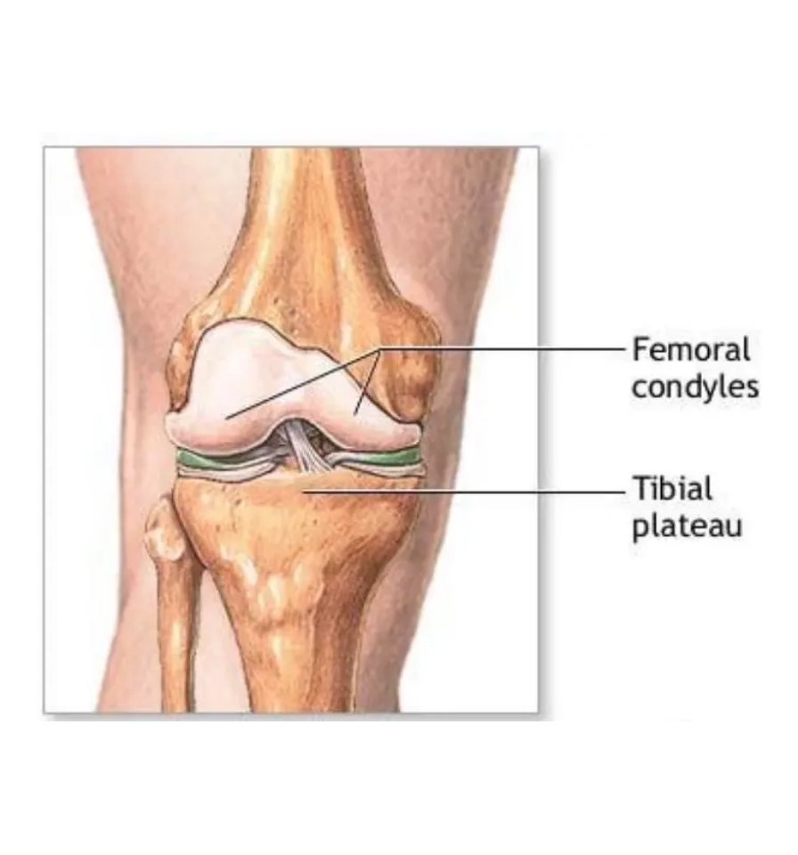



Anatomy and Biomechanics: The Hinge Joint
BRADFORD VTS • CLINICAL TEACHING MODULE
The knee is the largest joint in the body and the most commonly injured in sports and primary care. Despite its size, it possesses minimal bony stability.
Functional Biomechanics
Joint Type: Modified hinge joint (allows flexion/extension and essential rotation).
Bony Mismatch: Rounded femoral condyles sit on a relatively flat tibial plateau.
Total Dependency: Stability is entirely provided by soft tissues (ligaments, menisci, and muscles).
AKT FOCUS: Mechanism of Stability
Clinical Insight: Lack of bony stability makes the knee prone to high-velocity rotational injuries.
Structure of the Knee Joint: Note the limited contact area between Femoral Condyles and Tibial Plateau.

Slide 4



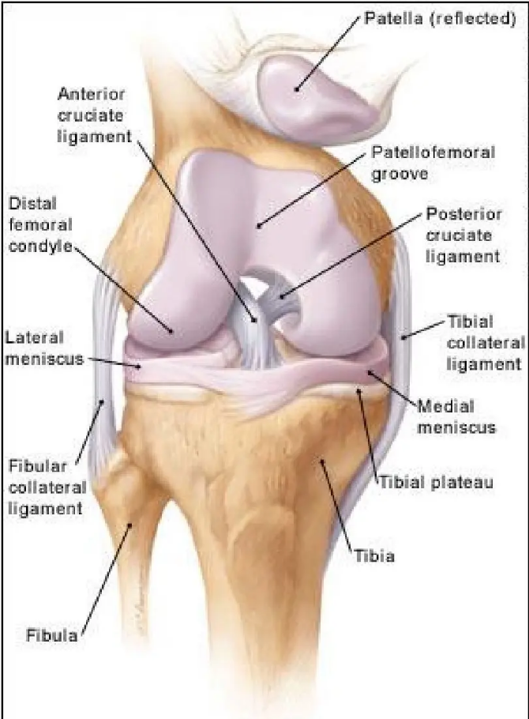






Structural Components: Menisci and Ligaments
BRADFORD VTS • CLINICAL TEACHING MODULE
The Menisci 80% Load Bearing
Structure: Semi-lunar, C-shaped fibrocartilage pads on the tibial plateau.
Function: Increases surface area for femoral condyles, aiding in load distribution.
Blood Supply: Only the outer third is vascularized (potential for healing).
Collateral Ligaments (MCL/LCL)
MCL: Resists Valgus (inward) stress. Most common ligamentous injury.
LCL: Resists Varus (outward) stress. Less common in sporting injuries.
Role: Provide side-to-side stability, primarily when the knee is in extension.
Cruciate Ligaments (ACL/PCL)
ACL: Prevents excessive anterior translation of the tibia and rotation.
PCL: Prevents posterior translation (the "posterior sag").
Clinical Note: 70% of acute knee haemarthroses are ACL ruptures.
Detailed internal structure of the knee joint showing ligaments and menisci.

Slide 5


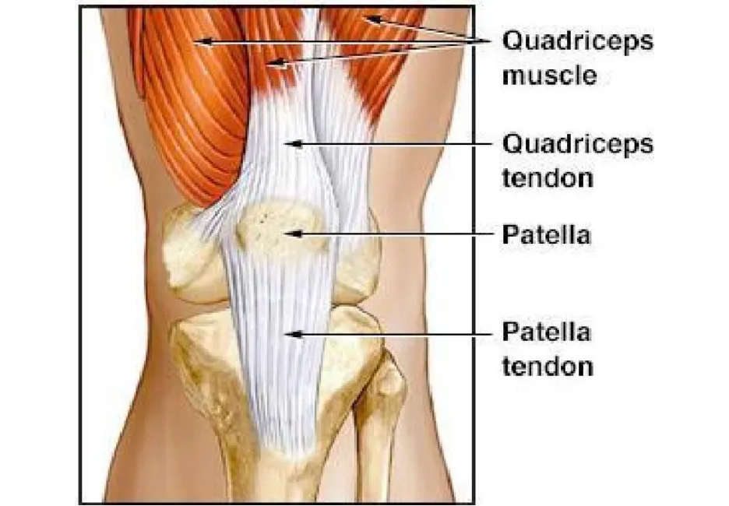







The Extensor Apparatus & Patellofemoral Joint
BRADFORD VTS • CLINICAL TEACHING MODULE
The Extensor Mechanism
Quadriceps: Rectus femoris & 3 vasti converge into the quadriceps tendon.
Patella: Largest sesamoid bone; acts as a pulley for the quadriceps.
Increases the mechanical advantage of extension by moving the tendon further from the joint axis.
VMO & Patellar Tracking
Tracking is controlled by the balance of Vastus Medialis (VMO) vs Vastus Lateralis.
VMO is the only medial dynamic stabilizer; its weakness leads to lateral maltracking.
CLINICAL PEARL
Imbalance is a primary driver of Patellofemoral Pain Syndrome (PFPS).
Muscle wasting (especially VMO) occurs rapidly after knee injury. Always compare quadriceps circumference 10cm above the superior patellar pole.
The Antagonists: Hamstrings
AKT FOCUS
Comprising Biceps Femoris, Semitendinosus, and Semimembranosus.
The Patellofemoral Joint (PFJ) is a frequent site of pseudo-locking. True locking is almost always intra-articular (meniscal/loose body).
Primary flexors of the knee; provide secondary stability to the PCL.

Slide 6










Normal Range of Movement and Alignment
BRADFORD VTS • CLINICAL TEACHING MODULE
Normal Flexion
Valgus Alignment
135–140°
Commonly known as "Knock-Kneed". The distal part of the leg is deviated laterally relative to the femur.
Functional range required for squatting and stairs. Check for symmetry with the contralateral limb.
Increases lateral compartment load
Full Extension
Varus Alignment
0°
Commonly known as "Bow-Legged". The distal part of the leg is deviated medially. Common in medial compartment OA.
"Extension Straight!" — Inability to reach 0° may indicate a mechanical block (e.g., bucket-handle meniscal tear).
Increases medial compartment load
AKT FOCUS
Always check for hyperextension (Genu Recurvatum). A loss of terminal extension is a high-yield clinical sign for internal derangement.

Slide 7







History-Taking: The Diagnostic Powerhouse
BRADFORD VTS • CLINICAL TEACHING MODULE
70–80%
Examination Limitations
Clinical examination only adds 10–20% of confirming information. Do not over-rely on tests in isolation.
The ACL Benchmark
90% of ACL diagnoses are based on history alone. In acute settings, pain and swelling often make initial examination unreliable.
The "9% Problem"
of diagnostic information is provided by history alone
The first doctor to see an ACL injury makes the correct diagnosis in only 9% of cases. GPs must lead the change.
GP Tip: If the history strongly suggests ACL (pop, immediate swelling), but the exam is normal, trust the history and refer.
"The story is 80% of the diagnosis; the exam is just confirmation."
Reference: Solomon et al., JAMA (2001) | NICE NG226 Standards

Slide 8













The RTA Analogy for Knee Injuries
BRADFORD VTS • CLINICAL TEACHING MODULE
01
ACL Rupture
MAJOR RTA
Dramatic presentation: audible pop/snap
Immediate severe pain; unable to continue
MAJOR
Rapid haemarthrosis (< 8 hours)
Significant instability: Lachman test positive
02
Meniscal Tear
MODERATE RTA
Twisting on planted foot; able to hobble
Delayed swelling/effusion (24–48 hours)
Mechanical symptoms: locking or catching
MODERATE
Focal medial or lateral joint line tenderness
03
Patellofemoral Pain
NEAR MISS / MINOR
Gradual onset; overuse or change in activity
Minimal or no swelling; vague peri-patellar pain
Aggravated by stairs, squats, or "Cinema sign"
MINOR
Clinical findings often subtle or unrewarding

Slide 9















Age and Sex Probability Guide
BRADFORD VTS • CLINICAL TEACHING MODULE
Age Group
Males
Females
0 – 12
Discoid lateral meniscus
Discoid lateral meniscus
12 – 18
First patellar dislocation
Osteochondritis dissecans
Osgood-Schlatter disease
18 – 30
Longitudinal meniscal tears
Recurrent patellar dislocation
Chondromalacia patellae
30 – 50
Rheumatoid arthritis
Rheumatoid arthritis
40 – 55
Degenerative meniscal lesions
Degenerative meniscal lesions
45+
Osteoarthritis (OA)
Osteoarthritis (OA)
Note: Use demographics as a guide to probability, not as a replacement for clinical history and examination.

Slide 10
















Key History: Mechanism of Injury
BRADFORD VTS • CLINICAL TEACHING MODULE
ACL (Dynamic)
Meniscal (Twist)
PFPS (Overuse)
"Were you running at speed or changing direction when it happened?"
"Was your foot fixed to the ground while your body rotated?"
"Did the pain come on gradually without a specific fall or hit?"
High-energy deceleration (stop-and-go)
Twisting on a planted, weight-bearing foot
Gradual onset, no acute traumatic event
Sudden pivot or cutting maneuver
Deep squatting or rising from a low position
Recent increase in training load or activity
Often non-contact (70% of cases)
Lower energy than ACL ruptures
Landing from a jump (valgus stress)
Worse descending stairs or hills (eccentric)
Often degenerative in patients aged 40+
Prolonged sitting with flexed knees
SUSPICION: AUDIBLE POP/SNAP
SUSPICION: JOINT LINE PAIN
SUSPICION: CINEMA SIGN
Mechanism determines the "Energy" of the injury: ACL = Major RTA, Meniscal = Moderate, PFPS = Near Miss.
AKT FOCUS

Slide 11









Swelling Timing: A Diagnostic Key
BRADFORD VTS • CLINICAL TEACHING MODULE
Rapid (< 8h)
Delayed (24-48h)
Minimal / Minor
HAEMARTHROSIS (BLOOD)
EFFUSION (FLUID)
REACTIVE / MILD
ACL Rupture (70%)
Meniscal Lesion
Patellofemoral Pain
Most common cause of rapid, large-volume swelling. "Major RTA" presentation.
Swelling often appears overnight or the next day. "Moderate RTA" presentation.
Minimal or no swelling. If a large effusion is present, rethink PFPS diagnosis.
Osteochondral Fracture
Acute Inflammatory Flare
Collateral Ligament
Check for fat in aspirate (lipohaemarthrosis).
Reactive synovial response to mechanical irritation or gout.
MCL/LCL Grade 1 often presents with localized swelling rather than joint effusion.
Diagnostic Pearl: "If the knee swells like a balloon within 2 hours, it is a haemarthrosis until proven otherwise (likely ACL)."

Slide 12








Clinical Symptoms: Locking and Giving Way
BRADFORD VTS • CLINICAL TEACHING MODULE
Locking Differentiation
Instability: Giving Way
TRUE LOCKING
DIAGNOSTIC CLUES BY MECHANISM
Mechanism: Mechanical block (Loose body or Meniscal flap).
On Rotation / Pivoting: High suspicion for ACL Rupture until proven otherwise.
Symptom: Unable to straighten (extension deficit).
On Stairs / Jumping: Often suggests Cruciate Ligament insufficiency (ACL or PCL).
Key Sign: Sudden onset, often requires manual "unlocking".
PSEUDO-LOCKING
Twisting / Uneven Ground: More typical of a Meniscal Tear (mechanical catching).
Mechanism: Pain inhibition / Patellofemoral catching.
Patellofemoral Instability: Sudden "letting go" due to quadriceps inhibition from sharp PFJ pain.
Symptom: Patient feels they cannot flex the knee.
Diagnosis: Patellofemoral Pain Syndrome (PFPS).
SCA Focus: Differentiate "true instability" (knee feels like it's coming apart) from "pain-related buckling" (quads giving out due to pain).
Exam Tip: A knee never locks in full extension. If it's "locked" straight, rethink the diagnosis.
Red Flag: Acute locked knee requires urgent orthopedic referral as the mechanical block can cause further articular damage.

Slide 13









Injury Sounds and Immediate Impact
BRADFORD VTS • CLINICAL TEACHING MODULE
Functional Capacity
The Audible Signature
Unable to continue immediately: Patient hit the ground and stayed down. Strongly suggests ACL Tear.
An audible "Pop, Snap, or Crack" at the moment of injury strongly suggests an ACL rupture.
Able to "hobble" initially: May have walked off but collapsed later or felt "unstable". Typical of Meniscal Tear.
Mechanism: Represents the sudden failure of high-tension fibers (The "Major RTA" sound).
Absence of sound does not rule out injury, but its presence is highly specific.
No immediate loss of function: Gradual onset or continued play suggests Patellofemoral Syndrome or minor ligament sprain.
SCA/AKT FOCUS
History alone provides 90% of ACL diagnoses. If the patient felt a "pop" and couldn't walk, assume ACL until proven otherwise—even if the exam is normal.
Ref: Bradford VTS "RTA Analogy"

Slide 14




























Pain Location and Distribution
BRADFORD VTS • CLINICAL TEACHING MODULE
Diffuse / Global
Medial Joint Line
Medial / Lateral Side
ACL Rupture / Fracture
Medial Meniscus Tear
MCL / LCL Sprain
Generalized pain, often described as "all over" or "internal." Deep-seated discomfort.
Precise tenderness along the medial groove. Pain with twisting or deep flexion.
Pain localized to the femoral condyles or tibial insertions (above/below the joint line).
Associated with large haemarthrosis; knee feels "tight" and "exploding."
Most common site of localized mechanical knee pain in primary care.
MCL tenderness is typically slightly proximal to the joint line.
Anterior / Peri-patellar
Lateral Joint Line
Specific Points
PFPS / Chondromalacia
Lateral Meniscus Tear
Baker's / Osgood-Schlatter
Vague pain around or "behind" the kneecap. Worse on stairs (descending) or squatting.
Tenderness along the lateral groove. Less common than medial but often sharper pain.
Posterior fullness (Baker's) or tibial tuberosity prominence (Osgood-Schlatter).
Positive "Cinema Sign" (pain after prolonged sitting with flexed knees).
Also consider ITB syndrome if pain is more proximal/lateralcondyle.
Anserine Bursitis: 4cm medial and distal to tibial tuberosity.
Clinical Pearl: Always ask the patient to "point with one finger" to the site of maximum pain.

Slide 15

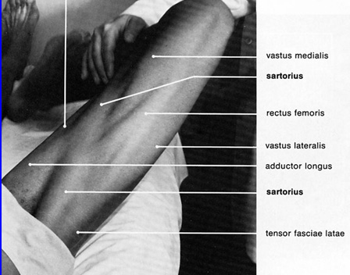
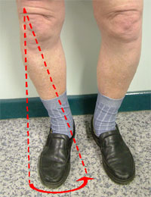









Examination: The Look, Feel, Move Approach
BRADFORD VTS • CLINICAL TEACHING MODULE
1. LOOK (Inspection)
• Observe gait and antalgic symmetry upon entry
• Check standing for alignment (Valgus/Varus)
• Inspect for swelling, muscle wasting (VMO), and scars
2. FEEL (Palpation)
• Assess temperature for inflammation or infection
• Palpate joint lines for localized meniscal tenderness
• Identify effusions (Patellar Tap / Fluid Bulge Sign)
Functional alignment and rotational tracking
must be assessed standing.
Clinical Golden Rule
3. MOVE (Range/Power)
Always compare both knees. The patient's "normal" side is your best diagnostic reference.
Muscle wasting occurs rapidly (days) after injury—measure quadriceps circumference for objective evidence.
• Active/Passive Flexion (135°) and Extension (0°)
• Check for patellofemoral crepitus or "locking"
• Assess stability via resisted movements and stress tests

Slide 16

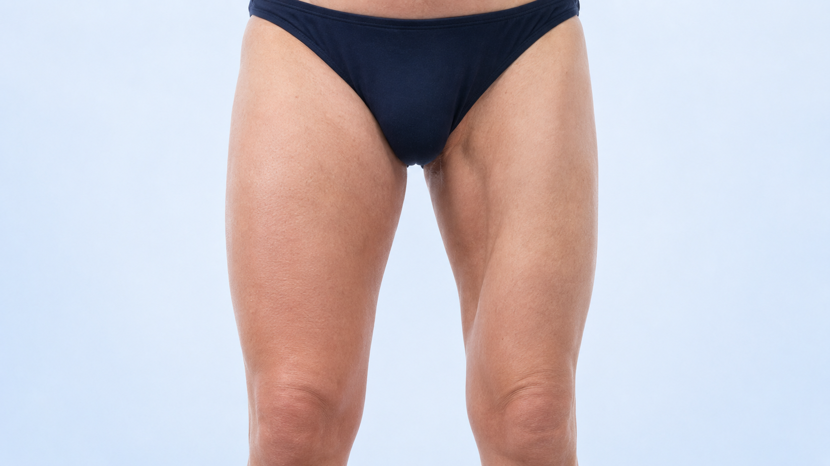






Inspection (Look): Standing and Lying
BRADFORD VTS • CLINICAL TEACHING MODULE
Phase 1: Standing
Gait: Observe entry; look for limp or antalgic gait.
Alignment: Check for Valgus (knock-kneed) or Varus (bow-legged).
Posterior: Identify popliteal cysts (Baker's cysts).
Feet: Check for arch collapse/pronation (affects tracking).
Phase 2: Lying
CLINICAL PEARL: MUSCLE WASTING
Symmetry: Always compare both knees for subtle swelling.
Look specifically at the Quadriceps (VMO). Wasting occurs rapidly after knee injury and is a strong indicator of chronicity or significant joint pathology.
Skin: Note bruising, scars (previous surgery), or rashes.
Patellar Position: Is the extensor apparatus intact/centered?
Note: Standing inspection often makes effusions more visible due to gravity.

Slide 17

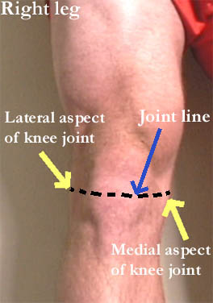


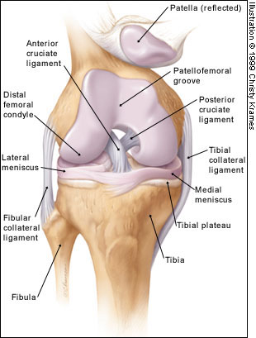














Palpation (Feel): Temperature and Tenderness
BRADFORD VTS • CLINICAL TEACHING MODULE
Swelling Types
Specific Tenderness
Effusion: Intra-articular fluid (Tap/Bulge tests).
Joint Line: Medial/Lateral (Meniscal tear).
Synovial: "Boggy" feel (Chronic inflammation).
Tuberosity: Tibial (Osgood-Schlatter).
Collaterals: Femoral condyle attachments.
Bursae: Localized fluctuant swelling.
Baker's Cyst: Posterior popliteal swelling.
Anserine: 4cm medial to tibial tuberosity.
Temperature
Compare both knees using the back of your hand.
Heat suggests inflammation or infection (Septic Arthritis/Gout).
Diagnostic Tip: Joint line tenderness is a key finding for meniscal lesions but must be used as part of a composite examination for reliability. Muscle wasting (quadriceps) can occur within days of injury.

Slide 18









Detecting Effusion: Patellar Tap and Bulge Sign
BRADFORD VTS • CLINICAL TEACHING MODULE
Patellar Tap Test
Bulge (Displacement) Sign
LARGE EFFUSIONS
SMALL EFFUSIONS
Patient lying supine with knee in full extension.
Sweep the medial side of the knee upwards 2-3 times to move fluid into the suprapatellar pouch.
Use one hand to "empty" the suprapatellar pouch by sliding it down the thigh towards the patella.
Apply quick downward pressure or a "sweep" on the lateral side of the knee.
Maintain pressure to keep fluid behind the patella.
Immediately observe the medial recess (the hollow on the inner side of the knee).
Use the other hand to sharply push the patella downwards against the femur.
POSITIVE FINDING
POSITIVE FINDING
A distinct "click" or sensation of the patella hitting the femoral condyles and bouncing back.
A visible wave or "bulge" of fluid reappearing in the medial recess. Sensitive to as little as 4-8ml.
Clinical Tip: Synovial thickening can mimic a small effusion but will not displace. In acute trauma, a rapidly developing large effusion (<8 hours) is a Haemarthrosis and strongly suggests an ACL rupture (70%) or osteochondral fracture.

Slide 19







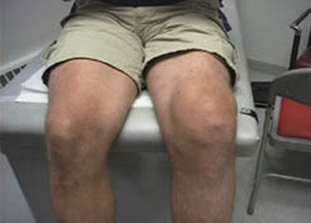


Movement (Move): Range & Assessment
BRADFORD VTS • CLINICAL TEACHING MODULE
Range of Movement
Examination Sequence
Flexion
1
Active Movement
135° – 140°
Patient moves knee through full range independently. Assess for pain or hesitation.
Compare with unaffected side.
Extension
2
Passive Movement
0° (Full Straight)
Examiner moves the joint. Note "end-feel" and any mechanical blocking/locking.
"Extension straight!" – check for hyperextension.
3
Resisted Movement
Test quadriceps (extension) and hamstrings (flexion) against resistance.
Patellofemoral Crepitus
Place hand over the patella while moving from flexion to extension. Feel for grating or vibration indicating cartilage irregularities.
CLINICAL EXAM TIP
In acute injuries, pain inhibition may cause muscles to guard, making movement assessment unreliable. Always compare both sides and document if movement is "limited by pain."

Slide 20




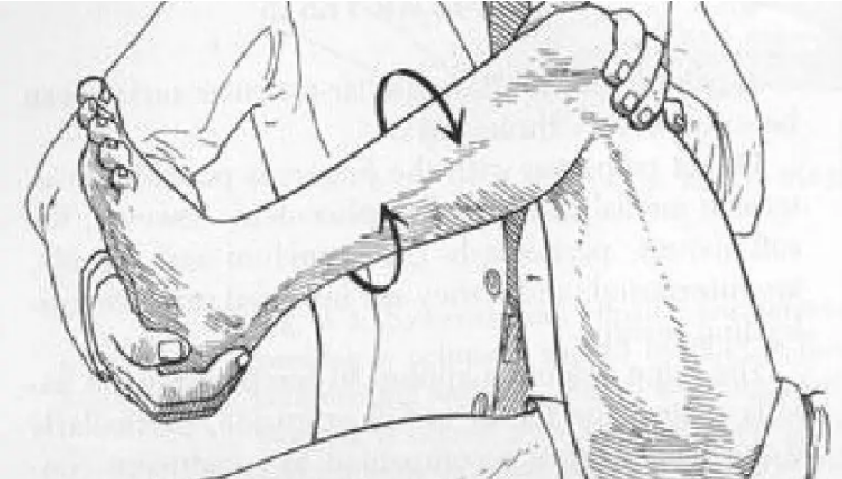
















Special Tests: Ligamentous Stability
BRADFORD VTS • CLINICAL TEACHING MODULE
Clinical Test
Positive Finding
Structures Tested
Forward tibial translation; "mushy" end-point
ACL (Most sensitive)
Lachman Test (20°)
LR+ 25.0
Forward translation of tibia on femur
ACL
Anterior Drawer (90°)
LR+ 3.8
Pivot Shift: Demonstrating dynamic ACL instability
Posterior Drawer
Posterior tibial "sag" or translation
PCL
Clinical Diagnostic Pearl
LR+ 21.0
In acute injuries, pain and muscle guarding often make examination unreliable. The Lachman test is superior to the Anterior Drawer because it avoids hamstring engagement.
Medial joint opening / laxity
Valgus Stress (30°)
MCL
AKT / SCA FOCUS: LACHMAN LR+ 25.0
Lateral joint opening / laxity
Essential Warning
Varus Stress (30°)
LCL
Valgus laxity in full extension suggests a major multi-ligamentous injury (MCL + PCL + Posterior Capsule).

Slide 21












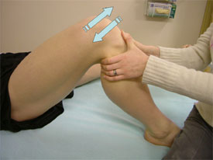




Special Tests: Meniscal Assessment
BRADFORD VTS • CLINICAL TEACHING MODULE
COMPOSITE EXAMINATION
The combined performance of all tests significantly outperforms individual maneuvers.
Test Name
Clinical Technique
Diagnostic Value
Passive flexion, rotation & extension; looking for pain/click.
77%
91%
McMurray's
Sens 53% | Spec 59%
Weight-bearing at 20° flexion, rotate body 3 times.
SENSITIVITY
SPECIFICITY
Thessaly
High Sensitivity
Patient prone, compress knee + rotate.
Apley's Grind
Low Significance
Palpation of the medial or lateral joint space.
Joint Line
Poor Alone
AKT EXAM FOCUS
In acute painful/swollen knees, muscles will not relax, making examination unreliable. In these cases, history provides 70-80% of diagnostic info.
Note: McMurray's test alone is a poor discriminator; never base a referral on a single positive test.

Slide 22












Special Tests: Patellofemoral Assessment
BRADFORD VTS • CLINICAL TEACHING MODULE
Patellar Grind (Clarke’s Sign)
Patellar Glide & Apprehension
Patient supine, knee extended, quadriceps relaxed.
Assess at 20° flexion (neutralizes secondary stabilizers).
Place hand above patella and apply downward/distal pressure.
Push patella medially/laterally to assess excursion.
Ask patient to contract the quadriceps against resistance.
Observe for apprehension or pain during lateral glide.
POSITIVE FINDING
SIGNIFICANCE
Reproduction of retropatellar pain (not just discomfort).
Suggests instability, maltracking, or subluxation history.
VMO Bulk Assessment
Foot Pronation & Q-Angle
Inspect Vastus Medialis Obliquus (inner quad) for wasting.
Examine the patient standing from behind and the side.
Compare symmetry with the asymptomatic knee.
Look for arch collapse (overpronation/flat feet).
Assess muscle tone during active isometric contraction.
Check for excessive internal tibial rotation.
Weakness leads to lateral patellar drift.
CLINICAL CLUE
PATHOPHYSIOLOGY
Atrophy occurs rapidly following knee pain/effusion.
Pronation increases Q-angle, causing lateral PFJ stress.
SCA TIP
PFPS is a diagnosis of exclusion. Reproducing the patient's specific pain (e.g., on a single-leg squat or during patellar compression) is more diagnostic in the SCA than naming the test itself.

Slide 23









Specific Conditions: ACL Rupture
BRADFORD VTS • CLINICAL TEACHING MODULE
Chronic Instability
Acute Rupture
PRESENTATION
Recurrent episodes of "giving way" on rotation, pivoting, or uneven ground.
MECHANISM
Non-contact pivot, sudden deceleration, or "stop-and-go" movement.
LATE EXAM FINDINGS
Quadriceps muscle wasting (rapid onset) and positive Anterior Drawer sign.
CLASSIC HISTORY (90% DIAGNOSIS)
Audible "pop/snap", immediate severe pain, and rapid swelling (haemarthrosis) within 8 hours.
LONG-TERM SEQUELAE
Secondary meniscal tears (bucket handle) and accelerated Osteoarthritis.
PRIMARY EXAM FINDINGS
Tense haemarthrosis and positive Lachman Test (LR+ 25.0).
THE COST OF MISSED DIAGNOSIS
21 Month Delay (UK Avg)
Functional Instability
AKT HIGH YIELD
70% of acute knee haemarthrosis = ACL Rupture.
SCA SAFETY TIP
History > Exam. If the story fits ACL, refer even if tests are "normal" due to muscle guarding.

Slide 24






Management of ACL Injuries
BRADFORD VTS • CLINICAL TEACHING MODULE
Acute Management Phase
Rehabilitation & Surgery
POLICE Protocol: Protection, Optimal Loading, Ice, Compression, Elevation.
Physiotherapy: Intensive quadriceps and hamstring strengthening to restore stability.
Aspiration: Therapeutic for large haemarthrosis; diagnostic for fat globules (fracture).
Surgical Reconstruction: Recommended for athletes and highly active patients (Graft: Patellar or Hamstring tendon).
Analgesia: NSAIDs for acute inflammation; avoid long-term regular opioids.
Conservative Path: Viable for older/sedentary patients; focus on functional compensation.
Safety Netting: Counsel on risk of locking or "giving way" on stairs.
Long-term Outlook: Monitor for early-onset OA (high risk despite surgery).
URGENT REFERRAL PATHWAY
Direct referral to Acute Knee Clinic / Orthopaedics (Goal: Review within 1 week).
CLINICAL OUTCOME TIP
Early mobilization and pre-op strength training improve surgical outcomes.
SCA EXAM FOCUS • CLINICAL SAFETY
Do NOT be falsely reassured by a normal examination in the acute setting. If the history suggests ACL rupture (pop + rapid swelling), refer based on history alone.

Slide 25









Posterior Cruciate Ligament (PCL) Injuries
BRADFORD VTS • CLINICAL TEACHING MODULE
Mechanism of Injury
Diagnostic Examination
Posterior Sag Sign: Visual "step-off" at tibial tuberosity.
The "Dashboard Injury"
Posterior Drawer Test: Tibia translates backward.
Forceful direct blow to the anterior tibia while the knee is flexed.
LR+ 21.0
Composite Exam Accuracy
Acute hyperextension (e.g., skiing, high-impact sports).
Rare: only 4% of acute knee injuries (vs. 70% ACL for haemarthrosis).
AKT FOCUS: EXAM RELIABILITY
Management Pathway
Clinical Presentation
Conservative: Primary choice for most cases.
Intensive Rehabilitation: Focus on Quadriceps strengthening.
Often asymptomatic once the acute phase settles.
Vague knee pain or patellofemoral discomfort.
Quadriceps provide anterior stability, compensating for PCL loss.
"Giving way" is rare (unlike ACL instability).
Long-term: Monitor for early Osteoarthritis (OA).
Swelling is usually moderate compared to ACL.
SCA Tip: Explain that PCL stability relies on muscle power rather than just the ligament.
Note: Frequently missed due to subtle symptoms.

Slide 26

























Collateral Ligament Injuries (MCL & LCL)
BRADFORD VTS • CLINICAL TEACHING MODULE
Mechanism & Epidemiology
MANAGEMENT STRATEGY
MCL (29% of Injuries)
LCL (2% of Injuries)
Conservative Care is Gold Standard
Valgus force to partially flexed knee (e.g., tackle from lateral side, skiing).
Varus force to the knee. Much less common in sports. Same grading system.
Excellent Prognosis: Conservative management outcomes equal surgical reconstruction across all grades.
Early Mobilisation: Crucial to prevent joint stiffness and muscle atrophy. Avoid prolonged immobilisation.
Clinical Grading System
Grade
Clinical Features
Laxity (at 30°)
Bracing: Recommended for Grade 3 tears to provide stability while allowing controlled mobilisation.
1
Medial pain; tenderness over femoral condyle (above joint line). No instability.
None
Analgesia: NSAIDs for acute inflammation and pain management during initial physio.
2
Local swelling over condyle; significant pain; partial ligament disruption.
Some opening
SCA & AKT FOCUS
To differentiate MCL from Medial Meniscus: MCL tenderness is typically above the joint line at the femoral condyle. Meniscal pain is directly on the joint line. Laxity in full extension suggests a major injury (PCL/Capsule involvement).
3
Complete tear; "wobbly" knee; often minimal pain as nerves are severed.
Gross laxity

Slide 27























Meniscal Tears: Presentation & Diagnosis
BRADFORD VTS • CLINICAL TEACHING MODULE
The Clinical History
Acute vs. Degenerative
Mechanism: Twisting on a flexed/planted knee (football, skiing).
Feature
Acute (Sports)
Degenerative (Age 40+)
Delayed Swelling: Effusion typically occurs 24–48 hours later (overnight).
Significant twisting force
Trauma
Minimal or no clear injury
Locking: Mechanical block to extension; "unlocking" sensation.
Onset
Sudden onset symptoms
Gradual; recurrent flares
Function: Patient can often "hobble" initially (unlike ACL).
Longitudinal / Bucket-handle
Pathology
Complex / Horizontal fraying
Key Exam Findings
Joint Line Tenderness: Most reliable clinical indicator (Medial > Lateral).
MRI: The Gold Standard
Essential for definitive diagnosis and surgical planning. High sensitivity for identifying tear morphology.
Effusion: Small to moderate fluid collection (Bulge sign).
Pain: Reproducible on deep squatting or rotation.
AKT Tip: Blood Supply
McMurray's Test: Poor sensitivity (53%) alone—use composite exam!
Outer 1/3 (Red Zone): Vascularized—can heal/repair.
Inner 2/3 (White Zone): Avascular—usually requires excision.

Slide 28









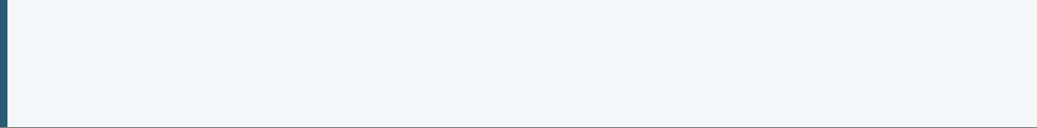






Management of Meniscal Tears
BRADFORD VTS • CLINICAL TEACHING MODULE
Conservative Protocol (POLICE)
Operative Considerations
P
OL
I
C
E
Selection depends on tear location and vascular supply.
PROTECT
LOADING
ICE
COMPRES
ELEVATE
Meniscal Repair
Partial Meniscectomy
For Outer 1/3 tears. Rich blood supply allows healing. Preferred in young, active patients.
For Central (avascular) tears. Minimally invasive excision of the unstable flap only.
Non-operative first line: Physiotherapy, targeted analgesia, and activity modification.
"Optimal Loading": Replaces old "Rest" — early controlled movement prevents muscle wasting.
Gold Standard: MRI for diagnosis, but clinical "locked knee" justifies urgent surgical review without delay.
Degenerative Tears (40+): Primarily non-surgical management unless mechanical locking persists.
Referral Guidelines
The OA Warning
Standard: Refer to acute knee clinic within 1 week for sports-related acute tears.
Total Meniscectomy: Historical practice now .
URGENT: Refer immediately if knee is "locked" (cannot straighten).
Directly leads to rapid, early-onset Osteoarthritis (OA).

Slide 29











Patellofemoral Pain Syndrome (PFPS)
BRADFORD VTS • CLINICAL TEACHING MODULE
Anatomy & Epidemiology
Clinical Presentation HIGH YIELD
Definition: Diffuse anterior knee pain (Old term: Chondromalacia Patellae - now abandoned).
History: Gradual onset, diffuse "peri-patellar" pain. No acute injury or effusion.
Who: 30% of adolescents; Women > Men; Physically active adults (18–40).
Cinema Sign
Stairs & Inclines
Risk Factors: Adolescent growth spurt, widened Q-angle, and foot overpronation.
Pain during prolonged sitting with flexed knees (theatre/driving).
Worse going DOWN stairs or hill descent (eccentric load).
Activity Flares
Key Exam Find
Squatting, kneeling, and cycling exacerbate the retropatellar friction.
Positive Patellar Grind test; Patellar Glide reproduces pain; VMO wasting.
PATHOPHYSIOLOGY
SCA SAFETY NETTING
If effusion is present, rethink diagnosis (think meniscus/ACL). PFPS typically presents without joint swelling.
Maltracking: Imbalance between VMO (medial pull) and Vastus Lateralis (lateral pull). Patella rubs lateral edge of femoral intercondylar groove.

Slide 30










Management of PFPS: Taping and Exercise
BRADFORD VTS • CLINICAL TEACHING MODULE
Activity & Foundation
Physical Interventions
Strategy & Outcomes
Activity Modification
McConnell Taping
Adolescent Growth
Avoid aggravating flexion: "Cinema sign" (sit in aisle seat), raise bicycle saddle, use easier gears.
Direct medial pull on the patella. Use during exercise to provide immediate mechanical relief.
In younger patients, wait for normal growth. Q-angle often improves naturally as the femur lengthens.
VMO Strengthening
73% improvement vs 10% control (Hinman et al. BMJ)
Patience is Key
Focus on Vastus Medialis Obliquus endurance and isolation to correct lateral patellar tracking.
Articular cartilage heals slowly. Recovery requires a diligent 3–6 month exercise program.
Foot Orthoses
Eccentric Training
Vasyli/arch supports for overpronation. Reducing flat feet decreases the Q-angle and lateral stress.
Hypermobility
Decline board squats are effective for loading the extensor apparatus correctly.
If BJHS suspected, refer to physiotherapists specializing in hypermobility management.
AKT HIGH YIELD: MCCONNELL TAPING EVIDENCE
Drugs play a MINIMAL role: NSAIDs only for acute flares. Save on prescribing costs.

Slide 31
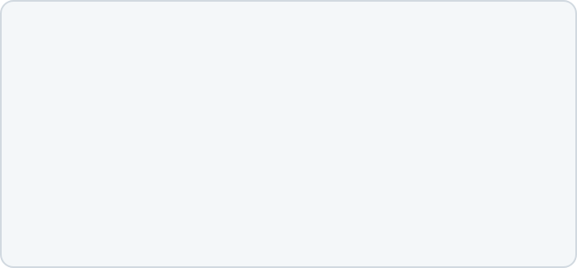



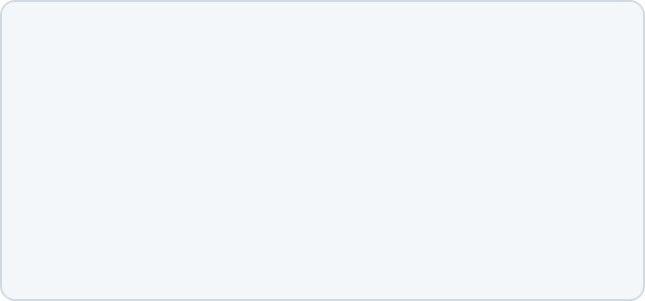



Knee Osteoarthritis: NICE NG226 Standards
BRADFORD VTS • CLINICAL TEACHING MODULE
REQUIREMENT 01
NICE NG226 (Oct 2022) Diagnosis Protocol
Patient is aged 45 years or older
Diagnose knee osteoarthritis clinically without the need for imaging in patients who meet the core clinical triad.
Clinical diagnosis is reliable in typical presentations. Relying on X-rays can lead to over-diagnosis of incidental findings or under-treatment of symptomatic patients with "normal" films.
REQUIREMENT 02
Activity-related joint pain
X-RAYS ARE NOT ROUTINELY REQUIRED FOR TYPICAL CASES
REQUIREMENT 03
No morning stiffness, or stiffness lasting ≤ 30 mins

Slide 32












OA Management: Core and First-Line Therapy
BRADFORD VTS • CLINICAL TEACHING MODULE
Exercise
Weight Control
Education
Central to management. Improves function even if joint is arthritic.
Essential for all patients with BMI > 25.
Empower patients through understanding.
Reduces mechanical load
Local muscle strengthening
Decreases systemic inflammation
Core education & self-management
General aerobic exercise
Realistic goal setting
Significant pain reduction with loss
Tailored & supervised initial sessions
Address fears (e.g., "wear and tear")
FIRST-LINE PHARMACOLOGICAL
HIGH-YIELD ADJUNCT
Topical NSAIDs
Safety Profile
"Patellar taping (McConnell) provides significant pain relief and improved function. Cheap, safe, and effective."
Offer to all patients with knee OA before oral NSAIDs or opioids. Examples: Diclofenac or Ibuprofen gel.
Highly effective for localized pain with minimal systemic absorption. Safer than oral NSAIDs for renal/cardiac risk.
Hinman et al. (2003) RCT: 73% improvement vs 10% control.
Benefits maintained even 3 weeks after removing tape.

Slide 33









OA Management: Important De-prescribing Updates
BRADFORD VTS • CLINICAL TEACHING MODULE
NICE NG226 (October 2022) marks a significant shift away from historical pharmacological reliance. Several "staple" treatments are now explicitly Not Recommended for long-term management.
PARACETAMOL
SUPPLEMENTS
OPIOIDS
Major Policy Change
Glucosamine & Chondroitin
Risk vs Benefit
Removed as first-line recommendation for long-term OA.
Do NOT offer glucosamine or chondroitin products.
Do NOT offer strong or weak opioids for long-term OA.
Evidence of limited benefit compared to placebo.
Evidence of clinical benefit is insufficient.
High risk of dependence and significant side effects.
Advise patients against self-funding these for OA.
Potential for long-term harm at regular doses (Hepatic/GI).
Topical NSAIDs are safer and more effective.
ALSO DO NOT OFFER:
Intra-articular hyaluronic acid • Arthroscopic lavage or debridement (unless mechanical locking) • Rubefacients
AKT & SCA EXAM FOCUS
Key Exam Trap: Historical questions often listed paracetamol as the first-line drug. Under NG226, the correct first-line pharmacological choice is Topical NSAIDs. For SCA, focus on Shared Decision Making when de-prescribing long-term opioids or paracetamol.

Slide 34


















Bursitis and Osgood-Schlatter's Disease
BRADFORD VTS • CLINICAL TEACHING MODULE
Common Knee Bursitis Variants
Osgood-Schlatter's Disease
Condition
Typical Presentation
Key Clinical Pearls
Pathophysiology
Traction apophysitis at the tibial tuberosity due to repetitive quadriceps pull in adolescents.
Pre-patellar
Fluctuant swelling at lower pole of patella.
Occupational kneeling; can be septic (look for erythema). Management: Avoid kneeling, NSAIDs, Aspiration.
"Housemaid's Knee"
Clinical Features
Bony prominence at tibial tuberosity; localized pain worse with running, jumping, or kneeling.
Pain 4cm medial to tibial tuberosity.
Common in obese women with OA. Steroid injections are NOT effective here. Focus on hamstring stretching.
Management Strategy
Anserine
Conservative care is primary. Focus on activity pacing rather than total rest. Reassurance is key.
Medial Bursa
Activity Pacing
PRN Analgesia
Time (>90% Resolution)
Popliteal
Posterior bulge; secondary to OA or Meniscal tears.
Rupture mimics DVT (calf swelling). Use USS to distinguish. Treat the underlying intra-articular pathology.
GP Pitfall: Avoid surgical referral for OSD. Most cases resolve as growth plates fuse. Ortho referral only for persistent adult fragments.
"Baker's Cyst"

Slide 35














Investigations: The Ottawa Knee Rules
BRADFORD VTS • CLINICAL TEACHING MODULE
Indications for Knee X-ray after Acute Injury
Age Factor
Patellar Tenderness
Fibular Head
Flexion Deficit
Weight Bearing
Patient is aged 55 years or older.
Isolated tenderness of the patella (no other bony tenderness).
Tenderness at the head of the fibula.
Inability to flex the knee to 90 degrees.
Inability to bear weight for 4 steps both immediately and in the clinic.
A knee X-ray series is indicated if ANY of these criteria are met.
Sensitivity ~98-100% for identifying fractures.
CLINICAL UTILITY:
SCA TIP:
Document these rules explicitly to justify (or decline) imaging.
Note: The rules apply to acute injuries only. Not designed for chronic atraumatic knee pain (e.g., OA).

Slide 36



Referral Pathways and Urgency
BRADFORD VTS • CLINICAL TEACHING MODULE
CLINICAL CONDITION
URGENCY
REQUIRED ACTION
Septic Arthritis
EMERGENCY
Immediate admission to A&E or Orthopaedic On-call for aspiration.
Hot, swollen, systemic symptoms
Acute Locked Knee
URGENT
Same-day or next-day Orthopaedic review. Risk of permanent damage.
Mechanical block (Bucket handle tear)
ACL / Meniscal Rupture
URGENT
Refer to Acute Knee Clinic. Aim for review within 1 week.
Haemarthrosis or instability
Failed Conservative OA
Routine Orthopaedic review for Joint Replacement consideration.
ROUTINE
Significant impact on QoL / Function
PFPS / Osgood-Schlatter
Initial management: Physio / Orthotics. Refer only if fails 6m therapy.
ROUTINE
Chronic maltracking or traction
Note: Clinical judgement overrides pathways. If "Locked", verify it is not pseudo-locking (PFPS).
www.bradfordvts.co.uk

Slide 37
























AKT Exam Focus: High Yield Evidence
BRADFORD VTS • CLINICAL TEACHING MODULE
Diagnostic Accuracy (Solomon et al, 2001)
NICE NG226 (Oct 2022) OA Management
Clinical Test
Sensitivity
Specificity
Likelihood Ratio (LR+)
FIRST-LINE PHARMACOLOGICAL
Lachman Test (ACL)
Topical NSAIDs (Offer to all)
85%
94%
25.0
SECOND-LINE PHARMACOLOGICAL
Anterior Drawer (ACL)
62%
88%
3.8
Oral NSAIDs (Lowest dose + PPI gastroprotection)
Pivot Shift (ACL)
NO LONGER RECOMMENDED
24%
98%
25.0
Paracetamol (Regular long-term use)
Opioids (Routine use)
McMurray Test (Meniscus)
53%
59%
1.3
Glucosamine / Chondroitin / Hyaluronic acid
Joint Line Tenderness
CORE NON-PHARMACOLOGICAL
76%
77%
3.3
Therapeutic Exercise (Strength & Aerobic)
Weight Management (if BMI >25)
*Composite examination (combining tests) improves sensitivity to 77% and specificity to 91%.
Timing of Swelling
Referral Thresholds
< 8 Hours (Haemarthrosis): 70% chance of ACL tear or osteochondral fracture.
Joint Replacement: NZ Priority Score > 70 typically indicates priority.
24–48 Hours (Effusion): Likely meniscal lesion or inflammatory response.
ACL Delay: UK average time to diagnosis is 21 months.
AKT Strategy: Prioritize the Lachman Test (LR+ 25.0) and Topical NSAIDs (NG226 First-line) as high-probability correct answers.

Slide 38












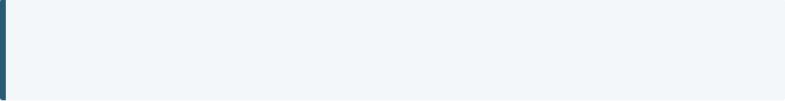
SCA Exam Focus: Consultation & Safety-Netting
BRADFORD VTS • CLINICAL TEACHING MODULE
Communication Frameworks
Safety-Netting & Red Flags
ICE & PSO
ACL / INSTABILITY
Explore Ideas (torn ligament?), Concerns (career ending?), and Expectations (MRI today?). Don't miss Psychosocial impact on work/sport.
"If the knee feels like it is collapsing or 'giving way' during normal walking, you must stop activity and contact us immediately."
LOCKED KNEE
Shared Decision Making (OA)
Offer Topical NSAIDs first. Frame exercise as "joint lubrication" rather than "wear and tear." Use Option Grids for surgery vs. lifestyle.
"If the knee becomes physically stuck and you cannot straighten it, this is an urgent mechanical block (meniscal flap) requiring A&E/Orthopaedics."
Explanation Skills
SEPTIC ARTHRITIS
Avoid jargon. Use analogies (e.g., "The ACL is like a tethering rope"). Check for understanding (Chunk & Check).
"Seek emergency care if the knee becomes increasingly hot, red, and swollen, or if you develop a fever and feel generally unwell."
#SCA_SafetyNet
#NICE_NG226
#BradfordVTS
AKT/SCA Tip: NICE NG226 de-prioritizes Paracetamol. Moving straight to Topical NSAIDs demonstrates up-to-date clinical competence.
Examiner Focus: Safety-netting for "Giving Way" is vital in suspected ACL to prevent secondary meniscal damage.

Slide 39












Red Flags and Common Pitfalls
BRADFORD VTS • CLINICAL TEACHING MODULE
Septic Arthritis
Hot, red, swollen joint; systemic upset (fever/rigors); unable to bear any weight (even passive movement).
Clinical Action Rail
Immediate safety-netting and pathways
Malignancy / Bone Tumours
IMMEDIATE REFERRAL
Unexplained night pain; systemic weight loss; hard bony swelling; bimodal age distribution.
Urgent A&E for joint aspiration and IV antibiotics.
2WW PATHWAY
Acute Locked Knee
Urgent X-ray within 48h; fast-track orthopaedic oncology.
True mechanical block (cannot straighten); usually a bucket-handle meniscal tear or loose body.
ACUTE ORTHO
Same-day/24h referral to acute knee clinic for unlocking.
Neurovascular Compromise
EMERGENCY
Loss of distal pulses; sensory deficit (peroneal nerve); cool foot post-trauma (dislocation).
999/Immediate A&E to rule out popliteal artery rupture.
COMMON PITFALLS & EXAM ERRORS
Over-reliance on McMurray’s: Sensitivity is only 53%. A negative test does NOT rule out a meniscal tear. Use composite findings.
Paracetamol for OA: NICE NG226 (2022) removed this. First-line is now topical NSAIDs. Do not prescribe paracetamol long-term.
The "Normal" Drawer Test: In acute ACL tears, muscle spasm can mask laxity. History of "pop" and rapid swelling is 90% diagnostic.

Slide 40











Quick Recall and Top Tips
BRADFORD VTS • CLINICAL TEACHING MODULE
ACL Rupture
MAJOR RTA
01
KEY HISTORY
EXAM TOOL
PRIMARY CARE ACTION
Pop/Snap, <8h Swelling, Dynamic Pivot, "Giving Way".
Lachman Test (LR+ 25.0) is the most reliable clinical sign.
Urgent Orthopaedic referral. History > Examination.
PRIORITY ONE
TOP TIP: 70% of acute haemarthrosis is ACL until proven otherwise.
Meniscal Tear
MODERATE RTA
02
KEY HISTORY
EXAM TOOL
PRIMARY CARE ACTION
Twist on planted foot, 24-48h swelling, Locking/Unlocking.
Medial joint line tenderness + Composite examination.
MRI gold standard. Refer locked knees urgently.
PRIORITY TWO
TOP TIP: Avoid total meniscectomy; preserving the meniscus prevents early OA.
PFPS & Osteoarthritis
MINOR / NEAR MISS
03
KEY HISTORY
EXAM TOOL
PRIMARY CARE ACTION
Stairs (Down), Cinema sign, 45+, Overuse or Age.
Patellar grind, Crepitus, VMO wasting, Foot pronation.
NICE NG226: Topical NSAIDs first. Weight loss & Exercise.
PRIORITY THREE
TOP TIP: Paracetamol & Opioids are no longer recommended for OA management.
History = 80% Diagnosis
Exercise is the Cornerstone
Follow NICE NG226 (2022)

