Slide 1



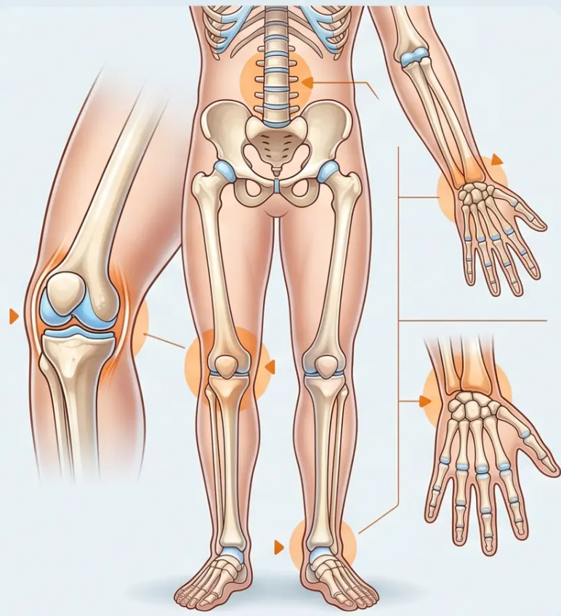
BRADFORD VTS TEACHING DECK
MSK · MUSCULOSKELETAL MEDICINE
MSK Common
Conditions & Key Points
Bradford VTS Teaching Deck for GP Trainees
Core Principles and Clinical Updates · June 2026
www.bradfordvts.co.uk
Bradford VTS · MSK Common Conditions & Key Points
www.bradfordvts.co.uk · June 2026

Slide 2













BRADFORD VTS · MSK TEACHING DECK
Key Principles in MSK Consultations
Five golden rules, disability mindset, motivational interviewing & fit notes
1
2
3
4
5
Expose
Adequately
Screen Above
& Below
Compare
Both Sides
Always Examine
Look · Feel · Move
Never skip the
physical examination
Proper exposure
reveals the full picture
Active, passive and
resisted movement
Joint above, joint
below + GALS screen
Always examine the
unaffected side
Avoid a Disability Mindset
Motivational Interviewing
Use the Fit Note
Use “wear and repair” not “wear and.
Encourage return to work — patients
don’t need to be 100% better.
Let patients talk themselves into
change. Listen, explore, reflect —
don’t instruct.
Focus on what the patient CAN do.
Support phased return to work.
Screen and treat for depression.
“Imaging rarely required — history and
examination are usually sufficient.” —
Bradford VTS · MSK Common Conditions & Key Points
www.bradfordvts.co.uk · June 2026 · Slide 2 of 10
●

Slide 3



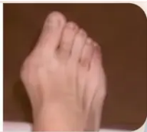







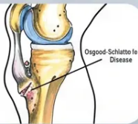
Common Foot & Ankle Conditions
Key diagnoses, myth-busting, and management pearls
Hallux Valgus (Bunions)
• Address risk factors first: flat feet, hyperpronation, tight footwear
• Physiotherapy + corrective footwear + injections
MYTH → surgery-only
• Over 150 surgical options exist — surgery is last resort
Plantar Fasciitis
• Worst pain on first steps in morning or after rest
• X-ray NOT needed; address obesity, tight Achilles, prolonged standing
NOT steroid injection first
• Treatment ladder: stretching (most effective) → NSAID gel → physiotherapy → steroid injection if refractory
Morton's Neuroma
• Interdigital neuroma between metatarsal heads → shooting pain/numbness in affected toes
• Mulder's click on lateral foot squeeze
NOT Morton's foot
• Size guides treatment: under 5mm → steroid injection; over 5mm → surgery
• Not worth investigating until after 6 weeks; always examine standing
Ankle Sprain + Ottawa Rules
• Ottawa Rules — X-ray if: bony tenderness at posterior tip of lateral or medial malleolus, OR
unable to weight bear immediately and in ED
NOT better at 2 weeks
• Complications to consider: talar dome fracture, peroneal tendon dislocation
Osgood-Schlatter Disease
• Osteochondritis of anterior tibial tubercle in active adolescents
• Self-limiting; treatment: activity modification, analgesia, physiotherapy
Clinical diagnosis — no X-ray needed
Bradford VTS · MSK Common Conditions & Key Points
Slide 3 of 10
www.bradfordvts.co.uk · June 2026

Slide 4




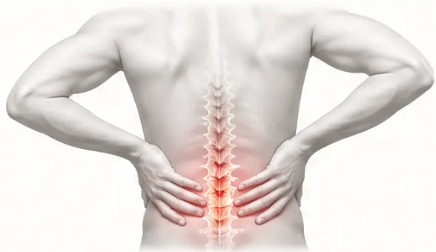
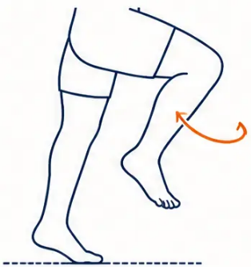
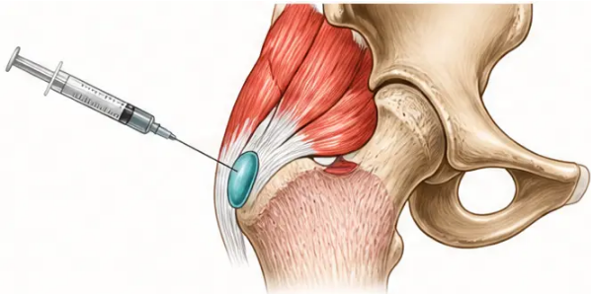


MUSCULOSKELETAL MEDICINE • PAGE 4
Common Knee Conditions & Back Pain
Diagnostic tests, clinical pearls, and red flag screening
● Meniscal Tears
● Trochanteric Bursitis
● Low Back Pain
McMurray's is NOT the best test
US guidance NOT needed for injection
Lifetime prevalence: 58%
• History first: weight-bearing rotational injury,
swelling, locking
• Acute: <6 weeks • Chronic: >3 months
• Inflammation at the greater trochanter
• Lateral hip pain after exertion; hip abductor
weakness
• Prevention: exercise, posture, weight
management
• Joint line tenderness on examination
• Thessaly test preferred over McMurray's —
validated against MRI
• Treatment: physiotherapy first, ice, steroid
injection if persistent
• Always screen for red flags (see panel below)
• Cauda equina = EMERGENCY 🚨
• Injection: landmark-guided is sufficient —
no ultrasound required
• Degenerative tears common in middle age
Trochanteric bursa injection — landmark-guided
Low back pain — most common MSK complaint
Back Pain Red Flags —
Screen Every Patient
• Age <20 or >55 with new pain • Thoracic pain • Non-mechanical pattern (no relief with rest)
• PMH malignancy / HIV / steroids • Unexplained weight loss • Widespread neurology
CAUDA EQUINA — saddle anaesthesia + bilateral weakness + bladder/bowel → 999 / Emergency A&E
Bradford VTS • MSK Common Conditions & Key Points
Slide 4 of 10
www.bradfordvts.co.uk • June 2026

Slide 5


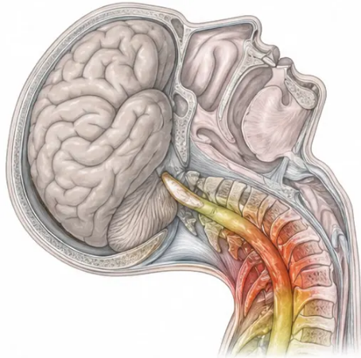
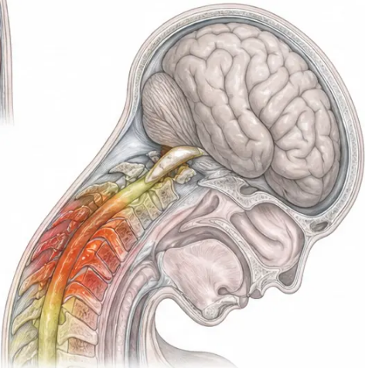


Whiplash & Acute Neck Sprain
Updated NICE CKS Management • No Collar • Early Mobilisation
Hyperextension
MECHANISM & SYMPTOMS
• Extension-flexion injury — cervico-dorsal junction most affected
• Symptoms often delayed 12–24 hours; worsen over days 3–5
• Pain at base of neck → trapezius → shoulders and arms
• Headache (often occipital), paraesthesiae, lightheadedness
Hyperflexion
MANAGEMENT
NO COLLAR
EARLY MOBILISATION
No evidence — may prolong stiffness
Active movement from day one
• Adequate analgesia — NSAIDs preferred
• Physiotherapy for symptoms persisting beyond a few weeks
• Antidepressants if chronic pain or fatigue develops
X-ray NOT routine — only if: neurology, dysphagia, high-velocity injury, or medico-legal
PROGNOSIS & POOR OUTCOME PREDICTORS
Prognosis:
Poor outcome associated with:
• 90% symptom-free by 2 years
• Pre-existing cervical degeneration
• Only 30% symptom-free at 7 months
• Female sex; previous neck injury
• Persistent intrusive symptoms at 3 months →
80% have abnormal psychometric tests
• Multiple symptoms at onset
Hyperextension-flexion mechanism — cervico-dorsal junction most vulnerable
• Unrelated stressful life events
AKT/SCA: Collar is NOT recommended • Early mobilisation is key • 90% recover by 2 years • Acknowledge medicolegal complexity sensitively in SCA
Bradford VTS • MSK Common Conditions & Key Points
Slide 5 of 10
www.bradfordvts.co.uk • June 2026

Slide 6

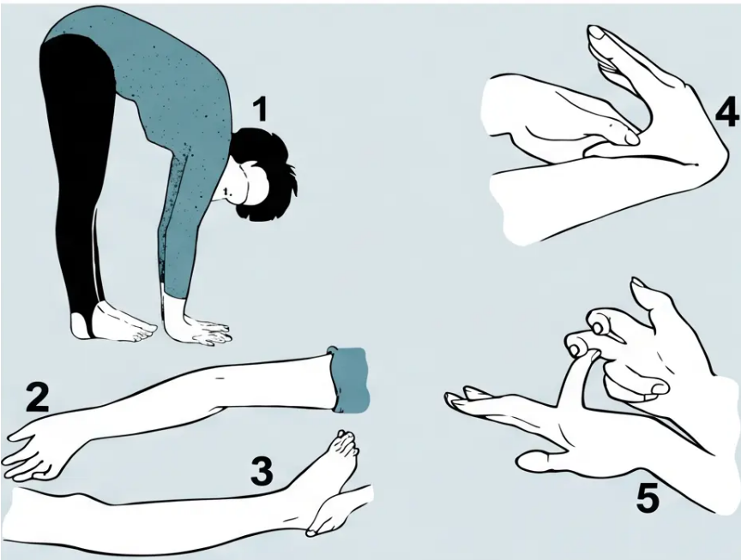













Hypermobility Syndrome
Beighton Score · Brighton Criteria · Management
Beighton Score (max 9 points)
● Palms flat on floor, knees straight [1]
● Elbow hyperextension >10° [1+1]
● Knee hyperextension >10° [1+1]
● Thumb touching forearm (wrist flexion) [1+1]
● Little finger dorsiflexion >90° [1+1]
*Bilateral tests marked L + R separately
Beighton Score — 5 test positions illustrated
Brighton Criteria for JHS
Management
Low-impact exercise — swimming and cycling to
build muscle strength
Beighton ≥ 4/9
Arthralgia > 3 months in ≥ 4 joints
Foot pronation — medial arch inserts recommended
Advise patients — joints dislocate/injure easily;
muscles fatigue quickly
= Joint Hypermobility Syndrome (JHS)
*"Keep active — improve strength, reduce pain, improve posture"
*Not the same as Ehlers-Danlos or Marfan's syndrome
Quick-recall fact: 1 in 5 people have joint hypermobility — usually benign · Common in gymnasts, ballet dancers, musicians
Bradford VTS · MSK Common Conditions & Key Points
Slide 6 of 10
www.bradfordvts.co.uk · June 2026

Slide 7



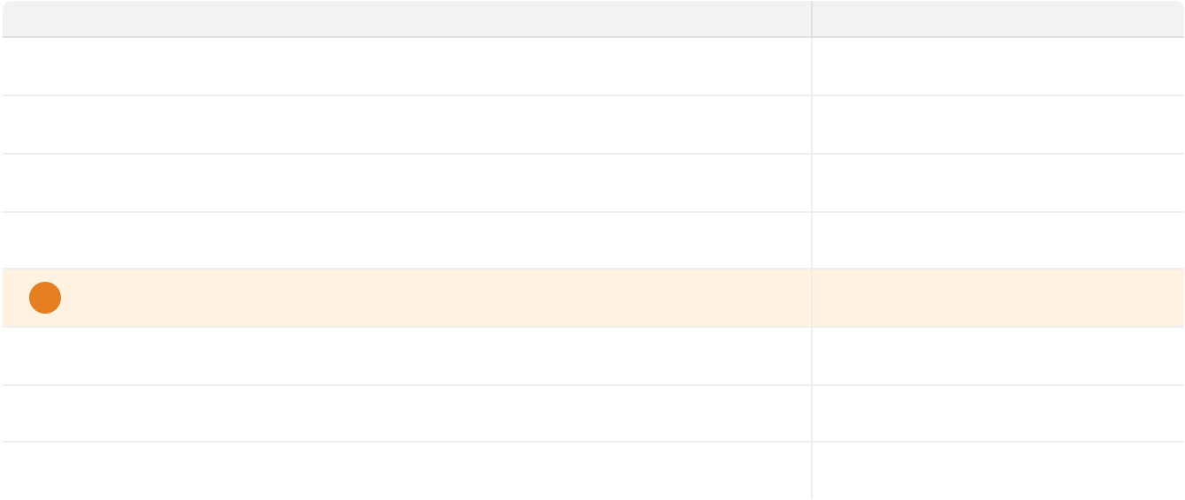







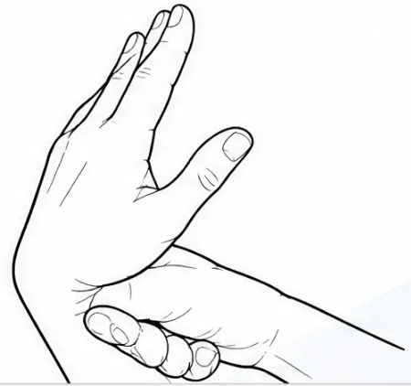









Carpal Tunnel Syndrome Scoring
AKT: Score ≥5 = diagnose CTS clinically.
Sensitivity 85%, PPV 90% — comparable to
nerve conduction studies.
Kamath & Stothard Clinical Questionnaire · Sensitivity 85% · PPV 90%
CLINICAL SCORING ITEMS
Symptom / Finding
Score
Classic CTS Symptoms
Nocturnal pain
+1
• Tingling / numbness in thumb, index, middle,
radial ring finger
Nocturnal tingling
+1
Morning tingling
+1
• Worse at night and on waking — “flick sign”
Trick movements to relieve symptoms
• Triggered by holding newspaper, phone,
steering wheel
+1
★No tingling in little finger
+3
• Worsens in pregnancy
Tingling with newspaper / steering wheel
+1
Tingling during pregnancy
+1
Wrist splint provided relief
+2
No neck pain scores 0 — does not add to or subtract from total
Score < 3
Score 3–4
Score ≥ 5
CTS Unlikely
Borderline
Diagnose CTS — No NCS Needed
TREATMENT PATHWAY
Wrist Splint — especially nocturnal
Corticosteroid Injection — short-term relief
Carpal Tunnel Decompression — persistent / severe
Bradford VTS · MSK Common Conditions & Key Points
7 / 10
www.bradfordvts.co.uk · June 2026

Slide 8

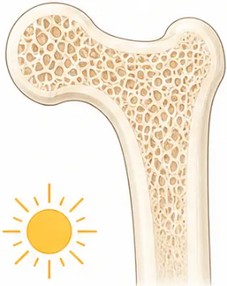
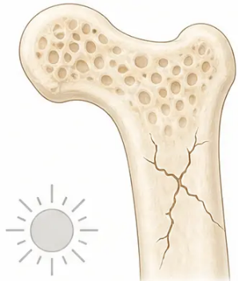







UPDATED • NICE 2025
Healthy Bone
Osteomalacic Bone
Vitamin D Deficiency & Osteomalacia
Check 25-OHD • Osteomalacia • Rickets • Prevention
IMPORTANT CORRECTION: Old 2003 guidance stated 'do NOT measure Vitamin D levels.'
This is outdated. Current NICE 2025: CHECK serum 25(OH)D when osteomalacia is suspected.
Recognise It
Investigate & Treat
Rickets in Children
Osteomalacia Profile
Adults with Osteomalacia
Refer All to Paediatrician
• 25(OH)D < 25 nmol/L = deficiency
Investigations:
• Vitamin D deficiency in childhood →
defective bone mineralisation
• ↑ ALP • ↓ Calcium • ↑ PTH • ↓ 25(OH)D
• Serum 25(OH)D ← primary test
• Bone pain: lower back, shoulder, ribs, pelvis
• Calcium • ALP • Creatinine • PTH
• Most common: South Asian children 6-24 months
• Proximal muscle weakness
Treatment:
Presents with:
• Waddling gait • generalised body aches
• Vitamin D 20 mcg + Calcium 1000 mg daily
• Bow legs or knock knees
• Symptomatic improvement: allow 2 months
Risk Factors
• Tetany and fits
• Review calcium levels after starting
• South Asian origin • dark skin
• Delayed walking
• Treat indefinitely if ongoing risk factors
• Housebound or institutional
• Dental defects
Prevention Thresholds
• Low dietary intake (oily fish, eggs, liver)
• At-risk adults < 65 yrs → 10 mcg/day
• Malabsorption: coeliac, IBD
REFER all children with suspected
rickets to paediatrician
• Liver or renal disease
• Everyone ≥ 65 yrs → 20 mcg/day
• Pregnancy and lactation
• Pregnant / breastfeeding → supplement
throughout
Bradford VTS • MSK Common Conditions & Key Points
Slide 8 of 10
www.bradfordvts.co.uk • June 2026

Slide 9
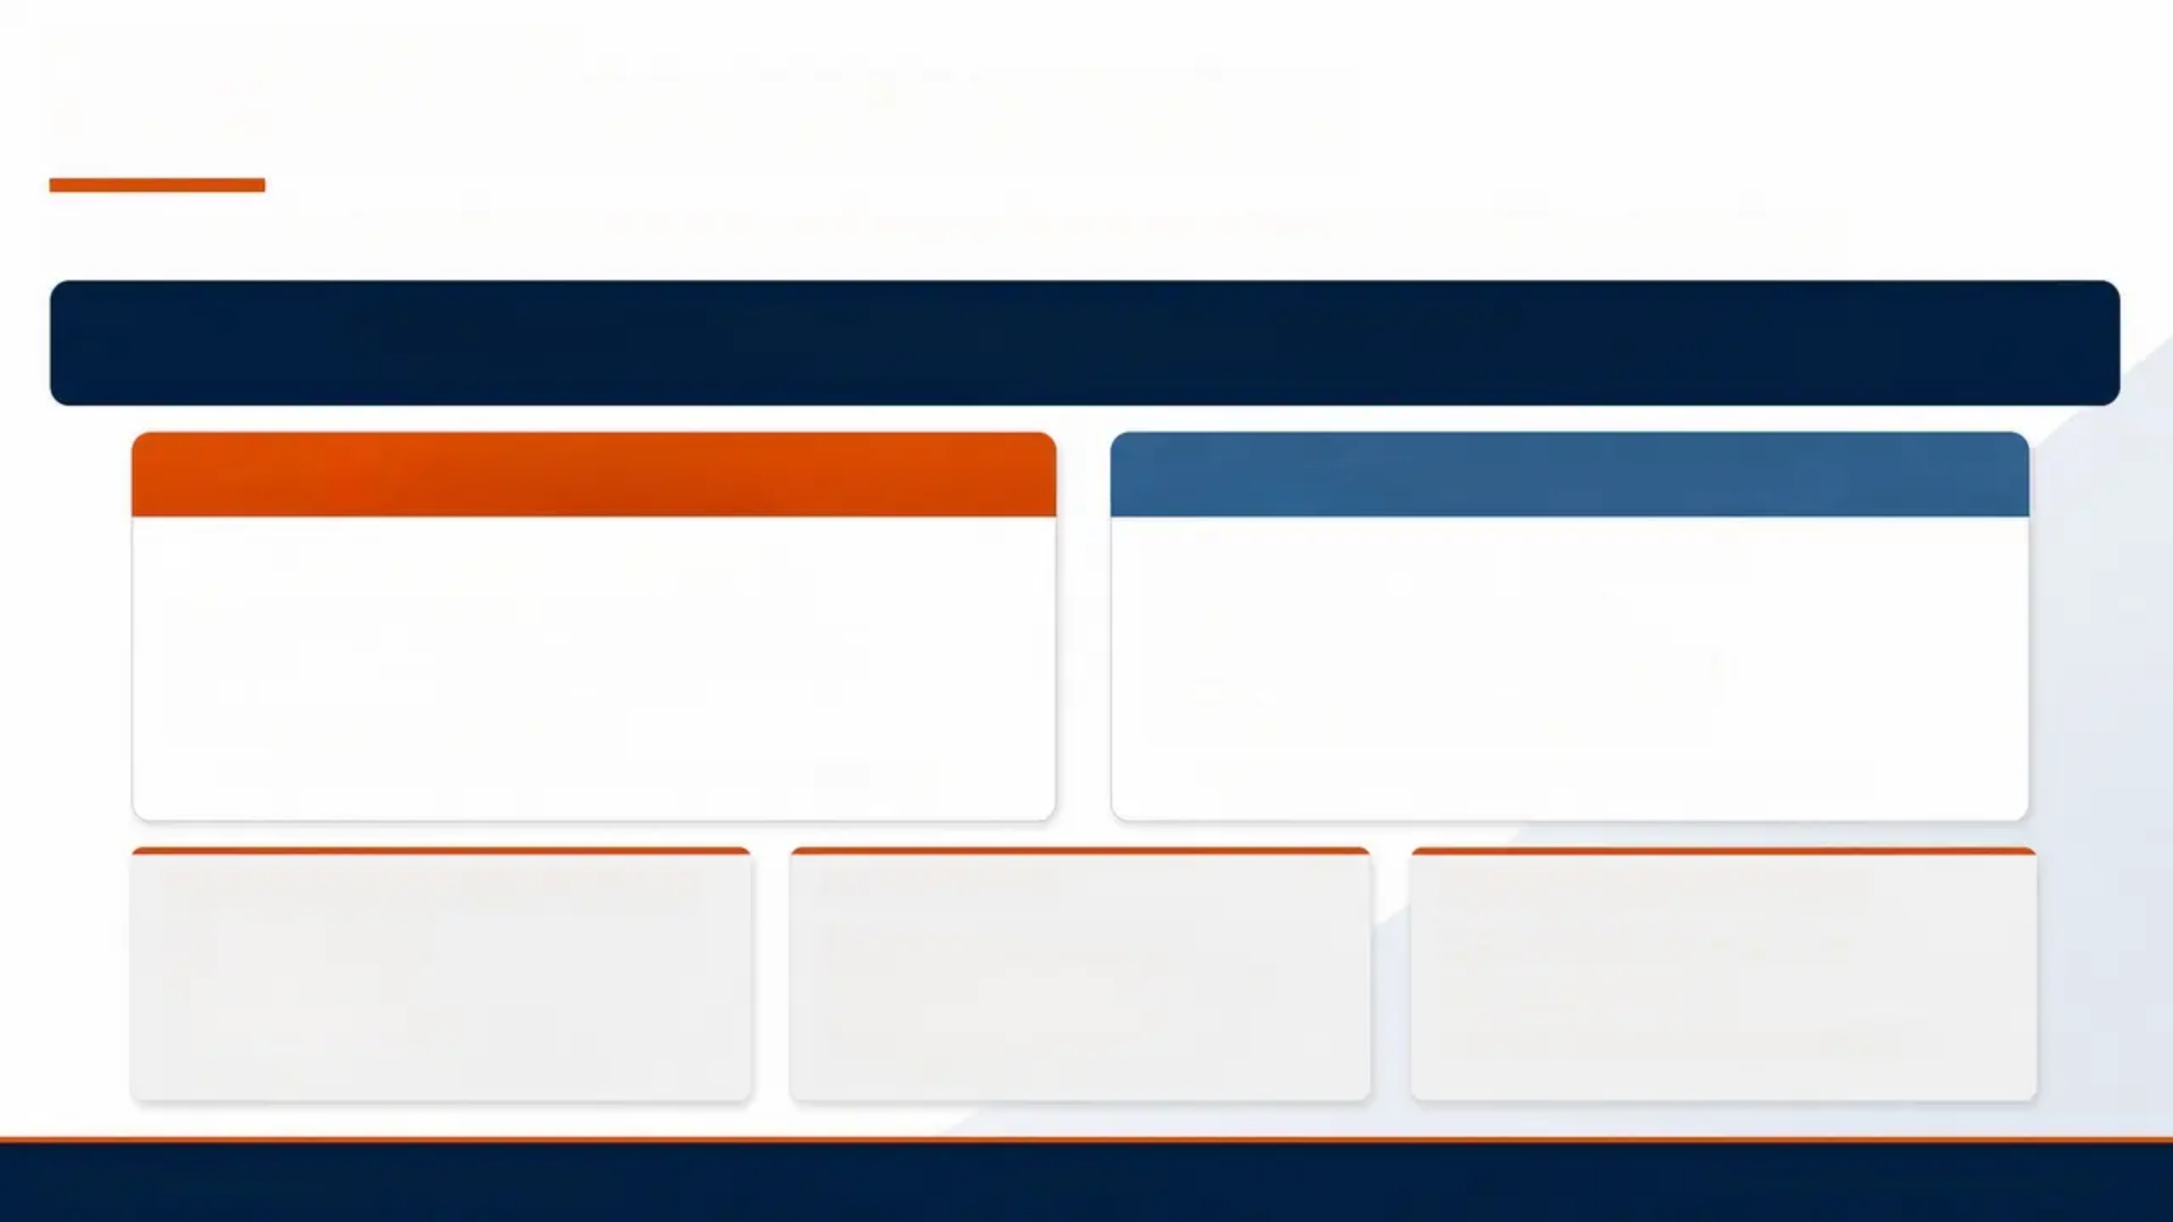








RHEUMATOLOGY • ARUK FRAMEWORK
Approach to Multiple Joint Pain
Differentiating inflammatory vs degenerative arthritis — and catching early RA in the window of opportunity
Early RA: the "Window of Opportunity" — DMARDs in the first months can induce remission.
Don't wait for positive RF or erosions.
INFLAMMATORY
DEGENERATIVE (OA)
• Morning stiffness › more than 30 minutes
• Pain with use › worsens through the day
• Worse after rest › improves with movement
• Stiffness › less than 30 minutes
• Systemic symptoms › fatigue, fever, weight loss
• Settles with rest › no systemic features
• Night pain › wakes from sleep
• End-of-day pain › mechanical pattern
Think: RA, psoriatic arthritis, ankylosing spondylitis, PMR, gout
Think: OA knee, hip, hand, spine — most common in practice
IN YOUR PRACTICE (per 10,000 pts)
EASILY MISSED
REFER TO RHEUMATOLOGY
OA → ~180 patients
• Early RA (no findings initially)
• Suspected inflammatory arthritis
RA → ~25 patients
• Psoriatic arthritis (dactylitis, enthesitis)
• Diagnostic uncertainty
Psoriatic arthritis → ~4 patients
• Acute gout (confused with cellulitis)
• OA/gout/PMR not responding to usual care
Ankylosing spondylitis → ~3 patients
• PMR (shoulder/hip pain in >50s)
Bradford VTS • MSK Common Conditions & Key Points
Slide 9 of 10
www.bradfordvts.co.uk • June 2026

Slide 10









SLIDE 10 OF 10 · SUMMARY & REFERENCE
Red Flags, Exam Focus & Pitfalls
MSK summary: what to know, what to watch for, what to avoid
RED FLAGS
AKT / SCA EXAM FOCUS
● Cauda equina — saddle anaesthesia, bilateral weakness,
bladder/bowel → A&E EMERGENCY
AKT Key Facts
SCA Consultation Tips
● Ottawa Rules: bony malleolus tenderness
OR can't weight bear
● Whiplash: acknowledge medicolegal
complexity; avoid early negative prognosis
● Thoracic back pain → malignancy / vertebral fracture
● Beighton ≥4/9 + arthralgia >3 months
≥4 joints = JHS
● Hypermobility: reassure not same as EDS;
low-impact exercise
● Hot single swollen joint → septic arthritis (urgent)
● CTS score ≥5 = diagnose (no NCS needed)
● Vitamin D: cultural sensitivity with
South Asian patients; supplement
concordance
● 25(OH)D <25 nmol/L = Vitamin D deficiency
● Fever + joint pain → septic / reactive arthritis / gout / CTD
● Whiplash: 90% recover by 2 years; NO collar
● Ankle: unable to weight bear → Ottawa Rules → X-ray
● Inflammatory arthritis: morning stiffness >30 min
● Morton's neuroma: <5mm = injection;
>5mm = surgery
● Early RA: don't wait for positive RF or
erosions on X-ray
COMMON PITFALLS
QUICK RECALL
1. Bunions — not surgical-only; address risk factors first
● Ottawa Rules: malleolus tenderness or weight-bear
● Vit D: 25-OHD <25 = deficiency
2. Whiplash — cervical collar NOT recommended; early mobilisation
● Plantar fasciitis: stretching first, not injection
● Hot joint: septic arthritis — urgent
3. Plantar fasciitis — steroid injection NOT first-line; stretching first
● CTS ≥5: diagnose without NCS
● Cauda equina: emergency A&E
4. Osgood-Schlatter — clinical diagnosis; X-ray NOT needed
5. Meniscal tear — McMurray's unreliable; use history + Thessaly test
● Beighton ≥4/9: hypermobility syndrome criterion
● Inflammatory: morning stiffness >30 minutes
6. CTS — don't refer all for NCS; questionnaire ≥5 is sufficient
● Whiplash: no collar; mobilise early
7. Vitamin D — check 25-OHD; old guidance (don't measure) is OUTDATED
● Early RA: normal tests don't rule out
Bradford VTS · MSK Common Conditions & Key Points
Slide 10 of 10
www.bradfordvts.co.uk · June 2026

