Slide 1


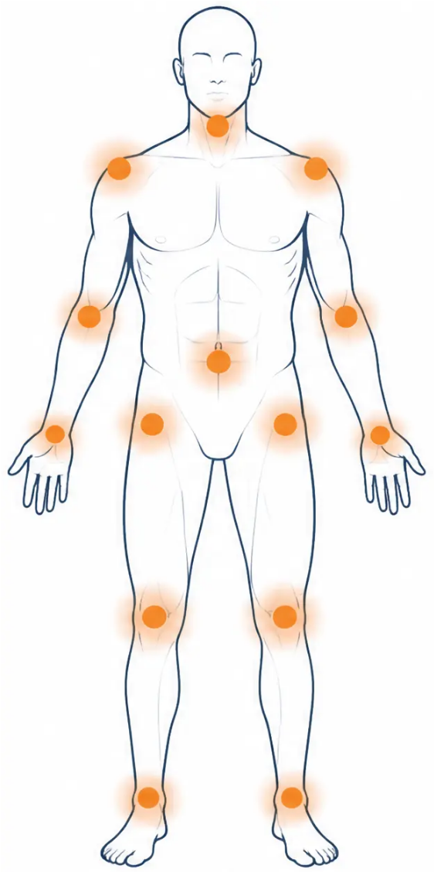
BRADFORD VTS TEACHING DECK
www.bradfordvts.co.uk | June 2026
MSK Exercises
GPs should know
Evidence-based self-management advice for
common MSK presentations
By Dr Ramesh Mehay
For GP trainees and primary care clinicians
Exercises sourced from Arthritis UK (formerly Versus Arthritis)
Registered charity No. 207711 | www.arthritis-uk.org
General advice only | Exclude red flags | Source: Arthritis UK | BRADFORD VTS | www.bradfordvts.co.uk

Slide 2





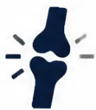



BRADFORD VTS TEACHING DECK
www.bradfordvts.co.uk
| June 2026
CLINICAL SAFETY
Before You Advise Exercises
Tailor to the Individual
Consider age, fitness level, and
comorbidities before advising.
Always Exclude RED FLAGS First
Suitable for Common Non-Inflammatory MSK
◆ Unexplained weight loss
These exercises are for mechanical,
degenerative, and overuse presentations.
◆ Night pain (waking from sleep)
◆ Fever or systemic illness
Complex Cases → Refer to Physiotherapy
◆ Neurological deficit (weakness, loss of sensation)
Post-surgical | Inflammatory arthritis |
Neurological involvement.
◆ Significant recent trauma
Exercises sourced from Arthritis UK (formerly Versus Arthritis) | www.arthritis-uk.org
“Start slowly and build up gradually — mild discomfort is normal, but sharp pain means stop.”
General advice only | Exclude red flags | Source: Arthritis UK | BRADFORD VTS | www.bradfordvts.co.uk

Slide 3

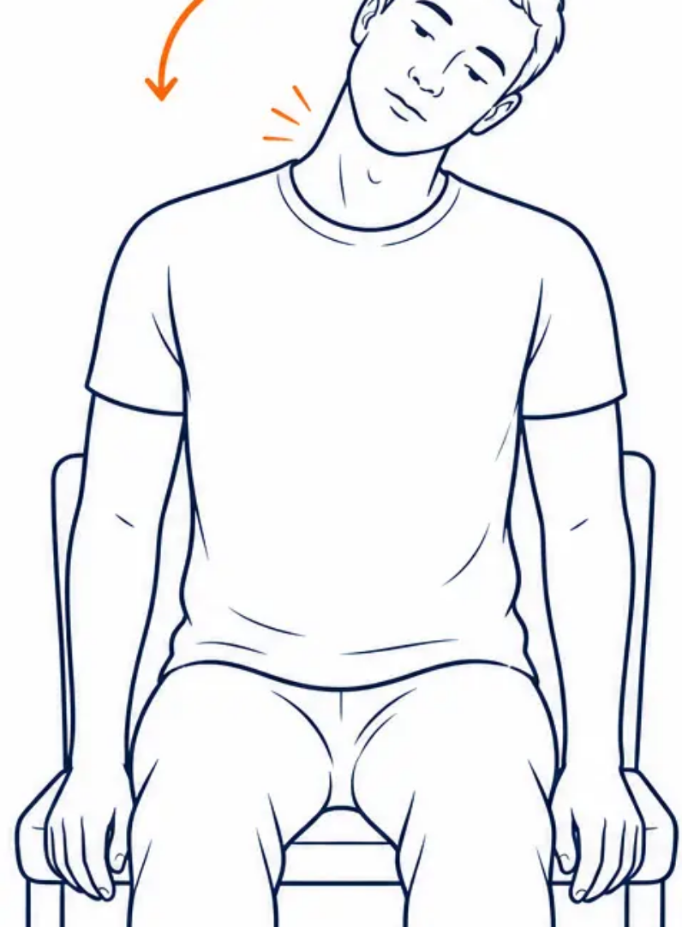


MSK Exercises for Primary Care
BRADFORD VTS | www.bradfordvts.co.uk
NECK PAIN
Exercise 1 of 4
Head Tilt
Ear to Shoulder
TREATS
Mechanical neck pain • Cervical stiffness • Range of motion
HOW TO DO IT
1. Sit down for balance.
2. Slowly tilt your head toward your shoulder — ear leading,
shoulder stays down.
3. Gently tense the neck muscles and hold for 5 seconds.
4. Return to centre. Repeat on the other side.
5 reps each side
1–2 times daily
Stop if: sharp pain • dizziness • pins and needles down the arm
General advice only | Exclude red flags | Source: Arthritis UK | BRADFORD VTS | www.bradfordvts.co.uk

Slide 4

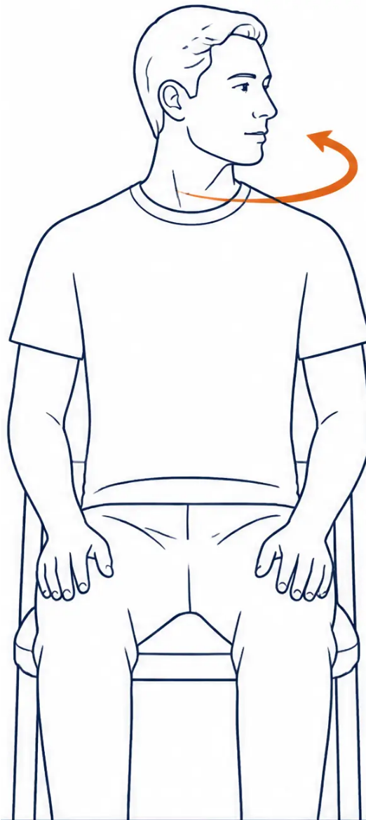



BRADFORD VTS TEACHING DECK
www.bradfordvts.co.uk | June 2026
NECK PAIN
Exercise 2 of 4
Head Turn
Cervical Rotation
Chin stays level
Shoulders still
WHAT IT TREATS
Neck stiffness · Mechanical neck pain · Posture
HOW TO DO IT
1. Sit down comfortably.
2. Turn your head slowly to one side — keep your chin at
the same height, don’t let it drop or tilt.
3. Hold for 5 seconds. Return to centre.
4. Repeat on the other side. If uncomfortable sitting,
try lying down with your head supported.
5 reps each side
Daily
⚠ Stop if dizziness or arm symptoms occur.
Lying version is equally valid.
General advice only | Exclude red flags | Source: Arthritis UK | BRADFORD VTS | www.bradfordvts.co.uk

Slide 5

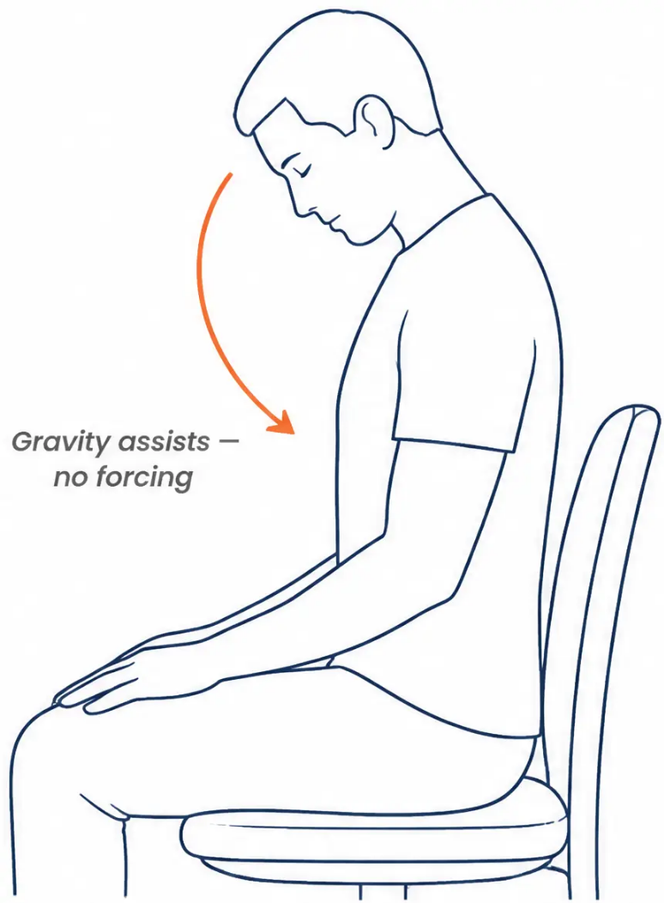




BRADFORD VTS TEACHING DECK
www.bradfordvts.co.uk | June 2026
NECK PAIN
Chin to Chest
Cervical Flexion
Exercise 3 of 4 — Neck Series
WHAT IT TREATS
Neck stiffness • Upper back tension • Mechanical neck pain
HOW TO DO IT
1. Sit or stand with good posture
2. Slowly lower your chin toward your chest
3. Hold for 5 seconds
4. Return gently to neutral
Let gravity help — do not force the movement
DOSE
5 repetitions
1-2 times daily
Stop if this causes tingling or arm pain. Keep the movement slow and gentle.
General advice only | Exclude red flags | Source: Arthritis UK | BRADFORD VTS | www.bradfordvts.co.uk

Slide 6

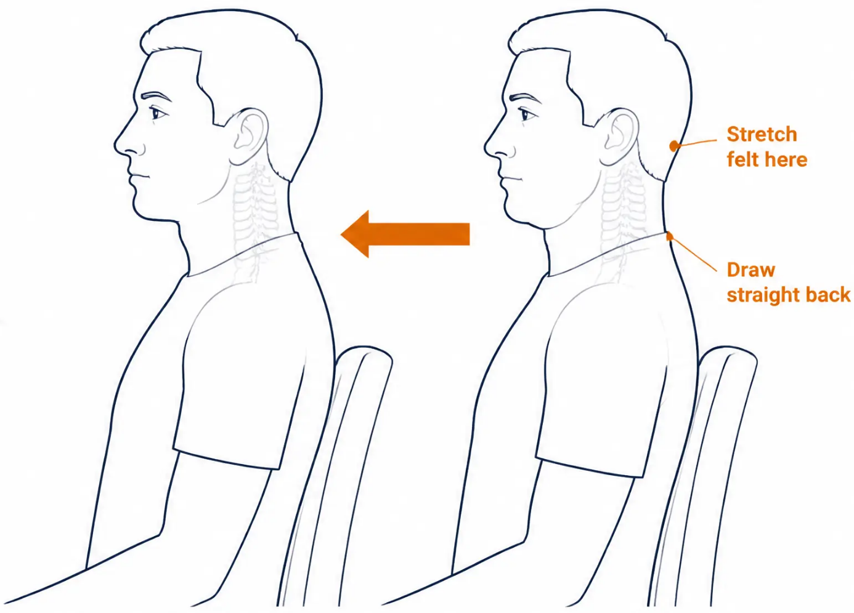






NECK PAIN
Exercise 4 of 4
NECK PAIN
Chin Tuck and Hold
Deep Cervical Flexor Activation
TREATS
Postural neck pain · Forward head posture ·
Desk-worker neck strain · Deep cervical flexor retraining
HOW TO DO IT
1. Sit or stand tall with relaxed shoulders
2. Gently draw your chin straight back — like making a "double chin"
3. Do NOT tilt your head up or down — purely a backward glide
4. Feel a gentle stretch at the base of the skull —
hold 5–10 seconds, then relax
Can be done at a desk, in a car, or anywhere during the day
10 reps
2× daily
Desk-friendly
Do not tilt the head — movement is purely
backward retraction. Stop if pain radiates to arms.
General advice only | Exclude red flags | Source: Arthritis UK | BRADFORD VTS | www.bradfordvts.co.uk

Slide 7

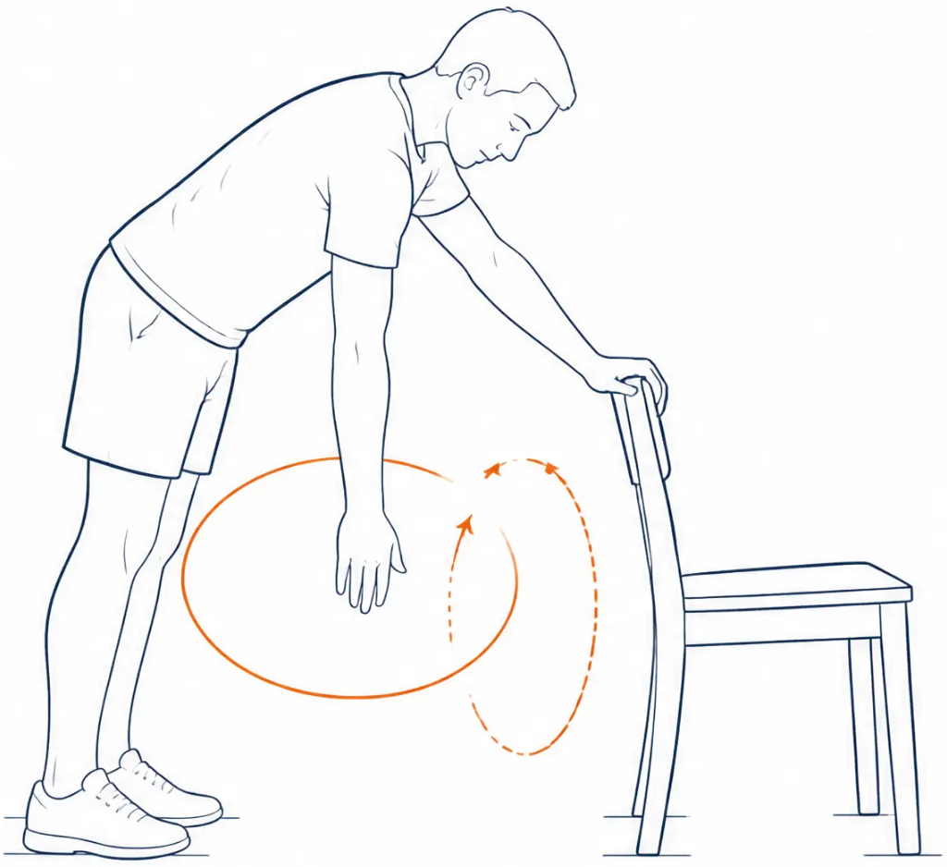






SHOULDER PAIN
BRADFORD VTS | www.bradfordvts.co.uk
SHOULDER PAIN
Exercise 1 of 3
Shoulder Circle
Pendulum Swing
TREATS: Shoulder stiffness • Frozen shoulder • Rotator cuff problems • Warm-up exercise
HOW TO DO IT
• Stand with one hand resting on a table or chair for support
• Let the other arm hang completely loose — don't force it
• Gently swing the arm forward and back, then in small circles
• Let gravity do all the work — the arm should feel heavy and relaxed
DOSE
5 circles each direction
2–3 times a day
Best used as a warm-up before other shoulder exercises
SAFETY
Gravity does the work — arm stays completely relaxed
The arm must feel relaxed and heavy throughout. Do NOT swing with force or muscular effort.
General advice only | Exclude red flags | Source: Arthritis UK | BRADFORD VTS | www.bradfordvts.co.uk

Slide 8

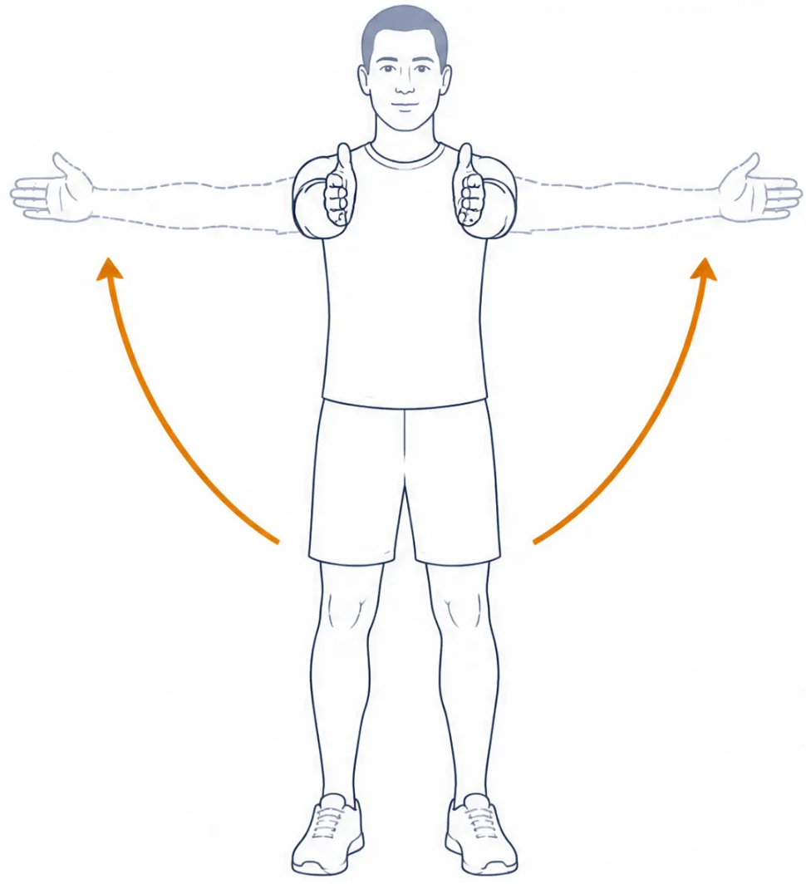








BRADFORD VTS TEACHING DECK
www.bradfordvts.co.uk | June 2026
SHOULDER PAIN
EXERCISE 2 OF 3
Arm Stretch Standing
Shoulder Range of Motion
WHAT IT TREATS
Shoulder stiffness · Impingement · Rotator cuff problems
HOW TO DO IT
• Stand with arms relaxed at your sides
• Raise both arms — either out to the sides OR straight in front —
palms facing each other
• Hold for 5–10 seconds, then slowly lower
• Alternate between front raises and side raises to stretch more muscles
DOSE
SAFETY TIP
5 repetitions
Raise only as far as comfortable
Daily
Stop if sharp catching or
pinching pain at the top of
the movement
Can also be done
lying on the back
Raise to front or sides — only as far as comfortable
General advice only | Exclude red flags | Source: Arthritis UK | BRADFORD VTS | www.bradfordvts.co.uk

Slide 9

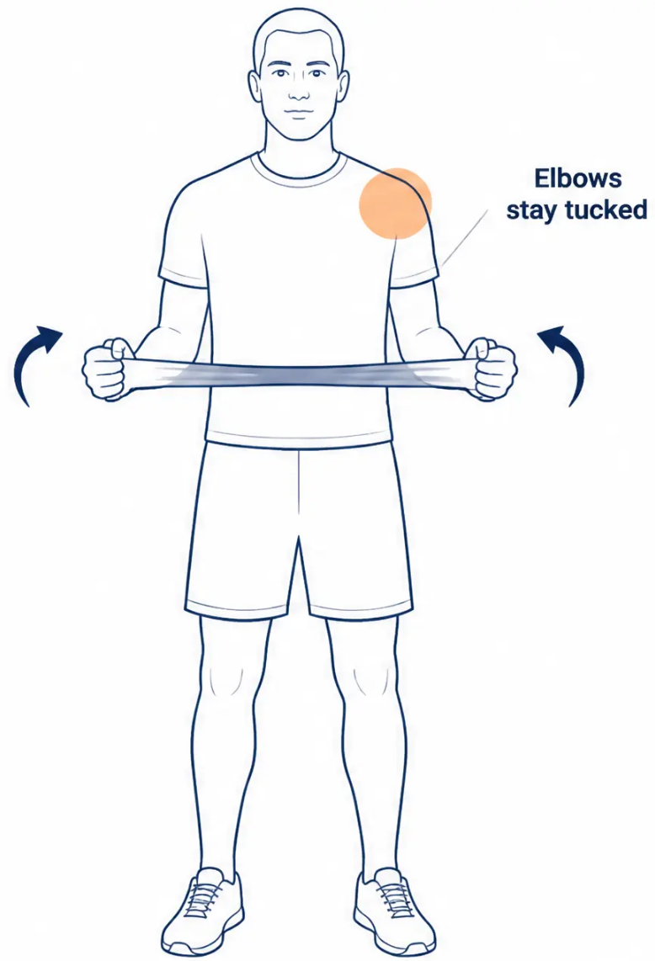


MSK Exercises for Primary Care
BRADFORD VTS | www.bradfordvts.co.uk
SHOULDER PAIN
Resistance Band External Rotation
Rotator Cuff Strengthening
WHAT IT TREATS
Rotator cuff weakness · Shoulder impingement · Shoulder instability
HOW TO DO IT
1. Hold a resistance band with both hands, palms facing inward
2. Elbows bent at waist height, tucked firmly at your sides
3. Slowly stretch the band outward as far as comfortable
4. Hold for a count of 10, then bring hands back in slowly
DOSE
⚠ SAFETY
• 10 repetitions
• Keep elbows tucked throughout
• 3 times a day
• Start with a light band –
build up gradually
General advice only | Exclude red flags | Source: Arthritis UK | BRADFORD VTS | www.bradfordvts.co.uk

Slide 10


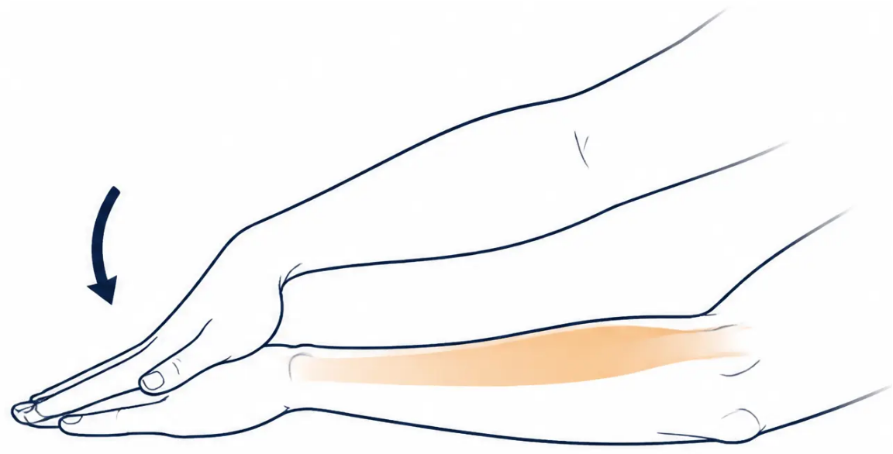

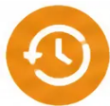

BRADFORD VTS TEACHING DECK
www.bradfordvts.co.uk | June 2026
TENNIS ELBOW (Lateral Epicondylalgia)
Wrist Extensor Stretch
Stretching the wrist extensors attached at the lateral epicondyle
Perform daily — before and after strengthening exercises
How to do it
Hold your arm straight out in front, palm facing DOWN.
Use your other hand to gently press the back of the hand
downward — bending the wrist toward the floor.
Hold for 15–30 seconds.
Then gently pull the fingers back upward and hold for 15–30 seconds.
Feel the stretch along the TOP of the forearm.
Reps & Frequency
3 repetitions each arm
Daily — before and after strengthening exercises
Stretch felt along top of forearm
Safety Tip
Gentle sustained stretch only — no bouncing.
Stop if sharp or shooting pain occurs.
General advice only | Exclude red flags | Source: Arthritis UK | BRADFORD VTS | www.bradfordvts.co.uk

Slide 11
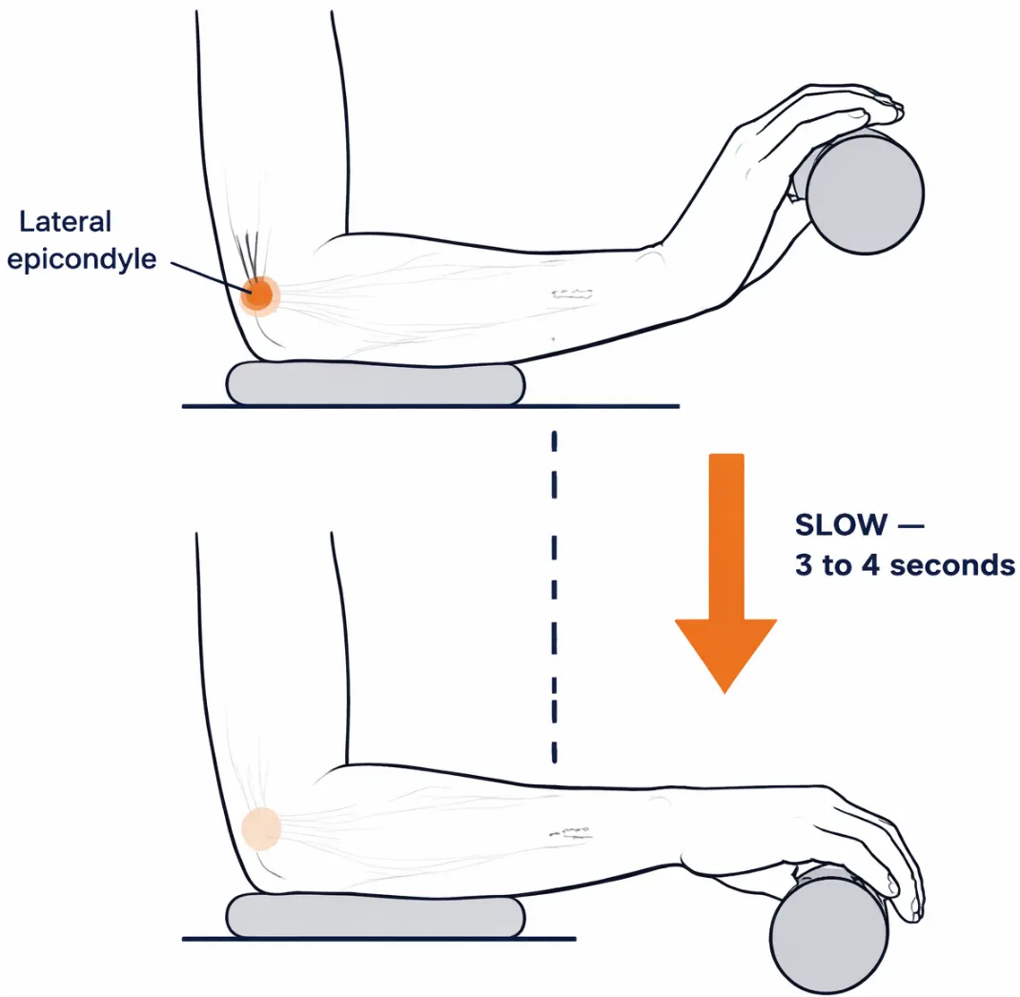









BRADFORD VTS TEACHING DECK
www.bradfordvts.co.uk | June 2026
TENNIS ELBOW · LATERAL EPICONDYLALGIA
EXERCISE 2 OF 3
Eccentric Wrist
Extension
Evidence-based core treatment for lateral epicondylalgia
How to do it:
• Bend elbow to a right angle, palm facing down
• Hold a light weight (0.5–1 kg or a tin of beans)
• Slowly bend wrist upward
• Then very slowly lower back down — 3–4 seconds on the way down
• The slow lowering phase is the treatment
The SLOW LOWERING phase is the key — not the lift
3 sets of 15 reps
Twice daily
Continue 8–12 weeks
Mild discomfort during exercise is normal and expected with eccentric tendon
loading. Stop if severe pain. Begin with very light weight or arm weight only.
General advice only | Exclude red flags | Source: Arthritis UK | BRADFORD VTS | www.bradfordvts.co.uk

Slide 12
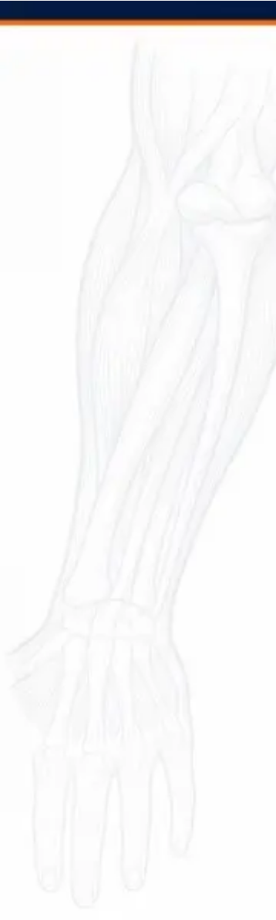
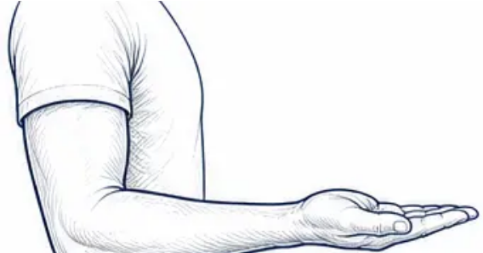

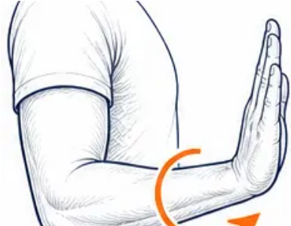

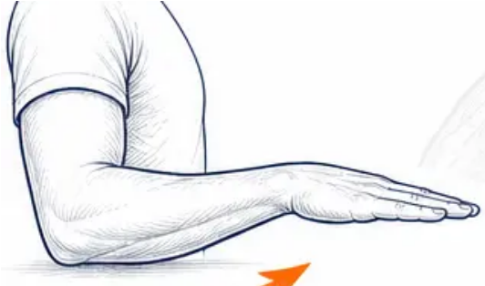






TENNIS ELBOW
Exercise 3 of 3
TENNIS ELBOW (LATERAL EPICONDYLALGIA)
1
Forearm Rotation /
Pronation & Supination
START —
Palm Up
WHAT IT TREATS
Tennis elbow — restoring forearm rotation and
reducing forearm stiffness.
2
HOW TO DO IT
Rotate
through
• Bend your elbow to a right angle, arm tucked at your side
• Start with your palm facing up — this is the starting position
• Slowly rotate your wrist so the palm faces down — hold 5 seconds
• Slowly return to palm-up — keep the elbow completely still throughout
3
• Can be progressed by holding a light weight or tin of beans
END —
Palm Down
30
Daily
repetitions total
(rest after every 10)
with light weight
to progress
Keep the movement smooth and controlled.
Avoid sudden forceful twisting.
Progress: hold a tin of beans
for added resistance.
General advice only
Exclude red flags
Source: Arthritis UK
BRADFORD VTS
www.bradfordvts.co.uk

Slide 13

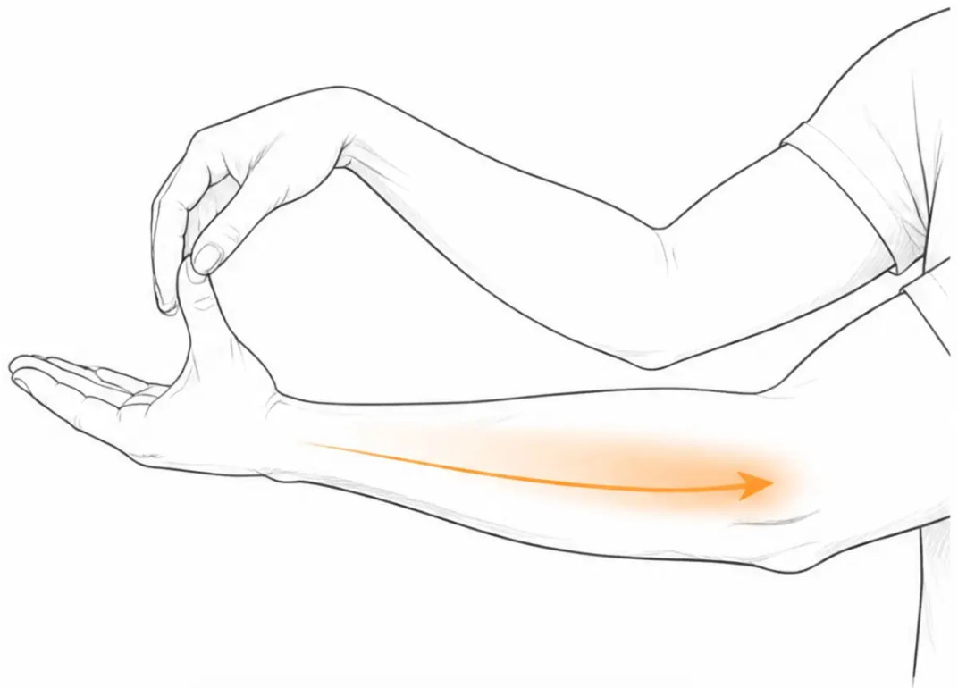





BRADFORD VTS TEACHING DECK
www.bradfordvts.co.uk | June 2026
GOLFER'S ELBOW (Medial Epicondylalgia)
Wrist Flexor Stretch
Golfer's elbow — stretching the wrist flexors
attached at the medial epicondyle
HOW TO DO IT
• Arm straight out in front, palm facing UP
• Other hand gently pushes fingers back toward the ceiling
• Feel the stretch along the inner forearm
• Hold for 15-30 seconds
• Release and repeat
DOSE
3 reps each arm
Before & after strengthening
Daily
Feel stretch along inner forearm
Gentle stretch only — should feel a mild pull,
not sharp or shooting pain. Stop if severe discomfort.
General advice only | Exclude red flags | Source: Arthritis UK | BRADFORD VTS | www.bradfordvts.co.uk

Slide 14
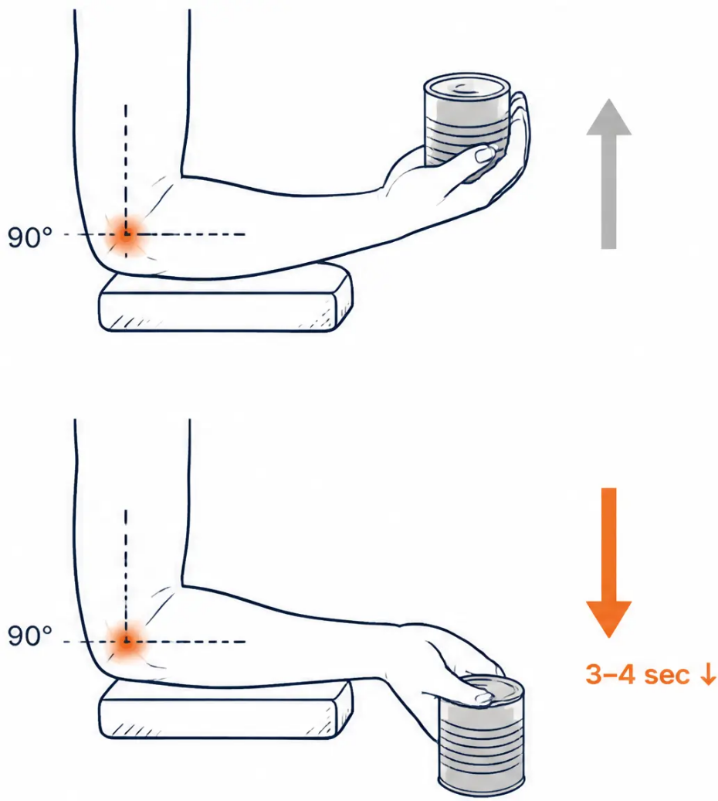






BRADFORD VTS TEACHING DECK
www.bradfordvts.co.uk | June 2026
GOLFER'S ELBOW (Medial Epicondylalgia)
Wrist Curl with Weight
Eccentric Wrist Flexion — The Key Golfer's Elbow Exercise
Medial epicondylalgia — eccentric loading of the wrist flexor tendons
1. Elbow bent at 90°, palm facing UP, forearm supported.
2. Hold a light weight — tin of beans or 0.5–1 kg.
3. Slowly curl the wrist upward toward you.
4. Very slowly lower the wrist back down — 3–4 seconds down.
↓ The slow LOWERING phase is the treatment.
3 sets of
15 repetitions
Twice daily
Continue for
8–12 weeks
Mild discomfort during exercise is normal with eccentric tendon
loading. Stop if severe or if pain radiates up the arm.
General advice only | Exclude red flags | Source: Arthritis UK | BRADFORD VTS | www.bradfordvts.co.uk

Slide 15

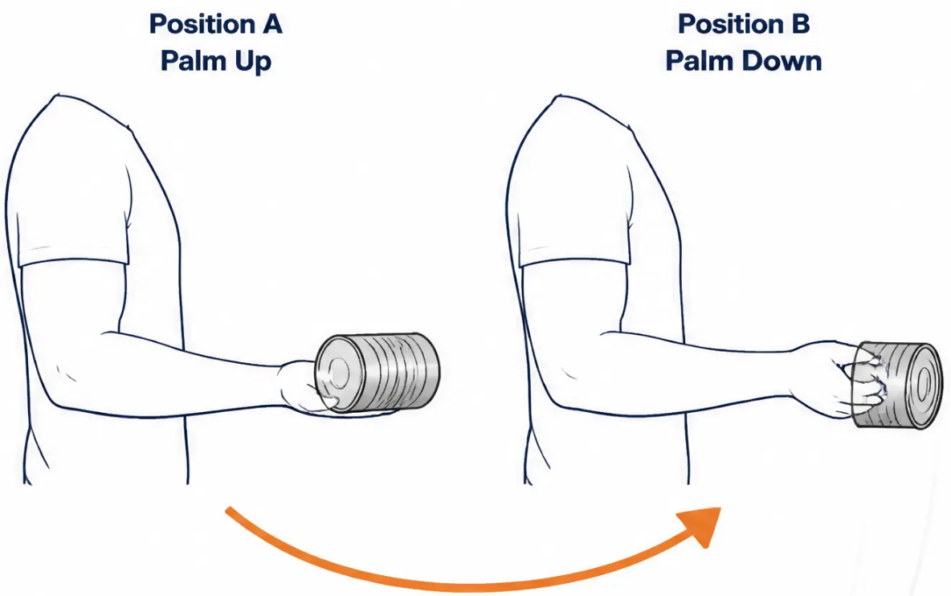
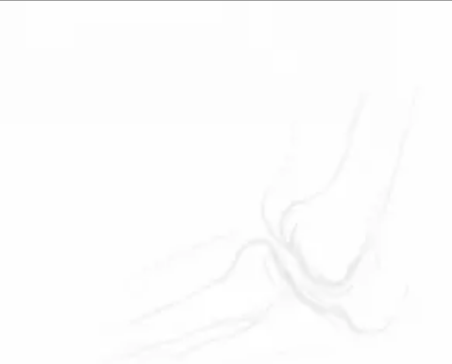

GOLFER'S ELBOW (Medial Epicondylalgia)
BRADFORD VTS | www.bradfordvts.co.uk
GOLFER'S ELBOW
Forearm Rotation
with Weight
WHAT IT TREATS
Golfer's elbow — strengthening forearm rotators for functional recovery
HOW TO DO IT
● Hold a light tin of food or a hammer at one end to create
a small lever effect
● With elbow bent at 90°, slowly rotate the forearm from
palm-up to palm-down
● Control the movement in BOTH directions — slow and
deliberate throughout
3 sets of 15 repetitions
Daily — increase weight gradually as strength improves
⚠ Start light. Build up over weeks. Stop if elbow pain
becomes severe or radiates.
General advice only | Exclude red flags | Source: Arthritis UK | BRADFORD VTS | www.bradfordvts.co.uk

Slide 16

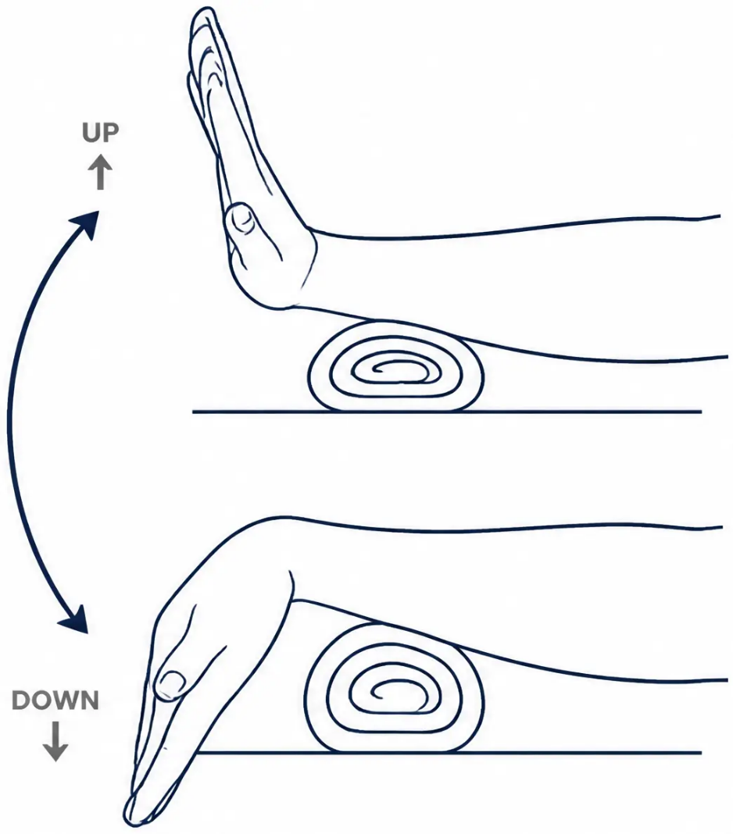









BRADFORD VTS TEACHING DECK
www.bradfordvts.co.uk | June 2026
WRIST & HAND PAIN Exercise 1 of 3
Hand Wave
Wrist Flexion & Extension
Maintains wrist range of motion — ideal for wrist stiffness and wrist pain
HOW TO DO IT
Rest your forearm on a table or your knee, with a rolled towel
underneath for padding, thumb pointing upward.
Move your wrist up and down through its full range — like a slow,
gentle wave.
Keep the movement smooth and controlled.
REPS & FREQUENCY
10-15 reps
2-3 times daily
Every day
SAFETY TIP
Move through a comfortable range only. Build up gradually.
Stop if sharp wrist pain.
General advice only | Exclude red flags | Source: Arthritis UK | BRADFORD VTS | www.bradfordvts.co.uk

Slide 17

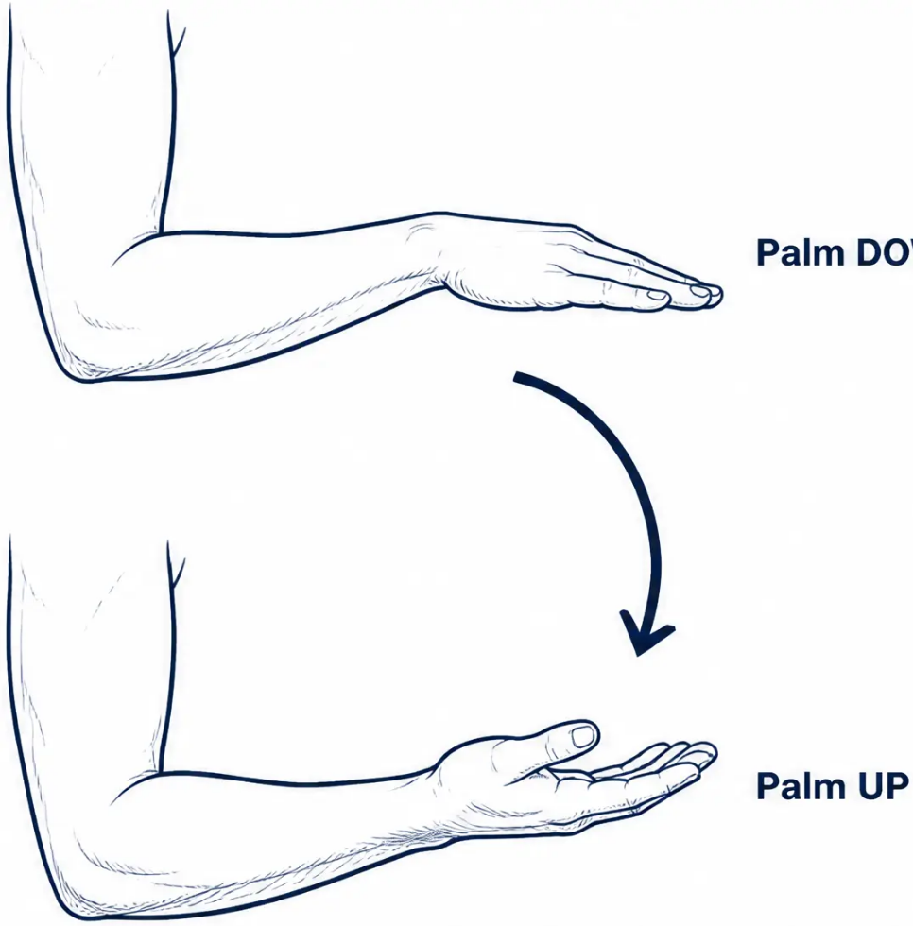






WRIST & HAND PAIN
BRADFORD VTS | www.bradfordvts.co.uk
EXERCISE 2 OF 3
Wrist Turn
Forearm Rotation — Pronation & Supination
WHAT IT TREATS
Wrist stiffness · Forearm pain · Maintaining forearm rotation range of motion
HOW TO DO IT
1. Bend your elbow to 90° with your palm facing down.
2. Slowly rotate your forearm so the palm turns to face up.
3. Pause, then slowly rotate back to palm-down.
Keep your elbow tucked in at your side throughout — do not let it drift outward.
10–15 repetitions
Daily
Smooth, controlled movement — not a quick snap
Stop if sharp pain. Keep the movement smooth and
controlled — avoid any sudden forceful twisting.
General advice only | Exclude red flags | Source: Arthritis UK | BRADFORD VTS | www.bradfordvts.co.uk

Slide 18


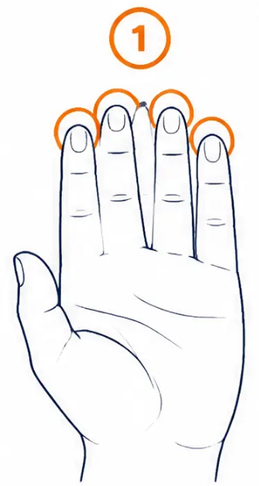
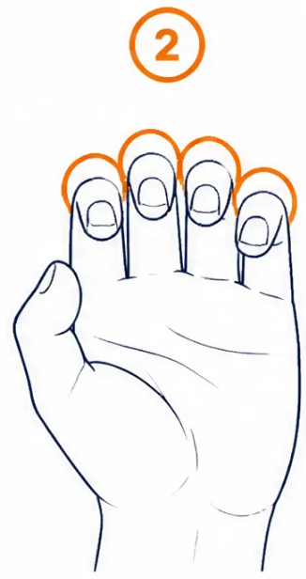
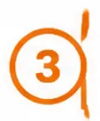




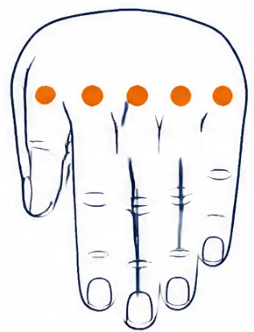
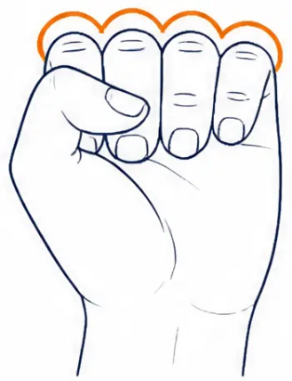





BRADFORD VTS TEACHING DECK
www.bradfordvts.co.uk | June 2026
WRIST & HAND PAIN
5–10 cycles
Finger Tendon Glide Sequence
2–3 times daily
Four positions — complete the full sequence each cycle
Straight Hand
Hook Fist
Full Fist
Straight Fist
Start and return position
Bend top two joints only
Fingers fully wrapped in
Bend at knuckles, keep fingers straight
Move through a comfortable range only — morning stiffness improves with regular practice. Stop if sharp pain.
General advice only | Exclude red flags | Source: Arthritis UK | BRADFORD VTS | www.bradfordvts.co.uk

Slide 19
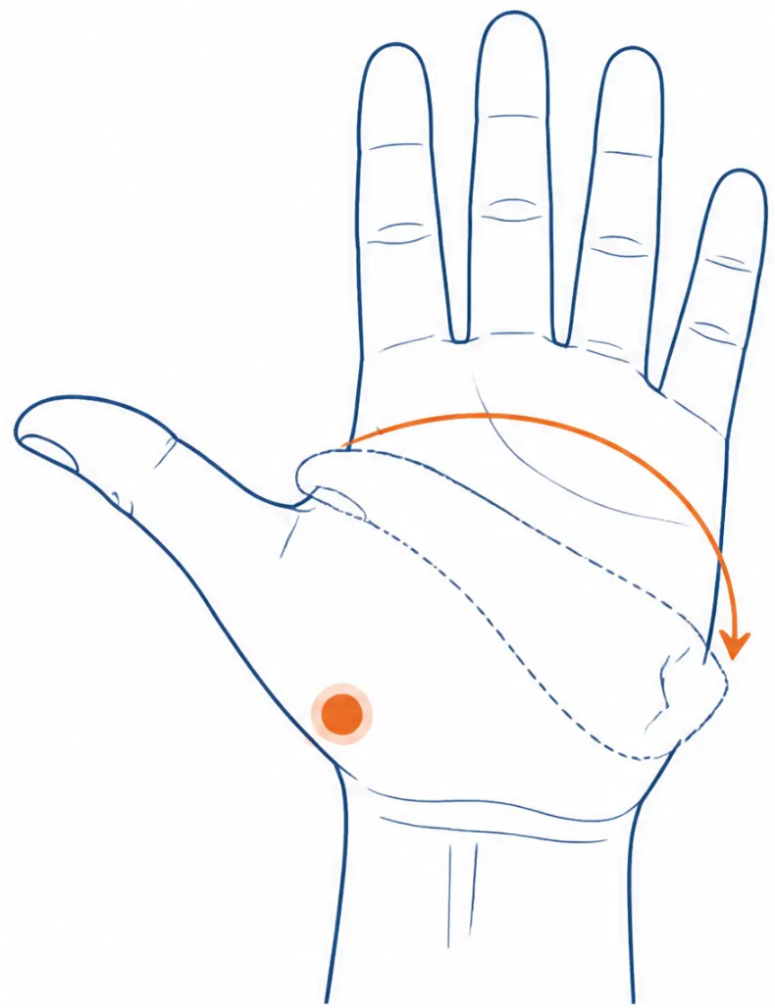




MSK Exercises for Primary Care
BRADFORD VTS | www.bradfordvts.co.uk
THUMB OA (Basal Joint / CMC Joint)
Thumb Opposition Stretch
Palmar Abduction and Opposition
CLINICAL USE
Thumb OA (trapeziometacarpal joint) — maintaining
thumb range of motion and joint mobility
HOW TO DO IT
Hold your hand in front of you, palm flat — as if saying "stop".
Start with your thumb pointing outward.
Slowly move your thumb across your palm toward your little finger.
Return to the starting position. Keep your fingers still throughout.
REPS / FREQUENCY
10 repetitions | 2–3 times daily
Move in a pain-free range. Sharp pain means ease off.
A thumb spica splint may complement this exercise
during daily activities.
Thumb moves in an arc across the palm
General advice only | Exclude red flags | Source: Arthritis UK | BRADFORD VTS | www.bradfordvts.co.uk
19 / 40

Slide 20

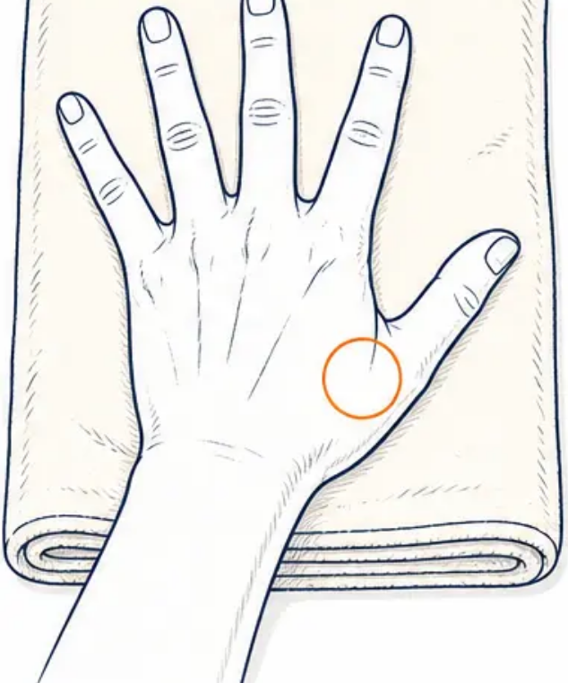
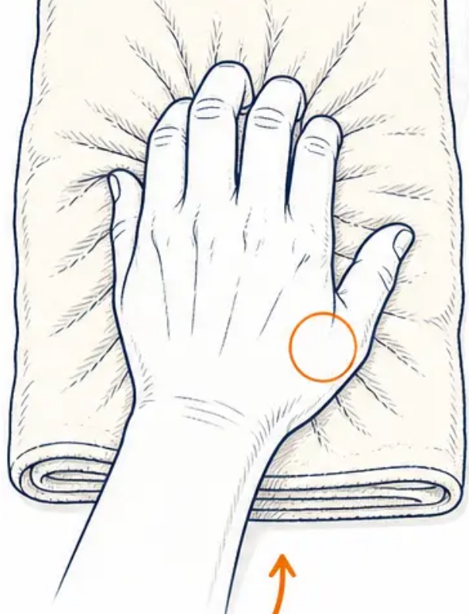









BRADFORD VTS TEACHING DECK
www.bradfordvts.co.uk
June 2026
THUMB OA — BASAL JOINT / CMC JOINT
EXERCISE 2 OF 3
Finger Strengthening
Pinch and Grip
WHAT IT TREATS
Thumb OA (trapeziometacarpal joint) — strengthens
pinch grip and intrinsic hand muscles to support
daily function
HOW TO DO IT
1. Place your palm flat on a towel on a table, fingers apart
2. Pull fingers together, pressing hand down and
bunching the towel
3. Hold for 5 seconds, then relax and spread fingers wide
Alternative: squeeze fingers together without the towel
10 reps
2–3× daily
Build gradually
Scrunch & hold 5s
Stop if this causes severe pain at the base of the thumb. Gentle progressive loading is the aim — never force.
General advice only | Exclude red flags | Source: Arthritis UK | BRADFORD VTS | www.bradfordvts.co.uk

Slide 21
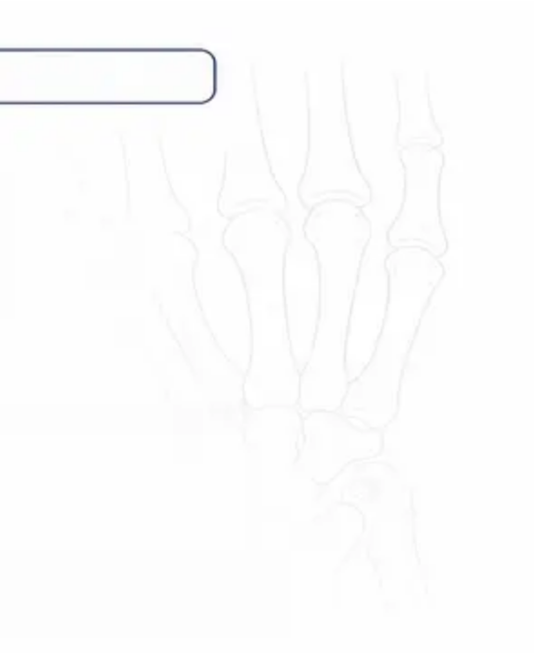

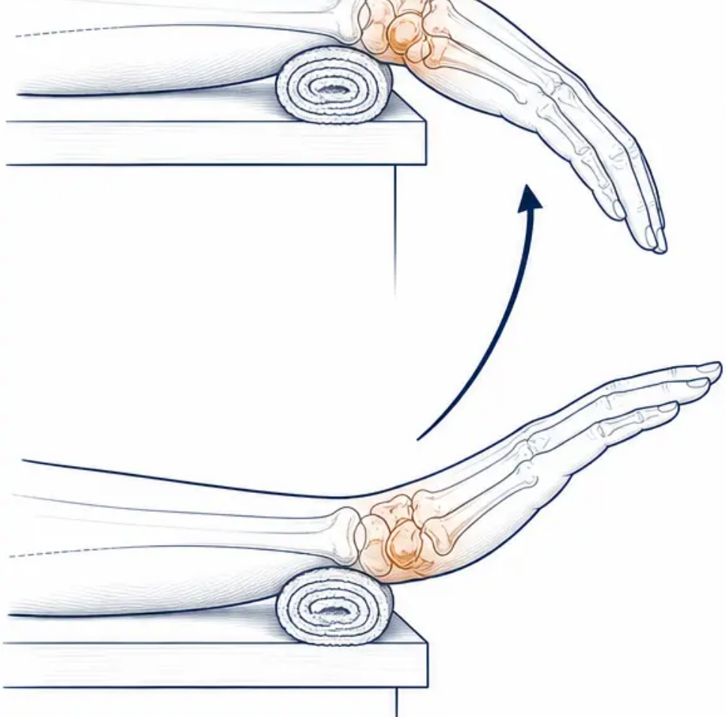



BRADFORD VTS TEACHING DECK
www.bradfordvts.co.uk
June 2026
THUMB OA (Basal Joint / CMC Joint)
EXERCISE 3 OF 3
Hand Lift
Wrist & Thumb Extension
Thumb and wrist OA — wrist mobility and extensor strength
HOW TO DO IT
1. Place your forearm flat on a table, hand hanging over the edge,
palm facing down.
2. Place a rolled towel under your wrist for comfort and support.
3. Keeping fingers relaxed, slowly raise your hand upward until you feel
a gentle stretch.
4. Hold briefly, then lower back down in a controlled way.
10 repetitions | Twice daily
Use a rolled towel under the wrist for comfort.
Gentle movement only. Stop if base of thumb pain is severe.
Forearm supported, hand lifts from hanging position
General advice only | Exclude red flags | Source: Arthritis UK | BRADFORD VTS | www.bradfordvts.co.uk

Slide 22

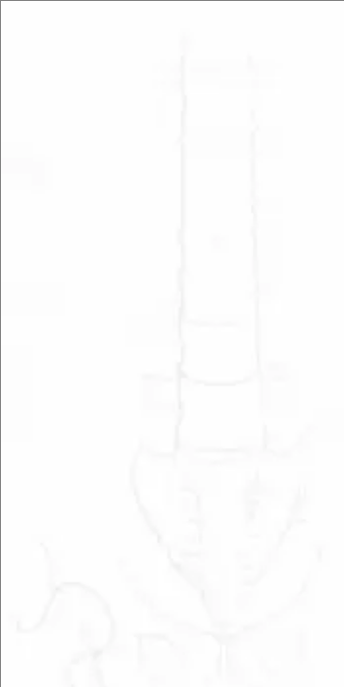

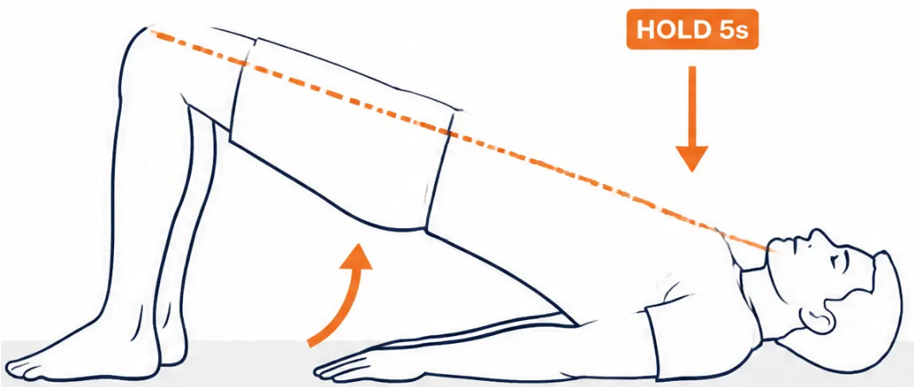



BRADFORD VTS TEACHING DECK
www.bradfordvts.co.uk | June 2026
HIP PAIN
HOW TO DO IT
EXERCISE 1 OF 3
Bridging
● Lie on your back, knees bent, feet flat on the floor
● Tighten your tummy muscles
Hip Extension & Gluteal Strengthening
● Lift your pelvis, squeezing your bottom as you rise
● Hold for 5 seconds — body forms a straight line
from knees to shoulders
| Hip pain · Hip OA · Low back pain · Gluteal & core strengthening
● Lower slowly and with control
REPS & FREQUENCY
10 repetitions
Once or twice daily
SAFETY TIP
Do not over-arch the lower back.
Control the lowering phase.
Stop if hip or back pain worsens.
General advice only | Exclude red flags | Source: Arthritis UK | BRADFORD VTS | www.bradfordvts.co.uk

Slide 23


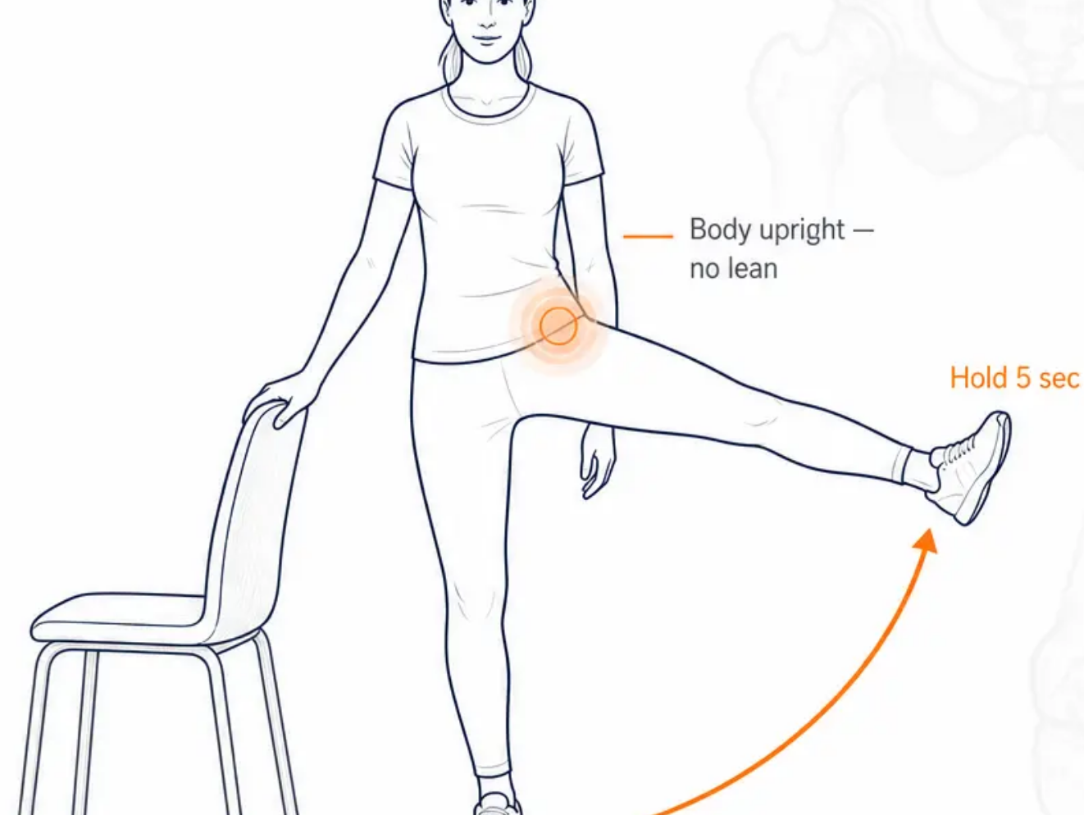


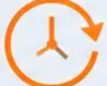
BRADFORD VTS TEACHING DECK
www.bradfordvts.co.uk | June 2026
HIP PAIN
Hip Abduction
Side Leg Raise
Hip abductor strengthening for hip OA and trochanteric bursitis
HOW TO DO IT
Stand beside a chair or work surface — hold it for support.
Keeping your body upright, lift one leg straight out to the side.
Hold for 5 seconds, then slowly lower back down.
Do not lean sideways — keep your trunk straight throughout.
5–10 reps each side
Daily — can also be done lying on your side
SAFETY TIP
Keep the standing knee slightly soft — not locked.
Avoid tilting the trunk sideways to compensate
for limited range.
General advice only | Exclude red flags | Source: Arthritis UK | BRADFORD VTS | www.bradfordvts.co.uk

Slide 24

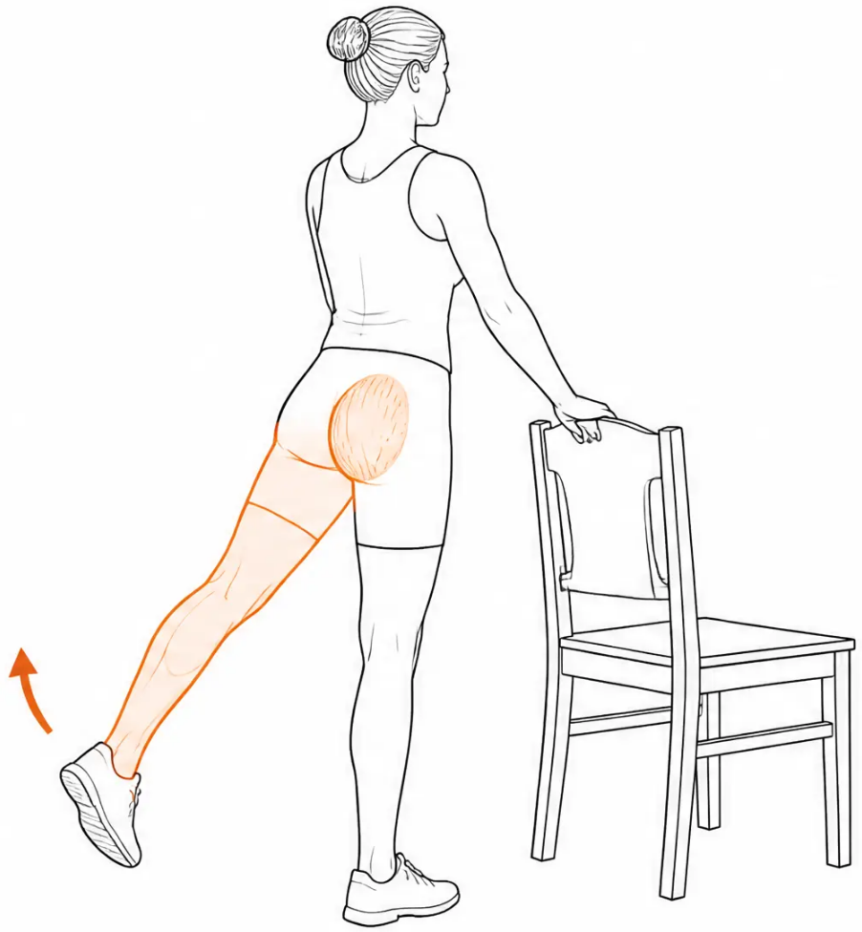




BRADFORD VTS TEACHING DECK
www.bradfordvts.co.uk | June 2026
Hip Extension — Backward Leg Raise
HIP PAIN
| Exercise 3 of 3 — Hip Extensors & Gluteals
TREATS
Hip pain · Hip OA · Gluteal strengthening · Hip extensor activation
HOW TO DO IT
1. Stand holding a chair or work surface for support.
2. Keeping your knee straight, move one leg backwards.
3. Clench your buttock tightly and hold for 5 seconds.
4. Keep your body upright — do not lean forward. Lower and
repeat on the other side.
DOSE
SAFETY TIP
Small controlled movement is
better than a large compensated
one. Stop if hip pain worsens
significantly.
5–10 reps each side | Daily
Keep body upright — small controlled movement
General advice only | Exclude red flags | Source: Arthritis UK | BRADFORD VTS | www.bradfordvts.co.uk

Slide 25

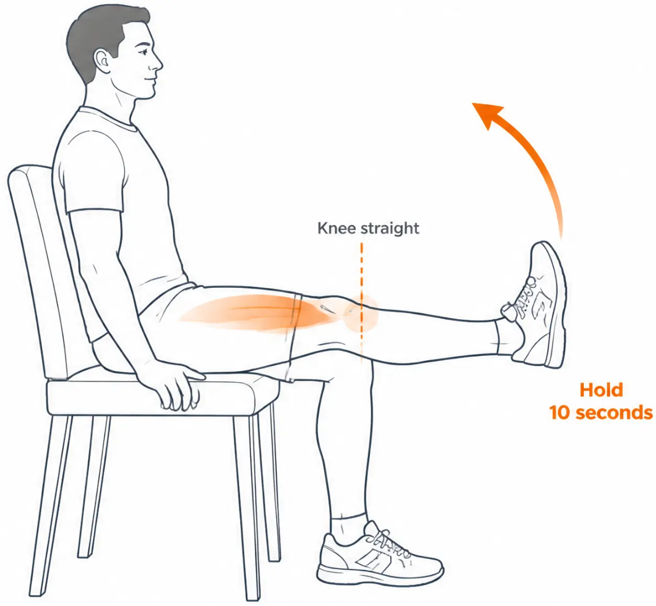


KNEE PAIN
BRADFORD VTS | www.bradfordvts.co.uk
KNEE PAIN
Straight Leg Raise
Seated Quadriceps Activation
WHAT IT TREATS
Knee pain · Knee OA · Patellofemoral pain · Quadriceps strengthening
HOW TO DO IT
① Sit back in a chair with a straight back
② Slowly straighten and raise one leg to hip level
③ Hold for a slow count of 10
④ Lower slowly — do not let the leg drop
DOSE
10 repetitions each leg
Twice daily
Keep back straight against the chair back.
Build hold time gradually from 5 to 10 seconds.
General advice only | Exclude red flags | Source: Arthritis UK | BRADFORD VTS | www.bradfordvts.co.uk

Slide 26


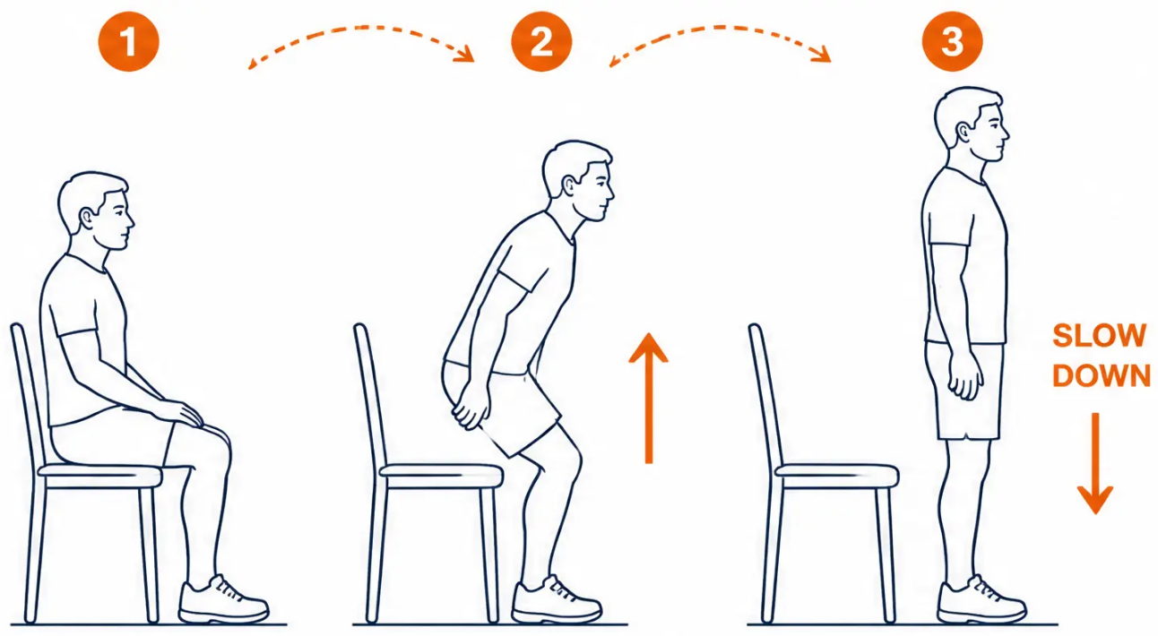



BRADFORD VTS TEACHING DECK
www.bradfordvts.co.uk | June 2026
KNEE PAIN
Exercise 2 of 3
Sit-to-Stand
Functional Quadriceps Strengthening
TREATS
Knee OA — quadriceps and lower limb
strength for daily activities
HOW TO DO IT
● Sit on a chair with feet flat on the floor.
● Without using your hands, slowly stand up in a controlled way.
● Then slowly sit back down — controlled in BOTH directions.
● Use a cushion to raise height if needed at first; remove as
strength improves.
DOSE
Repeat until fatigued | Rest 1 min | 3 sets | Daily
Controlled in both directions — up AND down
Safety: Never lock knees at the top. Use a cushion or
higher chair if needed to start safely.
General advice only | Exclude red flags | Source: Arthritis UK | BRADFORD VTS | www.bradfordvts.co.uk

Slide 27

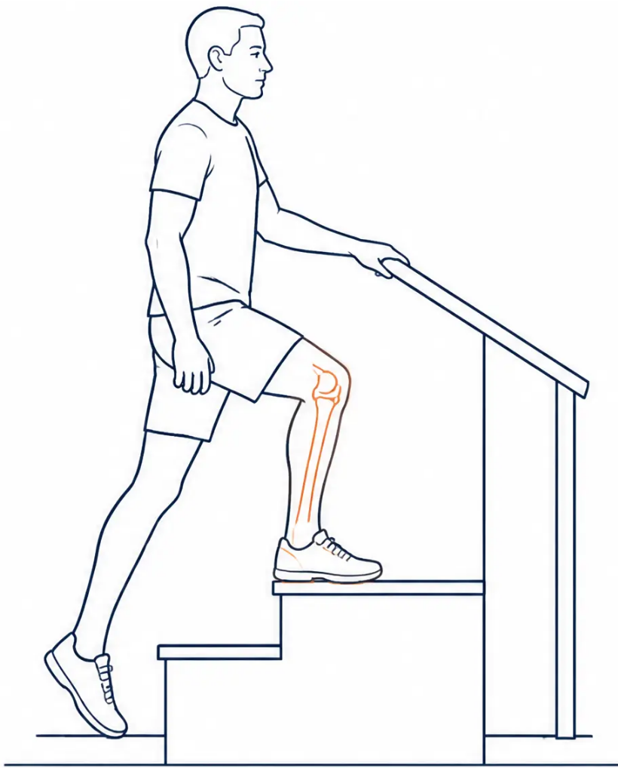




BRADFORD VTS TEACHING DECK
www.bradfordvts.co.uk
June 2026
KNEE PAIN
EXERCISE 3 OF 3
Step-Ups
Functional Strength, Balance and Stair Confidence
WHAT IT TREATS
Knee OA — functional lower limb strength, balance, and confidence on stairs
HOW TO DO IT
1. Stand at the bottom step of your stairs.
2. Step up with one foot, then bring the other foot up to join it.
3. Step back down, leading with the same foot.
4. Hold the bannister for safety. Alternate which foot leads each set.
Progress to two steps as strength improves.
DOSE
SAFETY
Repeat to fatigue ·
Always have the bannister
available. Start with the bottom
step only. Never go beyond the
point of good control.
Rest 1 min · 3 sets · Daily
Lead foot flat on step · Hold bannister · Controlled movement
General advice only | Exclude red flags | Source: Arthritis UK | BRADFORD VTS | www.bradfordvts.co.uk

Slide 28



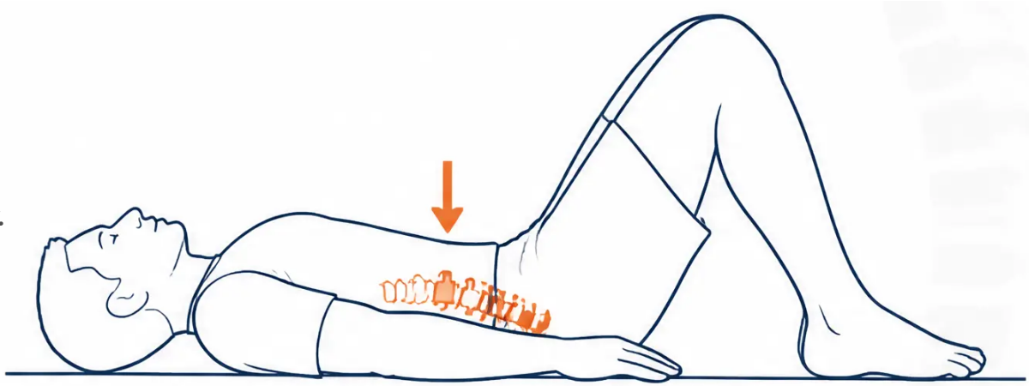





BRADFORD VTS TEACHING DECK
www.bradfordvts.co.uk | June 2026
LOW BACK PAIN
Pelvic Tilt
Core Activation & Lumbar Mobilisation
WHAT IT TREATS
Non-specific low back pain · Lumbar stiffness · Core stability activation
HOW TO DO IT
1. Lie on your back, knees bent, feet flat on the floor.
2. Tighten your stomach muscles — flatten your lower back against the floor.
3. Imagine pressing your belly button gently toward the floor.
4. Hold for 5 seconds. Breathe normally throughout.
5. Relax and repeat.
DOSE
5–10 reps
1–2 × daily
Lower back flattens to floor
Progress to 10-second holds as strength improves
SAFETY TIP
Keep breathing throughout — do not hold your breath.
This exercise can be built into a daily routine.
General advice only | Exclude red flags | Source: Arthritis UK | BRADFORD VTS | www.bradfordvts.co.uk

Slide 29


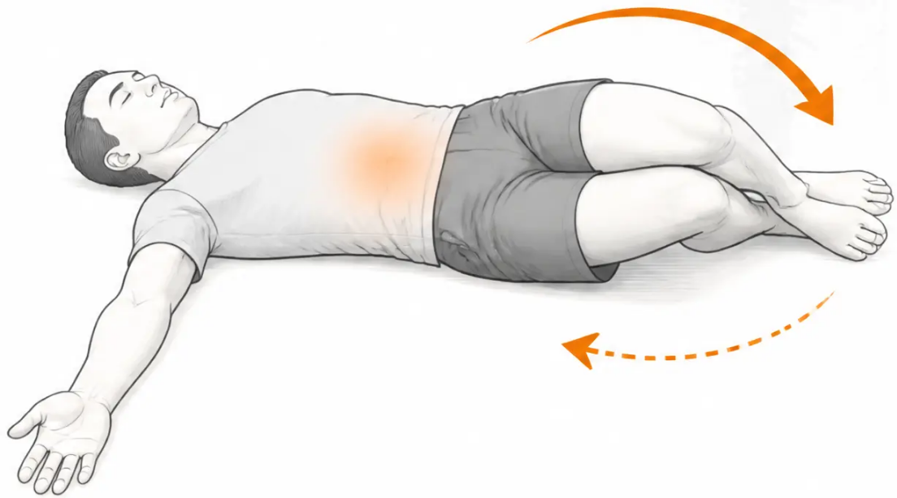





BRADFORD VTS TEACHING DECK
www.bradfordvts.co.uk | June 2026
LOW BACK PAIN
Exercise 2 of 3
Knee Rolls
Lumbar Rotation Stretch
TREATS
Low back pain · Lumbar stiffness · Gentle rotation mobility
HOW TO DO IT
1. Lie on your back, knees bent, feet together.
2. Keep both shoulders flat on the floor.
3. Slowly roll both knees to one side as far as comfortable.
4. Hold for 10 seconds.
5. Return to centre — repeat to the other side.
DOSE
SAFETY
3 reps each side | Daily |
Morning and evening
Shoulders must stay flat. Stop if
shooting or leg pain occurs — may
suggest nerve root involvement.
Keep shoulders flat — roll knees side to side
General advice only | Exclude red flags | Source: Arthritis UK | BRADFORD VTS | www.bradfordvts.co.uk

Slide 30

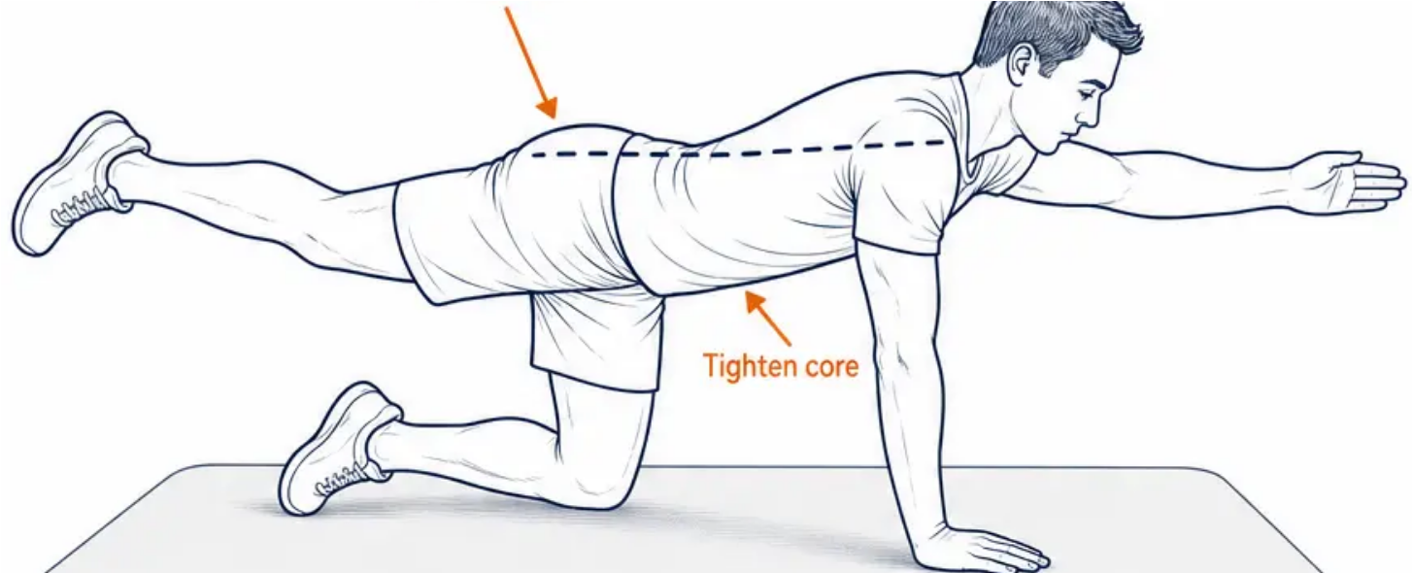


BRADFORD VTS TEACHING DECK
www.bradfordvts.co.uk
June 2026
LOW BACK PAIN
Exercise 3 of 3
Bird-Dog
Back Stabiliser & Core Strengthening
CLINICAL USE
Non-specific low back pain — core stability and
back extensor strengthening
HOW TO DO IT
● Kneel on all fours — back straight and flat,
not arched or drooping
● Tighten your stomach muscles gently
● Slowly raise one arm straight out in front —
hold for 10 seconds, then lower
● Progress: raise the opposite leg behind you
at the same time
10 reps each side | Once or twice daily
Start with arm only — add opposite leg when confident
Keep the pelvis level — do not let it rotate
or drop as you lift. Start with arm only
before adding the leg.
General advice only | Exclude red flags | Source: Arthritis UK | BRADFORD VTS | www.bradfordvts.co.uk

Slide 31

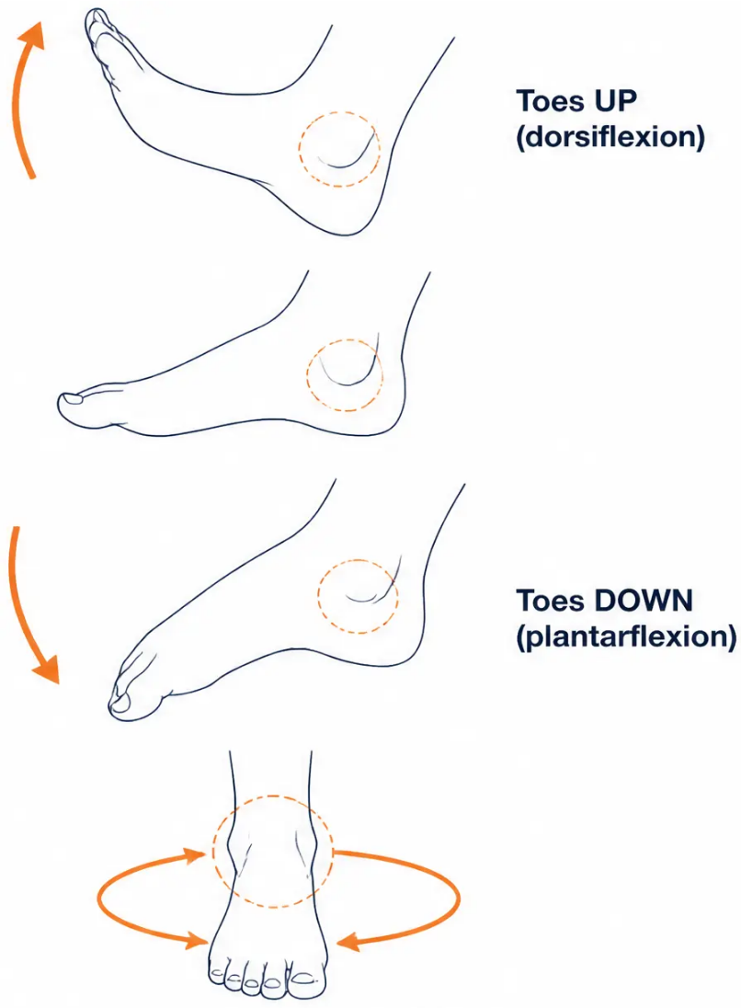







BRADFORD VTS TEACHING DECK
www.bradfordvts.co.uk | June 2026
ANKLE SPRAIN & ANKLE PAIN
EXERCISE 1 OF 3
Ankle Pumps
& Range of Motion
Ankle sprain recovery, ankle stiffness —
restoring joint mobility and reducing swelling
Pump movement:
Bend your ankle upward — pull toes toward you as far as
possible. Then point toes away as far as comfortable.
Repeat in a smooth, rhythmic pump.
Circle movement:
Slowly circle your ankle clockwise 10 times,
then anticlockwise 10 times.
10 pumps
10 circles each way
Several times daily
SAFETY TIP
Start within a pain-free range. Early controlled movement —
not immobility — significantly aids recovery and reduces swelling.
Clockwise × 10 | Anticlockwise × 10
General advice only | Exclude red flags | Source: Arthritis UK | BRADFORD VTS | www.bradfordvts.co.uk

Slide 32

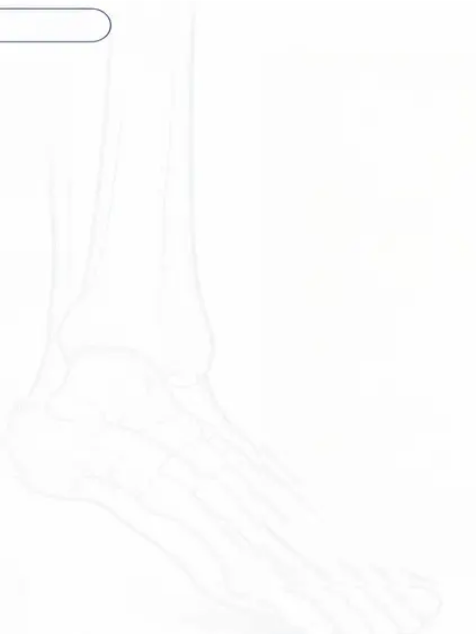

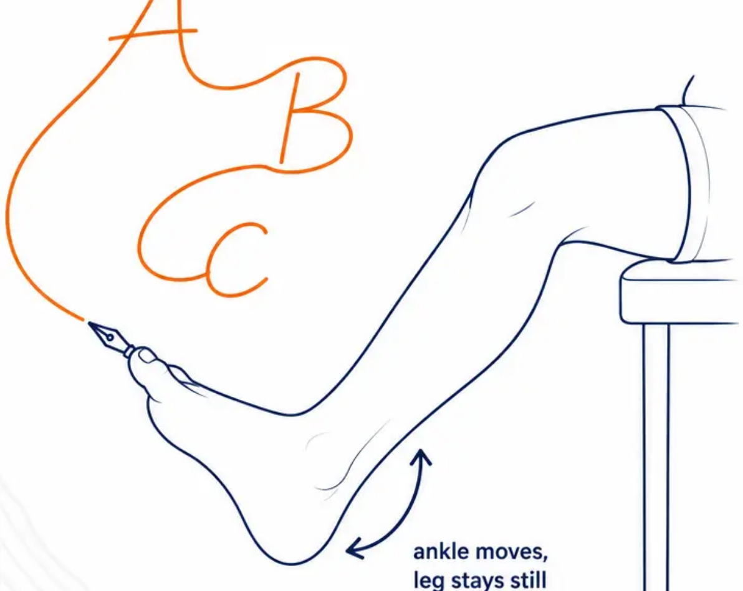


BRADFORD VTS TEACHING DECK
www.bradfordvts.co.uk
June 2026
ANKLE SPRAIN & ANKLE PAIN
Exercise 2 of 3
Ankle Alphabet
Writing
WHAT IT TREATS
Ankle sprain — restoring full range of motion and
proprioceptive warm-up
HOW TO DO IT
Sit with your foot off the floor.
Using your big toe as a pen, write all the letters
of the alphabet in the air.
Move only your ankle joint — not your whole leg.
Make the letters as large as possible.
Full alphabet once
Twice daily
Use the ankle joint only — not the whole leg.
This should feel like a comfortable mobility
exercise, not painful.
General advice only | Exclude red flags | Source: Arthritis UK | BRADFORD VTS | www.bradfordvts.co.uk

Slide 33

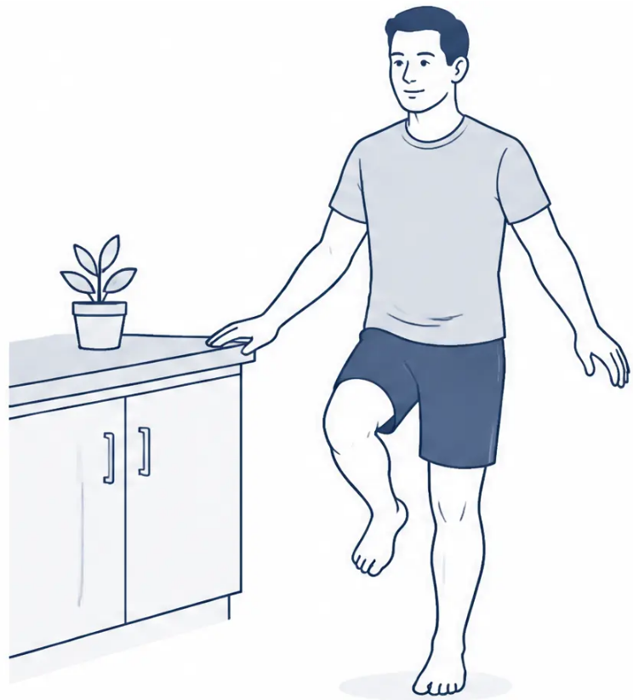
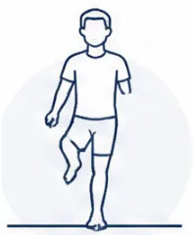
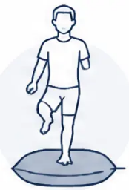
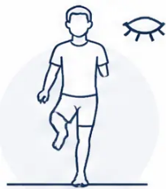





ANKLE SPRAIN & ANKLE PAIN
www.bradfordvts.co.uk | June 2026
EXERCISE 3 OF 3
Single Leg Balance
Proprioception & Re-injury Prevention
WHAT IT TREATS
Ankle sprain rehabilitation — restoring balance, proprioceptive
control, and preventing re-sprain
HOW TO DO IT
● Stand near a counter or stable surface for safety
● Balance on one foot, eyes open — build up to 1 full minute
● Repeat 3 times on each foot
● Progress: balance on a cushion → then try with eyes closed
3 repetitions | Twice daily
Progress: floor → cushion → eyes closed over several weeks
Always have something nearby to grab. Proprioception
training is as important as strength for preventing re-injury.
Floor
Cushion
Eyes Closed
General advice only | Exclude red flags | Source: Arthritis UK | BRADFORD VTS | www.bradfordvts.co.uk

Slide 34





BRADFORD VTS TEACHING DECK
www.bradfordvts.co.uk | June 2026
PLANTAR FASCIITIS
Exercise 1 of 3
Seated Plantar
Fascia Stretch
Most important exercise for plantar fasciitis —
do BEFORE first steps every morning
1 Sit on the edge of the bed before standing up.
2 Cross one foot over the opposite knee.
3 Hold the base of your toes and gently pull
them back toward your shin.
4 Hold for 15–20 seconds. Relax. Repeat 3 times
on each foot.
3 repetitions each foot
Before first steps every morning | Also after
long periods of sitting
This is the single most effective self-management exercise for
plantar fasciitis. Consistent morning use significantly reduces
first-step heel pain.
Best performed before standing —
while still seated on the bed edge
General advice only | Exclude red flags | Source: Arthritis UK | BRADFORD VTS | www.bradfordvts.co.uk

Slide 35









BRADFORD VTS TEACHING DECK
www.bradfordvts.co.uk | June 2026
PLANTAR FASCIITIS
EXERCISE 2 OF 3
Wall Calf Stretch
Gastrocnemius & Soleus — Both Versions
Calf tightness is a primary risk factor for plantar fasciitis — both calf muscles must be stretched
Gastrocnemius Stretch
Soleus Stretch
Back knee straight
Back knee slightly bent
Back knee: fully straight
Back knee: slightly bent
Heel: flat on floor
Heel: flat on floor
Hold: 30 seconds
Hold: 30 seconds
Frequency:
Safety:
Key tip:
10 repetitions of each version |
Version A = gastrocnemius |
Do both versions every session —
they target different muscles
At least twice daily
Version B = soleus | Both must be done
General advice only | Exclude red flags | Source: Arthritis UK | BRADFORD VTS | www.bradfordvts.co.uk

Slide 36











PLANTAR FASCIITIS
www.bradfordvts.co.uk | June 2026
PLANTAR FASCIITIS EXERCISE 3 OF 3
Foot Rolling
Plantar Fascia Self-Massage
Release the plantar fascia — reduce morning stiffness and pain
WHAT IT TREATS
Plantar fasciitis — self-massage to release the plantar
fascia, reduce stiffness and ease heel pain
HOW TO DO IT
Sit down and place a round firm object under the arch of your foot.
Options: a tin of beans, a small ball, or a frozen water bottle.
Slowly roll your foot over the object in all directions.
Apply gentle, comfortable pressure through the arch.
A frozen bottle gives both massage and soothing cold therapy.
DOSE
2–5 minutes | Twice daily
❄️ Frozen bottle especially recommended in the morning
SAFETY TIP
Gentle pressure only — do not force painful spots.
Build up pressure gradually over days.
General advice only | Exclude red flags | Source: Arthritis UK | BRADFORD VTS | www.bradfordvts.co.uk

Slide 37








ACHILLES TENDINOPATHY STRENGTHENING
Exercise 1 of 3
ACHILLES TENDINOPATHY
Double Leg
Heel Raise
Eccentric Calf Loading — Starting Point
TREATS
Mid-portion Achilles tendinopathy — eccentric heel raise to
stimulate tendon collagen remodelling (Alfredson protocol basis)
HOW TO DO IT
1. Stand near a counter or chair for light support
2. Rise slowly onto both tiptoes — take 2 seconds going UP
3. Very slowly lower both heels back down — take 3–4 seconds going DOWN
4. Keep knees straight throughout. The slow lowering IS the treatment.
3 × 15 reps
Twice daily
12 weeks minimum
Safety: Pain up to 5/10 during exercise is acceptable and expected —
this is evidence-based (Alfredson protocol). Pain over 5/10 or not settling
within 24 hours → reduce load. 12 weeks is the minimum — this does
not work if done for only a few weeks.
The eccentric (lowering) phase stimulates tendon remodelling
General advice only | Exclude red flags | Source: Arthritis UK | BRADFORD VTS | www.bradfordvts.co.uk

Slide 38



BRADFORD VTS TEACHING DECK
Slide 38 of 40 — ACHILLES TENDINOPATHY: Exercise 2
www.bradfordvts.co.uk | June 2026
ACHILLES TENDINOPATHY STRENGTHENING
Exercise 2 of 3
Single Leg Eccentric
Heel Drop off Step
Alfredson Protocol — Gold-Standard Achilles Exercise
Treats: Mid-portion Achilles tendinopathy — the gold-standard eccentric
loading exercise for Achilles tendon remodelling.
How to do it
Dose
➊ Stand on the edge of a step on the ball of the
affected foot, heel hanging off the edge.
- 3 sets of 15 repetitions
- Twice daily
- Continue for 12 weeks minimum
➋ Rise up on both feet to the top position.
- Progress: add weight in a backpack
when 3×15 becomes easy
➌ Lift the good foot off the step — now only the
affected foot remains.
➍ Slowly lower the heel below the step level —
3 to 4 seconds down. Use the good foot to
⚠ Safety: Pain up to 5/10 during exercise is acceptable
and expected — this is well-evidenced (Alfredson
⚠ Safety: Pain up to 5/10 during exercise is acceptable and expected — this is well-evidenced (Alfredson
protocol). Pain over 5/10 or not settling within 24 hours → reduce load.
Sudden severe pain or audible snap → stop immediately and seek urgent review
(possible Achilles rupture).
General advice only | Exclude red flags | Source: Arthritis UK | BRADFORD VTS | www.bradfordvts.co.uk

Slide 39






ACHILLES TENDINOPATHY STRENGTHENING
Exercise 3 of 3 | Bradford VTS
ACHILLES TENDINOPATHY
Towel Calf &
Achilles Stretch
WHAT IT HELPS
Achilles tendinopathy — gentle calf and Achilles stretching
to complement the primary strengthening programme
HOW TO DO IT
• Sit on the floor or on a bed with one leg stretched out straight in front of you.
• Loop a towel or resistance band around the ball of your foot.
• Keeping your knee completely straight, gently pull both ends
of the towel toward your body.
• Bend your ankle upward until you feel a firm stretch running up
the calf and along the Achilles tendon.
• Hold for 30 seconds, then relax.
• Repeat on the other foot.
DOSE
3 repetitions each foot
Daily
⚠ SAFETY TIP
This stretch supports — but does not replace — the eccentric
heel raise protocol (Exercises 1 & 2). Advise patients to
complete all three exercises together for best outcomes.
Stretching alone is NOT sufficient for Achilles tendinopathy.
Strengthening (heel drops — Exercises 1 and 2) is the primary
treatment. Use this stretch as a complement, not a replacement.
General advice only | Exclude red flags | Source: Arthritis UK | BRADFORD VTS | www.bradfordvts.co.uk
39 / 40

Slide 40







BRADFORD VTS TEACHING DECK
www.bradfordvts.co.uk | June 2026
CLINICAL SUMMARY
Key Messages for GP Practice
Ten evidence-based takeaways for everyday MSK management
01 Exercise Is Medicine
06 Ankle Sprains — Train Balance
For all common MSK conditions — appropriate
exercise reduces pain and improves function.
Single leg balance is as important as strength.
Proprioception training prevents re-sprain.
02 Signpost to Arthritis UK
07 Back Pain — Move, Don't Rest
Free patient exercise resources at www.arthritis-uk.org —
direct patients there confidently.
Reassure patients gentle movement is safe.
Pelvic tilt, knee rolls, bird-dog are excellent starters.
03 Tendinopathy Needs Time
08 Shoulder — Pendulum + Band
Elbow and Achilles tendinopathy require 8–12 weeks
of progressive loading. Set realistic expectations.
Pendulum swings and resistance band external
rotation are key for most shoulder presentations.
04 Knee OA — Quads First
09 Neck — Chin Tuck for Desk Workers
Quadriceps strengthening (SLR, sit-to-stand, step-ups)
is the single most important intervention.
Chin tuck and hold is especially effective for
postural neck pain and forward head posture.
05 Plantar Fasciitis — Morning Stretch
10 When to Refer to Physio
Stretch before first steps every morning +
calf stretching + foot rolling = core treatment.
No improvement after 6–8 weeks | Post-surgical |
Inflammatory arthritis | Neurological involvement.
Source: Arthritis UK (formerly Versus Arthritis) | www.arthritis-uk.org
BRADFORD VTS | www.bradfordvts.co.uk | June 2026
General advice only | Exclude red flags | Source: Arthritis UK | BRADFORD VTS | www.bradfordvts.co.uk

