Slide 1

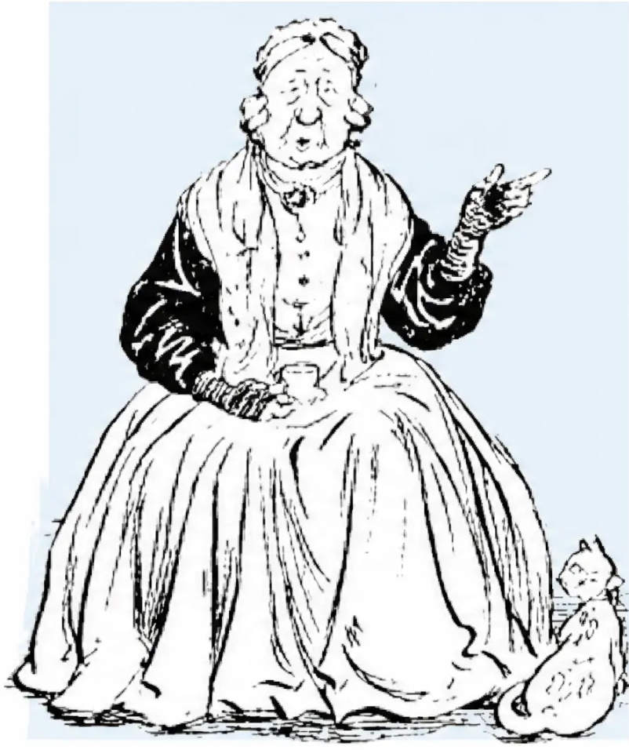

BRADFORD VTS TEACHING DECK
www.bradfordvts.co.uk
Osteoarthritis for GPs
A Clinical Update for GP Trainees (ST1–ST3)
Created June 2026
Updated to current NICE NG226 (October 2022) standards
Replaces CG177 (2014)
This presentation is intended for educational use by GP trainees. Clinical decisionsshould always be made in accordance with current NICE
guidance and local protocols. Content reflects NICE NG226 (October 2022).
www.bradfordvts.co.uk

Slide 2



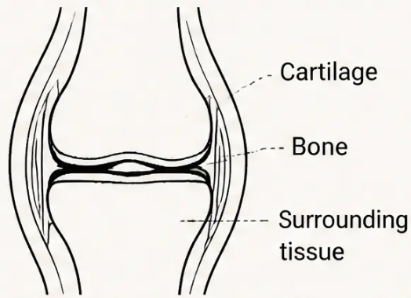






Definition, Pathology & Epidemiology
What OA is — and what it isn't
DEFINITION
PATHOLOGY
EPIDEMIOLOGY
Clinical Syndrome
Wear and Repair
Who Is Affected?
“A clinical syndrome of joint pain
accompanied by varying degrees of
functional limitation and reduced
quality of life”
~7%
of GP population affected
>55
predominant age group
— NICE NG226
2x
knee OA more common
than hip (over-60s)
clinically significant disease
among those with X-ray changes
Pain is biopsychosocial —
not purely structural
10–20%
● Localised loss of cartilage
● Remodelling of adjacent bone
Poor correlation between
X-ray changes and symptoms
● Associated inflammation
Prevalence rising — especially in
women, deprived areas, people
with obesity
● Joint tries to repair itself — living tissue
OA does not
necessarily deteriorate
NOT ‘wear and tear’ —
the joint responds and adapts
~10% in unbearable pain; ~20%
give up hobbies or retire early
www.bradfordvts.co.uk

Slide 3











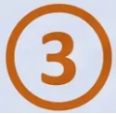

Clinical Diagnosis and Atypical Features
NICE NG226 — Diagnose OA clinically. Imaging is not routinely required.
Diagnose OA Clinically
Atypical Features
If ALL THREE of the following are present — no imaging required
Consider imaging or further investigation if any of these are present
Age ≥ 45 years
Recent history of trauma exclude fracture
Morning stiffness > 30 minutes
suggests inflammatory arthritis
Younger patients require further assessment
ALL THREE ✓
ANY ONE ⚠
Hot, swollen joint exclude septic arthritis
Activity-related joint pain
Pain triggered or worsened by movement
or loading
Rapid worsening of symptoms
investigate promptly
Patient age < 45 years
consider alternative diagnosis
Morning stiffness ≤ 30 minutes
Or no morning stiffness at all
Concerns about infection or malignancy
urgent investigation
Most commonly affected: Knee > Hip > Hand
When in doubt — investigate before labelling as OA
www.bradfordvts.co.uk

Slide 4




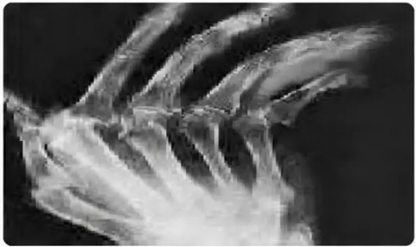
Biopsychosocial History & Examination Findings
NICE NG226 — Assessment Framework
History-Taking
Examination Findings
ICE Framework
KNEE
• Crepitus — hand over patella on rising from sitting
I — Ideas: "What do you think is causing your pain?"
• Genu varum (bow-legged) — medial compartment OA
C — Concerns: "Are you worried about what this might
mean long-term?"
• Fixed flexion deformity in advanced OA
• Joint effusion
E — Expectations: "What were you hoping we could do today?"
HIP
• Reduced internal rotation — early sign
Social
• Reduced external rotation — later
• Pain on active and passive movement
• Impact on work, home, and daily activities
• Trendelenburg test
• Social isolation risk
• Carer wellbeing
HAND
• DIP joints → Heberden's nodes
Psychological
• PIP joints → Bouchard's nodes
• Screen for depression and anxiety
• Squaring at base of thumb (1st CMC joint)
• Sleep quality and psychosocial stressors
• Pain on axial loading through thumb
• Support network
Clinical
Always examine the joint
above AND below — Look,
Feel, Move through full range
of motion.
• Pain duration, nature, flare pattern
• ADLs affected; stiffness after rest
• Comorbidities and current medications
• Attitudes to exercise
X-ray: Hand OA — note joint space changes
www.bradfordvts.co.uk

Slide 5







Differential Diagnoses & Red Flags
Distinguishing OA from other conditions — and recognising what cannot wait
Red Flags
Knee Differentials
Hip Differentials
Inflammatory arthritis (RA, psoriatic)
Polymyalgia rheumatica (PMR)
• Hot swollen joint → Septic arthritis
Gout
Avascular necrosis
• Constitutional symptoms →
Malignancy / Infection
Meniscal disease
Greater trochanteric pain syndrome
Prepatellar bursitis
Fibromyalgia
• History of trauma → Fracture
Fibromyalgia
Meralgia paraesthetica
• Sudden severe pain in stable OA →
Fracture, Gout, Sepsis
Referred pain from lumbar spine
• Rapid unexplained deterioration →
Urgent imaging ± referral
Key Rule: Remember Referred Pain
• Neurological symptoms →
Spinal stenosis / Nerve root
Back problem → hip pain · Hip problem → knee pain
Septic arthritis = same-day urgent review
www.bradfordvts.co.uk

Slide 6








Patient Communication & Prognosis
Changing the narrative — and setting realistic expectations
Wear and Tear
Wear and Repair
“Implies inevitable deterioration —
nothing can be done”
“The joint is living tissue — it tries
to repair itself”
reframe as
“In OA the joint recognises it is wearing and tries to repair itself — but this takes time. We can
help it with exercise, managing load, and sometimes medication.”
Four Common Outcomes — Progression is NOT Inevitable
1
2
3
4
Stays the Same
Gets Worse
Improves
Flares & Remissions
Symptoms remain stable;
no significant change
Only 30% of knee OA
progresses; 25% need hip
replacement after 4 years
Hand OA often settles
after a few years; knee
OA can improve
Most common pattern —
intermittent flare-ups with
periods of remission
www.bradfordvts.co.uk

Slide 7


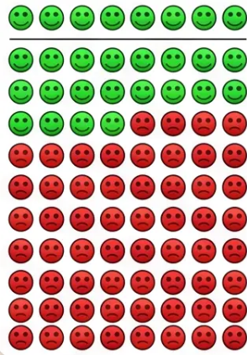
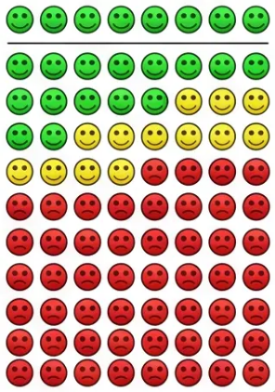














Core Non-Pharmacological Management
NICE NG226 — Offer These FIRST, Before Any Medication
✔ OFFER TO ALL PATIENTS
WITHOUT EXERCISE
WITH EXERCISE
Therapeutic Exercise
Weight Management
Aids & Thermotherapy
FIRST-LINE · NNT = 9
IF OVERWEIGHT/OBESE
• OFFER walking aids for lower
limb OA
• Offer to ALL — regardless of age,
pain severity, or comorbidity
• Any weight loss is beneficial
• Do NOT routinely offer
insoles/braces unless specific
biomechanical indication
• Even 6 kg makes a clinically
significant difference
• Local muscle strengthening +
general aerobic fitness
• Initial exercise pain is normal —
reassure patients
• 10% body weight loss better
than 5%
• Local cold for swelling; heat for
stiffness — patient choice
• Best exercise: whichever the
patient will actually do
• Use motivational interviewing
(DARN technique)
• Manual therapy: ONLY alongside
exercise, NOT standalone
If 100 people with knee OA do exercise, an extra
10 will have significantly less pain after 2 years
✘ DO NOT OFFER (NICE NG226)
Acupuncture
Dry Needling
TENS
Ultrasound Therapy
Interferential Therapy
Laser Therapy
Pulsed Short-wave
NMES
Previous guidance (CG177) recommended TENS — this is now superseded by NG226
www.bradfordvts.co.uk

Slide 8


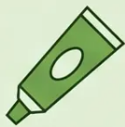


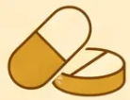



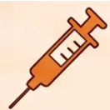
Pharmacological Management
Updated to NICE NG226 — October 2022
FIRST
LINE
Topical NSAID
Meta-analysis: 65% of users
respond vs 30% placebo
• Offer to ALL patients with knee OA — first pharmacological step
• Consider for OA at other joints — as effective as oral NSAIDs, far safer
SECOND
LINE
Oral NSAID
Consider COX-2 inhibitor if high GI risk
(age >65, concurrent steroids/warfarin,
PH of GI ulceration)
• Consider if topical treatment ineffective or unsuitable
• Always co-prescribe a PPI — use lowest dose, shortest time
NG226 change: paracetamol was previously 1st
line (CG177) — this is now superseded
DO NOT
OFFER
Paracetamol • Strong Opioids • Glucosamine
• No routine paracetamol or weak opioids — no strong evidence of benefit in OA (NG226)
• No strong opioids — risks outweigh benefits. No glucosamine or chondroitin.
Do NOT offer hyaluronan (no evidence of benefit)
INTRA-ARTICULAR CORTICOSTEROID INJECTION
• Consider when other pharmacological treatments are ineffective or unsuitable, or to support therapeutic exercise
• Short-term relief only: 2–10 weeks — NNT ≈ 3–5 (excellent evidence for knee OA)
www.bradfordvts.co.uk

Slide 9





Referral for Surgery & Common Pitfalls
NICE NG226 — Section 1.6 | Clinical Assessment, Not Scoring Tools
When to Refer
Common Pitfalls to Avoid
CONSIDER REFERRAL IF BOTH:
1. Labelling all joint pain as OA
● Joint symptoms substantially impact quality of life
(pain, stiffness, reduced function, progressive deformity)
Check age, morning stiffness, hot joint —
could be inflammatory arthritis
2. Paracetamol as default first-line
● Non-surgical management has been ineffective or is unsuitable
NG226: topical NSAID is first-line;
paracetamol not routinely recommended
DO NOT EXCLUDE FROM REFERRAL:
Age
3. Awaiting X-ray before diagnosing
Sex or gender
Diagnosis is clinical — X-ray wastes
time and radiation
Smoking status
BMI or obesity alone
4. Using TENS or recommending acupuncture
NICE does NOT recommend either —
counsel patients who use them
Refer before function is severely compromised —
don't wait too long.
5. Prescribing glucosamine or hyaluronan injections
No evidence of benefit —
NG226 explicitly advises against
⚠ DO NOT OFFER
“Arthroscopic lavage or debridement” — not indicated for OA
NG226 strengthens this to a blanket prohibition
6. Excluding patients from referral due to BMI or age
NG226 explicitly prohibits this —
clinical QoL assessment only
Bradford VTS Teaching Deck — Osteoarthritis for GPs | NICE NG226 (2022)
9 / 10
www.bradfordvts.co.uk

Slide 10



Exam Focus & Quick Recall
AKT · SCA · NICE NG226 (2022)
AKT & SCA EXAM FOCUS
⚡ QUICK RECALL — 10 PEARLS
AKT Key Points
1. Diagnose clinically: ≥45 + activity pain
■ NG226 replaces CG177 — know the key changes
2. Morning stiffness ≤30 min = OA
■ Diagnose clinically: ≥45 + activity pain + stiffness ≤30 min
3. Core: exercise + weight management first
■ First-line pharma: topical NSAID (not paracetamol)
■ No routine paracetamol, glucosamine, strong opioids
4. First pharma: topical NSAID (knee)
■ No TENS, acupuncture, hyaluronan injections
5. No routine paracetamol — NG226 change
■ Steroid injection: short-term 2–10 weeks only
6. No glucosamine, no strong opioids
■ Referral: clinical judgement — NOT scoring tools
■ Do NOT exclude based on BMI, age, or smoking
7. No TENS, acupuncture, hyaluronan
SCA Consultation Skills
8. Steroid injection: 2–10 weeks relief
■ ICE: Ideas · Concerns · Expectations — always explore
9. Referral: clinical assessment, not scores
■ SDM: "Wear and repair, not wear and tear" — reframe prognosis
10. No arthroscopic lavage or debridement
■ Safety-net: Hot swollen joint = same-day review;
sudden worsening = urgent contact
Exercise is medicine. Reframe, reassure, refer wisely.
■ Breaking news: Surgery not inevitable — reassure and empower
NICE NG226 (October 2022) · Bradford VTS · For educational use only
www.bradfordvts.co.uk

