Slide 1


BRADFORD VTS TEACHING DECK
www.bradfordvts.co.uk
OSTEOPOROSIS
Updated to NICE NG38 June 2025 Standards | BNF 2025
Created June 2025
⚠ Disclaimer: Always double check this advice and drug doses with the latest
NICE/BNF guidance. This document is for educational purposes only.
www.bradfordvts.co.uk

Slide 2



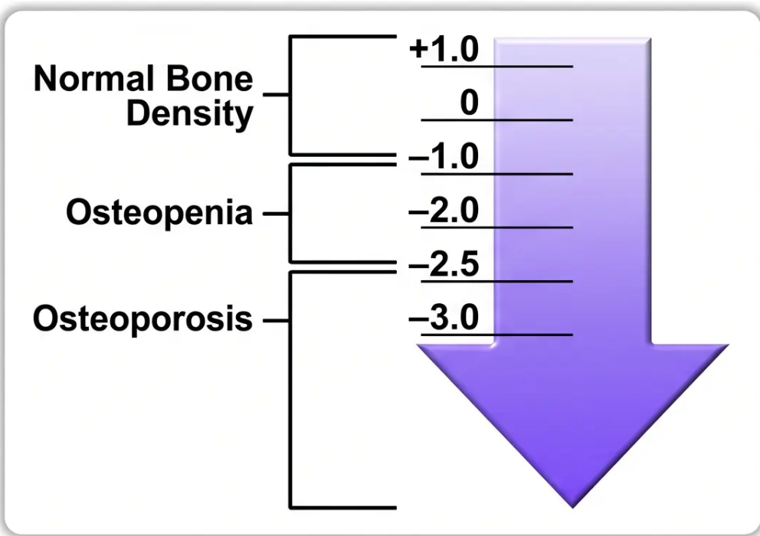


Definitions, Classification & Epidemiology
WHAT IS OSTEOPOROSIS?
“A systemic skeletal disease characterised
by low bone mass and microarchitectural
deterioration of bone tissue, with a
consequent increase in bone fragility and
susceptibility to fracture.” — WHO, 1994
• Affects approximately 3 million people in the UK
• Causes around 500,000 fragility fractures per year
• Most common sites: spine, hip, and wrist (Colles'
fracture)
T-Score Classification — WHO Diagnostic Criteria (BNF/NICE 2025)
Z-score < -2.0 suggests a secondary cause — investigate further.
1 in 2
1 in 5
70,000
£2 billion+
Women over 50 sustain
a fragility fracture
Men over 50 sustain
a fragility fracture
Hip fractures per year
in the UK
Annual cost to the NHS
www.bradfordvts.co.uk

Slide 3









Risk Factors and FRAX Assessment
Non-Modifiable
Modifiable
Secondary Causes
• Age (risk doubles each decade
over 50)
• Low BMI (<19 kg/m²)
Endocrine / Systemic:
• Cigarette smoking
- Glucocorticoids ★★
• Female sex
- Rheumatoid arthritis
• Alcohol >3 units/day ✅
- Type 1 & Type 2 diabetes
• Previous fragility fracture ★
• Physical inactivity
- Hyperparathyroidism, Cushing's
• Parental hip fracture
- Aromatase inhibitors / ADT
• Low calcium / vitamin D intake
• White or Asian ethnicity
Drugs & Other:
• Falls risk
• Early menopause / POI (<45 yrs)
- SSRIs, PPIs (long-term)
• Male hypogonadism
- Coeliac disease, IBD
- Chronic liver / kidney disease
- Parkinson's, dementia, stroke
★ Strongest independent predictor
★★ Most common secondary cause in primary care
FRAX TOOL
Who to Assess
10-Year Fracture Probability Calculator
• Postmenopausal women + men ≥50 with
clinical risk factors
• Calculates risk of hip fracture + major osteoporotic fracture (spine, hip, forearm, shoulder)
• Inputs: age, sex, BMI, prior fracture, glucocorticoids, alcohol, smoking, RA, parental hip fracture
• Women >65 / men >75 (even without risk factors)
• Can incorporate femoral neck BMD for greater precision
• Available at: www.sheffield.ac.uk/FRAX/
• Anyone with prior fragility fracture
• Anyone starting long-term glucocorticoids
⚠ FRAX may underestimate risk in: high-dose glucocorticoids, very elderly, recent fracture, frequent falls
www.bradfordvts.co.uk

Slide 4


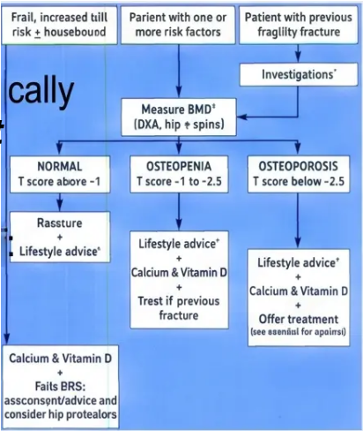


Investigations: DXA and Blood Tests
Excluding secondary causes — what to request and why
Blood Tests — Excluding Secondary Causes
Bone Mineral Density — DXA Scan
– Gold standard for diagnosing osteoporosis
Routine Panel
– FBC, ESR / CRP
– Measures femoral neck and lumbar spine (L1–L4)
– Results as T-score (vs young healthy adult) and Z-score (vs age-
matched peers)
– U&E — renal function
– LFTs — calcium, phosphate, alkaline phosphatase,
albumin, ALT/GGT
– Z-score below –2.0 → suggests secondary cause; investigate further
– TFTs — TSH (thyroid)
– Serum creatinine
When DXA is NOT routinely needed:
Additional if Indicated
– Women over 75 with fragility fracture → treat empirically
– Patient already willing to start treatment without
BMD confirmation
– Vitamin D (25-OH-D) — check before starting
bisphosphonates
– PTH — hyperparathyroidism
– Serum protein electrophoresis + urine Bence Jones
protein — myeloma screen
Vertebral Fracture Assessment (VFA) — indicated if:
– Height loss of 4 cm or more
– Coeliac antibodies (anti-TTG)
– Kyphosis or back pain with osteoporosis risk
– Long-term glucocorticoid therapy
– Testosterone, LH, SHBG — men
– T-score at or below –2.5
– FSH — women if menopausal status unclear
– Lateral thoracic and lumbar spine X-rays — vertebral
fracture identification
DXA-led diagnostic pathway — T-score classification and management
Clinical Pearl: A Z-score below –2.0 means bone loss is worse than expected for the patient’s age — always
investigate for a secondary cause before attributing to age alone.
www.bradfordvts.co.uk

Slide 5

















Management: Lifestyle & First-Line Therapy
Non-pharmacological foundations + NICE NG38 2025 first-line drug protocols
LIFESTYLE FIRST
FIRST-LINE DRUG TREATMENT
For all patients — regardless of drug treatment
Oral bisphosphonates — NICE NG38 2025
Weight-bearing exercise
Alendronic Acid (Alendronate)
FIRST LINE
Walking, jogging, aerobics +
resistance/strength training
Dose: 70 mg orally, once weekly
Licensed for: Postmenopausal osteoporosis · GIOP · Male osteoporosis
How to
Take
⚠️ Administration Rules (exam favourite):
Calcium ≥700 mg/day
- Take fasting, full glass of water
- At least 30 min before first food, drink, or other medication
Dairy, leafy greens, fortified foods.
Supplement only if dietary intake insufficient
— avoid over-supplementing (CV risk)
- Remain upright (sitting or standing) for ≥30 min after taking
Key side effects:
Contraindications: CrCl <30 mL/min
Vitamin D: 800 IU colecalciferol daily
Oesophageal abnormalities
Upper GI (dyspepsia, oesophagitis)
· Inability to sit/stand uprraight
(elderly, housebound — NICE NG187)
· Jaw osteonecrosis (rare)
Hypocalcaemia
· Atypical femoral fracture (long-term)
Stop smoking · Alcohol <14 units/week
Risedronate
ALTERNATIVE FIRST LINE
Both accelerate bone loss and increase
fracture risk
Use if: Alendronate not tolerated
Dose: 35 mg orally, once weekly
Same administration rules as alendronate
Falls prevention programme
⚠️ BEFORE STARTING ANY BISPHOSPHONATE: Correct hypocalcaemia
Home hazard assessment, balance training,
hip protectors in frail patients
Correct hypocalcaemia and vitamin D deficiency first — risk of symptomatic
hypocalcaemia if started when deficient.
www.bradfordvts.co.uk · Bradford VTS Teaching Deck · Osteoporosis · NICE NG38 2025

Slide 6


























Advanced Pharmacotherapy & Specialist Agents
Second-line, hormonal & anabolic options — NICE NG38 2025
Denosumab (Prolia®)
Raloxifene
HRT
Strontium Ranelate
SERM
HORMONAL
2ND LINE
Selective oestrogen receptor
modulator
• Prevention of postmenopausal
osteoporosis
SPECIALIST ONLY
RANK-ligand inhibitor
• 60 mg SC injection every 6 months
• All other options must be
unsuitable
• Consider if age ≤60 + menopausal
symptoms
• Use if bisphosphonate
contraindicated
• 60 mg orally daily
• Cardiovascular risk assessment
required
• Reduces vertebral fracture risk only
• Reduces invasive breast cancer
risk
• Individual risk-benefit assessment
required
• Check calcium before each dose
⚠ "Do NOT stop without specialist
review — rebound fracture risk"
• Continue 5–10 years for fracture
benefit
Not first-line >60 years
⚠ "Contraindicated: history of DVT/PE"
⚠ "May increase MI/thrombosis risk"
Teriparatide (Forsteo®)
⚠ CRITICAL SAFETY ALERTS
Romosozumab (Evenity®)
ANABOLIC — SPECIALIST
NEWEST ANABOLIC — SPECIALIST
NEVER STOP DENOSUMAB ABRUPTLY
Abrupt discontinuation → rapid bone loss
→ multiple vertebral fracture cascade.
Recombinant PTH 1–34 — stimulates bone formation
Anti-sclerostin antibody — dual action: ↑ bone
formation + ↓ bone resorption
• 20 mcg SC injection daily
Always transition to bisphosphonate
~6 months after last dose.
• Maximum 24 months treatment
• 210 mg SC injection once monthly
ROMOSOZUMAB: CV CONTRAINDICATION
• Maximum 12 months treatment
• For severe osteoporosis, multiple vertebral fractures
Absolutely contraindicated in patients
with prior MI or stroke. Always check
cardiovascular history before prescribing.
• Severe postmenopausal osteoporosis
• NICE: T-score ≤ –4, or ≤ –3 with ≥2 fractures
Must follow with antiresorptive therapy after completing course
Must follow with antiresorptive therapy after completing course
www.bradfordvts.co.uk

Slide 7















Glucocorticoid-Induced Osteoporosis (GIOP)
The most common cause of secondary osteoporosis in primary care — act early, act concurrently
When to Start Bone Protection
Stepwise Management
⚡ Start bone protection AT THE SAME TIME as
glucocorticoids — do not wait for BMD to fall
➊ Minimise GC dose — use the lowest effective dose;
consider alternative routes (inhaled, topical, intra-articular)
➋ Calcium + Vitamin D — adjuncts to treatment; not
standalone therapy
● Prednisolone ≥7.5 mg/day for ≥3 months
(or likely to be needed for ≥3 months)
➌ First-line drug: Oral bisphosphonate
• Alendronic acid 70 mg once weekly, OR
• Risedronate 35 mg once weekly
● Any dose in patients aged >70 years
➍ If oral bisphosphonate not tolerated:
IV Zoledronic acid 5 mg once yearly
● Any dose if prior fragility fracture exists
➎ If bisphosphonate contraindicated:
Denosumab as alternative
● High-dose / long-term GC: adjust FRAX upward
— FRAX underestimates GC-related risk
➏ Continue bone protection for the full duration of GC
therapy; review on stopping
Key Investigations in GIOP:
Calcium & Phosphate
Alk Phos + Albumin
FBC, U&E, LFTs, TFTs
Vitamin D (25-OH-D)
DXA scan
Lateral spine X-ray if indicated
Serum paraproteins if myeloma suspected
www.bradfordvts.co.uk
NICE NG38 2025

Slide 8







Monitoring, Red Flags & Common Pitfalls
Follow-up protocols · Clinical warning signs · Prescribing errors to avoid
Monitoring
Red Flags
Common Pitfalls
Follow-up & review schedule
Act promptly — do not miss
Errors to avoid in practice & exams
● 3, 6, 12 months — review adherence
and tolerability
● New back pain + known
osteoporosis/steroids → suspect
vertebral fracture; urgent spinal imaging
✕ Starting bisphosphonates with uncorrected
vitamin D deficiency → hypocalcaemia risk
● Repeat DXA — after 3–5 years of
treatment (sooner if fracture or new
risk factor)
✕ Prescribing etidronate or calcitonin as
first-line — now obsolete (NICE NG38)
● Bone pain + hypercalcaemia →
malignancy (myeloma, metastases,
hyperparathyroidism)
✕ 10 mg alendronate daily instead of 70 mg
once weekly — compliance failure
● Bone turnover markers (CTX) —
>30% reduction confirms
bisphosphonate response
● Fragility fracture + Z-score <–2.0 →
must investigate secondary cause
✕ Not counselling on bisphosphonate
administration (fasting, upright, 30-min wait)
● Acute back pain + neuro symptoms →
rule out cauda equina (urinary/bowel
dysfunction)
✕ Failing to start bone protection when
initiating high-dose glucocorticoids
● Drug holiday review — after 5 years;
low-risk patients: 2-year break;
high-risk: continue to 10 years
✕ Stopping denosumab without bisphosphonate
transition → rebound vertebral fractures
● Multiple new vertebral fractures post-
denosumab → rebound syndrome;
urgent specialist review
● During holiday — continue calcium +
vitamin D; DXA every 2 years
✕ Confusing T-score vs Z-score — T-score =
diagnosis; Z-score <–2 = secondary cause
● After teriparatide / romosozumab —
must start antiresorptive therapy
immediately
● Jaw pain/swelling on bisphosphonate
or denosumab → osteonecrosis of jaw;
refer oral surgery
✕ Using “premature menopause” — correct
term is POI (premature ovarian insufficiency)
✕ Over-supplementing calcium beyond dietary
needs — cardiovascular risk
● Fracture Liaison Services (FLS) —
coordinate post-fracture assessment
● Thigh/groin pain — long-term
bisphosphonate → atypical femoral
fracture; urgent X-ray
✕ Prescribing romosozumab in patients with
prior MI or stroke — absolutely contraindicated
www.bradfordvts.co.uk
NICE NG38 2025

Slide 9







Exam Focus & Quick Recall
High-yield pearls for AKT and SCA — Bradford VTS 2025
AKT EXAM PEARLS
Knowledge
SCA EXAM PEARLS
Consultation
- T-score ≤ -2.5 = osteoporosis; -1 to -2.4 = osteopenia
- ICE: “What do you understand about osteoporosis?”
- Alendronic acid: 70 mg once weekly (not daily)
- Concerns: “What worries you most about these tablets?”
- Oral bisphosphonate not tolerated → IV zoledronic acid 5
mg/year or denosumab 60 mg SC every 6 months
- Safety net: “Stop the tablet and call us if you have chest pain
or difficulty swallowing”
- GC-induced osteoporosis: start bone protection if
prednisolone ≥7.5 mg/day for ≥3 months
- Denosumab counselling: “Please don’t stop this injection
without speaking to us — stopping suddenly can cause serious
spine fractures”
- FRAX = recommended UK fracture risk tool (10-year probability)
- Teriparatide / romosozumab: specialist only; must follow with
antiresorptive therapy
- Breaking news: “Your scan shows your bones are thinner than
we’d like — but we have very effective treatments”
- Denosumab: do NOT stop without specialist review — rebound
fracture risk
- Falls: “Are you worried about falling? We can refer you for a
falls assessment”
- Vitamin D 800 IU daily for elderly/housebound (NICE NG187)
- Shared decision-making: “There are several options — let’s
find what works best for you”
- Etidronate and calcitonin: no longer recommended
- Hip fracture ≥75 years: treat empirically — no DXA needed first
⚡ Quick Recall
T-score ≤ -2.5 = osteoporosis
GC-induced: treat if ≥7.5 mg/day
Alendronate: 70 mg weekly, fasting
Correct vitamin D first
Never stop denosumab abruptly
FRAX: 10-year fracture probability
Etidronate/calcitonin: obsolete
Romosozumab: check MI/stroke history
Hip fracture ≥75: treat without DXA
Drug holiday: review after 5 years
⚠️ Disclaimer: Always double-check this advice and drug doses with the latest NICE/BNF guidance. This document is for educational purposes only.
www.bradfordvts.co.uk
Created June 2025 · Updated to NICE NG38 2025 Standards

