Slide 1





BRADFORD VTS TEACHING DECK
Rheumatoid Arthritis
for GPs
A comprehensive clinical guide for GP trainees (ST1–ST3) and IMGs preparing for AKT and SCA exams.
Created June 2026 • Updated to NICE NG100 (2024) and CKS (2025) standards
⚠ Disclaimer: Always double check this advice and drug doses with the latest NICE/BNF guidance. This document is for educational purposes only.
www.bradfordvts.co.uk
Primary Care Management Series

Slide 2






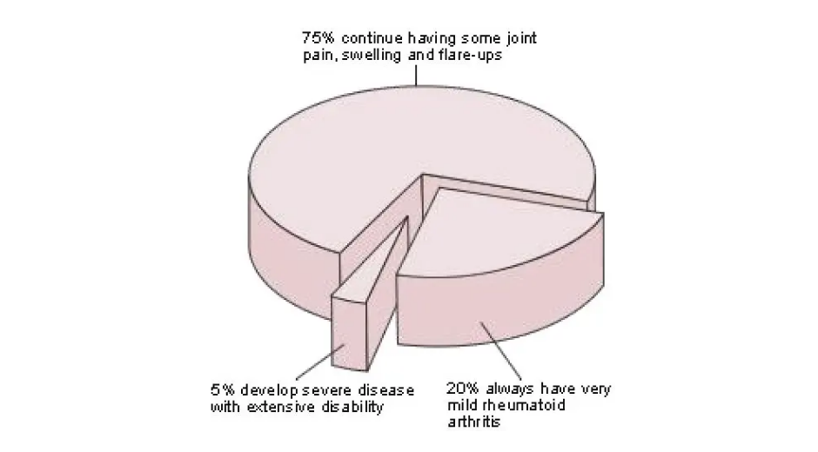




BRADFORD VTS TEACHING DECK
Epidemiology and Overview
~1%
50%
£3,500+
UK Prevalence
Work Disability
Annual NHS Cost
Approx. 700,000 people in England; leading cause of inflammatory arthritis.
Stop work within 10 years of diagnosis without effective modern treatment.
Average cost per patient per year; MSK accounts for 12% of GP consultations.
Disease Nature
RA is a lifelong, progressive autoimmune condition. Synovial inflammation leads to irreversible joint destruction, significant disability, and premature mortality—primarily from accelerated cardiovascular disease.
Demographic Distribution
Women: 3:1 ratio; peak onset during childbearing years (30s–50s).
Men: Peak onset later in life, typically the 6th to 8th decade.
AKT PEARL
Prevalence: 1%
F:M Ratio: 3:1
Women Peak: 30–50s
Men Peak: 60s–70s
www.bradfordvts.co.uk
Rheumatoid Arthritis for GPs

Slide 3


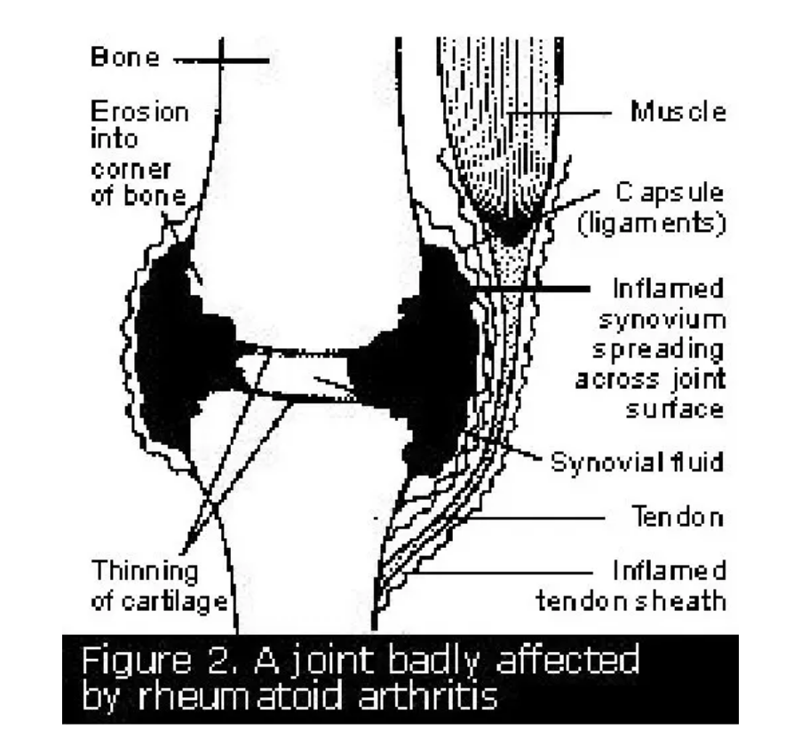







BRADFORD VTS TEACHING DECK
www.bradfordvts.co.uk
Rheumatoid Arthritis for GPs • Slide 3
Pathophysiology: Mechanisms of Joint Destruction
Autoimmune Synovitis
T-cell mediated immune activation leads to chronic inflammation.
Cytokine Storm: High levels of TNF-α IL-1 IL-6
Synovial Pannus: Proliferating synovial tissue invades joint space.
Result: Progressive erosion of cartilage and subchondral bone.
Risk Factors & Triggers
Genetic: Strong association with HLA-DR4; ~30% family history.
Smoking: The most significant modifiable environmental risk factor.
Obesity & Infection: Emerging roles in triggering immune dysregulation.
Joint Architecture: Synovial inflammation and marginal erosions
Seropositive (70%): Positive RF/anti-CCP. Associated with more aggressive disease and extra-articular features.
Seronegative (30%): RF/anti-CCP negative; requires clinical diagnosis of inflammatory arthritis.
AKT Pearl: The ulnar styloid and 5th metatarsal head are common early sites for radiographic erosions.

Slide 4





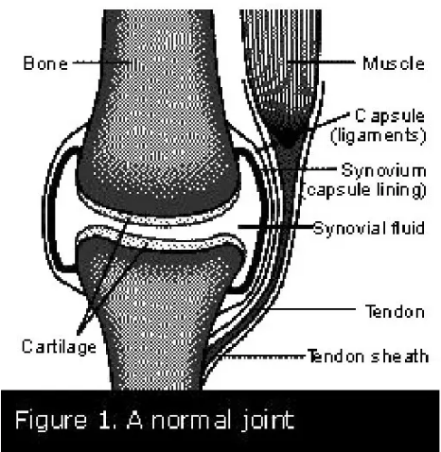




BRADFORD VTS TEACHING DECK
Rheumatoid Arthritis for GPs — Clinical Presentation
www.bradfordvts.co.uk
Clinical Presentation: Identifying RA
Hallmark Features
Key Exam Signs
Insidious onset: Weeks to months progression
Swelling: Soft, boggy, synovial thickening
Morning Stiffness: Persists >30 minutes (Hallmark)
Squeeze Test: Tenderness at MCP or MTP joints
Gel Phenomenon: Stiffness after periods of rest
Reduced Grip: Weakness due to pain/inflammation
Systemic: Fatigue, weight loss, low-grade fever
Joint Distribution
Symmetry: Bilateral involvement is typical
Small Joints: Classically MCP, PIP, and MTP joints
Wrists: Early and frequent involvement
Atypical: TMJ, C1-C2 (neck pain), cricoarytenoids
Reference: Normal joint anatomy. RA target: Synovium.
RED FLAG / SCA TIP
PURPLE AKT BOX
Acute monoarticular swelling in a known RA patient is Septic Arthritis until proven otherwise. "If in doubt, aspirate."
RA typically SPARES the DIP joints. If DIPs are involved, think Osteoarthritis (Heberden’s nodes) or Psoriatic Arthritis.

Slide 5




BRADFORD VTS TEACHING DECK
Rheumatoid Arthritis for GPs — Clinical Differentiation
www.bradfordvts.co.uk
Osteoarthritis vs. Inflammatory Arthritis
Osteoarthritis (OA)
Rheumatoid Arthritis (RA)
PRIMARY JOINTS
PRIMARY JOINTS
DIP, CMC, Knees, Hips
MCP, PIP, MTP, Wrists
ONSET & NATURE
ONSET & NATURE
Gradual, Use-related
Variable; Bilateral & Symmetrical
MORNING STIFFNESS
MORNING STIFFNESS
Brief (<30 minutes)
Prolonged (>30 minutes)
SWELLING TYPE
SWELLING TYPE
Bony (Hard)
Soft (Synovial)
SYSTEMIC FEATURES
SYSTEMIC FEATURES
Absent
Fatigue, Malaise, ±Fever
Clinical Pitfall: Osteoarthritis can co-exist with Rheumatoid Arthritis. Both can present with hot, swollen hand joints in older patients.

Slide 6










BRADFORD VTS TEACHING DECK
2010 ACR/EULAR Classification Criteria
Score ≥ 6 / 10 = Definite Rheumatoid Arthritis
1. Joint Involvement
0–5 Points
2. Serology
0–3 Points
1 medium-large joint
0
Negative RF and negative anti-CCP
0
2–10 medium-large joints
1
Low-positive RF or anti-CCP
2
1–3 small joints (with/without large)
2
High-positive RF or anti-CCP
3
4–10 small joints (with/without large)
3
>10 joints (at least 1 small joint)
5
Small joints: MCP, PIP, MTP 2–5, thumb IP, wrist.
3. Acute Phase Reactants
0–1 Point
4. Duration of Symptoms
0–1 Point
Normal CRP and normal ESR
0
< 6 weeks
0
Abnormal CRP or abnormal ESR
1
≥ 6 weeks
1
PURPLE AKT BOX: EXAM PEARL
Score ≥6 = RA. Most critical factors for diagnostic weight: Small joint involvement + High Seropositivity + Duration ≥6 weeks.
www.bradfordvts.co.uk
Rheumatoid Arthritis for GPs

Slide 7




















BRADFORD VTS TEACHING DECK
Investigations in Primary Care
Serology Interpretation
Baseline Bloods & Monitoring
Test
Sensitivity
Specificity
FBC: Check for anaemia of chronic disease (normocytic) or thrombocytosis.
70%
80%(20% false positives)
U&E / LFT: Mandatory baseline before starting DMARDs to check renal/hepatic function.
Rheumatoid Factor (RF)
ANA: Consider if systemic features suggest SLE or other CTD.
70%
95%(Highly specific for RA)
Uric Acid: Only if gout is a differential; check ≥2 weeks after acute attack.
Anti-CCP (ACPA)
Imaging: X-Ray Hands & Feet
Look for: Soft tissue swelling, periarticular osteoporosis, joint space loss, or erosions (ulnar styloid).
Seronegative RA: RF and Anti-CCP are negative in ~30% of patients.
Inflammatory Markers
Normal in early disease — do not delay referral for X-ray results.
ESR & CRP: Often raised, but may be normal in early or small-joint disease.
PURPLE AKT BOX
Anti-CCP specificity is 95% compared to RF (80%). If clinical suspicion is high and RF is negative, always check Anti-CCP. Both can be negative in seronegative RA.
Use to monitor disease activity and response to treatment.
www.bradfordvts.co.uk
Rheumatoid Arthritis for GPs

Slide 8











BRADFORD VTS TEACHING DECK
The Window of Opportunity and Early Referral
The 12-Week Window
Management While Awaiting Review
URGENT: 3 Working Days
Do not delay referral for results, but initiate relief while waiting:
IM Methylprednisolone 120mg stat
Refer within 3 days if there is a high level of clinical concern + active synovitis.
PREFERRED
Faster onset (~40h), lasts up to 6 weeks.
Short-course Oral Prednisolone: 10mg OD for 2 weeks, then reduce.
Refer to Rheumatology within 12 weeks of symptom onset.
Communication: Always inform the specialist if steroids have been administered as it masks physical signs.
Treat-to-Target (T2T) is most effective when DMARDs are initiated early.
Aggressive early intervention can achieve sustained remission and prevent irreversible joint destruction.
SCA COMMUNICATION TIP
"I'd like to refer you to a specialist today because getting treatment started as soon as possible makes a real difference to long-term outcomes. I'll also organise some blood tests. Do you have any questions?"
Delayed referral significantly worsens long-term functional prognosis.
Referral Letter Essentials
GP Top Tip
Symptoms: Distribution, duration, morning stiffness (min).
Exam: Swelling, tenderness, squeeze test results.
A normal X-ray in early disease is common and should never delay referral. Clinical synovitis with stiffness is the primary trigger for urgent specialist input.
Invests: FBC, CRP/ESR, RF, anti-CCP, ANA, (X-rays if done).
Working Diagnosis: Clearly state suspected RA.
Meds: Analgesia tried and any bridge steroids given.
www.bradfordvts.co.uk
Rheumatoid Arthritis for GPs

Slide 9












BRADFORD VTS TEACHING DECK
Treat-to-Target (T2T) Strategy — NICE NG100
Monitoring Disease Activity
Use validated tools: DAS28 (28-joint count), CDAI, or SDAI.
Review Frequency: Monthly reviews until the target is met.
REMISSION
Escalation Rules
3 MONTHS
Adjust therapy if there is no significant improvement.
The primary goal of treatment for all patients with Rheumatoid Arthritis.
6 MONTHS
Adjust therapy if the primary target has not been achieved.
Shared Care Model
Or lowest possible activity if remission is not achievable.
Specialist: Initiates and adjusts treatment.
General Practice: Monitors safety and coordinates care.
PURPLE AKT BOX: THE T2T PROTOCOL
Target = Remission; Monitoring = DAS28 score; Escalation = Adjust therapy if target not achieved within 3–6 months.
www.bradfordvts.co.uk
Rheumatoid Arthritis for GPs

Slide 10














BRADFORD VTS TEACHING DECK
Non-Pharmacological Management
GP & Rheumatologist
Specialist Nurse
Physiotherapist
THE MDT NETWORK
OT
Podiatrist
Pharmacist
Education & Self-Care
Exercise & Physiotherapy
NICE NG100: Core requirement for all.
Low-impact: Swimming, cycling, walking.
Disease understanding & medication adherence.
Physio-guided strengthening & flexibility.
Self-management strategies for flares.
Hydrotherapy for severe joint pain.
SCA Tip: Explore patient ICE (Ideas, Concerns, Expectations) regarding lifelong treatment early.
Weight management to reduce joint load.
OT & Podiatry
Psychological & Social
OT: Joint protection & adaptive equipment.
Screen for depression/anxiety (PHQ-9/GAD-7).
Functional splints for wrist/hand stability.
Occ Health referral for work adjustments.
Podiatry: Assessment of MTP involvement.
Access to Specialist Nurse helplines.
Footwear advice & orthotic inserts.
Support groups (e.g., NRAS, Versus Arthritis).
www.bradfordvts.co.uk
Rheumatoid Arthritis for GPs — Non-Pharmacological Management

Slide 11









BRADFORD VTS TEACHING DECK
First-Line DMARD: Methotrexate
Dosing & Administration
CRITICAL SAFETY
Weekly, Not Daily: Fatal errors occur with daily dosing.
Mechanism: Antifolate; inhibits dihydrofolate reductase.
Starting Dose: 7.5mg – 10mg ONCE WEEKLY
Tablet Strength: Prescribe 2.5mg tablets (avoid 10mg).
NEVER co-prescribe Trimethoprim or Co-trimoxazole.
Escalation: Increase by 2.5–5mg every 4–6 weeks.
Maintenance: Usually 15mg – 25mg per week.
Maximum: 30mg per week (BNF limit).
Folic Acid Co-prescription
Dose: 5mg once weekly (minimum).
Timing: Give the day AFTER Methotrexate.
Pre-treatment Screen
Alternative: 5mg daily on all days except MTX day.
FBC
U&E
Purpose: Reduces mouth ulcers, nausea, and hepatotoxicity.
LFT
CXR (within 6m)
www.bradfordvts.co.uk
Rheumatoid Arthritis for GPs | Slide 11

Slide 12









BRADFORD VTS TEACHING DECK
Methotrexate Monitoring and Safety
Blood Monitoring Protocol
Pre-treatment: FBC, U&E, LFT, CXR (within 6 months).
Initiation: FBC + U&E + LFT every 2 weeks until stable for 6 weeks.
CLINICAL RED FLAGS
Stable Dose: Monthly for first year, then every 2–3 months.
MTX Pneumonitis: New/worsening dry cough or breathlessness. STOP MTX immediately and refer urgently for CXR/Specialist review.
MCV > 105: Check B12 and folate levels.
Bone Marrow Suppression: Unexplained bruising, bleeding, or severe sore throat. Urgent FBC required.
Mandatory Withhold Criteria
WBC
Neutrophils
PURPLE AKT BOX: CRITICAL SAFETY
< 3.5 × 10⁹/L
< 2.0 × 10⁹/L
Trimethoprim: Never co-prescribe (Fatal interaction).
Weekly Dosing: 2.5mg tablets only; clarify WEEKLY.
Platelets
ALT / AST
Pregnancy: Stop 3 months before conception (M & F).
< 150 × 10⁹/L
> 2× ULN
* Also withhold for unexplained fall in albumin or deteriorating renal function.
www.bradfordvts.co.uk
Rheumatoid Arthritis for GPs

Slide 13







BRADFORD VTS TEACHING DECK
Sulfasalazine and Hydroxychloroquine
Sulfasalazine (SSZ)
Hydroxychloroquine (HCQ)
2–3g / day
Max 5mg/kg/day
DOSING SCHEDULE
CORE PROFILE
Start 500mg OD. Increase by 500mg weekly up to maintenance dose.
Least hepatotoxic DMARD. Often used in Triple Therapy (MTX+SSZ+HCQ). Dose based on real weight to minimize retinal risk.
COMMON SIDE EFFECTS
Nausea / GI
Headache
UPDATED EYE MONITORING (RCOPHTH 2020)
Baseline: VA assessment within 6 months of start.
Orange Urine
Rash
Annual Screening: Starts from Year 5 onwards.
Neutropenia
Low Sperm Count
Exceptions: Annual screening from Year 1 if renal failure (eGFR <30) or high dose (>5mg/kg).
MONITORING REQUIREMENTS
Pre-treatment: FBC, U&E, LFT.
BLOOD MONITORING
Weeks 0–12: FBC/LFT every 2 weeks.
No routine blood monitoring required for HCQ monotherapy.
Months 3–12: FBC/LFT every month.
EXAM ALERT: MONITORING UPDATE
Long-term: Every 3 months thereafter.
Old guidance suggested annual eye screening from Year 1. Current standards (2020+) defer annual screening to Year 5 for low-risk patients. Retinal toxicity is dose and duration dependent.
www.bradfordvts.co.uk
Rheumatoid Arthritis for GPs

Slide 14






BRADFORD VTS TEACHING DECK
Second-Line DMARDs: Leflunomide and Azathioprine
Leflunomide
Azathioprine
Dose: 100mg OD for 3 days (loading - often omitted), then 10–20mg daily maintenance.
Dose: Start at 1mg/kg/day; increase to 2–3mg/kg/day after 4–6 weeks.
Side Effects: Hypertension, diarrhoea, hepatotoxicity, alopecia, and blood dyscrasias.
TPMT Testing: Check Thiopurine Methyltransferase levels before starting to identify risk of severe myelosuppression.
Safety: Extremely long half-life; requires cholestyramine washout if rapid elimination needed.
Side Effects: Nausea, hepatotoxicity, and increased infection risk.
MONITORING REQUIREMENTS
CRITICAL AKT PEARL
FBC, LFT, U&E PLUS Blood Pressure every 2 weeks for 6 months; then every 8 weeks.
Allopurinol + Azathioprine: Allopurinol inhibits xanthine oxidase. Co-prescription risks fatal bone marrow suppression. REDUCE AZA DOSE BY 75% if combined.
PREGNANCY & CONTRACEPTION
Highly teratogenic. Effective contraception required during and for 2 years after stopping (or until washout confirmed by serum levels).
MONITORING REQUIREMENTS
FBC, LFT, U&E every 2 weeks for 2 months; then monthly thereafter (shared care).
www.bradfordvts.co.uk
Rheumatoid Arthritis for GPs

Slide 15













BRADFORD VTS TEACHING DECK
DMARD Monitoring Quick Reference
DMARD
STARTING DOSE
USUAL DOSE
KEY MONITORING
WITHHOLD / STOP RULES
7.5–10mg/week
15–25mg/week
FBC, U&E, LFT
Neut <2, ALT >2×ULN, New breathlessness
Methotrexate
500mg/day
2–3g/day
FBC, LFT
Neut <2, ALT >2×ULN, Unexplained rash
Sulfasalazine
200mg/day
200–400mg/day
Eyes (from Yr 5)
Retinal changes (refer Ophthalmology)
Hydroxychloroquine
10–20mg/day
10–20mg/day
FBC, LFT, BP
ALT >2×ULN, BP elevation, Blood dyscrasia
Leflunomide
1mg/kg/day
2–3mg/kg/day
FBC, U&E, LFT
Neut <2, Significant LFT rise
Azathioprine
AKT PEARL: Never co-prescribe Trimethoprim with MTX (fatal marrow suppression). Allopurinol + Azathioprine = severe toxicity; reduce Aza dose by 75% if combined.
www.bradfordvts.co.uk
Rheumatoid Arthritis for GPs

Slide 16







BRADFORD VTS TEACHING DECK
Biological Therapies and JAK Inhibitors
Indications & Anti-TNF
Mandatory Screening
NICE Criteria: Failed ≥2 csDMARDs (inc. MTX) AND DAS28 ≥5.1.
Latent TB: Mandatory IGRA/T-Spot before starting Biologics.
Anti-TNF Agents: Etanercept, Adalimumab (SC); Infliximab (IV).
Viral Serology: Hepatitis B, Hepatitis C, and HIV.
Mechanism: Rapidly block TNF-α cytokine activity.
Varicella: Check immunity; consider VZV vaccination if negative.
Combination: Most effective when used with Methotrexate.
Malignancy: History of skin cancer or lymphoma requires specialist review.
NICE GUIDELINE
CRITICAL SAFETY
Secondary care initiates only. GP role is monitoring and infection vigilance.
Biologicals can reactivate latent TB. Always check IGRA status in referral notes.
JAK Inhibitors (tsDMARDs)
Primary Care Role
Agents: Tofacitinib, Baricitinib, Upadacitinib (Oral tablets).
Infection Management: Withhold biologic if febrile/sepsis.
VTE RISK Assess venous thromboembolism risk before use.
Vaccinations: Annual Flu/Pneumococcal. No live vaccines.
Education: Ensure patient has Biologic Alert Card.
Herpes Zoster: High risk of shingles reactivation.
Surgical Planning: Coordinate withholding period with specialist.
MHRA 2023: Caution if >65, smoker, or CV risk factors.
SCA TIP
AKT EXAM PEARL
Advise patients: "If you develop a fever or need antibiotics, stop the injection and call us."
JAK inhibitors are "targeted synthetic" (tsDMARDs), not biologicals.
www.bradfordvts.co.uk
Rheumatoid Arthritis for GPs

Slide 17








BRADFORD VTS TEACHING DECK
Managing Acute Flare-Ups
Septic Arthritis: The #1 Priority
Polyarticular Flare Management
Rule out Septic Arthritis in any monoarticular flare in a patient on immunosuppressants.
1. Initial Checks: Verify medication compliance and rule out recent mechanical injury.
"If in doubt, aspirate."
2. Conservative: Increase analgesia (NSAIDs/Paracetamol) and advise strict rest.
Hot, swollen, single joint, systemically unwell, or fever indicates a surgical emergency. Refer to hospital if aspiration skills are not available.
3. Steroids: IM Methylprednisolone (120–160mg) is the preferred route (works in 40h, lasts 6 weeks). Alternative: Oral Prednisolone 10mg reducing over 2 weeks.
4. Liaison: Contact rheumatology helpline and notify them of the steroid dose given.
RED FLAG
SCA TIP: COMMUNICATION
Monoarticular flare + Fever + Immunosuppression =
SEPTIC ARTHRITIS → Same-day hospital referral.
"Flares are unfortunately a normal part of RA. Let's check whether your medication is being taken regularly, and we can organise some blood tests to check everything is stable..."
www.bradfordvts.co.uk
Rheumatoid Arthritis for GPs

Slide 18





BRADFORD VTS TEACHING DECK
Extra-Articular Manifestations
Common Systemic Features
Serious & Specialist Concerns
Cardiovascular Risk
Pulmonary Involvement
≥2× risk of MI/stroke vs general population; systemic inflammation accelerates atherosclerosis.
Diffuse interstitial lung fibrosis, pleural effusions, and MTX-induced pneumonitis.
Constitutional & Hematological
C1–C2 Instability
Profound fatigue, anemia of chronic disease (normocytic), and weight loss.
Atlanto-axial subluxation → risk of cervical myelopathy. Critical Peri-op Risk
Soft Tissue & Bone
Ocular Inflammation
Rheumatoid nodules (extensor surfaces), Carpal Tunnel, and Osteoporosis (30% prevalence).
Episcleritis and scleritis (presents with deep, boring pain; requires urgent referral).
Ocular Overlap
Vasculitis & Skin
Secondary Sjögren's Syndrome (dry eyes/mouth) in up to 30% of patients.
Skin ulceration, peripheral gangrene, and mononeuritis multiplex.
RED FLAGS: URGENT ACTIONS
MTX Pneumonitis: New breathlessness/dry cough in patient on Methotrexate → STOP MTX, urgent CXR.
Scleritis: New visual symptoms or deep ocular pain → Urgent Ophthalmology review.
C1–C2 Risk: Neck pain + neurological symptoms (tingling/weakness) → Urgent MRI for subluxation.
www.bradfordvts.co.uk
Rheumatoid Arthritis for GPs

Slide 19












BRADFORD VTS TEACHING DECK
Systemic Corticosteroids in RA
Strategic Role & Bridging
Osteoporosis Prophylaxis
Primary Role: Bridge therapy while waiting for DMARDs to take effect (often 6-12 weeks).
The "3-Month" Rule: Any patient on steroids for ≥3 months (any dose) requires prophylaxis.
Flare Management: Rapidly reduces acute inflammation and improves functional ability.
Standard Protocol: Bisphosphonate (e.g., Alendronate) + Calcium (1000mg) + Vitamin D (800 IU).
NICE NG100 Warning: Should NEVER be started as sole long-term monotherapy without a DMARD.
NICE NG187: Essential for protecting bone density in chronic inflammatory states.
Dosing Regimens
Monitoring & Side Effects
Route
Standard Dosing Strategy
Metabolic: Hyperglycaemia (Steroid Diabetes), Weight gain, Hypertension.
ORAL
Prednisolone 10–15mg OD; reduce to 5–7.5mg over 2–4 weeks as DMARD begins to work.
Ocular: Cataracts, Glaucoma risk.
IM
Methylprednisolone 120mg (buttock). Works within 40h, lasts 6 weeks. Preferred for adherence.
Other: Adrenal suppression, Skin atrophy, Immunosuppression, Avascular necrosis.
JOINT
Intra-articular (sterile technique) for 1-2 joints. Limit to <3–4 times per year per joint.
NICE NG100: Prednisolone doses >10mg/day are rarely indicated for long-term RA management.
www.bradfordvts.co.uk
Rheumatoid Arthritis for GPs

Slide 20








BRADFORD VTS TEACHING DECK
GP Annual Review and QOF
QOF & Registry Requirements
Targeted Screening
RA Register: Maintain accurate list of all patients with RA.
QRISK3: Annual CV risk for ages 30–84 (RA = separate factor).
Annual Review: 15-minute face-to-face review coded annually.
FRAX Score: Osteoporosis risk assessment every 2 years (50–90y).
Mental Health: Screen for depression using PHQ-9 (common co-morbidity).
Immunisation: Annual Flu; Pneumococcal (once or 5y repeat).
Shingles: Use Shingrix (non-live) for immunosuppressed.
Functional Status: Assess joint counts, pain, and functional ability.
Medication & Shared Care
Monitoring: Review cumulative FBC/LFT/CRP trends over the year.
PURPLE AKT BOX: HIGH-YIELD REVIEW
Compliance: Discuss side effects and DMARD adherence.
QRISK3 must be used (not QRISK2); RA CV risk ≈ Diabetes.
Reproductive Health: Advice for MTX/Leflunomide users (preconception).
Live Vaccines (Zostavax) are CONTRAINDICATED with biologics.
Check HbA1c annually if patient is on long-term steroids.
FRAX requires RA to be ticked as a specific clinical risk factor.
www.bradfordvts.co.uk
Rheumatoid Arthritis for GPs

Slide 21









BRADFORD VTS TEACHING DECK
Cardiovascular Risk and Bone Health
Managing systemic risk and proactive screening for osteoporosis.
Cardiovascular Risk
Bone Health
Doubled Mortality Risk
30% Osteoporosis Prevalence
RA independently doubles MI/Stroke risk via systemic inflammation accelerating atherosclerosis.
Driven by active inflammation, reduced mobility, and frequent corticosteroid use.
Annual QRISK3 Screening
FRAX Assessment
Mandatory for ages 30–84. QRISK3 includes RA as a separate variable (unlike QRISK2).
Every 2 years for patients aged 50–90. Includes RA as a specific risk variable.
RA Risk Factor = Diabetes Risk Factor
DEXA scan if FRAX indicates high risk
Aggressive Management
Prophylaxis Protocol
Stricter control of BP, lipids (statins), and smoking cessation. Screen for steroid-induced diabetes (HbA1c).
Bisphosphonates if steroids ≥3 months. Advise Calcium 1000mg + Vit D 800 IU daily for all.
www.bradfordvts.co.uk
Rheumatoid Arthritis for GPs

Slide 22








BRADFORD VTS TEACHING DECK
DMARDs in Pregnancy and Contraception
Teratogenic DMARDs (Stop!)
Safe / Compatible Options
Methotrexate (MTX): Highly teratogenic. Must stop 3 months before conception.
Hydroxychloroquine: Safe throughout pregnancy and during breastfeeding. No monitoring changes.
Applies to both male and female partners. Effective contraception mandatory while on treatment.
Sulfasalazine: Safe to continue. Crucial: Increase Folic Acid to 5mg OD.
Leflunomide: Stop 2 years before conception OR follow a formal cholestyramine washout protocol.
Note for Men: Sulfasalazine can cause reversible oligospermia (low sperm count).
Washout confirmed by two plasma drug level tests 14 days apart (< 0.02 mg/L).
Biologics: TNF-inhibitors (e.g., Certolizumab) are generally safe to continue in early pregnancy.
AKT PEARL
Pre-conception Planning
BSR 2023/2025: MTX requires a 3-month washout for both genders. If accidental pregnancy occurs on MTX, stop immediately and refer for urgent fetal medicine review.
Review all medications before conception.
Target: Lowest possible disease activity for at least 3–6 months prior to pregnancy.
Breastfeeding: MTX and Leflunomide are contraindicated. HCQ and SSZ are safe.
www.bradfordvts.co.uk
Rheumatoid Arthritis for GPs — Slide 22

Slide 23







BRADFORD VTS TEACHING DECK
Top Tips for GPs: High-Yield Clinical Pearls
The Window of Opportunity
Methotrexate Safety
Long-Term GP Role
Prescribe ONCE WEEKLY only. Use 2.5mg tablets to avoid confusion and daily dosing errors.
Aggressive CV Risk Management: Use QRISK3 (not QRISK2) annually. RA risk is equivalent to Diabetes.
Refer URGENTLY within 3 working days if there is clinical suspicion of active synovitis.
Always co-prescribe Folic Acid (usually 5mg) to be taken the day after the methotrexate dose.
Bone Health: Perform FRAX assessment every 2 years for patients over 50. Steroids >3 months need protection.
The target is to start DMARDs within 12 weeks of symptom onset to prevent irreversible joint damage.
Check for drug interactions: Trimethoprim and Co-trimoxazole must be avoided (fatal bone marrow suppression).
Don't delay referral for blood results or X-rays; clinical diagnosis of synovitis is the primary trigger for specialist review.
Mental Health: Screen for depression (PHQ-9) at every annual review; chronic pain and disability have high psychiatric co-morbidity.
STOP MTX if new dry cough or breathlessness (suspect pneumonitis).
www.bradfordvts.co.uk
Rheumatoid Arthritis for GPs

Slide 24


BRADFORD VTS TEACHING DECK
Exam Pearls: AKT
2010 ACR/EULAR Classification Criteria
01
Threshold: A score of ≥6/10 is required to classify as definite RA.
Weighting: Small joint involvement (MCP/PIP/MTP) and high-positive serology (RF/ACPA) carry the highest weight.
Serology: Anti-CCP (ACPA) is far more specific (95%) than Rheumatoid Factor (80%).
High-Yield DMARD Safety (Methotrexate & Azathioprine)
02
MTX Dosing: Always WEEKLY. Prescribe 2.5mg tablets. Folic acid 5mg weekly (day after MTX).
Fatal Interaction: Never co-prescribe Trimethoprim or Co-trimoxazole with Methotrexate.
Aza + Allopurinol: Reduce Azathioprine dose by 75% to avoid severe marrow suppression.
Screening Protocols & Long-term Health
03
HCQ Eye Screening: Royal College of Ophthalmology (2020) — starts at Year 5 (not Year 1).
Cardiovascular: Use QRISK3 (includes RA). RA doubles MI/Stroke risk (comparable to diabetes).
Vaccination: Annual flu + pneumococcal. Only Shingrix (non-live) is safe for immunosuppressed.
www.bradfordvts.co.uk
Rheumatoid Arthritis for GPs

Slide 25









BRADFORD VTS TEACHING DECK
Exam Pearls: SCA
Communication & ICE
Methotrexate Counseling
Explore Impact: "How is this stiffness affecting your ability to work or care for your kids?" (High morbidity).
Weekly Dosing: Essential safety check. "Take on the same day once a week." Prescribe 2.5mg tablets only.
Sharing Diagnosis: Be clear but hopeful. Emphasize that early treatment prevents permanent joint damage.
Folic Acid: Take the day after (or 6 days a week). Reduces nausea and mouth ulcers.
Addressing Concerns: Patients often fear being "wheelchair-bound"; reassure with modern "Treat-to-Target" outcomes.
Interactions: Avoid Trimethoprim (fatal bone marrow suppression risk). Limit alcohol.
SCA SCRIPT TIP
Monitoring: Frequent blood tests are required (FBC/LFT/U&E) for safety.
"I'd like to refer you to a specialist today because starting treatment as soon as possible makes a real difference to long-term outcomes."
Pregnancy & Contraception
Shared Decision Making
Teratogenicity: MTX and Leflunomide are highly harmful to the fetus.
Referral Urgency: Explain the 3-day urgent referral if synovitis is active. Don't wait for bloods to refer if clinically certain.
The 3-Month Rule: Both men and women must stop MTX at least 3 months before attempting conception.
MDT Involvement: Mention the specialist nurse helpline, physio, and OT to show holistic primary care management.
Effective Contraception: Must be used throughout treatment. Check patient's current method in the exam.
Safety Netting: Explicitly counsel on Septic Arthritis (hot/single joint) and MTX side effects.
Washout: Leflunomide may require a 2-year wait or a specific drug washout period.
www.bradfordvts.co.uk
Rheumatoid Arthritis for GPs — Exam Pearls: SCA

Slide 26









BRADFORD VTS TEACHING DECK
Red Flags in RA: Critical Clinical Actions
Septic Arthritis
URGENT
Trigger: Hot, swollen, single joint + fever/systemic illness in an immunosuppressed patient.
"If in doubt, aspirate."
ACTION: Same-Day Hospital Referral
Methotrexate Pneumonitis
Trigger: New or worsening breathlessness or a persistent dry cough in a patient taking MTX.
High mortality risk if treatment is not ceased immediately.
ACTION: STOP MTX, Urgent CXR, Urgent Referral
Cervical (C1-C2) Instability
Trigger: Neck pain + neurological symptoms (clumsiness, paresthesia, gait change).
Critical peri-operative risk for anaesthesia.
ACTION: Urgent MRI Spine & Neurosurgical Review
Ocular & Vascular Emergencies
Scleritis/Episcleritis: Severe eye pain or vision change.
Vasculitis: Skin ulceration, peripheral gangrene, or mononeuritis multiplex.
ACTION: Specialist Review (Ophthalmology/Rheumatology)
www.bradfordvts.co.uk
Rheumatoid Arthritis for GPs — Red Flags

Slide 27







BRADFORD VTS TEACHING DECK
Common Pitfalls in GP Practice
Delaying Urgent Referral
Live Vaccine Contraindication
Waiting for X-ray erosions or serology (RF/CCP) before referring. NICE/BSR emphasize clinical synovitis as the key trigger.
Giving live vaccines (e.g., Zostavax shingles vaccine) to patients on biologics or immunosuppressants.
Fact: X-rays are often normal in early RA
Action: Use non-live Shingrix instead
Methotrexate Dosing Errors
The "Just a Flare" Fallacy
Prescribing daily instead of ONCE WEEKLY, or using 10mg tablets. High risk of fatal bone marrow toxicity.
Treating a hot, swollen monoarticular joint as a simple RA flare without excluding Septic Arthritis.
Safety: Prescribe 2.5mg tablets only
Rule: If in doubt, aspirate urgently
Fatal Antibiotic Interaction
Underestimating CV Risk
Co-prescribing Trimethoprim or Co-trimoxazole with Methotrexate. Both are folate antagonists; combination can be lethal.
Using QRISK2 or failing to assess yearly. RA independently doubles the risk of MI and stroke (comparable to diabetes).
Risk: Severe bone marrow suppression
Update: Use QRISK3 for all RA patients
www.bradfordvts.co.uk
Rheumatoid Arthritis for GPs

Slide 28














BRADFORD VTS TEACHING DECK
Referral: When and How
Urgent Referral (NICE NG100)
High-Quality Referral Letter
Refer URGENTLY within 3 working days if:
Symptoms & History
Very high level of clinical concern (suspicion of RA).
Distribution of joints, duration of stiffness (>30 mins), systemic features (fatigue).
AND active synovitis (swelling) is present.
Positive squeeze test / persistent morning stiffness.
Examination Findings
Document specific joint swelling, tenderness, and Squeeze Test results.
The 12-Week Window
Investigations (even if pending)
For all suspected inflammatory arthritis:
FBC, CRP, ESR, RF, and Anti-CCP. Note: 30% are seronegative.
Aim for rheumatology review within 12 weeks of onset.
Management to Date
Early DMARD initiation → significantly better long-term prognosis.
NSAIDs used, efficacy, and any bridging steroids (dose/route/timing).
Do not wait for X-ray or blood results if suspicion is high.
Impact on Function
CRITICAL: If you have given steroids (IM/Oral) for symptom relief, YOU MUST document the dose and date in the referral.
ADLs, work status (50% stop work within 10 years without T2T).
www.bradfordvts.co.uk
Rheumatoid Arthritis for GPs

Slide 29





BRADFORD VTS TEACHING DECK
Quick Recall: 12 Key Clinical Facts
1
Epidemiology: Affects ~1% of UK population; 3:1 female-to-male ratio.
7
Fatal Interaction: Never co-prescribe MTX with Trimethoprim/Co-trimoxazole.
2
Hallmark: Morning stiffness >30 mins; symmetrical small joint involvement.
8
HCQ Eyes: Retinal screening starts at Year 5 (RCOphth 2020 update).
3
Serology: Anti-CCP is 95% specific; RF is 80% specific (30% are seronegative).
9
Septic Arthritis: Hot mono-joint in immunosuppressed = Emergency.
4
Diagnosis: 2010 ACR/EULAR score ≥6/10 classifies as definite RA.
10
CV Risk: QRISK3 yearly; RA cardiovascular risk equivalent to Diabetes.
5
Window: Urgent referral & DMARDs within 12 weeks of symptom onset.
11
Pregnancy: Stop MTX/Leflunomide 3 months before conception (both partners).
6
Methotrexate: Prescribe WEEKLY (2.5mg tabs); Folic acid 5mg day after.
12
Vaccines: Annual Flu; Pneumo once; Avoid live vaccines on Biologics.
www.bradfordvts.co.uk
Rheumatoid Arthritis for GPs

Slide 30














BRADFORD VTS TEACHING DECK
Final Disclaimer and Resources
Essential Resources
NICE NG100 & CKS RA
Guidelines
⚠ Disclaimer: Always double check this advice and drug doses with the latest NICE/BNF guidance.
BNF / NICE Formulary
Dosing
BSR 2025 Guidelines
This teaching deck is for educational purposes only. Clinical management should always be tailored to the individual patient and guided by current local and national protocols.
Specialist
www.bradfordvts.co.uk
Teaching
Created June 2026. Data accurate to NICE NG100 (2024) / CKS April 2025 standards.
QRISK3 / FRAX Tools
Assessment
www.bradfordvts.co.uk
Rheumatoid Arthritis for GPs

