Slide 1

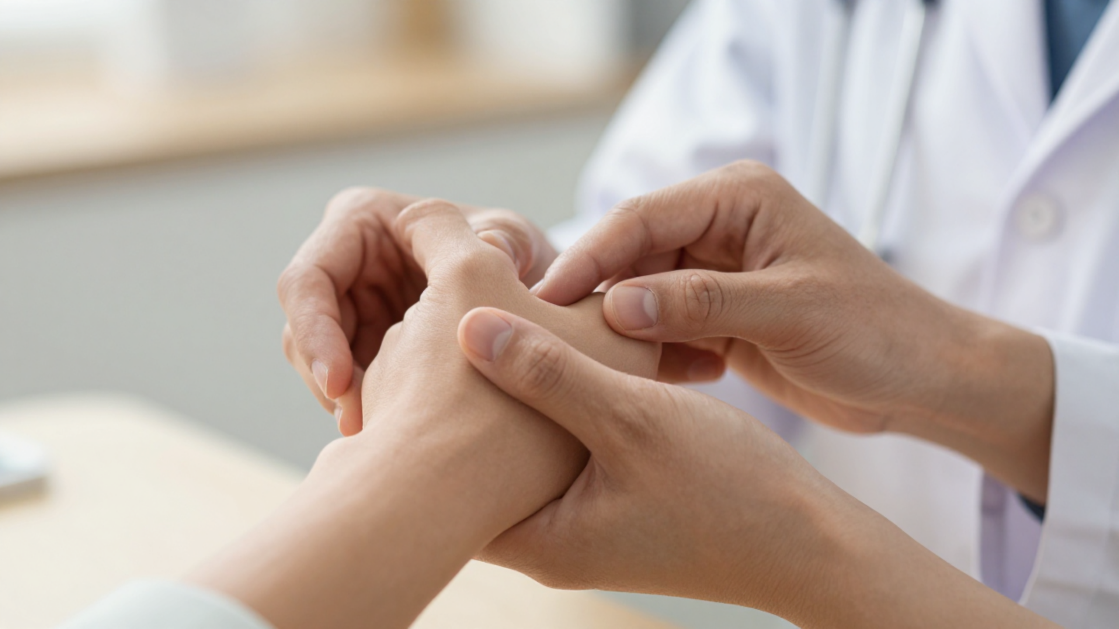







BRADFORD VTS TEACHING DECK
General Rheumatology in Primary Care — A Case-Based Approach
Comprehensive overview for GP trainees preparing for AKT and SCA examinations.
NICE CKS STANDARDS
BSR GUIDELINES
BNF 2025
⚠ DISCLAIMER: Always double check this advice and drug doses with the latest NICE/BNF guidance. This document is for educational purposes only and reflects standards as of June 2026.
www.bradfordvts.co.uk
Created June 2026 • GP Training Resources

Slide 2

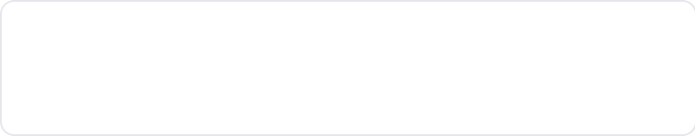
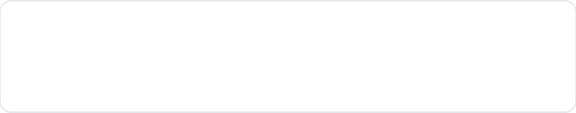
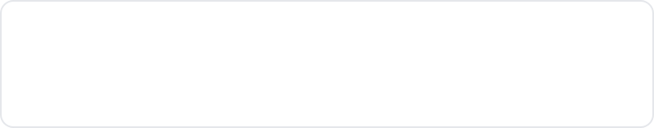






















BRADFORD VTS TEACHING DECK
Rheumatology Landscape and Diagnostic Framework
CLINICAL FRAMEWORK & NICE/BSR STANDARDS
12% of all GP consultations are for MSK disorders
~25 Million people in UK have an MSK complaint
3rd Most Common reason for consulting in Primary Care
1
Articular vs Periarticular
AKT KNOWLEDGE BOX
Feature
Inflammatory
Non-Inflammatory
Is the pathology inside the joint (synovium) or in the surrounding soft tissues?
Morning Stiffness
>30 min (often hours)
Brief (<30 min)
Swelling
Soft (synovial)
Bony / Minimal
2
Inflammatory vs Non-inflammatory
Differentiating autoimmune/crystal disease from degenerative/mechanical issues.
Effect of Rest
Worse (gel phenomenon)
Better
Blood Tests
Raised CRP / ESR
Normal markers
3
Joint Distribution Pattern
Mono (1), Oligo (2-4), or Polyarticular (5+). Bilateral or asymmetrical?
Examples
RA, Gout, PMR
OA, Soft Tissue
General Rheumatology in Primary Care
www.bradfordvts.co.uk

Slide 3










BRADFORD VTS TEACHING DECK
www.bradfordvts.co.uk
Case 1: Acute Monoarthritis Framework
CLINICAL FRAMEWORK & NICE/BSR STANDARDS
Clinical Presentation
Diagnostic Approach
01
"46-year-old man, sudden onset pain, redness, and swelling of the right knee; no preceding injury."
History
Onset speed, fever, skin breaks, recent infection, STI risk, travel, medications (diuretics).
02
Examination
POSH-G Mnemonic for ACUTE MONOARTHRITIS
Systemic temperature, joint heat, swelling, erythema, range of movement.
03
P
Palindromic rheumatism
Investigations
Bloods: FBC, CRP/ESR, Urate, Glucose. Blood cultures if septic arthritis suspected.
O
Osteoarthritis (Acute flare with effusion)
04
Joint Aspiration — GOLD STANDARD
S
Septic arthritis (Must exclude first)
Urgent Gram stain, culture, and crystal microscopy.
H
Haemarthrosis (Anticoagulants, trauma)
05
Imaging
X-ray: Check for chondrocalcinosis, erosions, or soft tissue swelling.
G
Gout / Pseudogout (CPPD)
SEPTIC ARTHRITIS ALERT
Single hot swollen joint + fever + systemically unwell = ADMIT same day. Never inject steroids into a joint before excluding infection.
General Rheumatology in Primary Care

Slide 4





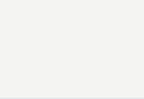









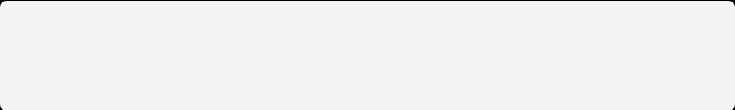
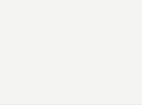


BRADFORD VTS TEACHING DECK
Case 2: Chronic Polyarthralgia Patterns
CLINICAL FRAMEWORK & NICE/BSR STANDARDS
Case Scenario: 35-year-old woman, 6 months increasing hand pain; family history of arthritis; job security concerns.
SAVER-P Mnemonic
Arthritis by Age and Sex
SLE (Multi-system, young women, photosensitivity)
Age Group
Males
Females
Arthritis seronegative (Psoriatic, AS, Reactive)
Young
Reactive arthritis, Ankylosing spondylitis, Psoriatic arthritis
SLE, Rheumatoid arthritis
Viral (Typically self-limiting; check serology)
Middle Age
Gout, Rheumatoid arthritis
Early OA (DIP, CMC joints; older patients)
Rheumatoid arthritis, Sjögren's, Generalized OA
Rheumatoid arthritis (Small joint, bilateral, stiffness)
Elderly
Pseudogout, PMR, Malignancy
PMR, Osteoarthritis
Post-viral arthritis (Parvovirus B19, Hep B/C)
General Rheumatology in Primary Care
www.bradfordvts.co.uk

Slide 5





















BRADFORD VTS TEACHING DECK
Case 3: Widespread Myalgia and the Tired Patient
CLINICAL FRAMEWORK & NICE/BSR STANDARDS
DIFFERENTIAL DIAGNOSES
S
Statins — Myopathy
DIFFERENTIAL MNEMONIC
Very common; check CK; onset correlates with statin initiation; dose-dependent
STAMP
HF
T
Thyroid Disease — Hypothyroidism
Proximal myopathy, fatigue, weight gain, cold intolerance; check TSH
A
Anaemia — Any Cause
Fatigue, myalgia, pallor; check FBC; identify underlying aetiology
M
Malignancy — Occult Cancer
Weight loss, night sweats, lymphadenopathy; don't miss in atypical elderly presentation
Statins · Thyroid · Anaemia
Malignancy · PMR
Hypermobility · Fibromyalgia
P
PMR — Polymyalgia Rheumatica
Age >50; bilateral shoulder/pelvic girdle; ESR & CRP markedly raised; dramatic response to prednisolone
H
Hypermobility / Fibromyalgia
Central sensitisation; diffuse tender points; all investigations normal; NICE NG193
Case: 65F — 6 months of muscle pain in both arms, back & legs. Overwhelming tiredness. Normal examination.
F
Fibromyalgia — Central Sensitisation
Diagnosis of exclusion; widespread pain >3 months; fatigue; sleep disturbance; normal bloods
ESSENTIAL INVESTIGATIONS TO EXCLUDE SERIOUS CAUSES
FBC
ESR / CRP
TSH
CK
LFTs
Calcium
25-OH Vit D
HbA1c
Protein Electrophoresis
Bence Jones Protein
Urine Dipstick
General Rheumatology in Primary Care
www.bradfordvts.co.uk

Slide 6



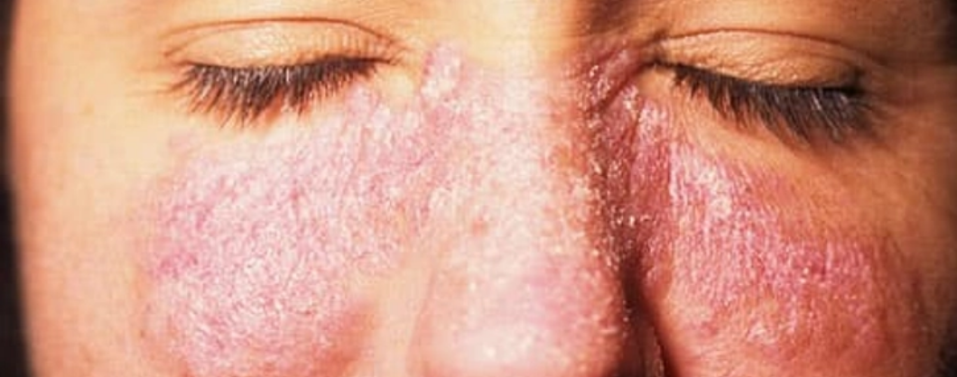

















BRADFORD VTS TEACHING DECK
Case 4: Connective Tissue Disease & SLE
CLINICAL FRAMEWORK & NICE/BSR STANDARDS
Case Presentation
25yo Woman: Fatigue + Joint pains + Cold fingers (Raynaud's) + Proteinuria.
SLE Epidemiology & Markers
F:M Ratio 9:1
ANA: 95% Sensitive
Peak onset: 15–45y
Anti-dsDNA: Specific
Afro-Caribbean / Asian risk
Low C3/C4 (Active)
Classic Malar (Butterfly) Rash — Sparing Nasolabial Folds
Raynaud's Phenomenon
Episodic vasospasm on cold exposure:
WHITE (Ischaemia)
BLUE (Hypoxia)
RED (Reperfusion)
SLICC Criteria (11 Domains)
Malar Rash / Photosensitivity / Oral Ulcers
GP Investigation Panel
Serositis (Pleurisy/Pericarditis)
Glomerulonephritis (Proteinuria/Casts)
ANA, Anti-dsDNA
Anti-Sm, Anti-Ro/La
CNS Involvement (Seizures/Psychosis)
Complement (C3/C4)
FBC, U&E, LFT
Haematological (Anaemia, Leukopenia)
Urinalysis (Protein)
ESR / CRP
General Rheumatology in Primary Care
www.bradfordvts.co.uk

Slide 7







BRADFORD VTS TEACHING DECK
Key Connective Tissue Diseases for GPs
CLINICAL FRAMEWORK & NICE/BSR STANDARDS
Condition
Key Clinical Features
Specific Tests / Markers
SLE
F:M = 9:1; malar (butterfly) rash; photosensitivity; oral ulcers; serositis; glomerulonephritis; multi-system involvement.
ANA positive in 95%; anti-dsDNA (highly specific); low complement (C3/C4) in active disease.
Sjögren's
Dry eyes (xerophthalmia) + dry mouth (xerostomia) - sicca syndrome; can be primary or secondary to RA/SLE.
ANA; anti-Ro (SS-A) and anti-La (SS-B); Schirmer's test for tear production.
Scleroderma
Raynaud's phenomenon; tight shiny skin (sclerodactyly); pulmonary fibrosis; GORD; renal crisis.
anti-centromere (Limited/CREST); anti-Scl-70 (Diffuse systemic sclerosis).
Polymyositis
Proximal muscle weakness; heliotrope rash & Gottron’s papules (if Dermatomyositis).
Significantly raised Creatine Kinase (CK); anti-Jo-1; MRI muscles; EMG.
ANCA Vasculitis
Multi-system; haematuria; haemoptysis (pulmonary-renal syndrome); sinusitis; mononeuritis multiplex.
cANCA (linked to GPA); pANCA (linked to MPA, EGPA); Tissue biopsy is gold standard.
PURPLE AKT BOX: HIGH-YIELD SEROLOGY
Sjögren's: anti-Ro and anti-La. • Scleroderma: Limited SSc = anti-centromere; Diffuse SSc = anti-Scl-70. • Polymyositis: Markedly raised CK. • ANCA vasculitis: Triad of haematuria + haemoptysis + sinusitis → Urgent referral mandatory.
General Rheumatology in Primary Care
www.bradfordvts.co.uk

Slide 8


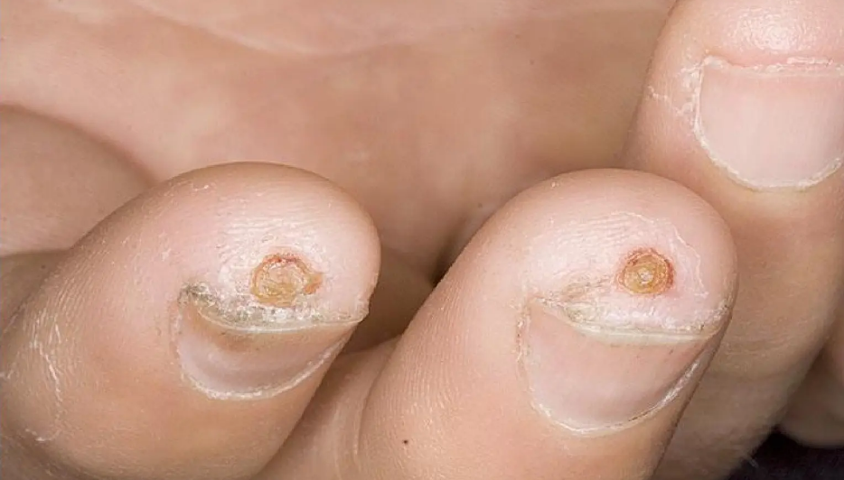





BRADFORD VTS TEACHING DECK
General Rheumatology in Primary Care
www.bradfordvts.co.uk
Digital Ulcers & CTD Complications
CLINICAL MANAGEMENT & SPECIALIST REFERRAL
Clinical Presentation
Pathology: Major complication of Scleroderma (SSc) and severe Raynaud's phenomenon.
Locations: Tips of fingers/toes or over bony prominences/pressure areas.
Infection Signs: Increased pain, redness, or discharge. Action: Take wound swab.
Typical appearance of ischaemic digital ulcers on toes
Management Hierarchy
GP Clinical Pearls
Conservative: Protection from cold/trauma, intensive wound care, keeping core temperature warm.
Immunosuppression masks typical inflammatory signs of infection.
Primary Care: Low threshold for antibiotics in CTD patients (infection often masked by immunosuppression).
Check for underlying Systemic Sclerosis (SSc) if ulcers present with tight skin or GORD.
Secondary Care: IV Iloprost (vasodilator) for severe or non-healing ulcers.
Smoking cessation is mandatory for peripheral perfusion.
Refer urgently if new presentation or severe ulceration.

Slide 9








BRADFORD VTS TEACHING DECK
Case 5: Localised Soft Tissue Conditions
CLINICAL FRAMEWORK & NICE/BSR STANDARDS
Condition
Key Features
Management
Frozen shoulder
Global restriction all planes; pain eases then stiffness develops.
Physio; intra-articular steroid; education: usually resolves in 1–3 years.
Tennis elbow
Lateral epicondyle tender; pain on resisted wrist extension.
Rest; NSAID; physiotherapy; consider corticosteroid injection if severe.
Golfer's elbow
Medial epicondyle tender; pain on resisted wrist flexion.
Management similar to tennis elbow: rest, NSAIDs, and physiotherapy.
Carpal tunnel
Nocturnal paraesthesia (thumb/index/middle); +ve Tinel's & Phalen's.
Wrist splint; steroid injection; refer if failing → nerve conduction/surgery.
Plantar fasciitis
Heel pain — characteristically worst with first steps in morning.
Stretching exercises; insoles; NSAIDs; consider steroid injection.
Trochanteric bursitis
Lateral hip pain; localized tenderness over greater trochanter.
Physiotherapy; NSAIDs; local corticosteroid injection.
De Quervain's
Radial wrist pain; +ve Finkelstein's test (ulnar deviation).
Rest/thumb spica splint; NSAIDs; corticosteroid injection.
Trigger finger
Locking or clicking of finger on flexion; palpable nodule.
Rest; steroid injection into flexor tendon sheath; surgery if recurrent.
General Rheumatology in Primary Care
www.bradfordvts.co.uk

Slide 10






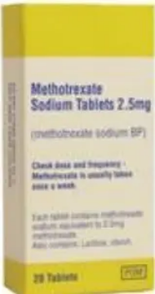



BRADFORD VTS TEACHING DECK
Methotrexate Monitoring and Safety
CLINICAL FRAMEWORK & NICE/BSR STANDARDS
Dosing & Prescribing
Stop & Contact Rheumatology
WEEKLY dosing only (Never daily)
WBC < 3.5 or Neutrophils < 2.0
Prescribe as 2.5mg tablets
Platelets < 150 (×10⁹/L)
Folate 5mg/week (day after MTX)
ALT / AST > 2× Upper Limit of Normal
FATAL INTERACTION
Unexplained low albumin
NEVER co-prescribe Trimethoprim or Co-trimoxazole (Bone marrow suppression).
New breathlessness or dry cough (Pneumonitis)
Abnormal bruising or sore throat (FBC urgently)
Active significant infection (Withhold during illness)
Safe to Continue Monitoring
Isolated lymphopenia
Isolated ALP rise
Mild Hb drop (9–10 g/dL) if not MTX-related
AKT BOX
MTX = WEEKLY. 2.5mg tabs. Never trimethoprim. Stop if neutrophils < 2, ALT > 2×ULN, or new dyspnoea/cough.
General Rheumatology in Primary Care
www.bradfordvts.co.uk

Slide 11











BRADFORD VTS TEACHING DECK
Rheumatology Referral Guide
CLINICAL FRAMEWORK & NICE/BSR STANDARDS
URGENT (DAYS)
SEMI-URGENT
ROUTINE
Septic Arthritis (Same-day A&E)
Early Inflammatory Arthritis (Within 12 weeks of onset)
Established RA with loss of control
GCA with visual symptoms (Same-day)
Refractory PMR (>2 years steroids)
New RA (Within 3 working days)
Suspected SLE or systemic CTD
Refractory Gout
ANCA Vasculitis (Multi-system)
GCA without visual symptoms
Complex soft tissue conditions
Inflammatory Arthritis in child
What to include in ALL Referrals
Symptoms: Duration, distribution, bilateral/symmetrical?
Bloods: FBC, ESR, CRP, RF, anti-CCP, ANA, Urate
Examination: Specific findings; joint swelling present?
Imaging: X-ray reports and previous investigations
Medications: Meds tried + response; current prescriptions
Context: PMH and functional impact on daily life
General Rheumatology in Primary Care
www.bradfordvts.co.uk

Slide 12


BRADFORD VTS TEACHING DECK
Top Tips for Primary Care
CLINICAL FRAMEWORK & NICE/BSR STANDARDS
01
Framework First
05
Screen Young Women
08
Malignancy Mimicry
Is it articular? Inflammatory? Mono/oligo/poly? Use these to narrow differentials quickly.
Don't miss CTD in young women with multi-system symptoms, Raynaud's, or malar rash.
Cancer can present with arthralgia. Screen elderly patients with weight loss or night sweats.
02
Septic Arthritis Must-Not-Miss
06
Soft Tissue Prognosis
09
MTX Pneumonitis
Any hot swollen joint requires infection rule-out. Admit same-day if systemically unwell.
Most frozen shoulders, tennis elbows, and carpal tunnel syndrome resolve with conservative care.
Any new dry cough or breathlessness on MTX is an emergency. Stop drug and get urgent CXR.
03
Refer RA Early
07
Statin Myopathy
10
Raynaud's Screening
Refer within 12 weeks. Do not wait for RF/anti-CCP results if synovitis is clinically present.
A common cause of aches. Always check CK and TSH to exclude metabolic or drug causes.
Secondary Raynaud's + systemic features = CTD screen (ANA, anti-Ro, anti-Scl-70).
04
MTX Safety
Prescribe MTX ONCE WEEKLY only. Never co-prescribe trimethoprim (fatal marrow suppression).
General Rheumatology in Primary Care
www.bradfordvts.co.uk

Slide 13








BRADFORD VTS TEACHING DECK
AKT and SCA Exam Pearls
HIGH-YIELD KNOWLEDGE & CLINICAL COMMUNICATION
AKT Knowledge Pearls
SCA Communication Pearls
Acute Monoarthritis Diagnosis
Methotrexate Counselling
Always exclude septic arthritis via joint aspiration. Gram stain and culture are gold standard.
Emphasize ONCE WEEKLY dosing. Warn specifically about fatal interactions with trimethoprim.
Crystal Identification
Validation & Impact
Gout: Negative birefringent needles. Pseudogout: Positive birefringent rhomboids.
"I can see how much this is affecting your daily life." Acknowledge the burden of chronic pain.
SLE Serology Profile
Systemic Screening
ANA positive in 95% (sensitive); anti-dsDNA is highly specific; Low C3/C4 levels indicate active flare.
Systematically ask about rashes, dry eyes/mouth, and breathing problems in suspected CTD.
CTD Specific Markers
Raynaud's Lifestyle Advice
Sjögren’s: Anti-Ro/La. Scleroderma: Anti-centromere (limited) vs. anti-Scl-70 (diffuse).
Core warmth (layering), warm drinks, smoking cessation, and avoiding beta-blockers.
Vasculitis (ANCA)
Safety-Netting Criteria
cANCA associated with GPA; pANCA associated with MPA/EGPA. Watch for haematuria + haemoptysis.
Fever + hot joint = A&E. Persistent swelling >6 weeks = Return for urgent reassessment.
General Rheumatology in Primary Care
www.bradfordvts.co.uk

Slide 14














BRADFORD VTS TEACHING DECK
Red Flags and Quick Recall
General Rheumatology in Primary Care
www.bradfordvts.co.uk
CLINICAL FRAMEWORK & NICE/BSR STANDARDS
Quick Recall
SEPTIC ARTHRITIS
Hot, swollen single joint + fever = ADMIT same day for aspiration/IV antibiotics.
Crystal Microscopy
Gout: Negative birefringent needles.
Pseudogout: Positive birefringent rhombi.
GIANT CELL ARTERITIS (GCA)
Visual loss or amaurosis fugax = Emergency same-day ophthalmology review.
SLE Markers
ANCA VASCULITIS
ANA positive in 95%; Anti-dsDNA is highly specific. Low C3/C4 in active flares.
Haematuria + Haemoptysis + Sinusitis = Potential GPA/MPA. Urgent referral.
MTX PNEUMONITIS
Sjögren's & Scleroderma
Sicca: Anti-Ro/La. Scleroderma: Anti-centromere (Ltd) or Anti-Scl-70 (Diff).
New dry cough or breathlessness on Methotrexate = STOP MTX, urgent CXR.
DERMATOMYOSITIS
Proximal weakness + Heliotrope/Gottron's rash = Urgent CK, MRI, and referral.
Methotrexate (MTX)
PAEDIATRIC ARTHRITIS
WEEKLY dosing. Never co-prescribe Trimethoprim. Monitor: FBC, LFTs, U&Es.
Any child with persistent joint swelling = Urgent paediatric rheumatology referral.
Diagnostic Framework
1. Articular/Peri? 2. Inflammatory/Non? 3. Mono/Oligo/Poly?

Slide 15


BRADFORD VTS TEACHING DECK
Final Disclaimer
CLINICAL FRAMEWORK & NICE/BSR STANDARDS
Educational Purpose & Clinical Safety
This teaching deck is designed for educational purposes only and serves as a summary of current clinical frameworks for GP trainees. It is not a substitute for clinical judgment or official guidelines.
Medical knowledge and standards of care are constantly evolving. Users must independently verify all clinical advice, diagnostic criteria, and management pathways.
CRITICAL: Always double-check drug dosages and contraindications with the latest NICE CKS, BNF 2026, and BSR specialist guidance before prescribing.
Last Updated: June 2026 | Prepared by Bradford VTS
General Rheumatology in Primary Care
www.bradfordvts.co.uk

