Slide 1
Shoulder Examination
BRADFORD VTS TEACHING DECK
Ernest Schilders, MD
Consultant orthopaedic surgeon
Bradford teaching hospitals

Slide 2
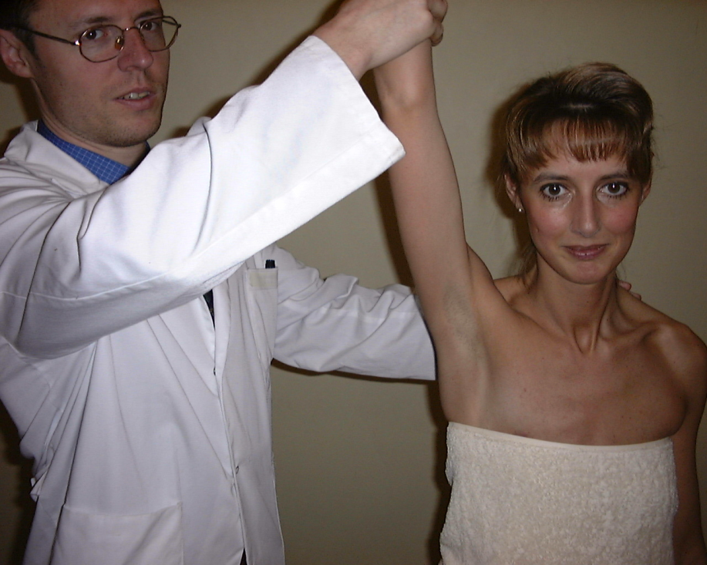
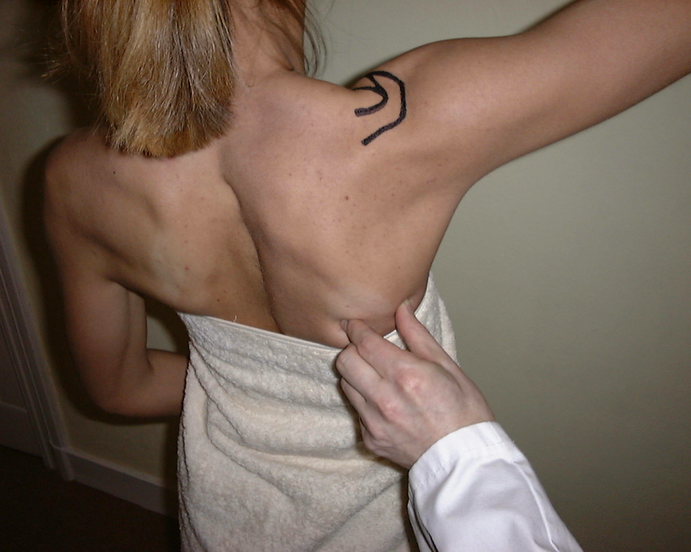
Passive forward elevation
Gleno-humeral mobility

Slide 3
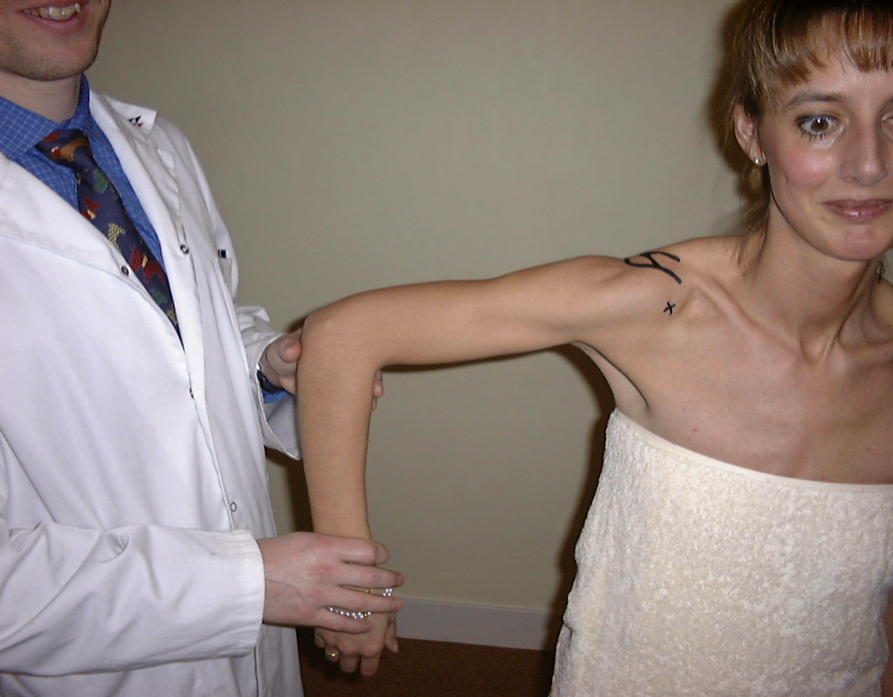
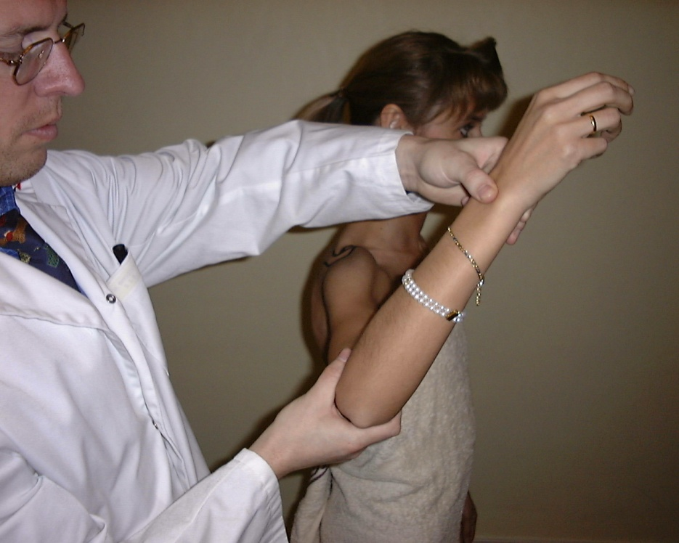
Assessment Passive Range of Motion
Internal rotation
External rotation

Slide 4

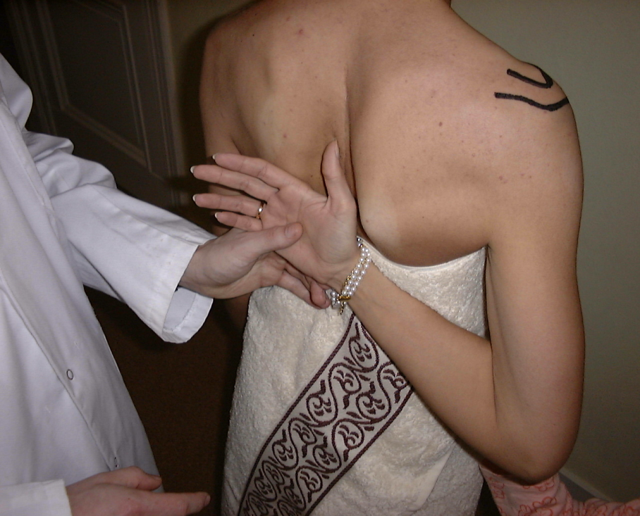
Internal rotation in 90° abduction
Internal rotation

Slide 5
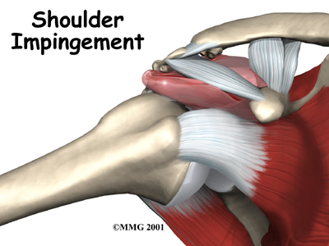
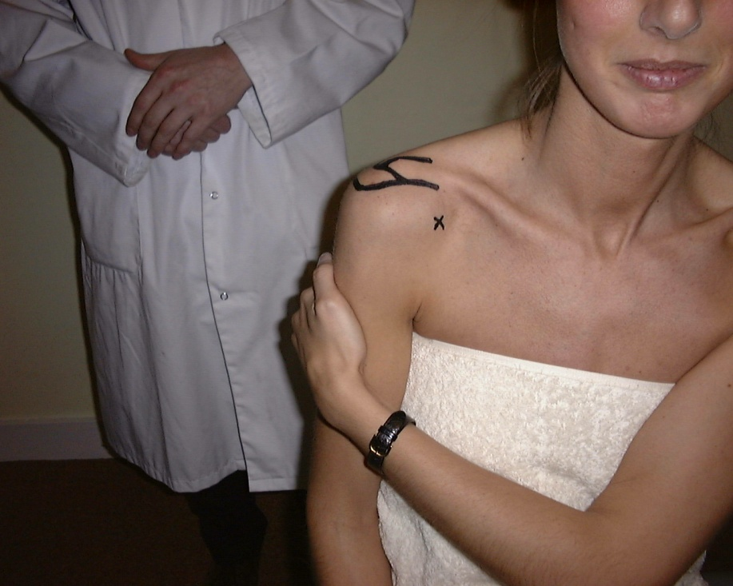
Localization of pain
Clinical signs
Painful arc of abduction
Hawkins sign
Neer sign

Slide 6
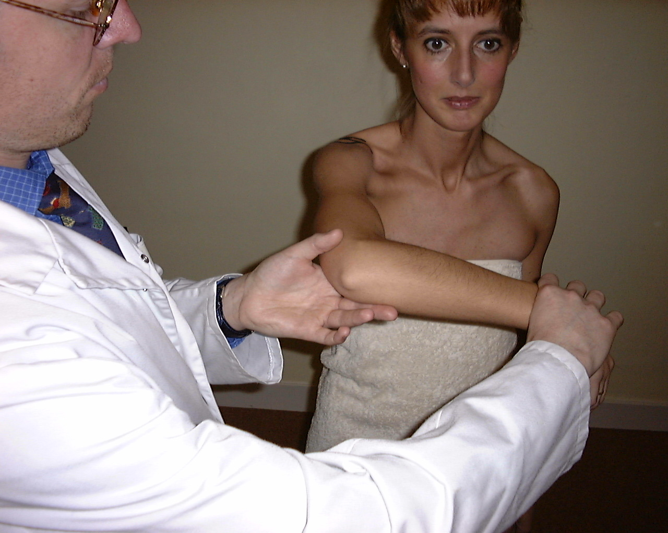
Hawkins impingement sign

Slide 7
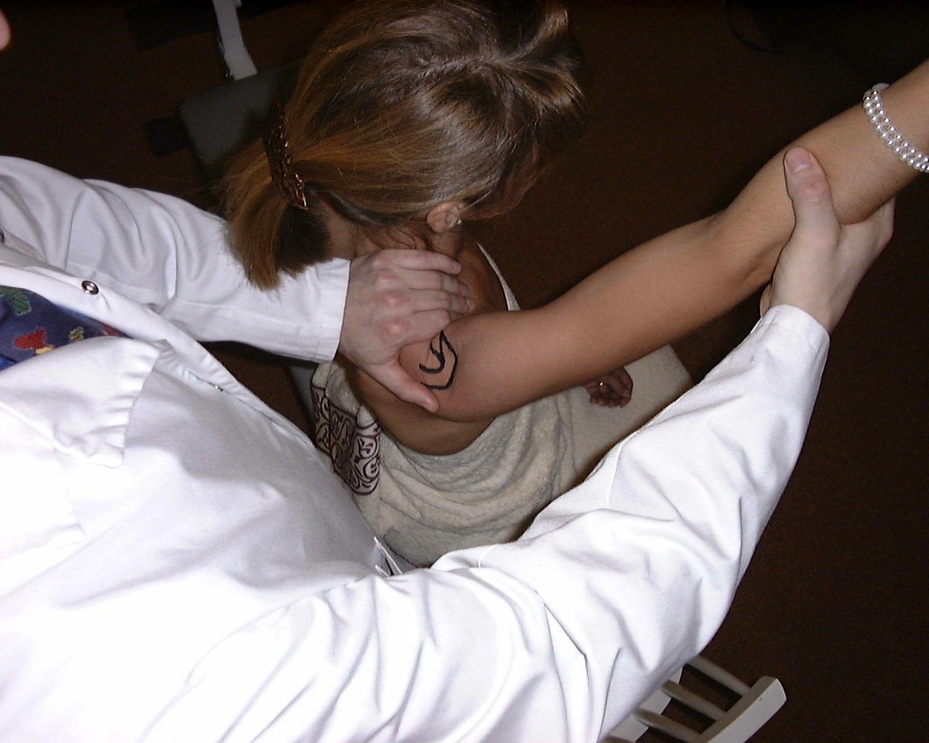
Neer Impingement sign

Slide 8
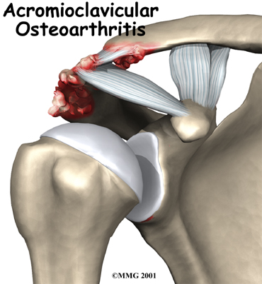
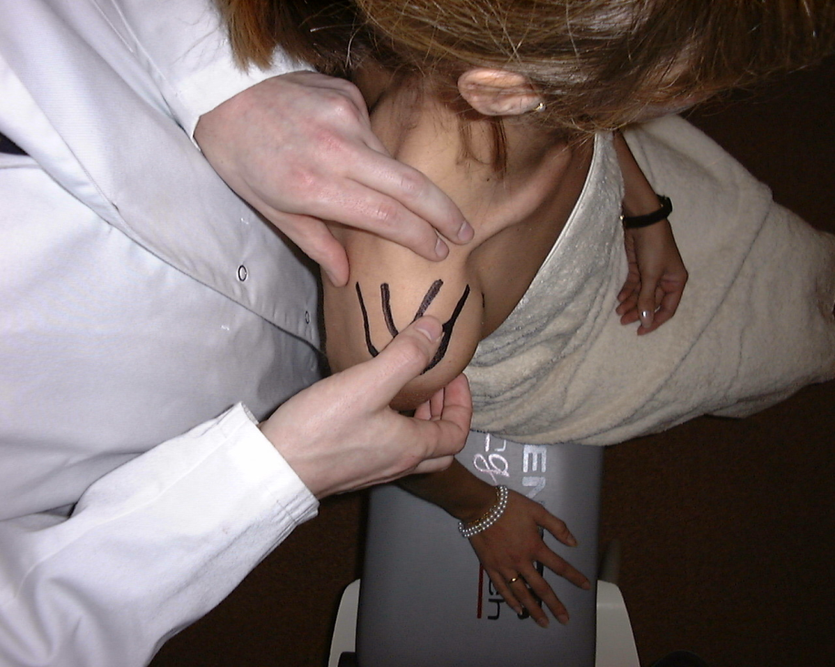
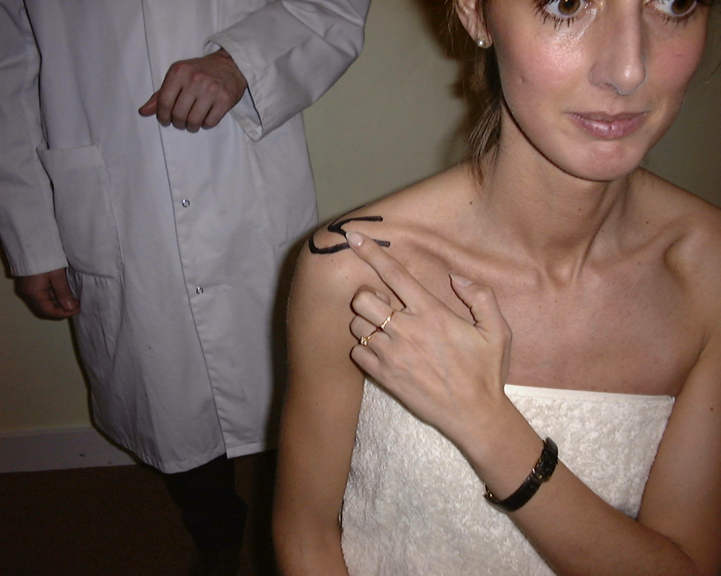
Clinical examination
Direct palpation of the AC joint
Localization of pain

Slide 9
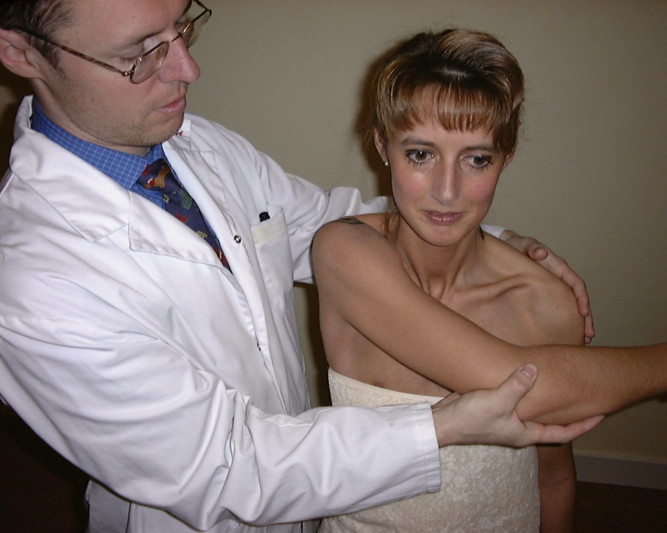
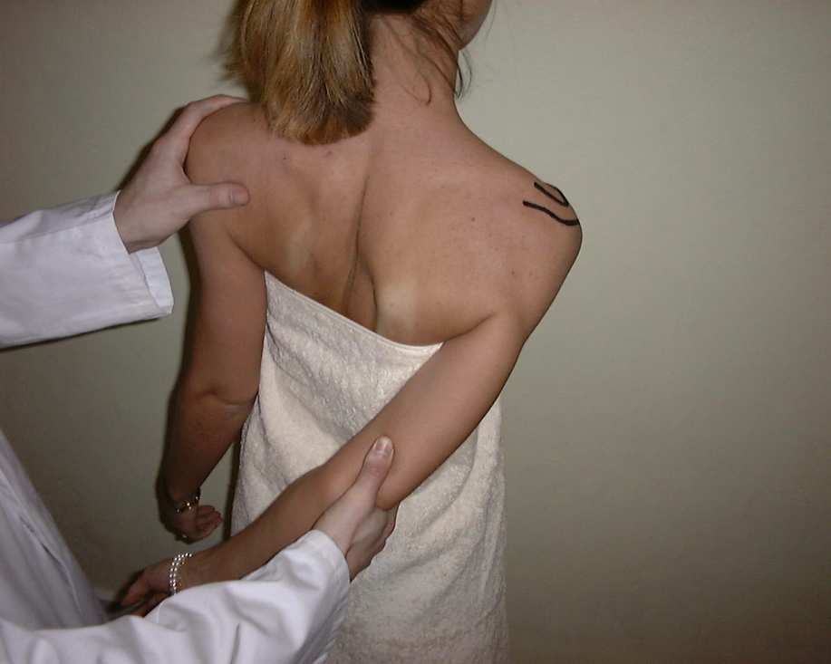
Horizontal adduction of the arm across the body
Internal rotation: twist and compress AC joint

Slide 10
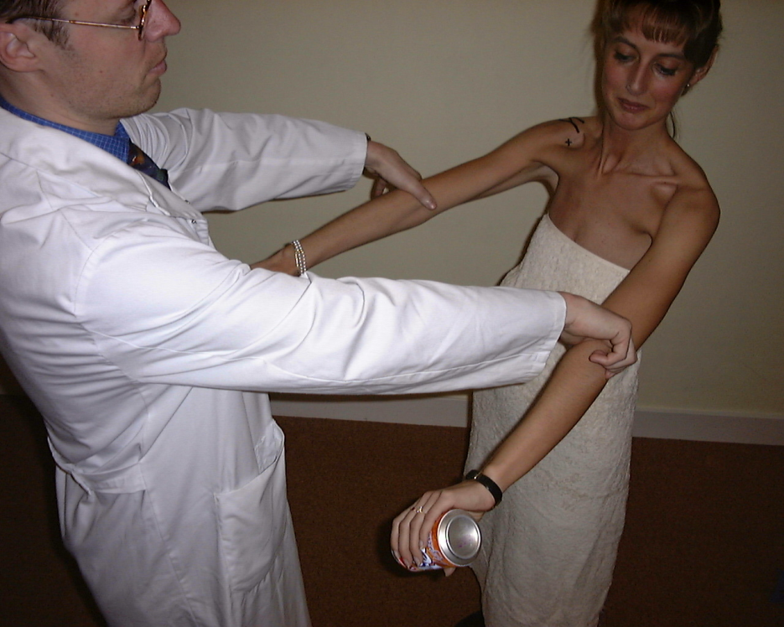
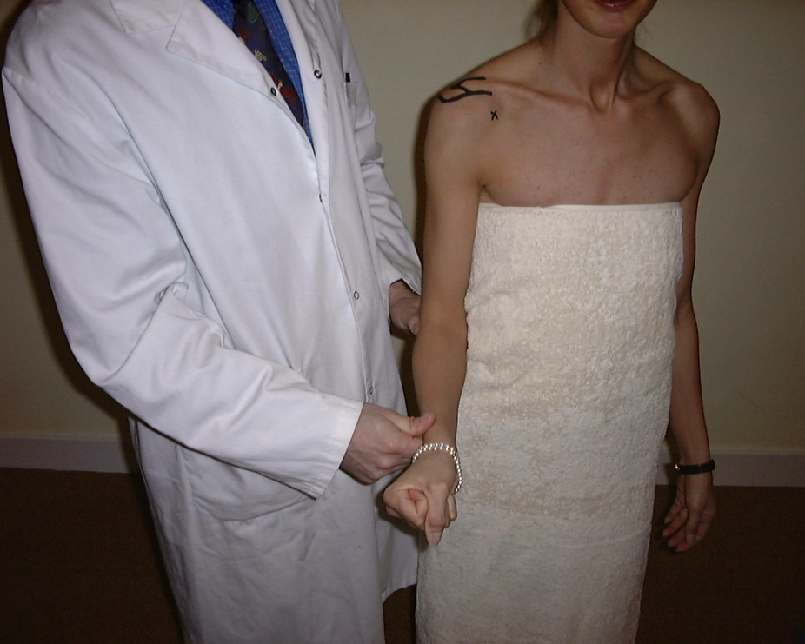
Estimate strength of supraspinatus
Estimate strength of infraspinatus

Slide 11
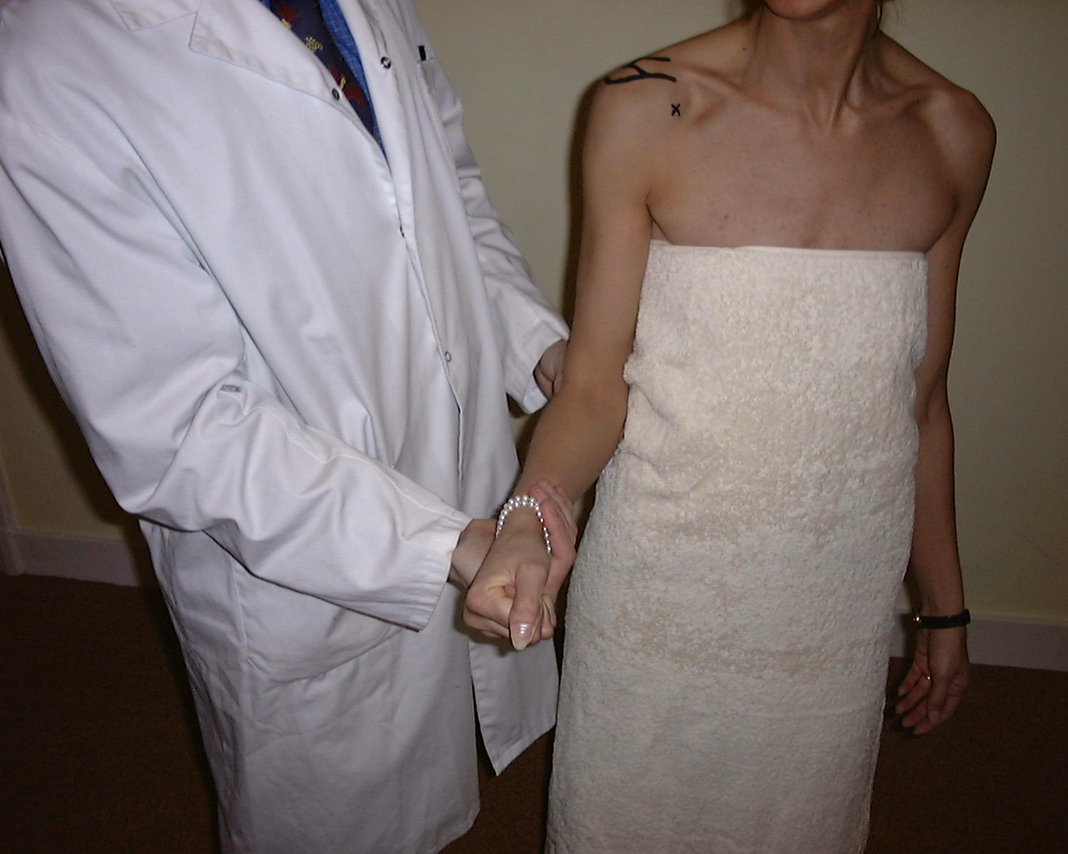
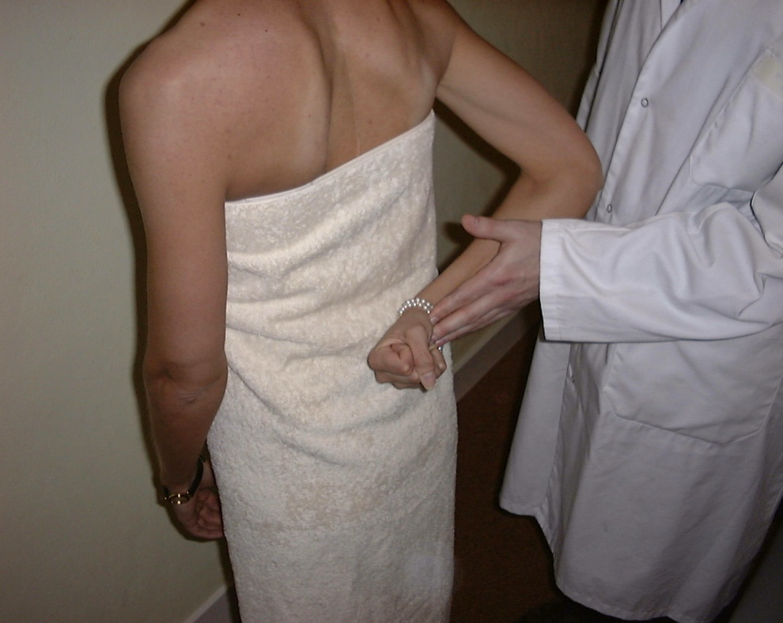
Estimate strength of subscapularis
Lift-off test (subscapularis)

Slide 12
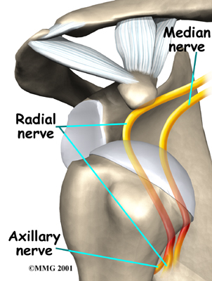
Instability

Slide 13
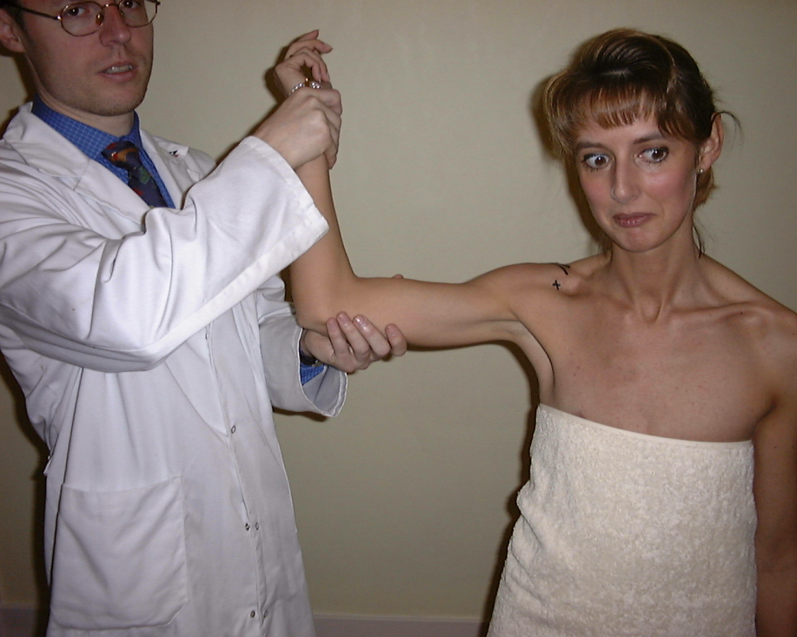
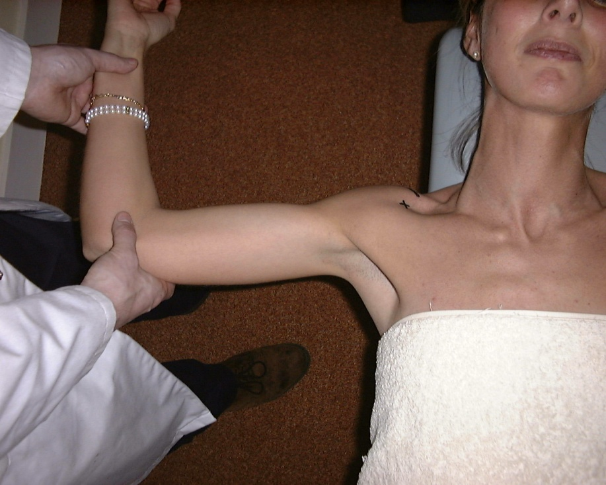
Apprehension test

Slide 14
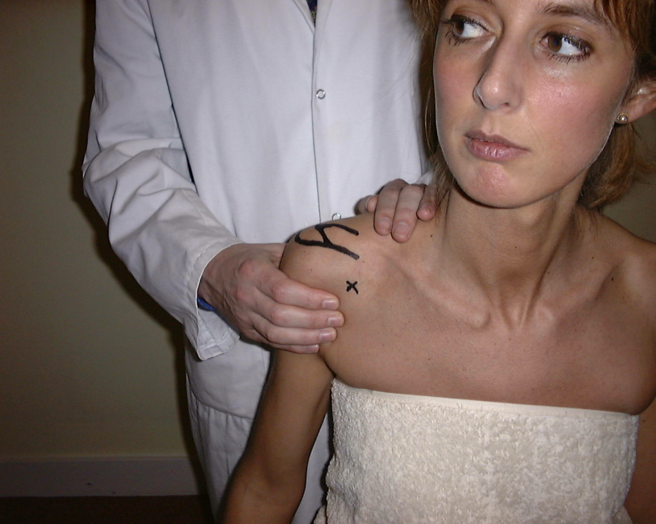
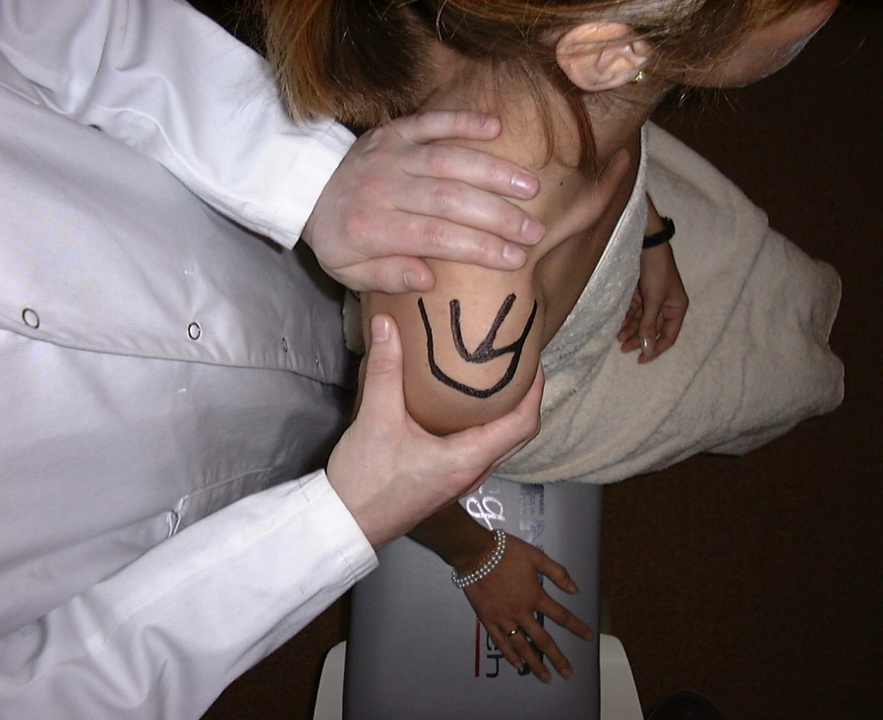
Load and shift test

