Slide 1








BRADFORD VTS TEACHING DECK
Shoulders in
General Practice
Comprehensive Clinical Resource for GPs & Trainees
Created: June 2026
Updated to NICE / BESS 2025 Standards
Target: ST1-ST3 | International Medical Graduates
AKT FOCUS
SCA READY
Disclaimer: This teaching deck is intended for educational and clinical guidance only. It does not replace professional medical judgment. Always consult the latest NICE and BESS (British Elbow and Shoulder Society) 2025 guidelines for specific patient care pathways.
www.bradfordvts.co.uk

Slide 2








BRADFORD VTS TEACHING DECK
Introduction to Shoulder Pain in Primary Care
#3 Most Common MSK Complaint
Safe to Manage in Primary Care
Shoulder pain ranks third in primary care, after back and neck pain — encountered in every GP surgery, every week
Most shoulder problems can be diagnosed clinically
Conservative management is first-line for the majority
Physiotherapy + analgesia resolves most tendinopathy
Key History Points
Frozen shoulder is largely self-limiting (2+ years)
Corticosteroid injections can be administered in GP
Dominant / non-dominant hand — impacts function and management priority
Occupation — overhead work raises impingement risk (painters, builders)
Onset Pattern Clues
Sport — throwing sports → instability/impingement; swimming → impingement
Comorbidities — diabetes, hypothyroidism, epilepsy, cardiac/lipid disease
Sudden Calcific tendinitis, rotator cuff tear, dislocation
Pain character — night pain, rest pain, activity-related; "toothache-like" = frozen shoulder
Gradual Frozen shoulder, tendinopathy, glenohumeral OA, MDI
Trauma history — acute onset after injury = tear or dislocation until proven otherwise
Structured Diagnostic Approach
Step 1 — Age: Guides the most likely diagnosis (under 35 vs. 35–50 vs. over 50)
AKT Pearl
Step 2 — Onset: Sudden (tear, calcific, dislocation) vs. gradual (tendinopathy, frozen shoulder)
Age + onset + examination = diagnosis in most cases — no imaging required initially
Step 3 — Examination: Active vs. passive ROM, painful arc, special tests
Diabetes, hypothyroidism, and epilepsy are key risk factors to screen for in every shoulder history
Step 4 — Imaging if needed: Ultrasound first-line; X-ray for trauma; MRI for tears
NSAIDs do NOT address tendinopathy pathology — degenerative, not inflammatory
www.bradfordvts.co.uk
Bradford VTS — Shoulder Problems in General Practice — Created June 2026 | Updated to NICE/BESS 2025 Standards

Slide 3




BRADFORD VTS TEACHING DECK
Age-Based Diagnostic Framework
<35
Shoulder InstabilityTraumatic (Dislocation) or Atraumatic Multidirectional Instability (MDI)
YEARS
Impingement & TendinopathyRotator cuff tendinopathy, subacromial bursitis, calcific tendinitis
35-50
Early Frozen ShoulderAdhesive capsulitis; significantly higher risk in diabetic patients
YEARS
>50
Rotator Cuff TearsOften post-trauma; suspect in older patients with sudden weakness
Degenerative Joint DiseaseAC Joint OA (localised pain) and Glenohumeral OA (global stiffness)
YEARS
AKT FOCUS
Frozen Shoulder: 10–20% of NIDDM and 36% of IDDM patients; 2–4× increased risk overall.
www.bradfordvts.co.uk

Slide 4






BRADFORD VTS TEACHING DECK
Key History and Onset Patterns
Temporal Onset Patterns
Key Diagnostic Clues
SUDDEN / ACUTE ONSET
OCCUPATION & LIFESTYLE
Rotator Cuff Tear: Often post-trauma (fall/pull)
Overhead Work: Painters, builders (Impingement)
Calcific Tendinitis: Acute resorptive phase
Throwing Sports: Swimmers, tennis (Instability)
Dislocation: Traumatic event
PAIN CHARACTERISTICS
GRADUAL / INSIDIOUS ONSET
Night Pain: Bursa pressure (Tendinopathy)
Frozen Shoulder: Global stiffening
Rest Pain: Acute inflammation or malignancy
Tendinopathy: Chronic overhead wear
Osteoarthritis: Progressive wear over 50s
AKT FOCUS: MEDICAL LINKS
SCA FOCUS: PATIENT IMPACT
Diabetes: 10–20% risk of Frozen Shoulder.
Screen for hand dominance and impact on ADLs (dressing/grooming) to gauge severity in consultation.
Epilepsy/Seizures: High risk for Posterior Dislocation (often missed).
Thyroid/Cardiac: Associated with bilateral adhesive capsulitis.
www.bradfordvts.co.uk

Slide 5



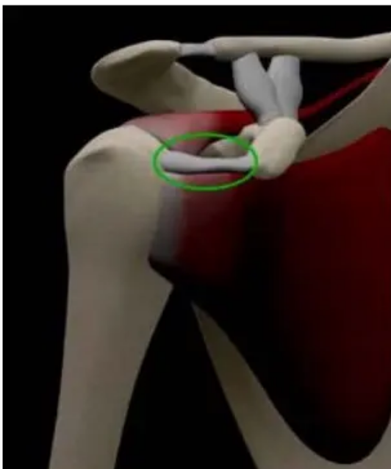





BRADFORD VTS TEACHING DECK
Anatomy of the Rotator Cuff (SITS)
S
Supraspinatus
I
Infraspinatus
Initiates abduction (first 15°). Responsible for 45% of abduction strength. Most common site for injury/tears.
Primary external rotator. Responsible for 90% of external rotation strength. Located in the posterior fossa.
AKT: 45% STRENGTH
AKT: 90% STRENGTH
T
Teres Minor
S
Subscapularis
Assists in external rotation and adduction. Works with Infraspinatus to stabilize the posterior joint.
Primary internal rotator. The only SITS muscle on the anterior side. Key for stabilizing the front of the joint.
Subacromial Space
The narrow gap between the acromion above and the humeral head below. Contains the Supraspinatus tendon and subacromial bursa.
SCA: Narrowing leads to Impingement Syndrome.
www.bradfordvts.co.uk

Slide 6














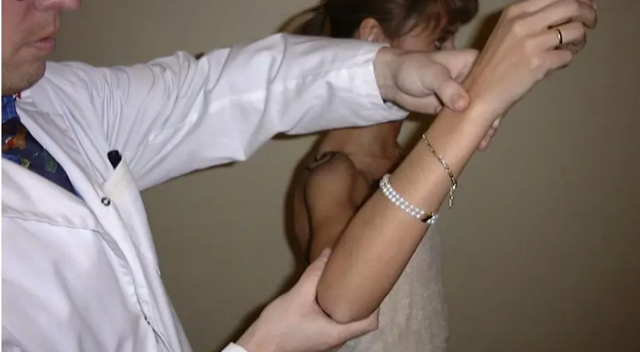

BRADFORD VTS TEACHING DECK
Clinical Examination: Look and Move
Look (Inspection)
Move (Functional Assessment)
Muscle Wasting: Inspect supraspinatus/infraspinatus fossa (suggests tear or chronic pathology).
Sequence: Active movements first, then Passive if restricted.
Clinical Finding
Likely Pathology
Painful arc 60°–120° abduction
Scapular Winging: Check for serratus anterior weakness (long thoracic nerve).
Subacromial Impingement / Tendinopathy
Symmetry & Swelling: Observe shoulder girdle height and AC joint prominence.
Painful arc 90°–120°+
AC Joint Pathology
Global restriction (Active & Passive)
Frozen Shoulder (Adhesive Capsulitis)
Weakness only, Passive preserved
Rotator Cuff Tear
AKT FOCUSPathognomonic Sign: Loss of passive external rotation (>50% vs unaffected side) is the most reliable clinical sign of Frozen Shoulder.
June 2026 | Bradford Teaching Hospitals
www.bradfordvts.co.uk

Slide 7











BRADFORD VTS TEACHING DECK
Special Tests for Rotator Cuff & Impingement
Empty Can (Jobe)
Neer Sign
TECHNIQUE
TECHNIQUE
Abduct arm to 90°, 30° forward flexion, thumb pointing down. Patient resists downward pressure.
Stabilize scapula and passively elevate the internally rotated arm in the scapular plane.
POSITIVE FINDING
POSITIVE FINDING
Pain or weakness suggests Supraspinatus tear or tendinopathy.
Pain between 70–120° suggests Subacromial Impingement.
Hawkins-Kennedy
Drop Arm (Codman)
TECHNIQUE
TECHNIQUE
Flex shoulder and elbow to 90°; clinician forcibly internally rotates the humerus.
Passively abduct arm to 90°. Ask patient to lower it slowly or remove your support suddenly.
POSITIVE FINDING
POSITIVE FINDING
Pain suggests Subacromial Impingement (sensitive test).
Arm drops uncontrollably; suggests a Complete Rotator Cuff Tear.
AKT Pearl: Subacromial impingement is often diagnosed by a cluster of tests. Neer and Hawkins-Kennedy together provide high sensitivity for ruling out the condition if negative.
SCA Pearl: Always warn the patient: "I'm going to move your arm in a way that might be painful; please let me know immediately if it is too much."
www.bradfordvts.co.uk

Slide 8









BRADFORD VTS TEACHING DECK
Special Tests for Instability & AC Joint
Apprehension Test
Sulcus Sign
Anterior glenohumeral instability
Inferior / multidirectional instability (MDI)
Position:
Arm abducted to 90°, elbow flexed to 90°
Position:
Patient seated or standing; arm relaxed at side, elbow extended
Technique:
Externally rotate the arm while applying gentle anterior pressure to the posterior humeral head
Technique:
Apply steady downward (inferior) traction to the arm below the elbow; observe the subacromial region
Positive:
Patient reports apprehension / fear of dislocation rather than just painApprehension ≠ Pain
Positive:
Visible or palpable sulcus (indentation) below the acromion >1 cm = significant
Suggests:
Anterior glenohumeral instability; Bankart lesion in young patients
Suggests:
Multidirectional instability (MDI); inferior capsule laxity; common in young hypermobile females
Note:
Relocation test (posterior pressure) relieves apprehension — confirms anterior instability
Note:
MDI management is rehabilitation-first; surgery rarely needed
Scarf Test
CLINICAL PEARLS
Cross-body adduction / AC joint pathology
Position:
Standing; elbow flexed, arm forward flexed to ~90°
Apprehension (fear) is diagnostic — pain alone is non-specific
Technique:
Passively bring the arm across the body (horizontal adduction) toward the opposite shoulder
AC pain on abduction >90° and through full range; subacromial eases after 120°
Young athletes with "impingement" — always exclude instability first
Positive:
Pain localised directly over the AC joint
Axillary nerve (regimental badge area) must be checked after any dislocation
Suggests:
AC joint arthritis or osteolysis; pain continuing above 90° distinguishes AC from subacromial pathology
AKT FOCUS
95% of dislocations are anterior (ABduction + ER mechanism)
Posterior dislocation: seizure / electrocution — commonly missed; "light-bulb sign" on X-ray
Bankart lesion: labral + anterior capsule tear — MRI arthrogram for diagnosis
Refer <25 years post-dislocation: high recurrence; surgical stabilisation indicated
www.bradfordvts.co.uk

Slide 9


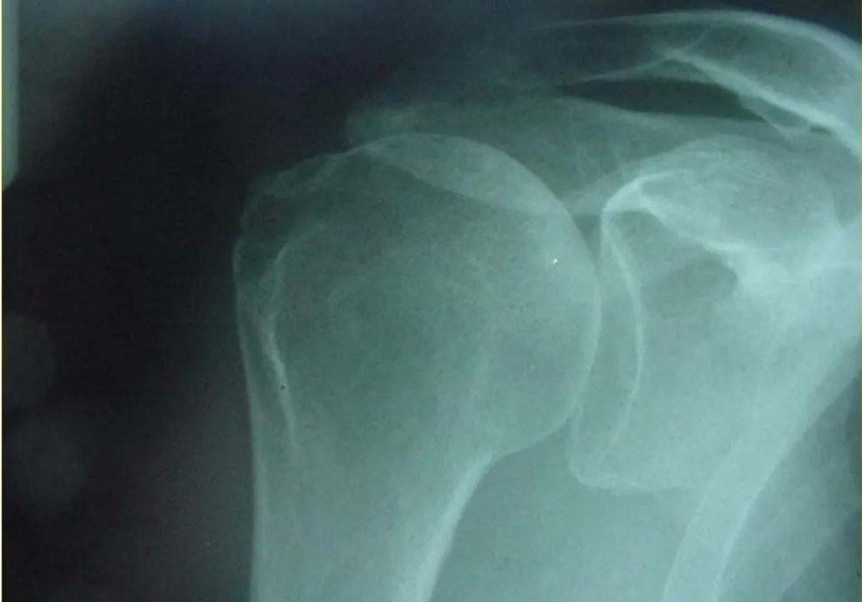





BRADFORD VTS TEACHING DECK
Imaging Strategies in Primary Care
Plain X-Ray (AP & Lateral/Axillary)
Trauma: Exclude fractures or acute dislocations.
Calcific Tendinitis: Visualise hydroxyapatite deposits.
OA: Identify joint space narrowing and osteophytes (AC/GH).
Bony Pathology: Screen for malignancy in red flag cases.
Ultrasound (US) - First Line
Soft Tissue: Best for rotator cuff tears and tendinopathy.
Dynamic: Can assess impingement during movement.
Accuracy: Operator-dependent; excellent for bursitis.
Pre-Injection: Guide clinical decisions for therapy.
MRI / MR Arthrogram
Standard shoulder radiograph: Essential for ruling out bony pathology and trauma.
Full Tears: Gold standard for surgical planning.
Instability: MRA required for Bankart/labral lesions.
Diagnostic: Reserved for complex or resistant cases.
When to Scan?
Order imaging for acute trauma, sudden weakness in patients >45yrs (suspected tear), or persistent symptoms despite 6 weeks of conservative care. Avoid routine scans for gradual-onset pain in young patients without trauma.
www.bradfordvts.co.uk

Slide 10









BRADFORD VTS TEACHING DECK
Frozen Shoulder Definition and Risk Factors
Definition (BESS 2025)
Systemic Risk Factors
Adhesive Capsulitis: Global restriction of glenohumeral movement (Active AND Passive).
Endocrine: Hypothyroidism and diabetes are the strongest associations.
No obvious radiological cause; mean age of onset is 56 years.
Neurological: Epilepsy (AEDs like phenytoin) and Parkinson's.
External Rotation (ER) loss: Passive ER < 50% of unaffected side. PATHOGNOMONIC
Cardiovascular: Post-MI, cardiac surgery, and hyperlipidaemia.
AKT EXAM FOCUS
Classification
Diabetes Association
Primary (Idiopathic): No identifiable underlying cause.
36% of IDDM patients will develop frozen shoulder (vs 10-20% NIDDM).
Secondary: Following trauma, surgery, hemiplegia, or rotator cuff pathology.
Diabetics are 2–4× more likely to be affected and often have bilateral disease.
Shared pathology with Dupuytren's disease (fibroblastic proliferation, TGF-beta).
58% of patients with primary frozen shoulder have Dupuytren's elsewhere.
www.bradfordvts.co.uk

Slide 11






BRADFORD VTS TEACHING DECK
The Three-Stage Natural History
Dominant feature: Severe, "toothache-like" deep shoulder pain.
Stage I: Freezing
(Painful Phase)
Significant pain at rest and debilitating night pain.
Weeks to ~3 Months
Inflammatory synovitis begins; ROM starts to decrease.
Stiffness becomes the primary symptom; global ROM restriction.
Stage II: Frozen
(Stiffening Phase)
Pain at rest typically resolves; pain persists at end-ranges of motion.
4 to 12 Months
Pathology shifts to capsule maturation and dense scarring (fibrosis).
Gradual return of glenohumeral movement and function.
Stage III: Thawing
(Recovery Phase)
Pain is largely resolved; residual stiffness is minimal for most.
9 to 18 Months
Spontaneous resolution occurs as vascularity returns and scar softens.
BESS 2025 Clinical Update: Total duration is typically 2 years, but full resolution is NOT guaranteed. Studies show ~50% of patients still report mild pain or stiffness at 7 years post-onset.
www.bradfordvts.co.uk

Slide 12






BRADFORD VTS TEACHING DECK
Pathognomonic Signs of Frozen Shoulder
Examination Highlights
Global Restriction: Affects both active AND passive movements (unlike cuff tears).
Specific ER Limits: Passive ER < 60° from sagittal plane (often < 0° in primary cases).
Elevation: Combined elevation typically restricted to < 100°.
> 50%
Negative Findings: Minimal tenderness; No muscle wasting (key differentiator).
PASSIVE ER LOSS
Loss of Passive External Rotation compared to the unaffected side is the hallmark sign.
AKT EXAM PEARL
If a patient has preserved passive range of motion but limited active motion, the diagnosis is likely a Rotator Cuff Tear, not Frozen Shoulder. Frozen shoulder requires global restriction.
www.bradfordvts.co.uk

Slide 13






BRADFORD VTS TEACHING DECK
Management of Stage I Frozen Shoulder
Clinical Medical Strategy
Physiotherapy & Taping
Analgesia (1st Line): Paracetamol and short-term oral NSAIDs (e.g., Naproxen 500mg BD) for "toothache-like" night pain.
Gentle ROM: Focus on pain-free range of motion exercises only (e.g., pendulum swings).
Early IA Steroid: Intra-articular (glenohumeral) corticosteroid injection (BESS 2025/NICE).
McConnell Taping: Consider twice-weekly taping to improve proprioception and scapulothoracic rhythm.
Injection Mix: Triamcinolone 40mg + Lidocaine 1% (standard subacromial/IA mix).
Benefits: Provides significant short-term pain relief and may reduce overall disease duration if given early.
AKT EXAM PEARL
Maximum 3 steroid injections total per shoulder. Intra-articular injections target the joint space, distinct from subacromial bursal injections.
Counseling: Reassure patient that recovery is slow (typically 2 years) but generally follows a known trajectory.
COMMON PITFALL
AVOID aggressive stretching in Stage I. This worsens synovitis, increases inflammatory pain, and can prolong the "freezing" phase.
www.bradfordvts.co.uk

Slide 14








BRADFORD VTS TEACHING DECK
Management of Stages II and III
Stage II: Stiffening
Stage III: Thawing
Hydrodilatation
4 – 12 MONTHS POST-ONSET
9 – 18 MONTHS POST-ONSET
ARTHROGRAPHIC DISTENSION
Intensive Stretching: Transition from gentle to aggressive end-of-range stretching as pain subsides.
Gradual Recovery: Spontaneous return of movement; focus on functional restoration.
Procedure: High-volume injection (Saline + Steroid + Local Anaesthetic) to expand joint capsule.
Mobilisation: Manual therapy and soft tissue work to address compensatory muscle tension.
Strengthening: Focus on rotator cuff and scapular stabilisers to correct movement patterns.
BESS 2025: Evidence of short-term benefit in pain, ROM, and function.
Functional Progression: Return to sports and overhead occupational activities.
Indication: Patients with persistent stiffness "unable to cope" with non-operative course.
Home Exercise Program: High compliance required to maintain passive gains.
Re-evaluate if no improvement by 24 months; check for secondary causes.
Consider second corticosteroid injection if significant pain persists alongside stiffness.
AKT: TRIAMCINOLONE 40mg + LIDOCAINE
SCA: SHARED DECISION MAKING
www.bradfordvts.co.uk

Slide 15





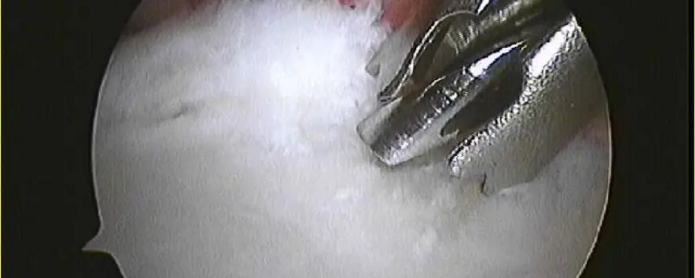

BRADFORD VTS TEACHING DECK
Surgical Interventions for Frozen Shoulder
Manipulation Under Anaesthesia (MUA)
Arthroscopic Capsular Release
75% near-normal Range of Motion (ROM) achieved.
Preferred by many surgeons over MUA (controlled release).
79% significant pain relief reported.
Constant score improvement: 14 → 66 post-op.
75% return to work within 9 weeks.
Identifies associated pathologies; avoids MUA bone risks.
Risks: Iatrogenic fractures, capsule/labral tears, or rotator cuff injury.
BESS 2025: Reserved for those failing non-operative therapy.
COMMON PITFALL: Poor MUA Outcomes in Diabetics
Diabetic patients respond poorly to MUA alone. Improvement is often lost within 4 weeks. Consider early referral for Arthroscopic Capsular Release in this cohort as pathology is more severe and bilateral.
www.bradfordvts.co.uk
Slide 16 of 36

Slide 16


















BRADFORD VTS TEACHING DECK
Rotator Cuff Tendinopathy and Impingement
Stage
Age / Patient
Pathological Features
Management Strategy
Histological Shift
Stage I
< 25–40 yrs
Young athletes
Reversible oedema and inflammation; overhead use.
Conservative: Activity modification, physio. Full recovery.
Modern evidence shows a shift from "Tendinitis" (implies inflammation) to "Tendinopathy".
Histopathology reveals no inflammatory cells. Instead, findings include:
~40 yrs
Occupational
Fibrosis and tendinosis; irreversible changes; pain at rest.
Conservative first; often needs subacromial decompression.
Mucoid degeneration
Stage II
Loss of collagen structure
Neovascularisation with neural ingrowth
EXAM PEARLS: AKT FOCUS
Clinical Significance
Older adults
Chronic onset
Partial/full tear + bony change; spurs on anterior acromion.
Surgical evaluation; rotator cuff repair or acromioplasty.
Stage III
Important for AKT: Since the pathology is not primarily inflammatory, NSAIDs do not address the underlying tendon degeneration. They provide short-term symptomatic relief only.
www.bradfordvts.co.uk

Slide 17





BRADFORD VTS TEACHING DECK
Symptoms and Risk Factors for Impingement
Clinical Presentation
Risk Profile
Pain Characteristics
Occupational Hazards
Lateral and anterior shoulder pain, typically sharp with overhead activities and dull at rest.
Repetitive overhead work: Painters, decorators, builders, and heavy labourers.
Night Pain
Sporting Activities
Severe discomfort when lying on the affected shoulder due to pressure on the subacromial bursa.
Swimming (freestyle/butterfly), tennis (serving), and throwing sports (cricket/javelin).
Onset & Age
Structural & Postural
Gradual insidious onset in patients typically over 35 years. Sudden weakness may suggest a tear.
Protracted shoulders (scapular position) and age-related tendon degeneration.
PATHOGNOMONIC FINDING
Painful Arc: 60° – 120° Abduction
COMMON PITFALL
Don't assume night pain always indicates a full-thickness rotator cuff tear. Subacromial bursitis, which is common in impingement syndrome, often causes severe sleep disturbance.
www.bradfordvts.co.uk

Slide 18












BRADFORD VTS TEACHING DECK
Conservative Management of Cuff Disorders
Initial Approach & Physio
Subacromial Injection
Activity Modification: Avoid precipitating overhead work/sports for 3-6 months.
Diagnostic: 10mL 1% Lidocaine relieves pain if the origin is truly subacromial.
Physiotherapy: Core focus on rotator cuff strengthening and scapular stabilizers.
Therapeutic: Add Triamcinolone 40mg or Methylprednisolone 40mg.
Accuracy: Ultrasound-guided injections improve delivery into the deeper bursa.
Progression: Pendulum → AAROM → Active → Progressive resistance exercises.
MAXIMUM 3 INJECTIONS PER SHOULDER
Analgesia Strategy
SCA FOCUS: SHARED DECISION MAKING
NICE 1st Line: Topical NSAIDs (e.g., Diclofenac gel 1%) for localized relief.
Discuss the trade-off: Injections provide excellent short-term relief for physio engagement but do not fix underlying tendinopathy. Ensure patient understands the "3-injection limit" to protect tendon integrity.
Stepwise: Paracetamol as base; short course oral NSAIDs (Ibuprofen/Naproxen) if needed.
Imaging Considerations
Caution: GI/CV/Renal risk assessment for long-term oral NSAID use.
Scan BEFORE Injection: If clinical picture is unclear or trauma is suspected.
SAFE TO MANAGE
US Findings: Identify if cuff is intact, severely degenerate, or torn to guide referral.
Gradual onset symptoms with a painful arc and preserved passive ROM are ideal for primary care management. Continue conservative measures for 3–6 months.
www.bradfordvts.co.uk

Slide 19






BRADFORD VTS TEACHING DECK
Surgical Options for Rotator Cuff Disorders
Indications for Surgery
Common Procedures
Failure of conservative management after 3–6 months (Physio + Injections).
Arthroscopic Subacromial Decompression (ASD): Removal of inflamed bursa and soft tissue debridement.
Persistent night pain interfering with sleep quality.
Acromioplasty: Surgical smoothing of the under-surface of the acromion to increase subacromial space.
Significant functional deficit affecting ADLs or occupation.
Confirmed Neer Stage II or III changes with bony impingement.
Coracoacromial Ligament Release: Detaching the ligament to reduce mechanical "pinching."
Contraindication:Not indicated for primary Rheumatoid Arthritis (RA) joint destruction.
AC Joint Resection: If distal clavicle osteophytes are contributing to subacromial narrowing.
EXAM PEARL: SCA FOCUS
EXAM PEARL: AKT FOCUS
Shared Decision Making: Discuss that surgery is elective. Manage expectations—rehab post-op is intensive and full recovery takes months.
Surgical intervention is typically considered transition from Stage II (Fibrosis) to Stage III (Bony spurs/Tears) in the Neer Classification.
www.bradfordvts.co.uk
June 2026 | NICE/BESS 2025 Standards

Slide 20






BRADFORD VTS TEACHING DECK
Calcific Tendinitis Management
Clinical Presentation
Management Pathway
Typical Profile: Female, aged 40–50 years.
1st Line: Activity modification and NSAIDs (Oral/Topical) for acute pain.
Acute Phase: Sudden, severe "toothache" pain (resorption phase) causing intense inflammation.
Injection: Subacromial steroid (Triamcinolone) provides rapid relief in acute flare.
Chronic Phase: Dull persistent pain, often an incidental finding on imaging.
Barbotage (Needling): US-guided aspiration and lavage of the deposit; very effective for acute phase.
Investigations
ESWT: Shockwave therapy for chronic cases unresponsive to conservative measures.
Plain X-ray: AP and Lateral views are diagnostic; shows calcium in supraspinatus/bursa.
Surgical: Arthroscopic debridement if all non-operative treatments fail.
Ultrasound: Identifies specific location and aids guided procedures (Barbotage).
AKT FOCUS
SCA FOCUS (SHARED DECISION)
Crystals are Hydroxyapatite, typically deposited in the supraspinatus tendon. ESWT is NICE-approved for Chronic calcific tendinitis.
"We can try a procedure called Barbotage, where a radiologist uses a needle to break up the chalk-like deposits under ultrasound guidance."
www.bradfordvts.co.uk | Shoulder Problems in General Practice (June 2026) | Clinical Use Only

Slide 21










BRADFORD VTS TEACHING DECK
Identifying and Managing Rotator Cuff Tears
Clinical Suspicion
Referral Pathways
Age > 45 + Acute Trauma: Typically a fall onto the arm or a sudden heavy pull.
Acute Full-Thickness: Urgent orthopedic referral for surgical repair (optimal within 3–6 weeks).
Sudden Onset Pain: Often described as a "tearing" or "snapping" sensation.
Partial Tears: Conservative management (Physio/NSAIDs) for 3 months; refer if failing to progress.
Weakness vs Pain: Loss of strength in abduction or external rotation despite preserved passive ROM.
Shrugging Sign: Whole shoulder girdle elevation when attempting to abduct the arm.
AKT EXAM PEARL
80% of anterior shoulder dislocations in patients over 45 years old are associated with a rotator cuff tear. Always screen this age group post-reduction!
Pathognomonic: Drop Arm (Codman) Sign
Inability to lower the arm slowly from 90° abduction without it dropping.
RED FLAG: ACUTE WEAKNESS
Sudden inability to lift the arm following trauma in a previously healthy shoulder requires Urgent MRI/Ultrasound and specialist review.
www.bradfordvts.co.uk

Slide 22





















BRADFORD VTS TEACHING DECK
Shoulder Instability and Dislocation
Feature
Anterior Dislocation
Posterior Dislocation
Frequency
95% (Most common)
2-5% (Commonly missed)
Specific Lesions
Bankart Lesion: Labral tear + anterior capsule detachment. Common in young patients post-dislocation.
Mechanism
Abduction + External Rotation force (e.g., fall)
Seizure, Electrocution, Direct posterior blow
Hill-Sachs Lesion: Compression fracture of postero-lateral humeral head (impact against glenoid).
Clinical Signs
Squared-off shoulder; humeral head palpable anteriorly
Arm locked in internal rotation & adduction; flat anteriorly
Multidirectional (MDI)
Key Risks
Axillary nerve injury (regimental badge area)
Locked posterior dislocation; missing on AP X-ray
Atraumatic, typically young females.
Global laxity; Sulcus Sign positive (>1cm).
Management: 1st line is Rehabilitation (Four P's).
EXAM PEARL: AKT FOCUS
Always suspect Posterior Dislocation in patients presenting post-seizure or electric shock. Standard AP X-rays can look normal (the "lightbulb sign"); request Axillary or Velpeau views to confirm.
High Recurrence Risk: Patients < 25–27 years or sports-active have a 70-90% recurrence rate. Refer for surgical stabilisation early.
www.bradfordvts.co.uk

Slide 23
















BRADFORD VTS TEACHING DECK
Emergency Management & Rehabilitation
Post-Reduction Care — Step-by-Step
The "Four P's" Rehabilitation Programme (Schilders)
1
X-ray first: AP + axillary/Velpeau view — confirm type, exclude fracture-dislocation before any reduction attempt
P1
P2
2
Nerve assessment: Axillary nerve — test sensation over "regimental badge area" (lateral proximal arm) before and after reduction
Glenohumeral Protectors
Scapular Pivotors
SITS muscles — Supraspinatus, Infraspinatus, Teres Minor, Subscapularis; dynamic stabilisers of GH joint
Serratus anterior, Trapezius, Rhomboids, Levator scapulae; optimise scapular position and rhythm
3
Reduction under sedation: Entonox, IV midazolam/morphine; techniques — Cunningham, Kocher, or Hippocratic
4
Post-reduction X-ray: Confirm successful reduction and exclude iatrogenic fracture
5
Immobilisation: Sling for 5–7 days only — early mobilisation prevents frozen shoulder
P3
P4
6
Referral decision: Young (<25–27 yrs) or sports-active → surgical stabilisation given high recurrence risk
Humeral Positioner
Power Drivers
Deltoid — positions the humeral head within the glenoid; essential for overhead function
Latissimus dorsi, Pectoralis major; generate power for throwing and pushing activities
Referral Criteria — Orthopaedics
Urgent: Fracture-dislocation, vascular injury, locked posterior dislocation, neurovascular deficit post-reduction. Routine: Age <25–27 yrs (1st dislocation), sports-active patients, recurrent instability → MRI arthrogram for Bankart lesion assessment.
Axillary Nerve — Key Assessment Point
Test: Light touch over lateral proximal arm ("regimental badge area" — C5 dermatome). Axillary nerve injury occurs in ~5–10% of anterior dislocations. Also supplies deltoid — test abduction power post-reduction. Most recover spontaneously within 3–6 months; EMG if no recovery by 3 months.
AKT PEARL
Posterior dislocation is commonly missed — caused by seizure or electrocution; AP X-ray may look deceptively normal ("light bulb sign"). Always request axillary view. MDI (multidirectional instability): sulcus sign >1 cm; rehabilitation (Four P's) is first-line — not surgery.
www.bradfordvts.co.uk
Created June 2026 — Updated to NICE/BESS 2025 Standards

Slide 24









BRADFORD VTS TEACHING DECK
AC Joint and Sternoclavicular Disorders
AC Joint Osteoarthritis
SC Joint & Management
Presentation: Pain localized to the top of the shoulder; patient typically points with "one finger."
Sternoclavicular Joint: Tenderness directly over the joint; most shoulder movements elicit pain.
Scarf Test: Positive cross-body adduction (pain at AC joint).
IV Drug Users: High suspicion for Septic Arthritis in both AC and SC joints.
Abduction Arc: Pain increases > 90° and persists (unlike impingement).
High-Risk Groups: Weightlifters (isolated trauma) and patients > 45 years (associated with impingement).
PRIMARY CARE MANAGEMENT
NSAIDs: Topical diclofenac (NICE first-line) or oral course.
Injection: Corticosteroid into AC joint (Direct superior approach).
AKT FOCUS
Differentiate ACJ pain from subacromial pain: ACJ pain is higher up and triggered by horizontal adduction.
Modification: Avoid heavy overhead lifting or cross-body loads.
Surgical: Distal clavicle resection if severe/refractory.
SCA FOCUS
Confirm point-tenderness before offering an injection; use shared decision-making regarding surgical resection risks.
www.bradfordvts.co.uk

Slide 25











BRADFORD VTS TEACHING DECK
Glenohumeral Arthritis
OA vs. Frozen Shoulder
Radiographic Hallmarks (X-ray)
Age Profile
Loss of glenohumeral joint space
Osteophytes (inferior humeral head)
Typically >60 years (OA) vs. 40–60 years (Frozen Shoulder).
Subchondral Sclerosis
Clinical Clues
Subchondral Cysts
Crepitus and joint enlargement in OA; severe night pain in early Frozen Shoulder.
AKT PEARL: THE "GOAT'S BEARD"
Range of Motion
Large inferior humeral head osteophytes are a classic radiographic sign of advanced glenohumeral OA.
Both have global restriction (esp. External Rotation), but OA restriction is often bony/fixed.
Management Pathway
SCA FOCUS: PATIENT IMPACT
Assess ADLs (dressing, washing) and sleep. Shared decision-making regarding the timing of referral for joint replacement is key.
Conservative
Analgesia
Physio for ROM maintenance and strengthening.
Topical NSAIDs, Paracetamol, or oral NSAIDs.
Injections
Surgical
IA Corticosteroids for acute flare/pain relief.
Total Shoulder Arthroplasty (if cuff intact).
CUFF TEAR ARTHROPATHY
OA secondary to chronic large rotator cuff tears often requires a Reverse Total Shoulder Replacement.
www.bradfordvts.co.uk

Slide 26









BRADFORD VTS TEACHING DECK
Injection Techniques Subacromial
Posterior Approach (Preferred)
Drug Preparation
Patient seated, arm relaxed at side.
Standard Mix:
Palpate posterolateral corner of acromion.
Triamcinolone 40mg (1mL) + Lidocaine 1% (approx. 5-9mL).
Entry point: 2-3cm inferior and 1cm medial to corner.
Direction: Aim towards the coracoid process anteriorly.
Maintain strict aseptic technique.
Advantages: Larger target area, lower risk of hitting rotator cuff tendons directly.
Use 21G (Green) needle for injection.
Ensure no resistance; fluid should flow easily into the bursa.
Lateral Approach
Directly lateral to the acromial edge.
AKT FOCUS: NICE LIMITS
Entry point: 1-2cm below the mid-lateral acromion.
Maximum 3 injections per shoulder (NICE CKS).
Evidence suggests multiple injections may weaken tendon collagen structure. Always allow 3-6 months of conservative management before surgical referral.
Direction: Horizontal/slightly superior into subacromial space.
Note: Often used for diagnostic Lidocaine tests (Neer's test).
www.bradfordvts.co.uk

Slide 27








BRADFORD VTS TEACHING DECK
Injection Techniques: Intra-articular & AC Joint
Posterior Glenohumeral
Direct Superior AC Joint
Indications: Frozen Shoulder (Stage I/II), Glenohumeral OA.
Indications: AC Joint Osteoarthritis, Distal Clavicle Osteolysis.
Patient Position: Sitting upright, arm resting in lap (neutral/slight internal rotation).
Patient Position: Sitting upright, arm hanging naturally to distract joint.
Landmarks: Palpate posterolateral corner of acromion. Identify "soft spot" ~2cm inferior and 1cm medial.
Landmarks: Palpate the distal end of the clavicle and the acromion process. Find the narrow vertical joint line.
Trajectory: Aim needle anteriorly towards the coracoid process.
Trajectory: Insert needle vertically (superior to inferior) into the joint space.
Technique: Insert needle (green 21G) to hilt or until joint capsule is penetrated (loss of resistance).
Technique: Use a shorter needle (orange 25G or blue 23G); joint is shallow (~0.5-1.0cm).
TYPICAL FORMULARY
TYPICAL FORMULARY
Triamcinolone 40mg + 1% Lidocaine (total 5-10ml)
Triamcinolone 10-20mg + 1% Lidocaine (total 1-2ml)
AKT
Max 3 injections per shoulder; avoid "blind" AC injections if palpable landmarks unclear.
SCA
Shared decision-making: Discuss steroid "flare" and skin depigmentation risks (AC joint).
www.bradfordvts.co.uk

Slide 28












BRADFORD VTS TEACHING DECK
When to Refer to Orthopaedics
Urgent Referral Criteria
Routine Referral Criteria
Suspected Septic ArthritisAcute onset severe pain, fever, systemic malaise, erythema, or warmth.
Resistant Frozen ShoulderFailure to improve after 6 months of conservative care (Steroids + Physio).
Acute High-Velocity TraumaClinical deformity, suspected fracture, or shoulder dislocation (AP/Axillary X-ray first).
Chronic ImpingementSymptoms persisting > 3–6 months despite activity modification and exercises.
Acute Full-Thickness Cuff TearSudden loss of function/weakness following trauma (especially if age < 50).
Persistent InstabilityRecurrent subluxations or dislocations despite a dedicated rehabilitation programme.
Malignancy Red FlagsUnexplained weight loss, night pain preventing sleep, or prior history of cancer.
Advanced Glenohumeral OASevere functional restriction and pain not managed by medical therapy/injections.
Refer within 2 weeks if malignancy or acute tear suspected.
Ensure conservative management is documented before routine referral.
www.bradfordvts.co.uk

Slide 29







BRADFORD VTS TEACHING DECK
Top Tips for GPs
Age as a Diagnostic Guide
The Pathognomonic Sign
Screen for Diabetes
Use the patient's age to narrow your differential diagnosis immediately:
Differentiating stiffness from weakness is critical for primary care diagnosis:
Every new diagnosis of Frozen Shoulder warrants metabolic screening:
< 35 years: High suspicion for instability.
Loss of passive external rotation (ER) > 50% is pathognomonic for Frozen Shoulder.
10–20% of NIDDM patients develop frozen shoulder.
35–50 years: Impingement, calcific tendinitis, or early frozen shoulder.
Weakness with preserved passive ROM suggests a rotator cuff tear.
36% of IDDM patients are affected.
> 50 years: Rotator cuff tears, AC joint OA, or GH joint OA.
Diabetics have a 2–4x increased risk and often have more severe, bilateral disease.
Global restriction (active and passive) confirms adhesive capsulitis.
SAFE TO MANAGE
Most shoulder problems can be managed conservatively in primary care with a structured clinical approach.
www.bradfordvts.co.uk

Slide 30











BRADFORD VTS TEACHING DECK
Exam Pearls AKT Focus
Clinical Foundations
Staging & Management
Rotator Cuff Anatomy (SITS)
S
Supraspinatus: Initiates Abduction (0–15°)
Neer Stages (Impingement)
I
Stage I: Reversible oedema/inflammation (<25y)
Infraspinatus: External Rotation (90% strength)
Stage II: Fibrosis and tendinosis (~40y)
T
Teres Minor: Ext. Rotation & Adduction
Stage III: Partial/full tear + bony spurs (>50y)
S
Subscapularis: Internal Rotation (Anterior)
Evidence-Based Treatment
Diabetes Risk Percentages
ESWT: Extracorporeal Shockwave Therapy
• 10–20% of NIDDM patients affected
• NICE-approved for Chronic Calcific Tendinitis
• 36% of IDDM patients affected
• Barbotage (needling) for acute presentations
• 42% of bilateral cases are diabetic
• Histopathology: Tendinopathy, NOT Tendinitis
• Overall 2–4× increased risk vs non-diabetics
CONSULTATION PEARLUse staging to manage expectations; Stage II/III often require surgical decompression if conservative measures fail.
SCA INTEGRATIONScreen every Frozen Shoulder for Diabetes; explain the significant statistical link to the patient.
www.bradfordvts.co.uk

Slide 31










BRADFORD VTS TEACHING DECK
Exam Pearls: AKT vs. SCA Focus
AKT Focus: Clinical Knowledge
SCA Focus: Consultation Skills
ROTATOR CUFF MNEMONIC
SHARED DECISION-MAKING (SDM)
Discussing Corticosteroid Injections:
S
I
T
S
"This can provide rapid pain relief, but won't cure the stiffness immediately."
Supraspinatus
Infraspinatus
Teres Minor
Subscapularis
HIGH-YIELD STATISTICS
Risk discussion: Infection, skin changes, and sugar spikes (in diabetics).
Diabetes: 36% risk of Frozen Shoulder in IDDM patients.
Bilateral: 42% of bilateral FS cases are diabetic.
ICE PHRASES FOR FROZEN SHOULDER
Age: Peak incidence for FS is ~56 years.
Ideas: "What have you heard about frozen shoulder? It's a common term but often misunderstood."
KEY GUIDELINE FACTS
Concerns: "I understand you're worried about your work as a painter; let's talk about adaptations."
Neer Stages I (Oedema), II (Fibrosis), III (Tear).
ESWT NICE-approved for chronic calcific tendinitis.
EFFECTIVE SAFETY-NETTING
ER Loss >50% reduction in passive ER is pathognomonic for FS.
"It is normal for this to take up to 2 years to resolve. However, I need to see you sooner if you develop a fever, the pain becomes unbearable at night, or if you lose feeling in your arm."
www.bradfordvts.co.uk

Slide 32










BRADFORD VTS TEACHING DECK
Red Flags in Shoulder Pain
URGENT ACTION
Systemic & Constitutional
Emergency Referral: Same-day Orthopaedics/A&E if Septic Arthritis or Fracture suspected.
Unexplained weight loss, persistent fever, night sweats, or malaise. Suspect malignancy or systemic infection (Septic Arthritis).
Severe Night & Rest Pain
Diagnostic Suite: Urgent Bloods (CRP/ESR/Cultures) and X-ray.
Pain that is unremitting, non-mechanical, and fails to respond to standard analgesia. Often a sentinel sign for malignancy.
Neurological Deficits
Advanced Imaging: Urgent MRI if malignancy or Pancoast tumour is on the differential.
Associated limb weakness, sensory loss, or Horner’s syndrome. Consider Pancoast tumour or cervical spine pathology.
Acute Trauma Signifiers
Safety Net: Clear instructions to return immediately if symptoms worsen or fever develops.
High-velocity trauma in elderly (fracture risk) or children (physis injury). Acute deformity or inability to abduct post-trauma.
www.bradfordvts.co.uk
*Clinical suspicion outweighs negative initial tests in the presence of Red Flags.

Slide 33















BRADFORD VTS TEACHING DECK
Common Pitfalls to Avoid
Amber Alert: Aggressive physio in Stage I, wrong injection site, and missing underlying instability in young athletes.
Stage I Over-Activity
Anatomic Target Errors
Missing Youth Instability
Aggressive stretching in the Freezing Phase (Stage I) is counterproductive.
Applying Subacromial injections for suspected Frozen Shoulder (needs Intra-articular).
Treating young athletes (<35) for "impingement" without checking for Instability.
Triggers inflammatory synovitis flare-up, significantly increasing night pain and stiffness.
Failure to distinguish impingement (subacromial space) from capsulitis (glenohumeral joint).
Secondary impingement often masks underlying multidirectional instability (MDI).
Correction: Focus on pain-free gentle ROM and analgesia only in Stage I.
Correction: Verify diagnosis via Passive External Rotation before choosing the site.
Correction: Always perform Apprehension and Sulcus tests in young active patients.
Pitfall: MRI might show "tendinosis" which is incidental to MDI.
AKT Tip: Stage I = Synovitis. Stage II/III = Fibrosis.
SCA Skill: Explain the 'why' and 'where' to the patient.
www.bradfordvts.co.uk

Slide 34








BRADFORD VTS TEACHING DECK
Quick Recall: High-Yield Points
PATHOGNOMONIC SIGNS
KEY MUSCLE TESTS
NICE/BESS TREATMENTS
Frozen Shoulder
Supraspinatus (S)
Frozen Shoulder (Stage I)
Passive External Rotation loss > 50% vs. unaffected side.
Empty Can (Jobe) Test: Resistance at 90° abduction/30° forward flex.
Early Intra-articular Corticosteroid injection (Triamcinolone 40mg).
AKT FOCUS
Subscapularis (S)
Calcific Tendinitis
Subacromial Impingement
Gerber’s Lift-off: Inability to lift hand away from lower back.
ESWT (Shockwave) or US-guided barbotage for chronic deposits.
Painful Arc between 60° – 120° of active abduction.
SCA FOCUS
AKT FOCUS
AC Joint Pathology
Complete Tear
Shoulder Instability
Pain on high abduction > 90° and positive Scarf test.
Drop Arm (Codman): Arm drops suddenly when passive support is removed.
Rehabilitation of the Four P's (Protectors, Pivotors, Positioners, Drivers).
www.bradfordvts.co.uk

Slide 35






BRADFORD VTS TEACHING DECK
Disclaimer and Conclusion
Clinical Disclaimer
Final Conclusion
This teaching deck is intended for educational purposes only for GP trainees (ST1-ST3) and International Medical Graduates.
Mastery of the clinical exam (Look, Move, Special Tests) is essential for AKT and SCA success.
Always screen for Red Flags and underlying conditions like Diabetes in Frozen Shoulder.
While every effort has been made to ensure accuracy based on NICE CKS and BESS 2025 standards (as of June 2026), clinical guidelines are subject to change.
Utilize the "Four P's" framework for rehabilitation and long-term joint stability.
This resource does not replace professional clinical judgment or the need to consult local secondary care pathways.
Shared decision-making is key to successful conservative and surgical management.
www.bradfordvts.co.uk
Created for Bradford VTS | Updated to BESS 2025 Standards
June 2026

