Slide 1


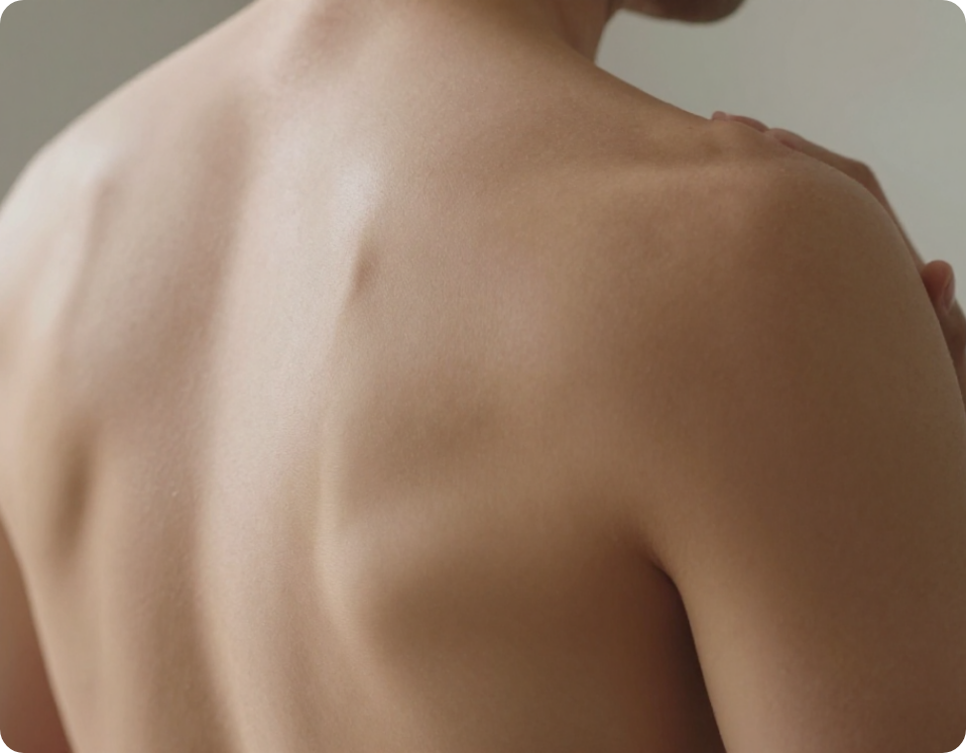
BRADFORD VTS TEACHING DECK
Shoulders, Elbows & Wrists at a Glance – and when to image
RCGP AKT and SCA Exam Preparation
Updated to NICE NG59 (2020) Standards.
June 2026
www.bradfordvts.co.uk
Disclaimer: This teaching deck is for educational purposes only and is designed for GP trainees preparing for professional examinations. Clinical decisions remain the sole responsibility of the attending practitioner. Content follows NICE NG59 (2020) guidance for low back pain and sciatica.

Slide 2













Shoulder Clinical Approach
BRADFORD VTS
Exam Pearl: Painful Arc Interpretation
Look & Inspect
Arc / Movement
Clinical Suggestion
Symmetry & Wasting: Check Supraspinatus/Infraspinatus fossa.
60–120° Arc
Supraspinatus / Rotator cuff tendinopathy (Impingement)
Scapular Winging: Assess during movement or wall-push.
Protracted Shoulders: Increases subacromial impingement risk.
90–120°+ (Continuing)
AC Joint OA
Pain Localisation
Global Restriction
(Active + Passive)
Frozen Shoulder (Adhesive Capsulitis); ER is most reduced
One Finger Pointing: Highly suggestive of AC Joint pathology.
Diffuse Pointing: Often suggests Subacromial Bursitis or Rotator Cuff issues.
Weakness
(Passive preserved)
Rotator Cuff Tear
www.bradfordvts.co.uk

Slide 3










Key Shoulder Diagnoses
BRADFORD VTS
Rotator Cuff
Frozen Shoulder
AC Joint OA
PRIMARY PATHOLOGY
PRIMARY PATHOLOGY
PRIMARY PATHOLOGY
Supraspinatus tendinopathy / Impingement
Adhesive capsulitis (capsular tightening)
Acromioclavicular joint osteoarthritis/dysfunction
CLINICAL PRESENTATION
KEY ASSOCIATIONS
PAIN LOCALISATION
Pain on abduction; often diffuse pointing to bursa
Diabetes mellitus, age >50, prolonged immobility
Point tenderness localized to the top of the shoulder
DIAGNOSTIC TESTS
PHYSICAL SIGNS
AKT Empty Can Test, Painful Arc (60–120°)
Global restriction (Active & Passive); External Rotation most reduced
DIAGNOSTIC TESTS
AKT Scarf Test, Painful Arc (high range 90–120°+)
PAINFUL ARC INTERPRETATION SUMMARY
Arc Range
Likely Diagnosis
Key Differentiating Feature
60–120°
Rotator Cuff Tendinopathy
Pain clears after 120° as humerus clears acromion
90–120°+
AC Joint Dysfunction
Pain continues/increases at top of movement
Global Loss
Frozen Shoulder
Restriction in both active and passive movements
Weakness
Rotator Cuff Tear
Passive range preserved; active movement weak/painful
www.bradfordvts.co.uk

Slide 4











Shoulder Imaging Guidelines: Indications for shoulder scans, focusing on trauma and sudden weakness, while avoiding imaging for gradual-onset pain in younger patients.
BRADFORD VTS
When to Request Imaging
When to Avoid Routine Scans
Clear Trauma: Acute injury with persistent symptoms that do not improve with initial management.
Young Adults: Gradual-onset shoulder pain without a specific traumatic event.
Older Patients (>50): Sudden onset weakness following a minor strain or fall.
Degenerative Changes: Normal age-related "grey hairs" of the joint found in asymptomatic people.
Suspected Rotator Cuff Tear: Significant loss of active power with preserved passive range.
Primary Care MSK: Most cases should be managed with clinical diagnosis and physiotherapy first.
Red Flags: Suspicion of malignancy (e.g., Pancoast tumour) or infection.
Non-Specific Pain: Imaging rarely changes the management plan for atraumatic chronic pain.
COMMON PITFALLImaging gradual-onset pain in young adults often reveals incidental findings (e.g., mild tendinopathy or bursal thickening) that are physiological. This leads to over-medicalisation and patient anxiety.
www.bradfordvts.co.uk

Slide 5



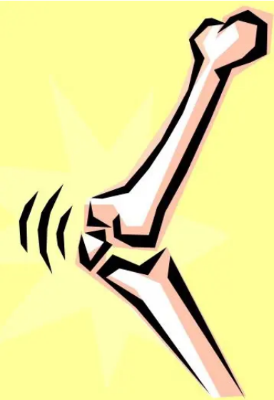








Elbow Anatomy and Epicondylitis
BRADFORD VTS
Anatomy Mnemonic
FM = Flexors → Medial Epicondyle
Think: "Flexor-Medial"
EL = Extensors → Lateral Epicondyle
Think: "Extensor-Lateral"
Condition
Clinical Features
Lateral Epicondylitis
(Tennis Elbow)
Commonest cause; pain on lateral aspect; aggravated by resisted wrist extension.
Medial Epicondylitis
(Golfer's Elbow)
Pain on medial aspect; aggravated by resisted wrist flexion.
EXAM PEARL: Bilateral Symptoms
Always check the Cervical Spine if a patient presents with bilateral epicondylitis. Symptoms originating in the neck frequently refer to both elbows simultaneously.
Assessment Tip
Elbow is linked to both wrist and shoulder; problems in adjacent joints can refer pain to the elbow.
www.bradfordvts.co.uk

Slide 6






Common Elbow Conditions
BRADFORD VTS
Olecranon Bursitis
Pulled Elbow
• Significant posterior elbow swelling (the "egg")
• Children (1-4y) following traction injury
• Causes: RA, repeated trauma, gout, or infection
• Arm held slightly flexed and pronated
• Usually non-tender unless septic or acutely inflamed
• Management: Reduction via supination and flexion
Elbow Osteoarthritis
Cubital Tunnel Syndrome
• Often secondary to previous trauma or surgery
• Ulnar nerve compression at the medial epicondyle
• Earliest clinical sign: Loss of terminal extension
• Numbness/tingling in 4th and 5th fingers
• Locking or clunking may suggest loose bodies
• Positive Tinel's sign behind the medial epicondyle
RED FLAG: SEPTIC BURSITIS
Warmth, spreading erythema, fever, or exquisite tenderness in olecranon bursitis suggests infection. Urgent aspiration and antibiotics required.
www.bradfordvts.co.uk

Slide 7












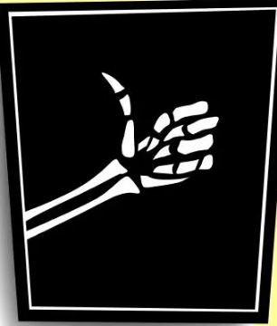


Wrist and Hand Examination
BRADFORD VTS
Identifying Objective Synovitis
Clinical Differentiation
Look: Localized swelling, loss of normal anatomical hollows (snuff box, extensor valleys).
Feature
Localized Issue
Systemic Arthropathy
Mono/Oligoarticular
Polyarticular (Multiple)
Feel: Increased warmth compared to adjacent skin.
Joint Count
Palpate: Boggy or "spongy" feel; unlike the hard, bony expansion of Osteoarthritis.
Asymmetrical
Typically Symmetrical
Symmetry
Synovitis is often easy to feel in the wrist due to its superficial nature.
De Quervain's, CMC OA
RA, PsA, Reactive Arthritis
Examples
Localized/Traumatic
Widespread/Inflammatory
Synovitis
AKT EXAM PEARL
Multiple joints with active synovitis should trigger a systemic workup (RF, CCP, ESR/CRP). Don't forget to check the cervical spine if symptoms are bilateral and neurological!
www.bradfordvts.co.uk

Slide 8

























Key Wrist and Hand Conditions
BRADFORD VTS
Condition
Key Clinical Features
Tests & Management
De Quervain’s Tenosynovitis
Common in "new mums" (lifting infants)
Pain at radial styloid process
Finkelstein's test (+ve)
Steroid injection: >80% cure rate
Thumb CMC Osteoarthritis
Common over 55s
Pain at base of thumb (snuff box area)
Grind test (+ve)
Splinting, NSAIDs, Steroid injection
Trigger Finger
Finger "locking" or painful clicking
Palpable nodule at A1 pulley
Steroid injection: 70–80% success
Surgical release if persistent
Carpal Tunnel Syndrome
Nocturnal tingling/pain; wakes from sleep
Median nerve distribution
Phalen's/Tinel's tests
Night splints, injection, or decompression
Nodal OA (DIPJ/PIPJ)
Heberden's (DIPJs) / Bouchard's (PIPJs)
Strong genetic link; bony swellings
Clinical diagnosis
Topical NSAIDs, activity modification
Top Tip: Hand Injections
Steroid injections are highly effective for De Quervain's and Trigger Finger. For Carpal Tunnel, they provide excellent temporary relief and can be used as a diagnostic trial before surgery.
www.bradfordvts.co.uk

Slide 9






Final Summary and Disclaimer
BRADFORD VTS
Normalise, Don't Medicalise: Reassure patients that degenerative changes are normal ageing, not necessarily pathology.
Exercise First: Prescribe movement and functional rehabilitation as the primary treatment for LBP and upper limb conditions.
Evidence-Based Prescribing: Follow NICE NG59—No paracetamol alone and no gabapentinoids for low back pain.
Vigilance: Always screen for Red Flags (Cauda Equina) and Yellow Flags (Psychosocial risk factors for chronicity).
MANDATORY CLINICAL DISCLAIMER
This teaching deck is designed for UK GP trainees (ST1-ST3) and IMGs preparing for RCGP exams. Clinical decisions must be based on the latest NICE/CKS guidelines and individual patient assessment. While every effort has been made to ensure accuracy at the time of publication (June 2026), clinical evidence evolves rapidly. Bradford VTS accepts no liability for clinical outcomes based on this material.
www.bradfordvts.co.uk
www.bradfordvts.co.uk

