Slide 1



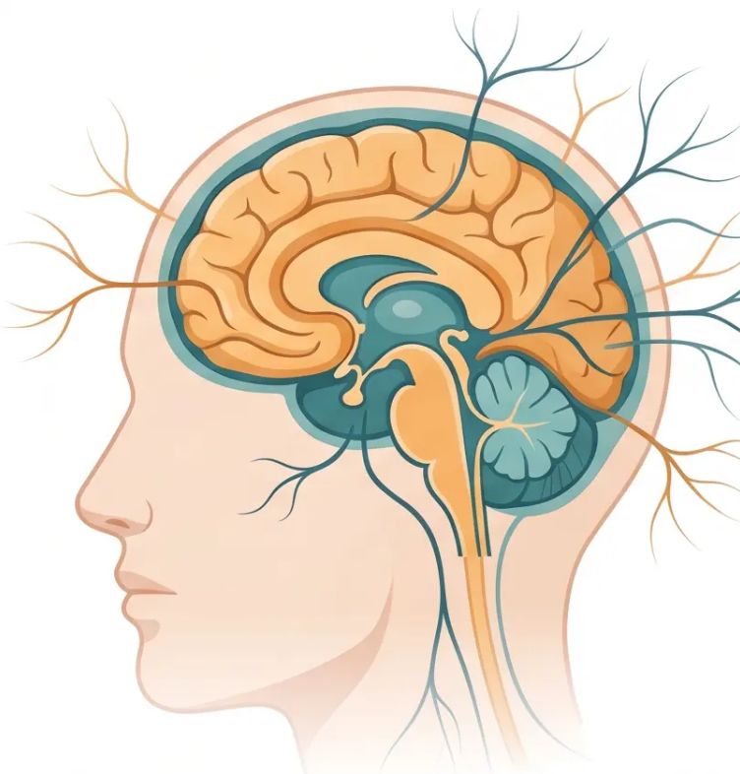
BRADFORD VTS TEACHING DECK
www.bradfordvts.co.uk
NEUROLOGY FOR PRIMARY CARE
Basic Overview of
Neurology for
Primary Care
Created May 2026
Sources: NICE NG217 (Jan 2025) · NICE CKS TIA/Stroke (Nov 2025) · NICE CKS GCA (Jan 2026) · BNF 2025–2026
⚠️ Educational purposes only. Always verify drug doses and guidance with current NICE/BNF resources.

Slide 2






BRADFORD VTS TEACHING DECK
www.bradfordvts.co.uk
EDUCATIONAL CONTEXT
Disclaimer
Always verify all clinical advice and drug doses with the latest
NICE guidelines and BNF before applying to patient care.
This deck is designed for educational and teaching purposes only. It does
not replace clinical judgement or individual patient assessment.
Key Guidelines
Last Updated
Intended Audience
NICE NG217 · NICE CKS Nov 2025 · BNF 2025–2026
May 2026
GP Trainees · Bradford VTS

Slide 3










SECTION 1 — NEUROLOGICAL EXAMINATION IN PRIMARY CARE
The Neurological Consultation
in Primary Care
History is 80% of the diagnosis in neurology
Always get a witness account for blackouts and seizures
Why It Feels Daunting
The Systematic Approach
• Among the most feared consultations for GP
trainees
① Localise the lesion
Where in the nervous system is the problem?
• Complex anatomy and unfamiliar terminology
② Make the diagnosis
• Fear of missing serious pathology
Use history, examination and investigations
Most presentations are common conditions
managed entirely in primary care
③ Manage
Primary care, referral, or emergency?
⚠️ Cross-reference: Headache covered in separate Bradford VTS deck

Slide 4
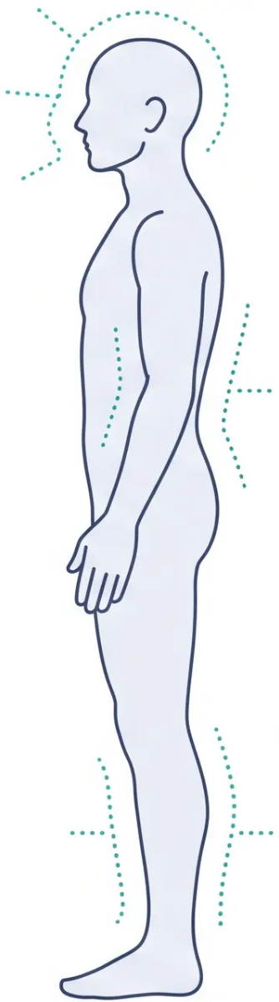



















NEUROLOGICAL EXAMINATION
Examination Framework
A systematic approach — localise the lesion → make the diagnosis → manage
LEVEL 1 — Always Perform
Mental State
/ Cognition
Cranial
Nerves
Upper Limb
Motor + Sensory
Lower Limb
Motor + Sensory
Coordination
(Cerebellar)
Gait and
Stance
LEVEL 2 — When Clinically Indicated
Fundoscopy
Neck Stiffness
Kernig's Sign
— papilloedema, hypertensive
retinopathy
— meningism
— meningeal irritation
Key principle: History is 80% of the diagnosis in neurology — examination confirms and localises.

Slide 5







SECTION 9 · EXAM PREPARATION
AKT & SCA Exam Pearls
High-yield neurology facts and communication strategies for the GP trainee examinations
AKT
SCA
Applied Knowledge Test · Clinical Facts
Structured Clinical Assesment · Communication
• TIA — ABCD2 score no longer NICE-recommended
All TIAs = urgent 24h referral (NICE CKS Nov 2025)
• Seizure history taking:
Opening the seizure history:
• Bell's palsy — LMN: forehead involved
UMN stroke: forehead spared
"Can you tell me exactly what happened from the very beginning?"
• Witness account:
Establishing a witness account:
• GCA — start prednisolone SAME DAY
Do not wait for temporal artery biopsy
"Is there anyone with you who saw what happened? Their
account will really help us."
• Status epilepticus — community first-line:
Buccal midazolam (not rectal diazepam)
Valproate (MHRA 2025) — two-specialist review
for ALL under-55s; absolute contraindication in
women of childbearing potential unless PPP + 2 methods
• DVLA safety-netting after first seizure:
Safety-netting — driving and DVLA:
"You must not drive and you'll need to notify the DVLA — this is a
legal requirement. I'll help you understand how to do that today."
• GCA urgent communication:
• Topiramate — mandatory PPP from 2024 (MHRA)
Driving: first seizure = 6 months off
Established epilepsy = 12 months seizure-free
TIA = 1 month off driving
Explaining urgency in GCA:
"I think this could be a serious condition affecting the blood supply
to your eyes. I'd like to start treatment today — before results back."
• Epilepsy and contraception:
Contraception counselling with ASMs:
• Carbamazepine = enzyme inducer
Reduces OCP efficacy → advise alternative contraception
"Some epilepsy tablets can affect how well the contraceptive pill
works. Let's talk through the safest option for you."
• SUDEP discussion:
• BPPV: Dix-Hallpike to diagnose → Epley to treat
• Trigeminal neuralgia: carbamazepine first-line
Check sodium, FBC, LFTs before starting
Raising SUDEP sensitively: "I want to make sure we talk about
something important — there is a small risk associated with
uncontrolled seizures that we should be aware of together."
Bradford VTS Teaching Deck · Neurology for Primary Care
Slide 33 of 35

Slide 6


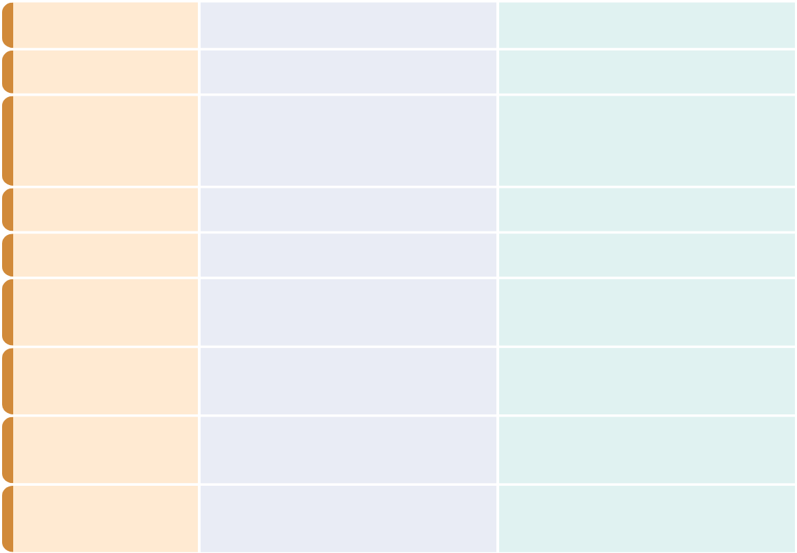

















CLINICAL SAFETY
Red Flags & Common Pitfalls
Emergency features to act on — and clinical errors to avoid
RED FLAGS — ACT NOW
COMMON PITFALLS — DON’T DO THIS
Presentation
Red Flag Feature
Action
❌ Missing cardiac syncope
Headache
Thunderclap onset
999 — SAH
Diagnosing seizure without checking ECG first
Headache
Age >50 + jaw claudication + temporal tenderness
Same-day steroids + GCA referral
❌ Valproate without PPP
Starting in a woman of childbearing potential without specialist review
and Pregnancy Prevention Programme
Dizziness
Diplopia + ataxia + vertigo
999 — posterior stroke
❌ Waiting for biopsy — GCA
Seizure
Still seizing >5 minutes
Starting prednisolone must not wait — vision loss is irreversible
999 + buccal midazolam
TIA
Still symptomatic at consultation
999 — possible stroke
❌ Using ABCD2 score to delay TIA referral
NICE Nov 2025: all TIAs = urgent 24h referral regardless of score
Facial palsy
Bilateral
Urgent neurology — GBS / Lyme
❌ Long-term prochlorperazine for vertigo
Suppresses central adaptation — use only for acute nausea
Neuropathy
Rapid onset + ascending weakness
999 — Guillain-Barré
❌ Bell's palsy steroids after 72 hours
Prednisolone only effective if started within 72h of onset
Any
Progressive weight loss + new neuro symptoms
Urgent 2WW referral
❌ Forgetting DVLA advice
First seizure and first TIA both carry legal notification obligations — document it
❌ Switching ASM brand without warning
Phenytoin and carbamazepine — bioavailability differences risk toxicity
Slide 34 of 35 · Bradford VTS · May 2026
● All red flags require immediate action — document clinical reasoning clearly

Slide 7
















BRADFORD VTS TEACHING DECK
www.bradfordvts.co.uk
CLOSING SUMMARY
Quick Recall
Topiramate Safety
💊 Mandatory Pregnancy Prevention Programme (MHRA 2024)
Risk: cleft lip/palate + neurodevelopmental disorders
Key facts to carry into practice — and into your AKT.
Driving — Epilepsy
GCA — Same-Day Steroids
🚗 First unprovoked seizure → 6 months off
Established epilepsy → 12 months seizure-free
Withdrawing ASMs → do not drive during withdrawal + 6 months after
🔴 Do NOT wait for biopsy
No visual symptoms → prednisolone 40–60mg daily
Visual symptoms → 1mg/kg/day or IV methylprednisolone → 999
Driving — TIA
TIA — All Urgent
🚗 Group 1 → 1 month off driving after TIA
Group 2 (HGV/bus) → 1 year off after TIA
🔴 Aspirin 300mg stat
24-hour specialist referral — all TIAs
ABCD2 score NOT recommended (NICE Nov 2025)
Status Epilepticus — Community
💊 Buccal midazolam 10mg first-line
Rectal diazepam only if midazolam unavailable
Seizure > 5 minutes → treat + call 999
BPPV
👁️ Dix-Hallpike → confirms diagnosis
Epley manoeuvre → curative
Do NOT use prochlorperazine long-term
Valproate Safety
Bell's Palsy
💊 Women of childbearing potential → absolute contraindication
unless PPP + 2 contraception methods
All under-55s → mandatory 2-specialist review (MHRA 2025)
🔔 Prednisolone only if within 72 hours of onset
Protect the eye — lubricating drops + night taping
LMN = forehead involved (unlike UMN stroke)
⚠️ Disclaimer: Always double check this advice and drug doses with the latest NICE/BNF guidance. This deck is for educational purposes only
and does not constitute clinical advice. Verify all guidance before applying in practice.
bradfordvts.co.uk
Sources: NICE NG217 (Jan 2025) - NICE CKS TIA/Stroke (Nov 2025) - NICE CKS GCA (Jan 2026) - BNF 2025–2026 - Created May 2026

