Slide 1


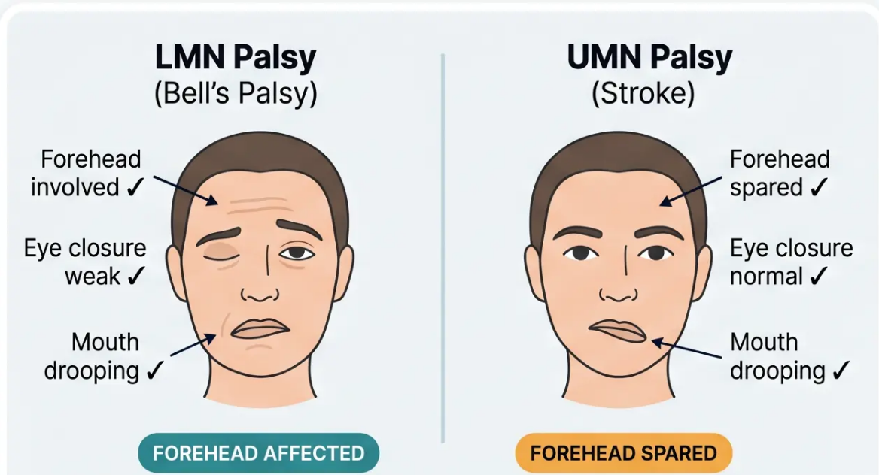
OTHER NEUROLOGICAL CONDITIONS
Bell’s Palsy: Recognition & Treatment
Acute unilateral LMN facial nerve palsy — usually idiopathic · NICE CKS Feb 2023
Steroid Treatment
• Prednisolone 50mg once daily for 10 days
OR 60mg once daily for 5 days, then taper
• Must start within 72 hours of symptom onset
• Antivirals (aciclovir) — only in severe cases; limited evidence
Protect the Eye
• Lubricating eye drops — e.g. hypromellose
• Night-time eye taping if unable to close
• Refer urgently if corneal exposure risk
Prognosis & When to Refer
• 80–85% fully recover
• Worse prognosis: complete paralysis · age >60 · severe pain
LMN = Forehead involved · UMN = Forehead spared
• Refer ENT/Neurology: bilateral palsy, other cranial nerve
involvement, recurrence
Prednisolone is only effective if started within 72 hours of onset.
After this window, do not prescribe steroids.
 72-Hour Window

