Slide 1



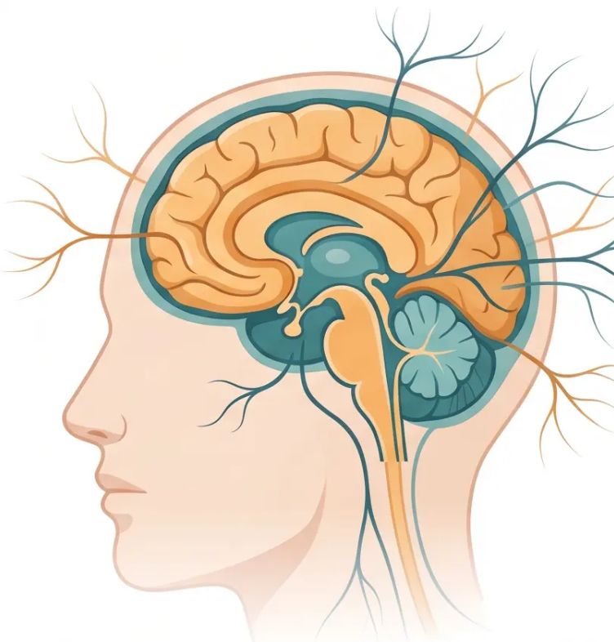
BRADFORD VTS TEACHING DECK
www.bradfordvts.co.uk
NEUROLOGY FOR PRIMARY CARE
Dizziness & Vertigo
& TIA
Created May 2026
⚠️ Educational purposes only. Always verify drug doses and guidance with current NICE/BNF resources.

Slide 2






BRADFORD VTS TEACHING DECK
www.bradfordvts.co.uk
EDUCATIONAL CONTEXT
Disclaimer
Always verify all clinical advice and drug doses with the latest
NICE guidelines and BNF before applying to patient care.
This deck is designed for educational and teaching purposes only. It does
not replace clinical judgement or individual patient assessment.
Key Guidelines
Last Updated
Intended Audience
NICE NG217 · NICE CKS Nov 2025 · BNF 2025–2026
May 2026
GP Trainees · Bradford VTS

Slide 3








BRADFORD VTS TEACHING DECK
www.bradfordvts.co.uk
Section 5 — Dizziness & Vertigo
Dizziness and Vertigo Classification
“These two terms are not interchangeable — the distinction shapes your entire differential diagnosis.”
DIZZINESS
VERTIGO
Non-specific
Specific illusory movement
A vague, non-specific feeling — may include
lightheadedness, imbalance, or a sensation of
nearly fainting
A definite, illusory sensation of movement — either
the self is moving or the surroundings are
spinning
• Lightheadedness
• Rotational spinning sensation
• Feeling faint or pre-syncopal
• Environment appears to move
• Unsteadiness or imbalance
• Often provoked by head position change
• “Wooziness” — hard for patients to describe
• May be accompanied by nausea and nystagmus
Think: cardiac, postural hypotension, anxiety, drugs
Vertigo = specific symptom → structured differential diagnosis
Clinical tip: Always ask “Does the room spin, or do you feel faint?” — this single question separates your differentials before examination begins.

Slide 4














SECTION 5 • DIZZINESS AND VERTIGO
Differential Diagnosis of Vertigo
Peripheral causes are common and benign — central causes are rare but life-threatening
PERIPHERAL
CENTRAL
Inner Ear / Vestibular Nerve
Brainstem / Cerebellum — MUST EXCLUDE
Benign Paroxysmal Positional Vertigo
Vertebrobasilar TIA or Stroke
Brief episodes triggered by head position change
Torsional nystagmus • Fatigues on repeat testing
Most common cause of vertigo
Vertigo + diplopia, dysarthria, dysphagia
Bilateral or shifting weakness / sensory loss
→ 999 immediately
Vestibular Neuritis / Labyrinthitis
Cerebellar Haemorrhage
Acute severe continuous vertigo
May have hearing loss (labyrinthitis)
Usually viral — resolves over weeks
Acute severe vertigo + ataxia
Cannot walk or stand — EMERGENCY
→ 999 immediately
Ménière’s Disease
MS • Brain Tumour • Migraine
Episodic vertigo + hearing loss + tinnitus + ear fullness
Recurrent attacks lasting 20 min – several hours
Refer audiology / ENT
Consider in young adults with relapsing symptoms
Vertical or non-fatiguing nystagmus
Refer neurology
KEY DISTINGUISHING
FEATURES
Nystagmus fatigues • Latency present ↔ Nystagmus persistent • No latency
Hearing loss possible (Ménière’s) ↔ Other brainstem signs present
Patient can walk (unsteady) ↔ Unable to walk / stand — EMERGENCY

Slide 5








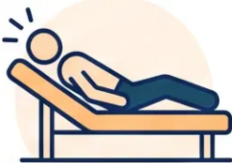








SECTION 5 • DIZZINESS AND VERTIGO
BPPV: Diagnosis & Treatment
Most common cause of vertigo — highly treatable in the surgery
DIAGNOSIS
TREATMENT
Dix-Hallpike Manoeuvre
Epley Manoeuvre
Highly effective for posterior canal BPPV
Perform in surgery or teach patient to self-manage
Single session often curative
1 Patient seated upright on couch, head turned 45°
to the affected side
2 Rapidly lower patient to supine with head extended
over edge of couch (30° below horizontal)
SELF-MANAGEMENT
Brandt-Daroff Exercises
Daily vestibular habituation exercises
Useful if Epley not available or for recurrence
Performed at home — provide written instructions
3 Observe eyes for nystagmus — wait up to 30 seconds
Positive result
MEDICATION NOTE
Vestibular Suppressants (e.g. prochlorperazine)
Short-term ONLY — acute nausea relief
Do NOT use long-term — suppresses central adaptation
✓ Torsional upbeat nystagmus with latency (5–20 sec)
✓ Fatigues with repeated testing
✓ No imaging required if positive
Lateral canal BPPV: use supine roll (Pagnini-McClure) test instead
Most BPPV resolves spontaneously within weeks to months
EXAM PEARL: Dix-Hallpike positive + torsional nystagmus with latency = BPPV. Treat with Epley. No imaging needed.

Slide 6
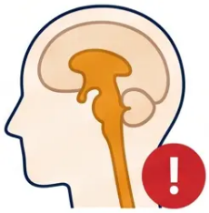














DIZZINESS & VERTIGO · SECTION 5
Red Flags in Vertigo
These features demand immediate action — do not attribute to a peripheral cause
Thunderclap Headache + Vertigo
Diplopia · Dysarthria · Dysphagia
Suspect posterior fossa haemorrhage — call
999 immediately
Vertebrobasilar stroke — call 999; do not
observe and wait
Vertical or Non-Fatiguing Nystagmus
Ataxia Without Peripheral Explanation
Always central origin — brainstem or cerebellar
lesion; urgent neurology
Cerebellar haemorrhage or infarct — call 999
Hearing Loss + Tinnitus + Recurrent
Vertigo
Syncope · Cardiac Symptoms · Falls
Ménière's disease — refer audiology and ENT;
not an emergency but must not be missed
Exclude cardiac cause — ECG, echo, tilt table;
not peripheral vertigo
Vertical nystagmus = always central. Peripheral nystagmus fatigues. Central nystagmus does not.

Slide 7















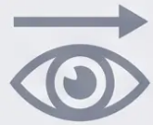



BRADFORD VTS TEACHING DECK
www.bradfordvts.co.uk
Section 5 · Dizziness and Vertigo
Clinical Guide to Nystagmus
Interpreting eye movement patterns to distinguish benign peripheral from serious central pathology
Clinical rule: Direction, fatigability, and associated symptoms determine peripheral vs central origin
Transient Positional Nystagmus WITH Vertigo
Vertical Nystagmus (Any Direction)
Fatigues on repeated testing · Latency before onset
Upbeat or downbeat · Does not fatigue
Always central — brainstem or cerebellar pathology
Peripheral cause — consistent with BPPV
Torsional upbeat direction; resolves with Epley manoeuvre
Never a peripheral cause; urgent neuroimaging required
PERIPHERAL — BENIGN
CENTRAL — URGENT
Positional Nystagmus WITHOUT Vertigo
Horizontal Nystagmus When Sitting Upright
Nystagmus present · No subjective spinning sensation
Gaze-evoked · Worsens on lateral gaze · No positional trigger
Suggests brainstem lesion — dissociation of
nystagmus from vertigo is a red flag
Suggests cerebellar pathology — ataxia often co-present
Assess for past-pointing, heel-shin test, dysarthria
Refer urgently; MRI brain required
CENTRAL — RED FLAG
CENTRAL — CEREBELLAR
Fatigues + vertigo = BPPV
Vertical nystagmus = always central
Nystagmus without vertigo = brainstem lesion

Slide 8




BRADFORD VTS TEACHING DECK
www.bradfordvts.co.uk
Section 6 · Transient Ischaemic Attack
Transient Ischaemic Attack — Definition
TIA is a Neurological Emergency
20% risk of stroke within 90 days · 50% of those within 7 days
TRADITIONAL DEFINITION
CURRENT DEFINITION
Time-Based Definition (Old)
Tissue-Based Definition (New — NICE CKS Nov 2025)
Being replaced
NICE CKS Nov 2025
“Focal neurological dysfunction due to a
vascular cause, with symptoms fully
resolving within 24 hours”
Evolving
definition
“Any MRI evidence of infarction = Stroke
— even if symptoms resolved
within 24 hours”
Often resolved within minutes in practice
Tissue-based, not time-based
Based on duration of symptoms only — no imaging
required under old criteria
Imaging now defines the diagnosis — symptom
duration alone is insufficient
Typical resolution
Vascular cause
Key implication
Minutes to hours (not always 24h)
Ischaemia — not haemorrhage
Treat every TIA as stroke until proven otherwise
⚠️ Educational purposes only. Always verify with current NICE/BNF guidance.
24 / 35

Slide 9
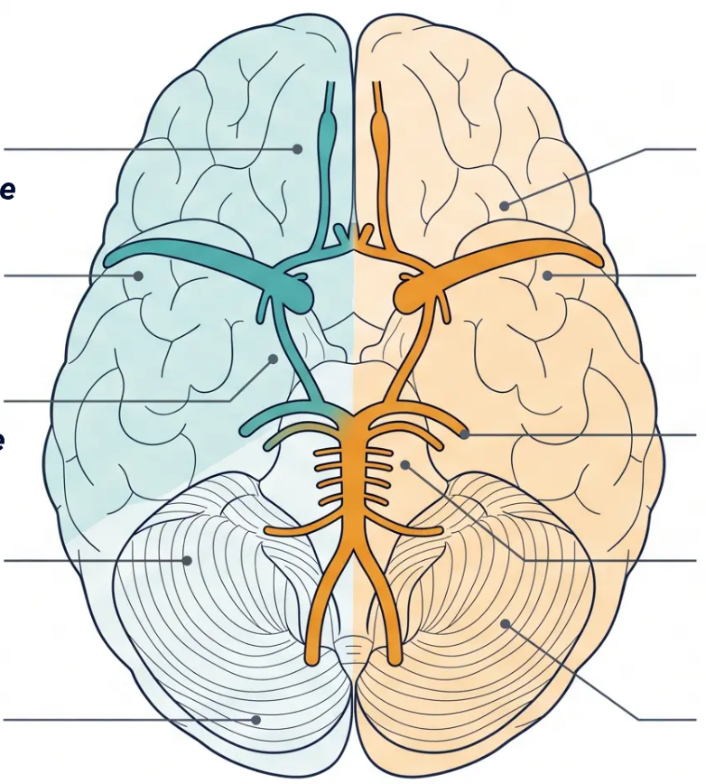
SECTION 6 · TRANSIENT ISCHAEMIC ATTACK
TIA Vascular Territories
Localise the territory → guide investigation and management
Anterior Circulation
Posterior Circulation
Carotid territory · ~80% of TIAs
Vertebrobasilar territory · ~20% of TIAs
● Contralateral hemiparesis or hemiplegia
Weakness of arm, leg or face on the opposite side
● Bilateral or shifting weakness / sensory loss
Crosses midline — hallmark of posterior territory
● Contralateral hemisensory loss
Numbness or tingling — same distribution
● Diplopia
Double vision — brainstem cranial nerve
involvement
● Dysphasia
Dominant hemisphere involvement — expressive
or receptive
● Dysarthria or dysphagia
Slurred speech or swallowing difficulty
● Amaurosis fugax
Ipsilateral transient monocular blindness —
“curtain coming down”
● Vertigo WITH other brainstem signs
Vertigo alone is rarely vascular — look for
accompanying features
● Contralateral homonymous hemianopia
Visual field loss on the side opposite the lesion
● Bilateral visual loss
Occipital cortex ischaemia — both eyes affected
⚠️ Clinical pearl: Vertigo in isolation is rarely a TIA — posterior circulation events almost always have additional brainstem signs (diplopia,
dysarthria, ataxia, bilateral weakness)

Slide 10











SECTION 6 · TRANSIENT ISCHAEMIC ATTACK
Immediate Management of Suspected TIA
⚠️ TIA is a neurological emergency — 20% stroke risk within 90 days; 50% of those within 7 days
STEP 1 — IMMEDIATE
Aspirin 300 mg stat
Give immediately if patient is not already on antiplatelet therapy or anticoagulation.
Do not delay waiting for specialist assessment.
STEP 2 — WITHIN 24 HOURS
Urgent specialist assessment
Refer to TIA clinic or stroke unit within 24 hours of symptom onset. If still symptomatic
at presentation — call 999 immediately (may be eligible for thrombolysis).
STEP 3 — IMPORTANT REMINDER
Do NOT use ABCD2 score
NICE CKS Nov 2025: ABCD2 score is no longer recommended to guide referral urgency.
All suspected TIAs require urgent assessment — no exceptions.
DVLA: Patient must not drive for 1 month after TIA · Group 1 licence · Document advice in records

Slide 11











BRADFORD VTS TEACHING DECK
www.bradfordvts.co.uk
Section 6 · Transient Ischaemic Attack
TIA Secondary Prevention and DVLA
Secondary Prevention After TIA
DVLA Driving Restrictions
ANTIPLATELET
Aspirin 75mg + dipyridamole MR 200mg twice daily →
Continue for 2 years, then aspirin 75mg alone
If aspirin intolerant: clopidogrel 75mg daily
Aspirin 300mg stat given immediately at presentation
GROUP 1 Cars and Motorcycles
Must not drive for 1 month after TIA
Can resume after 1 month if no further events
No formal DVLA notification required for TIA (unlike
seizure) — but advise clearly and document
IF ATRIAL
FIBRILLATION
DOAC first-line — timing individualised by stroke specialist
Warfarin only if valve disease or specialist preference
Do NOT give antiplatelet AND anticoagulant together routinely
GROUP 2 HGV and Bus Drivers
STATIN
Atorvastatin 80mg — high-intensity, regardless of
baseline cholesterol
Must not drive for 1 year after TIA
Requires satisfactory specialist assessment
before return
BLOOD PRESSURE
ACE inhibitor + thiazide-like diuretic
Every 10 mmHg fall in diastolic BP → risk halves
If ipsilateral stenosis >70%
Within 48 hours (high-risk) or ≤14 days (all others)
CAROTID STENOSIS
Advise the patient, document the
conversation, and record in the notes.
NICE CKS NOV 2025
All TIAs = urgent 24h referral · ABCD2 score no longer recommended · Aspirin 300mg stat immediately
Do not delay — every hour matters

