Slide 1



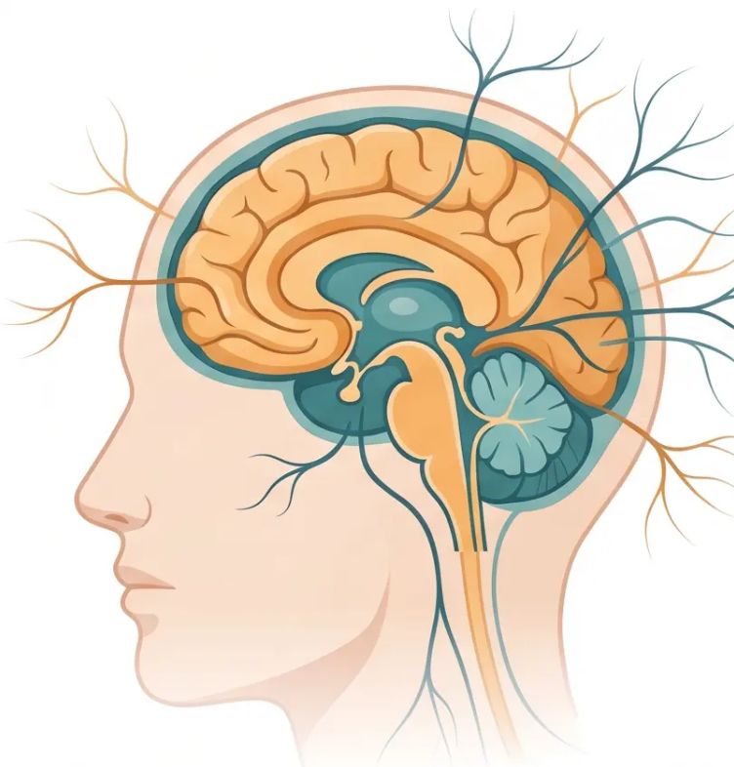
BRADFORD VTS TEACHING DECK
www.bradfordvts.co.uk
NEUROLOGY FOR PRIMARY CARE
Epilepsy in
Primary Care
Created May 2026
⚠️ Educational purposes only. Always verify drug doses and guidance with current NICE/BNF resources.

Slide 2






BRADFORD VTS TEACHING DECK
www.bradfordvts.co.uk
EDUCATIONAL CONTEXT
Disclaimer
Always verify all clinical advice and drug doses with the latest
NICE guidelines and BNF before applying to patient care.
This deck is designed for educational and teaching purposes only. It does
not replace clinical judgement or individual patient assessment.
Key Guidelines
Last Updated
Intended Audience
NICE NG217 · NICE CKS Nov 2025 · BNF 2025–2026
May 2026
GP Trainees · Bradford VTS

Slide 3










SECTION 1 — NEUROLOGICAL EXAMINATION IN PRIMARY CARE
The Neurological Consultation
in Primary Care
History is 80% of the diagnosis in neurology
Always get a witness account for blackouts and seizures
Why It Feels Daunting
The Systematic Approach
• Among the most feared consultations for GP
trainees
① Localise the lesion
Where in the nervous system is the problem?
• Complex anatomy and unfamiliar terminology
② Make the diagnosis
• Fear of missing serious pathology
Use history, examination and investigations
Most presentations are common conditions
managed entirely in primary care
③ Manage
Primary care, referral, or emergency?
⚠️ Cross-reference: Headache covered in separate Bradford VTS deck

Slide 4
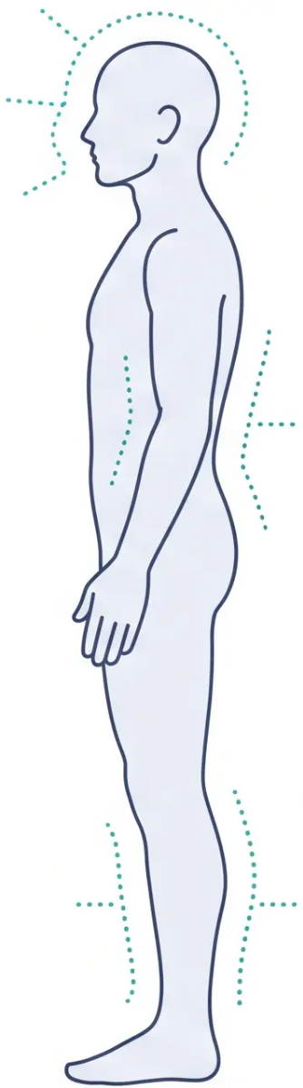



















NEUROLOGICAL EXAMINATION
Examination Framework
A systematic approach — localise the lesion → make the diagnosis → manage
LEVEL 1 — Always Perform
Mental State
/ Cognition
Cranial
Nerves
Upper Limb
Motor + Sensory
Lower Limb
Motor + Sensory
Coordination
(Cerebellar)
Gait and
Stance
LEVEL 2 — When Clinically Indicated
Fundoscopy
Neck Stiffness
Kernig's Sign
— papilloedema, hypertensive
retinopathy
— meningism
— meningeal irritation
Key principle: History is 80% of the diagnosis in neurology — examination confirms and localises.

Slide 5







SECTION 2 — EPILEPSY
Epilepsy Epidemiology & SUDEP Risk
50
4–7
~10
per 100,000 / year
per 1,000
patients
Incidence of epilepsy
Prevalence — active epilepsy
On an average GP list
New cases in the UK annually
Seizure or treatment in past 5 years
2–3 will have continuing seizures
despite treatment
SUDEP
SUDEP risk falls dramatically
with good seizure control
350–400
deaths per year in the UK
Sudden Unexpected Death in Epilepsy — discuss with every patient (NICE NG217)
NICE NG217 · Jan 2025

Slide 6








SECTION 2 · EPILEPSY
Seizure Classification Focal Onset
ILAE 2017 Terminology · NICE NG217 (Jan 2025)
FOCAL ONSET SEIZURES — 60% of all epilepsy
Consciousness is the key distinguishing feature
Focal Impaired
Awareness
Focal to Bilateral
Tonic-Clonic
Focal Aware
Previously: Simple Partial Seizure
Previously: Complex Partial Seizure
Previously: Secondary Generalised Seizure
Seizure activity in one brain region.
Seizure activity in one brain region with
impaired but not fully lost consciousness.
The patient cannot respond normally.
Focal onset seizure that spreads to
involve both hemispheres, producing a
generalised tonic-clonic convulsion.
Consciousness and awareness are fully
preserved throughout.
• Motor, sensory, autonomic, or psychic
symptoms
• Automatisms present in ~90% of cases
• Begins focally — may have an aura
• Post-ictal drowsiness in ~75%
• Patient remains alert and can respond
• Progresses to full tonic-clonic
convulsion
• May have post-ictal weakness (Todd's
paresis)
• Staring, lip-smacking, fumbling
movements
• Post-ictal confusion and fatigue
• Amnesia for the episode is typical
• Jacksonian march: sequential spread
along motor strip
• Lateralising signs at onset help
localise focus
Diagnosis is clinical — witness account is essential
Bradford VTS · Neurology for Primary Care · 2026

Slide 7












EPILEPSY • SEIZURE CLASSIFICATION
Generalised Onset Seizures
Generalised seizures involve both hemispheres simultaneously from onset — consciousness is typically impaired
Absence
Myoclonic
Tonic-Clonic
Petit Mal
Sudden Single Jerks
Grand Mal
Brief staring episodes — seconds only
No convulsion; abrupt onset and offset
3 Hz spike-and-wave on EEG
Brief muscle jerks — usually morning
Consciousness preserved
Common in juvenile myoclonic epilepsy
Loss of consciousness
Tonic phase → rigid stiffening
Clonic phase → rhythmic jerking
Atonic
Tonic / Clonic
Drop Attacks
Isolated Forms
Sudden loss of muscle tone
Abrupt falls — injury risk high
Brief; immediate recovery
Tonic only — sustained stiffening
Clonic only — rhythmic jerking alone
Less common than tonic-clonic combined
Generalised seizures are classified by ILAE 2017 terminology — used throughout NICE NG217 (Jan 2025)
bradfordvts.co.uk

Slide 8









EPILEPSY · DIAGNOSIS
Clinical Diagnosis of Epilepsy
Clinical History
EEG
MRI Brain
80% of the Diagnosis
Supports — Does Not Confirm
Specialist-Initiated
– History from patient AND witness
is essential
– Supports diagnosis but does NOT
rule out epilepsy if normal
– Recommended at specialist
initiation (NICE NG217)
– Describe: onset, duration, post-ictal
state, tongue biting, incontinence
– Absence epilepsy: 3 Hz spike-
and-wave is characteristic
– Identifies structural cause: tumour,
cortical dysplasia, hippocampal
– Witness account for blackouts is
non-negotiable
– Interictal EEG may be entirely
normal in confirmed epilepsy
– Do NOT arrange MRI in primary
care — refer first
Diagnosis is clinical – tests support,
not replace, the history
Specialist-requested, not routine
primary care
NICE NG217 — MRI brain for all newly
diagnosed epilepsy
20% of Patients Referred to Epilepsy Clinics Do NOT Have Epilepsy
Always consider: cardiac syncope · non-epileptic attack disorder (NEAD) · functional seizures
ECG is mandatory in the workup of any first suspected seizure
Bradford VTS Teaching Deck · Neurology for Primary Care
8 / 35

Slide 9









EPILEPSY — FIRST PRESENTATION
Primary Care Management of First Seizure
Take a thorough history
01
From patient AND witness — witness account is essential for blackout events
⚠ DON'T MISS
Identify provoked causes
Cardiac Syncope
02
Always request ECG before
labelling a blackout as
epilepsy
Alcohol withdrawal · drug withdrawal · hypoglycaemia · hyponatraemia · fever · medications
Request essential bloods
03
Consider also:
Glucose · FBC · U&E · LFT · Calcium · Magnesium
Syncope
Perform an ECG
NEAD / Functional seizures
04
Hypoglycaemia
Exclude cardiac arrhythmia — cardiac syncope is commonly misdiagnosed as seizure
Cardiac arrhythmia
Refer urgently to neurology
05
NICE NG217
Same-day if seizure ongoing, status epilepticus, or clinical uncertainty
Urgent neurology
Advise on DVLA obligations
assessment — same day
if uncertain
06
Patient must stop driving and notify DVLA immediately — document this advice
Bradford VTS Teaching Deck · Neurology for Primary Care
Slide 9 of 35

Slide 10












10 of 35
SECTION 2 • EPILEPSY
Seizure First Aid & Status Epilepticus
SEIZURE FIRST AID
STATUS EPILEPTICUS
What to do during a convulsion
Seizure > 5 minutes — act immediately
STEP
COMMUNITY FIRST-LINE
Protect from injury — cushion the head, clear hazards
1
Buccal Midazolam 10mg
Time the seizure from onset
(Epistatus® or Buccolam®)
Do NOT restrain the person
Call 999 immediately
Do NOT put anything in the mouth
Rectal diazepam 10mg if midazolam unavailable
After convulsion stops — place in recovery position
STEP
IN HOSPITAL
CALL 999 IF:
2
IV Lorazepam
• Seizure lasts more than 5 minutes
First-line intravenous benzodiazepine
• No recovery after the seizure stops
• Injury has occurred
STEP
REFRACTORY
• This is a first seizure
3
IV Levetiracetam or Phenytoin
• Repeated seizures without recovery between
Then anaesthesia if seizure continues
• Patient is pregnant
NICE NG217: Any seizure exceeding 5 minutes must be treated as status epilepticus
NHS First Aid Guidance, Dec 2024

Slide 11










EPILEPSY · SECTION 3
Prescribing Anti-Seizure Medications
Know your role — what the specialist starts, the GP continues safely
Specialist-Initiated Only
GP Continues the Regimen
Annual Structured Review
Do NOT start anti-seizure
medications in primary care without
a confirmed specialist diagnosis.
Initiation belongs to neurology.
Once stabilised, the GP prescribes
repeat ASMs, monitors for side
effects, and supports the
patient's ongoing care.
Seizure control · Side effects
Contraception · SUDEP discussion
DVLA status · Mental health
NICE NG217
Shared Care Agreement
Document everything
Do NOT switch between brands for these drugs
NICE NG217
Phenytoin · Carbamazepine · Phenobarbital · Primidone
Different manufacturers' formulations have different bioavailability. Switching brands — even to the same
generic — risks toxicity or loss of seizure control. Always prescribe by brand name.
Bradford VTS Teaching Deck · Neurology for Primary Care
11 / 35

Slide 12























BRADFORD VTS TEACHING DECK
www.bradfordvts.co.uk
SECTION 3 — ANTI-SEIZURE MEDICATIONS
First-Line ASMs by Seizure Type
BNF 2025–2026 · NICE NG217 (Jan 2025)
Initiation is specialist-led — GPs continue the prescribed regimen. Do not start ASMs in primary care without a confirmed specialist diagnosis.
SEIZURE TYPE
FIRST-LINE ASM
DOSING GUIDE
Carbamazepine
Carbamazepine: 100–200 mg once or twice daily → maintenance 800–1200 mg/day
Lamotrigine: 25 mg daily × 2 wks → 50 mg daily × 2 wks → maintenance 100–200 mg/day
Levetiracetam: 250–500 mg twice daily → max 3000 mg/day
Focal Onset
Lamotrigine
Focal aware · Focal impaired awareness
Focal to bilateral tonic-clonic
Levetiracetam
Sodium Valproate
Sodium Valproate: Initial 600 mg/day → maintenance 1–2 g/day
Generalised Tonic-Clonic
Grand mal · Loss of consciousness
⚠ See valproate safety slide
Absence
Ethosuximide: 500 mg/day → maintenance 1000–1500 mg/day
Ethosuximide
Petit mal · Brief staring · 3 Hz spike-and-wave
Sodium Valproate (men only)
Sodium Valproate: 1–2 g/day (men)
Women: discuss alternatives with specialist – lamotrigine or levetiracetam
Juvenile Myoclonic
Morning jerks · Preserved consciousness
⚠ AVOID in women of childbearing potential
*Add-on therapy: Clobazam 5–15 mg/day (max 60 mg/day) — adjunctive use only
⚠️ Educational purposes only. Always verify doses with current BNF and specialist guidance.

Slide 13







ANTI-SEIZURE MEDICATIONS · SAFETY
Sodium Valproate Safety
MHRA Critical Updates 2024–2025
MHRA Drug Safety Update Feb 2025
Mandatory 2-specialist review required for ALL patients under 55 initiating
valproate — male and female
Women of
Childbearing Potential
Men Under 55
Valproate in Pregnancy
Precautionary advice required
ABSOLUTE CONTRAINDICATION
10× increased risk
Potential neurodevelopmental
effects on offspring
unless enrolled in Pregnancy
Prevention Programme
of major malformations
30–40% risk
Mandatory 2-specialist review
before initiation
AND two methods of
contraception confirmed
of neurodevelopmental problems
Discuss at every prescribing
opportunity
MHRA Feb 2025
Teratogenic — avoid in pregnancy
MHRA Sept 2024
DO NOT INITIATE IN PRIMARY CARE Valproate is specialist-initiated. GP role: continue, monitor, and counsel — not start.

Slide 14




BRADFORD VTS TEACHING DECK
www.bradfordvts.co.uk
ANTI-SEIZURE MEDICATIONS · SAFETY
Topiramate Safety & Drug Monitoring
⚠ Topiramate — Mandatory PPP
- Pregnancy Prevention Programme (PPP) now mandatory — introduced MHRA 2024 for all women of childbearing potential
- Risks to exposed infants: cleft lip/palate and neurodevelopmental disorders
- Both valproate AND topiramate now require mandatory PPP — counsel patients at every review
MHRA Drug Safety Update 2024 · Confirm contraception and understanding at each prescription
BLOOD MONITORING REQUIREMENTS BY DRUG
Drug
Monitoring Required
Carbamazepine
FBC + LFTs before starting and regularly; blood level if toxicity or compliance concern
Phenytoin
Blood level if toxicity or compliance suspected; narrow therapeutic window; check FBC + LFTs
Valproate
FBC + LFTs before starting and regularly; blood level not routinely useful
Lamotrigine
No routine blood monitoring required
Levetiracetam
No routine blood monitoring required
Clobazam
No routine blood monitoring required
💡 Key rule: If the patient is well controlled — do NOT check drug levels without a clinical reason
⚠ Educational purposes only. Always verify doses and monitoring with current NICE NG217 and BNF 2025–2026.

Slide 15










BRADFORD VTS TEACHING DECK
www.bradfordvts.co.uk
EPILEPSY — SECTION 4
Epilepsy, Contraception & Enzyme Inducers
NICE NG217 · Hormonal contraceptive interactions in clinical practice
⚠ Enzyme-Inducing ASMs Reduce OCP Efficacy
Non-Enzyme-Inducing ASMs OCP Remains Effective
• Carbamazepine
• Sodium valproate
• Primidone
• Gabapentin
• Phenytoin
• Oxcarbazepine
• Lamotrigine
• Clobazam
• Phenobarbital
• Topiramate (>200 mg/day)
• Benzodiazepines
• Levetiracetam
Combined OCP — UNRELIABLE with these drugs
Standard OCP efficacy maintained
Recommended Contraception with Enzyme Inducers
⚡ Lamotrigine + OCP — Special Interaction
Use LARC — long-acting reversible contraception
OCP increases lamotrigine clearance → lower lamotrigine levels
Risk: seizure breakthrough when OCP is started
IUD (copper or hormonal) — unaffected by enzyme inducers
Risk: lamotrigine toxicity during pill-free week (levels spike)
Implant — may have reduced efficacy; use with caution
Action: specialist review before starting/stopping OCP in
patients on lamotrigine
Depo-Provera injection — manufacturer reports no interaction
Barrier methods — always appropriate as addition
Monitor closely — dose adjustment may be needed
⚠ Educational purposes only. Always verify with current NICE/BNF guidance.

Slide 16








BRADFORD VTS TEACHING DECK
www.bradfordvts.co.uk
Epilepsy · Special Situations
Pregnancy & Pre-conception Care
Before Pregnancy
Preferred ASMs in Pregnancy
During & After Pregnancy
• Pre-conception counselling is essential
— plan ahead
✅ Lamotrigine — most safety data; widely used
• Over 90% of women with epilepsy have
a successful pregnancy with careful
management
✅ Levetiracetam — good safety profile in
pregnancy
• Start folic acid 5mg daily at least 3
months before conception
⚠️ Monitor lamotrigine levels — OCP
interaction affects clearance
• Seizure control remains the priority —
uncontrolled seizures also harm the fetus
• Continue folic acid through the entire
first trimester
• Monotherapy always preferred over
polytherapy
• Vitamin K for neonate if mother is on
enzyme-inducing ASM
• Review current ASM — is monotherapy
possible?
• Use lowest effective dose throughout
• Continue specialist-led monitoring
throughout pregnancy
• Aim for lowest effective dose
AVOID
• Discuss risk vs benefit of withdrawing
ASMs if seizure-free ≥ 2 years
❌ Sodium valproate — teratogenic; 10x
malformation risk
• Breastfeeding: generally supported —
seek specialist advice per ASM
❌ Topiramate — mandatory PPP; cleft palate risk
NICE NG217 Jan 2025 · NICE NG247 Jan 2025
💊 FOLIC ACID REMINDER
📋 NICE NG217 KEY PRINCIPLE
5mg daily — start 3 months before conception, continue through first
trimester. Standard 400mcg dose is NOT sufficient in epilepsy.
>90% of women with epilepsy can have a successful
pregnancy. Careful planning and monotherapy are key.
⚠️ Educational purposes only. Always verify with current NICE NG217, NICE NG247, and BNF guidance.

Slide 17







Epilepsy · DVLA & Driving
DVLA Regulations for Epilepsy
GROUP 1 — CARS & MOTORCYCLES
● First unprovoked seizure 6 months seizure-free before driving
Not advising DVLA
after a first seizure
is a medicolegal
obligation failure
● Established epilepsy 12 months seizure-free before driving
● Nocturnal seizures only 1 year of nocturnal-only seizures; no daytime attacks
Document every
conversation. Every time.
● Withdrawing ASMs Do not drive during withdrawal and for 6 months after
GROUP 2 — HGV & BUS DRIVERS
10 years seizure-free AND not on ASMs for 10 years AND no structural cause
This is a much higher bar — counsel patients early if they hold a Group 2 licence
GP RESPONSIBILITIES — MEDICOLEGAL
✔ Advise the patient to stop driving immediately after first seizure or diagnosis
✔ Advise patient to notify DVLA — this is the patient’s legal duty, not the GP’s
✔ Document this advice clearly in the medical record — date, wording, patient response
If patient refuses to stop driving → challenge, document, and notify DVLA directly
DVLA guidance updated Nov 2025 · NICE NG217 (Jan 2025)

Slide 18



BRADFORD VTS TEACHING DECK
www.bradfordvts.co.uk
EPILEPSY — SECTION 4
SUDEP Communication
and Prevention
NICE NG217 Requirement: Discuss SUDEP risk with every patient with epilepsy — and document that you have done so.
Understanding the Risk
Prevention Strategies
● 350–400 deaths per year in the UK are attributed to SUDEP
● Optimise seizure control — review ASMs; refer if uncontrolled
● 1 in 1,000 people with epilepsy per year (general population)
● Nocturnal supervision — discuss with patient and family sensitively
● 1 in 250 at tertiary epilepsy clinics — reflecting higher-risk patients
● Seizure alarm devices — available for high-risk patients; refer to
epilepsy specialist nurse
● Risk falls dramatically with good seizure control — this is the key
prevention message
● Avoid prone sleeping — advise patient and household members
Highest-Risk Profile
How to Have the Conversation
● Uncontrolled tonic-clonic seizures — especially nocturnal
● Frame positively: "Seizure control dramatically reduces this risk"
● Sleeping alone without supervision
● Involve family or carers where appropriate
● Prone sleeping position after a seizure
● Document the discussion in the medical record — this is a NICE
requirement
CLINICAL REMINDER
Seizure control is the single most effective SUDEP prevention. Every uncontrolled seizure is an opportunity to review and act.

Slide 19







SECTION 9 · EXAM PREPARATION
AKT & SCA Exam Pearls
High-yield epilepsy facts and communication strategies for the GP trainee examinations
AKT
SCA
Applied Knowledge Test · Clinical Facts
Structured Clinical Assesment · Communication
• Seizure history taking:
• Status epilepticus — community first-line:
Buccal midazolam (not rectal diazepam)
Valproate (MHRA 2025) — two-specialist review
for ALL under-55s; absolute contraindication in
women of childbearing potential unless PPP + 2 methods
Opening the seizure history:
"Can you tell me exactly what happened from the very beginning?"
• Witness account:
Establishing a witness account:
"Is there anyone with you who saw what happened? Their
account will really help us."
• DVLA safety-netting after first seizure:
• Topiramate — mandatory PPP from 2024 (MHRA)
Driving: first seizure = 6 months off
Established epilepsy = 12 months seizure-free
TIA = 1 month off driving
Safety-netting — driving and DVLA:
"You must not drive and you'll need to notify the DVLA — this is a
legal requirement. I'll help you understand how to do that today."
• Epilepsy and contraception:
Contraception counselling with ASMs:
"Some epilepsy tablets can affect how well the contraceptive pill
works. Let's talk through the safest option for you."
• Carbamazepine = enzyme inducer
Reduces OCP efficacy → advise alternative contraception
• SUDEP discussion:
Raising SUDEP sensitively: "I want to make sure we talk about
something important — there is a small risk associated with
uncontrolled seizures that we should be aware of together."
Bradford VTS Teaching Deck · Neurology for Primary Care
Slide 33 of 35

