Slide 1

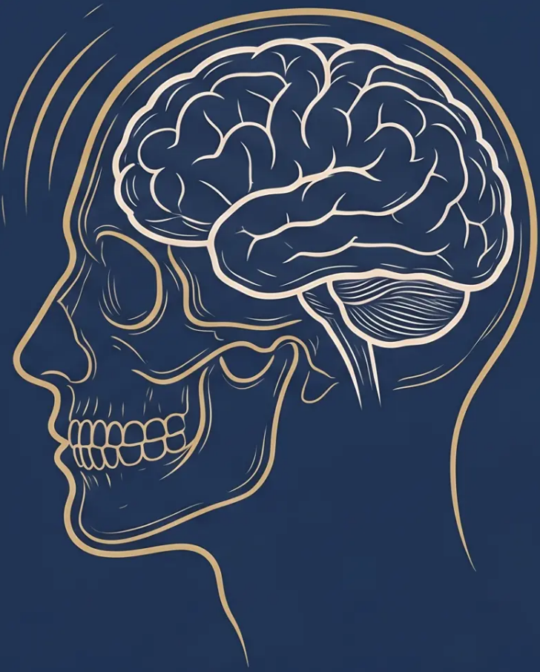

BRADFORD VTS TEACHING DECK
www.bradfordvts.co.uk
Headache & Migraine
in Primary Care
Created May 2026 · Updated to NICE CG150 December 2025 Standards
Always double check this advice and drug doses with the latest
NICE/BNF guidance. This document is for educational purposes only.
Bradford VTS · www.bradfordvts.co.uk · For Educational Use Only

Slide 2





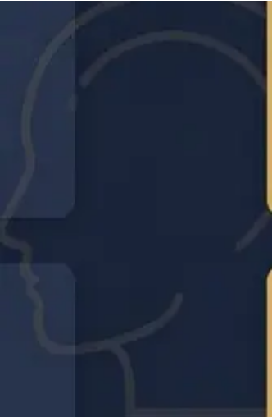


Slide 3 · Section 1: Classification
PRIMARY HEADACHES
IHS Headache Classification
MIGRAINE
TENSION-TYPE HEADACHE
With and without aura
Most common primary headache type
15% of the general population
25% of women · 8% of men
Up to 80% of adults affec
episodically
Peak ages 25–55 · Female predominance 3:1
Episodic or chronic (>15 days/month for ≥6 months)
⚡ CLUSTER HEADACHE
OTHER PRIMARY HEADACHES
Rare but severely debilitating
■ Cough headache
■ Sexual headache
1 in 1,000 people
■ Exertional headache
■ Cold-stimulus headache
Male predominance 3:1 · Episodic or chronic
Often benign — but always exclude secondary cause first
IHS = International Headache Society · Classification basis for all clinical diagnosis
www.bradfordvts.co.uk

Slide 3

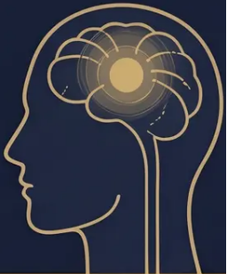



IHS CLASSIFICATION · SECONDARY HEADACHES
Secondary Headaches: Always Exclude First
These diagnoses must be actively considered and ruled out in every new or changed headache presentation.
⚡ EMERGENCY — CALL 999
Subarachnoid Haemorrhage
Meningitis / Encephalitis
Hypertensive Crisis
Venous Sinus Thrombosis
Thunderclap — worst headache of life
Fever + meningism + rash
Severe BP elevation + symptoms
OCP use, postpartum, progressive
⚠ URGENT — SAME-DAY ASSESSMENT
Giant Cell Arteritis
Raised Intracranial Pressure
Space-Occupying Lesion
Age >50 · jaw claudication · ESR↑
Focal signs · waking headache · progressive course
Progressive · worse lying flat · papilloedema
✦ IMPORTANT — DIAGNOSE AND MANAGE
Medication Overuse Headache
Cervicogenic / Sinus / Dental
Post-Traumatic Headache
Hypertension-Related
1 in 50 adults · often missed
Structural and local causes
History of head injury
Usually mild; rarely sole cause
· Slide 4 of 35
Source: IHS Classification 3rd Edition · NICE CKS Headache Assessment (March 2022) · NICE CG150 (Dec 2025)
www.bradfordvts.co.uk

Slide 4











EPIDEMIOLOGY
NICE CKS · BSW NHS Pathway · 2026
Headache in General Practice
95%+
4th
3:1
of the population experience
headache at some point
most common reason for
GP consultation
female to male ratio in
migraine prevalence
15%
2 in 3
1 in 50
of adults live with migraine —
peak ages 25 to 55
migraineurs never
consult a doctor
adults affected by medication
overuse headache
Headache accounts for significant GP workload — yet 2 in 3 migraineurs never seek help. Early identification and management matters.

Slide 5










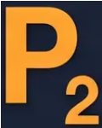
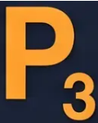
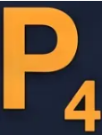
RED FLAGS — EVERY HEADACHE CONSULTATION
Red Flag Screening: The SNOOP4 Tool
Systematically screen every patient — one missed flag can be life-threatening
Systemic
Onset —
Thunderclap
Neurological
Older Age
Fever · weight loss · HIV ·
immunosuppression
Focal deficit · confusion ·
impaired consciousness
Worst headache of life →
SAH until proven otherwise
New headache age >50
→ GCA · malignancy
Precipitated
by Valsalva
Progressive
Postural
Papilloedema
Worsening over days
or weeks
Cough · sneeze ·
exercise → raised ICP
Worse lying flat or
on standing
Seen on fundoscopy
→ urgent
ALSO CONSIDER
Headache waking from sleep · New headache in pregnancy · Jaw claudication · Scalp tenderness · Meningism (neck stiffness · Kernig's)
NICE CKS Headache Assessment — March 2022
www.bradfordvts.co.uk

Slide 6











NICE CKS 2022 · NICE CG150 Dec 2025
Urgent Management of Red Flag Headaches
Immediate clinical actions — do not delay
THUNDERCLAP HEADACHE
GIANT CELL ARTERITIS (GCA)
RAISED ICP · FOCAL DEFICIT
"Worst headache of my life" —
sudden onset
Age >50 · jaw claudication ·
scalp tenderness · ESR↑
Papilloedema · progressive
worsening · focal neurology
Start prednisolone 40–60mg
immediately
Call 999 immediately
Urgent CT or MRI head
• Transfer to A&E without delay
• Same-day neurology referral
• Do NOT wait for bloods before treating
• SAH must be excluded — CT
head urgently
• Check ESR, CRP, examine temporal
arteries
• Do NOT perform LP before
imaging
• LP if CT negative (xanthochromia)
• Monitor for herniation signs
• Same-day urgent referral to rheumatology
SUBARACHNOID HAEMORRHAGE
UNTIL PROVEN OTHERWISE
SIGHT-THREATENING — ACT SAME DAY
SPACE-OCCUPYING LESION UNTIL EXCLUDED
When in doubt — refer, don't wait. Document your clinical reasoning.
Bradford VTS · www.bradfordvts.co.uk

Slide 7









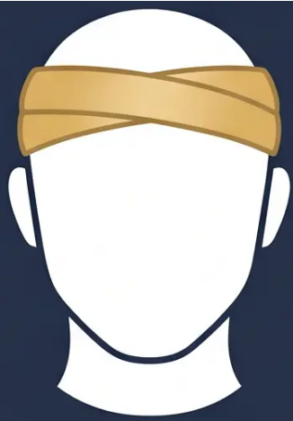









SECTION 3 — TENSION-TYPE HEADACHE
Bradford VTS · NICE CG150 (Dec 2025)
Tension-Type Headache: Clinical Diagnosis
What It Feels Like
Key Exclusions
Duration & Subtype
❌ NOT aggravated by routine
physical activity
EPISODIC
30 minutes → 7 days per attack
❌ NO nausea or vomiting
< 15 headache days/month
❌ NOT both photophobia
AND phonophobia
CHRONIC
(one may be present — not both)
Bilateral
Pressing / Tightening
> 15 headache days/month
For ≥ 6 months
*These exclusions help distinguish
TTH from migraine*
Non-pulsating
Mild to Moderate
Clinical Pearl: TTH is the most common headache type — up to 80% of adults experience it
episodically. The diagnosis is clinical: bilateral, pressing, no nausea, not worsened by movement.

Slide 8














TENSION-TYPE HEADACHE · ACUTE TREATMENT
Acute Management of Tension-Type Headache
NICE CG150 (December 2025) — Stepwise Approach
STEP 1 — FIRST-LINE
Paracetamol 1g
AVOID OPIOIDS
Up to four times daily · Soluble or standard tablet
Fast-acting; preferred starting point for all patients
Codeine and opioid-containing
preparations carry high risk of
medication overuse headache
(MOH)
STEP 2 — IF PARACETAMOL INSUFFICIENT
NICE does not recommend
opioids for headache management
Aspirin 600–900mg · Ibuprofen 400–600mg
NSAIDs — take with food · Avoid in peptic ulcer disease
Naproxen 250–500mg — alternative NSAID option
OVERUSE THRESHOLD
STEP 3 — ALTERNATIVE / NAPROXEN
Simple analgesics: no more than
15 days per month
Naproxen 250–500mg
Useful for longer-duration attacks · Good tolerability profile
Can be used when ibuprofen is not tolerated
Exceeding this threshold
risks developing MOH
NICE CG150 · December 2025
www.bradfordvts.co.uk ·
Page 9 of 35

Slide 9












TENSION-TYPE HEADACHE
NICE CG150 · December 2025
Prophylaxis & Prevention
*For patients with ≥2 episodes/week or chronic pattern
PHARMACOLOGICAL
NICE-RECOMMENDED
LIFESTYLE
Amitriptyline — First-line
Headache Diary
Acupuncture
- Track: frequency, duration, triggers,
- Start: 10mg at night
- Up to 10 sessions over 5–8 weeks
- NICE CG150 explicitly recommends
offering this
- Essential before starting any prophylaxis
- Titrate slowly: up to 75mg if needed
- Identify patterns and overuse
- Allow 4–6 weeks per dose step
- Good evidence base for chronic TTH
Sleep Hygiene
- Especially useful: poor sleep,
co-existing low mood
- Regular sleep and wake times
Cognitive Behavioural Therapy (CBT)
- Avoid oversleeping at weekends
- Addresses stress and pain
catastrophising
Meal Pattern & Hydration
- No skipped meals
Why amitriptyline?
- Particularly effective in chronic TTH
- Adequate daily fluid intake
Tricyclic antidepressant — reduces
central sensitisation; works at
sub-antidepressant doses
Relaxation Therapy
Regular Aerobic Exercise
- 3–5× per week
- Progressive muscle relaxation
- Biofeedback techniques
- Reduces frequency and severity
Physiotherapy
⚠ NOT botulinum toxin — NICE does
not recommend for TTH
*Document that you have offered these
options — medicolegally important
- For cervicogenic component
- Neck and shoulder muscle tension
🔑 Key Rule: Trial each agent for at least 2–3 months before judging efficacy — and always address lifestyle alongside medication
*Taper prophylaxis gradually after 6–12 months of good control

Slide 10

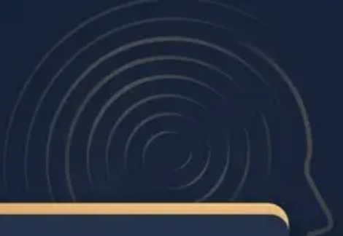





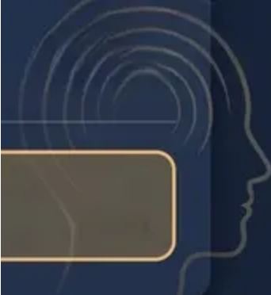



MIGRAINE DIAGNOSIS
IHS Criteria · NICE CG150 (Dec 2025)
Without Aura
(Common Migraine — 75% of cases)
AT LEAST 2 OF 4
AT LEAST 1 OF 2
Headache Features
Associated Symptoms
Minimum 5 Attacks
■ Unilateral location
■ Nausea and / or vomiting
■ Pulsating / throbbing quality
Each attack must meet the
criteria below to count toward
the diagnosis.
■ Photophobia AND phonophobia
(both must be present)
■ Moderate to severe intensity
■ Aggravated by routine
physical activity
(e.g. walking, climbing stairs)
> 🕒 Duration: 4–72 hours
Fewer attacks = probable migraine
(untreated or unsuccessfully treated)
“POUND” mnemonic: Pulsating · One day duration · Unilateral · Nausea · Disabling
Diagnosis is CLINICAL — no investigations required in typical presentation

Slide 11


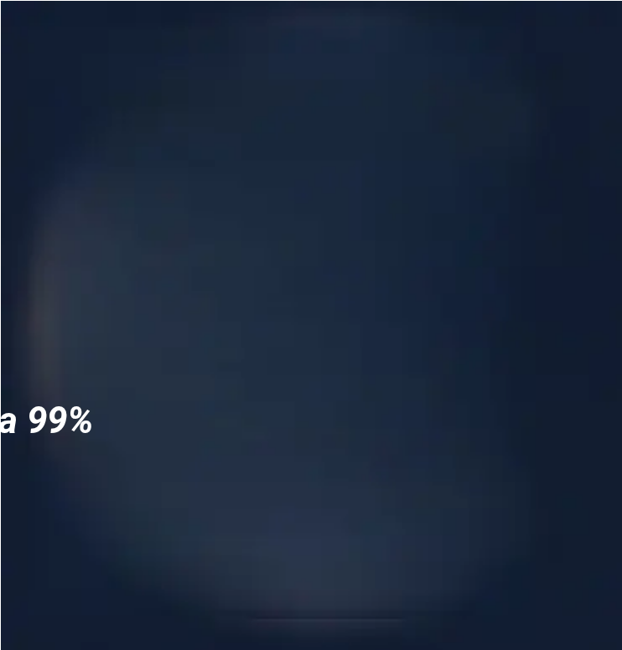

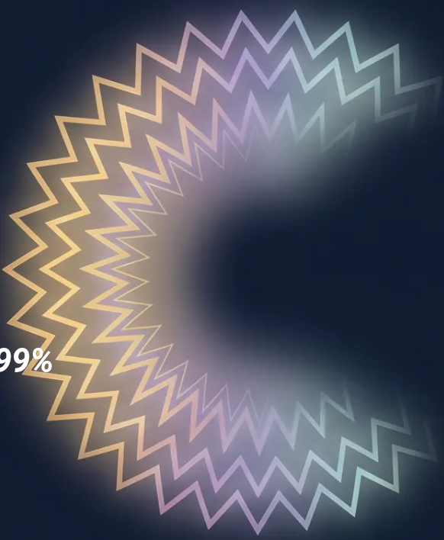






MIGRAINE DIAGNOSIS
NICE CG150 · IHS Criteria
With Aura
Classical Migraine · 25% of all migraines · Minimum 2 attacks required
AURA MUST BE
▪ Fully reversible (neurological symptoms that resolve completely)
▪ Developing gradually over 5–20 minutes
▪ Duration less than 60 minutes per symptom
▪ Headache usually follows within 60 minutes of aura resolution
TYPES OF AURA
● Visual — Scintillating scotoma, fortification spectra, positive/negative phenomena 99%
● Sensory — Unilateral paraesthesia or numbness spreading gradually 31%
● Speech — Dysphasia, word-finding difficulty 18%
● Motor — Hemiparesis (rare — consider hemiplegic migraine) 6%
Minimum 2 attacks meeting the above criteria required for formal diagnosis
Motor aura: always consider hemiplegic migraine — specialist referral if suspected
sensory
speech
hemiplegic
Migraine with aura carries a 2x increased ischaemic stroke risk — see Slide 29 for contraception implications
12 / 35

Slide 12


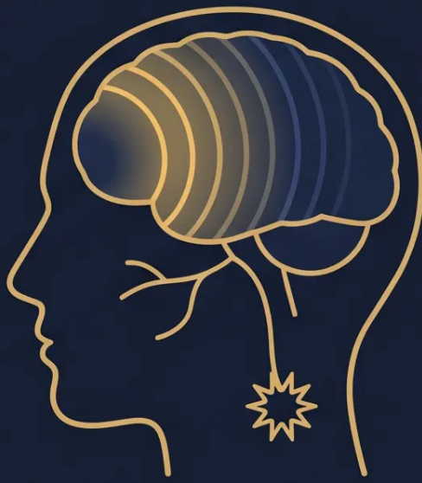















BRADFORD VTS · NICE CG150 DEC 2025
Migraine Pathophysiology and Phases
THE MECHANISM
Cortical Spreading Depression (CSD) — A slow wave of neuronal depolarisation
spreads across the cortex at ~3mm/min — this triggers aura and activates pain pathways
Trigeminal Activation — CSD activates the trigeminal nerve → release of
inflammatory neuropeptides (CGRP) → vasodilation → throbbing pain
Serotonin (5-HT) — Depletion of serotonin lowers the pain threshold and plays a role
in triggering attacks — the basis for triptan therapy
Strong genetic component — 70% have a positive family history
PRODROME
AURA
HEADACHE
POSTDROME
1
2
3
4
Hours to days before
20–60 minutes
4–72 hours
Hours to a day after
Yawning, mood changes
Food cravings, fatigue
Neck stiffness
Visual: scintillating scotoma
Sensory: paraesthesia
Speech: dysphasia (less common)
Unilateral, pulsating
Moderate–severe
Nausea, photo/phonophobia
Fatigue, “migraine hangover”
Cognitive slowing
Mood changes
Absent in 75% of migraineurs
Triptans work by reversing serotonin depletion and constricting dilated vessels — understanding phases guides when to treat

Slide 13


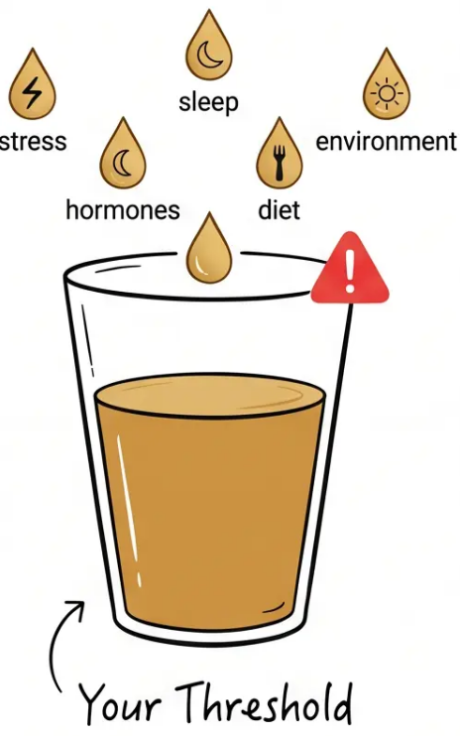



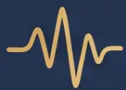





BRADFORD VTS · Slide 14
Identifying Migraine Triggers
Triggers accumulate — it's rarely just one thing
STRESS
HORMONAL
SLEEP
DIETARY
ENVIRONMENT
Acute stress
trigger
'Let-down
headache' —
weekend/post-
stress onset
Menstruation
(most common
in women)
OCP changes,
HRT fluctuation
Too much sleep
Too little sleep
Irregular
schedule
Skipping meals
Dehydration
Alcohol (red wine,
beer)
Bright or flickering
lights
Strong smells
Weather changes
Altitude
Excessive exercise
Caffeine
withdrawal
Cheese, chocolate
(less evidence)
Oestrogen
withdrawal
THE THRESHOLD MODEL
Triggers stack up — when
the bucket overflows,
migraine begins
🔑 Clinical Pearl: Ask patients to keep a headache diary — identifying personal
trigger patterns is the foundation of lifestyle-based migraine management

Slide 14







SECTION 5 · ACUTE MIGRAINE TREATMENT
Acute Migraine: NICE Stepwise Approach
NICE CG150 · Dec 2025 UPDATE
🔄 Key Change: NICE CG150 now recommends offering a triptan AND an NSAID or paracetamol
together at attack onset — not as a step-up sequence. Combined therapy is superior to either alone.
STEP 1: First-Line (At Attack Onset)
STEP 2: Triptans
(5-HT1B/1D Agonists)
STEP 3: Non-Oral Alternatives
(When vomiting or severe attack)
- Aspirin 900mg soluble OR Ibuprofen
Ibuprofen 400mg OR Paracetamol 1g
- Take at onset of headache
(NOT during aura)
- PLUS Antiemetic:
- Sumatriptan SC injection 6mg
- Domperidone 10mg (preferred in
young adults)
- Allow 2 hours before repeat dose
- Sumatriptan nasal spray 20mg
- Headache recurrence in 20–40%
within 24 hours
- Zolmitriptan nasal spray 5mg
- OR Metoclopramide 10mg
- Use soluble/dispersible forms —
faster absorption
- Diclofenac suppository 100mg +
domperidone suppository
- 7 triptans available — see next
slide for full dosing
- Gastric stasis during migraine
slows tablet absorption
💡 Offer WITH a triptan simultaneously
— not after failure
💡 Sumatriptan 50mg available OTC —
ask what patients already buy
💡 SC sumatriptan is fastest-acting —
most effective for severe attacks
NICE CG150 (December 2025) · NICE CKS Migraine (August 2025)
www.bradfordvts.co.uk
Page 15

Slide 15


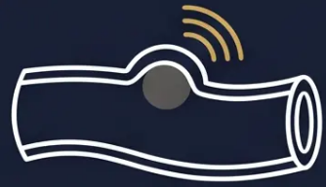

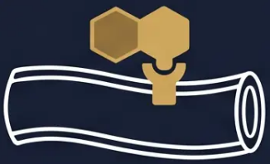

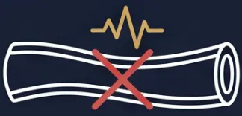


TRIPTANS
Mechanism and Clinical Use
5-HT1B/1D Receptor Agonists
WHEN TO TAKE
Trigeminal nerve activated →
vasodilation → pain signal
Take at headache onset
Not during aura — wait for headache to begin.
Taking during aura does not improve efficacy.
REPEAT DOSING
Triptan binds
Wait 2 hours before repeating
5-HT1B/1D receptors
If no response after 2 hours, a second dose may be taken.
Do not exceed the maximum 24-hour dose.
Vasoconstriction +
pain signal blocked
HEADACHE RECURRENCE
20–40% recur within 24 hours
A second dose or different triptan may be used for recurrence.
Simplified trigeminal-vascular pathway
Naratriptan and frovatriptan have lower recurrence rates.
NICE CG150 (Dec 2025): Offer triptan AND NSAID/paracetamol together at attack onset — combination is superior to either alone
Bradford VTS · www.bradfordvts.co.uk · Slide 16

Slide 16

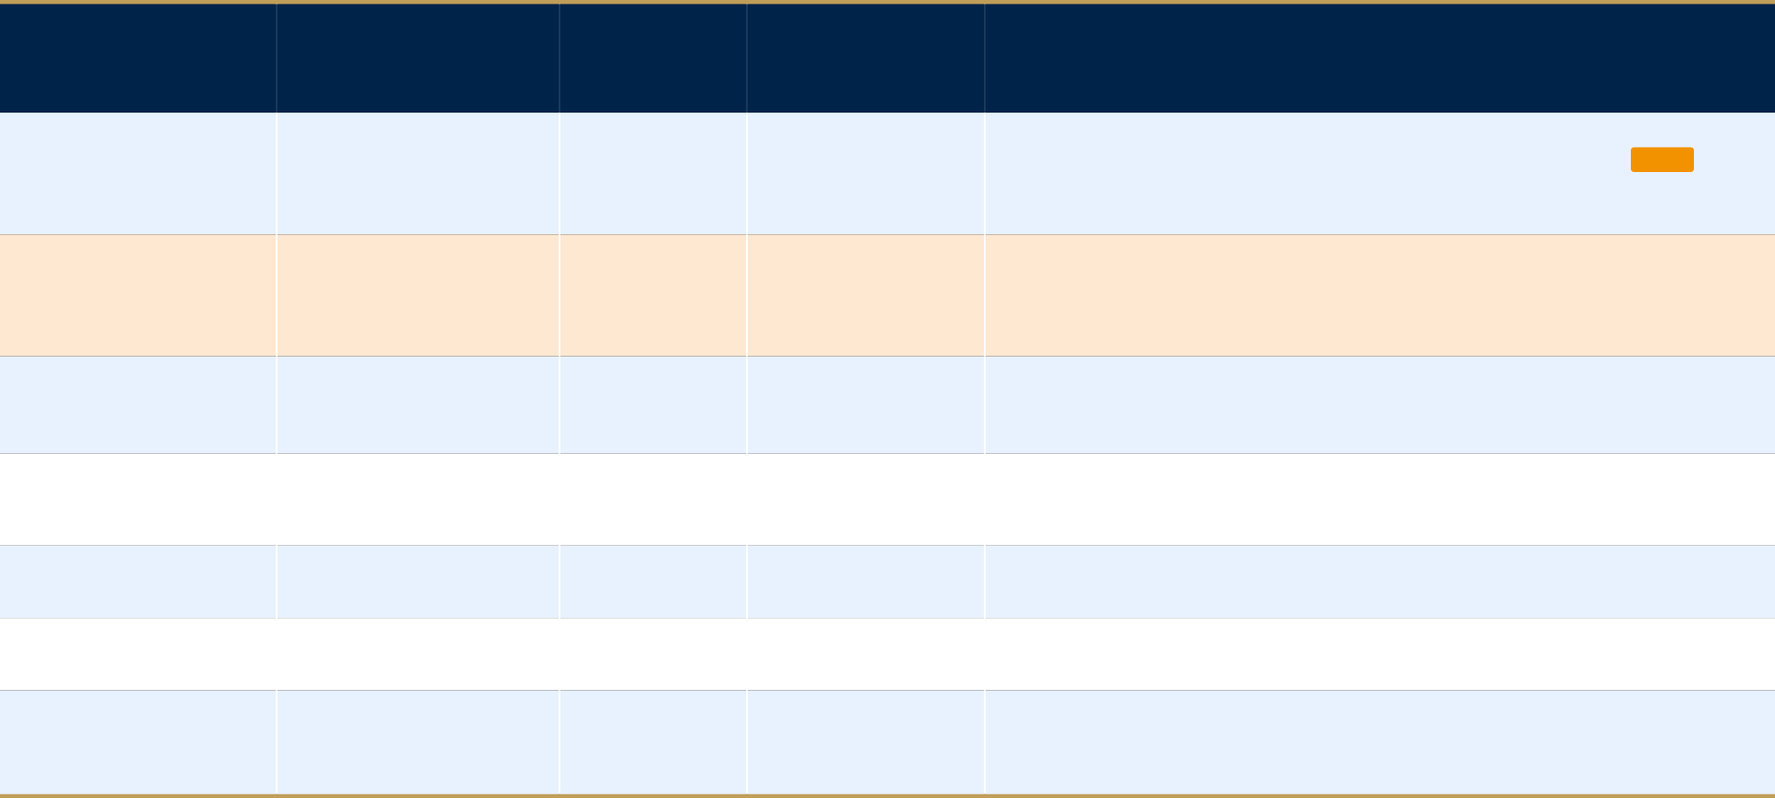





































ACUTE MIGRAINE TREATMENT · SLIDE 17 OF 35
BNF-verified · May 2026
Triptan Selection and BNF Dosing
Take at onset of headache — not during aura. Allow 2 hours before repeat dose.
TRIPTAN
STANDARD DOSE
MAX IN 24h
ROUTE(S)
CLINICAL NOTE
Non-oral options
Sumatriptan
50–100mg oral
6mg SC · 20mg nasal
300mg oral
Oral / SC / Nasal
when vomiting
★
Widest evidence base · First generic · Available OTC (50mg)
Sumatriptan SC 6mg
Rizatriptan
Sumatriptan nasal 20mg
10mg oral
20mg
Oral
(wafer available)
Zolmitriptan nasal 5mg
△
Reduce to 5mg if on propranolol — propranolol doubles rizatriptan levels
Naratriptan
2.5mg oral
5mg
Oral
Slowest onset · Fewest side effects · Good for headache recurrence
Oral triptans NOT
Zolmitriptan
effective in cluster
2.5mg oral or nasal
10mg
Oral / Nasal
headache — too slow
2nd dose permitted for same attack (nasal route)
Eletriptan
40–80mg oral
80mg
Oral
High efficacy profile
Almotriptan
12.5mg oral
25mg
Oral
Headache recurrence
Good tolerability · Useful in triptan-sensitive patients
Frovatriptan
20–40% within 24h
2.5mg oral
7.5mg
Oral
★
Long half-life · First choice for menstrual migraine prophylaxis (2.5mg BD, 2 days before onset)
Consider naratriptan
or frovatriptan for
recurrence-prone
patients
All doses BNF-verified May 2026. Triptans are 5-HT1B/1D agonists. Recurrence occurs in 20–40% of attacks within 24 hours.
www.bradfordvts.co.uk · Bradford VTS Teaching Deck · NICE CG150 Dec 2025

Slide 17






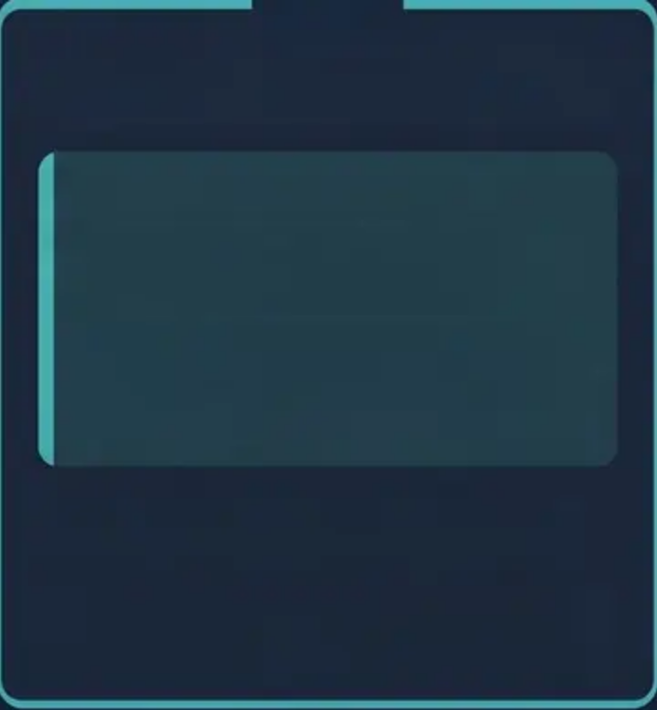

TRIPTAN SAFETY GUIDE · NICE CG150 DEC 2025
Triptan Contraindications and Safety
Essential checks before every prescription
ABSOLUTE CONTRAINDICATIONS
USE WITH CAUTION
KEY DRUG INTERACTION
■ Ischaemic heart disease
■ Pregnancy — not licensed; use
only if benefit outweighs risk
Propranolol + Rizatriptan
■ Cerebrovascular disease
(stroke / TIA history)
Propranolol doubles rizatriptan
plasma levels.
■ Sumatriptan has the most
safety data in pregnancy
■ Peripheral vascular disease
■ Reduce rizatriptan dose to 5mg
(not 10mg) when co-prescribed
with propranolol
■ Breastfeeding — seek specialist
advice
■ Uncontrolled hypertension
■ Hemiplegic migraine
■ Controlled hypertension — check
BP before prescribing
■ No dose adjustment needed for
other triptans with propranolol
■ Basilar-type migraine
■ Elderly patients — cardiovascular
risk assessment required
■ Check all concurrent medications
before prescribing any triptan
🎯 AKT PEARL — Oral triptans are ineffective in cluster headache (too slow onset).
Sumatriptan 6mg SC is the triptan of choice for cluster attacks.

Slide 18

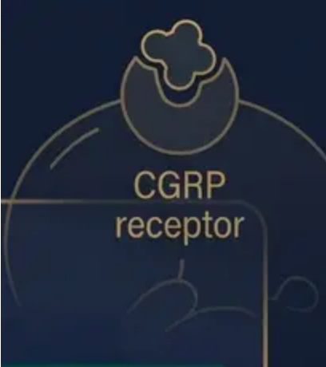






SECTION 5 · ACUTE MIGRAINE TREATMENT
✦ NEW — NICE APPROVED 2025/2026
CGRP Antagonists (Gepants)
When triptans fail — a new class with a critical advantage
RIMEGEPANT
ATOGEPANT
VYDURA · NICE TA906
NICE TA973
– ≥2 triptans have failed
✦ INDICATE WHEN: · OR triptans are contraindicated
- Dose: 75mg wafer (orally dissolving)
- Use: Acute treatment AND episodic prevention
- Dose: 60mg orally, once daily
- Prevention dose: 75mg every other day
- Use: Preventive treatment only
- Access: OTC and prescription
- Access: Prescription only
DUAL PURPOSE — only gepant licensed for both
ORAL PREVENTION — well tolerated, once daily
⚠ KEY CLINICAL ADVANTAGE
Gepants do NOT cause Medication Overuse Headache (MOH)
Safe to use more frequently than triptans — no rebound risk
Does not interact with
propranolol (unlike rizatriptan)
NICE CG150 (Dec 2025) · BNF verified May 2026
www.bradfordvts.co.uk
19 / 35

Slide 19




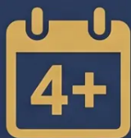



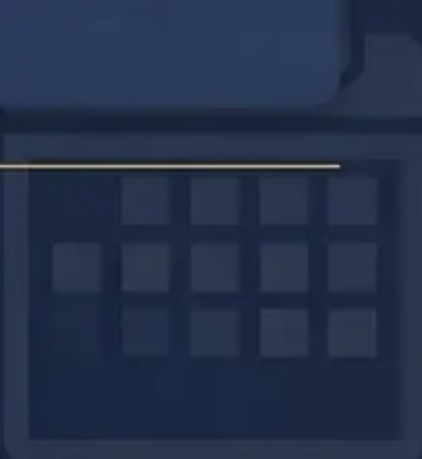
NICE CG150 · DECEMBER 2025
Migraine Prophylaxis
Initiation Thresholds
OFFER PROPHYLAXIS IF ANY OF THE FOLLOWING APPLY
≥ 4 Migraine Days
per Month
Acute Treatments
Frequently Fail
Significant Impact
on Quality of Life
Risk of Medication
Overuse
Primary NICE threshold
Or are contraindicated
Work, daily function, wellbeing
Acute treatment >10 days/month
GENERAL PRINCIPLES ONCE STARTED
■ Trial period - Allow 2–3 months
before judging efficacy — do not
abandon early
■ Duration - Continue for 6–12
months if effective, then review
and consider tapering
■ Lifestyle - Address triggers,
diary, sleep, and exercise
alongside any medication
BRADFORD VTS · www.bradfordvts.co.uk
Slide 20 of 35

Slide 20













MIGRAINE PROPHYLAXIS
NICE CG150 · December 2025 · BNF-verified May 2026
First-line Prophylactic Agents
PROPRANOLOL
AMITRIPTYLINE
CANDESARTAN
Propranolol
Amitriptyline
Candesartan
Beta-blocker
Tricyclic antidepressant
Angiotensin II receptor blocker (ARB)
DOSE
DOSE
DOSE
80–240 mg daily
Start: 10 mg at night
Start: 4 mg daily
Divided doses or modified-release preparation
Titrate gradually up to 75 mg nocte
Titrate to maximum 16 mg daily
✦ First-line if no contraindication
✦ Especially useful when concurrent
tension-type headache
✦ Good evidence base; well tolerated
Best evidence base for migraine
prevention
Ideal alternative when beta-blockers are
contraindicated
Helpful for patients with poor sleep or
mood symptoms
Also lowers BP — dual benefit in
hypertensive patients
Useful in patients with concurrent
hypertension
Works independently of antidepressant
Watch out
Watch out
Watch out
⚠ Avoid in: asthma · diabetes · heart block
⚠ Anticholinergic side effects — dry mouth,
constipation
⚠ Avoid in pregnancy — teratogenic
Reduces rizatriptan clearance — use
rizatriptan 5mg if co-prescribed
Monitor renal function and potassium
Sedation — take at bedtime; warn patients
Trial each agent for 2–3
Continue effective prophylaxis
for 6–12 months, then review
Taper gradually —
GENERAL
Always address lifestyle and
PRINCIPLES
months before judging efficacy
triggers alongside medication
do not stop abruptly

Slide 21
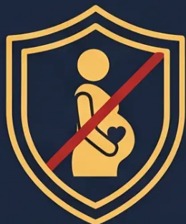







BRADFORD VTS · MIGRAINE PROPHYLAXIS
SLIDE 22 OF 35
Topiramate and the Pregnancy
Prevention Programme
MHRA MANDATORY SAFETY REQUIREMENT
WHAT IS THE PPP?
PRESCRIBING REQUIREMENTS
DOSE & SIDE EFFECTS
The Pregnancy Prevention
Before prescribing topiramate, the
prescriber MUST confirm:
Dosing (BNF 2026):
Programme (PPP) is a mandatory
MHRA risk minimisation programme.
Start: 25mg at night
Target: 50mg twice daily
■ Patient is enrolled in the PPP
Required for:
Maximum: 200mg daily
All women of childbearing potential
prescribed topiramate
■ Effective contraception is in place
Titrate slowly over several weeks to
improve tolerability.
■ Annual review and re-enrolment
documented
Why:
Common side effects:
Topiramate is highly teratogenic —
associated with:
■ Patient has received and signed the
acknowledgement form
• Cognitive slowing ("dopamax")
• Word-finding difficulties
• Neural tube defects
• Paraesthesia (tingling)
• Cleft palate
■ Pregnancy test confirmed negative
• Weight loss
• Low birth weight
ABSOLUTE CONTRAINDICATION
IN PREGNANCY
• Kidney stones (rare)
• Neurodevelopmental delay
in the child
Monitor weight and renal function
AKT PEARL: Topiramate requires mandatory PPP enrolment for ALL women of childbearing potential — this is non-negotiable and examinable
Sodium valproate carries the same PPP requirement — specialist initiation only

Slide 22






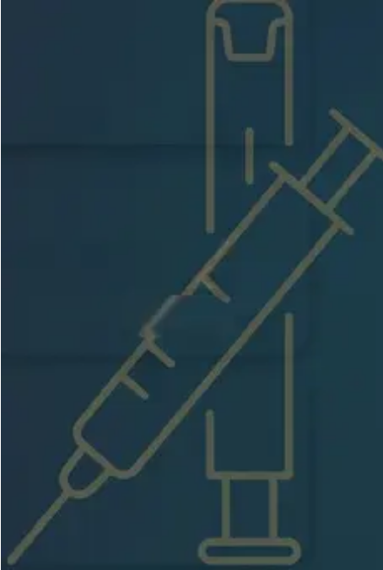






MIGRAINE PROPHYLAXIS
NICE CG150 · Dec 2025
Second-line & Specialist Prophylaxis
SECOND-LINE ORAL OPTIONS
CGRP MONOCLONAL ANTIBODIES · SPECIALIST-INITIATED
Pizotifen
Eligibility: Failure of ≥ 3 prophylactic treatments · Initiated by
headache specialist · Shared care with primary care
500 mcg at night → max 3 mg/day
Erenumab (Aimovig)
Weight gain and sedation limit use — falling out of favour
70–140 mg SC monthly NICE TA682
Sodium Valproate
Anti-CGRP receptor mAb
⚠ RESTRICTED
Not recommended in women of childbearing potential
Fremanezumab (Ajovy)
MHRA-restricted · Highly teratogenic · Specialist initiation
only · Requires Pregnancy Prevention Programme
225 mg SC monthly OR 675 mg SC quarterly NICE TA631
Anti-CGRP ligand mAb · Quarterly option aids adherence
Gabapentin / Venlafaxine
Off-label
Galcanezumab (Emgality)
Limited evidence · Use with caution · Not first-choice
120 mg SC monthly NICE TA659
Anti-CGRP ligand mAb
⚠ Do not start prophylaxis before withdrawing any overused medication (MOH).
SC = subcutaneous self-injection · May be continued in primary care under shared care agreement.
Bradford VTS Teaching Deck · Headache & Migraine · May 2026
23 / 35

Slide 23

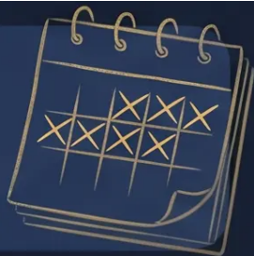







MEDICATION OVERUSE HEADACHE
NICE CG150 • December 2025
Definition & Diagnostic Thresholds
Headache on ≥ 15 days / month
PLUS regular overuse of acute headache medication for ≥ 3 months
SIMPLE ANALGESICS
TRIPTANS • OPIOIDS • ERGOTS
COMBINATION ANALGESICS
Triptans & Opioids
Simple Analgesics
Combination Analgesics
Paracetamol • Aspirin • NSAIDs
Sumatriptan • Codeine • Ergotamine
Codeine-containing preparations
≥ 15
≥ 10
≥ 10
days / month
days / month
days / month
for ≥ 3 months
for ≥ 3 months
for ≥ 3 months
⚠ MOH does NOT respond to prophylaxis — the overused medication must be withdrawn first
www.bradfordvts.co.uk • Bradford VTS Teaching Deck • Slide 24 of 35

Slide 24




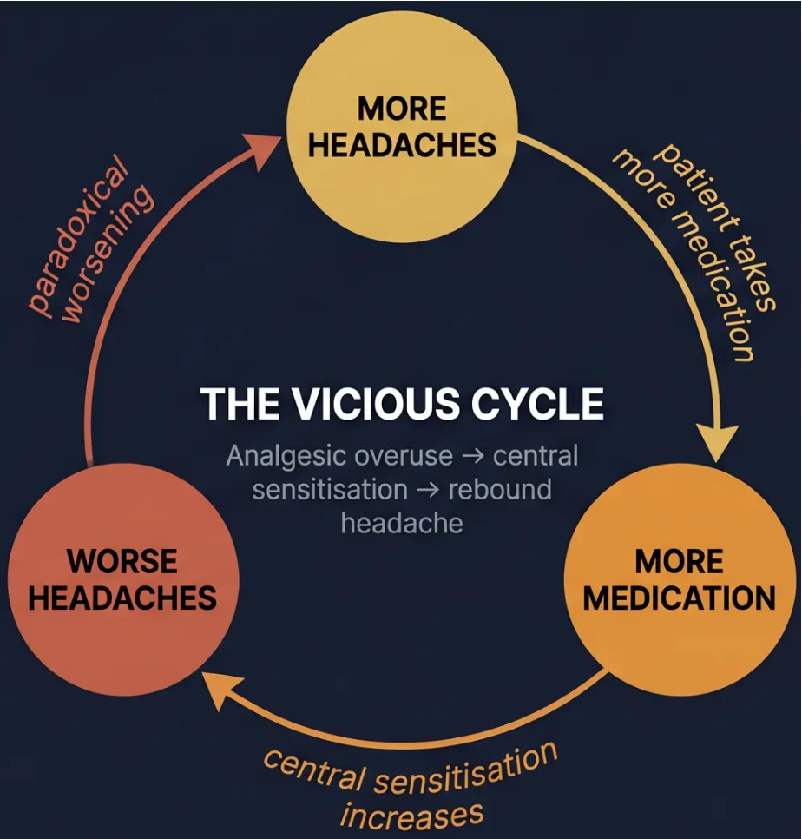



MEDICATION OVERUSE HEADACHE
Bradford VTS · NICE CG150 Dec 2025
Clinical Characteristics of MOH
RECOGNISE THE PATTERN
CLINICAL TRAPS
■ Morning headache — worse
on waking; improves briefly
with analgesia
▲ MOH does NOT respond to
prophylaxis until the
overused medication is
withdrawn first
■ Bilateral, dull, featureless —
no clear triggers; unlike
typical migraine
▲ Adding more analgesia
makes it worse — the
instinct to escalate
treatment is harmful
■ Preemptive use — patient
medicates before pain begins,
anticipating the headache
▲ Patient education is
essential — patients are often
resistant and disbelieving;
they feel the medication helps
■ F:M ratio 5:1 —
predominately affects women
“The medication that once
helped is now the cause.”
Paradoxically worsens with
treatment — diagnose early
Headache on ≥15 days/month + regular analgesia use = suspect MOH

Slide 25











NICE CG150 · DECEMBER 2025
Bradford VTS · Slide 26
Management of Medication Overuse Headache
NICE recommends: ABRUPT withdrawal of the overused medication — this is more effective than gradual reduction
STAGE 1
STAGE 2
STAGE 3
STAGE 4
Abrupt Withdrawal
Relapse Prevention
Recovery
Reassess
– Stop overused medication
completely
– Weeks 2–8: monitor
headache frequency
– Re-evaluate underlying
primary headache type
– Educate on medication
limits
– Naproxen 250–500mg
three times daily as bridge
(1–2 weeks)
– Avoid all opioid-containing
preparations
– Start appropriate
prophylaxis once MOH
resolved
– BASH patient information
leaflets
– Expect gradual
improvement
– Headache diary
monitoring
– Amitriptyline to support
withdrawal
– Prophylaxis will NOT work
until withdrawal is complete
Warn Your Patient — Symptoms WORSEN Before They Improve
Days 3–7 after stopping: expect rebound headache, nausea, and vomiting. This is
expected and temporary. Reassure the patient — it is a sign the withdrawal is working.
Remember: Prophylaxis will FAIL if overused medication is not first withdrawn · MOH does not respond to adding more treatment

Slide 26


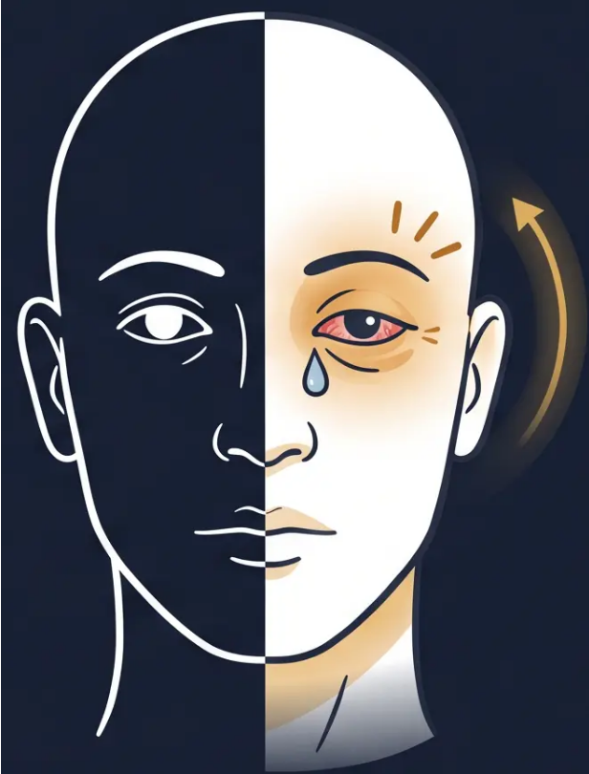



CLUSTER HEADACHE
Section 8 · Bradford VTS
Clinical Diagnosis
DIAGNOSTIC FEATURES
PAIN
Strictly unilateral — orbital, supraorbital, or temporal
Excruciating severity — often described as ‘the worst pain imaginable’
Duration: 15–180 minutes per attack
Frequency: 1–8 attacks per day during cluster period
AUTONOMIC — IPSILATERAL SIDE ONLY
Lacrimation (watering eye)
Rhinorrhoea/nasal congestion
Conjunctival injection (red eye)
Ptosis / miosis (Horner’s-like) Eyelid oedema
Facial sweating / flushing
BEHAVIOUR — KEY DIFFERENTIATOR
Patient is agitated, restless, pacing
Cannot keep still — contrast with migraine (patients lie still in dark)
Cluster periods: weeks to months, then complete remission
💬 ‘Suicide headache’ — the most severe primary headache disorder. Agitation and
restlessness are pathognomonic. If the patient is pacing and holding their eye, think cluster.
Ipsilateral autonomic features — always unilateral
NICE CG150 Dec 2025 · NICE CKS
27 / 35
www.bradfordvts.co.uk

Slide 27







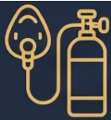
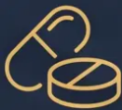


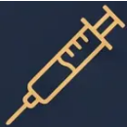


CLUSTER HEADACHE
Acute and Preventive Care
NICE CG150 · Dec 2025
ACUTE ATTACK
PROPHYLAXIS
100% Oxygen
Verapamil
FIRST-LINE
FIRST-LINE · SPECIALIST-INITIATED
12–15 L/min via non-rebreathe mask
240–960mg daily
Duration: 15–20 minutes
ECG monitoring required before and during titration
Arrange home oxygen supply via GP prescription pathway
Short-course prednisolone as bridge while verapamil loading
Sumatriptan 6mg SC
Second-Line Agents
MOST EFFECTIVE TRIPTAN FOR CLUSTER
SPECIALIST ONLY
Subcutaneous injection — fastest onset
Lithium — second-line
Zolmitriptan nasal spray 5mg: alternative
Methysergide — second-line
Oral triptans — NOT effective (too slow onset)
Greater occipital nerve injection
⚠ Do NOT prescribe opioids — ineffective and worsen disease
All prophylaxis initiated by headache specialist
■ Suspect early →
refer promptly
■ Prescribe home oxygen (arrange
via home oxygen pathway)
■ Sumatriptan SC for acute attacks
— prescribe in primary care
PRIMARY CARE ROLE
www.bradfordvts.co.uk
www.bradfordvts.co.uk
28 / 35

Slide 28






SECTION 9 — SPECIAL SITUATIONS
Migraine and Hormonal Contraception
UKMEC Categories — Know Before You Prescribe
MIGRAINE WITHOUT AURA
MIGRAINE WITH AURA
UKMEC 2
UKMEC 4
ABSOLUTE CONTRAINDICATION
Benefits of COC generally outweigh risks
Combined oral contraceptive (COC) is contraindicated
— unacceptable health risk
- COC triples ischaemic stroke risk in migraine with aura
- Combined oral contraceptive (COC): can be used
- Risk compounded further by smoking and hypertension
- Progesterone-only pill (POP): UKMEC 2 — safe
- Do NOT prescribe — this is a hard stop
- Implant, IUD, DMPA injection: all safe
✓ Safe Alternatives:
- Transdermal patch, vaginal ring: can use
- POP (progesterone-only): UKMEC 2 — safe
- Implant (etonogestrel): UKMEC 2 — safe
- Hormonal IUS (Mirena): safe
- Copper IUD: safe
Always reassess if aura develops during COC use
- DMPA injection: UKMEC 2 — safe
⚡ AKT/SCA PEARL: Always ask about visual symptoms (aura) BEFORE prescribing any combined hormonal contraceptive.
Migraine with aura + COC = UKMEC 4 — absolute contraindication.
www.bradfordvts.co.uk · NICE CG150 Dec 2025 · UKMEC 2016 (updated)

Slide 29














SPECIAL SITUATIONS
NICE CG150 · Dec 2025 | Bradford VTS
Migraine in Pregnancy & Menstruation
MENSTRUAL MIGRAINE
MIGRAINE IN PREGNANCY
Migraine without aura · Days –2 to +3 of menstruation · Driven by oestrogen withdrawal
Often improves in 2nd & 3rd trimester · Especially migraine without aura
PERIMENSTRUAL PROPHYLAXIS
A
✓ ACUTE TREATMENT
Frovatriptan 2.5 mg twice daily — start 2 days before anticipated onset
Paracetamol 1 g — first-line throughout pregnancy
Aspirin — avoid after 30 weeks
Long half-life · Best evidence for menstrual migraine
Ibuprofen — avoid after 30 weeks
ALTERNATIVE
Sumatriptan — not licensed; use only if benefit outweighs risk
(most safety data of all triptans)
Naratriptan 1 mg twice daily — perimenstrual use
Slower onset · Fewer side effects
B
PROPHYLAXIS — USE WITH CAUTION
HORMONAL OPTIONS
Propranolol — can use; monitor neonate for bradycardia
Amitriptyline — use with caution; discuss risks
Continuous transdermal oestrogen — specialist-initiated
Prevents oestrogen withdrawal trigger
C
✘ AVOID IN PREGNANCY
OCP CONSIDERATION
Topiramate — teratogenic; mandatory PPP
Sodium valproate — highly teratogenic; contraindicated
Continuous combined OCP — consider to eliminate withdrawal bleed
Candesartan — contraindicated in pregnancy
Check UKMEC category first — aura status critical
Always reassess migraine management at booking appointment — aura status, current medications, and contraception must all be reviewed
NICE CG150 Dec 2025 · BNF May 2026

Slide 30























BRADFORD VTS TEACHING DECK
Top Tips for GP Trainees
Practical wisdom for the consultation room
01
Ask every headache patient how often they use painkillers — MOH is dramatically underdiagnosed in primary care
06
MOH withdrawal: abrupt cessation is NICE-recommended — warn patients symptoms worsen days 3–7 before improving
02
NICE CG150 (Dec 2025): offer NSAID/paracetamol AND triptan together at attack onset — not as a step-up sequence
Cluster headache: prescribe 100% oxygen for home use — it works and is first-line; know your local home oxygen pathway
07
03
Migraine with aura + COC = UKMEC 4 absolute contraindication — always ask about aura before prescribing the pill
08
Sumatriptan 50mg is available OTC — always ask what patients are already buying before writing a prescription
04
Topiramate requires MHRA Pregnancy Prevention Programme registration — mandatory for all women of childbearing potential
09
New headache in a patient over 50 — always exclude GCA: check ESR, CRP, examine temporal arteries same day
05
CGRP gepants (rimegepant, atogepant) do NOT cause MOH — consider after failure of two different triptans
10
Acupuncture is NICE-recommended for both migraine and tension headache prophylaxis — document that you offered it
www.bradfordvts.co.uk · Created May 2026 · Based on NICE CG150 December 2025

Slide 31








AKT EXAM FOCUS | High-Yield Facts
⭐ Know these cold
MOH Thresholds
Migraine with Aura + COC = UKMEC 4
Analgesics (paracetamol/NSAIDs): ≥15 days/month · Triptans,
ergots: ≥10 days/month · Combination analgesics: ≥10 days/month
Absolute contraindication to combined oral contraceptive · 3-fold
increased ischaemic stroke risk · POP and progesterone-only
methods: UKMEC 2 — safe to use
Drug Interaction: Propranolol + Rizatriptan
Sodium Valproate Restrictions
Propranolol doubles rizatriptan plasma levels → reduce rizatriptan
dose to 5mg · Gepants do NOT interact with propranolol
NOT recommended in women of childbearing potential · Highly
teratogenic · Requires specialist initiation · MHRA Pregnancy
Prevention Programme mandatory
CGRP Gepants: Indication
NICE CG150 (Dec 2025): Acute Migraine
After ≥2 triptan failures OR triptans contraindicated · Rimegepant:
acute + prevention · Atogepant: prevention only · Do NOT cause MOH
Offer triptan AND NSAID/paracetamol TOGETHER at attack onset
· Not a step-up approach · Combination superior to either alone
Topiramate — Mandatory PPP
Ergotamine — Avoid
Absolute contraindication in pregnancy · All women of childbearing
potential must be enrolled in the MHRA Pregnancy Prevention
Programme before prescribing
Historical agent superseded by triptans · Causes ergot-
dependency headache · No role in modern clinical practice
Opioids in Headache
Sumatriptan OTC
NICE does NOT recommend opioids for any headache type ·
High MOH risk · Ineffective in cluster headache
50mg available over the counter · Always ask what patients are
buying before prescribing · Avoid double-dosing risk
Bradford VTS Teaching Deck · Updated to NICE CG150 December 2025 · www.bradfordvts.co.uk
32 / 35

Slide 32








BRADFORD VTS · SCA CONSULTATION FOCUS
SCA Consultation Focus: Skills & Safety
SCA SKILLS
🔍 OPENING RED FLAG SCREEN
“When did this start? Is this the worst headache of your life? Any changes in vision,
weakness, speech, or fever?”
Use at every new headache presentation · SNOOP4 framework
🛡️ SAFETY-NETTING
“If you develop the worst headache of your life, confusion, neck stiffness, a rash, or
sudden vision loss — call 999 immediately.”
Document safety-netting in every headache consultation · Medicolegally essential
💊 MEDICATION COUNSELLING
🤝 SHARED DECISION-MAKING
“I want to check how often you’re using
painkillers — more than 10–15 days a month
can actually make headaches worse.”
“There are several options for prevention
— shall we go through them together?”
Involve the patient · Document discussion
MOH awareness · Non-judgmental language
PATIENT RESOURCES www.migrainetrust.org · www.thebraincharity.org.uk · BASH patient leaflets
Slide 33 of 35 · Bradford VTS Teaching Deck · www.bradfordvts.co.uk

Slide 33



Common Pitfalls & Quick Recall
BRADFORD VTS · HEADACHE & MIGRAINE · CONSOLIDATION SLIDE
❌ COMMON PITFALLS
⚡ QUICK RECALL
❌ Prescribing codeine for headache — high MOH risk
◆ MOH: analgesics ≥15 days/month · triptans/opioids ≥10 days/month
◆ SNOOP4 — screen every headache consultation for red flags
❌ Starting prophylaxis before withdrawing overused medication in MOH
◆ NICE CG150: offer triptan + NSAID together at attack onset — not step-up
❌ Prescribing COC to a woman with migraine with aura — 3× stroke risk
◆ Migraine + aura + COC = UKMEC 4 — absolute contraindication
❌ Topiramate without PPP enrolment in women of childbearing age
❌ Not checking analgesia frequency — 50% of chronic daily headache
is undiagnosed MOH
◆ Topiramate → mandatory Pregnancy Prevention Programme registration
◆ Rimegepant: acute + preventive · no MOH risk · after 2 triptan failures
❌ Diagnosing migraine without discussing lifestyle and trigger
management
◆ MOH withdrawal: abrupt · warn patient: symptoms worsen days 3–7
◆ GCA >50: start prednisolone 40–60mg same day + urgent referral
❌ Missing GCA in new headache in a patient over 50 — sight-
threatening emergency
◆ Acupuncture: NICE-recommended for both TTH and migraine prophylaxis
❌ Prescribing opioids for cluster headache — ineffective and harmful
“Adding more analgesia makes MOH worse — not better.”
◆ Cluster: 100% O₂ 12–15 L/min + sumatriptan 6mg SC — not oral triptans
“If in doubt — check NICE CG150 Dec 2025 and the BNF.”
www.bradfordvts.co.uk · Created May 2026 · Updated to NICE CG150 December 2025 standards
34 / 35

Slide 34

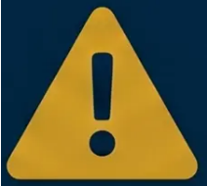
IMPORTANT DISCLAIMER
Always double-check this advice and drug doses
with the latest NICE and BNF guidance.
This document is for educational purposes only. It does not replace
clinical judgement or current national guidelines.
VERIFY WITH:
- ■ NICE CG150 — Headaches in over 12s (December 2025)
- ■ BNF / BNFC — Current edition
- ■ NICE CKS Migraine (August 2025)
BRADFORD VTS TEACHING DECK
Created May 2026 · Updated to NICE CG150 December 2025 Standards
www.bradfordvts.co.uk

