Slide 1


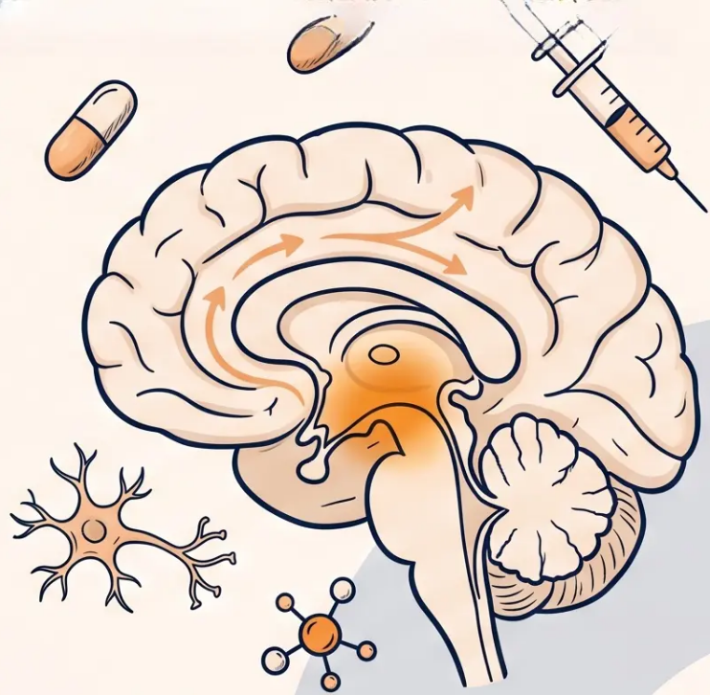



BRADFORD VTS TEACHING DECK
Pharmacological Management of
Parkinson’s Disease
A comprehensive guide to Parkinson’s
pharmacotherapy for GP trainees, updated
to NICE NG71 December 2024 and BNF
2025–2026 standards.
Created: May 2026 · Bradford VTS · www.bradfordvts.co.uk
⚠ Always verify drug doses against the latest NICE/BNF guidance. For educational purposes only.

Slide 2


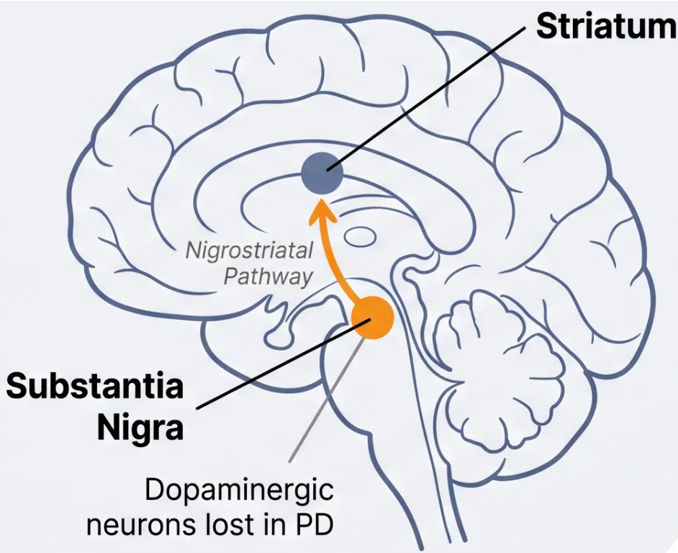



Background and Pathophysiology
What goes wrong — and why it matters
THE CONDITION
Progressive neurodegenerative disorder affecting
the substantia nigra pars compacta — leading to
dopamine deficiency in the striatum.
DIAGNOSTIC TRIAD
Bradykinesia
Rigidity
Resting Tremor
(pill-rolling)
*Bradykinesia is required for diagnosis — NICE NG71
EPIDEMIOLOGY
• 1 in 500 overall prevalence; 1 in 100 over age 75
• Peak onset: 60s · Slightly more common in men
• 1 in 20 diagnosed are under 40
Bradford VTS
Pharmacological Management of Parkinson's Disease
2 / 32

Slide 3








Why Pharmacotherapy
is Challenging
Treatment is symptomatic — and always bespoke
Symptomatic Only
Motor Complications
Bespoke Prescribing
No disease-modifying therapy
exists as of 2026. All current
treatments target the dopamine
deficit — they slow nothing, they
mask much.
~10% of levodopa-treated patients
develop complications per year —
wearing-off, dyskinesia, and on-off
fluctuations accumulate with
disease progression.
No one-size-fits-all approach.
Efficacy, motor complications,
neuropsychiatric side effects, and
patient lifestyle must all be
weighed together.
The art of PD prescribing is balancing what helps the brain against what harms the person.
Bradford VTS - NICE NG71 (Dec 2024)

Slide 4

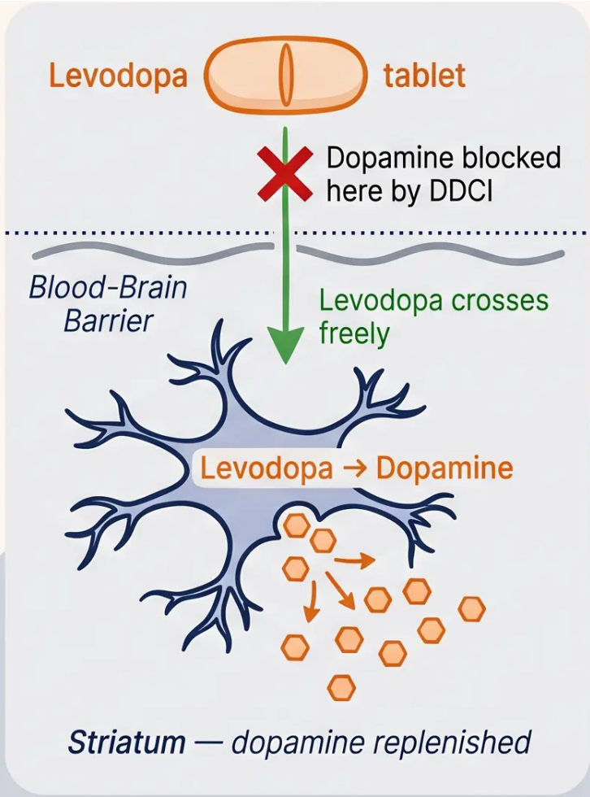

Levodopa (L-DOPA): The Cornerstone
Most effective treatment for Parkinson's motor symptoms
HOW IT WORKS
Levodopa is a dopamine precursor. Unlike dopamine itself, it crosses the
blood-brain barrier, where it is converted into dopamine by neurons in the
striatum — replenishing the deficit caused by Parkinson's disease.
ALWAYS GIVEN WITH A DDCI
A peripheral DOPA decarboxylase inhibitor (DDCI) is added to block
conversion of levodopa to dopamine outside the brain — reducing side
effects like nausea and allowing more levodopa to reach the brain.
Co-careldopa → levodopa + carbidopa → brand: Sinemet
Co-beneldopa → levodopa + benserazide → brand: Madopar
DIAGNOSTIC CLUE
A clear and sustained response to levodopa strongly supports a diagnosis
of idiopathic Parkinson's disease. Lack of response should prompt
specialist re-evaluation — consider MSA, PSP, or DLB.
*Bradford VTS · Parkinson's Disease · NICE NG71 (Dec 2024)
4 / 32

Slide 5






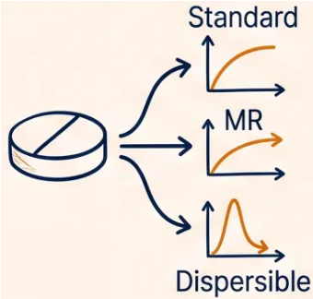


Levodopa BNF Doses and Formulations
Co-careldopa and Co-beneldopa — starting doses, titration, and formulation distinctions
Co-careldopa (Sinemet)
Co-beneldopa (Madopar)
Levodopa + Carbidopa
Levodopa + Benserazide
Starting dose:
12.5 mg / 50 mg or 25 mg /
Starting dose:
50 mg / 12.5 mg capsules
100 mg tablets
Three to four times daily
Three to four times daily
Titration:
Increase gradually based on
response and tolerability —
slow and steady
Titration:
Gradual increase based on
clinical response
Modified-
release (MR):
Co-careldopa MR — useful for
reducing overnight wearing-off
Smoother overnight coverage
Dispersible
Rapidly absorbed — used as
rescue boost for end-of-dose
wearing-off or swallowing
difficulty
Bradford VTS
Critical Prescribing Distinctions
• Co-careldopa MR 125 mg ≠ Sinemet CR 50/200 mg cut in half — use the specific product name to avoid dosing errors
• Madopar dispersible ≠ Madopar capsule — different pharmacokinetics; prescribe each explicitly and separately
NICE NG71 · BNF 2025-2026 · Bradford VTS

Slide 6








Levodopa Motor Complications
Complications that develop with long-term levodopa use —
affecting up to 10% of patients per year
‘Wearing Off’
Peak-Dose Dyskinesia
(End-of-Dose Effect)
• Involuntary writhing at peak levodopa level
• PD symptoms return before next dose
• Choreiform or dystonic movements
• Bradykinesia · tremor · stiffness
🔧 Shorten intervals · add COMT inhibitor · use
MR formulation overnight
🔧 Reduce dose · increase frequency ·
consider amantadine
On-Off Fluctuations
Early Morning Dystonia
• Unpredictable swings — mobile ↔ immobile
• Painful foot or leg cramping on waking
• Independent of dose timing
• Off-period phenomenon
🔧 Apomorphine SC · deep brain stimulation
(specialist)
🔧 Bedtime MR levodopa · dispersible
levodopa on waking
Bradford VTS · Parkinson's Disease Pharmacology
Slide 6 of 32

Slide 7

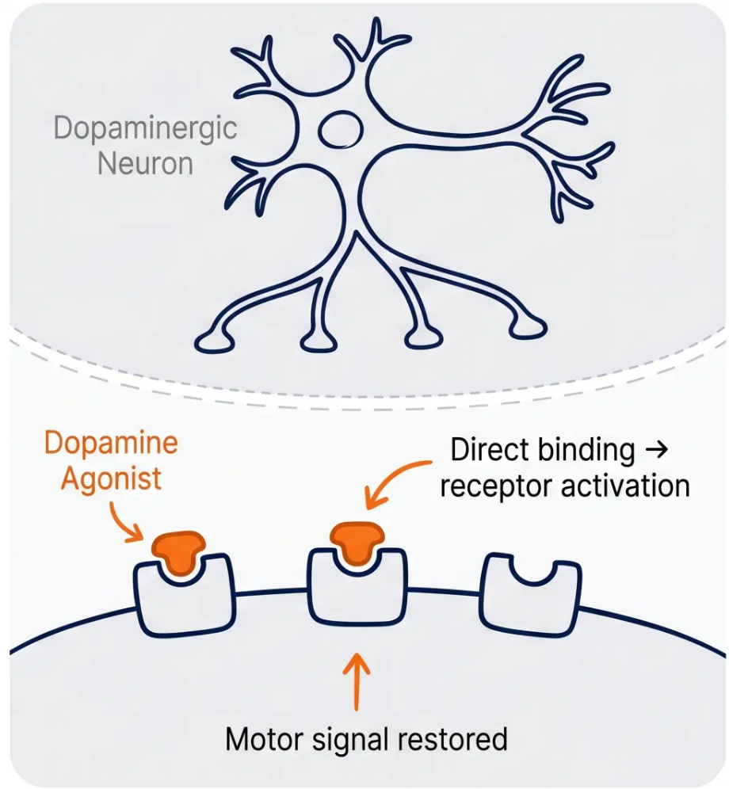




BRADFORD VTS · Pharmacological Management of Parkinson’s Disease
7 / 32
Dopamine Agonists: Mechanism and Use
“Direct receptor stimulation — smoother, more sustained motor control”
How They Work
Direct Dopamine Receptor Stimulation
Bind directly to dopamine receptors in the striatum — bypassing the
need for surviving dopaminergic neurons to convert a precursor.
Why Use Them?
Longer Half-Life = Smoother Effect
Longer duration of action than levodopa → fewer fluctuations, reduced
peak-dose dyskinesia risk. More sustained receptor stimulation.
When to Use First
First-Line in Younger Patients (<70)
NICE NG71: Consider dopamine agonist monotherapy first in younger
patients to delay levodopa and its long-term motor complications.
Non-ergot agonists only — ergot derivatives (bromocriptine,
cabergoline) are no longer recommended due to fibrotic reactions.
NICE NG71 (Dec 2024) · Ergot agonists avoided · ICD risk — always counsel before initiating

Slide 8

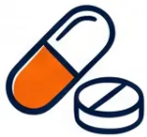







Non-Ergot Dopamine Agonists
Preferred first-line agonists — ergot agents are no longer recommended
ROPINIROLE
PRAMIPEXOLE
ROTIGOTINE
Requip
Mirapexin
Neupro patch
“NICE first-line non-ergot agonist”
“Available in once-daily
prolonged release”
“Only dopamine agonist as a
transdermal patch”
Dosing
Dosing
Dosing
Start: 0.25 mg three times daily
Start: 88 mcg (base) three times daily
Start: 2 mg per 24 hours patch
Increase: By 2 mg weekly
Usual range: 3–9 mg per day
Usual: Titrate to 1.1 mg three times
daily
Maximum: 24 mg per day
Early PD maximum: 8 mg per 24 hours
Modified release (XL): Once daily —
preferred for adherence
Prolonged release (PR): Once daily —
divide total daily dose by three for
conversion
Advanced PD maximum: 16 mg per 24
hours
“Particularly useful in swallowing
difficulties and nil-by-mouth situations
— acts as a levodopa bridge”
Titrate gradually based on response
and tolerability
Renal dose adjustment required —
check BNF
Always warn patients about impulse control disorders before starting any dopamine agonist — NICE NG71 requirement (See Slide 9)

Slide 9












Impulse Control Disorders (ICD)
A Critical Safety Warning
Up to 17% of patients on dopamine agonists develop ICD — NICE
NG71 mandates patient warning BEFORE starting treatment.
Pathological Gambling
Hypersexuality
Compulsive Shopping
Compulsive Eating
Uncontrolled urge to
gamble, often online
Inappropriate or
compulsive sexual
behaviour
Excessive, uncontrolled
spending behaviour
Binge eating, loss of
control around food
Before Starting
At Every Review
✓ Warn patient AND carer explicitly
✓ Ask directly — patients rarely volunteer
✓ Document the discussion in notes
✓ ‘Have you noticed any changes in behaviour?’
✓ Obtain informed consent
✓ Reduce or stop agonist if ICD confirmed
NICE NG71 (Dec 2024) · Dopamine agonist ICD risk applies to ropinirole, pramipexole, and rotigotine
Bradford VTS · www.bradfordvts.co.uk

Slide 10



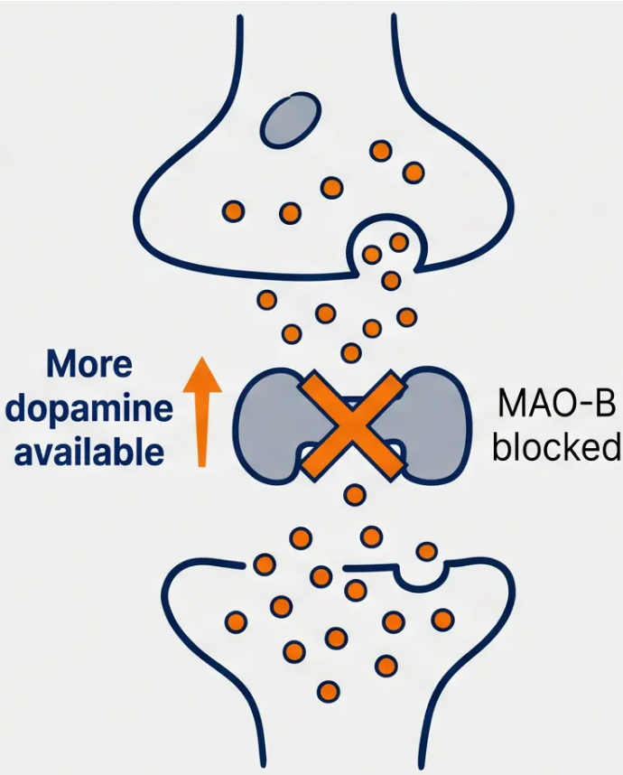



SECTION 4 · DRUG CLASSES
MAO-B Inhibitors
"Reducing dopamine breakdown — as monotherapy or adjunct to levodopa"
Rasagiline (Azilect)
1 mg once daily
• Used as adjunct to levodopa to reduce motor fluctuations
• May have mild neuroprotective effect (TEMPO trial — not yet clinically proven)
DANGEROUS INTERACTION: Rasagiline / Selegiline + Pethidine → Risk of
Serotonin Syndrome — NEVER co-prescribe
Selegiline (Eldepryl / Zelapar)
Oral: 5–10 mg once daily in the morning
Buccal (Zelapar 1.25 mg): higher bioavailability — useful in swallowing difficulty
• Stimulant metabolites — take in the morning; risk of insomnia if taken late
• Zelapar dissolves under the tongue — useful when oral route is compromised
Caution with SSRIs and SNRIs — serotonin interactions possible at therapeutic doses.
Review the full medication list.
Bradford VTS · Parkinson's Disease Pharmacology · NICE NG71 Dec 2024
10 / 32

Slide 11

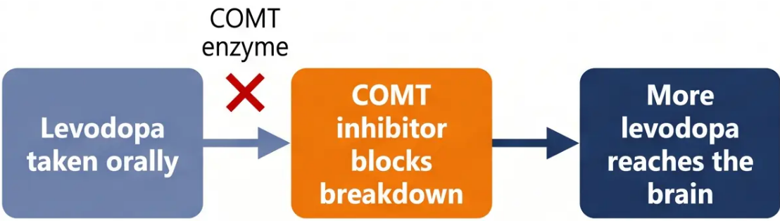



Bradford VTS
COMT Inhibitors
Extending levodopa’s reach by blocking peripheral breakdown
COMT inhibitors block catechol-O-methyltransferase,
reducing peripheral levodopa metabolism and
extending its duration of action. Used only as
adjuncts to levodopa — no benefit as monotherapy.
Entacapone (Comtess / Stalevo)
200mg with EACH dose of levodopa (max 10 doses/day)
• Reduces wearing-off and extends ON time
• Combined preparation available: Stalevo (levodopa +
carbidopa + entacapone)
⚠ Diarrhoea · Orange urine (harmless — warn patient) ·
May unmask dyskinesia
Opicapone (Ongentys)
NEWER
50mg once daily at bedtime
• Once-daily dosing — improved adherence
Result: Longer ‘ON’ time, reduced wearing-off episodes
• NICE NG71 (Dec 2024): recommended for end-of-dose
motor fluctuations
⚠ Dyskinesia · Constipation · Less diarrhoea than entacapone
bradfordvts.co.uk
Slide 11 of 32

Slide 12
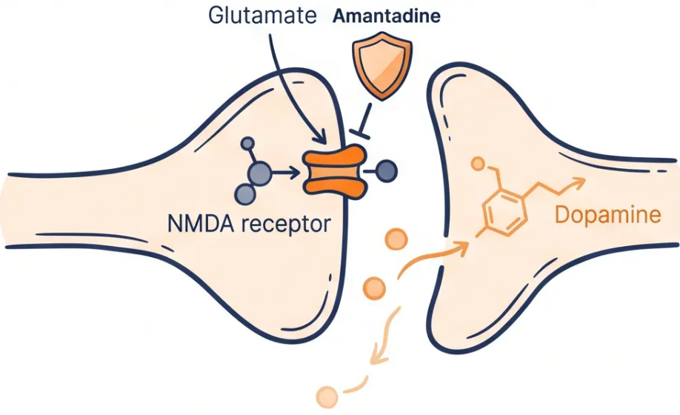







Amantadine
NMDA Receptor Antagonist · Dual-Role Agent
What Does It Do?
- NMDA receptor antagonist — reduces glutamate-
mediated excitotoxicity
- Weak dopaminergic and weak anticholinergic
properties
- Dual clinical role: mild motor benefit in early PD and
unique antidyskinetic effect in advanced disease
⚠️ Side Effects to Know
🔵 Livedo reticularis — mottled skin
discolouration (harmless; warn patient)
BNF Dose (2025–2026)
🔵 Ankle oedema
- Start: 100mg once daily
🔵 Hallucinations and confusion —
especially in elderly patients
- Increase to: 100mg twice daily
- Maximum: 400mg/day
🔵 Use with caution in pregnancy (MHRA
guidance)
- ⚠️ Reduce dose in renal impairment
Bradford VTS Teaching Deck · Pharmacological Management of Parkinson's Disease
12 / 32

Slide 13



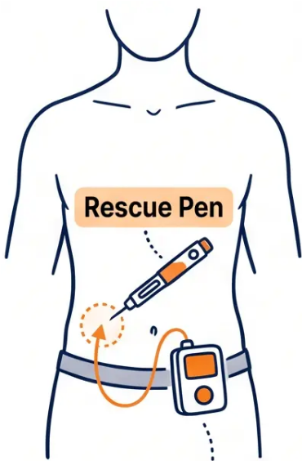








13 / 32
Apomorphine
Specialist-led rescue therapy for advanced Parkinson's disease
Role and Mechanism
What Is It and When Is It Used?
• Potent non-selective dopamine agonist — the most powerful available
• Reserved for advanced PD with motor fluctuations not controlled by oral therapy
Forms and BNF Doses
SC Rescue Injection (APO-go Pen)
Continuous SC Infusion (APO-go Pump)
Dose: 1–6 mg per injection
For: Severe, unpredictable motor fluctuations
Maximum: 10 injections per day
Continuous subcutaneous delivery via wearable pump
Maximum total daily dose: 100 mg
Specialist-initiated and monitored
Use: Sudden “off” periods — rapid rescue
Injection site reactions common — rotate sites regularly
Mandatory Co-prescription: Domperidone
Rescue Pen
⚠ Domperidone Co-prescription is Mandatory
- Domperidone 10 mg three times daily — start at least 3 days before apomorphine
- Continue for approximately 3 months to prevent nausea and hypotension
- Check QTc before starting — cardiac risk assessment required
*Primary care role: monitoring, supply, and site reaction review — apomorphine is always specialist-initiated.
Bradford VTS · www.bradfordvts.co.uk · Updated to NICE NG71 Dec 2024 & BNF 2025–2026

Slide 14











Bradford VTS
Drugs to Avoid in Parkinson’s Disease
“Dopamine-blocking drugs are absolutely contraindicated — they can cause catastrophic motor deterioration.”
NEVER PRESCRIBE THESE IN KNOWN PARKINSON’S DISEASE
Prochlorperazine
Metoclopramide
(Stemetil)
Haloperidol
Anti-emetic / Prokinetic
Anti-emetic / Phenothiazine
Typical Antipsychotic
Dopamine antagonist —
worsens PD severely
Dopamine antagonist —
absolutely contraindicated
Strong D2 blockade — causes
acute motor crisis
Chlorpromazine
Risperidone
Olanzapine
Typical Antipsychotic
Atypical Antipsychotic
Atypical Antipsychotic
Dopamine antagonist —
contraindicated
High D2 affinity —
contraindicated in PD
High risk — avoid; worsens
motor symptoms
Common trigger: Nausea or dizziness treated with metoclopramide or prochlorperazine in A&E or by a non-specialist. Always flag PD diagnosis clearly.

Slide 15











Page 15 of 32
Safe Alternatives for Nausea and Psychosis
When the usual drugs are off the table — know what IS safe in Parkinson’s
Nausea & Vomiting
Drug-Induced Psychosis
SAFE ANTI-EMETICS IN PD
SAFE ANTIPSYCHOTICS IN PD
Quetiapine
Domperidone 10mg
Lowest D₂ blockade — first choice; minimal
motor worsening
Does not cross the blood-brain barrier —
preferred first choice
Specialist-initiated; monitor metabolic profile
Monitor QTc; avoid in cardiac patients
Clozapine
Most effective for PD psychosis; requires CPMS
registration and blood monitoring Specialist only
Ondansetron
5-HT₃ antagonist — safe in PD; useful
when domperidone is contraindicated
Pimavanserin
5-HT₂ₐ antagonist — no dopamine blockade;
not yet widely available in UK Specialist only
✕ NEVER use: Metoclopramide · Prochlorperazine · Cyclizine
✕ AVOID: Haloperidol · Olanzapine · Risperidone · Chlorpromazine
Bradford VTS · Pharmacological Management of Parkinson’s Disease · NICE NG71 Dec 2024
www.bradfordvts.co.uk

Slide 16
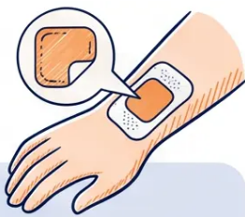







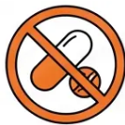







BRADFORD VTS TEACHING DECK · PHARMACOLOGICAL MANAGEMENT OF PARKINSON’S DISEASE
Nil By Mouth (NBM) Protocol
‘PD medications must continue — even when the
patient cannot swallow.’
Identify
Identify PD diagnosis and medication schedule
Communicate to surgical, anaesthetic, and nursing teams
before procedure.
‘Get It On Time — Every Time’
PD medications cannot be safely delayed. Even a 30-minute
gap can cause significant deterioration in motor function.
Calculate LED
Use PDMedCalc to calculate Levodopa Equivalent Dose (LED)
MHRA-ratified tool (March 2024). Convert total daily levodopa
dose to equivalent.
‘Nil by mouth does NOT mean nil medication’
Surgical and anaesthetic teams must be clearly briefed.
PD drugs continue through the perioperative period via an
alternative route.
Bridge with Rotigotine Patch
Apply Rotigotine (Neupro) patch as temporary bridge
Rotigotine 2mg/24h ≈ 100mg levodopa equivalent dose (LED)
Transdermal — no swallowing required. Suitable for NBM and
theatre settings.
‘Prepare the patient before admission’
Provide a medication list with exact timing. Advise patients
to bring medications and self-administer if doses are missed.
Share Parkinson’s UK “Get It On Time” information sheet.
Enteral Route if Available
Madopar dispersible via NG tube if enteral access exists
Rapidly absorbed. Document timing as a patient safety priority on
every drug chart.
NHS Patient Safety Alert: PD medication delays in hospital are a serious, preventable risk.
Document medication timing on every drug chart. Treat it as a safety-critical intervention.

Slide 17



Psychiatric Complications: Hallucinations
When PD medications cause visual hallucinations or delusions —
withdraw in this order
If Psychosis Persists After
Dose Reduction:
● Quetiapine — lowest D2 blockade;
first-line for PD psychosis
① Step 1 — Anticholinergics (e.g. trihexyphenidyl)
STOP FIRST Stop first — highest cognitive and psychiatric risk
● Clozapine — most effective;
requires CPMS monitoring (specialist)
② Step 2 Amantadine
Reduce then withdraw — hallucinations and confusion
● Rivastigmine — if underlying
cognitive decline is present
③ Step 3 Selegiline / MAO-B inhibitor
Reduce or stop — stimulant metabolites implicated
⚠ Never use haloperidol, olanzapine, or
risperidone — these worsen motor PD dramatically
④ Step 4 COMT Inhibitor (e.g. entacapone)
Reduce or stop — extends dopaminergic effect
⑤ Step 5 Dopamine Agonist
Reduce gradually — do not stop abruptly
⑥ Step 6 — LAST RESORT Levodopa
Reduce only as last resort — motor deterioration risk
Source: NICE NG71 (updated December 2024)
Bradford VTS Teaching Deck · Pharmacological Management of Parkinson's Disease · May 2026 · www.bradfordvts.co.uk

Slide 18

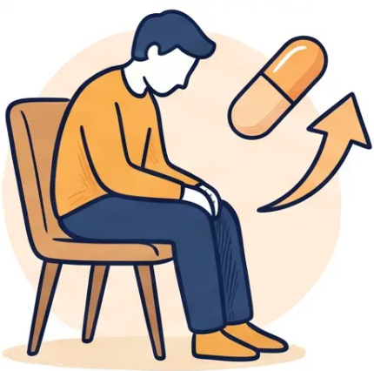




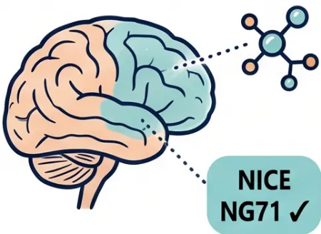



‘Depression and Dementia in PD’
Common comorbidities — recognise early, treat thoughtfully
Depression in Parkinson’s Disease
• Very common — affects 40–50% of PD patients · Often under-diagnosed and under-treated
• First-line treatment: SSRIs — Sertraline or Citalopram preferred
• Important dose note: Citalopram maximum 20mg/day if aged over 65 (cardiac QTc risk)
“TCAs: use with caution — anticholinergic
side effects worsen cognition in PD”
Parkinson’s Disease Dementia (PDD)
• Occurs in over 80% of patients over the course of the disease — a major late complication
• NICE NG71 First-line: Rivastigmine (cholinesterase inhibitor) — evidence-based for PDD
• Second-line: Donepezil · Avoid all anticholinergics — significantly worsen cognitive function
NEVER use conventional antipsychotics for PD psychosis — see Slide 15
Bradford VTS · Pharmacological Management of Parkinson’s Disease · NICE NG71 Dec 2024
18 / 32

Slide 19
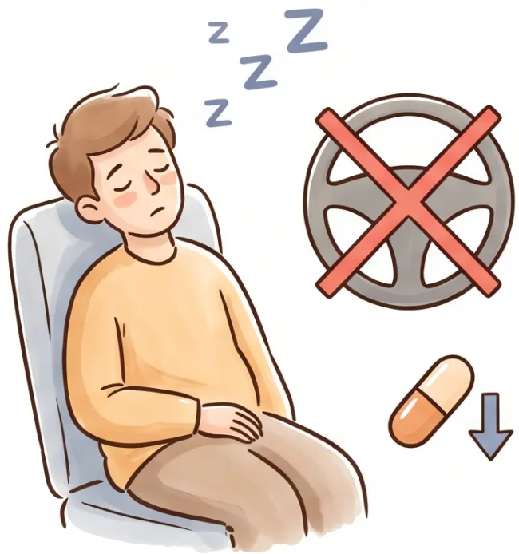




Sleep Disturbances and Somnolence
“Dopaminergic agents, driving safety, and dose management”
What Causes It?
• All dopaminergic agents can cause excessive daytime somnolence (EDS) and
sudden sleep attacks
• Dopamine agonists carry the highest risk — effect may be dose-related
• Sleep attacks can occur without warning — even during conversation or activity
⚠ Driving Safety — NICE NG71
• Warn all patients on dopaminergic therapy about the risk of sleep attacks
• Patients may need to stop driving — DVLA notification may be required
• Document the discussion in the medical record
Management Principles
• Fractionate doses — spread across the day rather than larger single doses
• Reduce dopamine agonist dose if EDS is prominent
• Review all sedating co-medications (e.g. benzodiazepines, antihistamines)
• Consider modafinil (off-label; note MHRA Dec 2020 caution — review suitability per patient)
NICE NG71 · BNF 2025–2026 ·
Bradford VTS ·
19 / 32

Slide 20

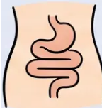
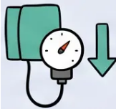












SECTION 11
Non-Motor Symptom Management
Part 1 — Autonomic Dysfunction in Primary Care
‘Non-motor symptoms often predate motor features and are a major determinant of quality of life.’
Constipation
Orthostatic Hypotension
Very common — affects up to 80% of PD patients
Symptomatic drop in BP on standing — dizziness, falls risk
🥦 High-fibre diet — fruit, vegetables, wholegrains;
increase fluid intake
🔍 Review antihypertensives — reduce or stop if
contributing
💊 Macrogol (Movicol) — first-line laxative; safe and
effective
🦵 Compression stockings — grade 2; worn during the day
🛌 Head-up tilt of bed — raise head end by 10–20
degrees overnight
💊 Lactulose — osmotic laxative; second option
💊 Midodrine — off-label; alpha-1 agonist; specialist advice
⚠️ Avoid codeine — worsens constipation significantly
💊 Fludrocortisone — mineralocorticoid; use with caution
in elderly
🚶‍♀️ Regular physical activity — promotes bowel motility
💧 Increase fluid and salt intake — simple first step
Bradford VTS · www.bradfordvts.co.uk · NICE NG71 (Dec 2024)
20 / 32

Slide 21








Primary Care Management Series
Non-Motor Symptom Management
Part 2: Urinary • Sialorrhoea • Pain • Sleep
Urinary Urgency
Sialorrhoea (Drooling)
• Exclude UTI first — always before treating
• Glycopyrronium buccal — NICE TA605 approved
• Avoid oxybutynin — anticholinergic confusion risk in PD
• Botulinum toxin injection to salivary glands —
specialist-initiated
• Solifenacin preferred anticholinergic (lower CNS penetration)
• Review swallowing — refer to SALT if concerns
• Refer to PDNS for bladder management support
• Reassure patient — very common and manageable
NICE TA605: glycopyrronium buccal spray first-line
Anticholinergics worsen cognition — use cautiously
Pain / Musculoskeletal
REM Sleep Disorder
• Paracetamol first-line analgesia
• Melatonin — first-line; safe, well-tolerated
• Physiotherapy — key non-pharmacological intervention
• Clonazepam — specialist-initiated; low dose at night
• Gabapentin for neuropathic pain component
• Advise on bed safety — acting out dreams can cause injury
• Optimise dopaminergic therapy — off-period pain often
improves with better motor control
• Warn partner — may be disruptive; reassure both
patient and carer
Off-period dystonia (e.g. early morning foot cramp) — adjust levodopa timing
REM sleep disorder often precedes PD motor symptoms by years
NICE NG71 (Dec 2024) • BNF 2025–2026 • Bradford VTS
www.bradfordvts.co.uk
21 / 32

Slide 22


BRADFORD VTS TEACHING DECK
Top Tips for GP Trainees
Referrals and Safety
01 Always Refer Untreated Suspected PD to a Specialist
NICE NG71 is explicit — do not start treatment before diagnosis is confirmed by a movement disorder neurologist or specialist geriatrician.
02 Never Prescribe Metoclopramide or Prochlorperazine in PD
These are dopamine antagonists — they worsen PD dramatically. This is a classic AKT question and a real patient safety risk.
03 The Only Safe Anti-Emetics in PD are Domperidone and Ondansetron
Check every prescription at every review — nausea is common and the wrong anti-emetic is a frequent and dangerous error.
04 Lack of Levodopa Response Should Prompt Diagnostic Re-evaluation
Consider MSA, PSP, or DLB. True idiopathic PD almost always responds to levodopa — no response is a red flag.
05 PDNS is Your Key Contact — Ensure Every Patient Has Their Number
Copy all correspondence to the Parkinson's Disease Nurse Specialist. They are the most accessible expert resource for patients and GPs alike.
www.bradfordvts.co.uk · NICE NG71 Dec 2024 · For educational purposes only

Slide 23





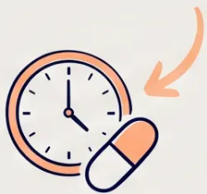
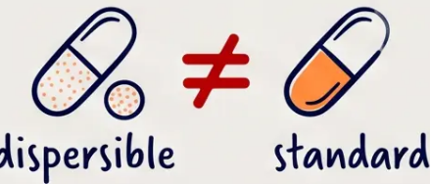


Top Tips for GP Trainees
Medication Management
TIPS 6 – 10
6 Madopar Dispersible
≠ Madopar Capsule
7 PD Meds On Time,
Every Time
8 PDNS Is Your Key
Contact
Different onset and duration.
Different onset and duration.
Prescribe explicitly by name and
formulation — never assume
one can substitute the other.
Warn patients going to hospital
to carry their medications and
self-administer if staff do not
give them on time. Even short
delays cause real deterioration.
Copy all correspondence to the
Parkinson's Disease Nurse
Specialist. Ensure patients have a
direct PDNS number — they are
the most accessible expert support
between clinic appointments.
🔑 “If in doubt — call the PDNS. They are the specialist link between primary and secondary care.”
Bradford VTS
www.bradfordvts.co.uk
23 / 32

Slide 24












BRADFORD VTS TEACHING DECK
AKT Exam Pearls
High-Yield Facts for the Applied Knowledge Test
AKT FOCUS
Safe Anti-Emetics in PD
Rivastigmine in PD Dementia
✅ Domperidone (preferred — does not cross BBB) ·
NICE NG71 first-line cholinesterase inhibitor for Parkinson's
disease dementia (PDD). Donepezil = second-line only.
AVOID anticholinergics — significantly worsen cognition.
✅ Ondansetron (5-HT3 antagonist — safe) · ❌
Metoclopramide and Prochlorperazine — CONTRAINDICATED
Impulse Control Disorders
Rotigotine Patch
Dopamine agonists → pathological gambling,
hypersexuality, compulsive eating. Affects up to 17%. NG71:
Warn patients BEFORE starting. Screen at every review.
Only dopamine agonist available as a transdermal patch.
Start 2mg/24h. Key use: NBM situations and swallowing
difficulty. Useful bridge during surgical procedures.
MAO-B Inhibitor Interactions
Opicapone & Entacapone
Rasagiline 1mg once daily. ⚠️ Pethidine — DANGEROUS
interaction (serotonin syndrome risk). Caution with
SSRIs/SNRIs. Selegiline: take in the morning — stimulant
metabolites cause insomnia.
Entacapone 200mg with each levodopa dose — adjunct
only, not monotherapy. Orange urine — warn patient
(harmless). Opicapone 50mg once daily at bedtime —
newer, better adherence.
*PDMedCalc = MHRA-ratified LED conversion tool for nil-by-mouth planning · Apomorphine: SC only; always co-prescribe domperidone

Slide 25











SCA FOCUS
SCA Exam Pearls: Communication and Safety
What you say matters as much as what you prescribe — here’s how to say it well.
Opening the Consultation
OPENING
Safety-Netting for Hospital Admissions
SAFETY-NETTING
“Can you tell me how your Parkinson’s has been
affecting you day to day?”
“If you’re going into hospital, please take your
medications and tell the team you must have them
on time — every time.”
Open-ended, patient-centred. Invites the patient’s
narrative before you introduce the clinical agenda.
Addresses the ‘Get It On Time’ risk. Empowers patient
and carer as active safety partners.
Shared Decision-Making
SHARED DECISION-MAKING
ICD Sensitive Screening
ICD SCREENING
“There are a number of options we can add — shall
we talk through what might suit your lifestyle best?”
“Some medications can occasionally lead to changes
in behaviour — have you noticed anything like that?”
Signals collaboration, not prescription. Respects patient
values and daily routine in treatment choice.
Non-judgemental, normalising language. Patients
rarely volunteer ICD symptoms — you must ask.
🌐 www.parkinsons.org.uk · 📞 Parkinson's UK Helpline: 0808 800 0303
Bradford VTS · Page 25 of 32

Slide 26






BRADFORD VTS TEACHING DECK
Red Flags: Alternative Diagnoses
“These features suggest the diagnosis may NOT be idiopathic Parkinson’s disease”
MSA — Multiple System Atrophy
PSP — Progressive Supranuclear Palsy
🚨 Rapid progression to wheelchair
within 3 years
🚨 Early falls within the first year of
diagnosis
Early autonomic failure · Cerebellar signs (MSA-C)
Vertical gaze palsy · Axial rigidity · No tremor
· Symmetrical onset
DLB — Dementia with Lewy Bodies
Atypical Features — Reconsider Diagnosis
🚨 Early dementia · Early visual
hallucinations · Fluctuating cognition
🚨 Symmetrical onset · Absence of
tremor · Poor levodopa response
Cognitive features precede or appear within 1
year of motor symptoms
Any of these should prompt specialist re-referral
and diagnostic review
“Lack of levodopa response is a key diagnostic signal — always re-evaluate.”
Disclaimer of these should prompt specialist re-referral and diagnostic review.

Slide 27












Red Flags: Urgent Deterioration
Recognise these emergency scenarios — act immediately
Neuroleptic Malignant
Syndrome (NMS)
Swallowing Difficulty /
Aspiration Risk
Severe Hallucinations /
Acute Agitation
TRIGGER: Abrupt PD medication
withdrawal or antipsychotic exposure
TRIGGER: Progressive dysphagia,
recurrent chest infections
TRIGGER: Medication changes,
infection, dehydration
• Hyperthermia • muscle rigidity •
altered consciousness
• Silent aspiration — may present as
recurrent pneumonia
• Visual hallucinations + severe
agitation → urgent review
• Autonomic instability (sweating,
tachycardia, labile BP)
• Inability to take oral PD medications
→ rapid motor deterioration
• Exclude underlying infection or
metabolic cause first
• Raised CK — life-threatening
emergency
• Weight loss, drooling, coughing
during meals
• Do NOT prescribe haloperidol or
olanzapine — will worsen PD
CALL 999
URGENT SLT REFERRAL
SAME-DAY SPECIALIST REVIEW
Sudden deterioration → suspect
infection, drug interaction, or NMS
Never stop PD meds abruptly →
taper under specialist guidance only
Always exclude infection first
→ delirium mimics psychiatric crisis
Bradford VTS
27 / 32

Slide 28















Common Pitfalls in PD Management
Eight clinical errors every GP trainee must know — and avoid
Using
metoclopramide
for nausea in PD
Stopping PD
medications suddenly
Starting haloperidol or
olanzapine for
psychosis
Not screening for
impulse control
disorders
Dopamine antagonist —
worsens PD dramatically.
Use domperidone instead.
Risk of neuroleptic
malignancy syndrome —
always taper or maintain.
Worsens motor symptoms.
Use quetiapine or
clozapine (specialist-led).
Occurs in up to 17% on
dopamine agonists. Ask at
every review.
Confusing Sinemet CR
with Co-careldopa MR
125mg
Failing to flag PD med
timing before elective
procedures
Using anticholinergics
in older patients with
PD
Delaying referral for
suspected PD
Different doses —
prescribe by specific product
name to avoid errors.
Delays in hospital cause
serious deterioration.
Document timing explicitly.
Significantly worsens
cognition — avoid in all
elderly PD patients.
NICE NG71 is explicit: refer
ALL suspected untreated
PD to a specialist.
Bradford VTS · Pharmacological Management of Parkinson's Disease · NICE NG71 Dec 2024
28 / 32

Slide 29


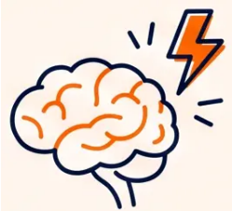












BRADFORD VTS TEACHING DECK
Quick Recall: Core Knowledge Check
*Rapid-fire essentials — PD symptoms, drug classes, safe prescribing, NBM bridging*
PD MOTOR TRIAD
LEVODOPA
DOPAMINE AGONISTS
Bradykinesia + Rigidity
+ Resting Tremor
Best efficacy for
motor symptoms
ICD risk — ALWAYS
warn and screen
Bradykinesia is ESSENTIAL for
diagnosis — NICE NG71
Co-careldopa = Sinemet · Co-beneldopa =
Madopar · Motor complications ~10%/year
Ropinirole · Pramipexole · Rotigotine
patch · Not ergots
NEVER IN PD
SAFE ANTI-EMETIC
NBM BRIDGE
Metoclopramide ·
Prochlorperazine ·
Haloperidol
Rotigotine patch +
PDMedCalc
DOMPERIDONE ✓
Dopamine antagonists — worsen
disease dramatically
Ondansetron also safe · Nothing else
2mg/24h ≈ 100mg LED · MHRA-ratified
conversion tool
🧠 Rasagiline + Pethidine = DANGEROUS
🩺 Rivastigmine = NICE first-line for PD dementia
💊 Entacapone = adjunct only + orange urine
Page 29 of 32
www.bradfordvts.co.uk

Slide 30





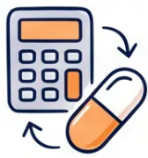


Resources for Patients and Clinicians
Trusted references to support you and your patients beyond the consultation.
Parkinson’s UK
PDMedCalc
NICE NG71
The leading UK charity for people
living with Parkinson's. Helpline,
local support groups, medication
guides, and carer resources.
MHRA-ratified levodopa equivalent
dose (LED) conversion tool. Essential
for nil-by-mouth planning and
medication switches.
Full NICE guideline on Parkinson's
disease in adults. Updated December
2024. Covers diagnosis, pharmacological
and non-pharmacological management.
www.parkinsons.org.uk
www.pdmedcalc.com
www.nice.org.uk/guidance/ng71
Helpline: 0808 800 0303
MHRA-ratified — March 2024
Updated: December 2024
For patients and carers
For clinicians
For clinicians
📌 Encourage all PD patients to register with Parkinson’s UK — peer support and information can be as valuable as medication.
Bradford VTS · www.bradfordvts.co.uk · May 2026
30 / 32

Slide 31














Final Summary & Key Takeaways
“Three principles that underpin everything in PD management”
Specialist
Diagnosis
On-Time
Medication
Vigilant
Monitoring
Get the Diagnosis Right
Meds On Time, Every Time
Monitor Motor & Non-Motor
Always refer untreated
suspected PD to a specialist
PD medications cannot wait
— even in hospital
Screen for ICDs, hallucinations,
depression at every review
Atypical features? Think
MSA, PSP, DLB
NBM ≠ no medications. Use
rotigotine patch as bridge
Non-motor symptoms often
precede and outlast motor ones
NICE NG71 Requirement
Patient Safety Priority
Every Consultation
◆ PD management is a long-term partnership — between patient, GP, specialist, and nurse. ◆
Bradford VTS Teaching Deck · Pharmacological Management of Parkinson's Disease · May 2026
www.bradfordvts.co.uk

Slide 32




BRADFORD VTS TEACHING DECK
Disclaimer and Attribution
⚠️ Educational Use Only
This teaching deck is intended for educational purposes for GP trainees and healthcare professionals.
All drug doses, clinical thresholds, and management recommendations should be independently verified
against the latest NICE guidance and current BNF before clinical application. Medicine is a rapidly
evolving field — always check for updates.
This resource does not replace clinical judgement or individualised patient care.
Sources and Standards
• NICE Guideline NG71: Parkinson’s disease in adults — updated December 2024
• NICE CKS: Parkinson’s Disease — reviewed February 2025
• British National Formulary (BNF) — NHS Formulary 2025–2026
• MHRA Drug Safety Updates — including December 2020 and March 2024 alerts
Bradford VTS
‘Created May 2026 · Updated to NICE NG71 December 2024 Standards’
VTS
www.bradfordvts.co.uk

