Slide 1


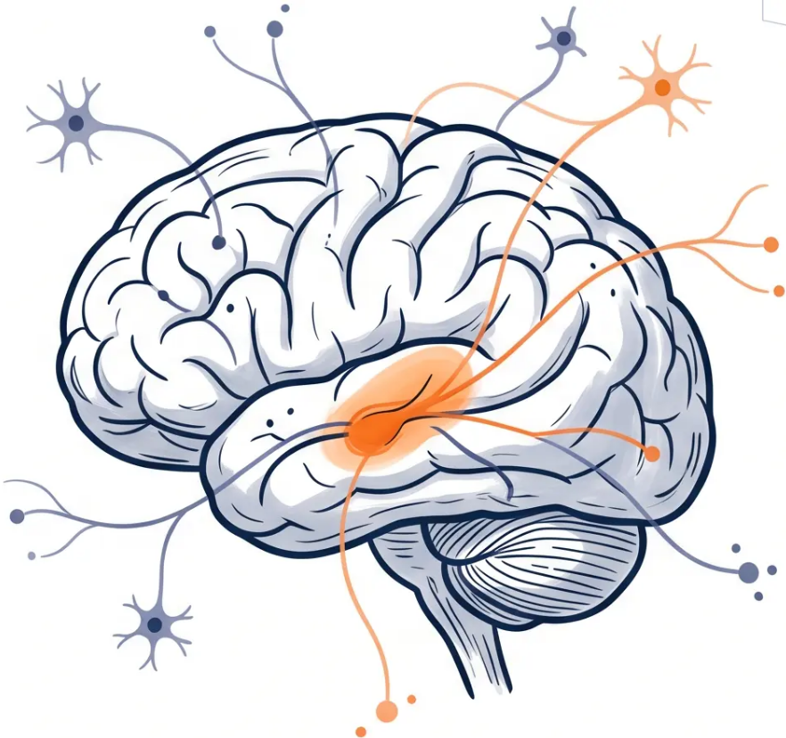

BRADFORD VTS TEACHING DECK
PARKINSON'S DISEASE
Management in
Primary Care
Bradford VTS Teaching Deck
Updated to NICE NG71 (Dec 2024) Standards
A comprehensive guide for GP trainees on managing
Parkinson's Disease in primary care — from diagnosis and
monitoring to medications, complications, and
end-of-life planning.
Created May 2026 · www.bradfordvts.co.uk
⚠ Always verify with current NICE/BNF guidance. Educational purposes only.
www.bradfordvts.co.uk
© Bradford VTS 2026

Slide 2






SECTION 1 — INTRODUCTION
Introduction and Epidemiology
UK PREVALENCE AT A GLANCE
1 in 500
WHAT IS PARKINSON’S DISEASE?
General UK population
A progressive neurodegenerative disorder
affecting the substantia nigra in the brain.
1 in 100
Loss of dopaminergic neurons leads to
Adults over 75 years
dopamine deficiency — disrupting movement,
mood, and autonomic function.
1 in 10
Nursing home residents
~145,000
Substantia nigra — site of
dopamine neuron loss.
People living with PD in the UK
1 in 20 diagnosed under age 40 — young-onset PD.
Slightly more common in males.
No cure exists — management focuses entirely on quality of life and symptom control.

Slide 3
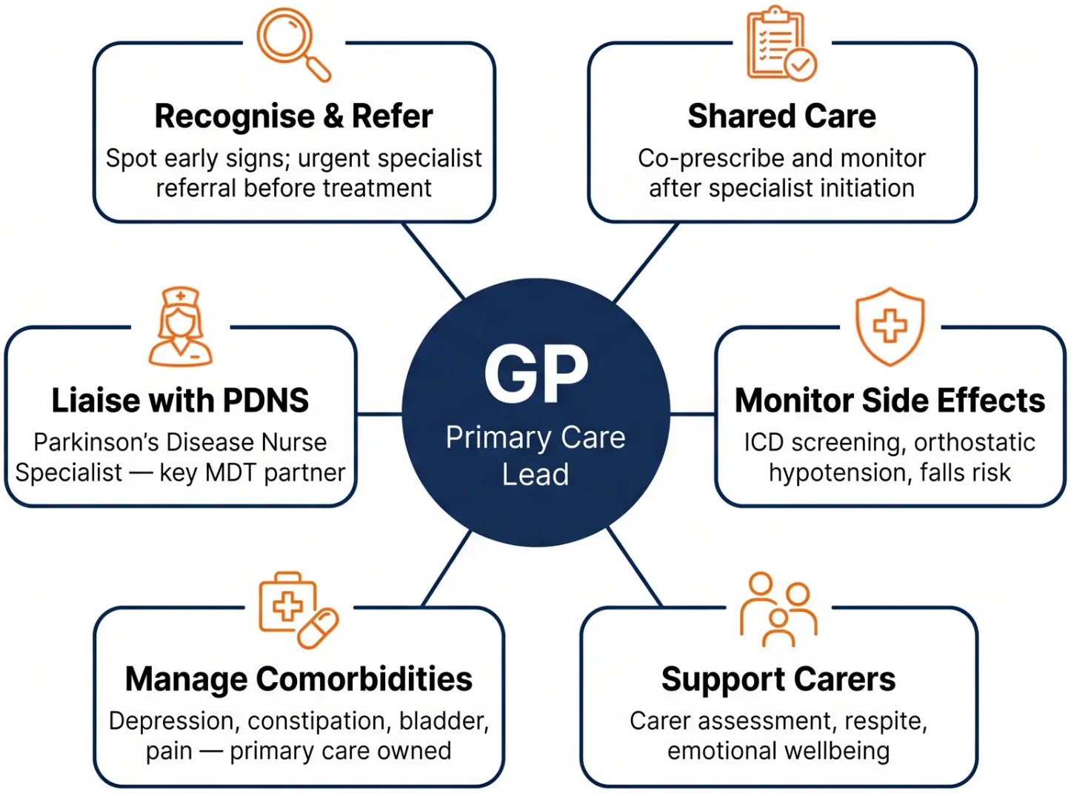


SECTION 1 · INTRODUCTION
The GP's Role in
Parkinson's Care
The GP is not a bystander —
from first suspicion to end of life,
the GP coordinates, supports,
and advocates.
NICE NG71
PDNS is your most valuable MDT partner — ensure every PD patient has their PDNS contact details.
www.bradfordvts.co.uk
Parkinson's Disease — Management in Primary Care
Page 3 of 32

Slide 4
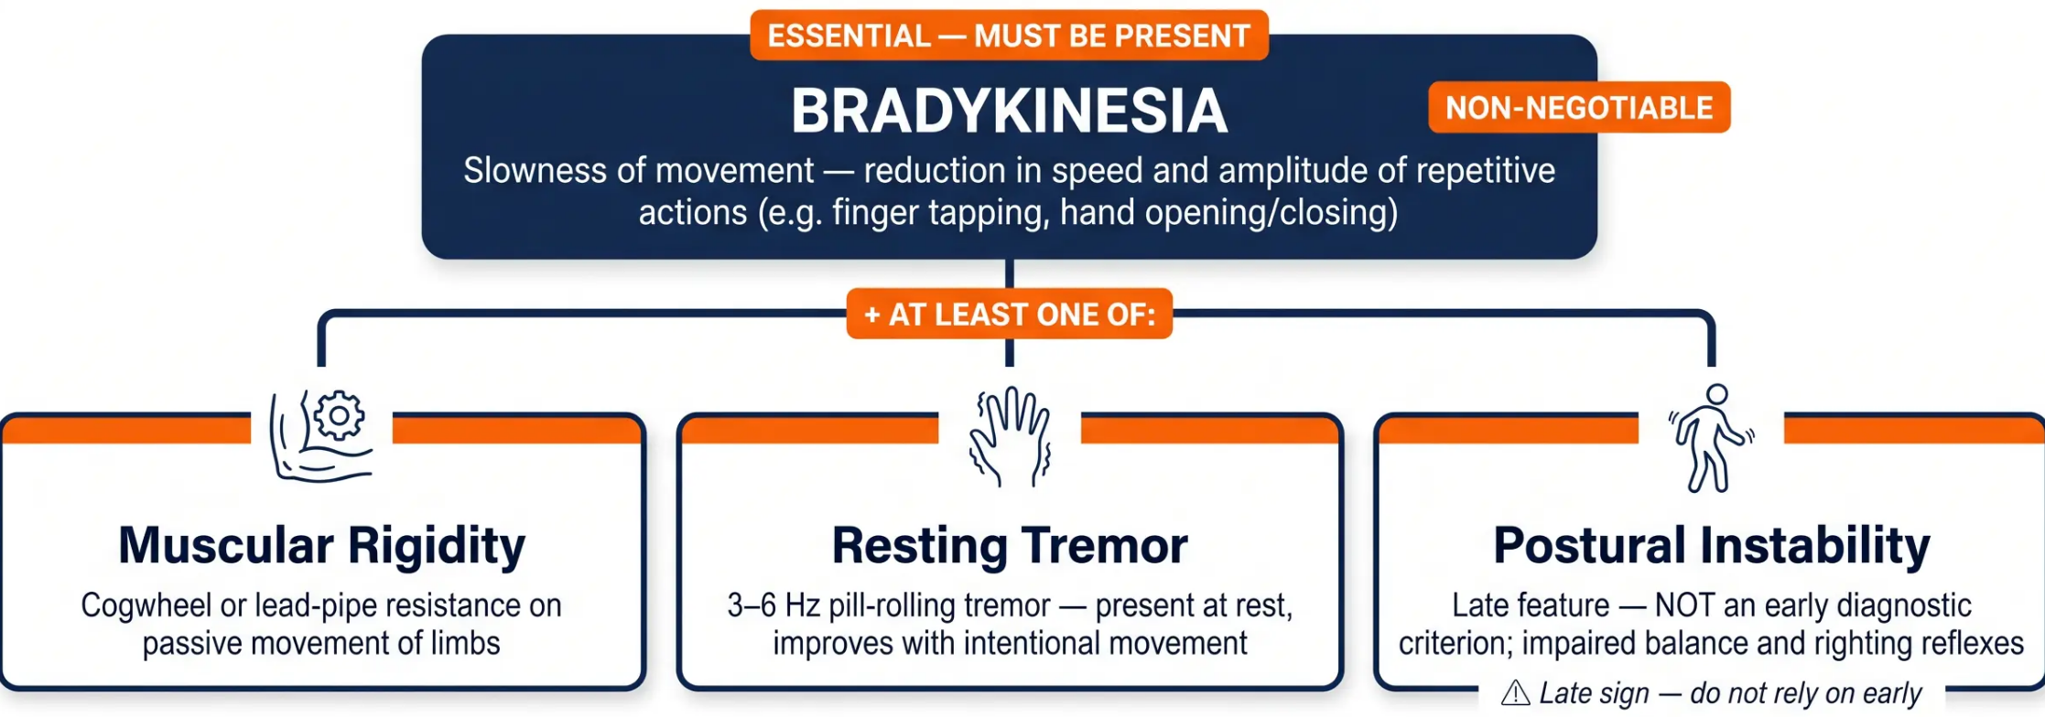
SECTION 2 — RECOGNITION & DIAGNOSIS
Cardinal Motor Features for Diagnosis
NICE NG71 — Bradykinesia is ESSENTIAL for diagnosis
SUPPORTING FEATURES (increase diagnostic confidence): Unilateral onset with asymmetry · Excellent levodopa response · Slow progression
NICE NG71 — Dec 2024
Bradford VTS · www.bradfordvts.co.uk

Slide 5




















SECTION 2 — RECOGNITION & DIAGNOSIS
Non-Motor Features
& Supporting Signs
These symptoms often appear years before motor features — and are frequently missed
⏰ OFTEN PRECEDE MOTOR SYMPTOMS BY YEARS
Anosmia
Constipation
REM Sleep Disorder
Depression & Anxiety
Orthostatic
Hypotension
Loss of smell —
very early sign
Often years before
diagnosis
Acting out vivid
dreams at night
Frequently missed —
ask directly
Dizziness on standing
Bladder urgency
Hypersomnia (daytime sleepiness)
Hypomimia · Micrographia · Hypophonia
SUPPORTING FEATURES — INCREASE DIAGNOSTIC CONFIDENCE
Unilateral Onset with
Asymmetry
Excellent Response to
Levodopa
Slow Progression
💡 Clinical Pearl
Gradual worsening over
years — rapid decline
suggests atypical PD
A patient presenting with
depression, constipation,
loss of smell — think PD,
even without tremor.
Symptoms begin on one side
and remain asymmetric
Clear, sustained improvement
confirms dopamine deficiency
NICE NG71 · NICE CKS PD (Feb 2025)
www.bradfordvts.co.uk

Slide 6









SECTION 2 • RECOGNITION & DIAGNOSIS
Not All Tremors Are Parkinson’s
Essential tremor is 8–10× more common than PD. Ask the right questions first.
Parkinson’s Disease
Essential Tremor
Drug-Induced Parkinsonism
• Resting tremor (3–6 Hz)
• Action/intention tremor (8–12 Hz)
• Caused by dopamine-blocking drugs
• Pill-rolling quality
• Bilateral and symmetric
• Metoclopramide, prochlorperazine
• Improves with intentional movement
• Head or voice tremor possible
• Antipsychotics (haloperidol, risperidone)
• Unilateral onset
• Improves with alcohol (classic clue)
• Usually bilateral and symmetric
• Associated bradykinesia and rigidity
• No bradykinesia or rigidity
• Resolves on stopping the drug
• Bradykinesia ESSENTIAL for diagnosis
• ALWAYS review full medication list
• Family history common
Bradykinesia = essential
8–10× more common than PD
Check ALL medications
KEY CLINICAL RULE
Before diagnosing PD: exclude drug-induced parkinsonism by reviewing every medication — including anti-emetics.
DAT-SPECT (DaTscan) can help distinguish PD from essential tremor in uncertain cases — but is not routine.
NICE NG71 • Dec 2024
www.bradfordvts.co.uk • Bradford VTS

Slide 7




Section 2 — Recognition & Diagnosis
NICE NG71 Diagnostic Guidance
How to diagnose Parkinson’s Disease — and what to do next
Clinical Diagnosis
DAT-SPECT (DaTscan)
Parkinson's Disease is a clinical diagnosis — there is no
definitive blood test or scan that confirms it.
A DaTscan is not required for routine diagnosis.
Consider in clinically uncertain cases — e.g. when essential
tremor cannot be confidently distinguished from PD.
Diagnosis is based on the presence of bradykinesia plus at
least one supporting motor feature.
Ordered by the specialist — not a primary care investigation.
The UK Parkinson's Disease Society Brain Bank criteria
remain the established clinical standard.
A normal DaTscan makes PD unlikely; an abnormal result
supports dopaminergic deficit but does not confirm PD alone.
⚠ NICE NG71 — MANDATORY RULE
Refer ALL untreated suspected PD to a specialist BEFORE starting any treatment
This includes movement disorder neurologists, geriatricians with PD expertise, or old age psychiatrists — depending
on local pathways.
Do NOT initiate levodopa or any dopaminergic therapy in primary care without specialist confirmation.
NICE NG71 — December 2024
Bradford VTS Teaching Deck — Parkinson's Disease in Primary Care
www.bradfordvts.co.uk

Slide 8










DISEASE STAGES
Stage 1: New Diagnosis
GP priorities at the point of diagnosis
Urgent Specialist Referral
STAGE 1 OF 4
Breaking the News Sensitively
Early / New Diagnosis
• Refer to movement disorder neurologist
or geriatrician with PD expertise
• Allow time and space for patient and carer
reactions
• Do NOT start treatment before specialist
confirmation (NICE NG71)
• Signpost to Parkinson's UK: 0808 800 0303
www.parkinsons.org.uk
DVLA Notification
Financial & Practical Support
• Patient must notify DVLA on diagnosis
• Blue Badge, PIP, Attendance Allowance
• Group 1 licence: may continue driving if
controlled
• Employment advice and carer
assessment
• Group 2 (HGV/bus): usually barred on
diagnosis
• PDNS contact details — essential from
day one
NICE NG71 • Dec 2024
Bradford VTS Teaching Deck — Parkinson's Disease in Primary Care
Page 8 of 32

Slide 9






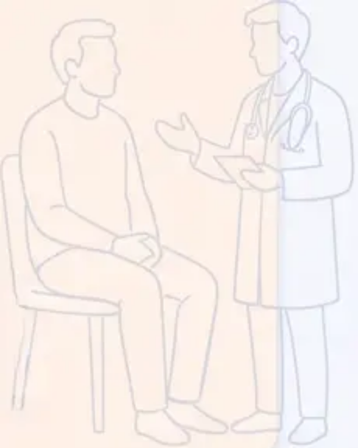


STAGE 2
Maintenance Phase
Established Parkinson's — GP priorities after specialist initiation
Medication Management
What Patients Are Thinking About
Continue and re-prescribe specialist-initiated drugs
Verify exact dose timings — time-critical
Screen for side effects at every review
● Work & financial planning
Discuss disclosure, adjustments, and
sick-leave entitlements sensitively
● Sexuality & relationships
Often not raised — ask directly and
create space for this conversation
Monitor and Coordinate
Motor complications: wearing-off, dyskinesia
Coordinate with PDNS and specialist team
Ensure MDT referrals are active and up to date
● Family and social impact
Social withdrawal is common;
encourage continued engagement
● Driving — ongoing reassessment
Document DVLA discussion at every
review — medicolegal requirement
Benefits and Employment
Benefits review — PIP, Blue Badge, Carer's Allowance
Signpost to Parkinson's UK employment resources
Occupational health referral if needed
These concerns are rarely volunteered. Ask.
www.bradfordvts.co.uk
Disease Stages — Stage 2: Maintenance Phase
NICE NG71 · Dec 2024

Slide 10










STAGE 3
Complex Parkinson’s
Managing motor, psychiatric, autonomic complications — and coordinating with your specialist team
Motor Fluctuations
Psychiatric Complications
• Wearing-off between doses
• Visual hallucinations (dopamine agonist-related)
• Peak-dose dyskinesia
• Paranoid delusions
• Unpredictable on-off periods
• Confusion and disorientation
• Early morning akinesia
• Depression and anxiety
• Freezing of gait
• Impulse control disorder (ICD)
→ Contact PDNS to adjust regime
→ Review dopamine agonist dose with specialist
Autonomic Features
Drug Regime Coordination
• Orthostatic hypotension (lying/standing BP)
• Complex titration — involve PDNS
• Never stop PD medications abruptly
• Constipation — macrogol first-line
• Urinary urgency — exclude UTI first
• Check for dopamine-antagonist drugs on all scripts
• Drooling — glycopyrronium buccal
• Exact dose timing is patient safety critical
• Excessive sweating
• Consider advanced therapies referral
→ Manage in primary care; escalate if refractory
→ PDNS is your key contact at this stage
Falls and safety assessment required at every Stage 3 review
Assess carer wellbeing — burden increases significantly at this stage
Bradford VTS Teaching Deck — Parkinson's Disease in Primary Care
10 / 32
Based on NICE NG71 (Dec 2024)

Slide 11












BRADFORD VTS TEACHING DECK
DISEASE STAGES • STAGE 4
Palliative Care
Ensuring comfort, dignity, and a good death — planning while capacity is present
COMFORT & DIGNITY
PALLIATIVE CARE REFERRAL
Symptom management — pain,
dysphagia, secretions, agitation. Prioritise
quality of life over disease modification.
Refer proactively to palliative care
services — do not wait for crisis. PDNS
remains a key contact throughout.
Pain
SOCIAL NEEDS ASSESSMENT
– Paracetamol first-line;
review analgesic ladder
Home care, nursing home placement, or
hospice — assess early and plan with
patient and family together. Prioritise,
patient and family together.
ADVANCE CARE PLANNING
DNACPR, preferred place of care,
advance decisions — initiate while the
patient has capacity. Document clearly.
Secretions & Drooling
– Glycopyrronium;
hyoscine patches
Agitation & Distress –
Low-dose midazolam;
specialist guidance
⚠ Plan early — advance care conversations are most meaningful while capacity is intact.
NICE NG71 (Dec 2024) • NICE CKS Palliative Care
www.bradfordvts.co.uk • Page 11 of 32

Slide 12







SECTION 4 — MULTIDISCIPLINARY TEAM
The Multidisciplinary Team
Clinical Roles
Three specialist roles form the clinical backbone of Parkinson's care — each with a distinct and essential function.
Neurologist
Geriatrician
PDNS
Movement Disorder Specialist
Older Adults & Complex Needs
Parkinson's Disease Nurse Specialist
• Confirms diagnosis of Parkinson's
Disease
• Diagnoses PD in older or frail patients
• Most accessible specialist contact for
patients
• Initiates and adjusts drug regimens
• Initiates pharmacological treatment
• Medication review and titration support
• Manages comorbidities alongside PD
• Manages complex motor complications
• Home visits and telephone advice
• Coordinates complex care for frail
patients
• Assesses suitability for Deep Brain
Stimulation (DBS)
• MDT coordination and referral hub
• Reviews atypical or uncertain
presentations
• Provides holistic assessment when
neurology not accessible
• NICE Quality Statement: every PD
patient must have PDNS contact details
NICE NG71 Quality Statement — Every Parkinson's patient must have their PDNS contact details. Ensure this at every review.
Bradford VTS Teaching Deck — Parkinson's Disease Management in Primary Care
Slide 12 of 32

Slide 13








MULTIDISCIPLINARY TEAM · ALLIED HEALTH
The Allied Health Team
Who to refer, when to refer, and what they deliver
Physiotherapist
Occupational Therapist
MOVEMENT · BALANCE · FALLS
DAILY LIVING · HOME · EQUIPMENT
- Gait training and balance rehabilitation
- Activity adaptation for daily tasks
- Fall prevention programmes
- Home environment assessment and safety
- LSVT BIG — amplitude movement therapy
- Equipment provision — rails, aids, adaptations
- Cognitive and fatigue strategies
- Exercise prescription tailored to PD stage
Dietitian
Speech & Language Therapist
SPEECH · SWALLOWING · SAFETY
NUTRITION · PROTEIN TIMING · WEIGHT
- Nutritional assessment and weight management
- LSVT LOUD — voice amplification programme
- Dysphagia assessment and management
- Protein timing guidance — high protein can
reduce levodopa absorption
⚠ Urgent referral if swallowing concerns —
aspiration risk
- Constipation management through diet
- Communication aids and strategies
- Dysphagia-adapted diet textures
Page 13 · Multidisciplinary Team
NICE NG71: All PD patients should have access to a PDNS and allied health services
www.bradfordvts.co.uk

Slide 14





Bradford VTS
PRIMARY CARE MONITORING
Motor & Medication Review
What to check at every Parkinson’s review — NICE NG71
MOTOR
MEDICATION
Functional & Movement Review
Drug Safety & Adherence Review
✦ Functional ability — how are daily activities managed?
✦ All PD drugs — dose, timing, and adherence check
✦ Dopamine antagonists — scan ALL prescriptions
including anti-emetics
✦ Falls — frequency, injuries, footwear, home safety
✦ On/off diary — “good times” vs “bad times” pattern
✦ Impulse control disorder — screen if on dopamine
agonist (ask directly — never volunteered)
✦ Wearing-off — symptoms returning before next dose?
✦ Side effect review — nausea, somnolence,
hallucinations, oedema
✦ Dyskinesia — any involuntary movements present?
⚠ ICD Screening Reminder: Always ask about impulse control behaviours at every review for patients on dopamine
agonists — gambling, hypersexuality, binge eating, compulsive shopping. It will not be volunteered.
NICE NG71 — Monitoring Framework
bradfordvts.co.uk
· Page 14

Slide 15












MONITORING IN PRIMARY CARE
Non-Motor & Safety Review
Essential checks at every Parkinson’s review — beyond the motor exam
Depression & Anxiety
Cognitive Assessment
Sleep Quality
• PHQ-9 and GAD-7 at every review
• MoCA or MMSE — annually as minimum
• Ask about REM sleep behaviour disorder
• Present in 40–50% of PD patients
• Screen for PD dementia (PDD) and DLB
• Excessive daytime somnolence (esp. on DAs)
• First-line: sertraline or citalopram
• Rapid decline → urgent specialist referral
• Review medication timing
• Avoid TCAs where possible
• Rivastigmine: NICE first-line for PD dementia
• Melatonin for insomnia — first-line
Frequently missed — ask directly
Specialist-initiated treatment
REM disorder may predate diagnosis
Orthostatic
Hypotension
Carer Wellbeing
Driving & DVLA
• Lying and standing BP at every review
• Carer assessment via social services
• Patient must notify DVLA at diagnosis
• Review antihypertensive medications
• PHQ-9 for carer depression
• Reassess at every review — document it
• Midodrine (off-label) if symptomatic
• Signpost: Parkinson’s UK carer support
• Group 1: may continue if controlled
• Compression stockings; adequate hydration
• Plan respite care proactively — not in crisis
• Group 2 (HGV/bus): usually barred
Major falls risk factor
Carers are patients too
Document every driving discussion
Source: NICE NG71 (Dec 2024) · NICE CKS PD (Feb 2025)
www.bradfordvts.co.uk

Slide 16

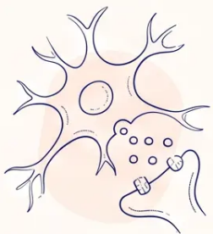
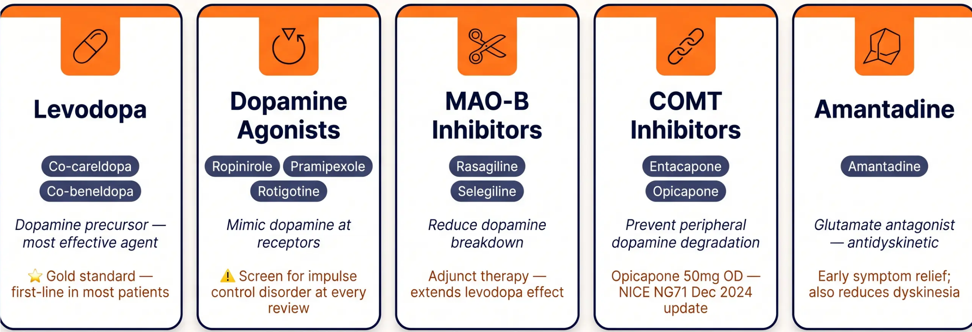

SECTION 6 — MEDICATIONS
Medication Overview for Primary Care
All drug classes below are specialist-initiated — GPs continue, monitor, and review
All medications above are initiated by a specialist. GP role: re-prescribe, monitor for side effects, and check for interactions at every review.
NICE NG71 · BNF 2025–2026

Slide 17









MEDICATION MANAGEMENT
GP Prescribing Responsibilities
Three rules every GP must know when managing Parkinson’s medications
01
02
03
Continue & Re-Prescribe
Exact Dosing Times
Never Stop Abruptly
Continue medications initiated by the
specialist without alteration.
PD medications are TIME-CRITICAL —
doses must be given at the prescribed
time.
Abrupt withdrawal risks Neuroleptic
Malignancy Syndrome (NMS).
Follow the exact drug, dose, and
formulation on the specialist letter.
NMS: rigidity, hyperthermia, confusion
— a medical emergency.
Even 30 minutes late can cause
devastating wearing-off.
Do not substitute branded for generic
formulations without specialist advice.
If the patient cannot take oral meds,
contact the specialist urgently.
Communicate exact timings
prominently on ALL referral letters.
Shared care agreements define GP
responsibilities — read them.
Patch or subcutaneous alternatives
exist — never just stop.
Coordinate with community pharmacy
for prompt dispensing.
NMS Risk — 999 if suspected
‘Get It On Time’ — Parkinson’s UK
⚠ Check for dopamine-antagonist drugs on ANY prescription — including anti-emetics and antipsychotics — at every medication review.
Bradford VTS · Parkinson’s Disease in Primary Care
NICE NG71 · BNF 2025–2026
17 / 32

Slide 18








MEDICATION SAFETY · SECTION 6
Drug Timing:
A Patient Safety Issue
PD medications are time-critical — even 30 minutes late can be devastating
Why Timing Matters
When Admitted to Hospital
• PD neurons fire in precise rhythms —
dopamine replacement must match this
window
• Always document PD drug timing
prominently on the referral letter
• State exact drug names, doses, and
scheduled times
• Wearing-off returns tremor, rigidity, and
freezing within minutes of a late dose
• Verbal handover: “These medications
are time-critical — please do not delay”
• Even a 30-minute delay can leave a
patient unable to move, speak, or swallow
• Advise patients to self-advocate if
doses are late
• Repeated missed doses risk neuroleptic
malignancy syndrome if abrupt
• Community pharmacy: coordinate for
prompt dispensing
Dose windows cannot wait
Ask your patient: ‘Do you know what to say
if your PD meds are late in hospital?’
‘Get It On Time’ — Parkinson’s UK National Campaign
Parkinson’s Disease — Management in Primary Care
www.bradfordvts.co.uk
Page 18 of 32

Slide 19











Page 19 of 32
NICE NG71 · DECEMBER 2024
What's New in NICE NG71?
Two key updates GP trainees must know
NEW RECOMMENDATION
TECHNOLOGY APPRAISAL TA605
Opicapone 50mg Once Daily
Sialorrhoea Management
For Motor Fluctuations
Drooling in Parkinson's Disease
NICE NG71 (Dec 2024) now recommends opicapone as an
adjunct to levodopa therapy for adults with Parkinson's
experiencing end-of-dose motor fluctuations.
NICE TA605 links updated within NG71 — two options now
recommended for troublesome drooling:
Botulinum toxin — injection into salivary glands
(specialist-administered)
Taken at bedtime — once daily dosing improves adherence
Glycopyrronium buccal — oral mucosa absorption;
primary care prescribable on specialist advice
Specialist-initiated — GP role: continue and re-prescribe
Glycopyrronium buccal: GP may prescribe after specialist recommendation
Both updates reflect NICE's commitment to improving quality of life in established Parkinson's — review your current PD patients for eligibility
Exam relevance: HIGH · AKT + SCA

Slide 20














Absolute Contraindications: Drugs to Avoid
These drugs BLOCK dopamine receptors — prescribing them in Parkinson’s Disease
causes dramatic, potentially irreversible worsening
Metoclopramide
Prochlorperazine
Haloperidol
Antiemetic / Dopamine
antagonist
Antiemetic (Stemetil) /
Dopamine antagonist
Typical antipsychotic
Worsens motor symptoms —
NMS risk
NEVER PRESCRIBE in PD
NEVER PRESCRIBE in PD
Chlorpromazine
Risperidone
Olanzapine
Typical antipsychotic
Atypical antipsychotic
Atypical antipsychotic
AVOID — strong dopamine
blockade
AVOID in PD
HIGH RISK — do not use
SAFE ANTI-EMETICS IN PD: Domperidone 10mg (preferred) · Ondansetron (5-HT3 antagonist — safe)
Bradford VTS Teaching Deck — Parkinson’s Disease
Slide 20 of 32 · NICE NG71 Dec 2024

Slide 21
















BRADFORD VTS TEACHING DECK
“Safe Alternatives for Nausea and Psychosis”
Recommended options when standard drugs are contraindicated in PD
Safe Antipsychotics in PD
Safe Anti-Emetics in PD
Specialist initiation only
Domperidone 10mg
Quetiapine
PREFERRED CHOICE
FIRST-LINE CHOICE
Acts peripherally — does not cross the blood-brain barrier
Does not block central dopamine receptors
Safe for nausea, vomiting, and gastric motility in PD
Lowest dopamine D2 blockade among antipsychotics
Preferred for hallucinations and psychosis in PD
Start at very low dose; titrate slowly
Monitor for sedation and postural hypotension
Note: Use lowest effective dose; cardiac caution with QTc prolongation at higher doses
Clozapine
Ondansetron
MOST EFFECTIVE
ALSO SAFE
5-HT₃ receptor antagonist — no dopamine receptor activity
Safe alternative when domperidone is not tolerated
Useful in hospital settings or post-operative nausea
Most effective agent for PD psychosis
Minimal extrapyramidal effects
Requires mandatory CPMS blood monitoring (agranulocytosis risk)
Key Principle: These alternatives work precisely because they do NOT block central dopamine receptors — preserving the
dopamine activity that PD patients depend on.
Section 7 — Drugs to Avoid & Safe Alternatives
www.bradfordvts.co.uk

Slide 22










**BRADFORD VTS TEACHING DECK**
SECTION 8 — COMPLICATIONS
Managing Motor Complications
Recognise the pattern — then act with your specialist team
Wearing-Off
Peak-Dose
Dyskinesia
On-Off
Fluctuations
Early Morning
Akinesia
Freezing of Gait
PD symptoms return
before next dose is due
Involuntary movements
at maximum drug effect
Unpredictable swings
between mobility and
immobility
Patient wakes frozen or
severely stiff before
first dose
Sudden inability to
initiate or continue
walking
PRIMARY CARE ACTION
PRIMARY CARE ACTION
PRIMARY CARE ACTION
PRIMARY CARE ACTION
PRIMARY CARE ACTION
Contact PDNS or
specialist to review dosing
intervals and regime
Contact PDNS — dose
reduction or regime
adjustment needed
Urgent specialist referral
— consider advanced
therapies
Bedtime modified-release
levodopa; dispersible
levodopa on waking —
discuss with PDNS
Refer to physiotherapy;
teach cueing strategies
(auditory, visual)
Never adjust PD drug doses in primary care without specialist guidance — contact your PDNS first
www.bradfordvts.co.uk
Parkinson's Disease — Management in Primary Care
Slide 22 of 32

Slide 23












SECTION 8 · COMPLICATIONS
Managing Non-Motor Complications
Primary care management strategies — what to prescribe, what to avoid
Depression
Constipation
Orthostatic Hypotension
Urinary Urgency
SSRI first-line — sertraline
or citalopram preferred
Macrogol laxative; increase
dietary fibre and fluids
Review antihypertensives;
compression stockings;
midodrine (off-label)
Exclude UTI first; solifenacin
if needed
Avoid TCAs — anticholinergic burden
Avoid codeine — worsens constipation
Check lying/standing BP at every review
Avoid oxybutynin — worsens cognition
Drooling (Sialorrhoea)
Cognitive Impairment
Insomnia
Pain
Glycopyrronium buccal
spray; NICE TA605
Review PD medication
timing; consider melatonin
MoCA assessment; refer to
specialist; rivastigmine
(specialist-initiated)
Paracetamol first-line;
physiotherapy; gabapentin for
neuropathic pain
Botulinum toxin — specialist referral
Screen for REM sleep behaviour disorder
Annual cognitive screen — MoCA or MMSE
Identify type: musculoskeletal vs
neuropathic vs central
Key Rule: Never use oxybutynin (anticholinergic, worsens cognition) or codeine (worsens constipation) in Parkinson's Disease
Managing Non-Motor Complications · NICE NG71
23 / 32 · www.bradfordvts.co.uk

Slide 24







SECTION 8 · COMPLICATIONS
Falls Risk and Management
Falls are a major cause of morbidity and mortality in Parkinson’s — assess at every review.
NICE NG71: Falls risk assessment is mandatory at every PD review
Bradford VTS
ASSESS
REFER
REVIEW MEDS
At Every Review
Specialist Support
Reduce Sedation Risk
• Falls frequency and any injuries sustained
• Physiotherapy — gait training, balance,
LSVT BIG programme
• Sedating drugs significantly worsen falls
risk — audit the full list
• Footwear — appropriate, supportive, non-
slip
• Occupational Therapy — home
assessment and equipment provision
• Benzodiazepines, antihistamines, opioids
— deprescribe where possible
• Home environment — trip hazards, lighting
Bradford VTS
• On/off diary — are falls linked to wearing-
off episodes?
• Consider hip protectors for high-risk
patients
• Antihypertensives — review if orthostatic
hypotension contributing
• Antipsychotics — avoid where possible;
worsens motor function
• Lying and standing blood pressure —
orthostatic hypotension
• Fall alarm systems — discuss and signpost
• PDNS — coordinate falls management plan
• Dopamine agonists — daytime somnolence
is a known risk
Bradford VTS Teaching Deck — Parkinson’s Disease
24 / 32
www.bradfordvts.co.uk

Slide 25










SECTION 9 · DVLA & DRIVING
Parkinson's and Driving
DVLA Regulations — What Every GP Must Know
Group 2 Licence
Group 1 Licence
GP's Role
(Cars & Motorcycles)
(Advise, Document, Act)
(HGV, Bus & Coach)
CAN CONTINUE DRIVING IF:
USUALLY BARRED ON DIAGNOSIS
AT EVERY REVIEW:
- Symptoms are adequately
controlled
- Diagnosis of PD typically revokes
Group 2 entitlement
- Advise patient to notify DVLA — it is
the patient's legal duty, not the GP's
- DVLA notified on diagnosis
- Assess fitness to drive: tremor,
dyskinesia, somnolence, cognition
- DVLA must still be notified
immediately
- DVLA issues licence with
conditions
- Exceptional cases reviewed
individually by DVLA
- Document driving discussion in every
review note
- Annual reassessment required
- Patient should cease driving
pending DVLA decision
- If patient refuses to notify and poses
a risk → GMC confidentiality guidance
permits GP to notify DVLA directly
- Inform DVLA if condition changes
⚠ Document every conversation —
medicolegal requirement
✘ Usually barred — notify DVLA immediately
May continue — subject to DVLA review
KEY RULE: The patient notifies DVLA — not the GP. But the GP must advise, assess, and document at every review.
Bradford VTS Teaching Deck · Parkinson's Disease Management in Primary Care
NICE NG71 (Dec 2024)
25 / 32

Slide 26
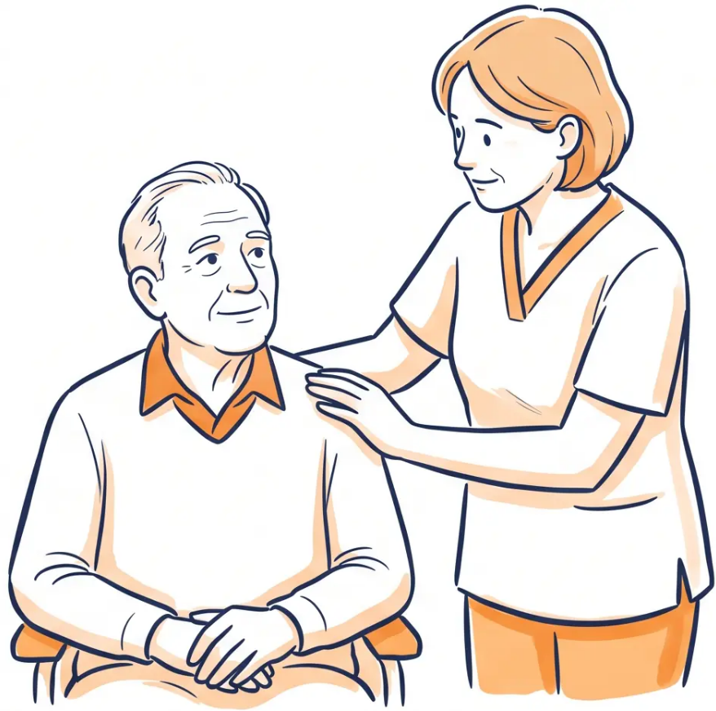






SECTION 10 — CARER SUPPORT
Carer Support and Wellbeing
Recognising burden early — and acting before crisis point
6.5 million unpaid carers in the UK — PD places one of
the heaviest progressive burdens of any neurological condition
Recognise the Burden
- Carer exhaustion leads to breakdown of home care
- PD burden increases with disease progression
- Ask at every review: "How are you coping?"
GP Actions
- Offer formal carer assessment via social services
- Screen for carer depression — use PHQ-9
NICE NG71 Reminder
- Plan respite care proactively, not in crisis
- Review Carer's Allowance and Carer's Premium eligibility
“Carers of people with PD should be offered a
formal assessment of their own physical and
mental health needs.”
Signpost and Support
- Parkinson's UK carer support line: 0808 800 0303
- Local carers' centres — refer actively
— NICE NG71 Quality Statement
- Parkinson's UK: www.parkinsons.org.uk
Parkinson's Disease — Management in Primary Care
www.bradfordvts.co.uk
26 / 32

Slide 27








BRADFORD VTS TEACHING DECK
TOP TIPS FOR GP TRAINEES
“Part 1: The Non-Negotiables”
Tips 1–5 · Referral, Safety, and Screening
01 Always refer BEFORE treating
NICE NG71: All suspected untreated PD must be seen by a specialist before any medication is started — never initiate levodopa in primary care
02 Never prescribe metoclopramide or prochlorperazine
These block dopamine receptors and will dramatically worsen PD — use domperidone or ondansetron instead
03 Ask about non-motor features at every review
Depression and cognitive decline are frequently missed — use PHQ-9 and MoCA; non-motor symptoms often predate motor features by years
04 Screen for impulse control disorders at every visit
Patients on dopamine agonists will not volunteer gambling, hypersexuality, or binge eating — you must ask directly and sensitively
05 Document driving advice at every review
DVLA notification is the patient's legal duty — but the GP must advise and document this conversation at every review; it is a medicolegal requirement
www.bradfordvts.co.uk
Parkinson's Disease — Management in Primary Care
27 / 32

Slide 28
















SECTION 11 · TOP TIPS FOR GP TRAINEES
Top Tips: Part 2
Tips 6–10 · Documentation, PDNS, Medication Safety & Palliative Planning
Document Driving
Advice Every Time
PDNS Is Your Most
Valuable Ally
Medications Are
Time-Critical
DVLA notification and driving fitness
discussion must be recorded at every
review — it is a medicolegal
requirement, not optional.
Every PD patient must have their
Parkinson’s Disease Nurse Specialist
contact details. The PDNS is
accessible, expert, and saves GP time.
A dose even 30 minutes late can
cause severe wearing-off. State exact
timings on every referral letter, sick
note, and hospital communication.
Never Stop PD
Medications Abruptly
Plan Palliative
Care Early
Sudden withdrawal risks neuroleptic malignancy
syndrome — a life-threatening emergency. Always
seek specialist advice before any medication change.
Begin advance care planning conversations while the
patient has capacity — preferred place of care, DNACPR,
and symptom management goals.
🔗 Parkinson’s UK Helpline: 0808 800 0303 · www.parkinsons.org.uk
Bradford VTS Teaching Deck — Parkinson’s Disease in Primary Care
28 / 32
www.bradfordvts.co.uk

Slide 29





















SECTION 12 · EXAM PREPARATION
AKT High-Yield Points
Key facts every GP trainee must know cold
DIAGNOSIS
DIAGNOSIS
Bradykinesia MUST be present for PD diagnosis —
tremor alone is not enough
NICE NG71: Refer to specialist BEFORE starting any
treatment — never initiate levodopa in primary care
DIFFERENTIAL
DIFFERENTIAL
Essential Tremor 8–10× more common PD — action
tremor, bilateral, improves with alcohol
Drug-Induced Parkinsonism Alt for metoclopramide,
prochlorperazine, antipsychotics on the drug list
MEDICATIONS — AVOID
MEDICATIONS — SAFE
❌ Metoclopramide and prochlorperazine are
absolutely contraindicated — use domperidone only
✅ Safe Anti-emetic Domperidone 10mg = preferred;
ondansetron also safe in PD
DVLA Notification
DVLA · GP's Duty
Patient must notify DVLA at diagnosis — Group 2 (HGV
/bus) usually barred; Group 1 may continue if controlled
GP advises patient to notify — does not report
directly unless patient refuses and poses risk
TREATMENT
NICE 2024 · Opicapone — New 2024
PD Dementia = NICE first-line for PD dementia —
specialist-initiated
Opicapone 50mg OD at bedtime — now recommended
for motor fluctuations (NICE NG71, Dec 2024)
Bradford VTS Teaching Deck · AKT Exam Preparation
AKT HIGH-YIELD
Page 29 of 32 · www.bradfordvts.co.uk

Slide 30






Bradford VTS
SCA Communication Skills and Pearls
Simulated Consultation Assessment — Patient-Centred Language for PD Consultations
DAILY LIFE IMPACT
“How has the Parkinson’s been affecting your daily life since we last spoke?”
Open question — invite the patient’s own narrative before moving to clinical agenda
MEDICATION SIDE EFFECTS / ICD SCREENING
“Have you noticed any changes you might not have expected from the medication — like changes in your behaviour or urges?”
Non-judgmental phrasing — ICD behaviours cause shame; this opens the door without accusation
CARER WELLBEING
“I’d like to check how your carer and family are managing — is there anything we can do to support them too?”
Explicitly include the carer — NICE NG71 requires carer assessment at every review
SAFETY-NETTING: HOSPITAL ADMISSION
“If you’re ever admitted to hospital for anything, please tell the team about your Parkinson’s
medications — and ask for them to be given at exactly the right time.”
‘Get It On Time’ — Parkinson’s UK campaign; delayed doses in hospital cause serious deterioration
Bradford VTS
SIGNPOSTING
“I want to make sure you know about the Parkinson’s UK helpline — they have specialist
nurses available and it’s completely free to call: 0808 800 0303.”
Signposting is SCA-scored — demonstrate knowledge of patient resources
Page 30 of 32 · Bradford VTS Teaching Deck
www.bradfordvts.co.uk

Slide 31










Bradford VTS
SECTION 13 · SAFETY
Red Flags and Urgent Deterioration
Act immediately — do not wait for the next routine review
The following presentations require IMMEDIATE clinical action
Sudden Worsening of PD Symptoms
Swallowing Difficulty (Dysphagia)
Exclude infection, new drug interaction, or missed
doses — urgent medication review
Urgent SALT referral — aspiration pneumonia is a
leading cause of death in PD
Hallucinations + Severe Agitation
Unexplained or Increasing Falls
Consider dopamine agonist-induced psychosis —
contact PDNS or specialist urgently; do NOT
prescribe typical antipsychotics
Urgent medication review + falls risk assessment;
refer physiotherapy and OT
Bilateral Leg Oedema + Dyspnoea
Rapid Cognitive Decline
On dopamine agonist? Consider cardiac valvulopathy —
check for ergot-derived agonist; urgent cardiology input
Consider DLB or PDD — urgent specialist referral;
MoCA assessment
CALL 999
Suspected Neuroleptic Malignancy Syndrome (NMS)
Rigidity · Fever · Confusion · After stopping PD meds or starting antipsychotic
Emergency admission — 999 immediately. Do NOT delay.
www.bradfordvts.co.uk
NICE NG71 · BNF 2025–2026
Page 31 of 32

Slide 32



FINAL SUMMARY
Common Pitfalls & Quick Recall
Errors to avoid · Core principles to carry forward
✕ COMMON PITFALLS
✓ QUICK RECALL
→ PD diagnosis = bradykinesia ESSENTIAL + rigidity / tremor /
instability
✕ Starting levodopa without specialist referral — NICE NG71
✕ Metoclopramide for nausea — will dramatically worsen PD
→ Prevalence = 1 in 500; 1 in 100 over age 75
✕ Not asking about ICD on dopamine agonists at every review
→ Refer BEFORE treating (NICE NG71 — no exceptions)
→ Non-motor early signs = anosmia, constipation, REM
disorder, depression
✕ Not advising DVLA notification at diagnosis and reviews
✕ Stopping PD medications suddenly — NMS risk
→ DVLA = patient notifies at diagnosis; document at every review
→ Safe anti-emetic = domperidone only (ondansetron also safe)
✕ Missing depression — present in 40–50%; always ask directly
→ PDNS contact = every patient must have their details
✕ Oxybutynin for bladder — anticholinergic, worsens cognition
→ Drugs to avoid = metoclopramide, prochlorperazine,
haloperidol, olanzapine
✕ Neglecting carer assessment — carers are frequently missed
→ Falls = physiotherapy + OT home assessment
→ Palliative planning = begin early while patient has capacity
Page 32 of 32 · Bradford VTS Teaching Deck · Parkinson's Disease — Management in Primary Care
⚠ Always double-check this advice and drug doses with the latest NICE/BNF guidance.
This document is for educational purposes only. · www.bradfordvts.co.uk · © Bradford VTS 2026

