Slide 1


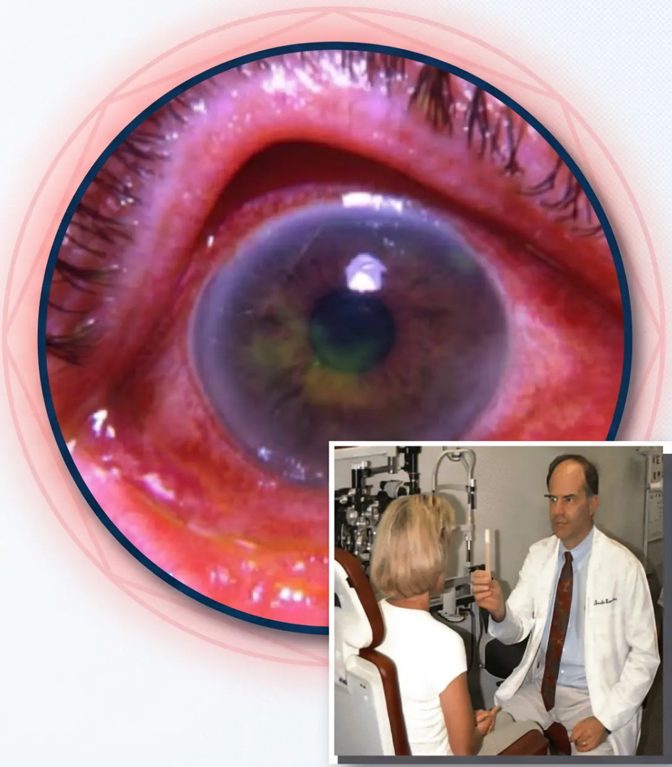
Bradford VTS — www.bradfordvts.co.uk
Acute Red Eye
in Primary Care
Comprehensive teaching deck for GP
trainees covering differentials,
management, and RCGP exam preparation
based on NICE CKS 2024/2025 and
Bradford VTS standards.
May 2026
RCGP AKT & SCA Revision | Bradford VTS
Bradford VTS Teaching Deck
May 2026 | NICE CKS 2024/2025

Slide 2


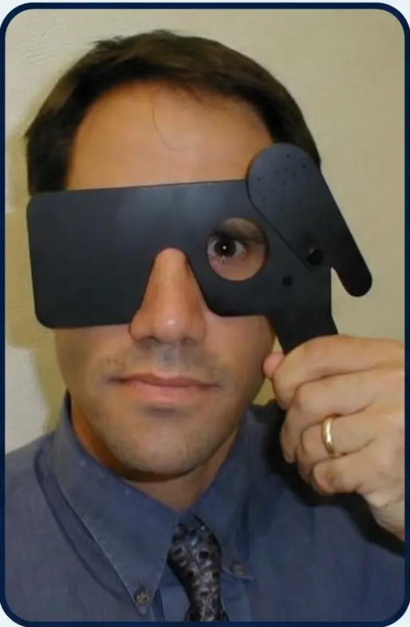




Overview & Red Flag Symptoms
Triage first — distinguish self-limiting from sight-threatening.
WHY IT MATTERS
⚠️ RED FLAGS — REFER URGENTLY
① Reduced visual acuity — any cause; always take
seriously; first thing to check
44%
of all GP eye problems
are conjunctivitis
② Severe pain or photophobia — out of proportion to
appearance suggests serious pathology
● Corneal opacity or haze — suggests keratitis or acute
glaucoma
1.5–2%
● Fixed or irregular pupil — mid-dilated fixed oval = acute
angle closure until proven otherwise
of all GP consultations
are eye-related
● Ciliary flush — limbal redness, deeper than conjunctival
injection — not simple conjunctivitis
The critical task is
distinguishing self-limiting
conditions from those
requiring urgent
referral.
⚠️ Contact lens wearer + pain / VA change — assume
microbial keratitis; refer same day
If ANY red flag is present → same-day urgent
ophthalmology referral.
Always check visual acuity first.
Bradford VTS Teaching Deck
May 2026 | Slide 2 of 10

Slide 3








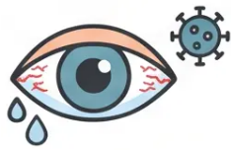

















Differential Diagnosis: Conjunctivitis Types
“Bacterial · Viral · Allergic — key features and NICE-aligned management”
Bacterial Conjunctivitis
Viral Conjunctivitis
Allergic Conjunctivitis
Discharge: Sticky, yellow-green; lids
stuck on waking
Discharge: Watery, stringy; may have
chemosis
Discharge: Watery (not purulent)
Sensation: Foreign body
Sensation: Foreign body (not true pain)
Sensation: Foreign body + ITCH
Itch: None
Itch: Sometimes mild
Itch: YES — the key differentiator
Key clue: Preceded by URTI; preauricular
lymphadenopathy; highly contagious
(adenovirus); family members affected
Key clue: Atopy, seasonal (hayfever) or
perennial (HDM); contact lens-induced
Key clue: Bilateral, hot feeling, swollen lids
• Usually self-limiting (1–2 weeks)
Adenovirus =
most common.
NO antibiotics.
ITCH = Allergic.
Single most
discriminating
symptom.
• Self-care first: saline bathing, cool compresses,
lubricants
• Remove allergen / stop contact lenses
• Self-limiting: 7–14 days
• Olopatadine (H1 blocker + mast cell
stabiliser) — first choice
• Topical antibiotics if: marked discharge,
discomfort, high-risk
• Cool compresses, lubricating drops, hygiene
• No topical antibiotics (adenovirus — does
not respond)
• Sodium cromoglicate 2% QDS — second line
• Chloramphenicol 0.5% drops — 1 drop every
2h × 48h, then QDS
• Otrivine-Antistin — traditional OTC option
• Highly contagious: meticulous handwashing;
no swimming pools
• Avoid topical steroids in primary care
• Fusidic acid 1% gel — BD, useful alternative
• Seasonal: usually self-limits; perennial may
need ongoing treatment
• Avoid contact lenses; hygiene advice
• Avoid antihistamines and steroids
Bradford VTS | Acute Red Eye
Slide 3 of 10
| NICE CKS 2024/2025

Slide 4



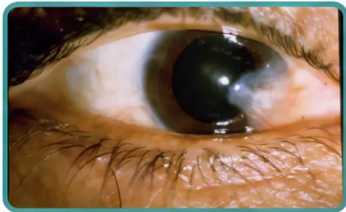
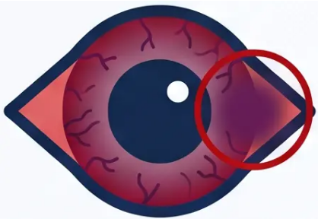





Episcleritis and Scleritis
Know the difference — one is benign, one demands urgent action.
EPISCLERITIS
SCLERITIS
Benign · Self-limiting
Sight-threatening · Systemic associations
VS
👁 Visual acuity: 6/12 or worse — may be reduced
👁 Visual acuity: 6/9 or better — unaffected
💬 Pain: Mild foreign body sensation only
🔥 Pain: SEVERE boring/deep pain — radiates to head and face
🔴 Injection: Localised, bright red, superficial — on the episclera
🟣 Injection: Deep, violaceous hue — ciliary involvement
💊 Discharge: None
⚠️ Photophobia: Present
Management
Systemic Associations
Usually self-limiting — reassure the patient
Topical vasoconstrictor for cosmetic relief if needed
Recurrence is common — manage expectations
Rheumatoid arthritis
SLE
Inflammatory bowel disease
Granulomatosis with polyangiitis
✓ No urgent referral needed
⚡ URGENT REFERRAL — Same Day
Bradford VTS | Acute Red Eye
Page 4 of 10

Slide 5







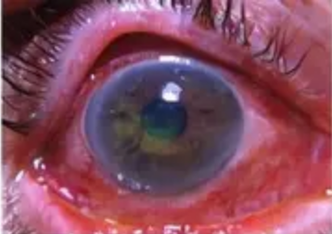

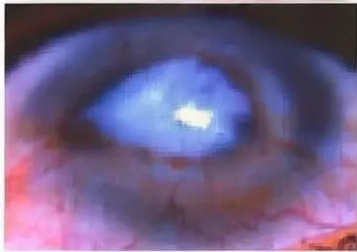



Anterior Uveitis & Acute Angle Closure Glaucoma
Both present with ciliary flush and pupil changes — both require same-day emergency referral
SAME-DAY
REFERRAL
EMERGENCY
— 999 —
IF NEEDED
ANTERIOR UVEITIS / IRITIS
ACUTE ANGLE CLOSURE GLAUCOMA
Visual Acuity: 6/12 to 6/60
Visual Acuity: 6/60 or worse
Pain: Deep aching, moderate-severe
SEVERE pain: ocular, headache, associated nausea
and vomiting
Discharge: None
Discharge: None
Photophobia: Marked +++
Photophobia: Yes, less marked
Cornea: Clear—slight cloudy, keratic precipitates
Cornea: Hazy, "ground glass" appearance
Pupil: Small, irregular shape
Pupil: Mid-dilated, fixed, oval, non-reactive
Pressure: May be elevated
Emergency Management:
Management:
• Urgent eye referral (same hour) or 999 if needed
• Urgent same-day ophthalmic referral
• Pilocarpine drops (if IOP > 40mmHg) to constrict pupil
• Steroid drops (e.g. Maxidex) only if prescribed by ophthalmologist
• Acetazolamide (Diamox) IV/Oral to reduce aqueous humor production
• Analgesia and anti-emetics for symptoms
• Mydriatic drops (e.g. Cyclopentolate) to dilate pupil and prevent synechiae
• Analgesia for pain relief
IOP is often > 50mmHg. Risk factors include female sex, hypermetropia (long-sightedness),
family history, and certain medications (e.g. anticholinergics).
HLA-B27 associated in 50% of cases. If recurrent, consider underlying systemic
conditions like Ankylosing Spondylitis.
⚠️ DIAGNOSTIC TRAP: AACG can present with
nausea/vomiting — always examine the eye
Bradford VTS | www.bradfordvts.com
Slide 5 of 10
May 2026

Slide 6



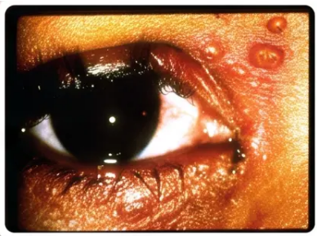





Bacterial & Herpes Simplex Keratitis
Corneal Infections — Urgent Referral Required
Bacterial Keratitis
Herpes Simplex Keratitis
URGENT SAME-DAY REFERRAL
REFER — DO NOT USE STEROIDS
👁 Visual Acuity: 6/12 to 6/60 — reduced
👁 Visual Acuity: 6/12 to 6/60 — reduced
☹ Pain: Significant — FB sensation plus headache
☹ Pain: FB sensation plus headache
💧 Discharge: Mucopurulent / sticky
💧 Discharge: Mild or absent
Periocular HSV vesicles —
classic presentation context.
☀️ Photophobia: Marked (++)
☀️ Photophobia: Marked (++)
🔴 Injection: Ciliary flush, worse near ulcer site
🔴 Injection: Ciliary flush
💨 Cornea: Cloudy — fluorescein staining at ulcer
🌿 Cornea: Dendritic ulcer — branching
pattern on fluorescein staining
How to Identify
👤 Pupil: May be small; posterior synechiae possible
Fluorescein staining reveals
a classic branching /
dendritic pattern. Always
stain in stain all red eyes.
👤 Pupil: Occasional posterior synechiae
Key Risk Factor Contact lens wear — especially overnight. Pseudomonas
is the feared pathogen. Do NOT patch a contact lens eye.
Management
Same-day ophthalmology referral
Intensive topical fluoroquinolones (specialist setting)
Corneal scraping for culture
Topical aciclovir 3% ointment — 5× daily for 14 days (BNF)
Refer to ophthalmology
Previous episodes: check history of cold sores / herpes labialis
⚠ NEVER prescribe topical steroids for a red eye without first excluding a dendritic ulcer
Steroids on an HSV cornea → catastrophic corneal melting. Fluorescein staining + slit lamp required before any steroid prescription.
Bradford VTS | www.bradfordvts.co.uk
May 2026 | NICE CKS 2024/2025

Slide 7





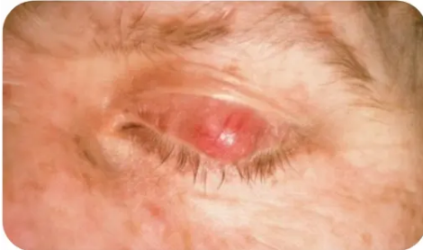



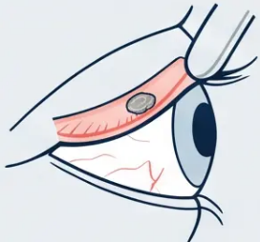

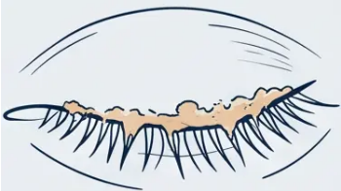




Differential Diagnosis
Foreign Bodies & Minor Conditions
*Practical management — eversion, rust rings, lid hygiene, and reassurance
Subtarsal Foreign Body
Corneal Foreign Body
Blepharitis
Subconjunctival Haemorrhage
VA: 6/9–6/24 | FB sensation on blinking
VA: 6/9–6/60 | History of grinding/tool use
VA: 6/6 (normal) | No pain | No discharge
Chronic, recurrent | Gritty, burning,
irritated eyes
Vertical corneal abrasion lines =
pathognomonic (caused by FB dragging
across cornea under upper lid)
Metal FB → rust ring → urgent referral
(rust ring causes ongoing corneal
damage if not removed)
Dramatic appearance — almost
always benign
Manage, don't cure — like atopy
– Fluorescein staining confirms FB site and
surrounding staining
– Reassure — resolves spontaneously in
2–3 weeks
– Lid hygiene routine (twice daily, long-term):
– Evert the upper lid – essential technique
- Warm compress to lids for 1–2 minutes
– Inspect subtarsal sulcus carefully
– Check blood pressure (hypertension
association)
- Lid scrub with diluted baby shampoo or
proprietary wipes
– Remove FB with moistened cotton bud or
needle tip
– Remove superficial FBs if trained and
equipment available
– Review anticoagulation medications
– Metal FBs with rust ring: refer urgently
to ophthalmology
– Lubricating drops for dry eye component
– Apply topical antibiotic drops post-
removal
– Ask about Valsalva trigger (coughing,
straining, vomiting)
– Topical chloramphenicol for acute bacterial
superinfection
– Re-examine cornea with fluorescein after
removal
– Do NOT patch the eye
– If bilateral or recurrent → investigate for
bleeding disorder
– Fusidic acid gel for staphylococcal
blepharitis
– Topical antibiotic cover post-removal
– Eye protection counselling — always
wear goggles when grinding
– No eye drops or treatment needed in
uncomplicated cases
– Chalazion/stye: warm compress first; refer
if persistent
Bradford VTS | www.bradfordvts.co.uk
May 2026 | NICE CKS 2024/2025

Slide 8





























































































Diagnostic Comparison Table Summary
Clinical features at a glance — VA, pain, discharge, photophobia, injection pattern, cornea, pupil & pressure
Condition
VA
Pain
Discharge
Photophobia
Injection
Cornea
Pupil
Pressure
Scleritis
6/12+
Severe boring
None
Yes
Ciliary, violaceous
Clear
± Synechiae
Normal
Anterior Uveitis (Iritis)
6/12–6/60
Aching headache
None
YES ++
Ciliary flush
Clear–cloudy
Irregular/small
± High
Acute Angle Closure Glaucoma
6/36–6/60
SEVERE
None
Yes
Ciliary / brick red
HAZY
Fixed mid-dilated
STONEY HARD
Bacterial Keratitis
6/12–6/60
FB + headache
Sticky
YES ++
Ciliary
Cloudy; stains
± Small
Normal
HSV Keratitis (Dendritic)
6/12–6/60
FB + headache
Mild
YES ++
Ciliary
Dendritic stain
± Synechiae
Normal
Episcleritis
6/9+
FB (mild)
None
No
Localised superficial
Clear
Normal
Normal
Subtarsal Foreign Body
6/9–6/24
FB on blink
No
Yes
Superior
Vertical lines
Normal
Normal
Corneal Foreign Body
6/9–6/60
FB sensation
No
Yes
Ciliary near FB
Stains at FB
Normal
Normal
Bacterial Conjunctivitis
6/9+
FB sensation
Yellow sticky
No
Generalised
Clear
Normal
Normal
Viral Conjunctivitis
6/9+
FB sensation
Watery
Mild
Generalised
Clear/punctate
Normal
Normal
Allergic Conjunctivitis
6/9+
FB + ITCH
Watery/stringy
No
Generalised
Clear
Normal
Normal
Subconjunctival Haemorrhage
6/6
None
None
No
Localised bright red patch
Clear
Normal
Normal
Blepharitis
Normal
Gritty/burning
Crusting
No
Lid margins
Clear
Normal
Normal
Urgent / Same-day Referral Moderate / Consider Referral Benign / Self-limiting
Bradford VTS Teaching Deck
May 2026 | NICE CKS 2024/2025

Slide 9





Bradford VTS | May 2026
AKT and SCA Exam Pearls
High-yield revision points for RCGP exams — know these cold.
AKT
SCA
Applied Knowledge Test — Key Facts
Simulated Consultation Assessment — Communication Skills
Opening
- Chloramphenicol 0.5% drops: 1 drop every 2 hours × 48h,
then QDS until 48h after resolution
“I can see your eye is quite red — I’m going to check your
vision first, if that’s OK?”
- Fusidic acid 1% gel: BD dosing — alternative, useful in pregnancy
♦ AACG profile: Hypermetropic · Female · Over 50 · Night onset ·
N+V + headache
Safety-Net
“If your vision becomes blurred, the pain gets worse, or it
hasn't improved in 5–7 days — please come back or go
straight to A&E.”
- Fixed mid-dilated oval pupil — the diagnostic hallmark
- Viral conjunctivitis: Adenovirus — self-limiting — NO antibiotics
♦ HSV keratitis: Topical aciclovir 3% ointment · 5× daily · 14 days ·
NO steroids
Steroid Safety
“I wouldn't want to prescribe steroid drops without being
sure there's no herpes infection — that would need a
specialist to check with a special lamp.”
♦ Anterior uveitis: HLA-B27 link — AS, psoriatic arthritis, IBD, Reiter's
- 2-minute referral rule: Reduced VA · Severe pain · Ciliary flush ·
Corneal signs · Fixed pupil → REFER
Contact Lenses
Always stop lenses immediately. Do not resume until fully
resolved — even if eye feels better.
ITCH = ALLERGIC — the single most discriminating symptom.
Bradford VTS — www.bradfordvts.co.uk
NICE CKS 2024/2025 | RCGP AKT & SCA Revision.

Slide 10
















Common Pitfalls & Quick Recall
Avoid these errors — know when to refer.
Common GP Pitfalls
1 Steroids in a Red Eye
2 Missing Acute Glaucoma
3 Contact Lens =
Conjunctivitis
4 Missing Orbital Cellulitis
Always exclude HSV keratitis
first — corneal melting risk
N+V + headache — don't
forget to look at the eye
Assume microbial keratitis;
refer same day
Check eye movements, prop-
tosis, fever in any swollen eye
6 Antibiotics for Viral
Conjunctivitis
7 Ignoring Previous
Episodes
5 Skipping Fluorescein
8 Weak Safety-Netting
Dendritic ulcers can be subtle
— always stain
Adenovirus won't respond —
reassure and support
Recurrent red eye → think
anterior uveitis
Specify symptoms, timeframe,
and where to go
IF IN DOUBT — REFER SAME DAY
Quick Recall: Red Flags for Urgent Referral
Ciliary Flush
Contact Lens
Neonatal
Discharge
Reduced VA
Severe Pain
Corneal Haze
Fixed Pupil
Proptosis/Fever
— any cause
— or photophobia
— opacity present
— mid-dilated/
irregular
— perilimbal
redness
— with pain or
VA change
— ophthalmia
neonatorum
— orbital cellulitis
May 2026
Bradford VTS Teaching Deck — www.bradfordvts.co.uk
| NICE CKS 2024/2025
10 / 10

