Slide 1

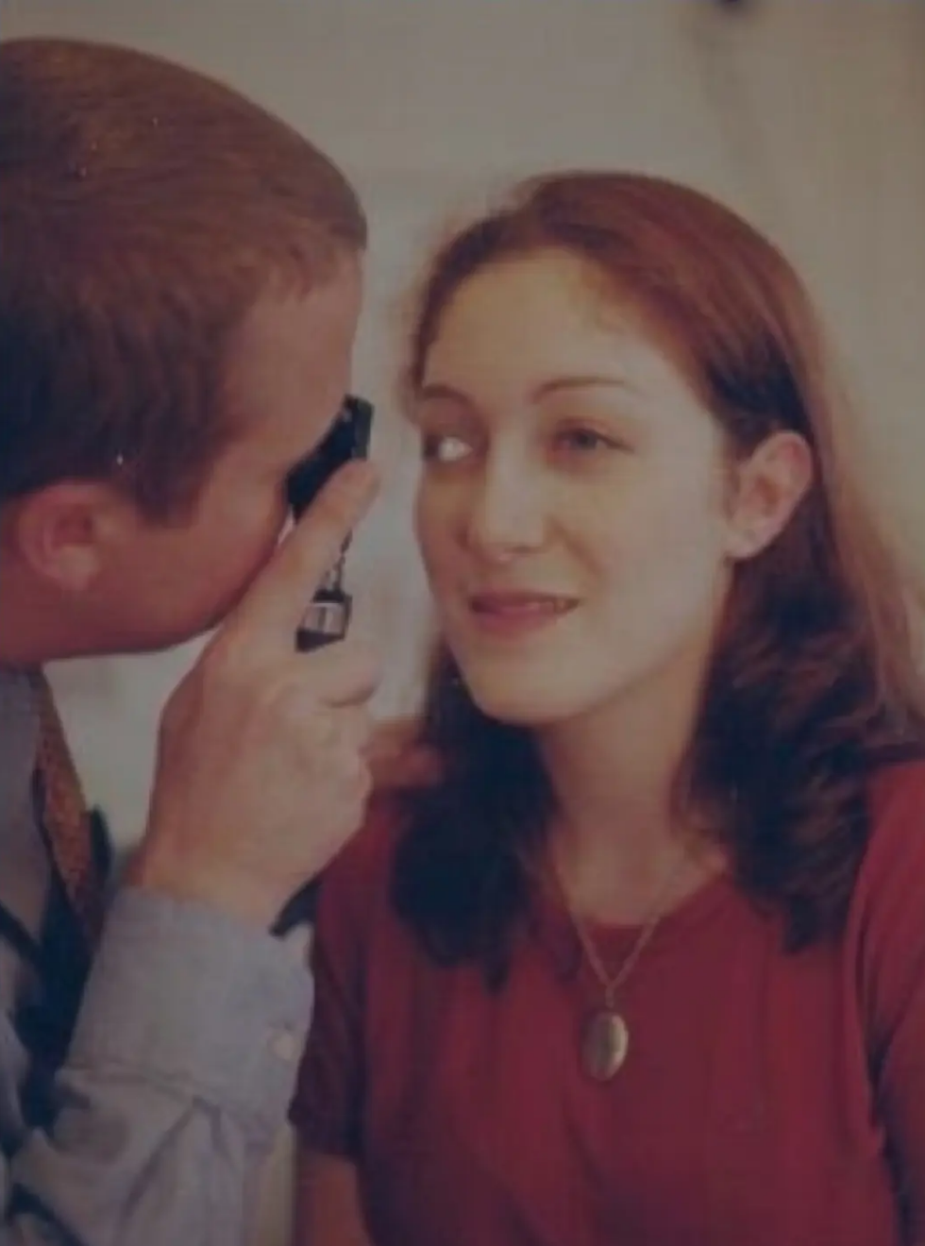




Bradford VTS — www.bradfordvts.co.uk
Bradford VTS Teaching Deck
Eye Trauma in
Primary Care
RCGP SCA & AKT Revision · 2024–2026 Clinical Standards ·
NICE CKS Guidelines
NICE CKS 2024
BNF 2025
May 2026
For GP Trainees · Bradford VTS
Eye Trauma in Primary Care
Bradford VTS · GP Training

Slide 2





Eye Trauma in Primary Care · Bradford VTS
Classification and Golden Rules
Classification of Eye Trauma
GOLDEN RULES
INJURY CLASSIFICATION
① Never force open a swollen or
injured eye without topical anaesthetic
Closed Globe
Open Globe
② Never patch a contact lens
wearer's eye — Pseudomonas risk
Globe intact
Globe wall breached
· Corneal abrasion
· Corneal/scleral laceration
③ Life-threatening injuries always
take priority over eye injuries
· Hyphema
· Intraocular foreign body
· Retinal detachment
· Globe rupture
④ Chemical injury → Irrigate
IMMEDIATELY before history or referral
Chemical Burns
Thermal / Radiation
Alkali > Acid severity
UV & heat injury
⑤ Document VA before and after every
intervention
· NaOH, KOH (alkali)
· Arc eye (UV keratitis)
· Battery acid
· Thermal burns
· Domestic bleach
⚠ Time-critical: Chemical burns → irrigate FIRST
Eye Trauma in Primary Care
Bradford VTS · Page 2 of 10

Slide 3









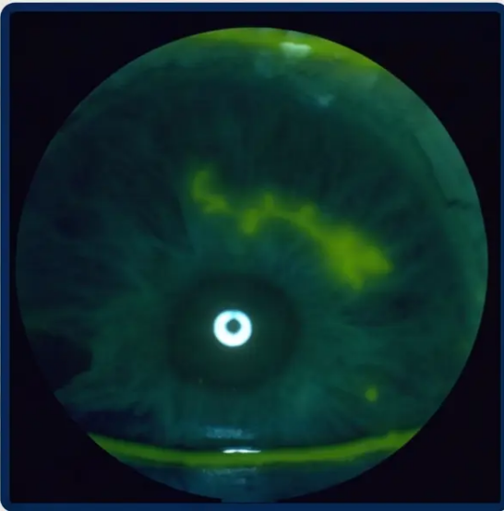







Chemical Eye Injury Management
⚠ IRRIGATE FIRST
Ask questions later
⚠ Ophthalmic Emergency — Time to Irrigation = Prognosis
Alkali Burns
Acid Burns
MORE SEVERE
LESS SEVERE
Saponification of cell membranes
Deep penetration → anterior chamber
Risk: corneal melt, cataract, glaucoma
Protein precipitation forms barrier
Damage limited to anterior structures
Exception: hydrofluoric acid = alkali behaviour
❶ IRRIGATE IMMEDIATELY — Saline, water, or Hartmann’s solution — before history, before VA check
❷ REMOVE CONTACT LENSES — Remove lenses and any particulate debris
❸ EVERT BOTH EYELIDS — Irrigate conjunctival fornices thoroughly
❹ IRRIGATE 20–30 MINUTES — Minimum duration — do not stop early
❺ CHECK pH — Use litmus paper; continue until pH neutral (7.0)
Fluorescein staining — clinical
assessment of ocular surface injury
❻ TOPICAL ANAESTHETIC — Proxymetacaine 0.5% — for patient cooperation
❼ URGENT OPHTHALMOLOGY REFERRAL — After irrigation — all chemical injuries, all grades
*Even milk or tap water if saline unavailable — irrigation is the single most important intervention
Roper-Hall Grading System
AKT Pearl
Grade 1
Grade 2
Grade 3
Grade 4
Alkali burns are worse than acid.
Time to irrigation is the key
prognostic factor — not the type
of chemical.
Clear cornea
Haze — iris visible
Opaque — iris obscured
Completely opaque
No limbal ischaemia
< 1/3 limbal ischaemia
1/3 – 1/2 limbal ischaemia
> 1/2 limbal ischaemia
Prognosis: Good
Prognosis: Good
Prognosis: Guarded
Prognosis: Very Poor
Increasing severity →
Eye Trauma in Primary Care
Bradford VTS · May 2026

Slide 4

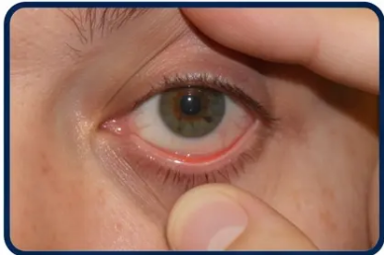






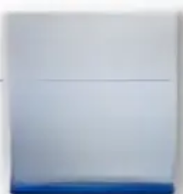
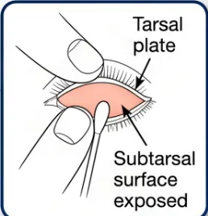






Page 4 · Eye Trauma in Primary Care
Corneal Abrasion & Foreign Bodies
Diagnosis · Treatment · Referral Thresholds
Corneal Abrasion
Corneal Foreign Bodies
Most common eye trauma in primary care
Metallic FBs form rust rings within hours
Lid eversion technique —
exclude subtarsal FB
Symptoms
Metallic FB
- Pain · FB sensation · photophobia · lacrimation
- Sudden severe pain · photophobia · lacrimation
- Foreign body sensation · blepharospasm
- Iron FBs oxidise → rust ring damages corneal stroma
Diagnosis
- Slit lamp / loupe required for full assessment
Primary Care Management
- Topical proxymetacaine 0.5% → allows examination
- Fluorescein staining → bright green epithelial defect under
cobalt blue light
- Superficial FB: attempt removal with cotton tip
- Topical chloramphenicol after removal
- Evert both eyelids → exclude subtarsal FB
- Review in 24–48 hours
Treatment — Non-CL Wearer
Refer to Ophthalmology
- Metallic FB + rust ring → specialist removal required
- Topical chloramphenicol 0.5% drops QDS or 1% ointment
- Oral paracetamol ± ibuprofen
- Deep or intraocular FB → EMERGENCY (do not irrigate)
- Cyclopentolate 0.5% for ciliary spasm if needed
Subtarsal FB — Key Clinical Tip
- Do NOT patch · Do NOT send home topical anaesthetic
- Vertical parallel linear abrasions = subtarsal FB
- Review in 24–48 hours
- Upper lid dragging over cornea creates parallel scratches
- Always evert the upper lid
Contact Lens Wearer — Different Rules Apply
DO
DO NOT
- Prescribe fluoroquinolone (ciprofloxacin 0.3% or ofloxacin)
- Use chloramphenicol alone
- Refer same-day to ophthalmology if any concern
- Patch the eye
- Treat as Pseudomonas risk
- Delay referral
Bradford VTS · www.bradfordvts.co.uk
May 2026

Slide 5

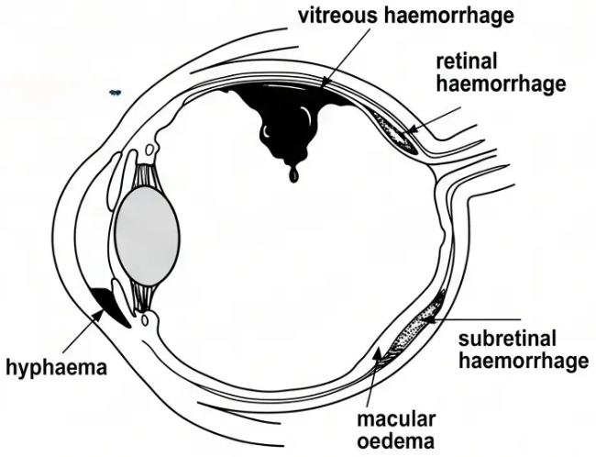
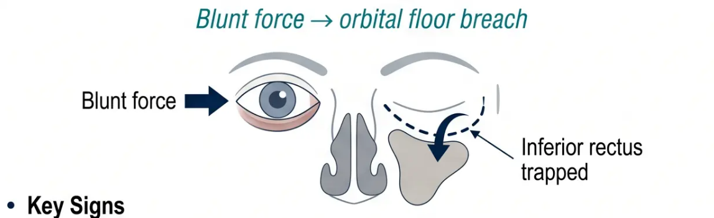











Hyphema & Orbital Blowout Fractures
05 / 10
Recognising urgent trauma – same-day referral criteria
HYPHEMA
ORBITAL BLOWOUT FRACTURE
Blood in the anterior chamber
• Cause: Blunt trauma → iris/ciliary body vessel rupture
Enophthalmos
Diplopia
Paraesthesia
Periorbital bruising
• Appearance: Visible blood level in inferior anterior chamber; graded 1–4
Restricted
upgaze
Cheek / upper
lip / nose
Black eye + swelling
Sunken eye
• Risks: Raised IOP · corneal blood staining · re-bleeding at 3–5 days
⚠ SAME-DAY OPHTHALMOLOGY
⚠ URGENT MAXILLOFACIAL / OPHTHALMOLOGY
✓ CT face / facial X-ray
✓ Bed rest · head elevated 45°
× No nose-blowing
× No aspirin / NSAIDs
✓ Rigid eye shield (no padding)
✓ Decongestant nasal drops
× No patching
✓ Surgical repair within 2–3 weeks if enophthalmos or restricted movement
Sickle cell patients: very high IOP spike risk → urgent same day
Diplopia + periorbital trauma = blowout fracture until proven otherwise
Eye Trauma in Primary Care
Bradford VTS · May 2026

Slide 6
















Penetrating & Open Globe Injuries
Ophthalmic Emergency — Treat as EMERGENCY Until Proven Otherwise
RECOGNITION — SIGNS OF OPEN GLOBE
Irregular Pupil
Flat Anterior
Chamber
Soft Globe
Tissue Extrusion
Markedly
Reduced VA
360° Subconj.
Haemorrhage
Teardrop-shaped —
iris prolapse
Loss of depth on
examination
Reduced intraocular
pressure
Uveal tissue or
vitreous visible
Significant visual
acuity drop
Full-circumference
bleed
AKT KEY SIGN
✓ DO
✕ DO NOT
• Apply rigid eye shield — without padding or pressure
• Apply any pressure to the eye — risk of expulsive haemorrhage
• Keep nil by mouth — patient may need GA for surgical repair
• Irrigate the eye — will worsen injury
• IV antibiotics — endophthalmitis prevention (specialist-initiated)
• Remove any visible foreign body — stabilises wound
• Tetanus prophylaxis — check and administer as appropriate
• Force the eyelids open — even to examine
• Patch with padding — rigid shield only, no cotton wool
• Emergency ophthalmology referral — immediate, no delay
Fluorescein washed away by leaking aqueous
= positive = open globe confirmed
Shield the eye, keep nil by mouth, call ophthalmology
— do not examine further in primary care
SEIDEL TEST
SCA PEARL
Eye Trauma in Primary Care
Bradford VTS · May 2026 · Page 6

Slide 7




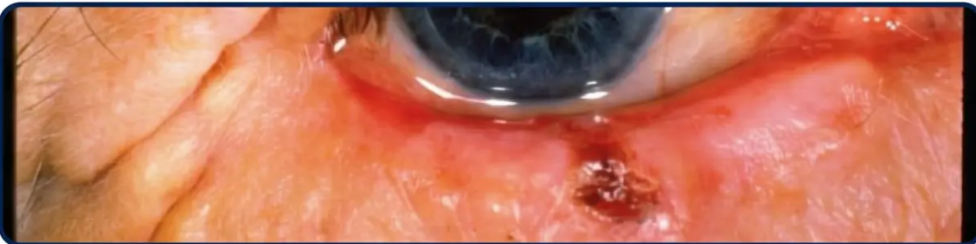

Arc Eye & Lid Lacerations
UV Keratitis Management · Lid Laceration Referral Criteria
🌟 Arc Eye — UV Keratitis
✂ Lid Lacerations
Bilateral · Delayed onset 6–12 hours · Self-limiting
Simple superficial = primary care · Complex = refer
▪ Causes: Welding without shield, sunlamps, tanning beds, snow
blindness (solar keratitis)
Can Manage in Primary Care:
- Simple superficial lacerations not involving the lid margin, medial
canthus, or deep structures — standard skin closure
▪ Symptoms: Gritty, burning pain; photophobia; blepharospasm;
lacrimation — onset delayed 6–12h after UV exposure
🚨 Refer to Ophthalmology / Maxillofacial if:
▪ Examination: Diffuse bilateral punctate epithelial erosions on
fluorescein staining
◆ Through the lid margin — risk of trichiasis or notching if poorly
repaired
Management
◆ Medial canthal involvement — risk of lacrimal duct damage →
chronic watering eye
1. Topical anaesthetic (proxymetacaine) — examination only,
not to take home
◆ Deep laceration with fat prolapse — orbital fat visible = open orbit
2. Oral NSAIDs — primary analgesia
◆ Any suspicion of globe injury beneath the laceration
◆ Full-thickness lid laceration with gaping wound
3. Cyclopentolate drops — for ciliary spasm pain
4. Topical chloramphenicol — infection prevention
5. Lubricating drops (artificial tears) — frequently
6. Dark glasses — avoid further UV exposure
> ⏱ Self-limiting — heals within 24–48 hours
> Review if not improving. Topical LA is for examination only —
never prescribe for home use.
Lower eyelid laceration — assess for margin involvement and globe injury
Eye Trauma in Primary Care
7 / 10
Bradford VTS · May 2026

Slide 8



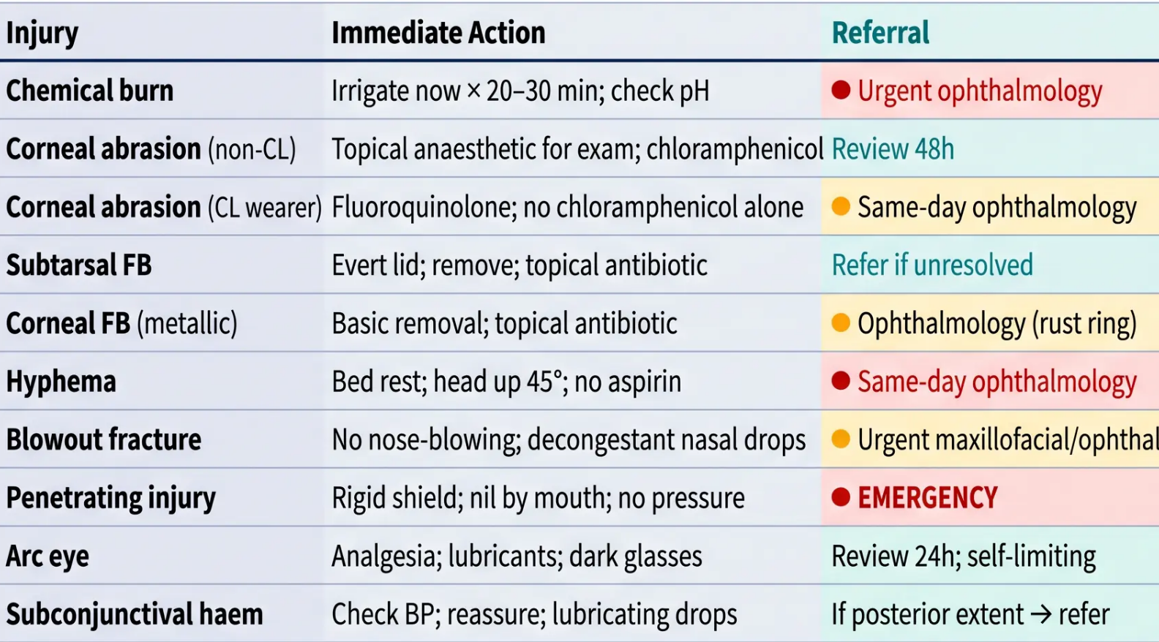

First Aid Summary & Red Flags
RED FLAGS
Emergency or same-day ophthalmology —
do not delay
Primary care actions at a glance — know when to act and when to refer
IMMEDIATE PRIMARY CARE ACTIONS
● Chemical burn (any) — irrigate
immediately; refer after
● Penetrating / open globe injury —
rigid shield; EMERGENCY referral
● Hyphema — same-day ophthalmology
● Suspected intraocular FB — EMERGENCY
(infection + retinal toxicity risk)
● VA loss after trauma — same-day (retinal
detachment / vitreous haemorrhage)
● Lid laceration through margin or medial
canthus — ophthalmology / maxillofacial
● Restricted eye movement + periorbital
injury — blowout fracture / orbital cellulitis
When in doubt — refer
Document VA before and after every intervention
● + Emergency / Same-day ● Urgent referral Teal = Review / Monitor
Eye Trauma in Primary Care
Bradford VTS • May 2026 • www.bradfordvts.co.uk

Slide 9










AKT & SCA Exam Pearls
High-yield recall · Clinical priorities · Communication strategies
☉ AKT — Know These Cold
1 Chemical Burns
2 CL Abrasion
3 Hyphema
4 Open Globe & Arc Eye
Alkali > acid in severity.
Irrigate × 20–30 min with
saline. Check pH neutral
(7.0) before stopping.
Fluoroquinolone
(ciprofloxacin 0.3%) — NOT
chloramphenicol alone.
Pseudomonas risk. Same-day
ophthalmology if concern.
Blood in anterior chamber
after blunt trauma. Avoid
aspirin/NSAIDs.
Same-day ophthalmology.
Sickle cell = high IOP risk.
Irregular/teardrop pupil =
emergency. Rigid shield;
nil by mouth.
Arc eye: bilateral, delayed
6–12 h, self-limiting 24–48 h.
AKT ◈ SCA
☉ SCA — Say This
Immediate Action
Safety-Netting
Explaining Referral
“The first thing we need to do right
now is wash your eye out — can you
lean over the sink while I do that? We
need to get all of that chemical out
as quickly as possible.”
“If your vision gets blurry, the pain
gets a lot worse, or your eye becomes
very red, come straight back or go
to A&E — don’t wait.”
“The metal leaves a small rust ring in
your eye that can cause damage if
it’s left — the eye team have a special
microscope to remove it safely. I
want to get you seen today.”
Safety action before history
Clear, specific, actionable
Justifies urgency without alarming
Eye Trauma in Primary Care
Bradford VTS · Page 9

Slide 10




Common Pitfalls & Quick Recall
What goes wrong — and what to remember
Common Pitfalls
Quick Recall: Top Tips
● Delaying irrigation for chemical burns
Taking a full history first — time is tissue
● Chemical injury — irrigate FIRST
Ask questions later; even milk or water if no saline
● Patching a contact lens eye
Dramatically increases Pseudomonas keratitis risk
● Topical anaesthetic for examination only
Never prescribe for home use
● Prescribing topical anaesthetic to take home
Masks pain signals; impairs corneal healing
● Always document VA before and after
Before any intervention, every time
● Chloramphenicol for CL corneal abrasion
Use fluoroquinolone — Pseudomonas risk
● Vertical abrasion lines = subtarsal FB
Evert the upper lid — always
● Missing a penetrating injury
Always check for teardrop pupil, soft globe, flat AC
● Teardrop pupil after trauma
Penetrating injury until proven otherwise
● Leaving a rust ring without urgent referral
Metal FB rust rings damage corneal stroma
● Never patch a contact lens wearer
No exceptions — Pseudomonas risk
● Not asking about occupation/eye protection
Key history for metallic FB and UV injury
● Diplopia after facial trauma
Think orbital blowout fracture — CT face
● Aspirin or NSAIDs in hyphema
Increases re-bleeding risk — avoid
● Arc eye is bilateral and delayed
6–12 hours after UV; self-limiting; dark glasses
When in doubt — shield, refer, and document.
Bradford VTS · Eye Trauma in Primary Care · www.bradfordvts.co.uk
May 2026

