Slide 1
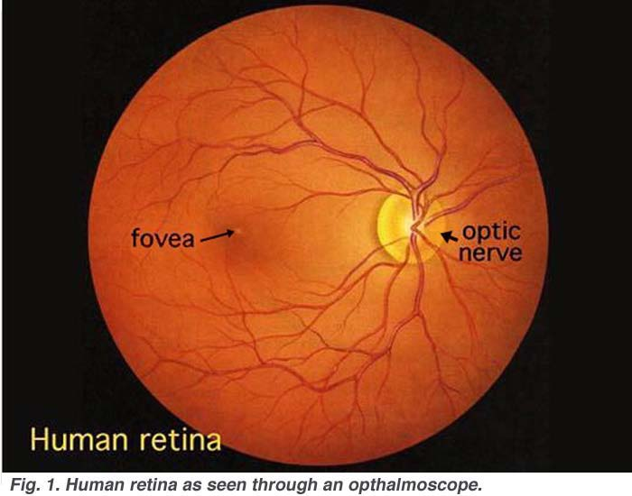
BRADFORD VTS TEACHING AIDS
June 2026
Ophthalmology for Primary Care
A practical, examination-led guide for primary care clinicians and GP trainees
Original author: Dr Layth Delaimy
Redesigned and clinically updated against current UK guidance (NICE / CKS, BNF, RCOphth, College of Optometrists) by Bradford VTS

Slide 2
BRADFORD VTS TEACHING AIDS
HOW TO USE THIS TEACHING AID
What we will cover
1
The 2-minute eye examination
2
Recognising eye disease
A simple, repeatable sequence you can do with basic kit
Acuity · fields · eye movements · pupils · surface · fundus
Visual acuity is the “vital sign” of the eye — check it first
The red eye — from harmless to sight-threatening
Lids and tear system
The fundus — disc, retina and sudden visual loss
Knowing what to refer — and how fast
Colour code used throughout:
Manage in primary care
Refer (routine / soon)
Refer TODAY — sight-threatening
Educational teaching aid — verify all guidance against current NICE/CKS, BNF and local policy before use.
Bradford VTS · June 2026
1

Slide 3
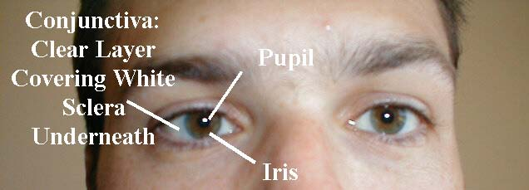
BRADFORD VTS TEACHING AIDS
ORIENTATION
A quick map of the eye
Front of the eye (anterior segment)
Conjunctiva — thin clear membrane over the white sclera
Cornea — clear front window; the main focusing surface
Iris & pupil — control light entering the eye
Anterior chamber — fluid-filled space behind the cornea
Back of the eye (posterior segment)
Lens — focuses light; clouds with age (cataract)
Retina — light-sensitive layer lining the back
Macula — central vision; Optic disc — nerve head
Vitreous — clear gel filling the eye
Conjunctiva, sclera, iris and pupil — the visible anterior eye
Educational teaching aid — verify all guidance against current NICE/CKS, BNF and local policy before use.
Bradford VTS · June 2026
2

Slide 4
BRADFORD VTS TEACHING AIDS
HISTORY & SAFETY
First, take a focused history
Ask about
🚩 The 5 NICE red flags
Onset & speed — sudden loss of vision is an emergency
Pain vs gritty discomfort vs itch
Vision — blurred, distorted, lost, or normal?
Discharge — watery, mucopurulent, sticky lids
One eye or both?
Photophobia, haloes, flashes or floaters
Contact lens wear · trauma · chemical splash
Systemic clues — diabetes, RA, headache, jaw pain
Any one of these → urgent (same-day) ophthalmology assessment.
Reduced visual acuity
Marked eye pain or photophobia
Copious purulent discharge
Contact lens wearer with a red eye
Trauma, chemical splash or penetrating / high-velocity injury
Source: NICE CKS — Red eye
Educational teaching aid — verify all guidance against current NICE/CKS, BNF and local policy before use.
Bradford VTS · June 2026
3

Slide 5
BRADFORD VTS TEACHING AIDS
THE STRUCTURED EXAMINATION
A 2-minute eye exam in 8 steps
1
Visual acuity
2
Visual fields
3
Eye movements
4
Pupils
Snellen / near chart · the eye’s vital sign
Confrontation · test for scotoma
6 positions of gaze · look for squint
Size, shape, reaction · check for RAPD
5
External eye & lids
6
Ocular surface
7
Fundoscopy
8
Intraocular pressure
Lids, lashes, lacrimal sac
Conjunctiva, cornea (fluorescein), sclera
Red reflex · disc, vessels, macula
Specialist / optometry (not bedside)
Educational teaching aid — verify all guidance against current NICE/CKS, BNF and local policy before use.
Bradford VTS · June 2026
4

Slide 6
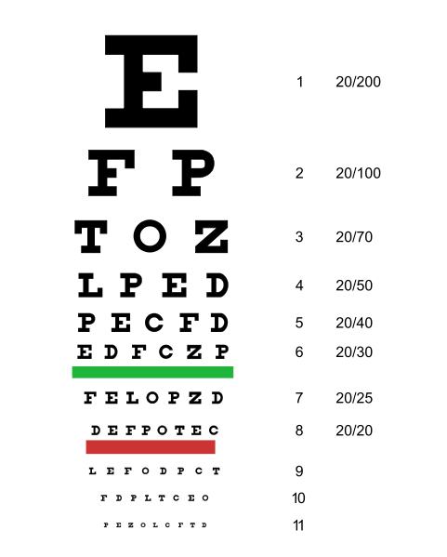
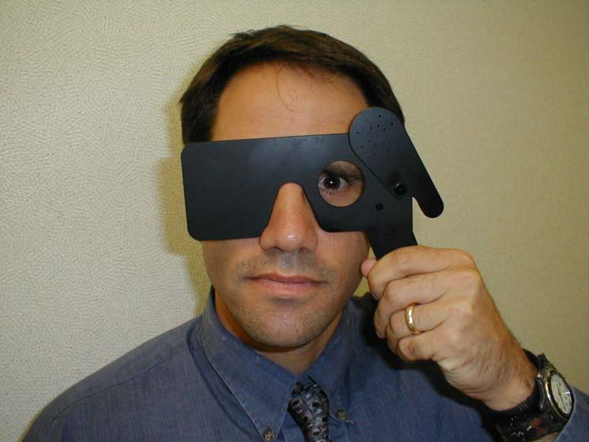
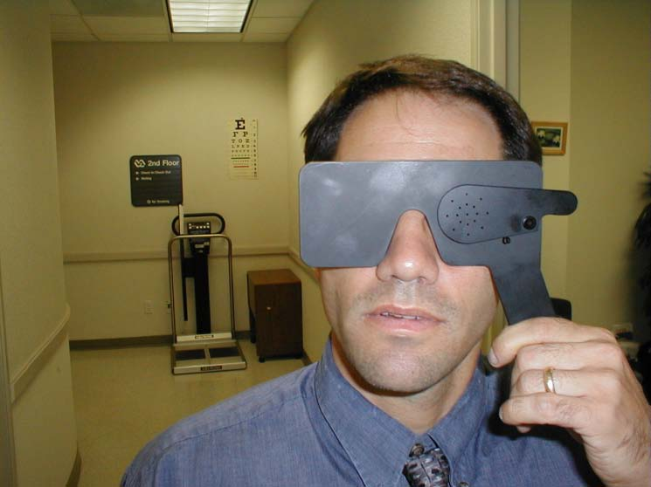
BRADFORD VTS TEACHING AIDS
STEP 1 · VISUAL ACUITY
Measure vision before anything else
How to test
Test each eye separately, then together, with usual glasses on
Distance: Snellen at 6 m (record e.g. 6/6, 6/12)
Near: small-print reading card
If worse than 6/6, repeat through a pinhole
Pinhole improves vision → refractive error (needs glasses)
No improvement → suspect ocular pathology — investigate
If can’t read the top letter: count fingers → hand movements → light perception
Pinhole occluder
In use
👁
Why acuity matters
A drop in acuity is the single most important red flag in any red or painful eye. Always document it.
Snellen chart
Educational teaching aid — verify all guidance against current NICE/CKS, BNF and local policy before use.
Bradford VTS · June 2026
5

Slide 7
BRADFORD VTS TEACHING AIDS
STEP 2 · VISUAL FIELDS
Confrontation field testing
Technique
Common patterns
Sit ~1 m away, eyes level with the patient
Patient covers one eye; you cover your opposite eye
Bring a moving/wiggling finger in from each quadrant
Compare the patient’s field with your own as a reference
Normal full field
Central scotoma
What you are looking for
Peripheral / tunnel
Scotoma — a blind spot or missing area in the field
Peripheral loss — glaucoma, retinitis pigmentosa
Hemianopia (half the field lost) → neurological cause
Central loss → macular or optic nerve disease
Right hemianopia
Educational teaching aid — verify all guidance against current NICE/CKS, BNF and local policy before use.
Bradford VTS · June 2026
6

Slide 8
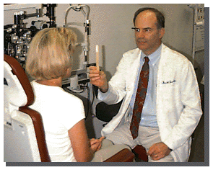
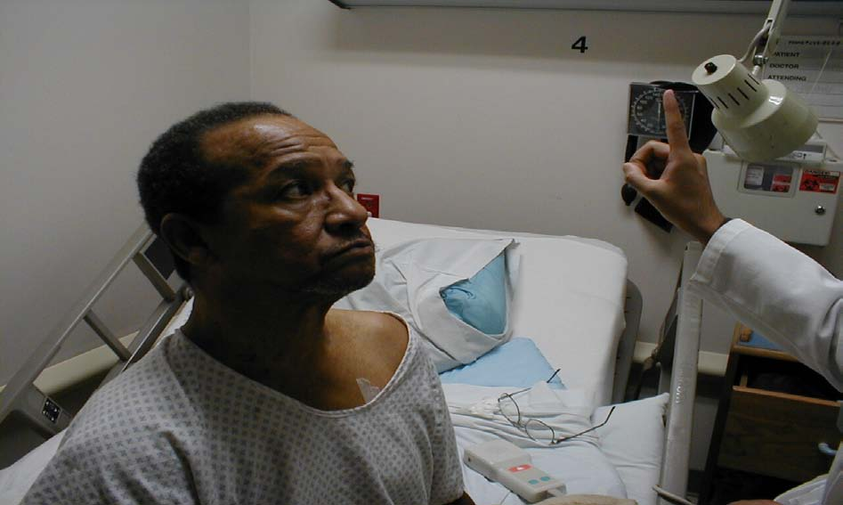
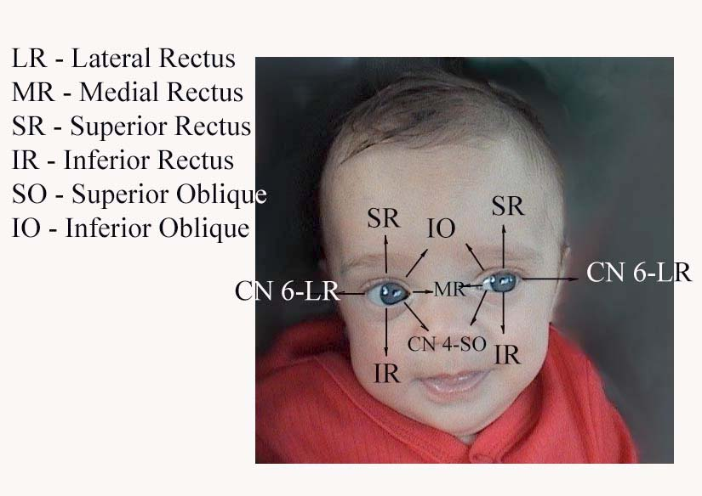
BRADFORD VTS TEACHING AIDS
STEP 3 · EYE MOVEMENTS
Ocular motility & squint (strabismus)
How to test
Shine a pen-torch: a centred corneal light reflex suggests aligned eyes
Ask the patient to follow the target with eyes only (head still)
Trace an “H” to cover the 6 positions of gaze
Ask about double vision in any direction
Cover test in a child
Follow the target through the gaze positions
In children
Cover test for squint
A constant squint or a white pupil (absent red reflex) needs prompt referral
Untreated childhood squint can cause amblyopia (lazy eye)
Cover the fixing eye — if the other eye moves to take up fixation, it was misaligned
New squint or new double vision in an adult → refer (exclude nerve palsy / serious cause)
Educational teaching aid — verify all guidance against current NICE/CKS, BNF and local policy before use.
Bradford VTS · June 2026
7

Slide 9
BRADFORD VTS TEACHING AIDS
STEP 4 · PUPILS
Size, shape, symmetry & reaction
Normal: PERRLA
The swinging-light test (RAPD)
Pupils Equal, Round, React to Light & Accommodation
Direct response — light in one eye constricts that pupil
Consensual response — the other pupil constricts too
Accommodation — pupils constrict when focusing on a near object
Swing a light between the two eyes every 2–3 seconds.
A relative afferent pupillary defect (RAPD): the affected pupil paradoxically dilates when the light swings to it.
It signals a serious optic nerve or extensive retinal problem (e.g. optic neuritis, central retinal artery occlusion).
A positive RAPD with visual loss → urgent referral.
Look for
Unequal pupils (anisocoria) or an irregular pupil
A fixed, mid-dilated pupil → think acute angle-closure glaucoma
A small, irregular, painful pupil → think anterior uveitis
Educational teaching aid — verify all guidance against current NICE/CKS, BNF and local policy before use.
Bradford VTS · June 2026
8

Slide 10
BRADFORD VTS TEACHING AIDS
STEP 6 · OCULAR SURFACE
Conjunctiva, cornea, sclera & anterior chamber
✓
Spelling & technique
It is fluorescein (not “fluorescence”). Instil one drop, then examine with a cobalt-blue light.
What to inspect
Conjunctiva — redness, discharge, follicles
Cornea — clarity and a crisp light reflection
Use fluorescein drops + a blue light to reveal abrasions and ulcers
A branching (dendritic) staining pattern = herpes simplex keratitis
Sclera — redness, and the bluish hue of scleritis
Anterior chamber — depth, cells, hypopyon (pus level)
Red-eye clues from the surface
Diffuse redness + discharge → conjunctivitis
Redness worse around the cornea (ciliary flush) → keratitis or uveitis
A single flat bright-red patch, white sclera elsewhere → subconjunctival haemorrhage
Any corneal opacity, ulcer or staining defect → refer urgently
Educational teaching aid — verify all guidance against current NICE/CKS, BNF and local policy before use.
Bradford VTS · June 2026
9

Slide 11
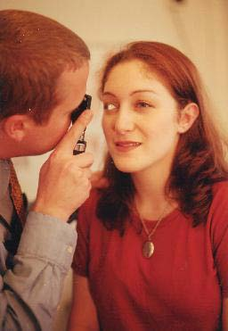
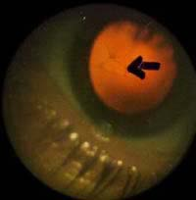
BRADFORD VTS TEACHING AIDS
STEP 7 · FUNDOSCOPY
Getting a view of the back of the eye
!
To dilate or not?
Dilating drops give a far better view but blur vision for hours. Avoid routine dilation if you cannot exclude a very shallow anterior chamber, and never delay a same-day referral to dilate.
A workable routine
Darken the room; ask the patient to fix on a distant point
Use your right eye for their right eye, left for left
Check the red reflex first — absent/abnormal in cataract, vitreous haemorrhage, or (in a child) retinoblastoma
Find a vessel and follow it back to the optic disc
Assess the disc: margins, colour, cup size
Then the vessels, macula and background retina
Disc signs to know
Right eye→right eye
Swollen disc, blurred margins → papilloedema
Pale disc → optic atrophy
Deep/large cup → glaucomatous cupping
Compare with the other eye — symmetry helps
Red reflex
Educational teaching aid — verify all guidance against current NICE/CKS, BNF and local policy before use.
Bradford VTS · June 2026
10

Slide 12
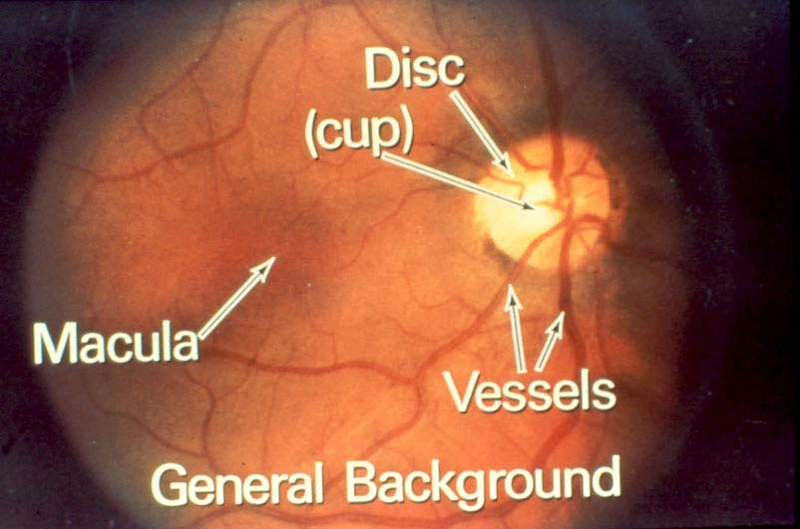
BRADFORD VTS TEACHING AIDS
REFERENCE
The normal fundus — know it before the abnormal
Landmarks
Optic disc — orange-pink, sharp margins, small central cup
Vessels — arteries thinner & lighter than veins; emerge from the disc
Macula — ~2 disc-diameters temporal to the disc; the fovea gives central vision
Background — even colour, varies with skin tone
Optic disc (right), macula and vessels
Healthy retina
Educational teaching aid — verify all guidance against current NICE/CKS, BNF and local policy before use.
Bradford VTS · June 2026
11

Slide 13
BRADFORD VTS TEACHING AIDS
PART TWO
Recognising eye disease
From the harmless to the sight-threatening — and what to refer

Slide 14
BRADFORD VTS TEACHING AIDS
THE RED EYE
One symptom, many causes — triage at a glance
Feature | Conjunctivitis | Subconj. haem. | Episcleritis | Keratitis / ulcer | Iritis (uveitis) | Acute glaucoma
Pain | Gritty | None | Mild ache | Sharp / FB feeling | Aching, photophobia | Severe + headache
Vision | Normal | Normal | Normal | Reduced | Reduced | Markedly reduced
Redness | Diffuse | Flat red patch | Sectoral | Around cornea | Around cornea | Around cornea
Discharge | Watery / pus | None | Watery | Watery | Watery | None
Pupil | Normal | Normal | Normal | Normal / small | Small, irregular | Fixed, mid-dilated
Action | Primary care | Reassure | Primary care | REFER today | REFER ≤24 h | EMERGENCY
A simplified teaching guide — not a substitute for examination. When in doubt, check acuity and refer. Source: NICE CKS Red eye; Prescriber 2024.
Educational teaching aid — verify all guidance against current NICE/CKS, BNF and local policy before use.
Bradford VTS · June 2026
13

Slide 15
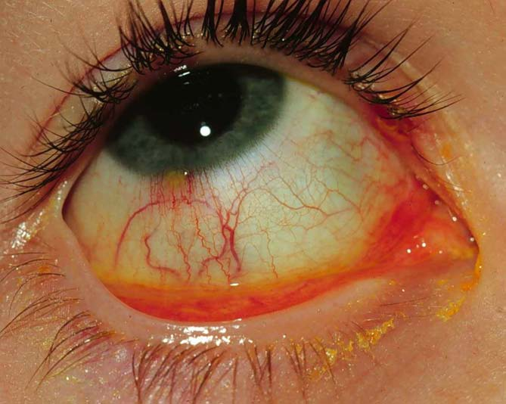
BRADFORD VTS TEACHING AIDS
RED EYE · COMMON
Conjunctivitis
Primary care
Recognise
Diffuse redness, gritty feeling, normal vision
Viral/allergic — watery, often both eyes, itch (allergic)
Bacterial — sticky mucopurulent discharge, lids stuck in morning
Manage
Most cases are self-limiting and settle within 1–2 weeks
First line: bathe lids, lubricants, hygiene advice; reserve antibiotics for severe or non-resolving cases
If treating bacterial: chloramphenicol 0.5% drops / 1% ointment (fusidic acid is an alternative)
Do NOT give antibiotics for viral conjunctivitis
🚩 Contact lens wearer with a red eye: refer urgently to exclude microbial / acanthamoeba keratitis.
Diffuse redness with discharge
Educational teaching aid — verify all guidance against current NICE/CKS, BNF and local policy before use.
Bradford VTS · June 2026
14

Slide 16
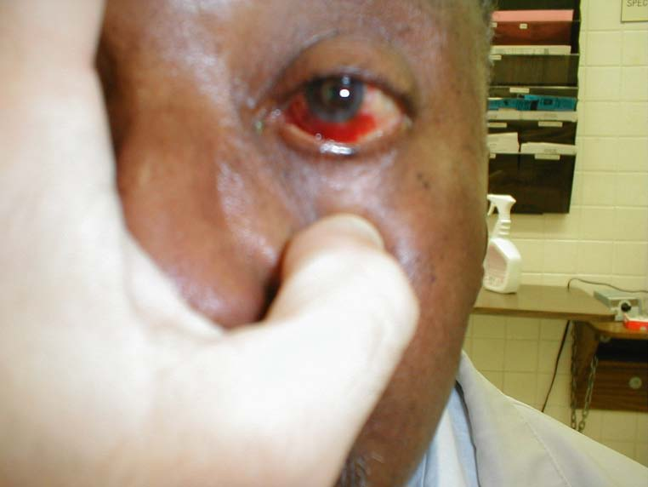
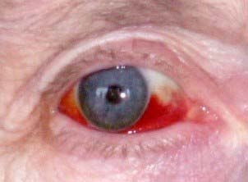
BRADFORD VTS TEACHING AIDS
RED EYE · COMMON
Subconjunctival haemorrhage
Reassure
Recognise
Painless, flat, bright-red patch on the white of the eye
Vision normal; no discharge; sharply edged
Often spontaneous, or after coughing/straining/minor trauma
Flat, bright-red patch; rest of sclera white
Manage
Benign — reassure; resolves over 1–2 weeks like a bruise
Check blood pressure; ask about anticoagulants/antiplatelets
If recurrent or spontaneous, review BP and consider clotting screen
Refer if associated with trauma, pain or reduced vision
Sharply demarcated blood
Educational teaching aid — verify all guidance against current NICE/CKS, BNF and local policy before use.
Bradford VTS · June 2026
15

Slide 17
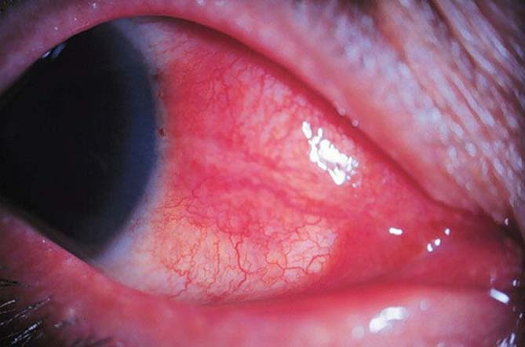
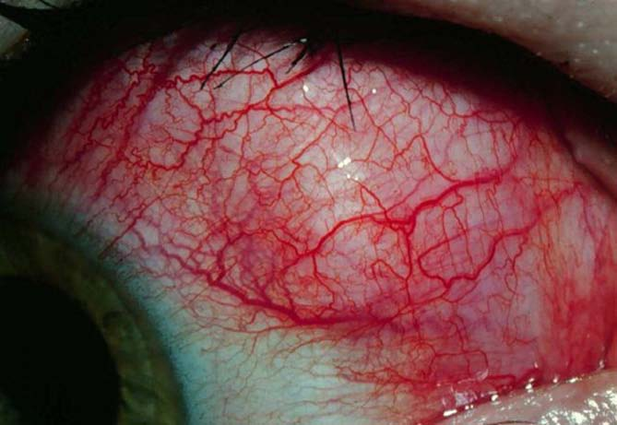
BRADFORD VTS TEACHING AIDS
RED EYE · THE WHITE OF THE EYE
Episcleritis vs scleritis — a crucial distinction
EPISCLERITIS
SCLERITIS
Mild or no pain
Vision normal
Benign, self-limiting (1–2 weeks)
Reassure ± lubricants ± oral NSAID
Severe, deep, “boring” pain — may wake from sleep
Globe tender to touch; vision may be affected
~½ have systemic disease (e.g. RA, vasculitis)
Sight-threatening → urgent referral
Episcleritis — sectoral redness
💧
Bedside test (phenylephrine 2.5–10%)
It blanches the superficial vessels of episcleritis, but NOT the deeper vessels of scleritis. Source: NICE CKS; Prescriber 2024.
Scleritis — deep, intense redness
Educational teaching aid — verify all guidance against current NICE/CKS, BNF and local policy before use.
Bradford VTS · June 2026
16

Slide 18
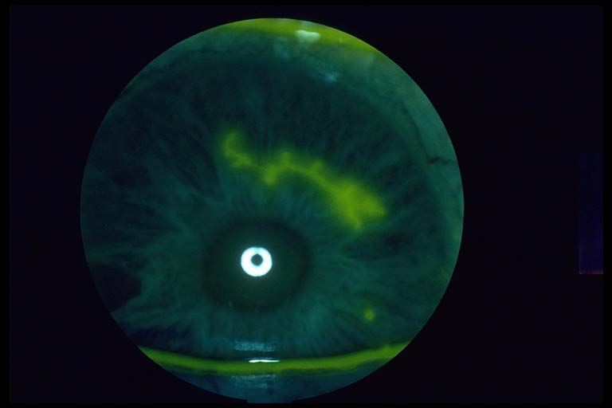
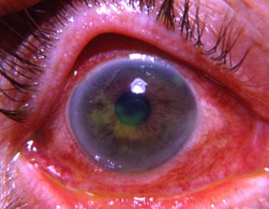
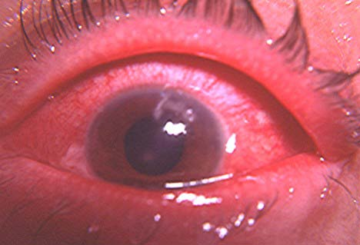
BRADFORD VTS TEACHING AIDS
RED EYE · SIGHT-THREATENING
Keratitis — HSV & herpes zoster
REFER TODAY
Herpes simplex keratitis
Painful red eye with a branching (dendritic) ulcer that stains with fluorescein
Refer urgently; treated with topical/oral antivirals (e.g. aciclovir) under specialist care
Dendritic ulcer (fluorescein, blue light)
Herpes zoster ophthalmicus (shingles, V1)
Hutchinson’s sign — rash on the tip/side of the nose — predicts eye involvement
Start oral aciclovir 800 mg five times daily for 7 days, ideally within 72 h, and refer if any eye involvement
⛔ You must NOT prescribe topical steroids to an undiagnosed red eye or a dendritic ulcer — they can cause a sight-threatening corneal melt. (NICE CKS; BNF — verify dose locally.)
Herpes zoster keratitis
Inflamed, painful eye
Educational teaching aid — verify all guidance against current NICE/CKS, BNF and local policy before use.
Bradford VTS · June 2026
17

Slide 19
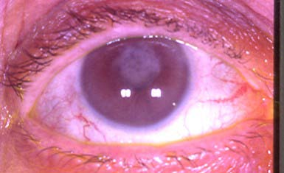
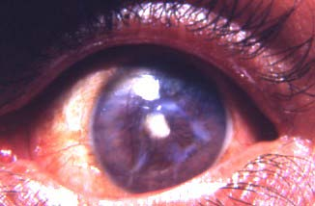
BRADFORD VTS TEACHING AIDS
RED EYE · SIGHT-THREATENING
Anterior uveitis (iritis)
REFER ≤ 24 h
Recognise
Painful red eye, marked photophobia, watering, blurred vision
Redness most intense around the cornea (ciliary flush)
Pupil may be small and irregular (posterior synechiae)
Often recurrent; linked to HLA-B27 disease (e.g. ankylosing spondylitis, IBD)
Circumcorneal (ciliary) redness
Manage
Refer to ophthalmology within 24 hours
Specialist treats with topical steroids + a dilating (cycloplegic) drop
Untreated it can cause glaucoma, cataract and macular oedema
ℹ Photophobia + reduced vision + a red eye is uveitis until proven otherwise. Source: NICE CKS; College of Optometrists.
Painful, photophobic eye
Educational teaching aid — verify all guidance against current NICE/CKS, BNF and local policy before use.
Bradford VTS · June 2026
18

Slide 20
BRADFORD VTS TEACHING AIDS
RED EYE · EMERGENCY
Acute angle-closure glaucoma
EMERGENCY
Classic presentation
⏱ Act now — blindness within hours
Sudden, severe, painful red eye
Headache, nausea and vomiting
Blurred vision and haloes around lights
Often in the evening / dim light, or after some drugs
Immediate / same-day ophthalmology referral
Lie the patient flat (face up)
Give analgesia and an antiemetic
Do NOT dilate the pupil
Hospital lowers pressure (e.g. acetazolamide, drops) then laser iridotomy
Signs
Fixed, mid-dilated, oval pupil
Hazy (cloudy) cornea; eye feels hard
Markedly reduced acuity
Source: RCOphth; NICE CKS Glaucoma.
Educational teaching aid — verify all guidance against current NICE/CKS, BNF and local policy before use.
Bradford VTS · June 2026
19

Slide 21
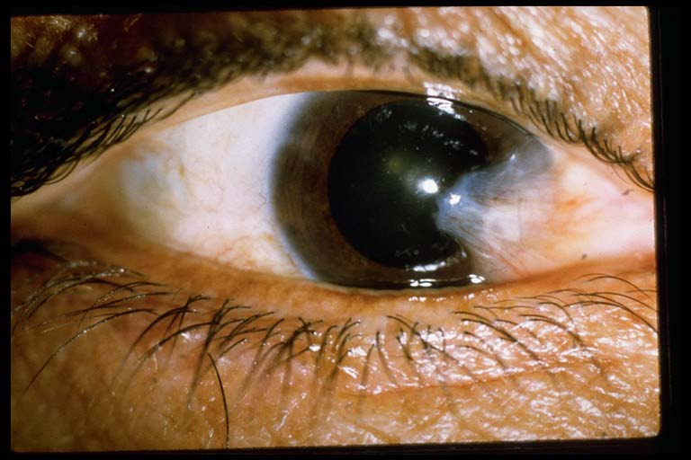
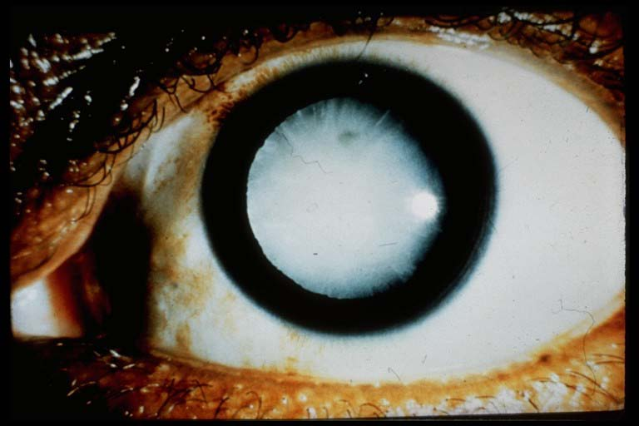
BRADFORD VTS TEACHING AIDS
GRADUAL, PAINLESS CHANGES
Pterygium & cataract
Pterygium
Fleshy, wing-shaped growth of conjunctiva creeping onto the cornea
Linked to sun (UV), wind and dust exposure; benign
Lubricants for irritation; advise sunglasses
Refer routinely if it threatens the visual axis, distorts vision, or for cosmesis
Pterygium
Cataract
Painless, gradual clouding of the lens; commonest with age
Blurred/misty vision, glare, faded colours; reduced red reflex
Also: diabetes, steroids, trauma, congenital (check red reflex in babies)
Routine referral for surgery when vision affects daily life
Cataract (cloudy lens)
Educational teaching aid — verify all guidance against current NICE/CKS, BNF and local policy before use.
Bradford VTS · June 2026
20

Slide 22
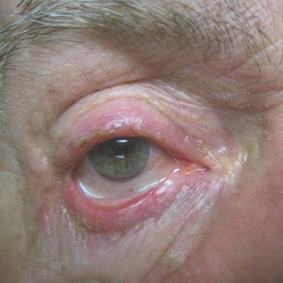
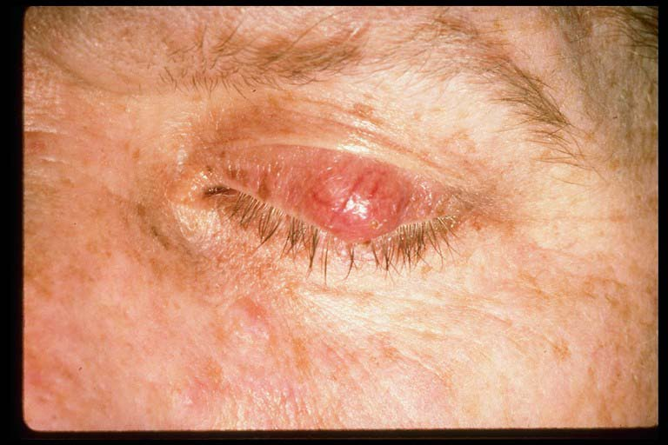
BRADFORD VTS TEACHING AIDS
LIDS & MARGINS
Blepharitis & chalazion
Blepharitis
Chronic inflammation of the lid margins — gritty, red, crusty lids
Mainstay is lid hygiene, done regularly and long-term:
warm compress → gentle lid massage → clean the lid margins
Treat associated dry eye with lubricants; refer only if not improving
Blepharitis — crusted lid margins
Chalazion (meibomian cyst)
Painless, firm lump from a blocked oil gland in the lid
Warm compresses + massage; most resolve over weeks
A stye (hordeolum) is the acute, painful, infected version
Refer for incision/curettage if persistent; refer any atypical/recurrent lump to exclude malignancy
Chalazion — painless lid lump
Educational teaching aid — verify all guidance against current NICE/CKS, BNF and local policy before use.
Bradford VTS · June 2026
21

Slide 23
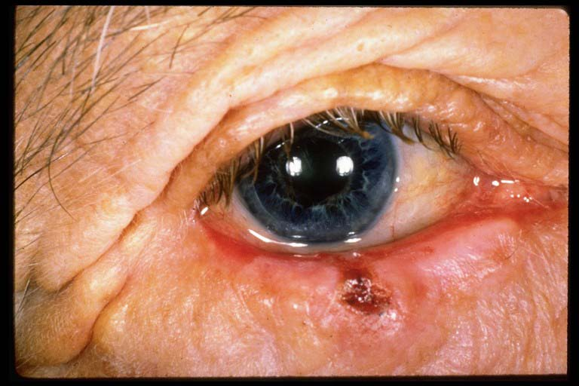
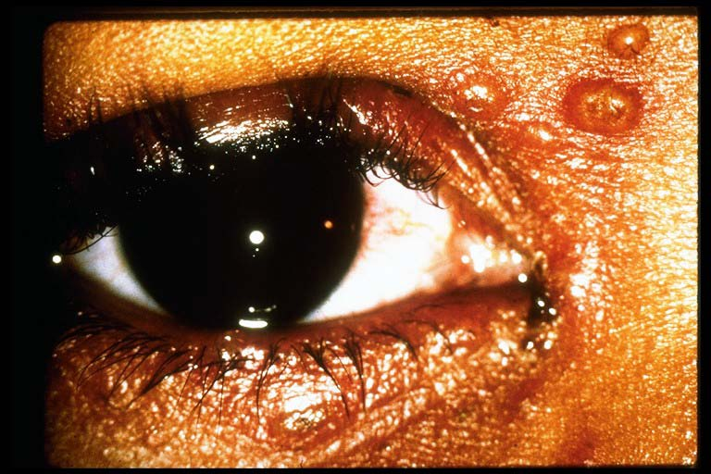
BRADFORD VTS TEACHING AIDS
LID LESIONS
Eyelid lesions — know the dangerous one
Basal cell carcinoma (BCC)
The commonest eyelid malignancy — usually lower lid / medial canthus
Pearly, rolled edge, surface vessels; may ulcer, bleed or destroy lashes
Refer for assessment and excision — do not freeze, cauterise or ignore
Basal cell carcinoma — pearly, ulcerated
Molluscum contagiosum
Viral, dome-shaped papules with a central dimple
Usually self-limiting; can cause a follicular conjunctivitis
Reassure; refer if lid-margin lesions cause persistent eye irritation
🔎 Any non-healing, ulcerating or pigmented eyelid lesion with lash loss should be referred for specialist assessment.
Molluscum contagiosum
Educational teaching aid — verify all guidance against current NICE/CKS, BNF and local policy before use.
Bradford VTS · June 2026
22

Slide 24
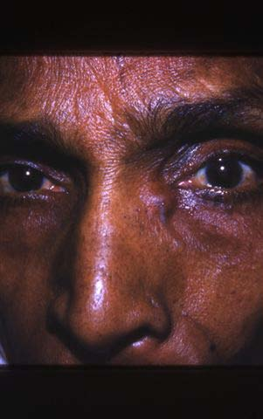
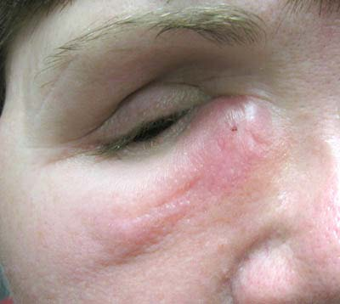
BRADFORD VTS TEACHING AIDS
TEAR SYSTEM
Dacryocystitis
Treat & refer
Recognise
Infection of the tear (lacrimal) sac
Painful red swelling just below the inner corner of the eye
Watering eye (epiphora) and discharge; may have fever
Tender swelling below the medial canthus
Manage
Oral antibiotics for the acute infection; warm compresses; analgesia
Refer to ophthalmology — recurrent cases need surgery (DCR) to restore drainage
If spreading cellulitis or systemically unwell → urgent same-day referral
Lacrimal sac infection
Educational teaching aid — verify all guidance against current NICE/CKS, BNF and local policy before use.
Bradford VTS · June 2026
23

Slide 25
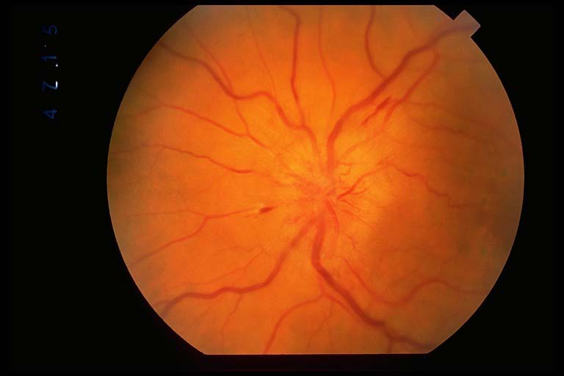
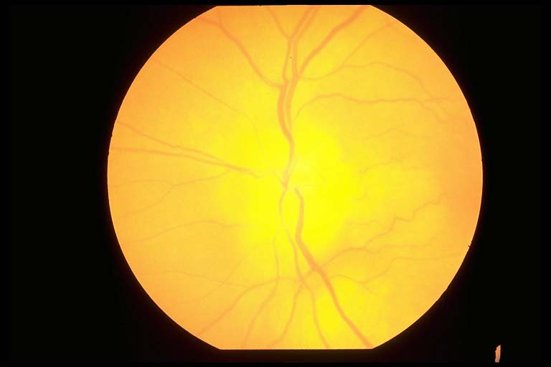
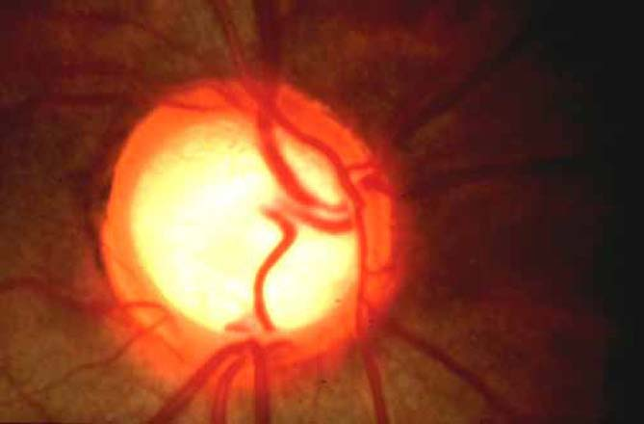
BRADFORD VTS TEACHING AIDS
THE FUNDUS · OPTIC DISC
Three disc appearances you must know
Papilloedema
Optic atrophy
Glaucomatous cupping
Swollen disc, blurred margins — usually both eyes. Means raised intracranial pressure until proven otherwise.
Abnormally pale disc. A sign of past optic nerve damage (ischaemia/GCA, compression, MS).
Enlarged cup-to-disc ratio in chronic glaucoma. Often symptomless until late.
→ Urgent investigation
→ Refer to find cause
→ Refer: pressure & fields
Educational teaching aid — verify all guidance against current NICE/CKS, BNF and local policy before use.
Bradford VTS · June 2026
24

Slide 26
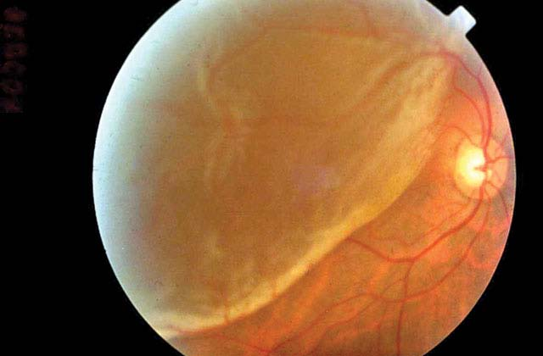
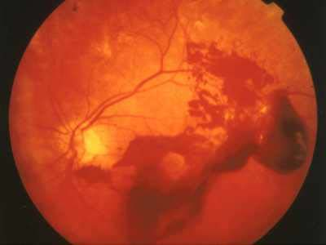
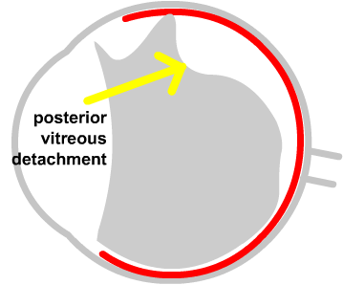
BRADFORD VTS TEACHING AIDS
THE FUNDUS · EMERGENCIES
Flashes, floaters & sudden visual loss
REFER TODAY
Retinal detachment
New floaters + flashes + a “curtain/shadow” across the vision
Same-day referral — earlier surgery saves sight
Vitreous haemorrhage
Retinal detachment
Sudden floaters or haze / loss; common in diabetes — urgent referral
Posterior vitreous detachment
Very common with age: flashes & floaters; usually benign
BUT must exclude a retinal tear — urgent assessment of new symptoms
⛔ Sudden painless loss of vision (artery/vein occlusion, GCA) is an emergency — refer immediately.
Vitreous haemorrhage
Posterior vitreous detachment
Educational teaching aid — verify all guidance against current NICE/CKS, BNF and local policy before use.
Bradford VTS · June 2026
25

Slide 27
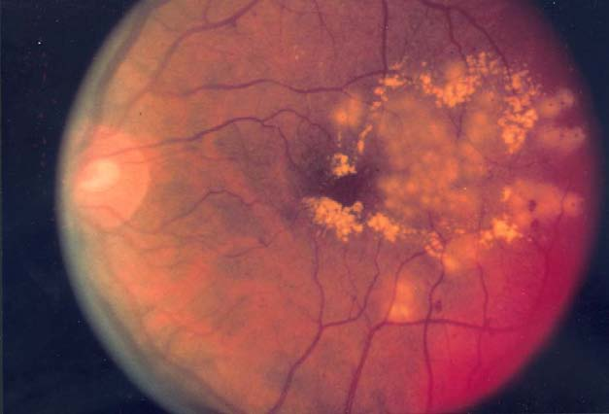
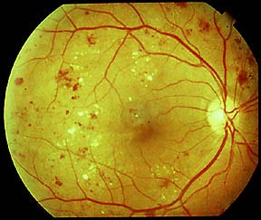
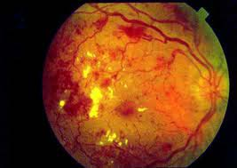
BRADFORD VTS TEACHING AIDS
RETINA & SYSTEMIC DISEASE
Diabetic retinopathy
Screening saves sight
Everyone with diabetes aged 12+ is invited to annual NHS diabetic eye screening
Leading cause of preventable sight loss in working-age adults
What you see
Haemorrhages & exudates
Microaneurysms, dot/blot haemorrhages, hard exudates, cotton-wool spots
New vessels (proliferative) and maculopathy threaten sight
Manage
Optimise glucose, blood pressure and lipids; support attendance at screening
Refer per screening grade; proliferative disease / maculopathy → ophthalmology
ℹ Source: NHS Diabetic Eye Screening Programme; NICE.
Background changes
Advanced disease
Educational teaching aid — verify all guidance against current NICE/CKS, BNF and local policy before use.
Bradford VTS · June 2026
26

Slide 28
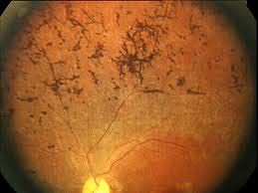
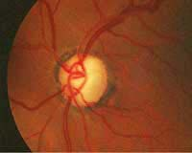
BRADFORD VTS TEACHING AIDS
THE FUNDUS · INHERITED
Retinitis pigmentosa
Recognise
Inherited degeneration of the retina’s photoreceptors
Night blindness first, then slowly progressive loss of peripheral (“tunnel”) vision
Fundus triad: bone-spicule pigmentation, waxy pale disc, narrowed vessels
“Bone-spicule” pigmentation
Manage
Refer for diagnosis, genetic counselling and low-vision support
Advise on driving — patients must inform the DVLA
Waxy pale disc
Educational teaching aid — verify all guidance against current NICE/CKS, BNF and local policy before use.
Bradford VTS · June 2026
27

Slide 29
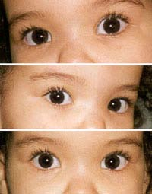
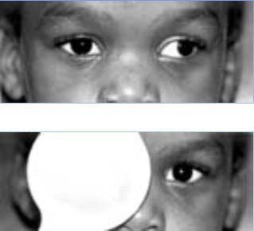
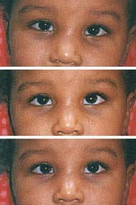
BRADFORD VTS TEACHING AIDS
ACTIVE RECALL
Quiz — test yourself
Ask yourself
A–C Which eye is misaligned, and which simple test confirms a squint?
What is the difference between a phoria and a tropia?
D Name two fundus features of diabetic retinopathy.
Which of today’s conditions need referral the SAME DAY?
What is the one test you must do in every red or painful eye?
Case A
Case C
Case B
Case D
Educational teaching aid — verify all guidance against current NICE/CKS, BNF and local policy before use.
Bradford VTS · June 2026
28

Slide 30
BRADFORD VTS TEACHING AIDS
REFER TODAY
If you remember nothing else…
🚩
Sudden loss of vision
Painless or painful — emergency
🚩
Acute painful red eye
With reduced vision or photophobia
🚩
Contact lens wearer
Any painful red eye → exclude keratitis
🚩
Chemical / penetrating injury
Irrigate chemicals immediately, then refer
🚩
Dendritic ulcer / keratitis
Never give steroids to an undiagnosed red eye
🚩
Suspected acute glaucoma
Severe pain, haloes, fixed mid-dilated pupil
🚩
Suspected GCA
Vision + headache/jaw claudication in over-50s
🚩
Flashes, floaters, curtain
Suspect retinal detachment
Educational teaching aid — verify all guidance against current NICE/CKS, BNF and local policy before use.
Bradford VTS · June 2026
29

Slide 31
BRADFORD VTS TEACHING AIDS
SUMMARY
Five things to take away
1
Acuity is the vital sign
Always measure and document vision in any eye complaint.
2
Know the 5 red flags
Reduced vision · pain/photophobia · copious discharge · contact lens · trauma.
3
Most red eye is benign
But a small number are sight-threatening — triage deliberately.
4
Never steroids blindly
No topical steroids in an undiagnosed red eye or dendritic ulcer.
5
When in doubt, refer
Match the speed of referral to the threat to sight.
Educational teaching aid — verify all guidance against current NICE/CKS, BNF and local policy before use.
Bradford VTS · June 2026
30

Slide 32
BRADFORD VTS TEACHING AIDS
IMPORTANT
Disclaimer
Key sources
This presentation is provided exclusively for educational and training purposes as a teaching aid. It does not constitute formal clinical guidance. Clinicians must independently verify all medical information, prescribing guidance, procedural protocols and legal requirements against current national guidance, local policies and the relevant regulatory bodies before applying it in practice.
NICE CKS — Red eye; Conjunctivitis (infective); Glaucoma; Shingles; Giant cell arteritis; Blepharitis
BNF — chloramphenicol, aciclovir
Royal College of Ophthalmologists guidance
College of Optometrists — Clinical Management Guidelines
NHS Diabetic Eye Screening Programme
Mamtora et al., Prescriber 2024 — red eye in primary care
Original author: Dr Layth Delaimy · Redesigned & clinically updated BRADFORD VTS TEACHING AIDS · Bradford VTS · June 2026

