Slide 1
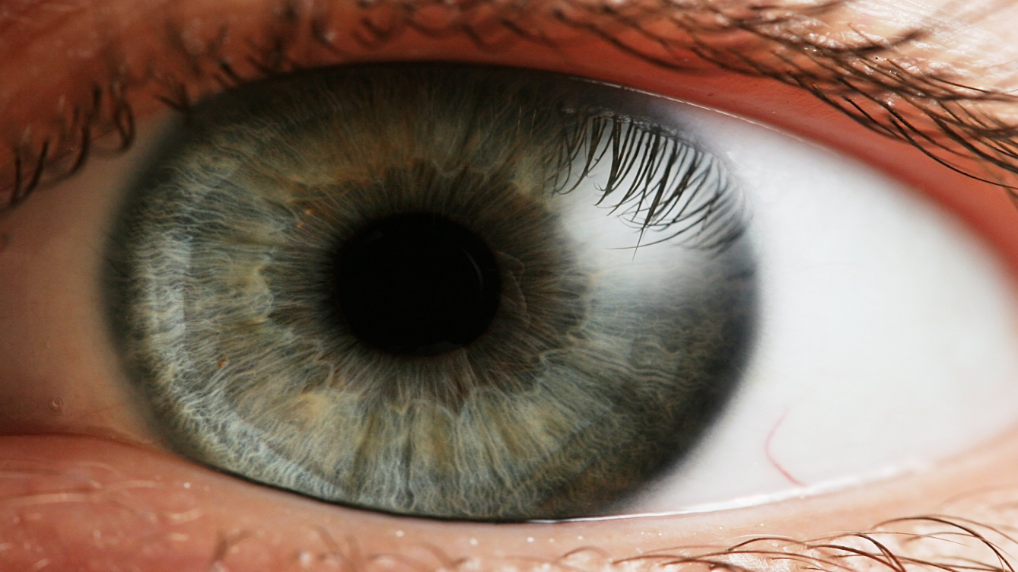
BRADFORD VTS TEACHING AIDS
Ophthalmology in
General Practice
A practical, case-based update for primary care
Spot the sight-threatening eye · know what to do · know when to refer
June 2026
Adapted & clinically updated from teaching by Dr Mazhar Khan & Dr Bruce Davies

Slide 2
BRADFORD VTS TEACHING AIDS
WHY IT MATTERS
Eyes turn up in your clinic every day
Could you handle these today?
2–5%
of all GP consultations are eye-related
New AF, wakes with sudden painless vision loss in one eye
Embolic retinal artery occlusion until proven otherwise
Elderly, vomiting, one red painful eye — "just gastroenteritis"?
Acute angle-closure glaucoma can mimic an acute abdomen
You don't need to be an ophthalmologist. You need to recognise the few conditions that threaten sight — and act fast.
Rheumatoid arthritis, sore gritty eyes not settling on antibiotics
Think scleritis / severe dry eye — not simple infection
Educational teaching aid — verify against current NICE / NICE CKS / BNF & local policy before use.
Bradford VTS · June 2026 · 2

Slide 3






BRADFORD VTS TEACHING AIDS
YOUR MENTAL MAP
Six ways an eye problem walks in
Sort every presentation into one of these six boxes first — it tells you what to look for and how urgently to act.
1 · The red eye
2 · Lids & lashes
3 · Watering & dry eye
Painful or painless? Vision affected? Most common — a few are emergencies.
Styes, cysts, blepharitis, turned-in/out lids, lumps to watch.
Too many tears or too few — common, irritating, rarely sinister.
4 · Sudden visual loss
5 · Gradual visual loss
6 · Trauma & squint
The "curtain." Almost all need same-day specialist assessment.
Cataract, macular, diabetic & hypertensive eye, glaucoma.
Injury, chemicals, children's squints & the white reflex.
Educational teaching aid — verify against current NICE / NICE CKS / BNF & local policy before use.
Bradford VTS · June 2026 · 3

Slide 4

BRADFORD VTS TEACHING AIDS
BE PREPARED
Your GP eye toolkit
Keep these to hand — most eye assessment needs only simple kit.
Snellen chart
Distance vision (+ near-vision card)
Pen-torch + cobalt blue
Pupils, anterior segment, fluorescein
Fluorescein strips
Stain every red or painful eye
Ophthalmoscope
Red reflex, disc, retina
Pinhole
Is blurred vision refractive?
Amsler grid
Central distortion — macular disease
Dilating drops
Tropicamide 1% for fundoscopy
Topical anaesthetic
Comfort + foreign-body removal
Golden rule
Tropicamide wears off in a few hours and the risk of triggering acute angle-closure is very small — do not let fear of dilating stop you examining the retina.
Educational teaching aid — verify against current NICE / NICE CKS / BNF & local policy before use.
Bradford VTS · June 2026 · 4

Slide 5

BRADFORD VTS TEACHING AIDS
STEP 1 · LISTEN
The focused eye history
Ask about the symptom
One eye or both?
Pain, grittiness, or just red?
Any change in vision — blurred, lost, distorted?
Speed of onset — minutes, days, weeks?
Discharge: watery, sticky/pus, or none?
Flashes, floaters, or a "curtain"?
Photophobia or haloes around lights?
What is actually worrying the patient?
Background that changes the game
Contact lenses →
sight-threatening keratitis risk
Myopia → ~10× risk of retinal detachment
Family history of glaucoma (1st-degree) → ~1 in 10 lifetime risk
Diabetes / hypertension / connective-tissue disease
Previous eye conditions — many relapse (uveitis, herpetic keratitis); the patient often knows the pattern
Current eye drops & systemic medicines
Educational teaching aid — verify against current NICE / NICE CKS / BNF & local policy before use.
Bradford VTS · June 2026 · 5

Slide 6

BRADFORD VTS TEACHING AIDS
STEP 2 · EXAMINE
A simple, systematic eye exam
Front of the eye
Visual acuity — Snellen at 6 m, then pinhole
Visual fields to confrontation (4 quadrants)
Pupils — size, shape, reactions, RAPD
Lids, lashes & lid margins
Conjunctiva, cornea, sclera, anterior chamber
Back of the eye
Dilate with tropicamide 1% in a dark room
Red reflex first — absent = media problem
Optic disc: colour, margins, cup-to-disc ratio
Vessels, haemorrhages, exudates
Macula (use the green/red-free filter)
NEVER forget to stain a red eye
Fluorescein + cobalt-blue light reveals abrasions, dendritic ulcers and foreign bodies you will otherwise miss. A green-staining branching pattern = herpetic dendritic ulcer.
Educational teaching aid — verify against current NICE / NICE CKS / BNF & local policy before use.
Bradford VTS · June 2026 · 6

Slide 7
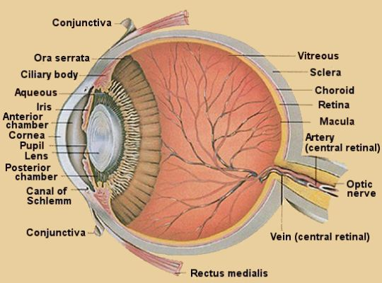
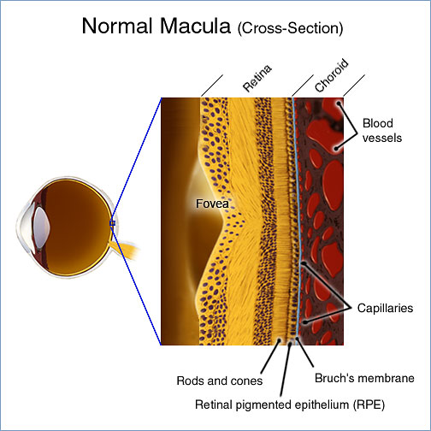
BRADFORD VTS TEACHING AIDS
ORIENTATION
A 30-second tour of the eye
Cross-section of the eye
The macula in close-up
Educational teaching aid — verify against current NICE / NICE CKS / BNF & local policy before use.
Bradford VTS · June 2026 · 7

Slide 8
BRADFORD VTS TEACHING AIDS
REFER NOW
Eye red flags — don't sit on these
Sudden loss of vision
Painless or painful — vascular, retinal or optic emergency
Painful red eye + reduced vision
Glaucoma, uveitis or keratitis until proven otherwise
Contact-lens wearer with a red, painful eye
Assume microbial keratitis — refer same day
Trauma or chemical splash
Irrigate chemicals immediately, then refer
Halos, headache, nausea + cloudy cornea
Acute angle-closure glaucoma
Distortion / central blank spot
Wet AMD — urgent macula referral
Flashes, floaters, a "curtain"
Retinal detachment
Rash on the nose tip (Hutchinson's sign)
Shingles threatening the eye
Educational teaching aid — verify against current NICE / NICE CKS / BNF & local policy before use.
Bradford VTS · June 2026 · 8

Slide 9
BRADFORD VTS TEACHING AIDS
SECTION 1
The Red Eye
Common, mostly benign — but a handful are sight-threatening. Pain and reduced vision are your warning lights.

Slide 10
BRADFORD VTS TEACHING AIDS
THINK FIRST
Red eye: a 10-second triage
Two questions sort most red eyes into "treat / reassure" versus "refer".
Is vision affected?
Is the eye truly painful?
Usually safe — manage in GP
Vision normal, only mild grittiness/itch
Discharge with sticky lids (conjunctivitis)
A bright bloody patch, white elsewhere (subconjunctival haemorrhage)
Localised redness, no discharge, comfortable (episcleritis)
Refer — sight may be at risk
Reduced or blurred vision
Deep ache, photophobia, severe pain
Cloudy/hazy cornea or fixed mid-dilated pupil
Contact-lens wearer with a painful red eye
Fluorescein shows an ulcer or dendrite
Educational teaching aid — verify against current NICE / NICE CKS / BNF & local policy before use.
Bradford VTS · June 2026 · 10

Slide 11
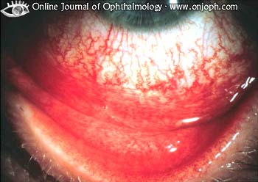

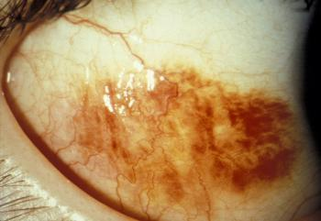
BRADFORD VTS TEACHING AIDS
RED EYE · COMMONEST
Infective conjunctivitis
Recognise the pattern
Bacterial —
yellow-white sticky discharge, lids gummed together, vision normal.
Viral —
watery, often with a cold/sore throat; very contagious; can last 1–2 weeks.
Both —
redness spreads across the whole conjunctiva and from eye to eye.
Management has changed
Most cases are self-limiting — self-care first
Bathe lids; cool compresses; lubricants
Hygiene to stop spread; own towel
Bacterial: sticky, purulent
If antibiotic needed
Chloramphenicol 0.5% drops / 1% ointment — now OTC (≥ 2 yrs). Source: NICE CKS.
Refer
Contact-lens wearers, no improvement after ~1 week, or any red flag.
Viral: watery, follicular
Educational teaching aid — verify against current NICE / NICE CKS / BNF & local policy before use.
Bradford VTS · June 2026 · 11

Slide 12
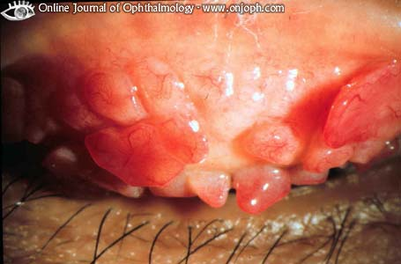
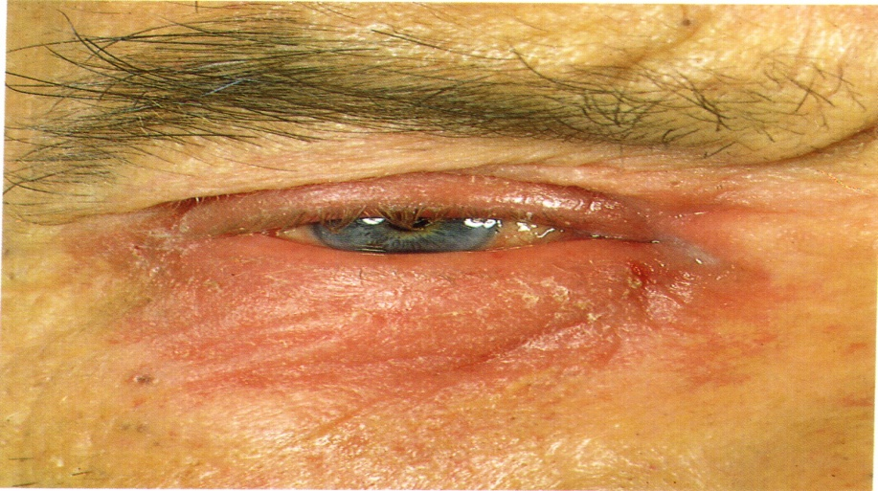
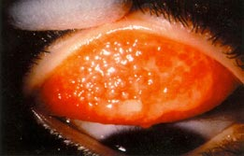
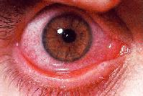
BRADFORD VTS TEACHING AIDS
RED EYE · DON'T MISS
Allergic — and the dangerous mimics
Allergic: how to treat
Itching ± stringy mucus, both eyes
Avoid the trigger; cool compress
Topical antihistamine / mast-cell stabiliser (e.g. sodium cromoglicate — may take days to work)
Refer if vision affected or not settling
Hyperacute / chlamydial
Profuse pus in hours → gonococcal — admit
Chronic, STI, vision loss → chlamydial — refer + sexual-health
Perennial / seasonal
Vernal
Neonate (<28 days)
Notifiable — refer the same day
Can scar / blind; treat & swab
Test parents for STIs
Atopic
Giant papillary
Allergic conjunctivitis — itch is the clue
Educational teaching aid — verify against current NICE / NICE CKS / BNF & local policy before use.
Bradford VTS · June 2026 · 12

Slide 13
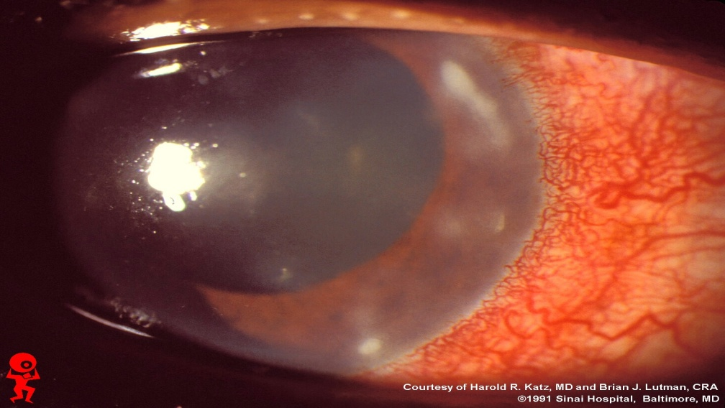
BRADFORD VTS TEACHING AIDS
CASE · RED EYE + PAIN
Corneal ulcer & herpetic keratitis
THE CASE A red eye was treated with steroid-antibiotic drops. Three days later vision is blurred, the eye more painful and intolerant of light.
What you're seeing
Painful red eye, watering, photophobia
Fluorescein shows a branching (dendritic) ulcer = herpes simplex
Causes: HSV, bacteria, contact lenses, trauma, dry/exposed cornea
Never steroids on a dendritic ulcer
Topical steroids turn it into a sight-threatening geographic ulcer. This is the classic trap.
Treat & refer
Topical aciclovir for HSV dendritic ulcer
Refer ALL corneal ulcers urgently — sight threat
Dendritic ulcer — fluorescein stain
Educational teaching aid — verify against current NICE / NICE CKS / BNF & local policy before use.
Bradford VTS · June 2026 · 13

Slide 14
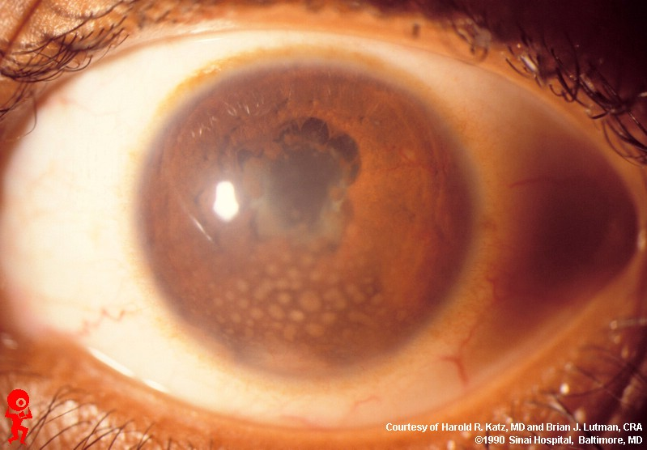
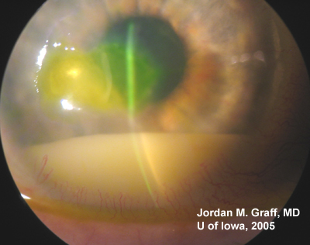
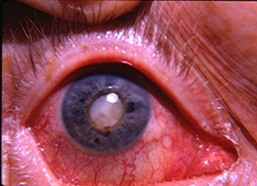
BRADFORD VTS TEACHING AIDS
CASE · RED EYE + PAIN
Anterior uveitis (iritis)
The story it tells
Pain → photophobia → blurred vision
Deep ache, watering, ciliary flush (redness hugging the iris)
Pupil small & sluggish; may be irregular
At risk: HLA-B27, ankylosing spondylitis, IBD, sarcoid, JIA, past attacks
Worsening signs = bad news
Hypopyon (pus level)
Keratic precipitates
Falling vision
Refer all — same day
Specialist confirms with slit-lamp; treated with steroid + dilating drops.
Ciliary flush + small irregular pupil
Hypopyon
Secondary cataract
Educational teaching aid — verify against current NICE / NICE CKS / BNF & local policy before use.
Bradford VTS · June 2026 · 14

Slide 15
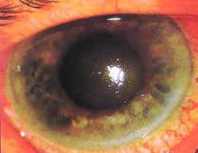
BRADFORD VTS TEACHING AIDS
EMERGENCY · RED EYE + PAIN
Acute angle-closure glaucoma
THE CASE 67-year-old, severe pain in one eye for 12 hours, blurred vision, now a throbbing headache and vomiting.
Spot it fast
Often evening onset; age 50+, long-sighted
Severe pain + haloes around lights
Cloudy ("steamy") cornea, hard eye
Nausea/vomiting can mimic an acute abdomen
Why it happens
Drainage angle blocks like a plughole — pressure rockets and the optic nerve suffers within hours.
Refer immediately — day or night
Same-day eye emergency. Refer even if pain spontaneously settles.
Red eye, hazy cornea, fixed mid-dilated oval pupil
Educational teaching aid — verify against current NICE / NICE CKS / BNF & local policy before use.
Bradford VTS · June 2026 · 15

Slide 16
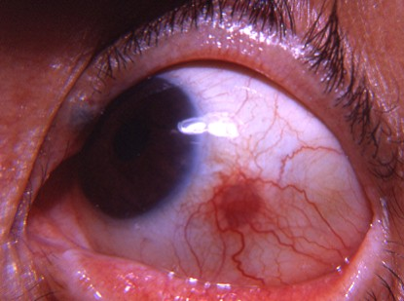
BRADFORD VTS TEACHING AIDS
RED EYE · LOCALISED
Episcleritis vs scleritis
Episcleritis — mild
Localised redness, mild or no pain
No discharge; vision normal
Usually idiopathic & self-limiting
Lubricants ± topical NSAID; reassure
Scleritis — dangerous
Severe, boring, deep ache (wakes from sleep)
Often with rheumatoid / vasculitis
Risk of scleral perforation & sight loss
Refer — needs systemic treatment
Localised sectoral redness
Quick test
Phenylephrine drops blanch episcleral vessels (episcleritis) but not the deeper scleral vessels.
Educational teaching aid — verify against current NICE / NICE CKS / BNF & local policy before use.
Bradford VTS · June 2026 · 16

Slide 17
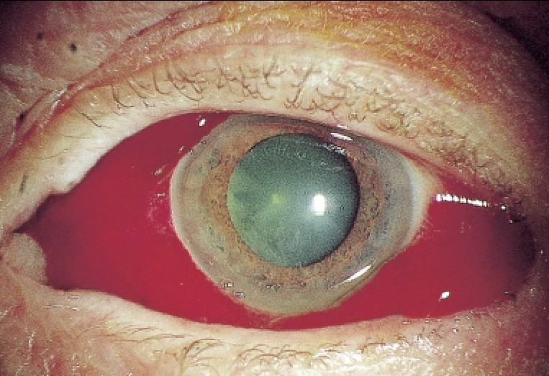
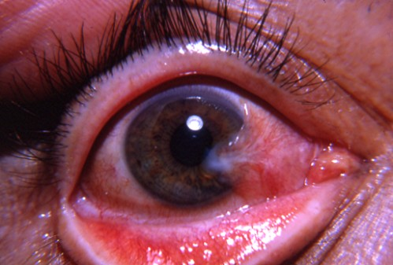
BRADFORD VTS TEACHING AIDS
RED EYE · REASSURE
Benign surface causes
Subconjunctival haemorrhage
Dramatic bright-red patch, but white sclera elsewhere, no pain, normal vision.
Reassure — resolves in 1–2 weeks. Check BP; ask about anticoagulants; if recurrent or after trauma, look further.
Pterygium
Fleshy wing of conjunctiva growing onto the cornea
Linked to sun/UV & dust exposure
Lubricants; refer if it nears the visual axis or for cosmesis
Subconjunctival haemorrhage
Pterygium
Educational teaching aid — verify against current NICE / NICE CKS / BNF & local policy before use.
Bradford VTS · June 2026 · 17

Slide 18
BRADFORD VTS TEACHING AIDS
SECTION 2
Lids, Lashes & Tears
Lumps, crusts and watery eyes are bread-and-butter GP work — with one true emergency hiding among them.

Slide 19
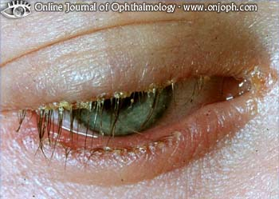
BRADFORD VTS TEACHING AIDS
CASE · SORE GRITTY EYES
Blepharitis
Common & under-diagnosed
Persistently sore, gritty, burning eyes — worse in the mornings
Red lid margins with crusts/scales at the lash bases
Often with styes, chalazia, dry eye
Linked to rosacea, eczema, seborrhoeic dermatitis
Cornerstone: lid hygiene
Warm compresses to soften oils
Gentle lid-margin cleaning, twice daily
Lubricant drops for comfort
It's a long-term condition — manage, don't “cure”
Crusty, inflamed lid margins
If not settling
Treat associated dry eye; consider a course of oral tetracycline (e.g. doxycycline) for rosacea-type disease — check BNF.
Educational teaching aid — verify against current NICE / NICE CKS / BNF & local policy before use.
Bradford VTS · June 2026 · 19

Slide 20
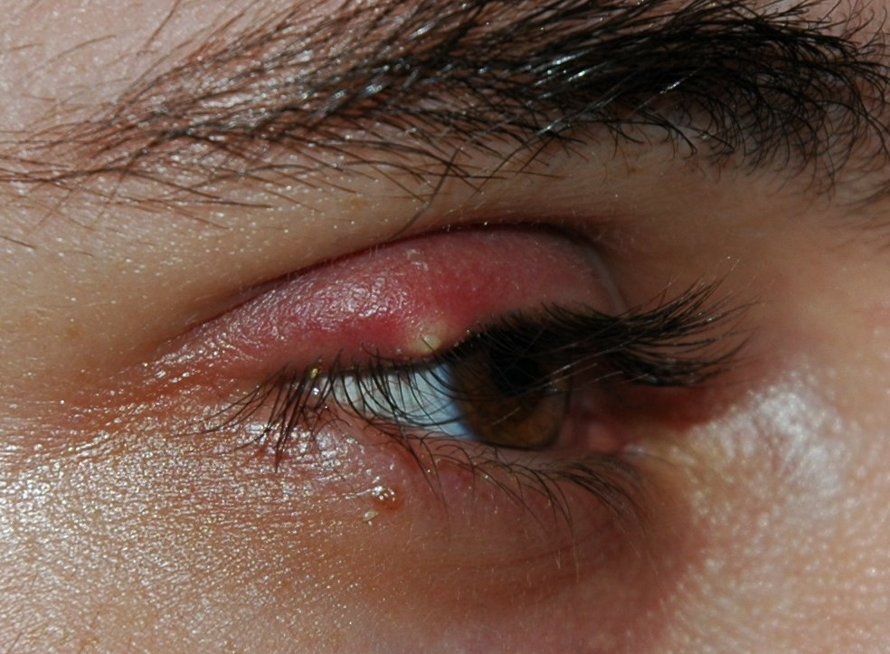
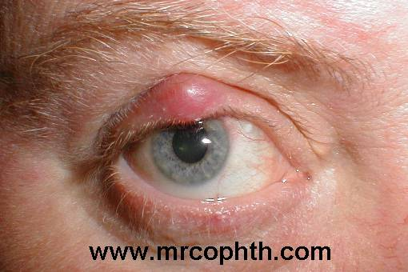
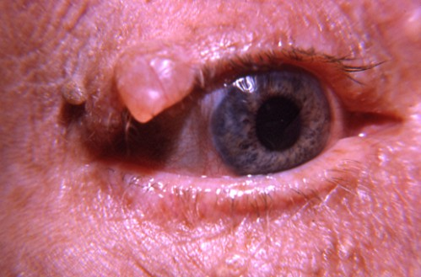
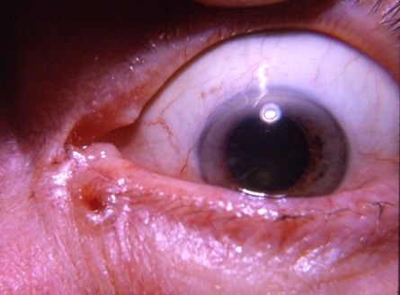
BRADFORD VTS TEACHING AIDS
LIDS · LUMPS
Lumps & bumps on the lid
Usually simple
Stye —
warm compresses; may discharge on its own.
Chalazion —
blocked meibomian gland; warm compresses; refer to incise if persistent.
Marginal cysts —
harmless; treat only if bothersome.
Don't dismiss a “lump”
Pearly, ulcerated or with lost lashes = BCC
Recurrent in the same spot = suspect malignancy
Refer for biopsy
Stye (lash-follicle abscess)
Chalazion (meibomian cyst)
Recurrent chalazia?
Look for blepharitis, rosacea or undiagnosed diabetes underneath.
Cyst of Moll / Zeiss
Basal cell carcinoma
Educational teaching aid — verify against current NICE / NICE CKS / BNF & local policy before use.
Bradford VTS · June 2026 · 20

Slide 21
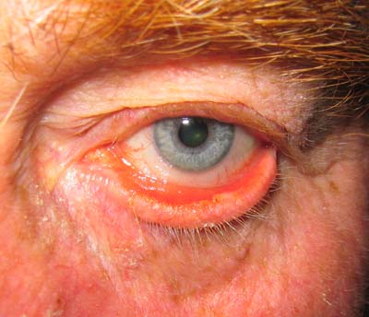
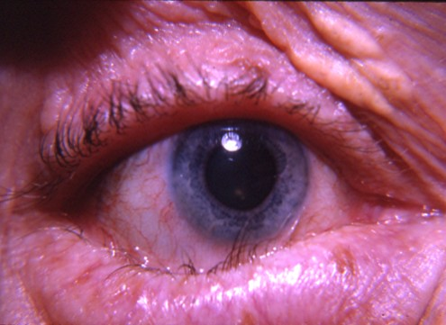
BRADFORD VTS TEACHING AIDS
TEARS
Watering & dry eyes
Watering eye (epiphora)
Ectropion —
lid falls outward (age/palsy); refer for repair.
Entropion —
lid turns in, lashes scratch cornea; refer.
Ingrowing lashes —
epilate; may need electrolysis.
Blocked tear duct —
common; consider in a watery, sticky eye.
Dry eye
Very common; gritty, burning, paradoxically watery
Worse with screens, air-con, central heating
Manage with regular lubricant drops/gels
Treat any underlying blepharitis
Ectropion (lid turned out)
Why “dry” eyes water
A dry, irritated surface triggers reflex tearing — like a dry throat making you cough. Lubricate and the watering settles.
Lid malposition → watering
Educational teaching aid — verify against current NICE / NICE CKS / BNF & local policy before use.
Bradford VTS · June 2026 · 21

Slide 22
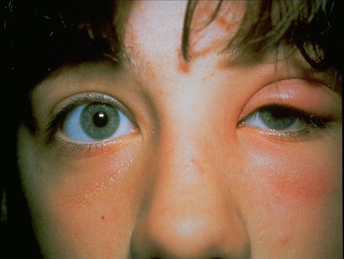
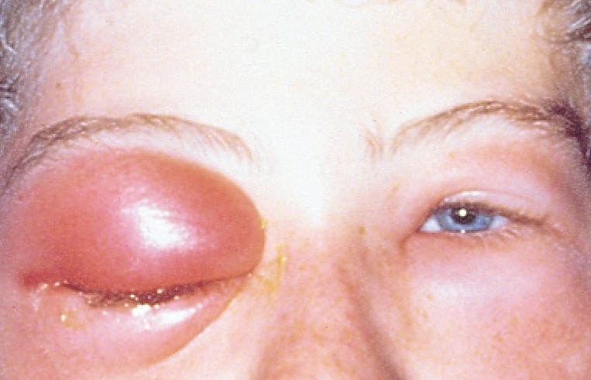
BRADFORD VTS TEACHING AIDS
EMERGENCY · LIDS
Periorbital vs orbital cellulitis
Periorbital (pre-septal)
Red, swollen lid; infection in front of the septum
Eye itself looks & moves normally
Vision normal, no proptosis, no pain on eye movement
Oral antibiotics + close review — but stay alert
Orbital — sight & life threat
Painful or restricted eye movements
Proptosis (eye pushed forward)
Reduced vision / colour vision
Unwell, febrile; usually from the sinuses
Children can lose sight in hours — ADMIT now
Periorbital (pre-septal)
Orbital — emergency
Educational teaching aid — verify against current NICE / NICE CKS / BNF & local policy before use.
Bradford VTS · June 2026 · 22

Slide 23
BRADFORD VTS TEACHING AIDS
SECTION 3
Sudden Loss of Vision
“Like a curtain coming down.” An easy list to remember — because almost every cause needs same-day specialist eyes.

Slide 24
BRADFORD VTS TEACHING AIDS
APPROACH
Sudden visual loss: the short list
First ask: painful or painless? Then act — these don't wait.
Painless — vascular & retinal
Retinal artery occlusion / amaurosis fugax
Retinal vein occlusion
Vitreous haemorrhage (often diabetic)
Retinal detachment (flashes, floaters, curtain)
Wet AMD (sudden central distortion)
Optic neuritis (pain on eye movement) / stroke
Your job in primary care
Check acuity, fields, pupils (RAPD), red reflex, fundus
Always think giant cell arteritis in the over-50s
GCA clues: scalp/temple tenderness, jaw claudication, raised ESR/CRP
Suspected GCA → high-dose steroids + same-day referral
Everyone else → same-day eye casualty / acute referral
Educational teaching aid — verify against current NICE / NICE CKS / BNF & local policy before use.
Bradford VTS · June 2026 · 24

Slide 25
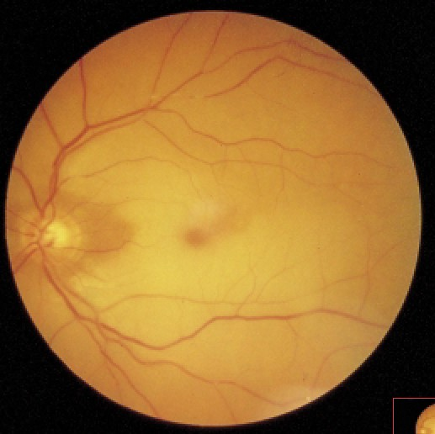
BRADFORD VTS TEACHING AIDS
CASE · PAINLESS LOSS
Retinal artery occlusion & GCA
THE CASE 69-year-old with atrial fibrillation suddenly loses vision in one eye. The fundus is pale.
The pattern
Sudden, painless, profound loss in one eye
“Curtain down”; a relative afferent pupil defect
Emboli from carotid or heart (AF) — it's the eye's stroke
Amaurosis fugax = a fleeting version = a retinal TIA = a warning
Same-day emergency
Refer immediately. Treat amaurosis fugax on the TIA pathway.
Always exclude GCA (>50)
ESR/CRP, temporal symptoms. Suspected GCA = high-dose steroids without delay to save the other eye.
Pale retina — artery occlusion
Educational teaching aid — verify against current NICE / NICE CKS / BNF & local policy before use.
Bradford VTS · June 2026 · 25

Slide 26
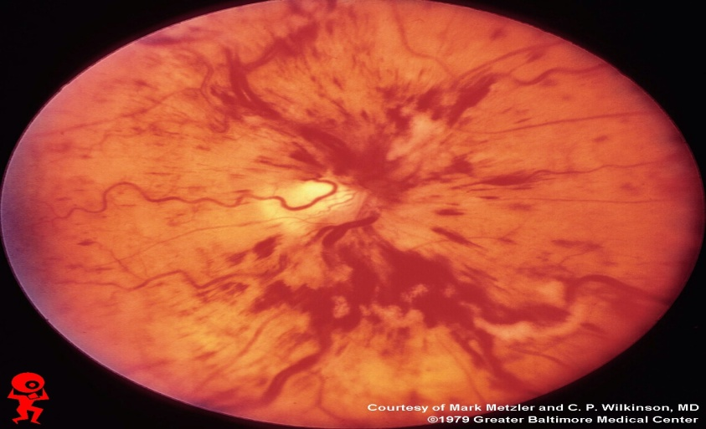
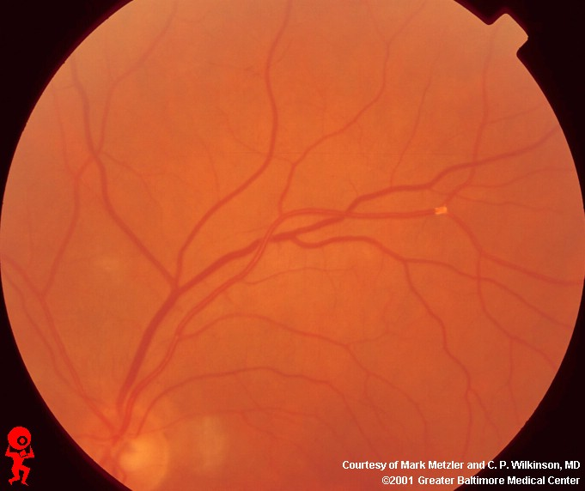
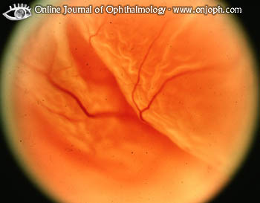
BRADFORD VTS TEACHING AIDS
PAINLESS LOSS · THE REST
Vein occlusion, bleed & detachment
How they differ
Vein occlusion —
“blood & thunder” retina; older, hypertensive, diabetic.
Detachment —
flashes, a shower of floaters, then a curtain; myopes at risk.
Vitreous haemorrhage —
sudden floaters/haze; red reflex lost; often diabetic.
All → same-day referral.
Retinal VEIN occlusion
Retinal detachment
Vitreous haemorrhage
Educational teaching aid — verify against current NICE / NICE CKS / BNF & local policy before use.
Bradford VTS · June 2026 · 26

Slide 27
BRADFORD VTS TEACHING AIDS
SECTION 4
Gradual Loss of Vision
Painless, creeping change in the “quiet eye.” Optometrists are your allies — but know which need urgent specialist care.

Slide 28
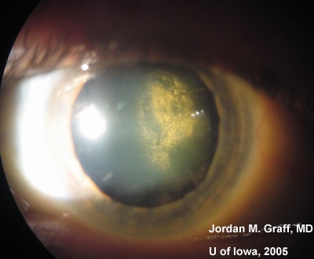

BRADFORD VTS TEACHING AIDS
GRADUAL LOSS
Cataract
Recognise it
Painless, gradual cloudy/misty vision
Glare & haloes, especially night driving
Faded colours; frequent glasses changes
Red reflex looks dull or shows a dark shadow
Manage in the community
Refer via optometry when vision limits daily life
Routine cataract surgery is day-case & very effective
In a child = urgent
A white pupil / absent red reflex in a baby may be congenital cataract or retinoblastoma — refer urgently.
Lens opacity
Educational teaching aid — verify against current NICE / NICE CKS / BNF & local policy before use.
Bradford VTS · June 2026 · 28

Slide 29
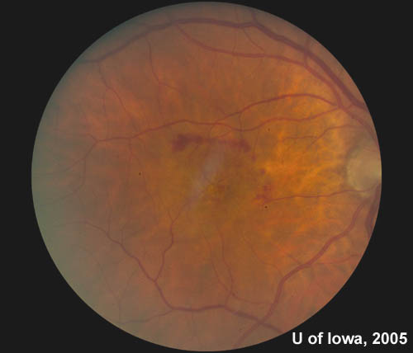
BRADFORD VTS TEACHING AIDS
GRADUAL LOSS · MACULA
Age-related macular degeneration
Dry vs Wet
Dry (most) —
slow central blurring over years; no cure, support low vision.
Wet —
new abnormal vessels leak; rapid central distortion & a dark central spot, often over days.
Hallmark symptom:
straight lines look bent or broken.
Wet AMD is now treatable — fast
Urgent referral to a macula service within 1 working day
Anti-VEGF eye injections, ideally within 14 days
Source: NICE NG82
AMD at the macula
Why speed matters
Anti-VEGF can halt the leak and save central vision — but only before scarring sets in. Days count.
Amsler grid:
ask about wavy lines or a missing patch when looking at a grid — a simple home test for distortion.
Educational teaching aid — verify against current NICE / NICE CKS / BNF & local policy before use.
Bradford VTS · June 2026 · 29

Slide 30
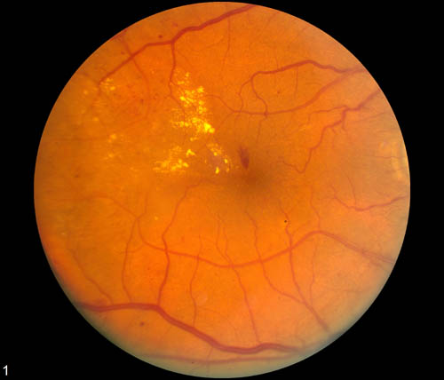
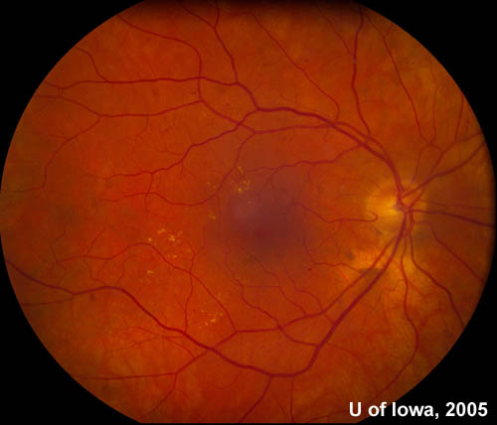
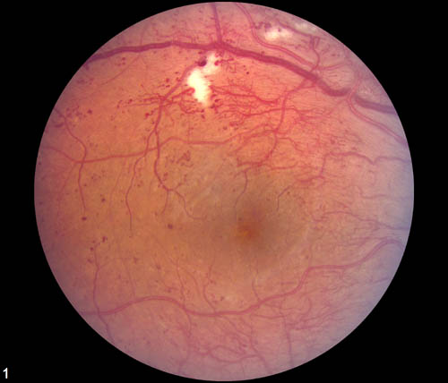
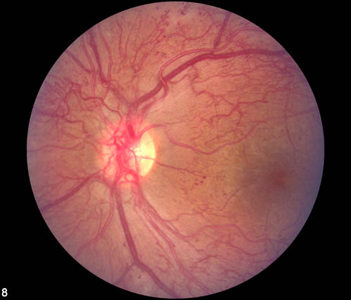
BRADFORD VTS TEACHING AIDS
GRADUAL LOSS · SYSTEMIC
Diabetic retinopathy
The progression
Microaneurysms & dot-blot haemorrhages (background)
Cotton-wool spots, venous changes (pre-proliferative)
New vessels = proliferative — risk of bleed & detachment
Maculopathy threatens central vision at any stage
Screening saves sight
Everyone with diabetes ≥ 12 yrs is invited to annual NHS diabetic eye screening
It catches disease before symptoms
Background
Pre-proliferative
Control + refer
Optimise glucose, BP & lipids. Refer proliferative or maculopathy for laser / anti-VEGF.
Proliferative
Advanced / maculopathy
Educational teaching aid — verify against current NICE / NICE CKS / BNF & local policy before use.
Bradford VTS · June 2026 · 30

Slide 31
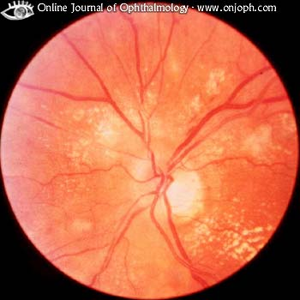
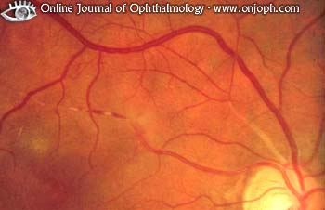
BRADFORD VTS TEACHING AIDS
GRADUAL LOSS · SYSTEMIC
Hypertensive eye & chronic glaucoma
Hypertensive retinopathy
Narrowed arterioles, AV nipping
Flame haemorrhages & cotton-wool spots
Swollen optic disc + severe BP = malignant hypertension — same-day medical emergency
A window onto whole-body vascular health
Chronic open-angle glaucoma
Silent: peripheral vision lost first, painlessly
Often found at routine optometry (pressure, disc, fields)
Risk: age, family history, Afro-Caribbean ethnicity
Lifelong drops to lower pressure; early detection prevents blindness
Mild hypertensive changes
Severe / accelerated
Educational teaching aid — verify against current NICE / NICE CKS / BNF & local policy before use.
Bradford VTS · June 2026 · 31

Slide 32
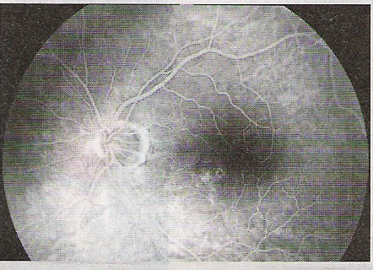
BRADFORD VTS TEACHING AIDS
A TEACHING TALE
“Is the ophthalmoscope faulty?”
A GP saw three patients in a week, each with a blurred patch at the centre of the left macula on fundoscopy. He wondered if his ophthalmoscope was broken — until he examined his own eyes and found the same. The diagnosis: central serous chorioretinopathy, which resolved over four months.
The condition
Fluid collects under the central retina, blurring and distorting vision. Often in younger, stressed adults; usually self-limiting.
Central serous chorioretinopathy
The lesson
Trust your examination — and remember the doctor can be the patient.
Educational teaching aid — verify against current NICE / NICE CKS / BNF & local policy before use.
Bradford VTS · June 2026 · 33

Slide 33

BRADFORD VTS TEACHING AIDS
SECTION 5
Special Situations
Driving, injuries and children — areas where the right action (and the right paperwork) really matters.

Slide 34

BRADFORD VTS TEACHING AIDS
THE LAW
Vision & driving (DVLA)
Cars & motorcycles (Group 1)
Read a number plate at 20 m (in good light)
Visual acuity at least 6/12 (both eyes open)
Horizontal visual field ≥ 120°
Wear glasses/lenses every drive if needed to meet it
Recording acuity
Write as 6 / denominator (test distance / smallest line read)
“6/9” = reads the 9 line at 6 m
Smaller bottom number = sharper vision
Use a pinhole to check for refractive error
Duty to inform
If a patient cannot meet the standard, they MUST tell the DVLA and must not drive. Advise clearly and document.
Lorries & buses (Group 2)
Stricter: ≥ 6/7.5 better eye and ≥ 6/60 worse eye
New monocular drivers cannot hold a Group 2 licence
Snellen chart
Educational teaching aid — verify against current NICE / NICE CKS / BNF & local policy before use.
Bradford VTS · June 2026 · 34

Slide 35
BRADFORD VTS TEACHING AIDS
EMERGENCY
Trauma & chemical injury
Chemical splash = irrigate FIRST, ask questions later
Irrigate copiously with saline/water for at least 20–30 minutes (evert the lids) BEFORE anything else, then refer urgently. Alkali burns are worse than acid.
Refer urgently if…
High-velocity injury (grinding, hammering) — ? intraocular foreign body
Any suspected penetrating injury — do NOT press on the eye
Reduced vision, irregular pupil, or blood in the anterior chamber (hyphaema)
Large or deep corneal abrasion / persistent foreign-body sensation
Manage in GP
Small, clean corneal abrasion after staining
Easily removed superficial foreign body
Give antibiotic ointment; review if not healing in 48 hours
Golden rule: when in doubt, stain and refer.
Educational teaching aid — verify against current NICE / NICE CKS / BNF & local policy before use.
Bradford VTS · June 2026 · 35

Slide 36
BRADFORD VTS TEACHING AIDS
PAEDIATRIC
Children: squint & the white reflex
Squint (strabismus)
Refer all new or constant squints — don't “wait and see”
Untreated squint risks permanent amblyopia (lazy eye)
The orthoptist is your key ally; a cover test confirms it
White pupil / absent red reflex
A white reflex (leukocoria) is NEVER normal
Causes include congenital cataract and retinoblastoma
Refer urgently — same day
Use the red reflex
Check it in every baby — like a camera red-eye photo, both eyes should glow equally. Any difference, white or dark patch = refer.
Childhood eye basics
Watch development of vision & alignment
Persistent watery/sticky eye — usually a blocked tear duct, often self-resolves
Educational teaching aid — verify against current NICE / NICE CKS / BNF & local policy before use.
Bradford VTS · June 2026 · 36

Slide 37
BRADFORD VTS TEACHING AIDS
TAKE IT HOME
Six things to remember
History first. The story usually makes the diagnosis before you touch the eye.
Always stain a red eye. Fluorescein reveals abrasions and dendritic ulcers.
1
2
Pain + reduced vision = refer. That combination is your red flag.
Never put steroids on an undiagnosed red eye. Dendritic ulcers turn dangerous.
3
4
Sudden visual loss is same-day. And always think GCA in the over-50s.
Work with optometrists. They prevent unnecessary referrals and catch silent disease.
5
6
Educational teaching aid — verify against current NICE / NICE CKS / BNF & local policy before use.
Bradford VTS · June 2026 · 37

Slide 38
BRADFORD VTS TEACHING AIDS
Don't turn
a blind eye.
A working knowledge of the eye and a few basic skills are enough to protect your patients' sight. You don't need to treat everything — just recognise what matters and act.

Slide 39

BRADFORD VTS TEACHING AIDS
SOURCES
Key sources & further reading
NICE CKS — Conjunctivitis (infective & allergic); Dry eye; Blepharitis; Red eye
NICE NG82 — Age-related macular degeneration (urgent wet-AMD referral; anti-VEGF)
NICE CKS — Shingles / herpes zoster ophthalmicus (oral aciclovir; Hutchinson's sign)
NICE CKS — Glaucoma; Corneal ulcer & keratitis; Acute angle-closure glaucoma
BNF — chloramphenicol, aciclovir & ocular preparations (doses & cautions)
DVLA — Assessing fitness to drive: visual disorders (Group 1 & Group 2 standards)
NHS Diabetic Eye Screening Programme — annual screening from age 12
College of Optometrists — Clinical Management Guidelines
Always confirm doses and current recommendations against the live BNF and NICE before prescribing or acting.
Educational teaching aid — verify against current NICE / NICE CKS / BNF & local policy before use.
Bradford VTS · June 2026 · 39

Slide 40
BRADFORD VTS TEACHING AIDS
Disclaimer
This presentation is provided exclusively for educational and training purposes as a teaching aid. It does not constitute formal clinical guidance. Clinicians must independently verify all medical information, prescribing guidance, procedural protocols, and legal requirements against current national guidance (NICE, NICE CKS, BNF), their relevant regulatory bodies, and local policies before applying any of it in practice.
Bradford VTS Teaching Aids · June 2026

