Slide 1


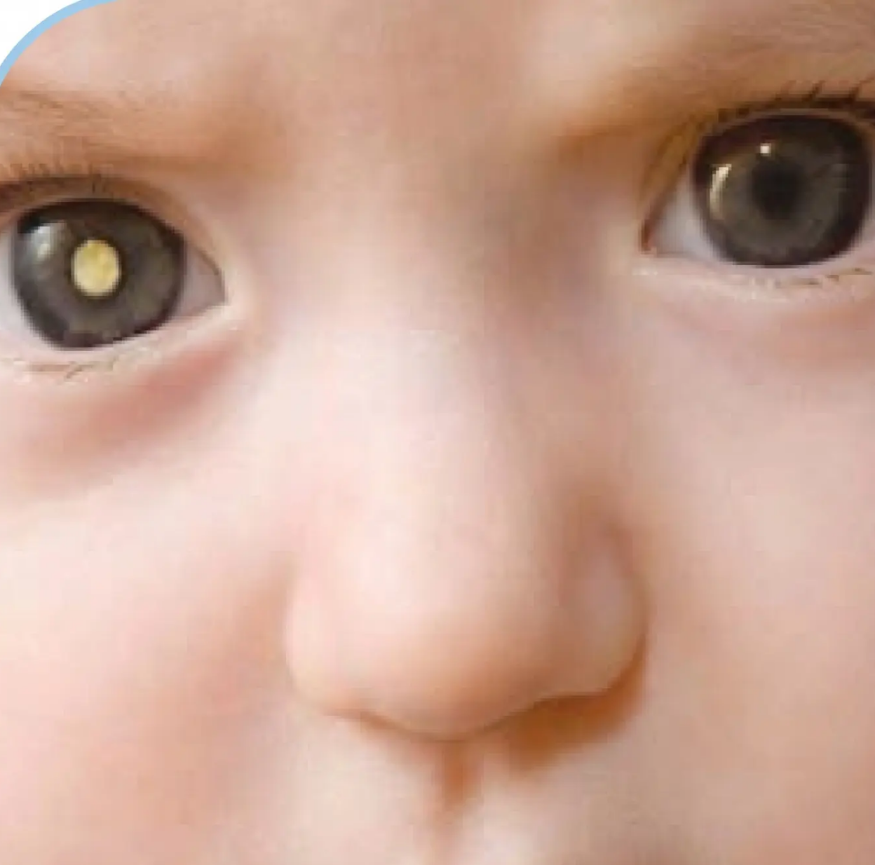



Bradford VTS Teaching Deck
Retinoblastoma
and the Red Reflex
in Primary Care
A teaching deck for GP trainees
Updated to NICE NG285 2023 standards
www.bradfordvts.co.uk
May 2026

Slide 2












Understanding Retinoblastoma
& Epidemiology
“The most common intraocular malignancy in children”
1 — Incidence
2 — Annual Cases
3 — Survival
4 — Age
1 in 20,000
40–50
98%
<5 yrs
live births
new cases/yr
survival rate
age of onset
UK incidence
United Kingdom
with timely diagnosis (UK)
retina matures ~5 years
What is Retinoblastoma?
Heritable Form
45% of cases
Malignant tumour of the retina — the most
common intraocular cancer in children
Autosomal dominant — mutation in the RB1 gene
(both alleles must be inactivated)
Accounts for 3% of all childhood cancers
Child inheriting altered RB1 gene: ~90% chance
of developing Rb
Unilateral in 60% of cases; bilateral in 40%
No gender or racial predisposition
Genetic counselling recommended for survivors
planning families
Life-threatening if untreated or diagnosed late —
but highly curable when caught early
Heritable Rb carries increased risk of second primary
cancers (sarcomas, 5–25 years post-treatment)
Bradford VTS · Retinoblastoma & the Red Reflex in Primary Care
2 / 10

Slide 3
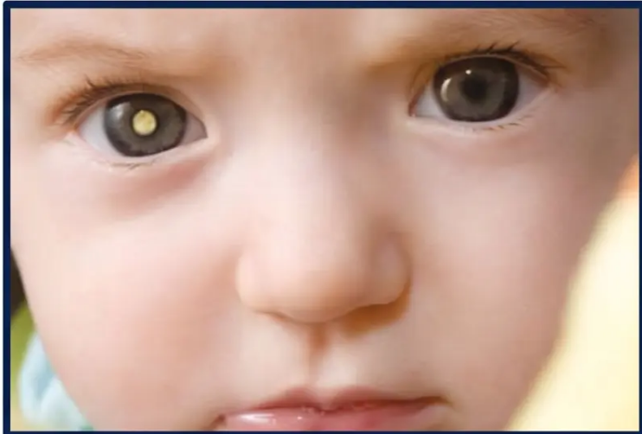
















Clinical Presenting Features
The child often appears systemically well — signs are limited to the eye
PRIMARY SIGN
PRIMARY SIGN
Leukocoria
Strabismus (Squint)
White pupillary reflex — ‘cat’s eye’
appearance
Any new squint in a baby or child
Red reflex test mandatory — Rb
Often noticed first in dim light
or flash photographs
must be excluded
Leukocoria — note asymmetric pupillary reflex
Card 1
Card 2
Card 3
Card 4
Iris Colour Change
Ocular Inflammation
Vision Deterioration
Nystagmus
Change in one iris or part of iris
Redness, swelling, or pressure
around eye — no infection found
Reduced vision in one or both
eyes, or poor vision from birth
Wandering or unsteady eye
movements
Any ONE of these signs warrants a red reflex test — parental concern alone is sufficient reason to examine
*Bradford VTS · www.bradfordvts.co.uk
May 2026

Slide 4


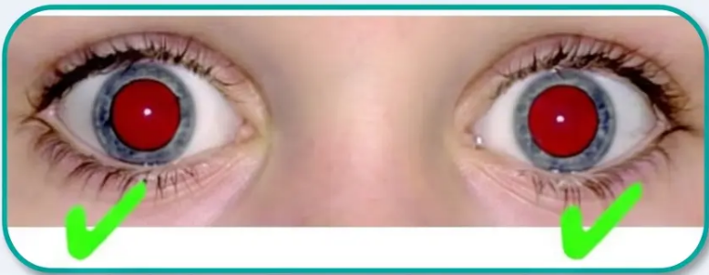







Page 4 of 10
‘Red Reflex Test Technique’
① Dim the room
Reduces ambient light — enhances pupillary reflex visibility
② Sit at arm’s length, face the child and parent
Ophthalmoscope at zero focus, halogen light preferred
Symmetric red reflex — normal
Bruckner finding
③ Examine the parent first
Calibrates normal reflex for that ethnic group — and reassures the child
Equal colour, equal brightness, equal size
④ Examine the child — both eyes simultaneously (Bruckner method)
Look for equal, symmetric orange-red reflex in both pupils
Why examine the parent?
Red reflex colour varies by
ethnicity — orange-red in fair skin,
paler or yellower in darker skin.
Examining the parent first sets your
baseline for that child.
⑤ Check corneal light reflex position
Should be identical in both eyes — asymmetry suggests squint
⑥ If unclear — dilate with tropicamide and recheck
If still abnormal after dilation → refer urgently
Bradford VTS · Retinoblastoma & Red Reflex in Primary Care
www.bradfordvts.co.uk · May 2026

Slide 5


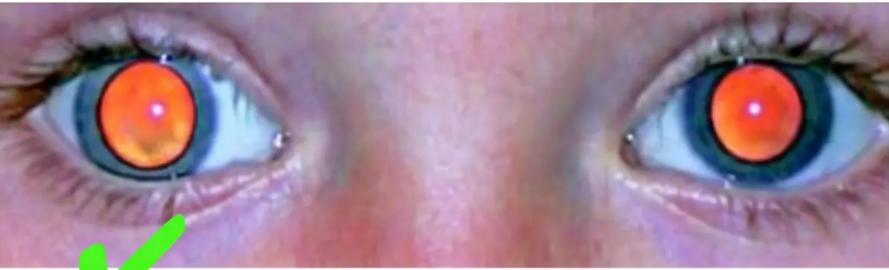
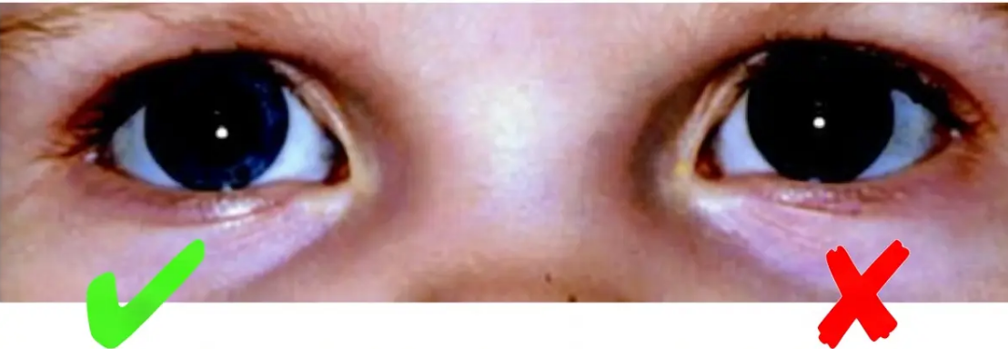


Normal versus Abnormal Findings
What to look for — and what demands urgent action
✓ NORMAL
✕ ABNORMAL — REFER URGENTLY
• Absent red reflex (one or both eyes)
• Equal, symmetric red/orange reflex in both eyes
• White pupillary reflex — leukocoria
• Corneal light reflex at identical positions
• Asymmetric reflex (different colour, size, brightness)
• Abnormal reflex with squint
If in doubt — refer urgently. The cost of a missed Rb is loss of sight or life.

Slide 6




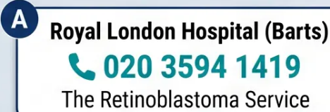
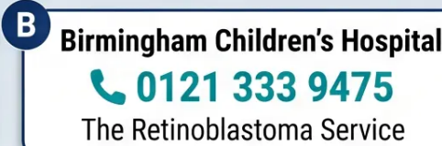


NICE Referral Criteria and Pathways
NICE NG12 & NG285 — Urgent Suspected Cancer Referral
⚠ Urgent 2-Week Referral — Refer if ANY of the following:
How to Refer
➊ Use the urgent 2-week wait (2WW) suspected
cancer referral pathway
via local referral system or e-referral
● White pupillary reflex (leukocoria)
● Absent red reflex — one or both eyes
➋ Phone the ophthalmology department directly
Do not wait — alert them to the urgency.
CHECT recommends direct contact.
● Asymmetric or abnormal red reflex
● Abnormal red reflex with squint
➌ If in doubt, refer. Don't delay.
*The cost of a missed Rb is loss of sight or life.*
● New squint where Rb is suspected
National Rb Specialist Centres
● Family history of Rb + visual problems
*A child may appear completely well — Rb is an intraocular cancer*
NICE NG12 (2015, updated 2023) · NICE NG285 (2023)
www.bradfordvts.co.uk

Slide 7













Early Diagnosis & Treatment Overview
Why timing changes everything — and what happens next
98%
70%
Survival rate in the UK
Need eye removal (enucleation)
When diagnosed and treated early, the vast
majority of children survive — with potential
for eye and vision preservation.
In unilateral Rb diagnosed late. Early referral is
the single most important action a GP can take.
TREATMENT PATHWAY — COORDINATED BY SPECIALIST RB CENTRES
Systemic
Intra-Arterial
Focal
Enucleation
Radiotherapy
Chemo
Chemo
Therapies
VCE regimen
Melphalan direct to
ophthalmic artery —
eye salvage focus
Laser, cryotherapy,
thermotherapy,
brachytherapy
When eye cannot be
salvaged — life-saving
Now largely replaced —
risk of second cancers in
hereditary Rb
(vincristine, carboplatin,
etoposide)
Source: CHECT / NICE NG285 2023
Bradford VTS — www.bradfordvts.co.uk

Slide 8








Long-term Follow-up and Late Effects
GP-led monitoring for Rb survivors — know what to watch for
Systemic Chemo (VCE)
Intra-arterial Chemo (IAC)
Radiotherapy
- Hearing loss (carboplatin
ototoxicity)
- Periocular oedema
- Cataracts
- Skin flushing (foreground/eyelid)
- Dry eye
- Kidney impairment
- Facial asymmetry (if treated in
early childhood)
- Ptosis
- Risk of second malignancies
- Minor blood count drops
- Monitor: audiology, renal
function
- Generally milder systemic
effects
- Retinal detachment
- ⚠️ Highest risk of second
malignancies
Second Primary Malignancies — Hereditary Rb
Significantly increased risk of sarcomas 5–25 years post-treatment; other cancers into adult life. Risk is highest
after radiotherapy.
Be alert to: unexplained or persistent pain, new lumps, changing moles. Rb survivors should be followed in
adult oncology.
● Artificial eyes: refer via GP to NHS National Artificial Eye Service (NAES) or oculoplastic surgeon
www.bradfordvts.co.uk
| May 2026

Slide 9








09 / 10
Exam Pearls
AKT & SCA — High-Yield Revision
Knowledge & recall questions
Consultation skills & communication
■ Most common intraocular malignancy in children
EXPLAINING THE TEST
→ Retinoblastoma
“I’m going to use a special light to look at the back of
your baby’s eye — it doesn’t hurt at all and only takes
a moment.”
■ Inheritance: Autosomal dominant — RB1 gene,
45% heritable, ~90% penetrance
URGENT REFERRAL LANGUAGE
■ UK incidence: 40–50 cases/year; 98% survival rate
“I want to refer your child to the eye specialists today
as an urgent appointment — I want to make absolutely
sure this is nothing serious.”
■ Mandatory screening: Postnatal exam + 6-week
developmental check
SAFETY-NETTING
■ Urgent referral trigger: Absent or asymmetric red
reflex → 2-week wait (NICE NG12/NG285)
“Please come back, or go to A&E, if your child seems
unwell or if the eye changes at all before you see the
specialist.”
Two signs: Leukocoria + Squint
“Key rule: A child who looks completely well can still have retinoblastoma — the disease is entirely within the eye.”

Slide 10





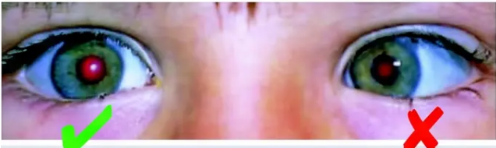
Top Tips & Common Pitfalls
10 / 10
Practical take-home messages for primary care
✓ Top Tips
✘ Common Pitfalls
● Red reflex on every squint — Any new squint in a baby or child
must have a red reflex test to exclude Rb before assuming it is benign.
● Skipping the red reflex when parents worry — Parental concern
about eye appearance is always an indication to test — never dismiss it.
● White reflex = urgent referral — Leukocoria means a 2-week
wait referral immediately, regardless of how well the child appears.
● “Squints are common” — not excluding Rb — Strabismus is
common, but Rb must be excluded before this reassurance is given.
● Check both eyes together — Use the Bruckner method;
asymmetry is easier to spot when comparing both eyes simultaneously.
● Missing leukocoria on photographs — Parents may show you a
photo with a white pupil reflex; treat this as a clinical finding.
● Examine the parent first — Calibrates the normal red reflex
colour for that ethnic group and reassures the child.
● Assuming illness is required — Children with Rb appear
systemically well — do not be falsely reassured by a well-looking child.
● The child looks well — that’s normal — Rb is an intraocular
cancer; children are systemically well until late disease.
● Relaxing because the 2WW seems manageable — Flag Rb
referrals as urgent, track them, and consider phoning the
ophthalmology department directly.
● If in doubt, refer — The cost of a missed Rb is loss of sight or life.
● Not counselling Rb survivors — Long-term cancer surveillance is
essential; ensure this is documented in discharge summaries and
GP records.
Children with Rb often appear completely
well — the eye is the only clue.
Bradford VTS · www.bradfordvts.co.uk
NICE NG285 2023 · May 2026
Check both eyes — asymmetry matters
Source: CHECT, NICE NG12/NG285

