Slide 1



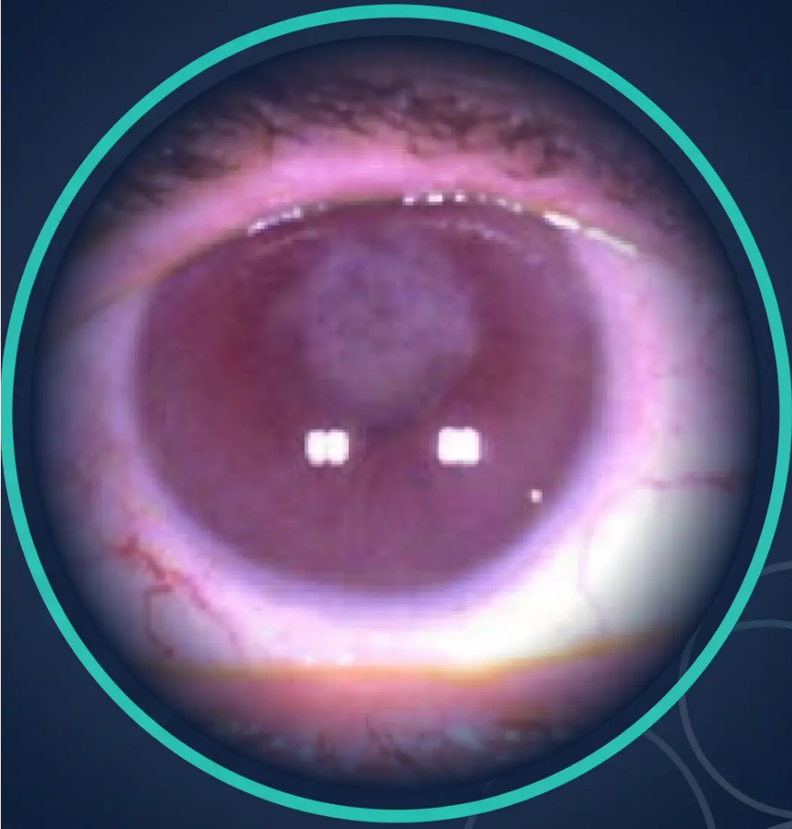

BRADFORD VTS
www.bradfordvts.co.uk
Sudden Loss of Vision
& Ophthalmic Emergencies
Bradford VTS Teaching Deck
Comprehensive guide for GP trainees covering
sudden visual loss causes, referral urgency, and
management — updated to NICE CKS 2024/2025 and
RCEM 2025 standards.
May 2026
OPHTHALMIC EMERGENCY
RCGP SCA & AKT Revision | Bradford VTS
Retinal · Vascular · Neurological

Slide 2


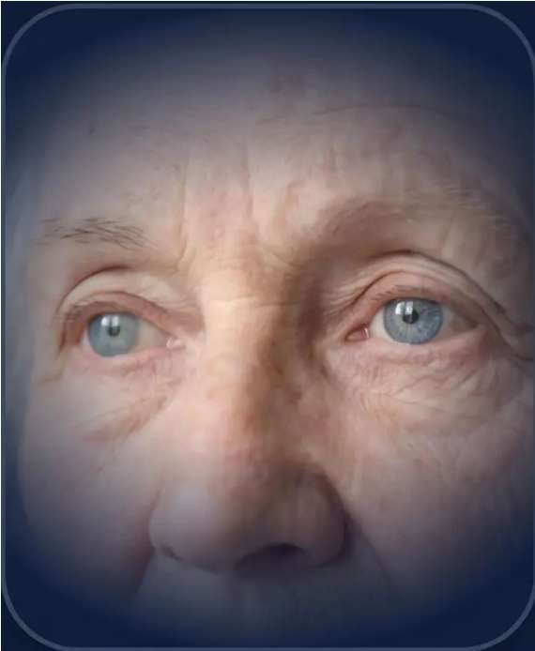





CLINICAL ASSESSMENT
Initial Assessment & Clinical Overview
The right questions asked in the right order can save a patient’s sight.
How did it start — and is it painful?
— Sudden + painless → vascular (CRAO, CRVO, retinal detachment, wet AMD)
— Sudden + painful → angle closure glaucoma, scleritis, uveitis
— Gradual over days → optic neuritis, AION
Unilateral or bilateral? What field is affected?
— Monocular → retinal or optic nerve pathology (CRAO, optic neuritis, RD)
— Binocular homonymous → cortical/tract lesion (stroke)
— Altitudinal defect → BRAO, NAION, retinal detachment
— Central scotoma → wet AMD, optic neuritis
Any associated systemic symptoms?
— Headache + jaw claudication + scalp tenderness → GCA (emergency)
— Flashes + floaters → PVD, retinal tear, detachment
— Pulsatile tinnitus + morning headache → raised ICP / papilloedema
*Systematic examination begins
with the right questions
— Cardiovascular risk factors → vascular occlusion, TIA pathway
⚠ Rule: Any new sudden visual loss = same-day ophthalmology discussion as minimum
*Never send home without specialist discussion — RCEM 2025

Slide 3



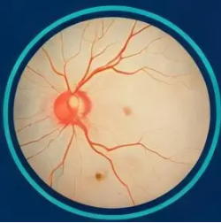
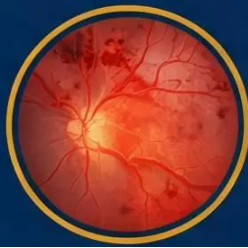


PAINLESS SUDDEN VISION LOSS
Retinal Vascular Occlusions
CRAO • CRVO
CRAO
CRVO
Central Retinal Artery Occlusion
Central Retinal Vein Occlusion
Ocular stroke equivalent
Blood and thunder fundus
*Cherry-red spot at fovea*
*Flame haemorrhages — all 4 quadrants*
• Onset : Seconds — profound monocular vision loss
(CF or NLP)
• Onset: Subacute — variable vision reduction
• Pupil: RAPD present
• Pupil: RAPD if ischaemic CRVO
• Cause: Embolism (AF, carotid stenosis), GCA if >50
if >50e
• Associations: Hypertension (commonest), glaucoma;
<45 -> thrombophilia screen
Emergency Action
Urgent Action
— Same-day ophthalmology (treat as stroke)
— Urgent ophthalmology referral
— GUII RAPD mandatory
— Intravitreal anti-VEGF for macular oedema
— Pan-retinal laser if ischaemic CRVO
• Cause: Embolism (AF, carotid stenosis, CRP, FBC
— Optimise BP and cardiovascular risk factors
— IV methyl prednisolone 1g/day > 3 if GCA suspected
— <45 yrs: thrombophilia screen, OCP review
— TIA clinic: ECC, carotid Dopplers, echo + aspirin
Both conditions require RAPD assessment and same-day/urgent ophthalmology referral — never send home
without specialist discussion

Slide 4

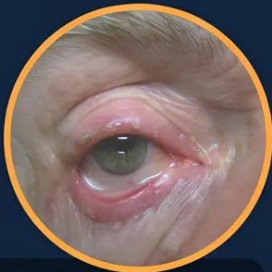










EMERGENCY MANAGEMENT
Giant Cell Arteritis (GCA)
Sight-threatening emergency — act before the biopsy
RECOGNISE GCA
New Temporal Headache
Visual Disturbance
Jaw Claudication
Scalp Tenderness
— Patient >50
Often unilateral
Highly specific
Amaurosis fugax = WARNING
Non-pulsatile temporal artery
ESR typically >50 mm/hr (often >80) · CRP elevated · FBC: normocytic anaemia, raised platelets · Temporal artery ultrasound: halo sign
MANAGEMENT PATHWAY
⚠ VISUAL SYMPTOMS
NO VISUAL SYMPTOMS
Vision loss · Diplopia · Amaurosis fugax
Headache · Scalp tenderness · Jaw claudication only
IV Methylprednisolone
Oral Prednisolone
Step 01
Step 01
500 mg – 1 g IV daily × 3 days
40 – 60 mg daily, start immediately
Same-day Ophthalmology
Same-day Discussion
Step 02
Step 02
Emergency referral — do not delay
Urgent ophthalmology discussion + fast-track GCA clinic
GCA Investigations
GCA Investigations
Step 03
Step 03
ESR · CRP · FBC · Temporal artery USS
ESR · CRP · FBC · Temporal artery USS
Rheumatology Referral
Bone Protection
Step 04
Step 04
Immediate specialist input
Bisphosphonate + calcium/vitamin D · Aspirin 75 mg
Temporal artery biopsy: positive in 50–80% —
negative result does NOT exclude GCA
DO NOT WAIT FOR BIOPSY — Vision loss can be irreversible within hours
AKT PEARL: Jaw claudication + temporal headache in >50 = GCA until proven otherwise · Normal ESR does NOT exclude GCA

Slide 5












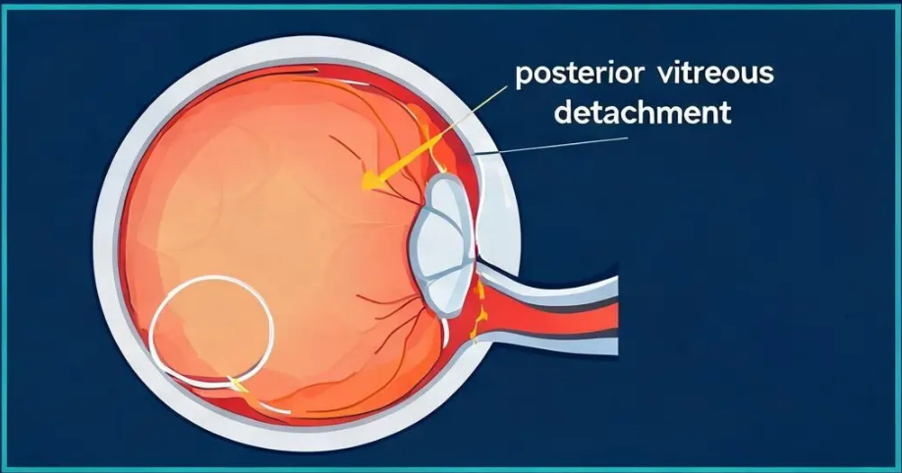


RETINAL CONDITIONS
Retinal Detachment & Vitreous Haemorrhage
STAGE 1
STAGE 2
STAGE 3
Posterior Vitreous
Detachment (PVD)
Retinal Tear
Retinal Detachment
• Flashes and floaters persist
• Curtain / shadow descending across field
• Flashing lights (photopsia)
• May develop scotoma
• Painless, progressive vision loss
• New floaters — especially "Weiss ring"
• Possible vitreous haemorrhage
• Macula-on vs macula-off is critical
• No visual field loss
Refer within 24 hours
Same day — within hours
Emergency — hours if macula threatened
VITREOUS HAEMORRHAGE
• Sudden shower of floaters; dense → profound vision loss
• Causes: retinal tear, diabetic retinopathy, trauma
• Urgent referral: fundus needs to exclude RD
CLINICAL PEARLS
• Macula-on RD = surgical emergency within hours — better prognosis
• Advise patient: avoid heavy lifting or straining until seen
• Asymmetric red reflex on fundoscopy = important sign
*Posterior vitreous detachment — vitreous separates from retina*

Slide 6



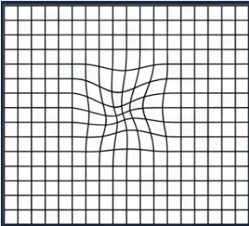







PAINLESS VISION LOSS
Wet AMD & Optic Neuritis
WET AMD
Age >60 · Subretinal Neovascularisation
OPTIC NEURITIS Age 20–45 · Demyelinating · Female predominance
Metamorphopsia — wavy, distorted lines
Red colour desaturation — early sign
*Ask patient to look at a door frame or window grid
Normal eye
Affected eye
• Retroorbital pain on eye movement — characteristic (present in ~90%)
• Metamorphopsia — straight lines appear wavy or bent
• Unilateral vision loss developing over hours to days
• Central scotoma — blurring or missing patch at centre of vision
• RAPD present — check with swinging flashlight test
• Rapid central vision deterioration over days to weeks
• Uhthoff's phenomenon — vision worsens with heat or exercise
• Fundoscopy: subretinal haemorrhage, grey-green membrane,
pigmentary changes at macula
⚠ ~50% risk of MS within 15 years after first episode
*MRI brain with contrast essential — white matter lesion risk stratification
Referral: Within 1–2 weeks (same day if severe)
Referral: Urgent same week — ophthalmology + neurology
Treatment: Intravitreal anti-VEGF injections (ranibizumab, aflibercept)
Lifestyle: Smoking cessation · AREDS vitamins (dry AMD) · Amsler grid
home monitoring
Treatment: IV methylprednisolone (hastens recovery; does not change
long-term outcome)
Investigation: MRI brain with contrast · Colour vision testing · Visual fields
💡 Clinical Pearl: ‘RAPD + reduced colour vision + retroorbital pain on movement in a young patient = optic neuritis until proven otherwise.
In an older patient with the same RAPD but no pain = consider AION or GCA.’

Slide 7









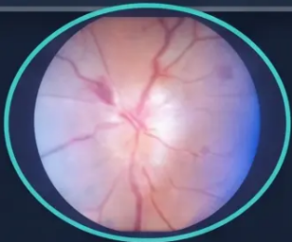

OPTIC NERVE & VASCULAR
AION, Amaurosis Fugax & Papilloedema
AION
Amaurosis Fugax
Papilloedema
Anterior Ischaemic Optic Neuropathy
Bilateral Disc Swelling — Raised ICP
Transient Monocular Visual Loss
NAION
Curtain coming down across one eye — then
lifting. Lasts seconds to minutes. Fully recovers.
Causes
• Sudden painless vision loss
• Brain tumour
• IIH
AAION
• ICH
• Brain pediosction
• Curtain painless vision loss (exclusion)
• Sudden painless vision loss
• Altitudinal field defect
• Swollen optic disc on fundoscopy
Presentation
• RAPD present | Swollen optic present
• Symptoms, amptom, regularly
• RAPD present | Swollen optic disc scopy
Shared features box
• Symptoms cause
sudden painless vision loss
= TIA of the Eye
• Bilateral disc swelling = raised ICP
altitudinal field defect
Stroke risk — act urgently
RAPD present | Swollen optic disc on fundoscopy
Management
ALL AION: GCA screen mandatory (ESR · CRP · FBC)
• Repairs ophthalmory control
Management
• If vision recur: neuro painless vision loss
RAPD present | swollen optic disc
• Papillo disc swelling
• Actions and enhamaimal medical
proven ment option
• Papillo comnta: swollen optic disc
• RAPD present | swollen optic disc
Bilateral disc swelling = raised ICP
until proven otherwise
If vision recurs or neuro symptoms → 999
Optic disc — fundoscopic appearance
Key Rule: Any RAPD + sudden painless vision loss = same-day ophthalmology — no exceptions

Slide 8























CLINICAL DECISION SUPPORT
Referral Urgency Guide & Red Flags
EMERGENCY — SAME DAY
URGENT — WITHIN DAYS
*Refer within hours — do not delay
*Refer promptly — do not routine
GCA (no visual symptoms) —
CRAO — Ocular stroke equivalent; within 90 min ideally
IMMEDIATE
SAME DAY
Oral prednisolone 40-60mg; fast-track GCA clinic
GCA + Visual Symptoms —
IMMEDIATE
Retinal Detachment (macula on, floaters/field loss)
IV methylprednisolone + ophthalmology
Within 24 hours
24 HRS
Retinal Detachment (macula threatened) —
Flashes + Floaters only — No field loss; exclude retinal tear
HOURS
24 HRS
Surgical emergency; preserve central vision
Vitreous Haemorrhage —
CRVO — Anti-VEGF treatment; cardiovascular risk
SAME DAY
DAYS
Exclude retinal detachment behind bleed
Optic Neuritis — MRI brain; MS risk stratification
SAME WEEK
Amaurosis Fugax —
SAME DAY
TIA of the eye; stroke pathway + aspirin 300mg
Wet AMD — Intravitreal anti-VEGF; 1–2 weeks maximum
1-2 WKS
Papilloedema — Raised ICP; CT/MRI head urgently
SAME DAY
NAION — Optimise vascular risk; GCA screen
SAME DAY
RED FLAGS — ESCALATE IMMEDIATELY:
● RAPD present
● New visual field loss
● Sudden painless monocular loss
● Jaw claudication + headache >50
● Curtain across vision
● Bilateral disc swelling

Slide 9







Exam Pearls: AKT & SCA Strategies
REVISION • PAGE 9 OF 10
AKT
SCA
Applied Knowledge Test
Structured Clinical Assessment
● Cherry-red spot + sudden painless monocular loss
● Explaining urgency without alarming
→ CRAO; immediate referral; GCA screen if over 50
“I need to refer you to the eye hospital today — this
type of sudden vision change can be a sign of
● “Blood and thunder” fundus → CRVO; haemorrhages
all four quadrants; anti-VEGF treatment
something serious and needs same-day assessment.”
● Safety netting — stroke warning signs
● Jaw claudication + temporal headache, age >50 →
“If your vision goes again, or you develop any
GCA until proven otherwise; start steroids before biopsy
weakness, slurred speech, or facial drooping — call
● Retroorbital pain on eye movement + RAPD + young
999 immediately. Don’t wait.”
patient → Optic neuritis; MRI brain + neurology referral
● Ideas and concerns — GCA
● Transient monocular visual loss (“curtain down then
“I understand this is worrying. Your symptoms make
me think of a condition where blood vessels become
up”) → Amaurosis fugax = TIA of the eye; aspirin
300mg + same-day TIA pathway
inflamed — we need to act quickly to protect your sight.”
Any new sudden visual loss = same-day ophthalmology discussion — minimum.

Slide 10








CLOSING SUMMARY
Quick Recall & Common Pitfalls
*What to remember — and what not to miss — in primary care
QUICK RECALL
COMMON PITFALLS
● Any new sudden vision loss → same-day ophthalmology discussion
● Missing GCA in >50s – not checking ESR/CRP with new headache
● GCA + visual symptoms → IV methylprednisolone NOW, before biopsy
● Delaying steroids in GCA while awaiting biopsy — vision lost while
waiting
● Cherry-red spot → CRAO; always screen for GCA if age >50
● Sending home flashes + floaters without ophthalmology referral
● “Curtain across vision” → retinal detachment until proven otherwise
● Not examining the fundus — missing bilateral papilloedema
● Flashes + floaters alone → within 24 hours; with field loss → emergency
● Diagnosing migraine in a patient with GCA-related AAION
● Amaurosis fugax = TIA of the eye → aspirin 300mg + same-day TIA
pathway
● Attributing RVO to hypertension alone — missing thrombophilia in
young patients
Check RAPD in every sudden vision loss case
– a single missed finding can change the entire management pathway
Jaw claudication + temporal headache = GCA until proven otherwise
– do not wait; start steroids and refer same day
RCGP SCA & AKT Revision
When in doubt — refer same day and discuss with ophthalmology
Bradford VTS · www.bradfordvts.co.uk
May 2026

