Slide 1





BRADFORD VTS TEACHING DECK
Asthma and Wheeze
in Children
NICE NG245 (November 2024) Clinical Update
for GP Trainees (ST1-ST3)
www.bradfordvts.co.uk
Created July 2026 | Updated to NICE NG245 (Nov 2024)
Disclaimer: This document is for educational purposes only. Always double check clinical advice and drug doses with the latest NICE NG245 and BNF guidance before patient care.
Optimising drug delivery with spacer technique

Slide 2












BRADFORD VTS TEACHING DECK
NICE NG245 (NOV 2024) UPDATE
Overview of Childhood Wheeze
Episodic Viral Wheeze (EVW)
INFANTS & TODDLERS
Under 2 Years
Wheeze exclusively associated with viral URTI episodes. The child is completely symptom-free between episodes. No personal or family history of atopy.
Broad differential: Bronchiolitis (RSV), viral-induced wheeze, or inhaled foreign body. Asthma diagnosis is rare and difficult at this age.
Multi-Trigger Wheeze (MTW)
Wheeze triggered by viruses plus other factors: exercise, cold air, allergens, or emotion. May have atopic features; often sits on the spectrum toward asthma.
PRE-SCHOOLERS
2 – 5 Years
Episodic viral wheeze is most common. Early asthma possible if multi-trigger or atopic. Objective tests (FeNO/Spirometry) are usually not feasible.
Childhood Asthma
Characterized by multi-trigger wheeze, persistent symptoms (nocturnal cough, exercise limitation), and strong association with atopy (eczema, hayfever).
SCHOOL AGE
Over 5 Years
Phenotype becomes more stable. Formal asthma diagnosis is more reliable using NICE NG245 objective testing (Spirometry and FeNO).
Wheeze is extremely common: ~30% of children wheeze at some point. Most pre-school wheezing is viral-induced, not lifelong asthma.
www.bradfordvts.co.uk | Created July 2026
Section 1: Overview

Slide 3




















NICE NG245 (NOV 2024) UPDATE
Asthma Diagnosis and Objective Testing
Characteristic Symptoms
Spirometry & Reversibility
Preferred > 5 yrs
Core Symptoms: Wheeze, breathlessness, chest tightness, and cough.
FEV1 / FVC RATIO
REVERSIBILITY (BDR)
< 70%
≥ 12%
Pattern: Typically episodic and variable; often worse at night or early morning.
Indicates obstructive pattern (or below LLN).
Improvement in FEV1 after Salbutamol.
Atopy: Personal or family history of eczema, hayfever, or allergic rhinitis.
Exercise
Cold Air
Viral URTI
FeNO Testing
Fractional Exhaled Nitric Oxide
Allergens
Smoke
DIAGNOSTIC THRESHOLD
≥ 40 ppb
≥ 40: High probability
Supports eosinophilic airway inflammation in children.
25–39: Intermediate
< 25: Less likely eosinophilic
Peak Flow: Use if spirometry unavailable. Significant if variability > 20% over 2–4 weeks.

Slide 4










NICE NG245 (NOV 2024) UPDATE
Probabilistic Diagnostic Approach
High Probability
Intermediate Probability
Low Probability
EVIDENCE BASE
EVIDENCE BASE
EVIDENCE BASE
Characteristic clinical history + positive objective tests (e.g., FeNO ≥40 ppb or positive reversibility).
Symptoms suggestive but objective tests are inconclusive or unavailable.
Atypical symptoms or negative objective tests for asthma.
RECOMMENDED ACTION
RECOMMENDED ACTION
RECOMMENDED ACTION
Trial of treatment + review at 6-8 weeks to reassess diagnosis.
Investigate for alternative diagnoses (mimics).
Start treatment as asthma.
NG245 emphasizes that if objective testing is not available immediately, do not delay treatment in patients with high clinical suspicion. Re-evaluate diagnosis if symptoms do not respond to initial therapy.

Slide 5







NICE NG245 (NOV 2024) UPDATE
Management for Children Aged 5 to 16
Foundation: Newly Diagnosed or Mild Asthma
PREFERRED
1
Low-dose ICS-formoterol (MART): Single inhaler for both maintenance AND reliever therapy.
Alternative: Regular low-dose ICS (e.g. beclomethasone 100-200 mcg/day) + SABA reliever.
STEP ONE
SABA-alone as reliever therapy is no longer recommended for children ≥5 years.
Steps 2 & 3: Sequential Add-on Therapy
2
Step 2: Add LTRA (e.g. montelukast) OR increase to moderate-dose ICS.
Step 3: Add LABA via ICS-LABA combination inhaler (Maintenance or MART).
ESCALATE
Review adherence, inhaler technique, and trigger avoidance before every step-up.
Step 4: Advanced Care & Referral
3
Urgent Referral: Refer to specialist if asthma remains uncontrolled on Step 3 therapy.
Consider add-on therapies: Tiotropium (LAMA) or oral LTRA if not already used.
SPECIALIST
Severe cases may require Biologic therapies (e.g. Omalizumab) in tertiary care.
Note: Step-down should be considered if the patient has been well controlled for at least 3 months.

Slide 6








NICE NG245 (NOV 2024) UPDATE
Management for Children Under 5
Diagnostic Foundation
Step-wise Pathway
Diagnosis is primarily clinical based on characteristic symptom patterns and history.
MAINSTAY (STEP 1)
Regular Low-dose ICS (Inhaled Corticosteroids).
Objective tests (Spirometry/FeNO) are difficult to perform and often unreliable in this age group.
RELIEVER THERAPY
Focus on multi-trigger wheeze vs. episodic viral wheeze phenotypes.
SABA (Salbutamol) used strictly for acute symptoms and relief.
ADD-ON / ALTERNATIVE
LTRA (Montelukast) can be considered as an add-on or alternative if ICS is insufficient.
If diagnosis is uncertain, consider a 6-8 week trial of treatment and review for clinical response.
Do NOT use LABA as monotherapy in children.

Slide 7


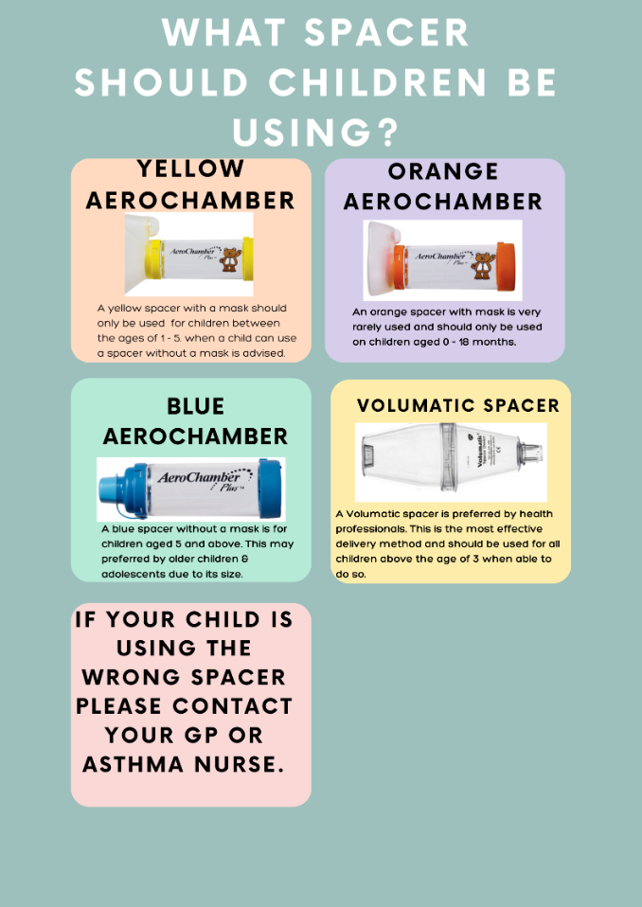



NICE NG245 (NOV 2024) UPDATE
Inhaler Devices and Spacer Selection
Preferred Delivery Method
All children should use a pMDI + spacer as the preferred device. Spacers optimize drug delivery to the lungs and significantly reduce oropharyngeal deposition.
Orange AeroChamber
Yellow AeroChamber
0 – 18 Months
1 – 5 Years
Infant mask; rarely used. Consider alternative if fit is poor.
Child mask. Transition to mouthpiece as soon as managed.
Blue AeroChamber
Volumatic Spacer
5+ Years
3+ Years
Mouthpiece only. Preferred for school-age and adolescents.
Large volume; most effective delivery. Professional preference.
Clinical Pearl:
Always transition from mask to mouthpiece as early as possible to ensure maximum drug deposition and minimize facial skin exposure.
Visual identification of standard UK paediatric spacers
Volumatic is preferred for ≥3 years if manageable
www.bradfordvts.co.uk
July 2026

Slide 8







NICE NG245 (NOV 2024) UPDATE
Spacer Care and Inhaler Technique
Spacer Maintenance
Optimising Inhaler Technique
Cleaning Protocol
STEP 1
STEP 2
Wash monthly using mild washing-up liquid. Rinse well but do not scrub.
Shake the MDI vigorously before use.
Actuate ONE puff at a time into the spacer.
Drying Method
Leave to air dry vertically. Do NOT wipe dry with a cloth or paper towel.
Replacement Cycle
STEP 3
STEP 4
Replace every 6–12 months. Check for cracks or stiff valves. One per patient.
Take slow, deep breaths (or 5 tidal breaths).
Hold breath for 10 seconds if possible.
The "Multi-Puff" Error
Firing multiple puffs into the spacer before breathing reduces drug delivery significantly.
Check technique at EVERY clinical review. Poor technique is the #1 cause of poor asthma control.
AKT PEARL: Wiping creates static charge, causing medication to stick to the spacer walls.

Slide 9






















NICE NG245 (NOV 2024) UPDATE
Acute Asthma Severity Assessment
Mild to Moderate
Physiological Cut-offs
SpO2 ≥94% in air
Able to complete sentences
Normal conscious level
Minimal or no recession
Age
Resp Rate
Heart Rate
Good air entry with wheeze
Normal HR and RR for age
2–4 years
<40 bpm
<140 bpm
5–12 years
<30 bpm
<120 bpm
Severe
SpO2 <94% in air
Significant recession
Too breathless to talk/feed
HR or RR above normal range
>12 years
<25 bpm
<100 bpm
Accessory muscle use
PEFR 33–50% best/predicted
Life-threatening
PEFR Assessment (% best)
Moderate:
50–75%
SpO2 <92% (High Risk)
Silent chest / Poor air entry
Severe:
33–50%
Exhaustion / Confusion
Cyanosis
Life-threatening:
<33%
Bradycardia / Hypotension
PEFR <33% best/predicted
Note: Use clinical judgment. If features of multiple categories, classify as the most severe.

Slide 10
















NICE NG245 (NOV 2024) UPDATE
Acute Management in Primary Care
Initial Treatment (O₂ Sats ≥94%)
Monitoring & Disposition
Salbutamol via MDI + Spacer
1
Reassess in 15-20 minutes after salbutamol
Children 5-16 years: 600-1000 mcg (6-10 puffs of 100 mcg)
2
If Improving: Continue 4-hourly salbutamol
Children <5 years: 2-10 puffs via spacer
3
Arrange same-day review or ACE Service
Technique Focus
Document & prescribe on SystmOne immediately.
ONE puff at a time into the spacer
4-6 breaths per puff; actuate once only per cycle
SAFETY NETTING & PLANNING
Oral Prednisolone
Provide Written Asthma Action Plan (PAAP)
Dose: 1-2 mg/kg/day (Max 40mg)
Clear instructions on when to call 999
Duration: 3-5 days short course
Fail to respond to 2 doses → URGENT HOSPITAL
No tapering required for short courses
Note: Spacers are as effective as nebulisers in mild to moderate acute asthma attacks in children.
www.bradfordvts.co.uk | Updated Nov 2024

Slide 11







NICE NG245 (NOV 2024) UPDATE
Severe Attacks & Bradford ACE Service
Acute Emergency Management
Bradford ACE Service
DIAL 999 IMMEDIATELY
REFERRAL CRITERIA (AGED >2 YEARS)
Oxygen saturations ≥94% in room air.
4-hourly inhalers manageable by family.
High-flow Oxygen: Target SpO2 94-98% via non-rebreathe mask.
Salbutamol: 10 puffs (100mcg) via spacer every 20 minutes while awaiting ambulance.
Last inhaler dose by 5:00 PM (for same-day home visit).
EXCLUSIONS (REFER PAEDS)
Device Choice: Do NOT attempt nebuliser if spacer available; spacer is as effective in mild/moderate distress.
History of PICU admission or brittle asthma.
Suspected foreign body, croup, or pneumonia.
Continuous Monitoring: Stay with the patient; assessment of exhaustion, cyanosis, or silent chest.
Spacer delivery (6-10 puffs) is preferred over nebulisation unless the child is too breathless to use the device.
Contact for Home Visit (Within 2 Hours)
01274 27 3354

Slide 12












NICE NG245 (NOV 2024) UPDATE
Annual Review and Action Plans
Symptom Assessment
Personalised Action Plan (PAAP)
RCP Three Questions (Past month):
GREEN: WELL CONTROLLED
Have you had any daytime symptoms?
Use maintenance treatment as usual; symptom-free.
Have you had any night-time waking?
AMBER: WORSENING
Has asthma interfered with usual activities?
Increased reliever use, night waking; start rescue prednisolone.
RED: SEVERE ATTACK
Calculate ACQ or GINA control score
Too breathless to talk, SpO2 <94%; Call 999 immediately.
Adherence: Check prescription issue rate vs. use
Every patient must have an updated, written PAAP at every review.
Review Checklist
Optimization & Step-Down
Step-down: Consider if well controlled for ≥3 months
Technique: Physical demonstration at every visit
Trigger Avoidance: Identify allergens/environmental factors
Spacer: Check fit, condition, and care (no wiping)
Replacement: New spacer every 6-12 months
Referral: If diagnosis in doubt or persistent symptoms at Step 3
Environment: Passive smoking exposure & triggers
Growth: Height monitoring for children on regular ICS

Slide 13












NICE NG245 (NOV 2024) UPDATE
Differential Diagnosis and Red Flags
Asthma Mimics & Differentials
Red Flags: Urgent Assessment
Viral-Induced Wheeze / Bronchiolitis
Oxygen Saturations <94% in Air
Episodic, often <2 years, RSV-associated, no symptoms between.
Inhaled Foreign Body
Life-Threatening Features (Silent Chest, Cyanosis)
Sudden onset, unilateral wheeze, no viral prodrome.
Vocal Cord Dysfunction
Failure to Respond to 2 Doses of Salbutamol
Inspiratory stridor, normal spirometry, stress/emotion triggers.
Unilateral Wheeze (Urgent CXR/Referral)
GORD / Congenital Heart Disease
Chronic cough (worse lying down) or murmur/failure to thrive.
Persistent Wet/Productive Cough (Not Asthma)
Cystic Fibrosis / PCD / Bronchiectasis
Chronic wet cough, steatorrhoea, persistent infections.
Poor Growth / Failure to Thrive
Tracheomalacia / Congenital Anomalies
Stridor/wheeze from birth or first 2 months of life.
Symptoms Starting in First 2 Months of Life
CALL 999 IMMEDIATELY FOR LIFE-THREATENING FEATURES
BRADFORD VTS TEACHING DECK
www.bradfordvts.co.uk | July 2026

Slide 14



NICE NG245 (NOV 2024) UPDATE
AKT and SCA Clinical Pearls
MART
Communication Pearls
TECHNIQUE CHECK
SABA-FREE FIRST LINE
"I want to check your inhaler technique—would you mind showing me how you use it?"
FeNO ≥40 ppb: Evidence of eosinophilic inflammation (likely asthma)
SPACER MAINTENANCE
"Has your spacer been replaced recently? These need replacing every 6-12 months."
Reversibility: ≥12% FEV1 improvement post-salbutamol confirms diagnosis
SYMPTOM ASSESSMENT
Volumatic Spacer: Preferred for ≥3 years; most effective delivery method
"Can I ask, how many nights in the last week has the wheeze woken you up?"
Spacer Care: Wash monthly, air dry only (wiping removes static charge)
SELF-MANAGEMENT
"I want to give you a written asthma action plan—it tells you exactly what to do in a red zone."
Acute Dose: 6-10 puffs salbutamol (100mcg) via spacer; 1-2mg/kg prednisolone
SAFETY NETTING
Life-threatening: Silent chest, SpO2 <92%, exhaustion → Emergency 999
"Right now your child looks comfortable, but I'd like to see you back in 24 hours to be sure."

Slide 15














BRADFORD VTS TEACHING DECK
NICE NG245 (NOV 2024) UPDATE
Quick Recall and Summary
DIAGNOSIS & PATHWAY
DEVICES & CARE
ACUTE & SAFETY
SABA-Free First Line: Low-dose ICS is the cornerstone. SABA monotherapy no longer recommended for ≥5y.
Orange
Infant mask (<18 months)
Acute Dosing
Yellow
Child mask (1–5 years)
6–10 puffs (100mcg) via spacer; 1 puff at a time; 4-6 breaths/puff.
MART Preferred: ICS-formoterol as both maintenance and reliever.
Blue
Mouthpiece (5+ years)
Oral Prednisolone: 1-2 mg/kg (max 40mg) for 3-5 days.
FeNO Threshold: ≥40 ppb supports eosinophilic asthma diagnosis.
Volumatic
3+ years (Most effective)
999 Red Flags: Silent chest, SpO2 <92%, cyanosis, exhaustion.
Maintenance: Wash monthly with liquid, air dry only (no wiping).
Reversibility: ≥12% improvement in FEV1 post-salbutamol.
PAAP: Every patient must have a written Personalised Asthma Action Plan.
Replacement: Every 6–12 months.
Under 5s: Diagnosis is clinical; objective tests are unreliable.
Check Technique: At clinical review.
Bradford ACE: Local referral for ≥94% sats needing support.
www.bradfordvts.co.uk | Created July 2026
For educational use only. Always verify doses in the latest BNF/NICE guidance.

