Slide 1


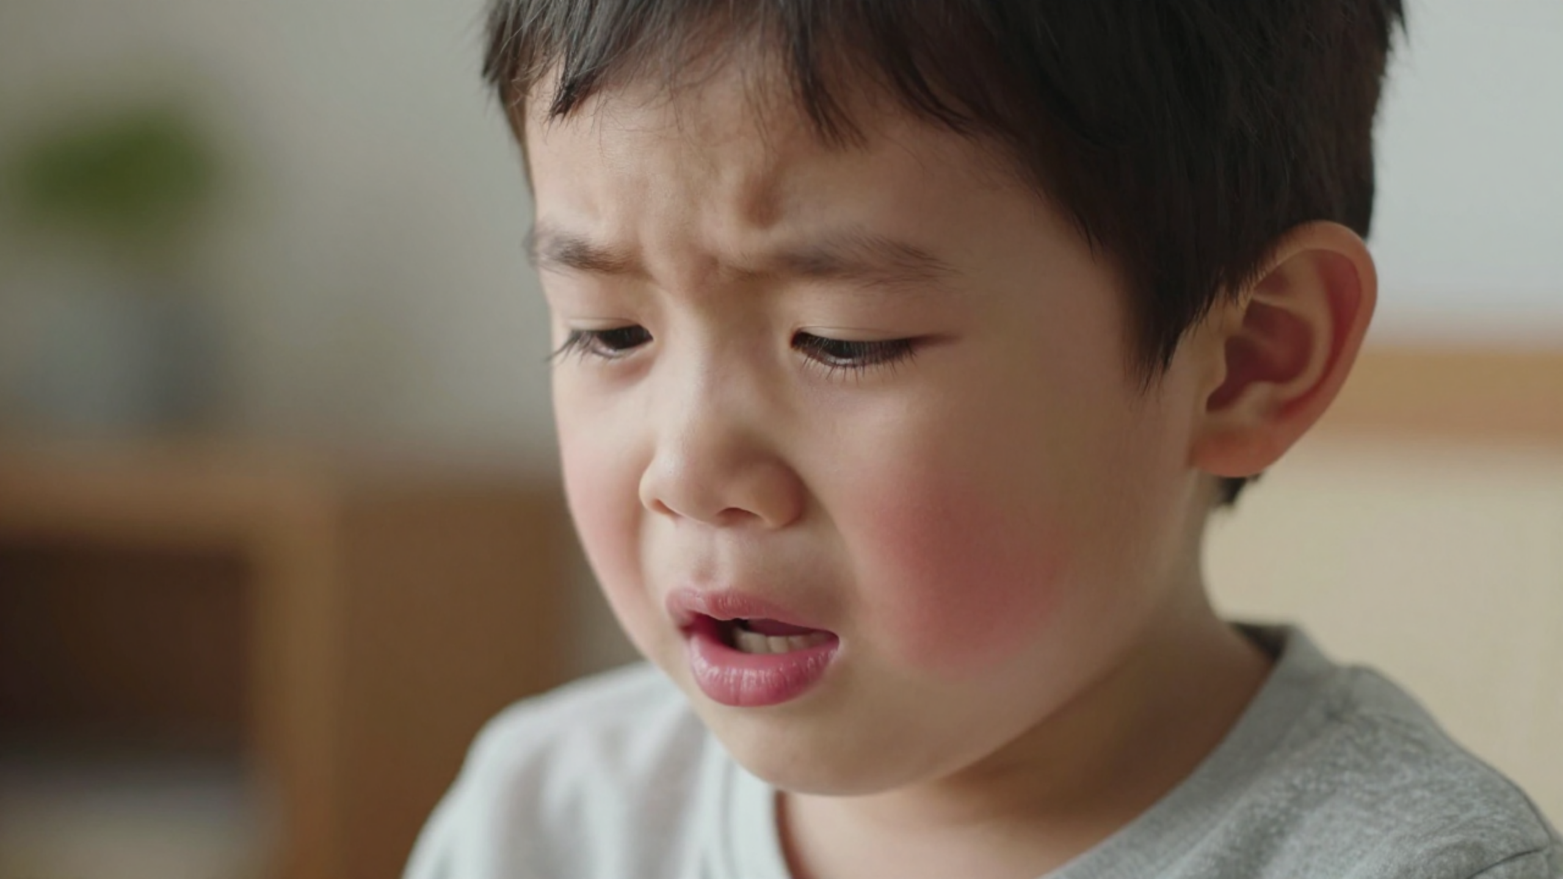

BRADFORD VTS TEACHING DECK
Croup in Children
Clinical Teaching for GPs & Trainees
Management Update: Dexamethasone 0.15 mg/kg single oral dose for ALL severities
www.bradfordvts.co.uk
|
Created July 2026
|
Updated to current NICE CKS
Disclaimer: This document is for educational purposes only. Always double check clinical advice and drug doses with the latest NICE CKS and BNF guidance.

Slide 2










BRADFORD VTS TEACHING DECK
Definition and Epidemiology
What is Croup?
UK INCIDENCE
PEAK AGE
60 / 1000
2 Years
Also known as acute laryngotracheitis (or laryngotracheobronchitis), croup is a viral-induced condition affecting the upper respiratory tract.
CHILDREN PER YEAR
RANGE: 6M – 3Y
Viral infection leads to subglottic inflammation.
Causes oedema at the narrowest part of the airway.
MALE PREDOMINANCE
SEASONALITY
Results in dynamic obstruction during breathing.
1.5 – 2 : 1
Autumn/Winter
Characterised by inspiratory stridor and barking cough.
BOYS VS GIRLS
PARAINFLUENZA CYCLES
www.bradfordvts.co.uk
Created July 2026 | Updated to NICE CKS

Slide 3


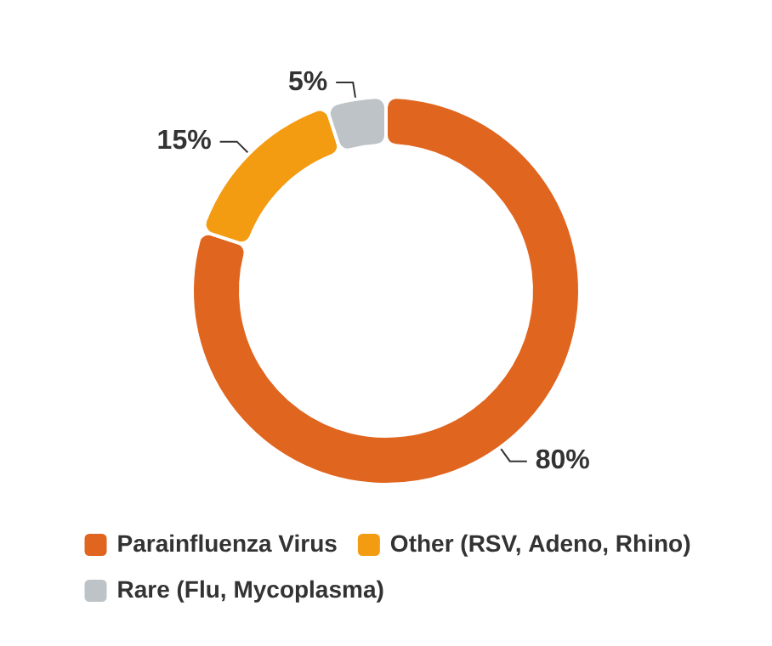








BRADFORD VTS TEACHING DECK
JULY 2026 UPDATE
Aetiology and Pathophysiology
Understanding the viral causes and subglottic mechanism
Causal Organisms
Pathophysiological Mechanism
Infection and Invasion
Viral URTI spreads locally to the larynx and trachea.
Inflammation & Oedema
Subglottic inflammation at the narrowest part of the pediatric airway.
Critical Airway Narrowing
Significant increase in airway resistance (Poiseuille’s Law).
Clinical Triad Result
Inspiratory stridor, barking cough, and hoarse voice.
www.bradfordvts.co.uk | Updated to NICE CKS
Created July 2026 | Slide 3 of 15

Slide 4












BRADFORD VTS TEACHING DECK
Clinical Features and Presentation
Recognition of the Classic Triad and Clinical Course
Barking Cough
Inspiratory Stridor
Hoarse Voice
Harsh, seal-like cough caused by vibration of subglottic tissues
High-pitched sound on inhalation due to narrowed airway
Caused by inflammation and oedema of the vocal cords
Clinical Progression
Key Characteristics
Preceded by 1–3 days of coryzal symptoms (rhinitis, low fever)
Low-grade fever (common)
Sudden onset of barking cough and stridor
Child usually appears well between episodes of coughing
Symptoms typically worsen significantly during the night
Agitation and crying can worsen the stridor
Day 1-3
24-72 Hours
Day 3-7
Symptoms are typically self-limiting and mild
Prodrome
Peak Severity
Resolution
www.bradfordvts.co.uk | Created July 2026
Source: NICE CKS Croup

Slide 5






















BRADFORD VTS TEACHING DECK
Westley Croup Score
Severity assessment tool used in the Bradford ACE pathway
Feature
Scoring Criteria
Points
Total Score
Stridor
None (0), With agitation (1), At rest (2)
0 - 2
0 - 2
Mild Croup
Recession
None (0), Mild (1), Moderate (2), Severe (3)
0 - 3
3 - 7
Moderate Croup
8 - 11
Air Entry
Normal (0), Decreased (1), Markedly decreased (2)
0 - 2
Severe Croup
≥ 12
Impending Failure
Cyanosis
None (0), With agitation (4), At rest (5)
0 - 5
Clinical Application: This score must be documented for all Bradford ACE (Ambulatory Care Experience) referrals. Use clinical judgment alongside the score, particularly in children under 1 year.
Consciousness
Normal (0), Altered (5)
0 - 5
www.bradfordvts.co.uk | Updated July 2026 | NICE CKS Croup

Slide 6













BRADFORD VTS TEACHING DECK
Severity Assessment in Primary Care
MILD
MODERATE
SEVERE
EMERGENCY
Westley Score 0-2
Westley Score 3-7
Westley Score 8-11
Westley Score ≥12
Occasional barking cough
Barking cough
Persistent stridor at rest
Cyanosis or pallor/mottling
No stridor at rest
Stridor at rest
Marked chest recession
Exhaustion / drowsiness
No or minimal recession
Subcostal/suprasternal recession
Significant work of breathing
Silent chest / reduced air entry
Child active and alert
Agitation or lethargy
Altered consciousness
Eating and drinking well
Able to complete sentences
Unable to feed / drink
Impending respiratory failure
Normal consciousness
O2 SATURATIONS
O2 SATURATIONS
O2 SATURATIONS
O2 SATURATIONS
≥ 95%
≥ 95%
< 95%
< 92%
Source: NICE CKS Croup (Updated July 2026) | Bradford ACE Pathway Clinical Criteria

Slide 7









BRADFORD VTS TEACHING DECK
Management: Dexamethasone Guidelines NICE CKS UPDATE
Universal First-Line Treatment Strategy
Onset & Duration
SINGLE ORAL DOSE
Onset of action: Usually within1 hour.
0.15 mg/kg
Peak effect: 3-6 hours.
Long half-life: Covers the typical peak distress period.
FOR ALL SEVERITIES OF CROUP
Administration Guidance
Oral routeis first-line for all children.
If vomiting or unable to tolerate: Urgent referral for IV/IM.
Core Recommendations
Alternative: Oral Prednisolone 1-2 mg/kg if Dexamethasone is unavailable.
Replaces older, complex variable-dose or high-dose regimens.
Recommended for Mild, Moderate, and Severe cases in Primary Care.
Evidence-based: Single dose provides effective symptom control.
Not Recommended
A second dose at 24h is rarely needed (refer to ACE/Hospital if not settling).
Nebulised Budesonide (expensive/distressing).
Steam inhalation (risk of scalding).
Antibiotics (Croup is viral).
www.bradfordvts.co.uk | Created July 2026
Source: NICE CKS Croup (Current Guidance)

Slide 8













BRADFORD VTS TEACHING DECK
Alternative & Non-Recommended Options
Guidance for Primary Care Management
Alternative Steroids
Not Recommended
Oral Prednisolone
Steam Inhalation
1 - 2 mg/kg (Max 40 mg) as a single dose.
No evidence of benefit. Significant risk of accidental scalding.
Usage Context
Reserved for when oral dexamethasone is unavailable.
Antibiotics
Croup is almost exclusively viral; antibiotics are not indicated.
Second Dose
Nebulised Budesonide
May be given at 24 hours following a clinical review by the ACE team.
Not superior to oral dexamethasone; more expensive and distressing for child.
Dexamethasone 0.15 mg/kg remains the first-line choice for all severities.
Oral route not feasible? If vomiting or severe distress prevents oral dosing, refer to hospital for IV/IM dexamethasone.
www.bradfordvts.co.uk | Updated July 2026
Source: NICE CKS Croup

Slide 9





BRADFORD VTS TEACHING DECK
www.bradfordvts.co.uk
Indications for Hospital Admission
Criteria for Emergency (999) and Urgent Same-Day Referral
ALWAYS REFER (999)
URGENT / SAME-DAY REFER
O2 sats <92% or cyanosis
O2 sats <95%
Exhaustion or altered consciousness
Child <1 year with croup
Silent chest / impending respiratory failure
Tracheal, sternal or subcostal recession at rest
Severe recession at rest
Toxic appearance, high fever, or dehydration
Child under 1 year with any stridor
Diagnostic uncertainty or safety-netting concerns
While Awaiting Ambulance for Severe Croup
Administer Nebulised Adrenaline (1:1000, 5 mL) via O2-driven nebuliser. Repeat every 30 mins if needed. Note: Temporising measure only; observe for 3-4 hours post-dose for rebound phenomenon.
Created July 2026 | Bradford VTS

Slide 10










BRADFORD VTS TEACHING DECK
Bradford ACE Service Referral
Ambulatory Care Experience for Mild-to-Moderate Croup (Aged 1-6 Years)
Referral Parameters
GP Management Tasks
O2 Saturations: ≥95% in air
Prescribe Dexamethasone 0.15 mg/kg (single dose)
Clinical: No drooling, no resting stridor, no grunting
Document Westley Croup Score on referral
Work of Breathing: Able to complete sentences
Provide ACE information leaflet to parents
Neurological: Normal consciousness, good air entry
Obtain verbal consent for data sharing
Heart Rate (bpm)
Resp Rate (bpm)
Provide robust safety-netting advice
12-24m: 100 – 150
12-24m: 25 – 35
2-6y: 95 – 140
2-6y: 25 – 30
ACE Exclusions
Age <1 year or >6 years
Upper airway abnormality or inhaled foreign body
PMHx: Severe/rapid croup, Brittle asthma, Anaphylaxis
Referral Contact (Professional Line)
Previous PICU admission for respiratory illness
01274 27 3354
Contact within 2h | Home visit | Parental education
www.bradfordvts.co.uk | Updated July 2026 | NICE CKS Croup Guidelines

Slide 11










BRADFORD VTS TEACHING DECK
Differential Diagnosis of Stridor
Distinguishing Croup from Life-Threatening Airway Conditions
Diagnosis
Key Distinguishing Clinical Features
Croup
Viral prodrome (coryza), characteristic barking cough, inspiratory stridor, low-grade fever. Child usually looks relatively well between coughing fits.
Epiglottitis
Sudden onset, high fever, toxic appearance, drooling, muffled voice, and 'tripod' positioning. Notably, there is barking cough.
Bacterial Tracheitis
Presents similarly to severe croup but the child is toxic-looking with a high fever. Crucially, symptoms show poor response to dexamethasone.
Inhaled Foreign Body
Sudden onset of stridor or respiratory distress without preceding coryza. May have unilateral reduced air entry or a history of playing with small objects.
Abscesses / Anaphylaxis
Abscess: Fever, drooling, stiff neck, dysphagia (Retropharyngeal) or 'hot potato' voice (Peritonsillar). Anaphylaxis: Urticaria, angioedema, known allergen.
CRITICAL EMERGENCY: SUSPECTED EPIGLOTTITIS
Call 999 immediately. DO NOT examine the throat or upset the child, as this may precipitate total airway obstruction. Rare since Hib vaccination.
Created July 2026 | Updated to NICE CKS
www.bradfordvts.co.uk

Slide 12














BRADFORD VTS TEACHING DECK
Emergency Red Flags
Critical warning signs requiring immediate action & 999 referral
Epiglottitis
Bacterial Tracheitis
Inhaled Foreign Body
• Drooling + Tripod position
• Looks like severe croup
• Sudden onset stridor
• High fever + Toxic
• High fever + Toxic child
• No preceding viral coryza
• Poor response to steroids
DO NOT EXAMINE THROAT
• History of playing with small objects
999 EMERGENCY
999 EMERGENCY
URGENT REFERRAL / CXR
Respiratory Failure
High Risk Infancy
Recurrent Croup
• O2 Sats <92% or cyanosis
• Age <1 year with stridor
• ≥2 episodes of croup
• Exhaustion or altered consciousness
• Rapidly progressive symptoms
• Investigate for underlying structural abnormality
• Silent chest / Silent stridor
• Known airway abnormality
999 + NEB ADRENALINE
HOSPITAL ADMISSION
PAEDIATRIC REVIEW
www.bradfordvts.co.uk | Updated July 2026
Dexamethasone 0.15 mg/kg for ALL severities

Slide 13






BRADFORD VTS TEACHING DECK
Parent Education and Safety-netting
Home management strategies and emergency "Red Flag" guidance
Supporting the Child at Home
When to Call 999
Reassure parents: Most croup is mild and self-limiting (usually resolves in 3-7 days).
Stridor at rest: If the noisy breathing is present even when the child is quiet.
Keep the child calm: Distress and crying significantly worsen airway narrowing and stridor.
Increased work: Severe drawing in of the chest or neck muscles (recession).
Environment: Cool fresh air (garden/open window) may help settle mild symptoms.
Cyanosis/Pallor: Blue or grey tinge to the lips/face, or looking very pale.
Steam Inhalation: NOT RECOMMENDED No evidence of benefit; high risk of scalding.
Altered consciousness: Child is unusually drowsy, limp, or exhausted.
Medication: Dexamethasone works within 1 hour; single dose is sufficient. Paracetamol for fever.
Drooling/Tripod: Difficulty swallowing or sitting forward to breathe.
No improvement: Symptoms worsening despite steroid treatment.
Created July 2026 | Updated to NICE CKS
www.bradfordvts.co.uk

Slide 14








BRADFORD VTS TEACHING DECK
www.bradfordvts.co.uk | July 2026
AKT and SCA Clinical Pearls
Key exam points and consultation strategies for GP trainees (ST1-ST3).
AKT PEARLS
SCA PEARLS
Dexamethasone 0.15 mg/kg: Single oral dose for ALL severities (NICE CKS first line).
INFORMATION GATHERING
"Has anyone given anything for it yet? How long has the breathing been like this?"
Aetiology: Parainfluenza virus is the cause in 80% of cases.
Peak Age: 2 years (typical range 6 months – 3 years).
TREATMENT EXPLANATION
Stridor at rest: Indicates moderate-severe croup → always treat.
"I want to give a single dose of a steroid medicine called dexamethasone — it'll start working within the next hour or so."
Epiglottitis: DO NOT examine throat. Hib vaccine has made this rare.
Nebulised Adrenaline: Temporising only; observe 3-4h for rebound effect.
SAFETY-NETTING
Avoid: Steam (scalding risk) and Antibiotics (viral cause).
"If the breathing gets much harder, the lips turn blue, or they become drowsy or limp, call 999 straight away."
Bacterial Tracheitis: Toxic appearance + high fever + poor steroid response.
ADDRESSING MYTHS
"Steam in the bathroom is not helpful — we used to recommend it, but it doesn't work and risks scalding. Cool air is better."
BRADFORD ACE REFERRAL
"I'm referring you to our ambulatory service — a nurse will contact you within two hours for a home visit."
Updated to current NICE CKS guidance. Dexamethasone 0.15 mg/kg single dose is now universal first-line for all severities.

Slide 15










BRADFORD VTS TEACHING DECK
Quick Recall & Final Disclaimer
Summary of core management facts and clinical guidance
Diagnosis Triad
Management
Urgent Red Flags
Barking/seal-like cough
Dexamethasone 0.15 mg/kg
Epiglottitis: Drooling, tripod position, high fever (999)
Inspiratory stridor
Single oral dose for ALL severities
Hoarse voice
Works within 1 hour; no repeat
Bacterial Tracheitis: Toxic, high fever, poor steroid response
Typically worse at night
Keep the child calm/distracted
Do Not Use
Bradford ACE
Admissions
Steam: No evidence, risk of burns
Age 1-6 years; O2 sats ≥95%
Age < 1 year with any stridor
Antibiotics: Croup is viral
No resting stridor or drooling
O2 sats < 95% (urgent refer)
Exams: Never examine throat in epiglottitis
Call 01274 27 3354
O2 sats < 92% (999 ambulance)
Home visit within 2 hours
Severe recession or cyanosis
FINAL DISCLAIMER
This teaching deck is for educational purposes only. Always double-check current clinical advice and pharmaceutical dosages with the latest NICE CKS and BNF / BNFc guidance before treating patients. Clinical judgment must be used for individual patient scenarios.
www.bradfordvts.co.uk
Created July 2026 | Updated to current NICE CKS

