Slide 1





BRADFORD VTS TEACHING DECK
Childhood Infections and Rashes
For GPs & Trainees
Disclaimer: Updated to NICE/UKHSA 2025-2026 standards. This deck is for educational purposes only. Always verify clinical guidance and drug doses with the latest BNF/CKS guidelines.
Created July 2026
www.bradfordvts.co.uk

Slide 2











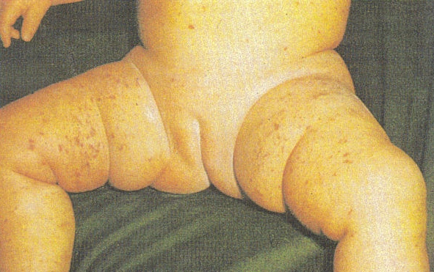



BRADFORD VTS TEACHING DECK
Meningococcal Septicaemia: Recognition & Management
NICE/UKHSA 2025-26 Standards
Recognition
Emergency Protocol (GP)
5-10%
10%
Administer IM/IV Benzylpenicillin BEFORE transfer:
Patient Age
Dose (IM or IV)
Mortality Rate
Morbidity (Deafness/Neuro)
Adults & Children >10 years
1.2 g
Peak Incidence: Children <4 years
Children 1–9 years
600 mg
Features: Fever, malaise, vomiting, lethargy
Children <1 year
300 mg
Late Signs: Meningism, seizures, irritability
Rash: Petechial rash in 50-60% cases
Allergy: Use Cefotaxime or Chloramphenicol
Action: Dial 999 for immediate blue-light transfer.
Prophylaxis: Ciprofloxacin single dose for contacts.
UKHSA: NOT Rifampicin
Public Health: Notifiable disease; notify UKHSA.
NON-BLANCHING RASH = EMERGENCY
Early rash may be maculopapular; repeat glass test.
Vaccination Context: MenB (Routine infant schedule) & MenACWY

Slide 3

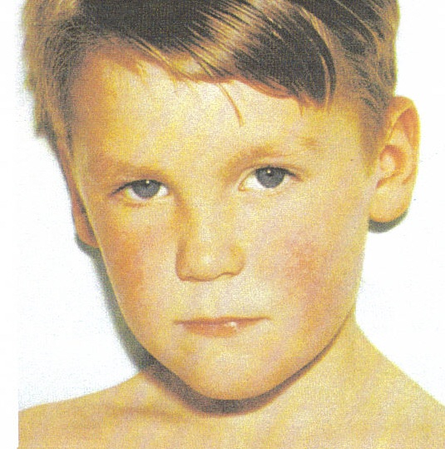




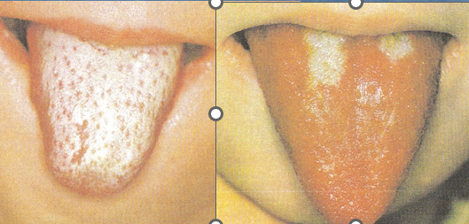
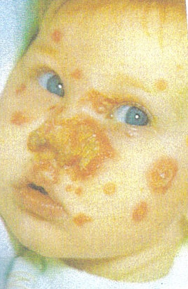







BRADFORD VTS TEACHING DECK
Impetigo and Scarlet Fever: NICE 2024 Updates
Impetigo Management
Scarlet Fever (GAS)
Non-bullous: Honey-coloured crusting (face)
Bullous: Larger blisters, neonates/infants
Highly contagious; risk in eczema patients
1
Hydrogen Peroxide 1% Cream3x daily for 5 days (Localised non-bullous)
2
Topical Fusidic AcidUse if H2O2 fails or is unsuitable
Rash: Rough 'sandpaper' texture, blanches
Tongue: Strawberry appearance (white then red)
Fever, pharyngitis, flushed face, circumoral pallor
3
Oral FlucloxacillinExtensive, bullous, or systemic signs
UKHSA ALERT: iGAS notifications increased significantly. Notifiable disease.
1st Line: Phenoxymethylpenicillin (10 days)
AVOID AMOXICILLIN (RASH RISK IN EBV)
EXCLUSION: UNTIL CRUSTED OR 48H POST-ANTIBIOTICS
EXCLUSION: 24 HOURS AFTER STARTING ANTIBIOTICS

Slide 4













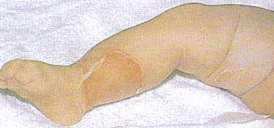


BRADFORD VTS TEACHING DECK
SSSS and Kawasaki Disease
NICE/UKHSA 2025-26 Standards
Staphylococcal SSSS
Kawasaki Disease
NIKOLSKY SIGN POSITIVE
Diagnosis: Fever ≥ 5 Days PLUS 4 of 5 features:
Caused by Staphylococcal exfoliative toxin (not bacteremic).
Bilateral Conjunctivitis
Polymorphic Rash
Hand/Foot Edema
Strawberry Tongue
98% of cases occur in children under 5 years.
Tender erythema → widespread desquamation (24-48h).
Cervical Lymphadenopathy (≥ 1.5cm, unilateral)
Blood cultures usually negative (toxin-mediated).
RISK: 25% risk of Coronary Artery Aneurysms if untreated
NICE TREATMENT
MANAGEMENT
Urgent Referral + High-dose Aspirin + IVIG (2g/kg)
Urgent admission + IV Flucloxacillin + Fluid resuscitation

Slide 5
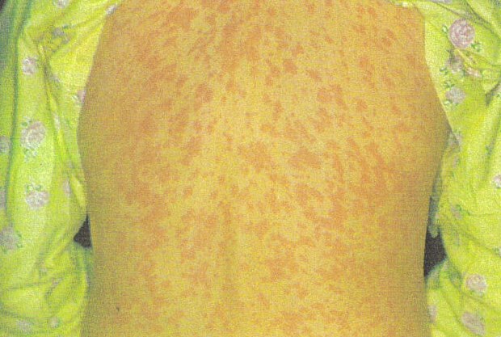











BRADFORD VTS TEACHING DECK
Measles and Varicella: Clinical and Prevention
Varicella (Chickenpox)
Measles (Rubeola)
CLINICAL FEATURES
PRODROME & PATHOGNOMONIC
Incubation: 10–21 days
Incubation: 7–14 days
Infectious: 2 days pre-rash until all crusted (~7 days)
Symptoms: Fever, cough, coryza, conjunctivitis
Progression: Macules → Papules → Vesicles → Pustules → Crusts
Koplik's Spots: Pathognomonic white spots on buccal mucosa (1-2 days before rash)
GP MANAGEMENT
Supportive: Calamine, fluids, antipyretics
RASH & COMPLICATIONS
Paracetamol ONLY— Avoid Ibuprofen (iGAS risk)
Exclusion: Until all lesions crusted
Maculopapular rash starts face/behind ears → spreads down
Complications: Otitis media, pneumonia, encephalitis, SSPE
Exclusion:4 days after rash onset
NOTIFIABLE DISEASE
Must notify UKHSA immediately on clinical suspicion.
UK Immunisation Update: MMRV Transition (January 2026)
The UK has transitioned from MMR to MMRV (Measles, Mumps, Rubella + Varicella). Wakefield paper remains fully retracted/discredited; safety and efficacy are extensively proven.

Slide 6












BRADFORD VTS TEACHING DECK
Rubella, Roseola, and Slapped Cheek
NICE/UKHSA 2025-26 Standards
Rubella
Roseola
Slapped Cheek
Incubation:
14–21 days
Pathogen:
HHV-6
Pathogen:
Parvovirus B19
Infectious:
7d pre to 5d post rash
Age Group:
Typically < 2 years
Incubation:
4–14 days
Mild fever and prodrome
Classic pattern: High fever (39°C+) for 3–5 days
Bright red "slapped" cheeks
Fine maculopapular rash (starts on face, spreads to body)
Followed by lacy reticular rash on limbs and trunk
Fever resolves abruptly, THEN rash appears
Posterior cervical lymphadenopathy is characteristic
Adults may present with polyarthropathy
Rose-pink maculopapular rash on trunk, lasts 1–2 days
School exclusion: 5 days from rash
No school exclusion required once rash visible
Child usually well once rash appears
CRUCIAL INFECTIVITY RULE:
High risk of febrile convulsions during the sudden high-fever phase. Management is supportive.
Infectious 7 days BEFORE rash. Child is NOT infectious once the rash appears.
Notifiable disease.
SEVERE RISK: Congenital Rubella
RISK: Fetal Hydrops in Pregnancy

Slide 7







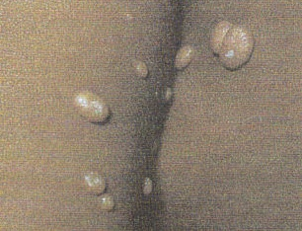


BRADFORD VTS TEACHING DECK
HFM, Molluscum, and EBV
NICE/UKHSA 2025-26 Standards
Hand, Foot & Mouth
Molluscum
EBV (Glandular Fever)
AETIOLOGY Coxsackie A virus; Incubation: 3–6 days.
AETIOLOGY Poxvirus infection; highly contagious.
TRIAD Pharyngitis, cervical lymphadenopathy, and significant fatigue.
CLINICAL FEATURES Mild fever, followed by oral ulcers/blisters and a vesicular rash on palms, soles, and buttocks.
APPEARANCE Pearly white/skin-coloured dome-shaped papules with pathognomonic central umbilication.
ASSESSMENT Splenomegaly is common. Monospot sensitivity is low in early disease.
MANAGEMENT Self-limiting; supportive care (fluids, analgesia).
NATURAL HISTORY Self-limiting; usually resolves within 12–18 months.
ADVICE Avoid contact sports for weeks (splenic rupture risk).
EXCLUSION Until fever-free and child is comfortable.
Referral Criteria
Immunocompromised children
Extensive/disfiguring disease
Eyelid involvement (risk of conjunctivitis)
CRITICAL: AVOID AMOXICILLINCauses a florid maculopapular rash in ~90% of patients with EBV. Often mistaken for penicillin allergy.

Slide 8




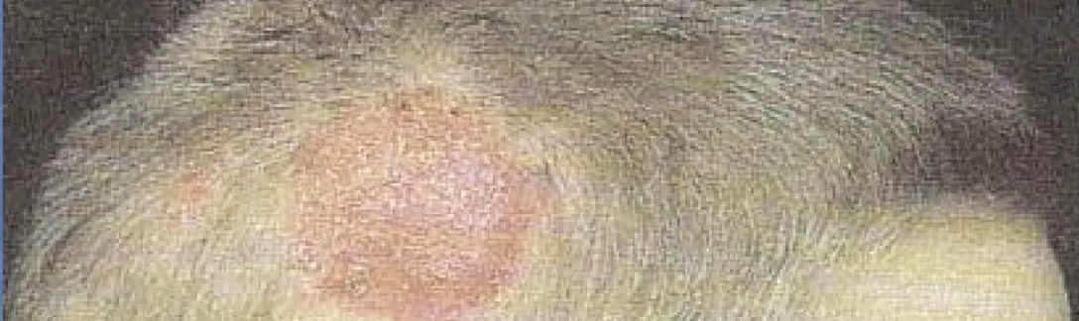



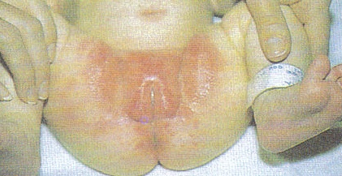

BRADFORD VTS TEACHING DECK
Fungal Infections: Tinea and Candida
NICE/UKHSA 2025-26 Standards
Dermatophyte Fungi (Tinea)
Tinea Capitis (Scalp)
Organisms: Trichophyton, Epidermophyton, Microsporum
Clinical Presentation: Annular, scaly, erythematous lesions with pathognomonic central clearing ("ringworm")
Tinea Types:
• Corporis: Body
• Pedis: Athlete's foot
• Cruris: Groin
• Unguium: Nails
Management:
CRITICAL: Topical treatment alone WILL FAIL. Scalp infections require SYSTEMIC antifungals.
- Obtain skin scrapings for mycological confirmation
- Topical: Clotrimazole or Terbinafine (usually sufficient for corporis/pedis)
Griseofulvin
(First-line for Microsporum)
Terbinafine
(First-line for Trichophyton)
AKT Pearl: Tinea corporis requires treatment for 1-2 weeks after the skin has healed to prevent recurrence.
Candida Infections
Nappy Candidiasis: Bright red confluent rash extending into skin folds with characteristic satellite lesions.
Oral Thrush: White patches on tongue/buccal mucosa (cannot be easily scraped off). Rx: Oral Nystatin.
Candidal Napkin
Dermatitis
Vulvovaginitis: Pruritus and thick "cottage cheese" discharge. Rx: Topical clotrimazole or single-dose oral fluconazole.

Slide 9









BRADFORD VTS TEACHING DECK
Parasitic Infections: Lice, Scabies & Threadworms
NICE CKS 2023-2024 Management Standards
Head Lice
Scabies
Threadworms
Diagnosis: Detection combing on wet hair (only treat if living lice found).
Presentation: Severe nocturnal pruritus; burrows in web spaces/wrists.
Symptoms: Perianal/vulval itching, worse at night; visible worms in stool.
1st Line: Dimeticone 4% (physical insecticide) or isopropyl myristate/cyclomethicone.
1st Line: Permethrin 5% cream (whole body including scalp/face in children).
Pharmacology: Mebendazole 100mg single dose; repeat after 14 days.
2nd Line: Malathion 0.5% aqueous liquid (avoid alcohol base in young kids).
Household: Treat the entire household to prevent re-infection cycles.
Protocol: Two treatments, exactly 7 days apart to kill emerging nymphs.
Hygiene: Wet-wipe perianal area each morning; daily towel/linen changes.
Contacts: Screen all household members; treat only if infested.
Contacts: Treat ALL household/close contacts simultaneously.
School: No exclusion required; "Bug Busting" as a viable non-chemical alternative.
Hygiene: Wash bedding/clothing at >50°C at time of first treatment.
NICE 2023: Dimeticone is preferred. Avoid routine malathion/permethrin due to resistance.
CRITICAL AKT POINT:
Mebendazole NOT licensed <2 years. Use strict hygiene measures only for 6 weeks.
Repeat treatment after 7 days. Pruritus may persist for 2-4 weeks post-eradication.

Slide 10




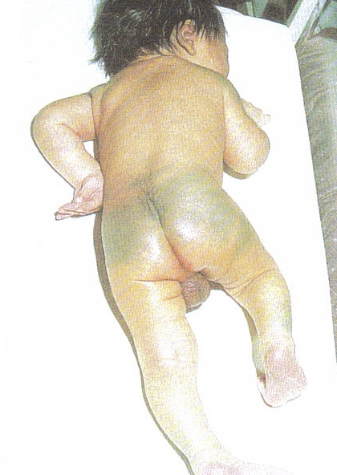
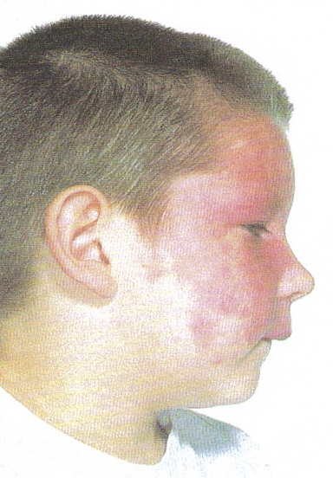



BRADFORD VTS TEACHING DECK
Neonatal Rashes: Benign vs Referral
NICE/UKHSA 2025-26 Standards
Common & Benign (Reassurance)
Referral & Specialist Monitor
Milia
Strawberry Naevus (Capillary Haemangioma)
Tiny white keratin cysts (nose/face). Completely self-resolving.
Grows for 2-3 weeks, regresses after 6 months.
Erythema Toxicum Neonatorum
Refer if: >5 lesions, eyelid, lip, or spinal involvement.
Blotchy red rash with yellow papules. Benign and transient.
Sebaceous Naevi
Salmon Patch (Stork Mark)
Yellowish hairless plaques on scalp.
Pink macular lesion on nape or eyelids. Typically fades over time.
Refer to Dermatology: Small risk of malignant transformation later in life.
Mongolian Blue Spot (MBS)
Blue-grey pigmentation on buttocks/back. Common in darker
skin tones.
Port Wine Stain (Naevus Flammeus)
Permanent vascular malformation.
Does not fade.
DOCUMENTATION PEARL
If V1 Trigeminal Distribution:
Refer to exclude Sturge-Weber Syndrome
(Glaucoma, Angioma).
You must document Mongolian blue spots clearly in the neonatal
record to prevent future confusion with bruising or Non-Accidental
Injury (NAI).
GP Management Tip
Clinical Image: Mongolian Blue Spot (MBS) on infant lower back
For vascular lesions, serial photography (with consent) is an excellent way to monitor growth or regression during routine health visitor or GP reviews.
Always check red-reflex and vision if peri-orbital lesions are present.

Slide 11
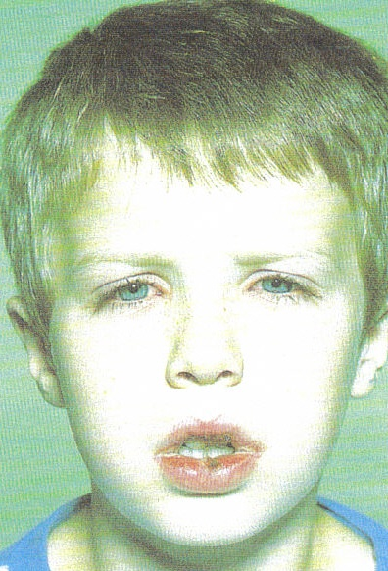
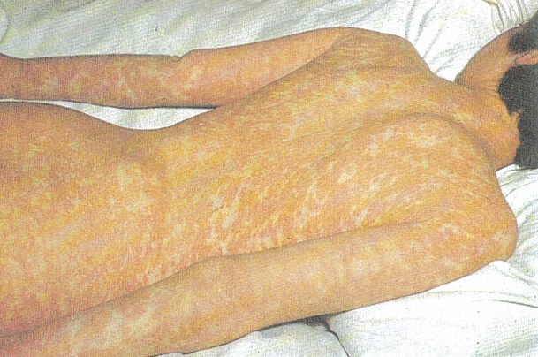
BRADFORD VTS TEACHING DECK
Don’t Miss…
Stephen Johnson Syndrome
Erythema Multiforme
Clinical Image: Mongolian Blue Spot (MBS) on infant lower back

Slide 12



BRADFORD VTS TEACHING DECK
Incubation & Exclusion Reference
NICE/UKHSA 2025-26 Standards
INFECTION & INCUBATION
INFECTIOUS PERIOD
UKHSA SCHOOL EXCLUSION
Chickenpox
2 days pre-rash until all lesions crusted (approx. 7 days)
REQUIRED
Until all lesions have crusted over
10–21 Days
Measles
REQUIRED
4 days from onset of rash
7–14 Days
4 days before rash onset to 4 days after rash appears
Scarlet Fever
Until 24 hours after starting appropriate antibiotic treatment
REQUIRED
24 hours after starting antibiotics
2–5 Days
Impetigo
REQUIRED
Until healed or 48h post-antibiotics
2–5 Days
Until lesions crusted/healed or 48h of antibiotics
Slapped Cheek
NONE
Not required once rash appears
4–14 Days
7 days BEFORE rash. Not infectious once rash visible.
Hand, Foot & Mouth
VARIES
Until fever-free and comfortable
3–6 Days
From onset of oral ulcers until fever has resolved
Mumps
REQUIRED
5 days from onset of swelling
12–25 Days
5 days before to 5 days after onset of parotid swelling
Reference: UKHSA Health Protection in Schools and Other Childcare Facilities (2025 Update)
CLINICAL QUICK REFERENCE

Slide 13











BRADFORD VTS TEACHING DECK
Clinical Red Flags & Safety
High-Yield Emergency Recognition
Non-Blanching Petechial / Purpuric Rash
IMMEDIATE ACTION
999 + IM/IV Benzylpenicillin before transfer
Suspected Meningococcal Septicaemia. Rapid progression can occur in hours.
Fever ≥ 5 Days (Child < 5 Years)
REFERRAL PATH
Urgent Paediatric Assessment (Kawasaki risk)
Check for: Conjunctivitis, rash, oral changes, hand/foot swelling, lymphadenopathy.
Positive Nikolsky Sign
ADMISSION
Emergency Admission: IV Fluids & Antibiotics
Top layer of skin slips away with slight pressure. Sign of Staph Scalded Skin Syndrome.
Pregnancy Exposure: VZV or Parvovirus B19
SPECIALIST ADVICE
Urgent Obstetric/Virology Review
Risk of Congenital Varicella Syndrome or Fetal Hydrops (Parvovirus).
Tinea Capitis (Scalp Ringworm)
PRESCRIBING ALERT
Systemic Antifungals Only (e.g. Terbinafine)
Topical antifungals alone will fail. Risk of permanent scarring alopecia (Kerion).
EBV (Glandular Fever) + Amoxicillin
SAFETY WARNING
Avoid Penicillins if EBV is Suspected
Prescribing amoxicillin/ampicillin in EBV triggers a florid maculopapular rash in 90%.
Safety-Netting: "If the rash spreads, doesn't blanch when pressed, or your child becomes much more unwell, call 999 immediately."

Slide 14




BRADFORD VTS TEACHING DECK
AKT Pearls: High-Yield Exam Facts
NICE/UKHSA 2025-26 Standards
Pathognomonic Signs & Patterns
Koplik's Spots: Pathognomonic for Measles (appear 1-2 days before rash).
AKT
Nikolsky Sign: Positive in SSSS (epidermal peeling with light pressure).
Roseola Sequence: High fever resolves *immediately* before rash onset.
Critical Safety & Contraindications
EBV + Amoxicillin: Avoid! Causes florid maculopapular rash in 90% of cases.
Mebendazole: Strictly contraindicated for children under 2 years old.
Tinea Capitis: Systemic antifungals required; topical treatments will fail.
2026 Updates & Guidelines
MMRV Vaccine: UK transition to MMR + Varicella from Jan 2026. NEW
Impetigo (NICE 2024): Hydrogen Peroxide 1% cream is now first-line.
Kawasaki: Fever ≥5 days + 4/5 features; coronary artery aneurysms are the primary risk.

Slide 15














BRADFORD VTS TEACHING DECK
SCA Pearls: Consultation & Communication
NICE/UKHSA 2025-26 Standards
EMERGENCY RECOGNITION
Effective Safety-Netting
"The rash doesn't blanch when I press it — I need to call 999 now."
"If the rash spreads, doesn't blanch when pressed, or your child becomes much more unwell, please call 999 immediately."
Clear, actionable instructions for parents.
Immediate action for suspected meningococcal septicaemia.
CONTACT PROPHYLAXIS
Parental Reassurance
"Does anyone else in the family have a sore throat? I want to check if we need to treat contacts."
Acknowledge parental anxiety; validate their concerns.
Explain clinical reasoning for 'wait and see' vs 'refer'.
Essential for Scarlet Fever and iGAS vigilance.
Provide written UKHSA/NICE leaflets where possible.
DIAGNOSTIC SUSPICION
Escalation Red Flags
"The fever has lasted five days — I want to examine closely for some specific signs."
Non-blanching petechiae/purpura anywhere on body.
Increased work of breathing or grunting.
Altered mental state, lethargy, or extreme irritability.
Communicating the threshold for Kawasaki disease assessment.
RISK MANAGEMENT
Medico-Legal Documentation
"Have you had chickenpox before? We may need to check your immunity."
Document specific 'Red Flags' discussed with parents.
Record time-sensitive advice (e.g., '24h review').
Screening for high-risk exposure in pregnancy.
Note any social/environmental barriers to monitoring.

Slide 16




















BRADFORD VTS TEACHING DECK
Quick Recall and Clinical Disclaimer
NICE/UKHSA 2025-26 Standards
Non-blanching rash: Meningococcal septicaemia → 999 + Benzylpenicillin.
Koplik's spots: Pathognomonic for Measles (appears before rash).
Roseola: High fever resolves → THEN rose-pink rash appears.
Slapped cheek: Child is NOT infectious once the rash is visible.
Kawasaki: Fever ≥5 days + 4/5 features → IVIG + Aspirin (Coronary risk).
Impetigo (NICE 2024): Hydrogen peroxide 1% cream first-line (localised).
Tinea Capitis: Systemic antifungal treatment required; topical will fail.
Threadworms: Mebendazole allowed ≥2 yrs; Hygiene only if <2 yrs.
NAI Safeguarding: Document Mongolian blue spots clearly to avoid confusion.
MMRV Vaccine: Varicella component added to UK MMR from Jan 2026.
Disclaimer: Always double-check clinical advice and drug doses with the latest NICE/UKHSA and BNF guidance. This teaching deck is for educational purposes only for Bradford VTS GP Trainees. Last updated July 2026.
www.bradfordvts.co.uk | Vocational Training Scheme for General Practice

