Slide 1


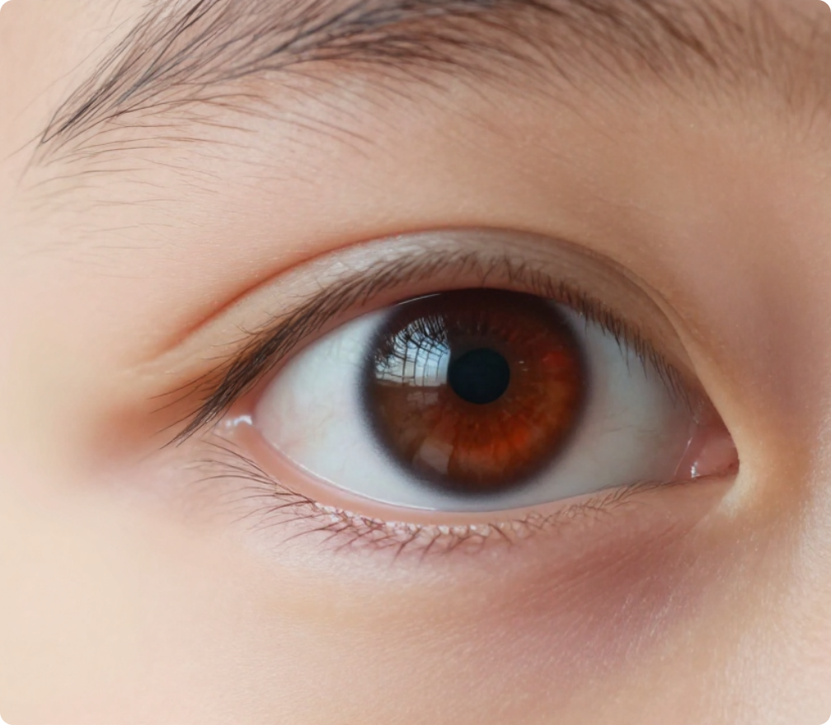

BRADFORD VTS TEACHING DECK
Red Reflex Testing and Retinoblastoma
Clinical Teaching Module for GPs & Trainees
Updated to NICE NG12 (2024) | CHECT Guidance
www.bradfordvts.co.uk
Created July 2026

Slide 2













BRADFORD VTS TEACHING DECK
Understanding Retinoblastoma
Nature & Epidemiology
Outcomes & Prognosis
Most common malignant intraocular tumour in children
98%
Represents ~3% of all childhood cancers
UK Survival rate with prompt diagnosis
No gender or racial predisposition identified
Survival is world-leading in the UK
1:20,000
PROGNOSIS DEPENDS ON SPEED OF REFERRAL
Incidence per live births (40-50 cases/year in UK)
Risks of Late Diagnosis
Clinical Development
CLINICAL CONSEQUENCES
Generally develops within the first 5 years of life
Delayed diagnosis increases the risk of:
Occurs while retinal cells are still developing
Can be unilateral (one eye) or bilateral (both eyes)
www.bradfordvts.co.uk
GP Teaching Module | July 2026

Slide 3






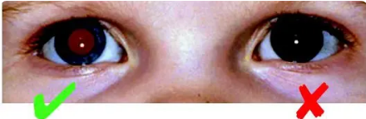


BRADFORD VTS TEACHING DECK
Importance of the Red Reflex Test
Why This Test Is Lifesaving
When to Perform the Red Reflex Test
A child with retinoblastoma may appear completely well systemically — signs are confined to the eye
Postnatal NIPE check — within 72 hours of birth
6–8 week GP check — routine infant surveillance
Signs are subtle and easy to miss without active examination
Routine developmental checks
The test is simple, non-invasive, quick and takes seconds to perform
Any squint (strabismus) — Rb must be excluded every time
Early detection directly determines whether a child keeps their eye, vision, and life
Parental concern about child's eyes, vision, or eye appearance
UK survival: 98% — dependent entirely on speed of referral
Any child presenting with signs suggesting intraocular pathology
CHECT Evidence (2012–13)
>50% of new Rb cases had significantly delayed diagnosis because an urgent referral was not made promptly. Delayed diagnosis risks enucleation, blindness, or death.
Normal red reflex (left ✓) vs. absent/abnormal reflex (right ✗) — absent reflex requires urgent referral
PROGNOSIS DEPENDS ON SPEED OF REFERRAL — Never reassure without performing a thorough red reflex test. Late diagnosis may result in enucleation, blindness, or death.

Slide 4






BRADFORD VTS TEACHING DECK
Examination Technique: Step-by-Step Guide
1. Preparation & Setup
2. Establish a Baseline
Perform in a darkened room to maximize natural pupil dilation.
First, focus on the parent's eyes.
Position yourself and the parent/child at arm's length distance.
Demonstrates to the child that the test is non-invasive and painless.
Direct ophthalmoscope: use a high-quality halogen light source.
Establishes the normal red reflex colour for that specific ethnic group.
Set the ophthalmoscope power close to zero.
Helps build rapport with the child before moving closer.
3. The Child Examination
4. Normal Reflex Indicators
Examine the child while they are comfortably held by the parent.
Bright red or orange reflex, symmetrical in both eyes.
Check both eyes simultaneously whenever possible.
Reflex should be uniform without dark spots or white areas.
Asymmetry is often the most critical indicator of pathology.
Corneal reflex (small white light) should be in the same position in each eye.
If the view is unclear: dilate pupils with drops before concluding a "normal" result.
Consistency in both colour and brightness is essential.
www.bradfordvts.co.uk | July 2026

Slide 5










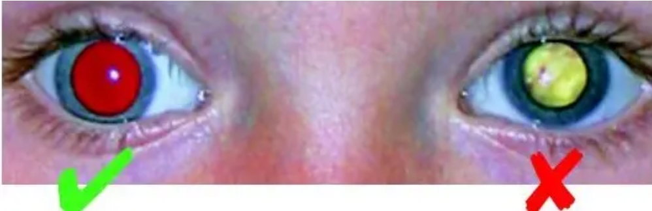


BRADFORD VTS TEACHING DECK
Interpreting Red Reflex Findings
ABNORMAL FINDINGS
Leukocoria: White pupillary reflex instead of red (often in photos).
NORMAL FINDINGS
Asymmetry: Differences in brightness or color between eyes.
Bright Red/Orange: Even, vibrant reflex consistent with ethnic group.
Absent Reflex: Total blackness/absence in one or both eyes.
Symmetrical: Both eyes show equal color, brightness, and clarity.
Corneal Symmetry: Small white light reflex (Hirschberg) in same position in each eye.
Clinical Tip: If reflex is unclear, dilate pupils before declaring normal.
URGENT OPHTHALMOLOGY REFERRAL
Required for ANY abnormal or asymmetric red reflex findings.

Slide 6










BRADFORD VTS TEACHING DECK
Clinical Signs and Symptoms
Leukocoria (White Pupil)
Other Clinical Features
The most common and classic presenting sign.
Iris Colour Change
Eye Inflammation
Heterochromia or change in part of the iris.
Redness/swelling without signs of infection.
Often first noticed by parents in dim lighting.
Classic finding: "White eye" instead of "Red eye" in flash photography.
Vision Loss
Nystagmus
Deterioration or poor vision from birth.
Wandering or involuntary eye movements.
Signifies a large tumour reflecting light back.
Raised IOP
Proptosis
Pain or large eye (buphthalmos).
Eye protrusion (typically advanced cases).
Strabismus (Squint)
Second most common presenting sign.
Parental Concern
Occurs when tumour affects the macula, causing loss of central fixation.
Always take parental anxiety about eye appearance or vision seriously. Early detection is the single most important factor for prognosis and eye salvage.
May be constant or intermittent.
RULE OUT RB IN ALL CASES OF SQUINT USING RED REFLEX TEST
URGENT REFERRAL: Leukocoria, absent reflex, or squint with abnormal reflex.

Slide 7








BRADFORD VTS TEACHING DECK
NICE NG12 Referral Pathway
URGENT ASSESSMENT REQUIRED
Local Pathway
NICE NG12 (2024) Criteria
Refer to Local Ophthalmology Department via suspected cancer pathway.
Consider urgent referral for ophthalmological assessment for retinoblastoma in children with:
Telephone ahead to alert the department and establish TWW appointment speed.
Absent red reflex
Leukocoria (white pupillary reflex)
New squint or change in visual acuity
Specialist Rb Centres
Family history of retinoblastoma
• When accompanied by new visual problems
For high concern or specialist advice, contact national centres directly:
Royal London Hospital
020 3594 1419
Birmingham Children's
0121 333 9475
Note: UK survival is 98% with prompt diagnosis and referral.

Slide 8





BRADFORD VTS TEACHING DECK
Genetics and Heritability
The RB1 Mutation
Screening & Counseling
45% of cases are heritable (RB1 gene mutation on chromosome 13q14).
Offspring of survivors: Mandatory referral to Rb specialist service from birth.
Autosomal dominant inheritance with high penetrance (~90%).
Prenatal Options: PGD, CVS (11 weeks), or amniocentesis (16 weeks).
Typically presents as bilateral or multifocal tumours at a younger age.
Siblings of affected children also require screening if mutation is present.
Sporadic (non-heritable) cases are usually unilateral and not transmissible.
Refer to Royal London or Birmingham Children's for specialist genetic workup.
Genetic Monitoring
SCA Tip: Communication
Survivors of heritable Rb require lifelong surveillance for second primary cancers (e.g., sarcomas).
Validate concerns: "Because of your history, your baby needs specialist checking from birth to ensure early detection."
www.bradfordvts.co.uk
Updated to NICE NG12 (2024) | Created July 2026

Slide 9











BRADFORD VTS TEACHING DECK
Treatment and Long-Term Effects
Specialist Treatment Options
GP Role: Monitoring Late Effects
Chemotherapy: Systemic or Intra-arterial (targeted)
Systemic Chemotherapy
Focal Therapy: Laser photocoagulation & Cryotherapy
Hearing loss (ototoxicity), renal impairment, blood count monitoring.
Radiotherapy: External beam (now avoided if possible due to significant late effects)
Radiotherapy / Local Treatment
Cataracts, dry eye, facial asymmetry, retinal detachment risk.
Enucleation: Surgical removal of the eye (necessary in 70% of unilateral cases)
Second Primary Malignancies
High risk in heritable Rb (sarcomas, skin cancers). Be alert to unexplained pain, lumps, or new moles. Lifelong monitoring in adult oncology is mandatory.
Treatment decisions are made by specialists at Rb centres (London/Birmingham).
NHS NAES
Artificial Eyes: Refer to NHS National Artificial Eye Service (NAES) or private ocularists.
Created July 2026 | www.bradfordvts.co.uk

Slide 10









BRADFORD VTS TEACHING DECK
Clinical Context: Squint in Children
Mandatory Assessment
Underlying Causes
ALWAYS perform a red reflex test on any child presenting with a squint.
Refractive Error: Commonest benign cause of squint.
Intraocular Tumour: Retinoblastoma or other mass.
Retinoblastoma must be ruled out in all cases of strabismus in babies and children.
Neurological: Raised intracranial pressure (ICP) or nerve palsy.
Squint is the second most common presenting sign of Rb after leukocoria.
Clinical Note: Constant squints are significantly more concerning than alternating squints.
The 3-Month Rule
Amblyopia & Safety
Squint is common in infants, but persistent squint after 3 months requires action.
Amblyopia (Lazy Eye): Develops secondary to uncorrected squint or refractive error.
Refer urgently for ophthalmology assessment if strabismus persists beyond this window.
Treatment Window: The window for correcting amblyopia effectively closes around 7-8 years of age.
Do not dismiss; early intervention is critical for both cancer detection and vision preservation.
Safety-net all cases; if you refer, explain to parents that it is to "make sure we aren't missing anything serious."

Slide 11






BRADFORD VTS TEACHING DECK
Differential Diagnosis
Congenital Cataract
Other Structural Causes
Commonest cause of absent red reflex after Retinoblastoma (~2-3 per 10,000 births).
Vitreous & Retinal Disorders
Vitreous Haemorrhage: Obscures reflex; often trauma or systemic related.
Bilateral Cataracts
Retinal Detachment: Can produce a pale or greyish reflex.
May be missed at NIPE if reflex is symmetrical but dull. Requires high index of suspicion.
Persistent Fetal Vasculature (PFV): Congenital developmental anomaly.
URGENT REFERRAL < 2 WEEKS
Iris & Globe Defects
Unilateral Dense Cataract
Aniridia: Complete or partial absence of the iris.
Causes profound amblyopia (lazy eye). Must be treated early to preserve visual development.
Coloboma: A keyhole-shaped defect in the iris or retina.
URGENT OPHTHALMOLOGY
GP Management Tip:
Visual Appearance
It is NOT the GP's role to distinguish these from Rb in primary care. Any abnormal reflex requires urgent ophthalmological assessment.
Often presents as an absent or abnormal white/grey reflex rather than the classic bright "Rb white".

Slide 12









BRADFORD VTS TEACHING DECK
Essential Red Flags
URGENT
Leukocoria — white pupil in any setting, including flash photographs
Retinoblastoma until excluded → urgent ophthalmology referral
Absent or asymmetric red reflex — one or both eyes
Urgent ophthalmology referral; do not delay
Squint in any child — always perform red reflex test first
Rb must be actively excluded; do not dismiss as benign without testing
ACTION
Family history of retinoblastoma
Screening from birth at Rb specialist centre; mandatory referral
Parental concern about eye appearance
Always examine; parents often detect leukocoria before clinicians
Rb survivor with unexplained pain, lump, or new mole
Second primary cancer surveillance; refer to adult oncology clinic
NEVER reassure without performing a thorough red reflex test — a normal-appearing child may still have retinoblastoma

Slide 13






BRADFORD VTS TEACHING DECK
AKT Pearls for GP Trainees
1
GENETICS & INHERITANCE
RB1 Mutation & Heritability
45% of cases are heritable: Caused by RB1 gene mutation (chromosome 13q14).
Pattern: Autosomal dominant inheritance; typically results in bilateral or multifocal tumours.
Offspring Rule: Children of Rb survivors require mandatory specialist screening from birth.
2
NICE NG12 (2024)
Referral Criteria & Squints
Urgent Referral: Mandated for absent red reflex or leukocoria (white pupil).
The Squint Rule: Perform a red reflex test in every child presenting with a squint; refer if persisting >3 months.
Leukocoria: Often first noticed by parents in flash photography or dim lighting.
3
CLINICAL CONTEXT
Late Effects & Differentials
Congenital Cataract: The commonest cause of an absent red reflex after retinoblastoma.
Second Cancers: Heritable Rb survivors have a significantly increased life-long risk of sarcomas.
UK Outcome: High index of suspicion is vital; prompt diagnosis leads to 98% survival rate.

Slide 14







BRADFORD VTS TEACHING DECK
SCA Communication Pearls
Validating Parental Concern
Explaining the Finding
Parent presents with "something odd" about the child's eye appearance.
After finding an abnormal red reflex during your examination.
"I take that kind of concern very seriously — let me examine the eye with my ophthalmoscope right now."
"I've found something I want to get checked more urgently. I'm going to refer [child] to the eye specialist today — the tests are quick and non-invasive."
Hereditary Risk Management
Squint Safety-Netting
Consultation with a parent who has a personal history of retinoblastoma.
Explaining the need for referral in a child presenting with strabismus.
"Because you had retinoblastoma, your baby needs to be checked at a specialist eye centre right from birth. I'd like to arrange that referral today."
"I want to refer this squint to ophthalmology to make sure we're not missing anything. A squint in a young child should always be checked properly."
SCA STRATEGY
Focus on Active Validation of parent intuition and Direct Action. Avoid false reassurance; prioritize the physical exam and immediate referral pathway.

Slide 15













BRADFORD VTS TEACHING DECK
Quick Recall and Final Disclaimer
When to Test
NICE NG12 (2024)
Clinical Pearls
Postnatal NIPE check (within 72h)
Urgent referral for absent red reflex
Test in a darkened room; sit at arm's length
6-8 week GP developmental check
Urgent referral for leukocoria
Use parent's eyes as a normal baseline
Any presentation of a new squint
Consider referral for new squint if cancer is suspected
Squint + Abnormal reflex = Emergency
Any parental anxiety about eyes
Never reassure without checking reflex
Family history of Retinoblastoma
Referral should be to local ophthalmology
Rb survivors: monitor lumps/moles
URGENT 2-WEEK WAIT
Red Flags
Heritability & Survival
Differential Diagnosis
Leukocoria (white pupillary reflex)
98% UK survival with prompt referral
Congenital Cataract (commonest cause of absent reflex)
Absent or asymmetric red reflex
45% are heritable (RB1 gene mutation)
Persistent squint (>3 months)
Vitreous Haemorrhage
Heritable cases: bilateral/multifocal
Change in iris colour (heterochromia)
Retinal Detachment
Screening from birth for offspring
Persistent Fetal Vasculature
Lifelong surveillance for 2nd cancers
SPECIALIST REFERRAL CENTRES:
Royal London: 020 3594 1419
Birmingham Children's: 0121 333 9475
Final Disclaimer: Always double check this clinical advice with the latest NICE NG12 and CHECT (Childhood Eye Cancer Trust) guidance. This document is designed as a teaching aid for GP trainees and is for educational purposes only. Clinical judgment must be applied to individual cases.
www.bradfordvts.co.uk
Created July 2026

